Slide 1


You see phenomena in forms
I see emptiness in all forms.
Don’t fill any form
Live and chant OM
That is the ultimate form
The emptiness of the form.
A form of nonsense dialogue (Hoban, 2008)
Tibetan Oracular and Divinatory Traditions
Notes:
The exile community under the Dalai Lama became a global example of people who use non-violent methods in response to aggression.

Slide 2
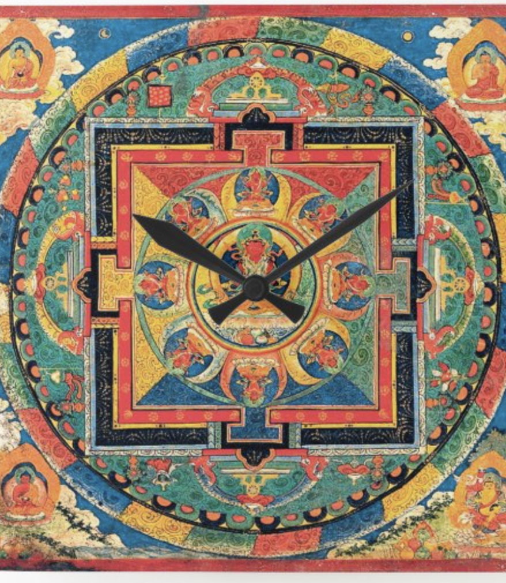
The role of time and timing in Tibetan oracular traditions and astrology
Astrology is often described as a sister-science to traditional medicine in Tibetan cultural regions.
Why?
Because astrology offers valuable insights at underlying energetic and elemental forces that might otherwise be hidden from perception.
It is primarily used for divination and for the study of time cycles:
Certain days of the week or month are elected for specific activities (i.e., best day to get married)
Lunar cycles (new moon and full moon) are auspicious days for invocation of deities

Slide 3
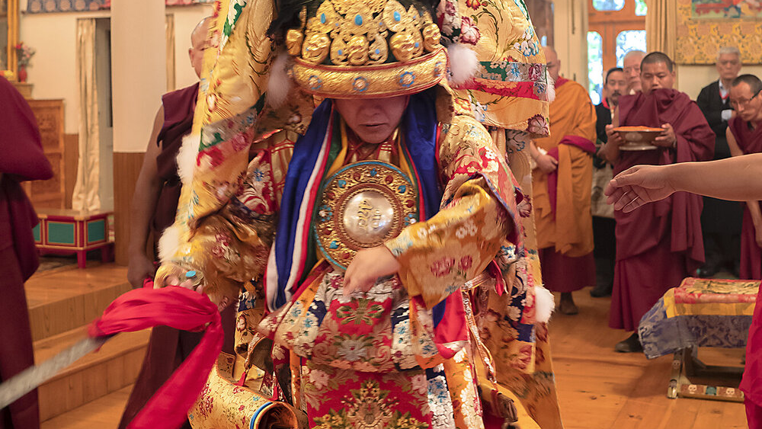
The role of the interpreter in Tibetan oracular traditions and divination

Slide 4
Some of the ‘protectors’, may at certain times take possession of a medium through whom they can speak. Mediumship is the mechanism by which the Gods become involved in mundane issues.
Heavenly Realm
The realm of Gods
Intermediate World
The status and function of oracles depends on the status of the deity possessing the interpreter /medium
The world of humans, animals and various spirits
Underground Regions
Oracles of lower status
Consulted for health problems, for conflict resolution, for private as well as communal decision-making, for weather forecasting, exorcism of evil spirits, to give protection and good luck
High-status Oracles
Oracles that prophesize the reincarnation of high-ranking Tibetan lamas. These oracles are also consulted for political decision-making.
Thupten Ngodup is the current Nechung oracle (14th oracle in line) – medium of the deity Dorje Drakden
The abode of nonhuman beings called lu (klu)
Notes:
According to traditional Tibetan cosmology the world is constituted of 3 levels.

Slide 5
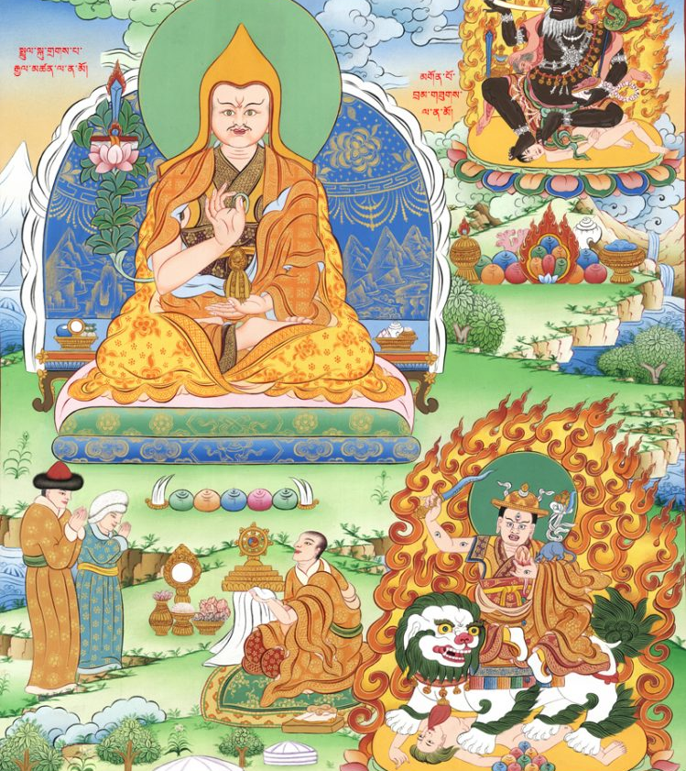
The role of divination in Tibetan reincarnation lineages and in traditional medicine
Tulkus – Reincarnate custodian of a specific lineage of teachings. Trained from young age by students of his or her predecessor.
A tulku is born with potential, but without spiritual education there is no possibility for the potential to be fulfilled.
The Nechung oracle also participates in the selection of reincarnate lamas (including that of the Dalai Lama)

Slide 6
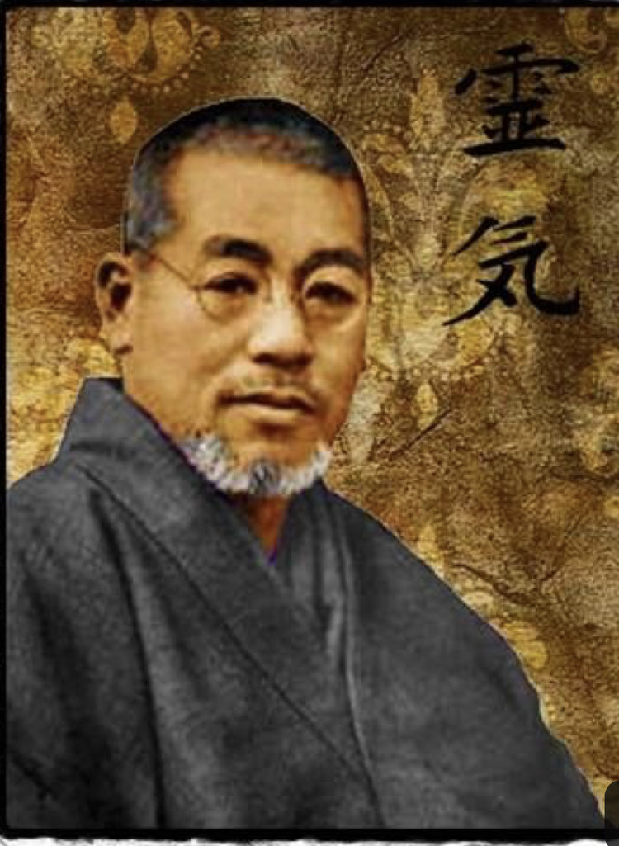
The role of divination in Tibetan reincarnation lineages and in traditional medicine
After China invasion to Tibet, hundreds of Tibetans live in exile in various part of the world spreading the traditional teachings and therapies such as Reiki.
The oracles of lower status are now consulted for decision making (such as choosing the right hospital) and not as a place for healing.
Therapies like Reiki empower the practitioner to become their own healer.
Mikao Usui – Born on 15th of August 1865

