Slide 1
Mitigation strategy
Thomas Reynolds (2305662)

Slide 2
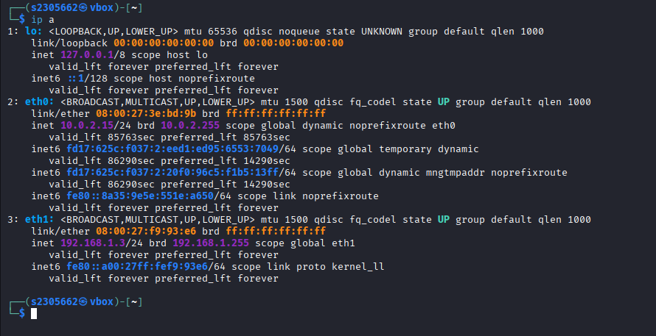
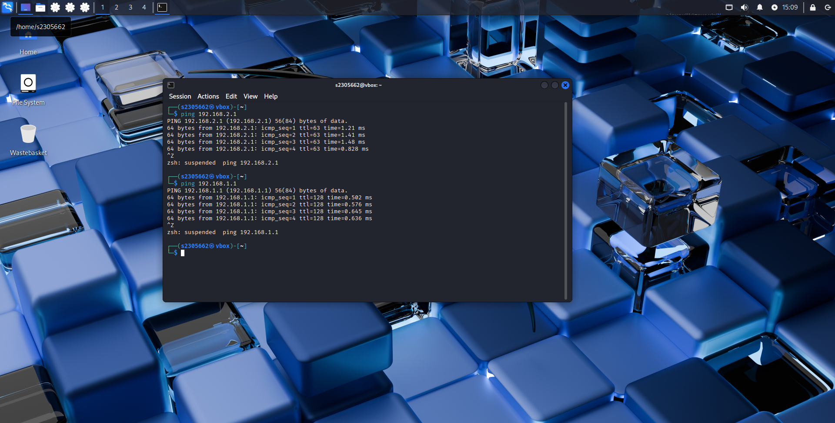
Security focused operating system

Slide 3
Information gathered from swansea.acca network
Debian machine has open ssh service running on tcp port 22.
On windows server port 5985 is open which is used for windows remote management.
On windows server chargen is still being used (port 19).
There are three devices on the network, 192.168.1.1,192.168.1.10 and 192.168.2.1
Two main networks, (192.168.1.0/24) and (192.168.2.0/24)
By enumerating users, you can see there is a default admin account called 'Administrator'

Slide 4
6 vulnerabilities
High:
SSH connection on debian machine.
Windows remote management on windows server.
Medium:
SMB signing not required for hosts accessing the Windows server.
Denial of service attack using chargen. Found on the Windows server.
Low:
OpenSSH version 10.0 installed on debian machine.
ICMP timestamp request remote data disclosure on windows server.

Slide 5
Highlights of exploitation and post exploitation
High:
(SSH) Outside machines can access the debian machine through ssh with credentials.
(Winrm) Access was gained by enumrating users to find half of the credentails, then all that was needed was the password. Evilwinrm gave access to the windows server.
Medium:
(SMB signing)Nessus tells us that this can be used to perform a man in the middle attack between a client and server.
(chargen) Chargen was used to test udp and tcp connections, it is an outdated method, an attacker can use them to slow down a network.
Low:
(SSH version) Nessus tells us this SSH version could lead to a proxycommand risk.
(ICMP timestamp) Provides an attacker with information that may assist in an attacker defeating time based authentication protocols.

Slide 6
IMPLEMENTED SECURITY MEASURES
High:
Disable SSH on debian machine, only allow certain IP addresses to use SSH.
Disable windows remote management or only allow certain IP addresses to use ports 5985.
Medium:
Enable the two network client digital sign in policies. Located in group policy editor.
In the registry editor set the key values to 0 for the two chargen options. (TCP AND UDP). Then restart simptcpservice in the command prompt.
Low:
Update openSSH to newer version, 10.2
Filter out the ICMP timestamp requests (13) and the outgoing ICMP timestamp replies (14) using firewall.

