Slide 1
Psychological Well-being:
PA and Exercise
Introduction to Health and Exercise Psychology
BMHN4002

Slide 2
Lifestyle impacts upon health…
What behavioural factors do you think are associated with longevity (whilst retaining a good QOL)?
25-year study of 2357 men.
Potentially modifiable biological and behavioral factors were associated with exceptional longevity of 90 or more years.
  Smoking, diabetes, obesity, and hypertension significantly reduced the likelihood of a 90-year life span.
Vigorous exercise substantially improved it.
Adverse factors associated with reduced longevity and poorer functional status in elderly years.
  Smoking,
  Obesity
  Sedentary lifestyle
  Yates, et al., (2008) Arch Intern Med
  http://archinte.jamanetwork.com/article.aspx?articleid=413931

Slide 3
Why is being physically active important?
Physical benefits?
Psychological benefits? – of particular relevance during Covid-19
  Stress / anxiety / depression / isolation
  http://health.gov/paguidelines/guidelines/Chapter2.aspx
  American site – Look at chapter 2.

Slide 4
Q. What motivates individuals to:
  Start exercising?
    Why did you start exercising?
  Adhere to exercise?
    What makes you keep going back…
  Try again after failure?

Slide 5
Combined Impact of Health Behaviours and Mortality
20,244 men and women aged 45–79yrs (no disease at baseline) 1993–1997, living in the UK - followed up to 2006.
  4 health behaviours
  not smoking,
  not being physically inactive,
  having a moderate alcohol intake (1–14 units a week),
  having a high fruit and vegetable intake (as indicated by plasma vitamin C level)
Inversely related with mortality over an average 11y follow-up.
Decreased mortality risk with increased number of positive health behaviours.
Those who scored four (+ve HB’s) reduced mortality risk by 25% compared to those who scored zero
Equivalent to approximately 14y difference in chronological age.
Khaw et al., (2008)
  http://journals.plos.org/plosmedicine/article?id=10.1371/journal.pmed.0050012

Slide 6
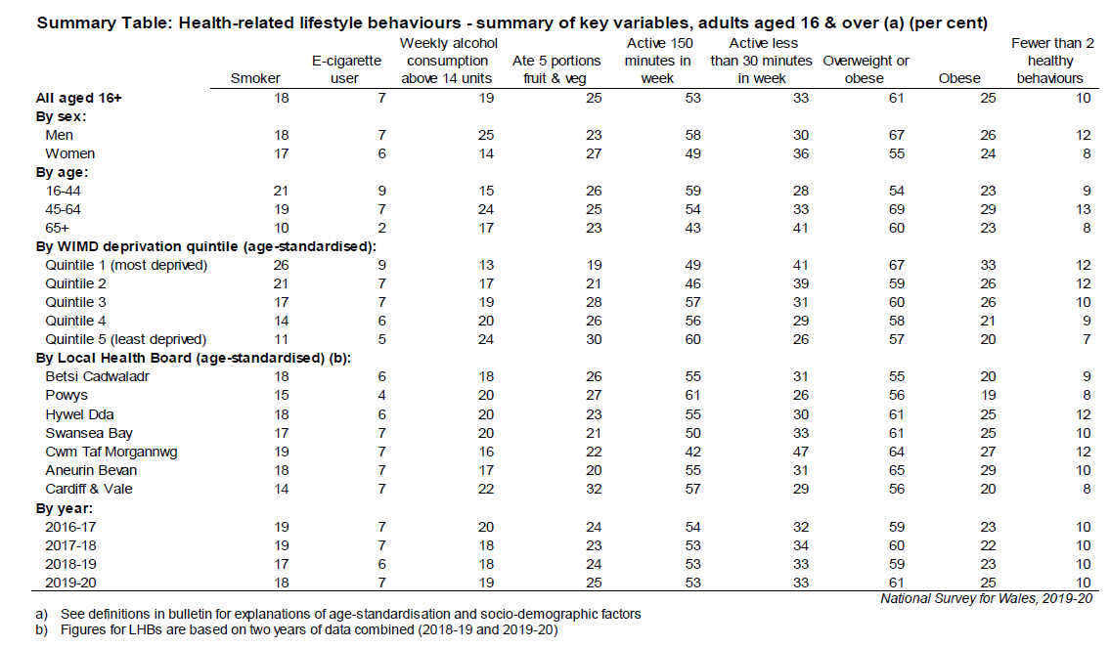
What is going on - recap?
Identify any differences by:
  Sex
  Age
  Areas of deprivation
  Local health board
  Over time? Year.

Slide 7
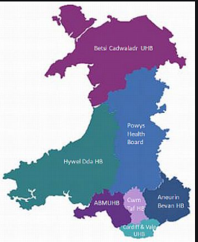
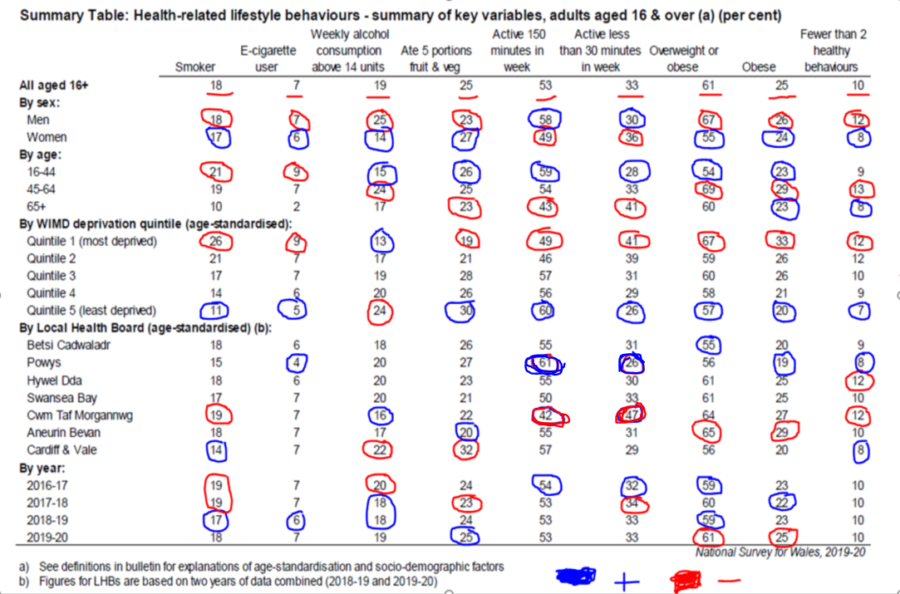
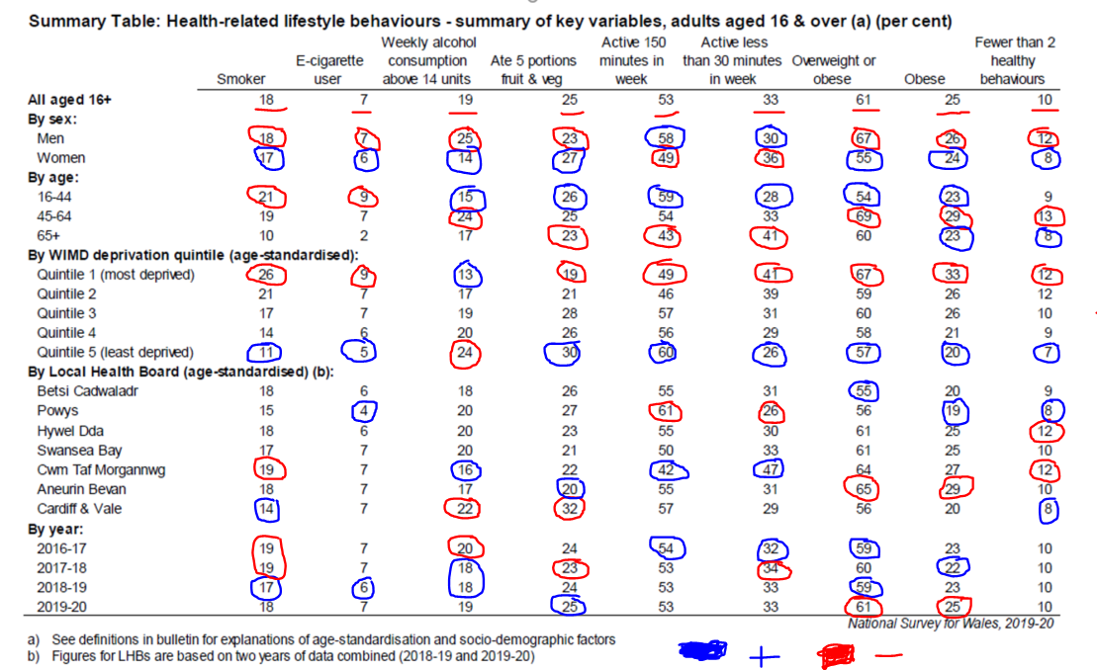
Task: What is going on?
Categories:
Smoker
E-Cigarettes
Alcohol consumption
5 portions of fruit and veg
Active 150 minutes
Active less than 150 minutes
Overweight or obese
Obese
Fewer than 2 healthy behaviours

Slide 8
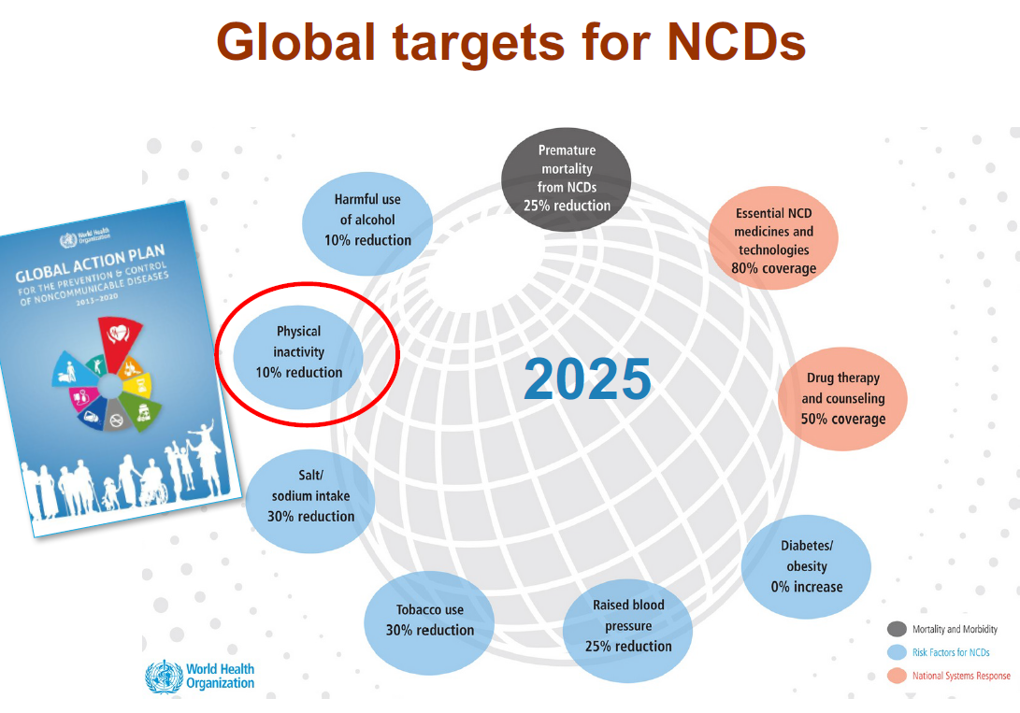

Slide 9
So why are we as a nation, not adhering to the recommended advice? …
  Why are we not more physically active as a nation?
  Barriers despite knowledge…

Slide 10
What are the proposed positive effects of being physically active?
Chronic Disease - can protect against
CHD (Lee et al., 2001), diabetes (Maiorana et al., 2001) & breast and colon cancer (Wells, 1999).
Balanced diet and exercise = inc’d life expectancy (DCMS, 2002).
Risk factors for CHD = inactivity, smoking, hypertension and hyperlipidemia .
Leading cause of death in Europe

Slide 11
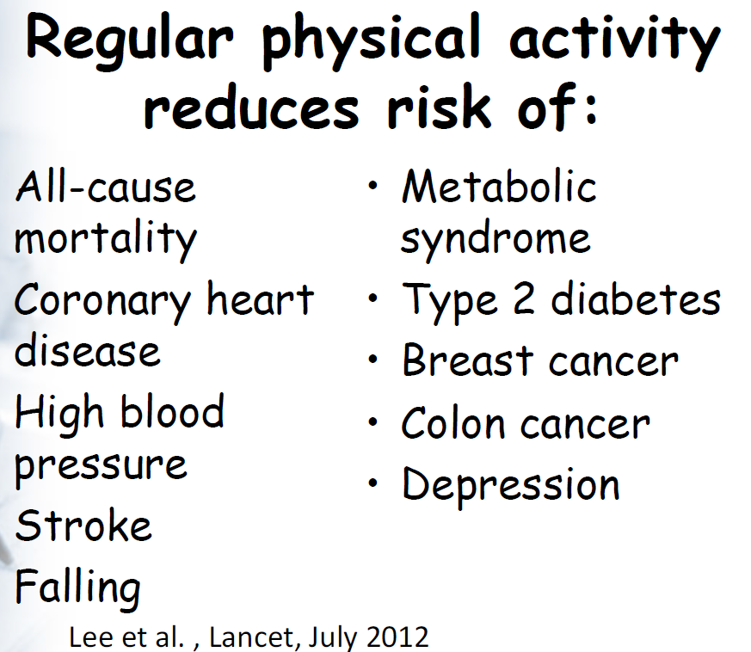

Slide 12
Lee & Skerrett (2001)
Dose response relationship between PA and / or aerobic fitness and premature mortality.
Protects against diseases causing premature death.
Longitudinal study (Linstead et al., 1991) 9484 men to complete lifestyle questionnaire. Revisited over 26 years to establish deaths.
Moderate activity associated with protective effects.
Effects of activity last into the 70’s and 80’s.
However…Paffenbarger (1993) found that taking up moderate intensity sports added 0.72 years to their lifespan.
Selling point?!

Slide 13
Carnethon et al. (2003) Importance of active lifestyle.
Men & Women (18-30yrs)
Max treadmill test to establish low / med / highly fit.
Follow up at 2,5,7,10,15 years after the test
At follow up CVD risk factors – HTN, Diabetes, high cholesterol recorded if not present at baseline.
Low / med fit = 3-6 fold inc risk of HTN / Diabetes

Slide 14
Blood pressure
HTN sig risk factor for CVD and stroke.
Cardiovascular risk decreases linearly with decreased blood pressure (Lewington et al., 2002).
Exercise reduces blood pressure (Pescatello et al., 2004) by average of 15mmHg (systolic) and 4mmHg (diastolic) lasting between 4-10hrs and up to 22hrs.
Types of exercise – walking (Kelley et al., 2001) aerobic activity (Fagard, 2001) and strength training (Kelley & Kelley, 2000).
Mod intensity aerobic is what is recommended.

Slide 15
Type of activities beneficial…
Low vol moderate intensity / low vol high intensity / high vol high intensity – all beneficial to weight, fat mass and central obesity (Slentz et al., 2004).
Positive for behaviour change.
Options!

Slide 16
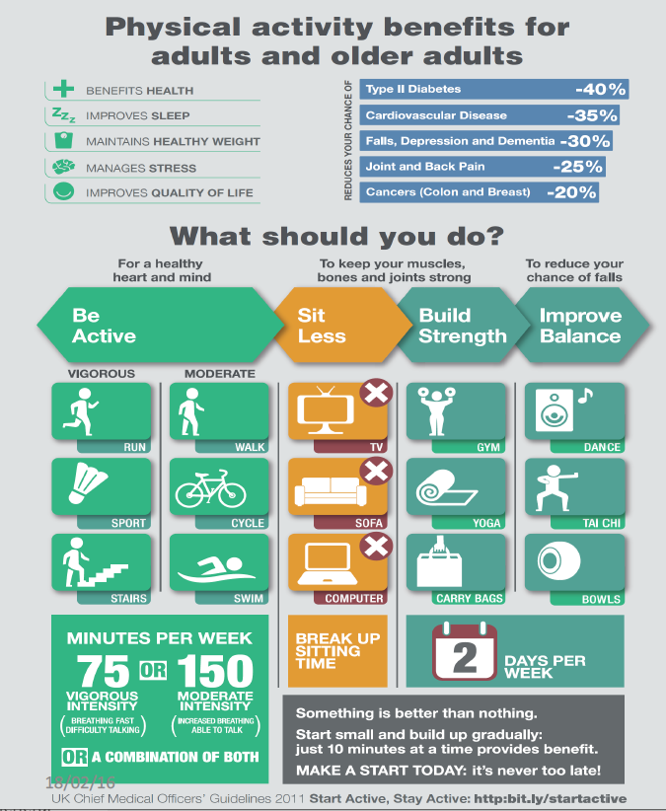

Slide 17
Task: Evaluation of an exercise setting
Choose an exercise facility of your choice…
E.g. University fitness suite / leisure centre / your local gym / swimming pool / group exercise sessions – e.g. boot camps
  You may go and look at the campus facilities.
Imagine that a client is planning to start exercising and this is their chosen option.
Make a note of the positive aspects and barriers to using the facilities for a client group of your choice.
  You may have someone specific in mind – this is fine.
Put yourself in THEIR position and then consider the environment.
Age? / chronic disease? / obese? / new to exercise?
Don't just think about the gym or exercise space itself! What else is important….(e.g. changing rooms / parking / access / cost)

Slide 18
What did you find / identify?
Client group of your choice?
The positive aspects?
Barriers to using the facilities?

Slide 19
Consider other exercise environments…Type of activity undertaken?

Slide 20
Effects of prescribing moderate versus higher levels of intensity and frequency. Adherence to exercise prescriptions
Perri, M. G. et al. (2002)
Sedentary adults (N = 379) were randomly assigned to walk 30 min per day at a frequency of either 3-4 or 5-7 days per week, at an intensity of either 45%-55% or 65%-75% of maximum heart rate reserve.
Analyses of exercise accumulated over 6 months showed greater amounts completed in the higher frequency (p <0.01) and moderate intensity (p<0.05) conditions.
Analyses of percentage of prescribed exercise completed showed greater adherence in the moderate intensity (p<0.05) condition.
Prescribing a higher frequency increased the accumulation of exercise without a decline in adherence,
Prescribing a higher intensity decreased adherence and resulted in the completion of less exercise.
HIIT current trend…Implications?

Slide 21
Groupness and adherence in structured exercise settings. Spink, K.S. (2010)
This study examined the relationship between groupness and self-reported exercise adherence.
Exercise participants (N = 86) recalled a structured setting where they had been active with others during the last six months.
Groupness - i.e., common fate, mutual benefit, social structure, group processes
Indicators of self-reported adherence where participants recall of frequency (times/month) and percent attendance in a specified structured exercise setting.
Groupness was positively related to self-reported adherence explaining 20% of the variance in adherence.
These findings provide preliminary support for the idea that perceiving a collection of exercise participants as being more like a group may be associated with adherence in a structured exercise setting.
Practical implications for exercise provider?

Slide 22
Task to complete by next Thursday:
I would like you to write no more than 200 words for the following task:
  Submit to the assignment link on Turnitin (Week 1 section)
Choose an exercise session / physical activity of your choice (e.g. gym / 30 minute walk) – make a note of this.
Write down how you are feeling physically and mentally prior to the activity.
Complete the activity.
Write down how you are feeling physically and mentally after the activity.
We are not looking for any particular answers, your information won’t be shared and so you can be honest

Slide 23
Relevant reading /Resources:
Pubmed.gov - http://www.ncbi.nlm.nih.gov/pubmed
Psycharticles (e-resources) LRC
Biddle, S.J.H. (2003) Physical Activity and Psychological Well-being [ebook], London: Routledge.
Biddle, S.J.H. (2008) Psychology of Physical Activity: Determinants, Well-being and Interventions. London: Routledge.
Weinberg, R. & Gould, D. (2015) Foundations of Sport & Exercise Psychology, Champaign, IL: Human Kinetics.

Slide 24
Some additional readings:
1. Global trends in insufficient physical activity among adolescents – November 2019
https://www.thelancet.com/action/showPdf?pii=S2352-4642%2819%2930323-2
2. Physical Activity Has Many Health Benefits: Chapter 2
http://health.gov/paguidelines/guidelines/Chapter2.aspx
3. National Survey for Wales summary – 2019/20 (29th July, 2020)
https://gov.wales/sites/default/files/statistics-and-research/2020-07/adult-lifestyle-national-survey-wales-april-2019-march-2020-390.pdf
4. An emphasis on physical activity rather than sport
https://www.sport.wales/files/f16771b9041ecbd847704e346c9e15bc.pdf

Slide 25
Any questions?

