Slide 1

Analysis of coaching session
By: Cerys Clark

Slide 2
Coaching plan
Day: Friday | Date: April 1st | Stage of athlete’s development: Moderate | Duration (mins): 20 minutes
Resources: Pull buoy, Float, Reciprocal Card, IPAD |  |  | Health and Safety Issues: Loose floats, Tiles, Water depth
Learning Outcomes: To confidently perform with accuracy, the correct kicking and pull techniques that is used in front crawl.
Justification for the use of this progression: This session allows for athletes to develop their front crawl stroke, by working on areas that need developing.
Session Structure
Time | Activity Sequence | Questioning | Coaching points | Coaching Style
5 mins | Warm-Up/Introduction Loosen up on the outside of the pool (Shaking legs, arm rotation) Run to whatever side of the pool the coach calls out (left, right, touch the floor and jump) Correct way to enter the pool (Swivel entry) | What’s the importance of warming up? | Place both hands to your side of your body. Roll onto tummy Slide into the water feet first. | Command and practice.
BP: 2 mins Legs: 5 mins Arms: 5 mins All together: 5 mins | Main session: All athletes swim a length of free style starting from deep end. Body Position Push n glide from the wall arms apart Push n glide from the wall- arms long and together Legs Leg kicking with float (breathing to the side) 1 length With a partner of a similar ability use reciprocal cards to analyse peers’ performance (given a certain action to focus on example: head or eyes) Arms Demonstration Walk across the pool practicing Just using arms with pull buoy between legs Just 1 arm Self-check using reciprocal cards All together Put arms and leg into action together | BP: Why is a body position important when starting? Legs: If your legs were too low down in the water what would happen? Arms: Why is it important to keep your fingers together? | Body Positioning Body streamline Legs together Long arms like an arrow Legs Kick legs from hip Toes pointed Floppy feet Arms Fingers together Elbow slightly bent Thumb/fingertips enter first | Body Position: command and practice Legs: Reciprocal Arms: Reciprocal All Together
Contingency Activity (what if?): Athletes who can’t go in the pool will be used to analyse other performance using the reciprocal card.

Slide 3
Whole part whole
This session began with getting all the athletes to swim a length of the pool, then breaking up specific skills and techniques into drills to improve performance and then finally getting them to adopt all the improved skills they have learnt into an all-encompassing final practices session.
Successful use of the whole part whole structure has been deemed to transform athletes “knowledge to wisdom” (Swanson & Law, 1993, pp.49-50).

Slide 4
Types of practice
According to Lawrence and Kingston (2007) blocked practice is “a practice schedule in which the performer repeatedly rehearses one task before moving onto another”.
The method of blocked practice was used. This allowed me to ensure that every aspect of the technique was mastered before practicing the next one and then putting them all together into one singular efficient technique.

Slide 5
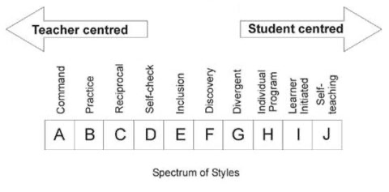
Coaching methods
References were made from Mooston and Ashworth (2002) spectrum in order to incorporate different coaching methods which maximized the learning environment (Gardner, 1993)

Slide 6
Command and practice
Athletes reproduce a specific set of outcomes on cue
Coaches demonstrate and then athlete's practice

Slide 7
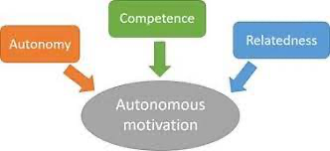
Reciprocal
Athletes are given a task card describing the progression and work together to analyze performance.
This coaching method incorporates the basic psychological needs model, more specifically relatedness. This model suggests that relatedness is the need to feel close, connected and cared for with important others, in this case their peers (Ryan & Deci, 2017)

Slide 8
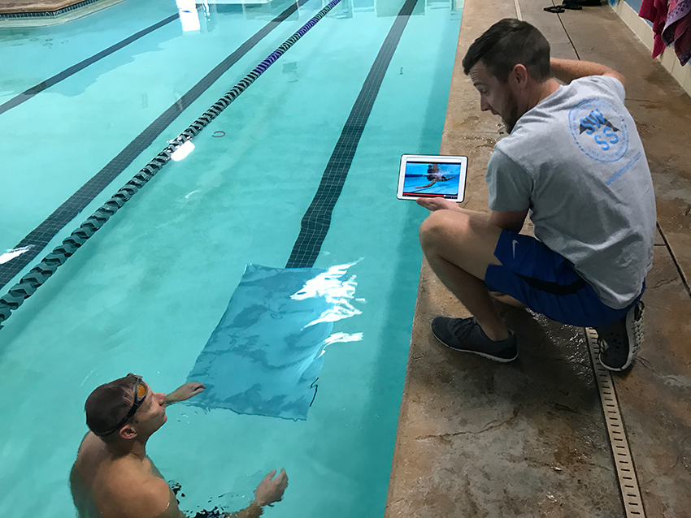
Video Analysis
When recording an athlete's performance, it provides them with a chance to break down aspect of their performance and focus upon small details and specific techniques which are often missed during a live performance.
Despite the effectiveness of video feedback research has demonstrated that athletes struggle to remain focused and concentrate on the important details of the skill when asked to recognise more than one movement (Hughes, Franks, & Dancs 2019).

Slide 9

Intrinsic Feedback
When applied correctly feedback will aid athletes' growth and development as well as develop their personal and professional skills (Atkinson, Watling & Brand, 2021).
Coaches should be able to provide feedback to their athletes on areas of improvement and how well they are performing or how well they performed. It is important that structured feedback picks up on both the positives and negatives aspects of the training session.

Slide 10
Augmented feedback
This type of feedback is not received from the movement itself it is provided by another person.
Baudrey et al., (2006) argues that augmented feedback has a “powerful effect” on athletes due to providing them with an outside perspective of what they are doing right and what they need to work on

Slide 11
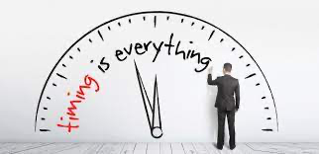
Timing of feedback
The feedback given to an athlete should be short and relevant to the skill or task they just performed.
Research by Miller (1956) suggests that individuals find it difficult to remember more than 5 to 9 verbal items at once.

Slide 12
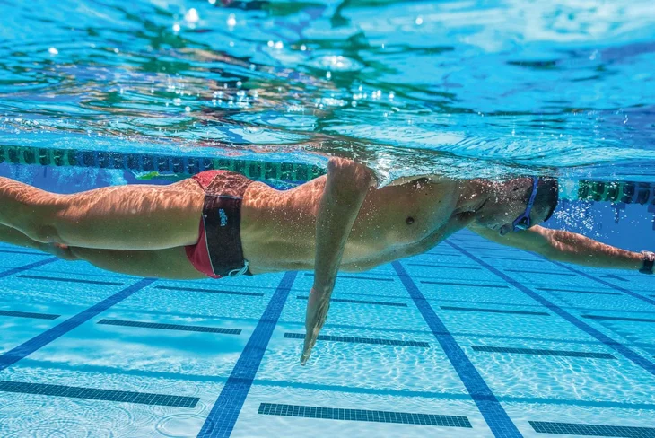
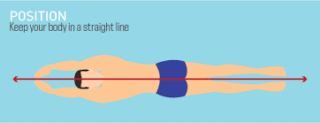
Attentional focus
Internal where the athlete look at a more technical side to the task, an example of this would be elbow flexion reaches 90 degrees when concentrating on the in-sweep action of the arms.
External is where the “performers attention is directed t the effect of the action”, an example of this would be point arms like an arrow when talking about the push and glide at the start of the lesson.

Slide 13
Reflection on session
What went well: I spoke clearly and thoroughly with proper instruction and direction and was able to include those who didn’t swim into the session.
Improvements: Give athletes a sense of autonomy and better demonstration.

Slide 14

Conclusion

Slide 15
References:
Angyal, A. (1941). Foundations for a science of personality.
Atkinson, A., Watling, C. J., & Brand, P. L. (2021). Feedback and coaching. European journal of pediatrics, 1-6.
Baudry, L., Leroy, D., Thouvarecq, R., & Chollet, D. (2006). Auditory concurrent feedback benefits on the circle performed in gymnastics. Journal of sports sciences, 24(2), 149-156.
Deci, E. D., & Ryan, R. M. (2000). The “what” and “why” of goal pursuits: Human needs and the selfdetermination of behavior. Psychological Inquiry, 11(4), 227–268.
Franks, M. I., Hodges, N., & More, K. (2001). Analysis of coaching behaviour. International Journal of Performance Analysis in Sport, 1(1), 27-36.
Gardner, H. (1993). Multiple intelligences: The theory into practice. New York: Basic Books.
Goldberger, M, Ashworth, S, Byra, M (2012) Spectrum of teaching styles retrospective 2012. Quest 64(4): 268–282.
Hughes, Franks, & Dancs, H. (Eds.). (2019). Essentials of performance analysis in sport. Routledge.
Hughes, M., Franks, I. M., Franks, I. M., & Dancs, H. (Eds.). (2019). Essentials of performance analysis in sport. Routledge.
International experts in safety training solutions (2012) Teaching Front Crawl. Available at: https://www.sta.co.uk/wp-content/uploads/2012/10/Teaching-Front-Crawl.pdf (Accessed 1 April, 2021)
Lawrence, G., & Kingston, K. (2007). Skill acquisition for coaches. In An Introduction to Sports Coaching (pp. 34-45). Routledge.
Magill, R. A. (2007). Motor learning and control: Concepts and applications (8th ed.). McGraw-Hill.
Magill, R., & Anderson, D. (2014). Motor learning and control: Concepts and applications. Boston: McGraw Hill.
Miller, G.A. (1956). The magical number seven, plus or minus two: Some limits on our capacity for processing information. Psychological Review, 63, 81–97.

Slide 16
References:
Mosston, M, Ashworth, S (2002) Teaching Physical Education. 5th ed. San Francisco: Benjamin Cummings.
Ryan, R. M., & Deci, E. L. (2017). Self-determination theory: Basic psychological needs in motivation, development, and wellness. Guilford Publications.
Steenbergen-Hu, S., Makel, M. C., & Olszewski-Kubilius, P. (2016). What one hundred years of research says about the effects of ability grouping and acceleration on K12 atudents’ academic achievement: Findings of two second-order meta-analyses.
Sunaryadi, Y. (2016). The role of augmented feedback on motor skill learning. In Proceedings of the 6th International Conference on Educational, Management, Administration and Leadership. Atlantis Press, Dordrecht, The Netherlands (pp. 271-5).
Swanson, R. A., & Law, B. D. (1993). Whole‐part‐whole learning model. Performance Improvement Quarterly, 6(1), 43-53.
Teixeira, P. J., Silva, M. N., Mata, J., Palmeira, A. L., & Markland, D. (2012). Motivation, self-determination, and long-term weight control. International Journal of Behavioral Nutrition and Physical Activity, 9(1), 22.
Walsh, C. M., Ling, S. C., Wang, C. S., & Carnahan, H. (2009). Concurrent versus terminal feedback: it may be better to wait. Academic Medicine, 84(10), S54-S57.
Whelan, N., Kenny, I. C., & Harrison, A. J. (2016). An insight into track and field coaches’ knowledge and use of sprinting drills to improve performance. International Journal of Sports Science & Coaching, 11(2), 182–190.
Wulf, G., & Su, J. (2007). An external focus of attention enhances golf shot accuracy in beginners and experts. Research quarterly for exercise and sport, 78(4), 384-389.

Slide 17
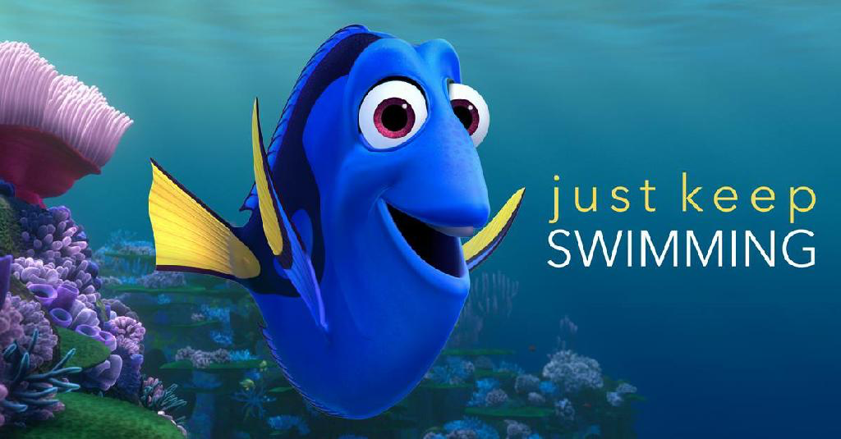
Questions??

