Slide 1
Datblygiad Cymdeithasol
& Hawliau Plant
Social development
& children’s rights
ECAD4007/C
Nanna Ryder
n.ryder@uwtsd.ac.uk

Slide 2
NOD
AIM
Ystyried sut mae plant yn datblygu eu sgiliau cymdeithasol
Archwilio pwysigrwydd hyn ar gyfer dysgu a’r athroniaeth sydd yn sail i hynny
Cyflwyniad i hawliau plant
Pwysigrwydd gwrando ar lais y dysgwyr a’u cyfranogiad yn y broses ddysgu
Consider how children develop their social skills
Explore the significance of this for learning and the underpinning theory
An introduction to children’s rights
The importance of listening to the voice of the child and their participation in the learning process

Slide 3
Pa sgiliau cymdeithasol sydd eu hangen ar blant?
What social skills do children need?

Slide 4
Sgiliau cymdeithasol
Social skills
Cydweithrediad a chydweithio
Creu cysylltiadau a chyfeillgarwch
Ymddygiad derbyniol ac annerbyniol
Cyfaddawdu – rhannu, cymryd tro
Rheoli a datrys gwrthdaro
Pendantrwydd
Dynameg grŵp
Canlyniadau ac achosion
Rheolau ymgysylltu’n gymdeithasol e.e. glanweithdra, bwyta
Rheolau arddangos emosiynau
Co-operation and co-working
Affiliation and friendship
Acceptable and unacceptable behaviour
Compromise – share, take turns
Managing and resolving conflict
Assertiveness
Group dynamics
Consequences and causation
Social engagement e.g. hygiene, eating habits
Emotional display rules

Slide 5
Datblygiad cymdeithasol - TASG social developmenT - task
Read the sheet. Can you match the statement with the age/stage?
What about Ella? Where is she? How do you know?
Darllenwch y daflen. A allwch chi gyfateb y datganiad gyda’r cam/oedran?
Nawr beth am Ella? Ble mae hi arni? Sut y gwyddoch chi hyn?

Slide 6
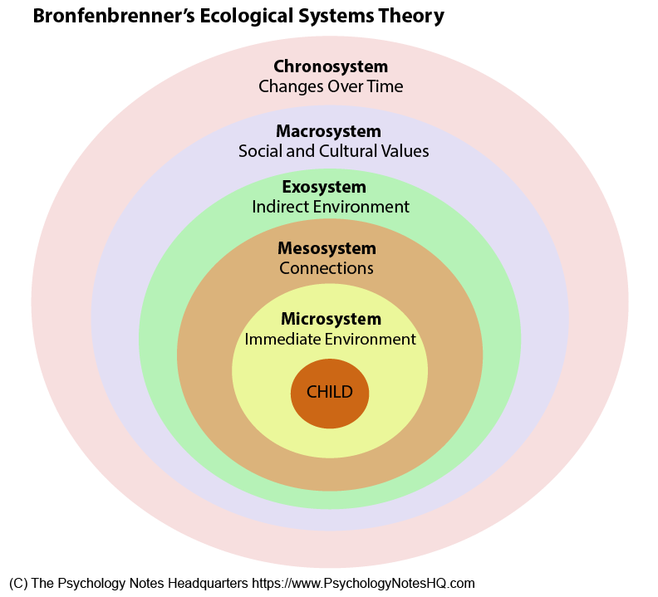
Mae dysgu’n weithgaredd cymdeithasol learning is a social activity
(Bronfenbrenner)
https://www.psychologynoteshq.com/bronfenbrenner-ecological-theory/

Slide 7
Rhagdueddiadau tuag at ddysgu – yr elfen gymdeithasol learning dispositions – the social aspect
(bruner)
‘… children develop persistent behavioural problems, including depression … scientists [to] conclude that there is an early critical period for the development of social and emotional traits and behaviour’.
Mae plant yn …’datblygu problemau ymddygiad parhaol, yn cynnwys iselder ysbryd’ …. Daw ‘sawl gwyddonydd at y casgliad bod cyfnod tyngedfennol cynnar o ran datblygu nodweddion ac ymddygiad cymdeithasol ac emosiynol’.
(Bruner, 2000:106)

Slide 8
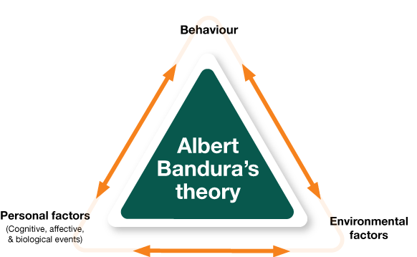
Damcaniaeth dysgu cymdeithasol bandura bandura’s social learning theory
https://www.pinterest.co.uk/pin/643381496736303682/?lp=true

Slide 9
Damcaniaeth dysgu cymdeithasol Vygotsky
Vygotsky’s social learning theory
Nodwch y negeseuon allweddol o’r ddamcaniaeth yma wrth wylio’r fideo islaw.
Note the key messages of this theory while watching the video below.
https://www.youtube.com/watch?v=45ERp8yE-1U

Slide 10
Dysgwyr a’u hawliau learners and their rights

Slide 11
Beth yw hawliau?
What are rights
Hawliau Dynol yw’r pethau sylfaenol y mae arnom ni eu hangen i oroesi ac i gyflawni ein potensial. Mae Hawliau Dynol yn:
Gynhenid – rydych wedi cael eich geni i fod yn ddynol
Gyffredinol – perthnasol i bawb
Anwahanadwy – dim un yn llai neu’n fwy pwysig na’r llall
Anaralladwy – all neb fynd å hwy oddi wrthoch chi
Diamod – maent yn awtomatig
(Comisiynydd Plant Cymru, 2019)
Human rights are the basic things we need in order to survive and fulfil our potential. Human Rights are
Inherent – you have them because you are born a human
Universal – apply to all
Indivisable – can’t be separated and no one less or more important than the rest
Inalienable – nobody can take them from you
Unconditional – people have rights automatically
(Children’s Commissioner for Wales, 2019)

Slide 12

Fy hawliau
TASG/TASK
my rights

Slide 13
Pam mae hawliau plant a phobl ifanc yn bwysig?
Why are children and young people’s rights so important?
Mae plant yn fwy agored i gael eu cam-drin a’u hecsbloetio
Yn dibynnu ar eu hoed, mae plant yn ddibynnol ar oedolion yn llwyr neu i raddau helaeth – nid yw eu lles pennaf bob amser yn cael ei ystyried
Mae plant yn wynebu llu o derfynau oed cyfreithiol pryd y bernir eu bod nhw’n gallu gwneud penderfyniadau drostynt eu hunain
Mae plant yn aml heb lais
(Comisiynydd Plant Cymru, 2019)
Children are more vulnerable to abuse and exploitation
Dependent on age, children are entirely or mostly dependent on adults – best interests not always considered
Children face an array of legal minimum ages at which they are considered capable of making decisions for themselves
Children are often voiceless
(Children’s Commissioner for Wales, 2019)

Slide 14
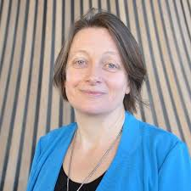


Slide 15
Confensiwn y Cenhedloedd Unedig ar Hawliau Plant (CCUHP)
United Nations Convention on the Rights of the Child (UNCRC)
Mabwysiadawyd gan Lywodraeth Cymru yn 2004
54 o erthyglau
Erthyglau 1–42 yn berthnasol i hawliau plant a phobl ifanc 0-18
Erthyglau 43-54 yn berthnasol i lywodraethau o ran sut y gweithredir yr hawliau
Dyletswydd ar bawb sydd yn gweithio gyda phlant a phobl ifanc i sicrhau bod yr hawliau hyn yn cael eu diwallu
https://www.complantcymru.org.uk/ccuhp-hawliau-plant/ccuhp-hawliau-plant
Ratified by the Welsh Government in 2004
54 articles
Articles 1–42 are relevant to children and young people’s rights (0-18)
Articles 43-54 are relevant to authorities and refer to how these rights are implemented
A duty on all those working with children and young people to ensure that these rights are being implemented
https://www.childcomwales.org.uk/uncrc-childrens-rights/uncrc/

Slide 16
Egwyddorion principles
Embedding the rights – essential when planning provision
Equality and non-discrimination – an inclusive approach whereby every individual has the opportunity to achieve their full potential
Empower children – better able to take advantage of their rights
Participation – listening to children and giving them the opportunity to voice their opinion
Accountability – authorities should be accountable to children regarding decisions that affect their lives
(Children’s Commissioner for Wales, 2019)
Ymgorffori’r hawliau – yn greiddiol wrth gynllunio’r ddarpariaeth
Cydraddoleb a dim camwahaniaethu – ymagwedd gynhwysol lle caiff pawb gyfle cyfartal i gyflawni eu llawn botensial
Grymuso plant – eu galluogi i fanteisio ar eu hawliau
Cyfranogiad – gwrando ar blant a rhoi cyfle iddynt i fynegi eu barn
Atebolrwydd – dylai awdurdodau fod yn atebol i blant am benderfyniadau sydd yn effeithio ar eu bywydau
(Comisiynydd Plant Cymru, 2019)

Slide 17
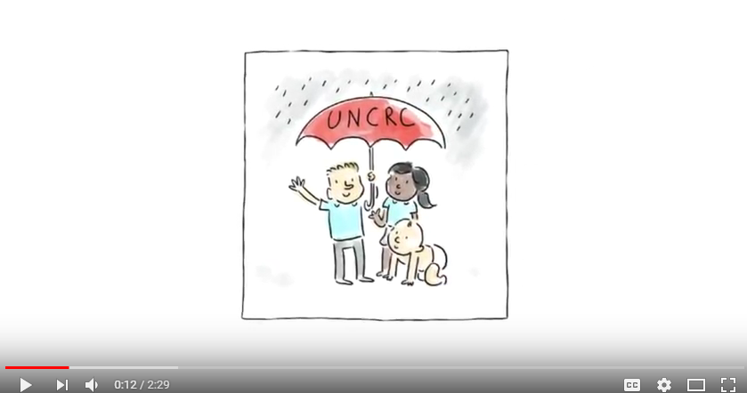
https://www.youtube.com/watch?v=0cQqjWlVp8k (Cymraeg)
https://www.youtube.com/watch?v=WSpfLMV3_sA (English)

Slide 18

Gwrthfwlio | Anti Bullying
Article | Erthygl 19
Arfer Adferol | Restorative Practice
Articles | Erthyglau 12/36/17
Y Cyfnod Sylfaen | Foundation Phase
Article | Erthyglau 28/29/31
Llais y disgybl | Pupil voice
Article | Erthygl 12 – Right to be heard / Hawl i gael eu clywed
ADCDF| ESDGC
Article | Erthygl 2
CCUHP
UNCRC
Ysgolion Iach/Eco
|Healthy/Eco Schools
Article | Erthygl 24 –
Gweithgareddau Allgyrsiol | Extra Curricular Activities
Article | Erthygl 15
Ethos yr Ysgol | School Ethos
Articles | Erthyglau 28 / 29

Slide 19
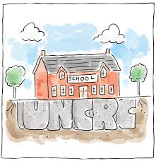
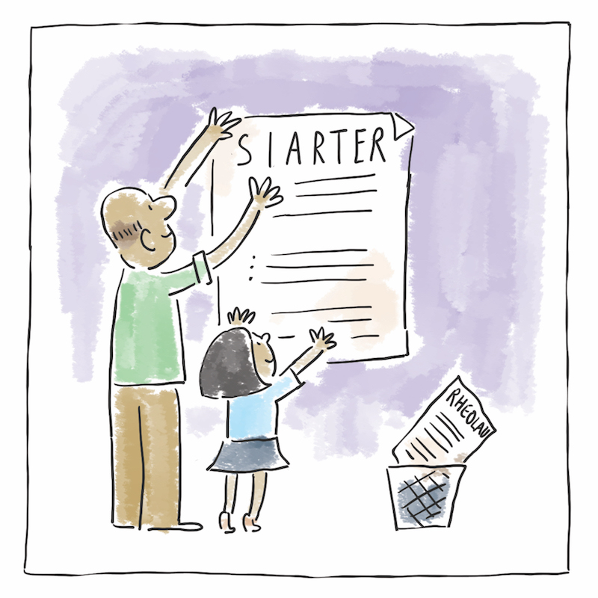
Darllen pellach further reading
Er mwy cael trosolwg mwy cyflawn o Gonfensiwn y Cenhedloedd Unedig ar Hawliau’r Plentyn, dilynwch y ddolen hon ac edrychwch ar y cyflwyniadau a’r adnoddau yma:
https://www.complantcymru.org.uk/ccuhp-hawliau-plant/adnoddau-ccuhp/
For a more comprehensive overview of the United Nations Convention on the Rights of the Child, follow this link and go through these presentations and resources:
https://www.childcomwales.org.uk/uncrc-childrens-rights/rights-resources-universities-colleges/

