Slide 1
Applying Erikson’s Psychosocial Theory to Jenny’s Case Study
Name: Nasreen Akhtar Ahmed
Student number: 2428725
Module: Psychology in Health and Social Care
Module Code: LCHS4010
Lecturer name: Alice Clayton
Module title: Psychology in Health and Social care

Slide 2
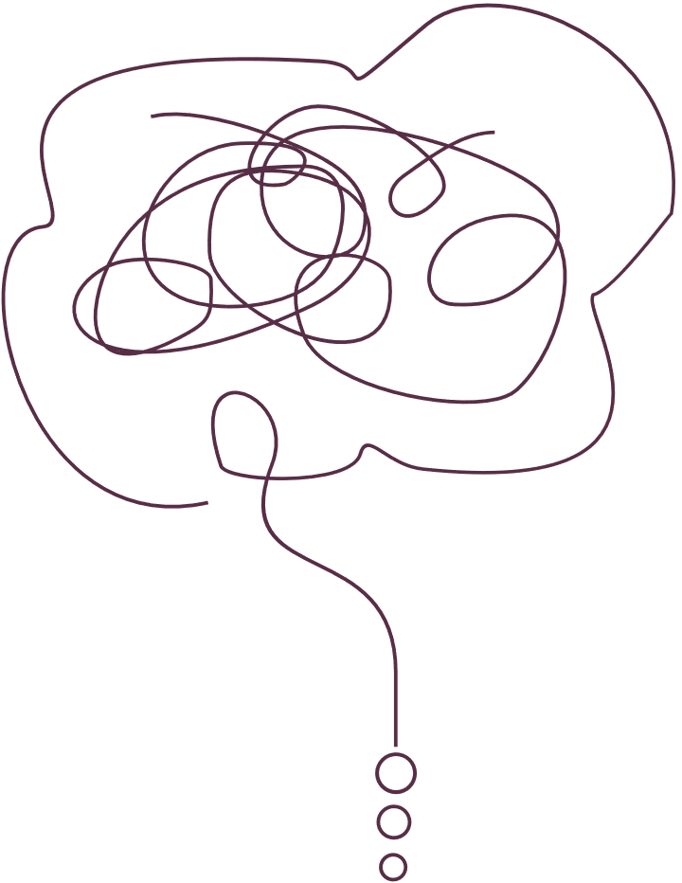
INTRODUCTION
  My name is Nasreen and this presentation is for the module Psychology in Health and Social Care (LCHS4010).
  This presentation will explore the case study of Jenny, a 16-year-old young carer
  The presentation will use Erikson’s Psychosocial Theory to explain the impact of Jenny’s experiences on her development and well-being.
  It will also discuss how this theory can be used to support Jenny in her current situation.
  Jenny has been caring for her mother for the past five years following the death of her father, which has affected her emotional and social development.

Slide 3

JENNY’S CASE STUDY
  Jenny is a 16 year old adolescent who has become a young carer.
  Five years ago Jenny's father died and since then she has had to take care of her mother.
  Jenny's mother has problems with mobility, and this affects her ability to perform daily household tasks.
  She also has issues with memory, forgetfulness, and experiences low mood and needs more emotional and practical support.
  As a result, Jenny provides regular care including cooking, cleaning, shopping and helping with administrative tasks.
  These responsibilities demand a lot from Jenny emotionally, socially, and developmentally at an important time in her adolescence.

Slide 4
OVERVIEW OF ERIKSON’S PSYCHOSOCIAL THEORY
Erikson's Psychosocial Theory is a theory that explains how people develop emotionally and socially throughout life (Maree, 2021). Erik Erikson suggested that development is carried out in eight stages where each stage brings a psychosocial conflict that needs to be resolved.
Key features of the theory include:
Unresolved conflicts may result in emotional and/or social problems later in life
Successful resolution of conflicts helps with healthy psychological development (Turnbow, 2024)
Development is from infancy until adulthood (Arterberry and Bornstein, 2023)
Each stage is affected by social relationships and life experience
This theory is widely used in health and social care to understand the importance of life experiences on emotional well-being and how they shape identity formation.

Slide 5
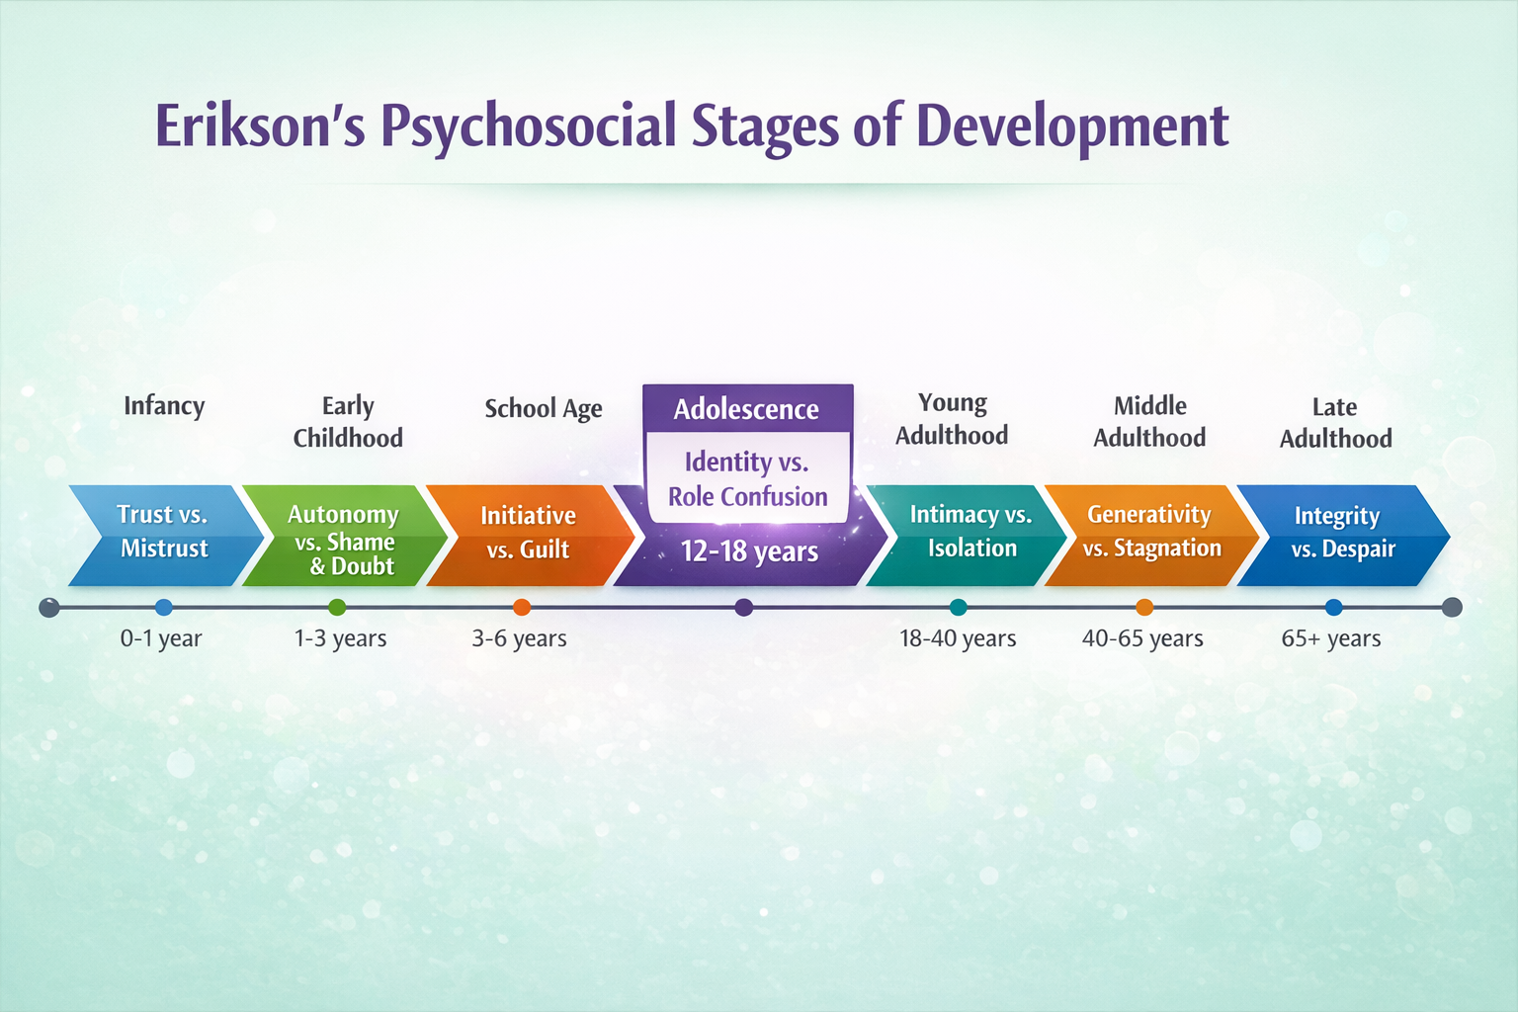
ERIKSON’S STAGES: ADOLESCENCE
Erik Erikson identified 8 stages of psychosocial development, each having a particular age range and developmental challenge. In adolescence (around 12 - 18 years old), people go through an age called Identity vs. Role Confusion.
At this stage, young people start to explore who they are, what their values are and what their place in society is. Developing a sense of identity is critical to emotional health and healthy functioning as an adult.

Slide 6
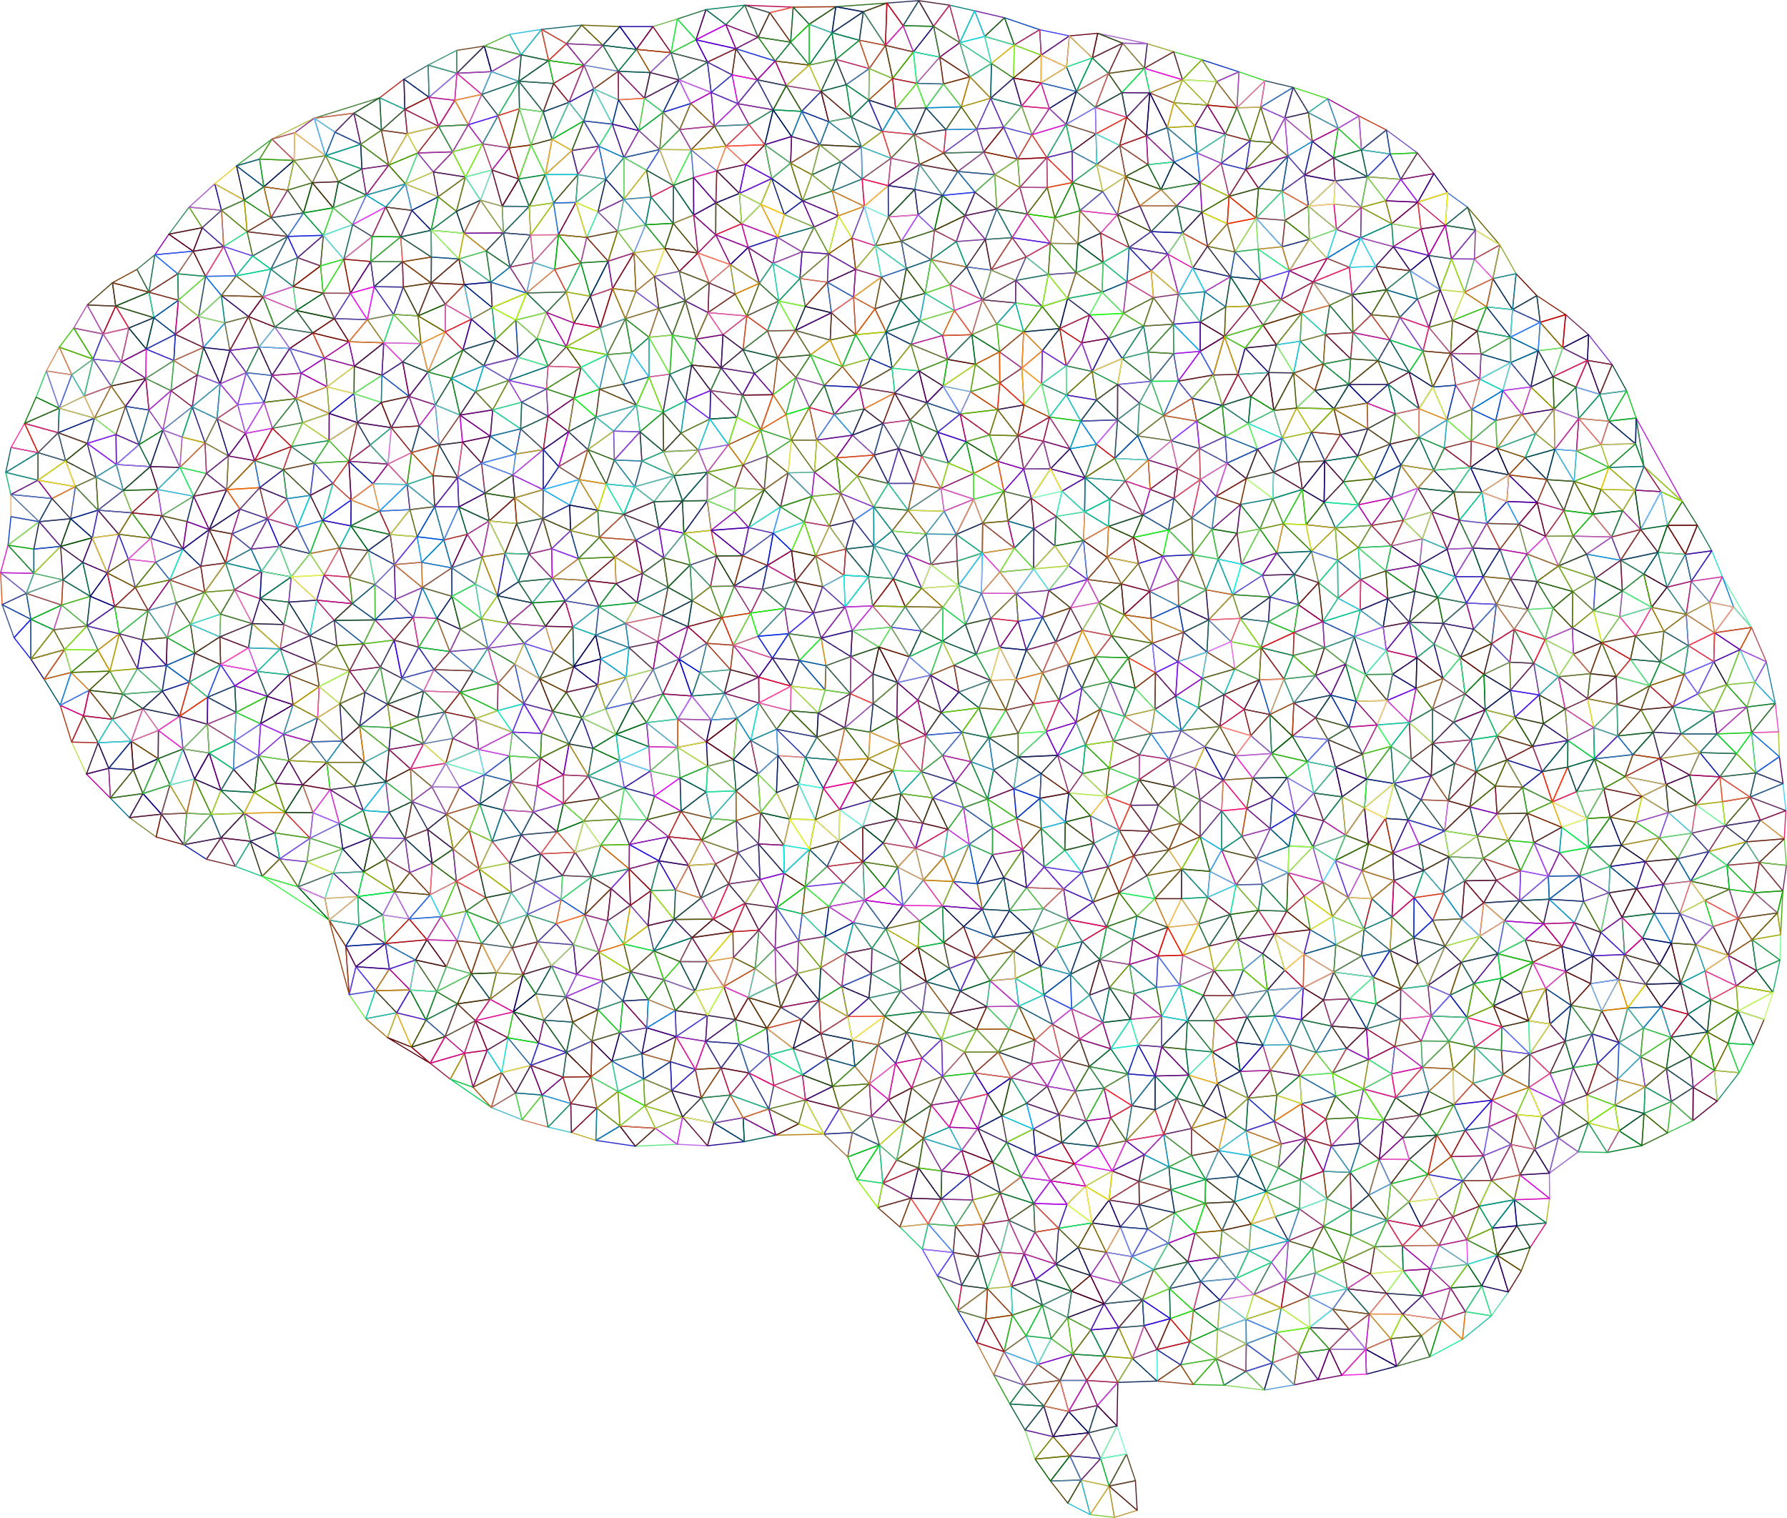
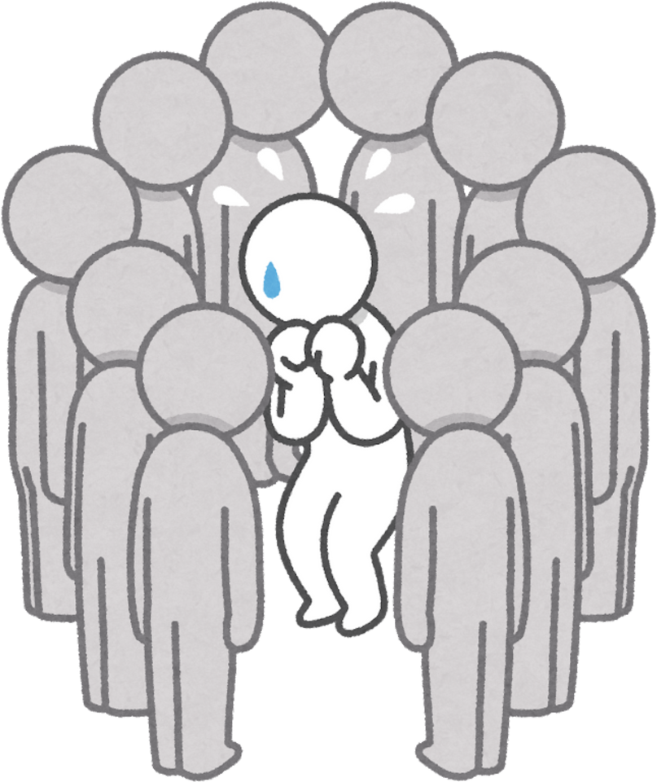


APPLYING ERIKSON’S THEORY TO JENNY
According to Erikson's theory on psychosocial development, adolescence is a crucial time for the formation of a definite sense of identity (Zhang and Qin, 2023). During this stage, youth require opportunities to explore independence, relationships and personal goals.
In Jenny's case, assuming a caring role from a young age might get in the way of this developing process.
Applying the theory to Jenny suggests that:
Jenny has been forced to assume the role of adulthood in adolescence
Her caring role may restrict opportunity to explore identity
Reduced time to develop peer relationships may impact on social development
There is a high risk of role confusion because of competing responsibilities

Slide 7
IMPACT ON JENNY’S WELL-BEING
Adolescence is a critical period for emotions. According to Erikson's theory, challenges in resolving the stage of Identity vs Role Confusion could negatively impact on psychological well-being.
In Jenny's case, the long term caring responsibilities could lead to increased stress, lack of social contact and put her at more risk for anxiety, low mood and low self esteem.
Key impact:
Jenny's role as a carer could be having an impact on her healthy emotional development in adolescence.

Slide 8

PRACTICAL STRATEGIES TO SUPPORT JENNY
Intervention that is related to Jenny should be aimed at diminishing the pressure of caregiving and encouraging healthy identity formation in adolescence.
Young Carer Support Services
School-Based Support
Mutual support and experience.
Pastoral and academic flexibility.
Emotional Counselling
Respite & Community Care
Stress support, emotion support and identity development.
On-the-job counseling to limit the influence of Jenny among the mother.

Slide 9
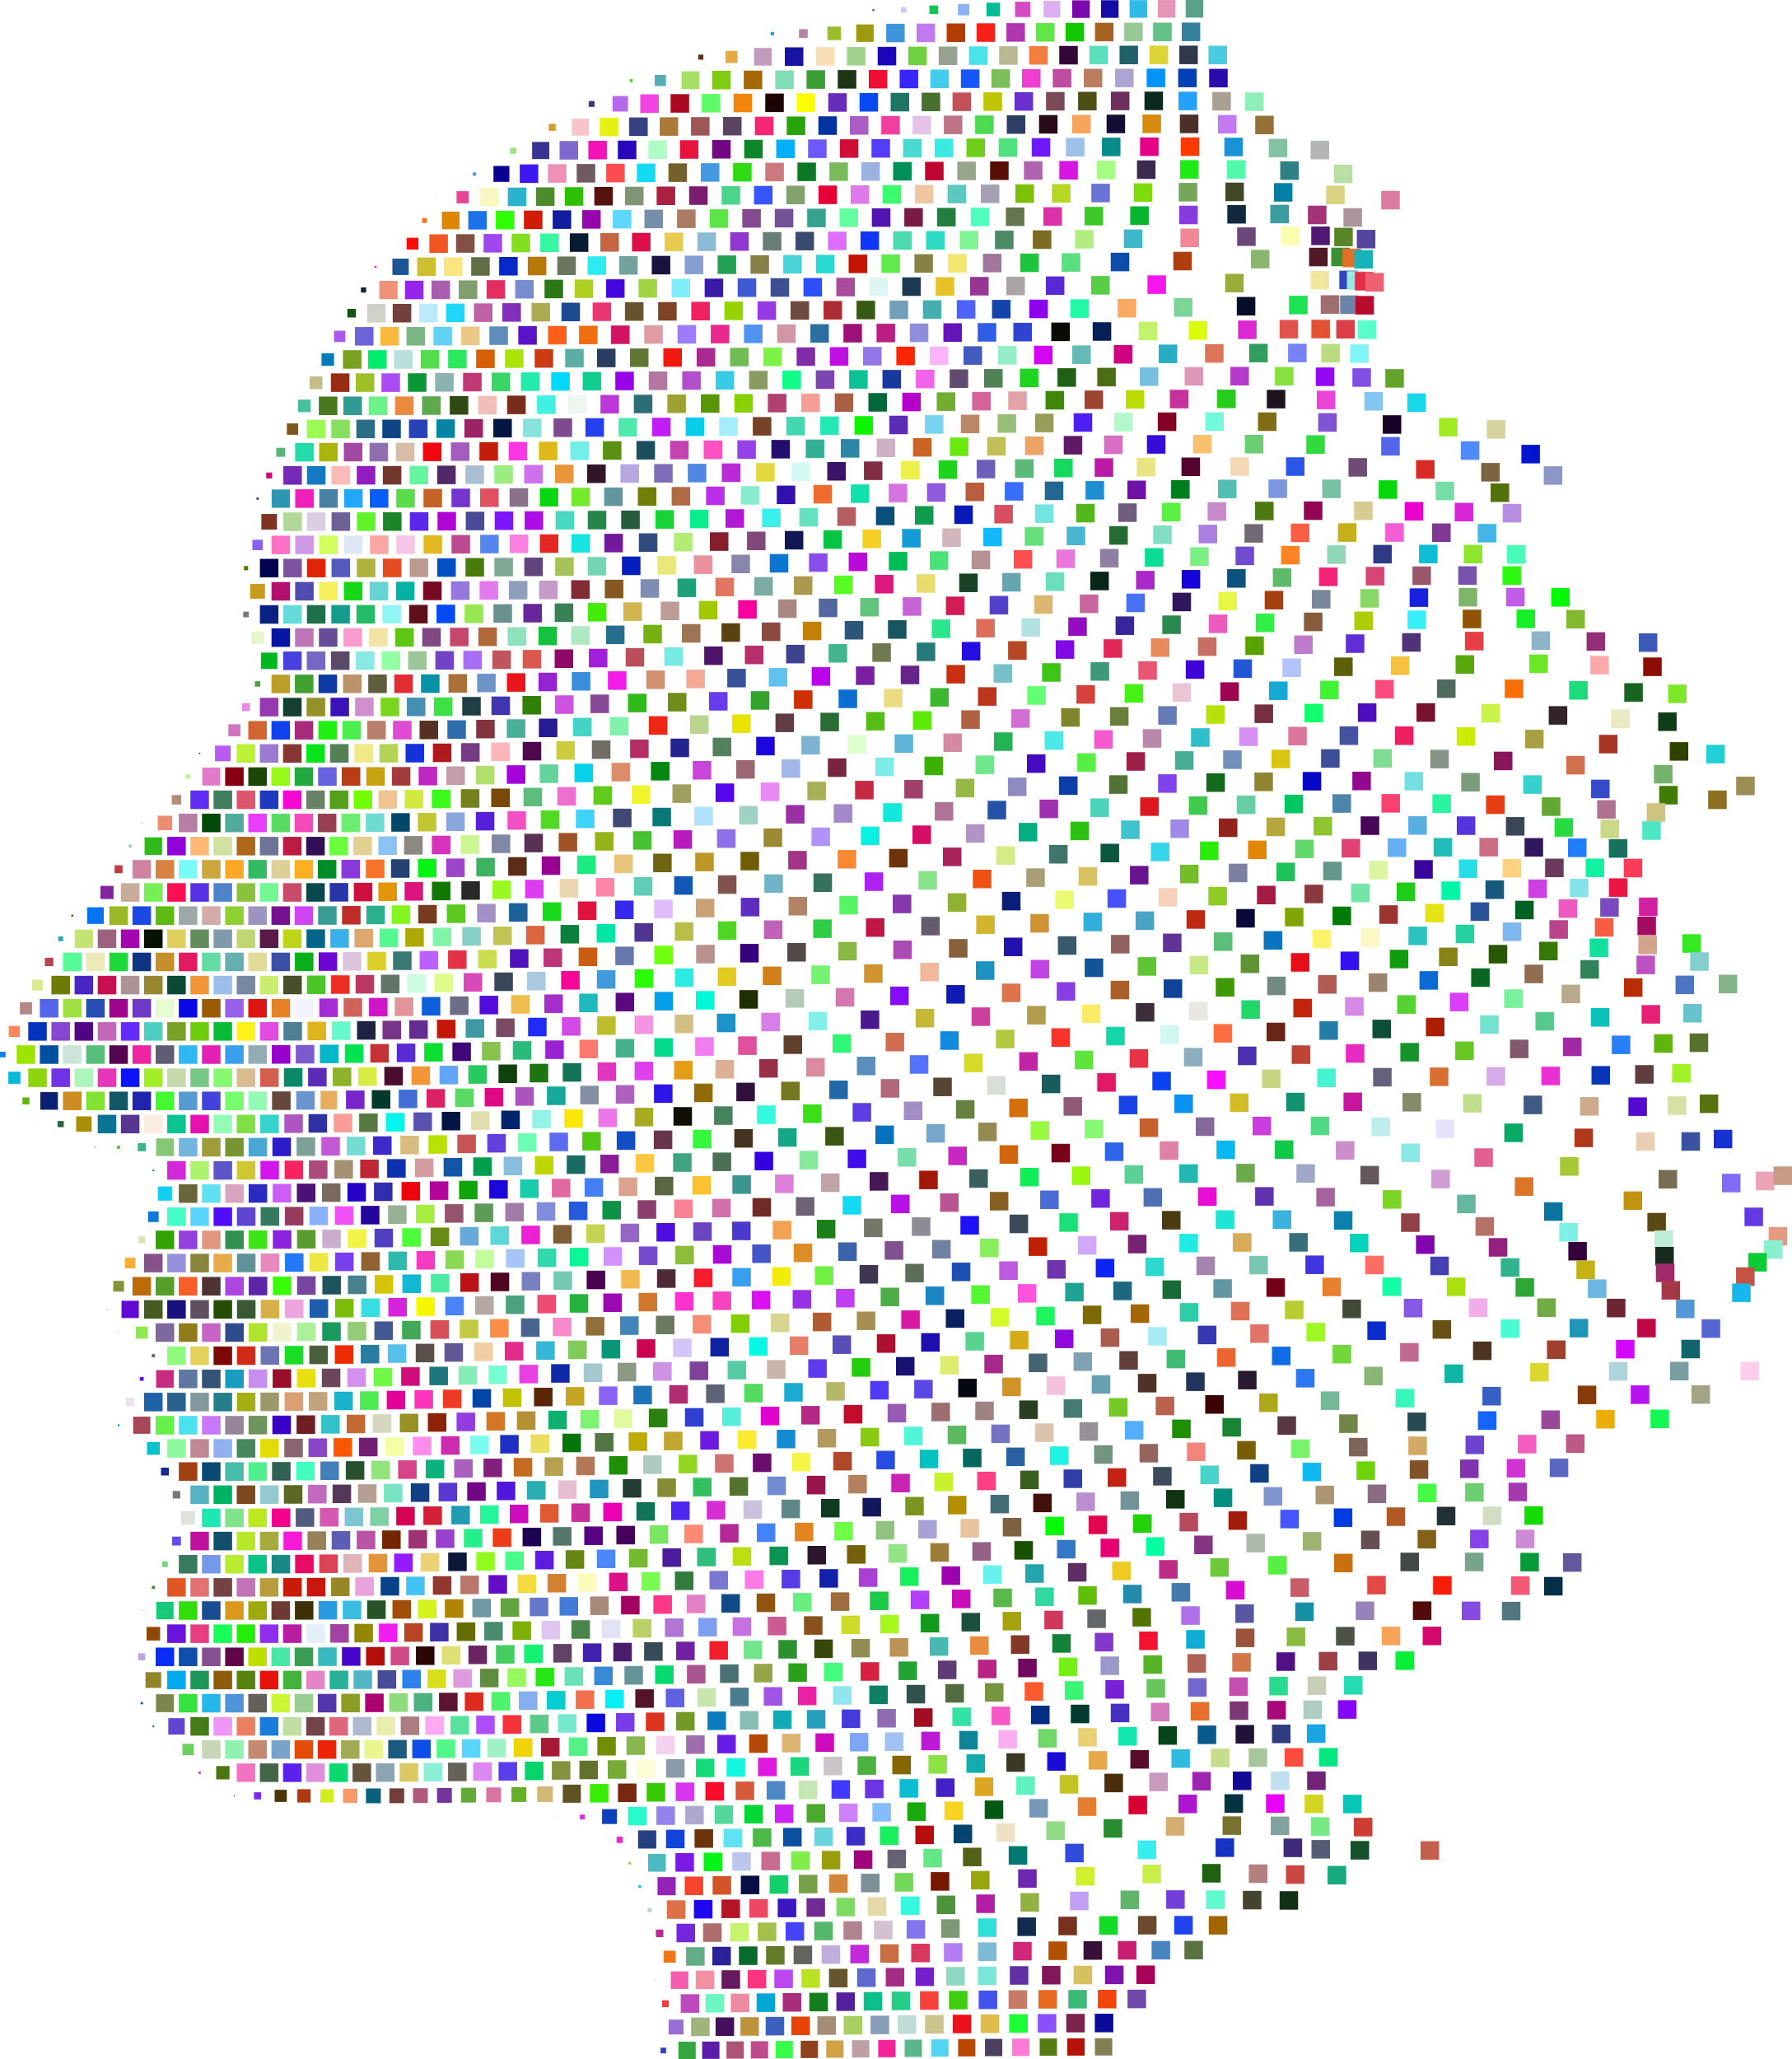
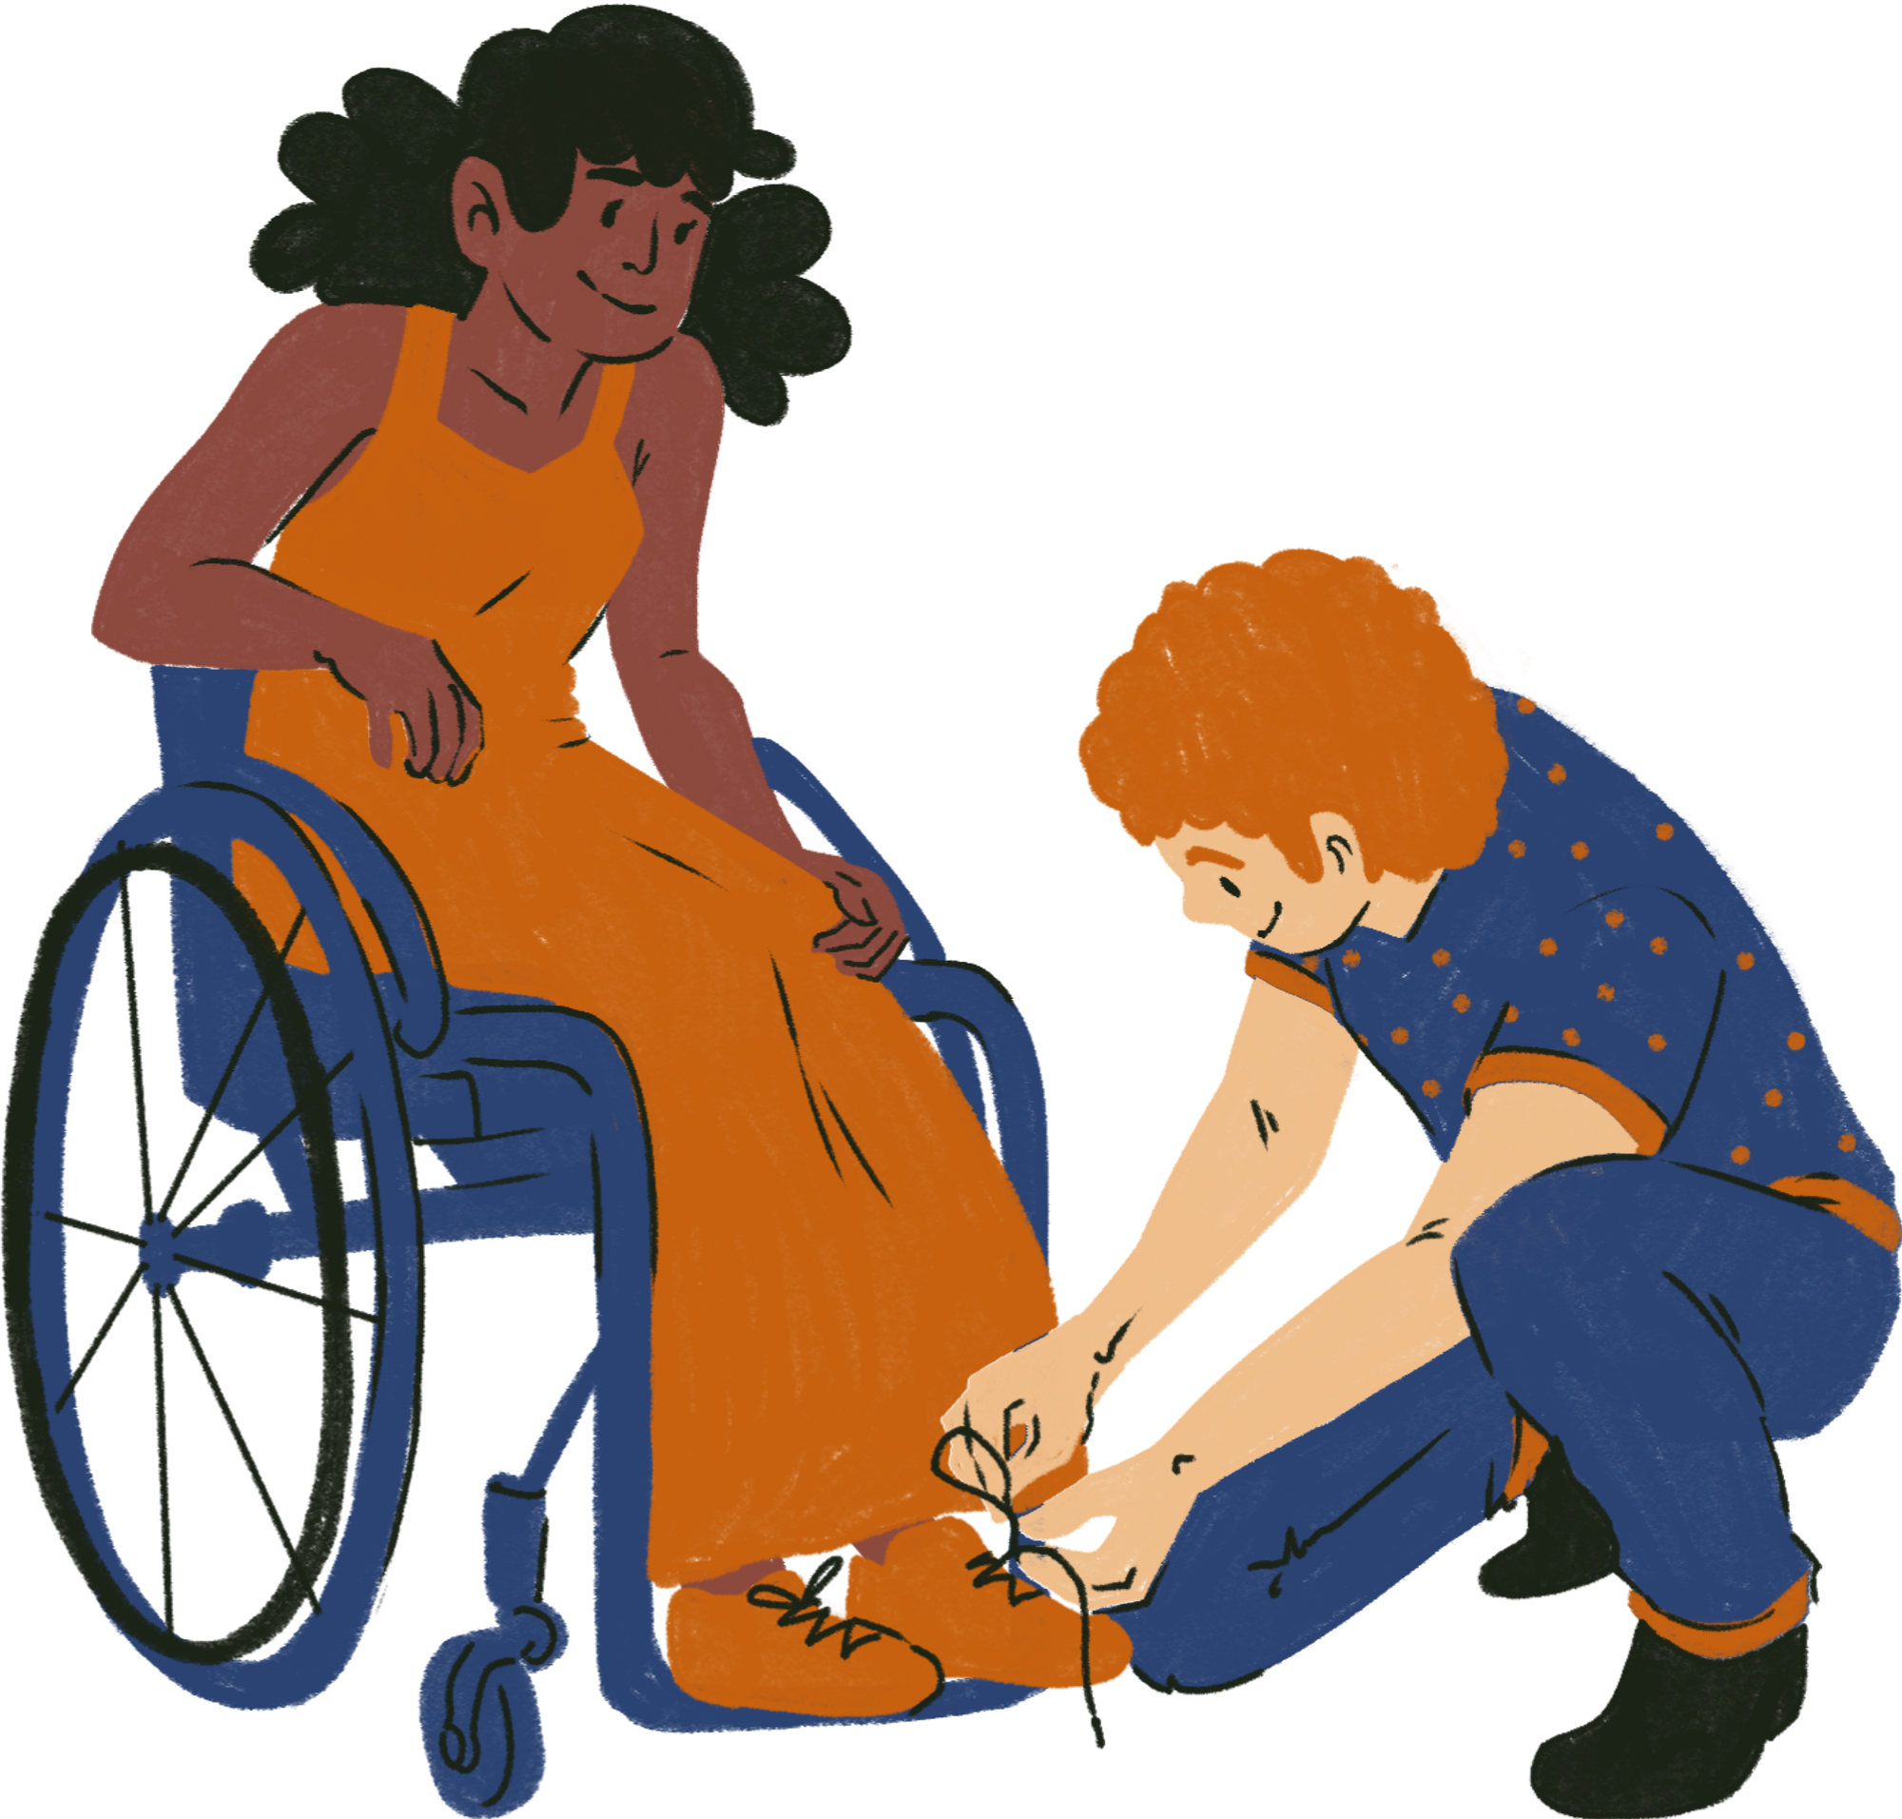

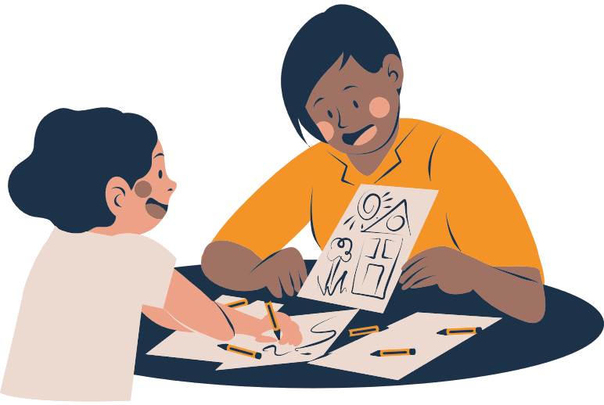

PROFESSIONALS INVOLVED IN JENNY’S SUPPORT
Jenny requires a multi-agency solution to her psychological health and developmental requirements.
School / College Staff
GP / Mental Health Services
Community Care Services
Young Carers Organisation
Social Worker
Evaluation and service planning and service access.
Practical assistance of the mother of Jenny.
Peer support and advocacy
Academic flex and pastoral care.
Moral and psychological support.

Slide 10
NATURE VS NURTURE IN JENNY’S DEVELOPMENT
The biological factors (nature) and environmental factors (nurture) have developed Jenny psychologically.
NATURE (BIOLOGICAL FACTORS)
NURTURE (ENVIRONMENTAL FACTORS)
  Development of brain and age.
  Loss of her father
  Adolescence emotional regulation.
  Caring duties over a long period of time.
  Physical and hormonal modifications.
  Family conditions and stress.
  Little peer time and free time.
The relationship of nature and nurture affects Jenny in terms of emotional health and identity development.

Slide 11






EVALUATION OF ERIKSON’S THEORY
Strengths
Psychosocial theory developed by Erikson would help explain the development of Jenny as it is devoted to the formation of identity, emotional satisfaction, and relationships with the surrounding environment as a teenager. This renders it very applicable in the practice of health and social care.
Limitations
Nevertheless, the theory by Erikson is rather general and does not pay proper attention to individual variations, culture, and the stress of taking care of in the long-term. It may thus be required to be applied together with other theories.

Slide 12
CONCLUSION
The psychosocial theory of Erikson can help me to understand that Jenny had a lot of caring responsibilities that have influenced her emotional growth and identity formation as an adolescent.
Using this theory, one can notice that the pressure of caring and giving proper emotional and practical assistance can preserve the health of Jenny and ensure her healthy development.
In general, psychology is a significant aspect of health and social care that can assist professionals to learn about the needs of individuals and come up with effective and person-centred support.

Slide 13
References
Arterberry, M.E. and Bornstein, M.H. (2023). Development in Infancy. Routledge. doi:https://doi.org/10.4324/9781003340263.
Maree, J.G. (2021). The psychosocial development theory of Erik Erikson: critical overview. The Influence of Theorists and Pioneers on Early Childhood Education, [online] 1(1), pp.119–133. doi:https://doi.org/10.4324/9781003120216-11.
Turnbow, A. (2024). An Examination of the Importance of Developing Conflict Resolution Skills within Adolescence. [online] ScholarWorks@GVSU. Available at: https://scholarworks.gvsu.edu/gradprojects/455/ [Accessed 31 Jan. 2026].
Zhang, Y. and Qin, P. (2023). Comprehensive Review: Understanding Adolescent Identity. Studies in Psychological Science, [online] 1(2), pp.17–31. Available at: https://www.pioneerpublisher.com/SPS/article/view/410.

