Slide 1

Digital Skill – Using Excel
Week 8 – BMSW4003 Digital Skills and Research Methods

Slide 2



During this session…
Enter Data or record results
calculate sum and means.
Produce charts and graphs.

Slide 3

MS Excel on Office 365
Weverka (2019, p231) describes Excel as the “official number cruncher of Office 365”.
Excel has some key terms:
Workbook
  this is the excel term for a file created in Excel, you can use a blank workbook or use a template workbook.
Worksheet
  also known as a spreadsheet is the table into which you enter data.
Rows
  these are numbered and run horizontally across the worksheet.
Columns
  these are labelled with letters AA to AZ then BA to BZ and so on.
Cells
  These are the individual boxes within the worksheet. Each has an ‘address’ to show its location, for example, A1 is next to B1, and A1 is directly above A2
Notes:
Highlight that Workbook template will offer pre-prepared organisation and embedded calculations that provide the user with what they need, for example invoices or payslips. Students will not need to use a template in this module but may find these useful in the workplace.
The worksheet or spreadsheet as its much more commonly known is like the first page of a ledger or book, one worksheet is provided as default but further worksheets can be added using the + tab at the bottom of the worksheet.
When describing the Rows, Columns and Cells – you may find it helpful to have a blank workbook open to refer to with the students – A labelled image does appear on the next slide.

Slide 4
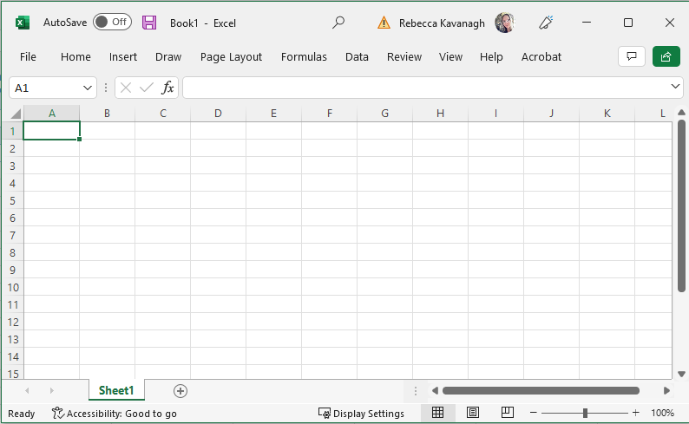
Workbook
Cell
Column
Row
Worksheet
Notes:
This image shows the labelled parts of a workbook.

Slide 5

Creating a blank workbook
On a desktop version of Office 365.
Search for Excel.
Open the app.
Create a blank workbook.
Notes:
The video is not narrated and simply shows how to open a blank workbook on Excel – remind student of the need to ‘save as’

Slide 6
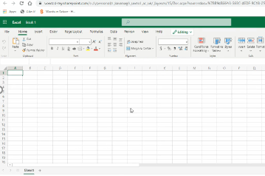
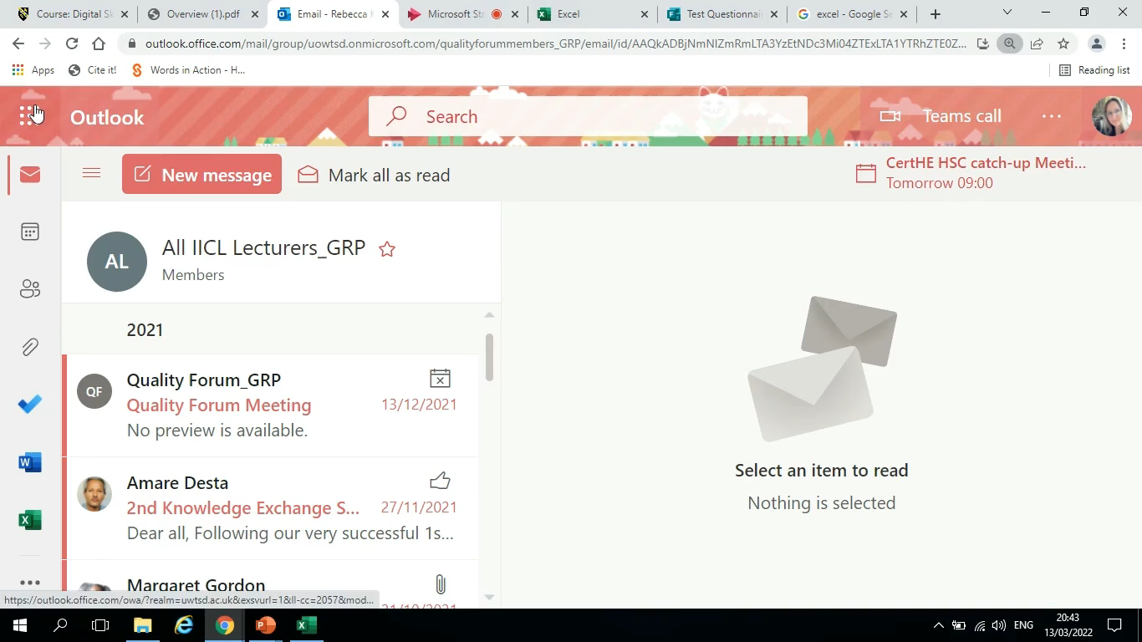
Creating a blank workbook
On the OneDrive version
Select Excel from your palette of OneDrive Apps.
Create New Blank Workbook.
Notes:
The video is not narrated. Remind students of the need to save and name their work when they use the OneDrive version of Excel to prevent them losing track of their different files. Remind students that do not see the Outlook view shown here to log in to www.office.com to log in to their Office 365 using their university log on.

Slide 7
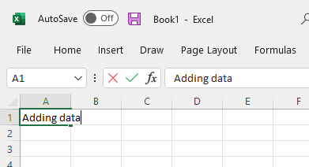
Adding data to your workbook
You will notice that what you type appears in the formula bar.
If you need to edit your data or data label, then you will use the formula bar to do it.
Click on the cell to type in your data or data label.
Notes:
Explain to the students that if you enter data into a cell and move on to another cell, if you decide to click back to a prior cell to make a correction then the correction or adjustment needs to be made in the formula bar otherwise your original data will disappear as Excel will assume that you are entering new information and not editing old info. For example if you put a label of ‘question 1’ but you decide to put ‘Question 1’ instead, then when you return to the cell to add the capital letter if you click and type, you will need to add the full piece of information whereas the formula bar is where you can click anywhere in the cell text to edit.

Slide 8
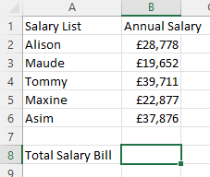
Activity - Entering some Data.
Open a blank Excel Workbook.
Save As ‘Week 8 Activity 1’
Enter the following data into your worksheet
Notes:
Give students a clear time when they will share a screen shot or copy of their work with you. Highlight that this data needs to be entered prior to being shown how to calculate totals using the Excel Sum tool.
Remind students that they need to enter the data as it is shown, the total does not need to be calculated, that is our next task together. Highlight that these basic skills are essential for being able to use Excel and that whilst the data does not relate to their project, the skills being learned do apply and have vital relevance. The task here is not optional.

Slide 9


Calculating a total.
We will be using the AutoSum tool to calculate the total.
Notes:
Link to the Video - https://express.adobe.com/video/AZJ0UwCb82jNQ
After watching the video, allow students time to try out the tools. Are they able to gain the same results as each other from the data? What are the common error or difficulties?

Slide 10

Charts and Graphs.
Notes:
Link to video https://express.adobe.com/video/zS9J4Iv1LT2dr

Slide 11
Activity – Create a bar chart using the data from activity 1.
Notes:
Allocate a time limit for task, share examples of strong work. Encourage students to share challenges and tackle any misconceptions.
Remind students that this will be the final opportunity to all work together using a common data set so this is the time to test skills in a supportive environment.

Slide 12
Share your Charts.
Post your charts in the MS Teams or via email to your lecturer.
Compare how differently the same data can be presented, which styles worked effectively?
What were the most challenges skills to learn with using data and creating charts?

Slide 13
After the break…
Our research skill this week is analysis.

Slide 14
References
Weverka, P., (2019) Office 365 – All–in-One, Hoboken: John Wiley & Sons

