Slide 1
Student Name: Adnan Ameen
Student ID: 2523397
Lecturer’s Name: Deji Olagboye
Module Code: LCLM 4004
Module Name: Problem Solving and Decision-Making
Component 1: Basil’s Bakery

Slide 2
Basils Bakery
Good morning/afternoon. My name Adnan Ameen
In my presentation I will:
  Provide an overview of Basil’s Bakery and the nature and scope of the problems they are encountering.
  Provide a critique and application of the PESTEL framework.
  Provide a critique and application of the Cause-and-Effect model.
  And, finally, provide a summary of the key findings.

Slide 3
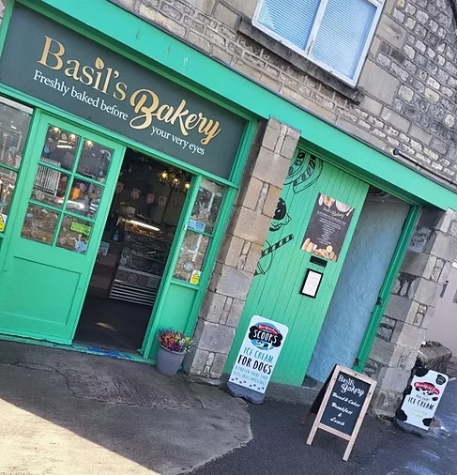
Basil's Bakery
Independent artisan bakery established in 2015.
Located in a retail park in Coventry, UK.
Sells premium cakes, pastries and breads.
Uses high-quality organic ingredients.
Serves shoppers, retail workers, office staff and warehouse employees.
Experienced strong sales growth between 2015 and 2019.
Since 2020, sales have failed to return to pre-pandemic levels and remain approximately 25% lower than 2019 levels

Slide 4
Nature and Scope of the Problems
Problem | Control
Delivery service | High
Pre-order system | High
Retail park footfall | Low
Remote working | Low
Rising costs | Low-Medium
Root Problem
Sales stagnation and reduced profitability
Internal Problems
No delivery service available.
Limited ability to answer customer calls.
Inability to consistently offer pre-order services.
Reliance on expensive organic ingredients.
External Problems
Reduced retail park footfall.
Store closures causing job losses.
Increased remote working.
Rising utility costs, rent, rates and insurance.
Volatile prices of organic produce.

Slide 5

Critique of the PESTEL Framework
What is PESTEL?
PESTEL is a strategic tool used to analyse the external macro-environment affecting an organisation.
Benefits
✓ Identifies opportunities and threats
✓ Encourages strategic thinking
✓ Supports decision-making
✓ Provides a structured environmental scan
Limitations
✗ Does not prioritise factors
✗ Can become outdated quickly
✗ Focuses only on external influences
✗ May oversimplify complex business environments
References
Johnson et al. (2023)
Kotler et al. (2022)
Gupta (2013)

Slide 6
PESTEL Analysis of Basil's Bakery
Political | Economic
Business rates increasing | Inflation increasing costs
Social | Technological
More remote working | No online ordering system
Changing shopping habits | Lack of delivery technology
Legal | Environmental
Food safety compliance | Organic crops vulnerable to climate change
Employment regulations | Sustainable sourcing expectations

Slide 7

critique of the Cause-and-Effect model
What is the Cause-and-Effect Model?
Also known as the Fishbone Diagram or Ishikawa Diagram.
Purpose
Identifies root causes of problems.
Organises complex issues visually.
Supports problem-solving and decision-making.
Benefits
✓ Easy to understand
✓ Identifies multiple causes
✓ Encourages systematic analysis
✓ Useful for brainstorming
Limitations
✗ Does not show importance of causes
✗ Can become complex
✗ Relies on subjective judgement
Reference
Ishikawa (1986)

Slide 8

Root Problem
Sales 25% Below 2019 Levels
People
Customers working from home
Retail staff redundancies
Methods
No delivery service
Limited pre-order process
Machines/Technology
No online ordering platform
Limited communication systems
Materials
Expensive organic ingredients
Supply uncertainty
Measurement
Limited customer demand data
Limited forecasting
Environment
Reduced retail park footfall
Shop closures
Economic pressures

Slide 9

Discussion of Fishbone Findings
Main Causes Identified
Reduced customer numbers due to remote working.
Declining retail park activity.
Lack of technological solutions.
Increasing operating costs.
Supply chain uncertainty.
Most Significant Causes
Social changes in working patterns.
Reduced footfall.
Lack of delivery and online ordering.
These causes collectively contribute to lower sales and threaten long-term business viability.

Slide 10

Key Findings
Key Finding 1
Sales have stagnated due to a combination of internal and external factors.
Key Finding 2
Social and economic changes have significantly reduced customer demand.
Key Finding 3
The absence of delivery and online ordering limits customer accessibility.
Key Finding 4
Rising operating and ingredient costs are reducing profitability and increasing business risk.

Slide 11
Reference List:
Gupta, A. (2013) 'Environmental and PEST Analysis', International Journal of Modern Social Sciences, 2(1), pp. 34-43.
Ishikawa, K. (1986) Guide to Quality Control. Tokyo: Asian Productivity Organization.
Johnson, G., Scholes, K. and Whittington, R. (2023) Exploring Strategy. 13th edn. Harlow: Pearson.
Kotler, P., Keller, K. and Chernev, A. (2022) Marketing Management. 16th edn. Harlow: Pearson.
University of Sunderland (2026) LCLM4004 Assessment Specification: Basil's Bakery Case Study.

Slide 12
Thank you for listening

Slide 13


