Slide 1

DEVELOPING AND MANAGING INDIVIDUALS AND TEAMS

Slide 2


Introduction
HealthConnect UK is a digital growing health care firm.
HR issues are a threat to the quality of services and expansion of an organisation (Figueroa et al., 2019).
HRM has the potential to raise recruitment and worker training and retention.
The presentation offers viable recommendations on how to maintain performance of the workforce.
Notes:
The company, HealthConnect UK, has been delivering patient remote monitoring and virtual consultations both in the United Kingdom and various other areas. This is essential to its further growth because it needs to get good and talented man power, train and keep them. The assessment of workforce planning, recruiting and selecting, learning and development, talent management, performance management and motivation in this presentation. The recommendations focus on making staff performance better, increasing retention and making the organisation a lasting success.

Slide 3

Organisation Overview and Workforce Challenges
Offers Tele-health and Tele-monitoring.
Trusting the work of the professional and qualified healthcare and tech workers.
High turnover rate, burnouts, and low engagement levels.
Strategic HRM of the quality of services and business development (Sharma and Kohli, 2023).
Notes:
The knowledge healthcare and IT skills must work hand in hand in a tough environment HeathConnect UK. Staff who work multidisciplinarily include clinical, software, data analysts, administration and team leaders. When an employee cannot get a replacement to work, due to shortage of skilled employees, it may cause stress to the employees that may lead to others burning out and quitting. Other consequences of limited involvement include collaboration and service delivery. Strategic HRM may help to bridge the gap between decisions of HRM and needs of the organisation to give the workers the appropriate type of skill, load and avenues of their personal development.

Slide 4

Workforce Planning and Skills Gap Analysis
Projections and planning should be done on staffing needs based on projected needs of service at any given time.
Assess the current clinical, managerial and electronic competencies.
Determine shortages using information on vacancy and turnover/workload.
Adopt a combined approach of in-house recruitment/selection and external recruitment/selection (Sisneros, 2025).
Notes:
HealthConnect can no longer be reactive and must plan to meet staffing requirements. HR ought to have the ability to foresee needs as per department, as per the professional area and as well as per the anticipated growth of the services. Stated differently, the level of effectiveness and competence of digital consultations and remote monitoring workers, and the way they address data security or leadership of a team can be measured with a skills matrix. Vacancy duration/workload Turnover reporting may reveal what issues should be tackled. In-house training is the case where an employee can be trained on an asset in a limited span of time, and specialist skills are acquired through external recruitment where there is an acute need for the skill.

Slide 5
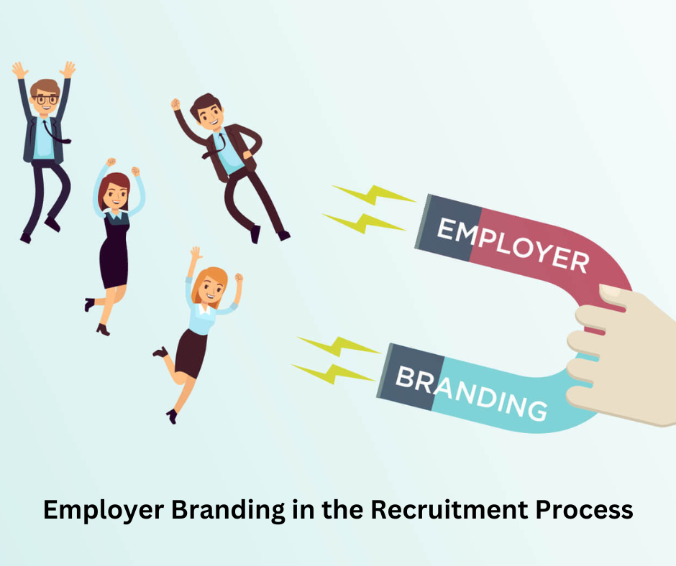
Recruitment Methods and Employer Branding
Recruitment through internal upliftment- promotion and transfer/career promotion.
Amenable to hiring specialist agencies, University networks and professional networks.
Online recruiting - careers websites, job platforms and social media.
Promote positive engagement in the health care system, discouraged benefits and flexible working (Karaferis et al., 2022).
Notes:
HealthConnect ought to make use of a hybrid method of recruitment to get the appropriate talent. This internal recruitment also assists in bringing about progression and retaining some kind of knowledge within the organisation, but when requiring new skills, internal recruitment can be a limitation. New capabilities can be acquired in a more complex and expensive recruitment process, but this time, by an external hire. Severe screens may be made, and online platforms and networks may reach more people. The Employer Branding Content Imperatives must convey the healthcare mission of the organisation, the development opportunities, along with working conditions.

Slide 6

Selection and Equal Opportunities
Get to know the occupation (Job role) and Person specification.
Make the shortlisting process standard, not just for different educational backgrounds but also across the industry.
Schedule interviews and conduct suitable hands-on evaluation (Kambur and Yildirim, 2022).
Report on credentials, professional registration and references.
Notes:
HealthConnect will make sure that the decisions made are fair, consistent and pertinent to the post. To illustrate, a digital healthcare analyst ought to be knowledgeable of how to interpret data, be technologically competent, aware of confidentiality concerns, and be a communicator. Before conducting the structured interview and practicals, HR ought to filter out the applications according to the published screens. The clinical appointments are done in case of proper qualification and checks of professional registration. Although standardised marking methods can help mitigate the subjectivity of marking, poorly drafted tests can be a disadvantage to highly able candidates.

Slide 7

Learning and Development
Full in-depth Competency Review (training needs analysis) to give individual advice on training requirements (Emerson and Berge, 2018).
Offer web-based health care, data-protection, and cyber-security training.
Mentoring, coaching and simulation practice and supervised practice at the institute.
Assess learning and work performance.
Notes:
Learning should be tailored to the learning competency gap of the individual and not to all the employees. As an example, a new remote patient-monitoring coordinator could possess the basic knowledge of patient care, but feel uncomfortable with a digital patient-monitoring system. The manager should test the level of skill of the group and identify the objectives of desired skills, and through this, relevant training should be arranged on the platform. Simulation and/or mentoring can be used to build confidence in self-confidence before embarking on independent practice. Experiential learning is about a process that aids employees in learning by experience, reflection and application.

Slide 8

Talent Management and Employee Retention
Learn significant functions and possibilities.
Develop and have proper succession/career strategies.
Provision of mentoring, competitions and transfers.
Monitor employee movement, employee promotion and retention (Burnett and Lisk, 2021).
Notes:
The talent management should focus on recruiting, developing and retaining employees who possess the appropriate talent needed to grow HealthConnect going forward. Clear career opportunities can demonstrate how clinicians, as well as digital specialists/administrators can build their career towards higher positions or towards a specialist role. Succession Planning process is involving those potential staff to fill in the key roles and develop them and reduce the impact of loss of experienced staff members in case they exit. However, without the right working conditions or awards, the career development itself cannot address the problem of career development. Progression opportunities should be introduced into the fair process of promotion and stay and exit interviews should be implemented.

Slide 9

Performance Management and Employee Effectiveness
Set particular, quantitative and achievable performance objectives.
Give feedback in a constructive and positive manner and in a timely manner.
Discuss the ways of assessing the quality of services, co-operation, skills and professionalism (Gibbs and Kharouf, 2020).
Optimize the productivity and assists patients to stay safe and staff to stay healthy.
Notes:
HealthConnect must also undergo an ongoing performance management system and cannot do appraisal once a year. Managers can concede that they will agree to a fee to sign the concerns aired about proper monitoring documentation, quick reporting of concerns about patients, cooperation working and requisite training. Follow-up or frequent feedback should also be adopted to make sure that the workers are aware and understand what is expected, besides assisting to address the problems which may turn out to be problematic. There should be a set of performance measures, such as impact per individual and team impact. Excessive focus on numeric goals may lead to shortcuts or being overworked.

Slide 10

Employee Motivation, Rewards and Wellbeing
Remuneration and benefits, along with recognition, are to be described.
Encourage flexible work and workloads (Kossek, Gettings and Misra, 2021).
Enhance Autonomy, Competence and a Sense of belonging at work.
Track Burnout, Absenteeism, Employee Engagement and Feedback.
Notes:
One of the major aspects of a motivated employee is compensation and work environment. HealthConnect should offer competitive pay, as well as proper flexibilities that benefit employees. Employees should also be given time to contribute and build competence, as well as supportive working relationships. Although the option of financial compensation may assist in recruiting a few specialists, it is not a substitute for the shortage of leadership or overworking. Under the organisation staffing levels, there should be an inspection of the staff recovery time, staff wellbeing access and concerns.

Slide 11

Leadership, Teamwork and Implementation
To provide training managers with training on coaching, Inclusive Leadership and conflict resolution (Korkmaz et al., 2022).
Describe different health care providers.
Implement a phased 90-day HR improvement plan.
Quarterly, monitor recruitment, retention, training and engagement indicators (Burnett and Lisk, 2021).
Notes:
HealthConnect will need to be well directed, and through delivering a culture of anticipation and support of personnel. The skill of coaching can be trained to act as a skill, and the application of inclusive leadership can motivate the clinician and tech workers to exchange their expertise and decide how to come together. Within the first month (30 days), HR is to gather certain background information about the workforce and concentrate on the problem that should be addressed first. Interventions on days 31-60 with managers should be targeted by recruitment, training and wellbeing interventions. Days 61-90 are supposed to be reflective and make amends to the programme where necessary, depending on the early results of the programme and are proposed by HR to be undertaken during this activity.

Slide 12

Measuring HR Effectiveness and Recommendations
Determine baseline information before workforce interventions.
Monitor the vacancy length, turnover and internal promotion (Timsina, 2024).
Track training completion, skill development and involvement (Sitzmann and Weinhardt, 2018).
Respond to the results to refine HR priorities and resource allocation.
Notes:
Whether the HR interventions proposed offer significant improvements should be an assessment to consider by the Executive Board. The time to hire and the cost of recruiting and retaining candidates are also good measures of the effectiveness of the recruitment process. Competency assessment should be used to determine the effectiveness of development programmes alongside employee performance in the workplace, although employee experience evaluation can be conducted by employee engagement surveys. The information on turnover and absence can prove helpful to pinpoint intractable workload issues and/or management issues. These need to be considered collectively, and progress in one indicator does not always reflect that there is an issue in another.

Slide 13
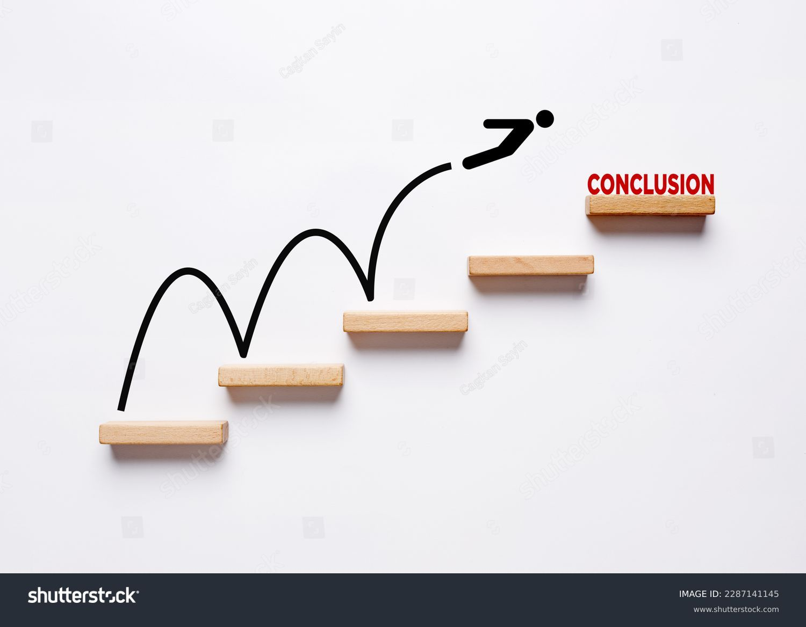
Conclusion
Use of Clinical Skills Shortages and Digital Skills Shortages should be accepted as a norm in workforce planning.
Workforce competence could be improved through just hiring and specific training.
Retention should be enhanced by supportive leadership and reward and wellbeing measures.
The HR Outcomes measure needs to be linked with the progress of the organisation rate, constantly measured.
Notes:
In conclusion, an HRM policy should be incorporated within the context of the formation of HealthConnect UK that would not only consider any workforce issues, but service quality as well. Effective workforce planning to identify future needs and skills, fair recruitment and specific learning to acquire skills will be in place. An obvious career path, good salary, positive management and workloads will enhance employee satisfaction and retention. It should also have a basis of a planned phased implementation and resources allocated/check by the workforce indicators and approved by the Executive Board.

Slide 14

Reference list
Burnett, J.R. and Lisk, T.C. (2021). The future of employee engagement: Real-time monitoring and digital tools for engaging a workforce. Routledge eBooks, [online] 1(1), pp.117–128. doi:10.4324/9781003142492-9.
Emerson, L.C. and Berge, Z.L. (2018). Microlearning: Knowledge management applications and competency-based training in the workplace. Knowledge Management & E-Learning, [online] 10(2), pp.125–132. Available at: https://eric.ed.gov/?id=EJ1254686 [Accessed 19 Oct. 2026].
Figueroa, C.A., Harrison, R., Chauhan, A. and Meyer, L. (2019). Priorities and challenges for health leadership and workforce management globally: A rapid review. BMC Health Services Research, 19(1), pp.1–11.
Gibbs, T. and Kharouf, H. (2020). The value of co-operation: An examination of the work relationships of university professional services staff and consequences for service quality. Studies in Higher Education, 47(1), pp.38–52. doi:10.1080/03075079.2020.1725878.
Kambur, E. and Yildirim, T. (2022). From traditional to smart human resources management. International Journal of Manpower, 44(3). doi:10.1108/ijm-10-2021-0622.
Karaferis, D., Aletras, V., Raikou, M. and Niakas, D. (2022). Factors influencing motivation and work engagement of healthcare professionals. Materia Socio Medica, [online] 34(3), pp.216–224. doi:10.5455/msm.2022.34.216-224.
Korkmaz, A.V., van Engen, M.L., Knappert, L. and Schalk, R. (2022). About and beyond leading uniqueness and belongingness: A systematic review of inclusive leadership research. Human Resource Management Review, [online] 32(4), p.100894. doi:https://doi.org/10.1016/j.hrmr.2022.100894.
Kossek, E., Gettings, P. and Misra, K. (2021). The future of flexibility at work you can tailor programs and policies to fit your employees” needs. [online] Available at: https://www2.mvcc.edu/shn/pdf/presentations/2021-11/Future-of-Flexibility-at-Work.PDF [Accessed 19 Oct. 2026].
Sharma, R.C. and Kohli, D. (2023). Embracing digital transformation for sustainable development: The synergy between learning organizations, human resource management, and service quality. Journal of Chinese Human Resources Management, [online] 14(3), pp.3–17. doi:10.47297/wspchrmwsp2040-800501.20231403.
Sisneros, K.R. (2025). The impact of recruitment and selection strategies on organizational performance and employee productivity. [online] Scholars Crossing. Available at: https://digitalcommons.liberty.edu/doctoral/6422/ [Accessed 19 Oct. 2026].
Sitzmann, T. and Weinhardt, J.M. (2018). Training engagement theory: A multilevel perspective on the effectiveness of work-related training. Journal of Management, [online] 44(2), pp.732–756. doi:10.1177/0149206315574596.
Timsina, S. (2024). Employee turnover and engagement programs for retention. Theseus.fi, [online] 1(1). Available at: https://www.theseus.fi/handle/10024/851623 [Accessed 19 Oct. 2026].

Slide 15


