Slide 1
Body Image and Exercise
Sport and Exercise Psychology
Week 4

Slide 2
Body Image Defined
A multidimensional construct that reflects the following:
How we see our own body
How we think, feel, and act toward it
Four Dimensions of Body Image
Perceptual:
  How we imagine ourselves to look
Cognitive:
  How we think about or evaluate our body in terms of its appearance and function
Affective (Emotional):
  Feelings (i.e., comfortable, proud, anxious, disgusted) experienced in relation to our body’s appearance and function
Behavioural:
  What we do to reflect our positive or negative perceptions, thoughts, and feelings

Slide 3
Healthy Body Image
Accurate perceptions about body shape and size
  Thoughts and feelings about one’s body that are predominantly positive
  Behaviour that reflects positive evaluations
Body Image Disturbance:
Inaccurate perceptions of one’s body shape and size; image differs from one’s actual shape/size
Negative thoughts and feelings about one’s body
Actions performed to hide or change the body without regard to health implications

Slide 4
Body Image Disturbance
Women vs. Men
No longer just a “women’s issue”
–Body image dissatisfaction has increased dramatically for both genders
–Body image disturbance has become almost as common among men as among women

Slide 5
Body Reality and Body Ideal
Body reality:
  Our actual physical characteristics—height, weight, body fat, lean body mass, bone structure, fitness, strength, disease, etc.
Body ideal:
  How we think our body should look and function
Body image reflects an interplay between body reality and body ideal

Slide 6
Factors in Body Image Formation and Disturbance
Media influence
Activity participation
Changes to body reality
Media influence
Displaces personal body ideals with media-driven body ideals
Promotes strict and narrowly defined image of an ideal body
Promotes unrealistic ideals that are unattainable for the vast majority of the population
Perpetuates the misconception that bodies of fashion models and movie stars are the norm

Slide 7
Media Influence: In groups / pairs
How do popular magazines portray exercise and body image for men and women?
In the magazines that you read, do the articles and ads generally refer to exercise as a way to improve appearance or improve health?
Do the models in these magazines (articles and ads) have bodies that are representative of the general population?

Slide 8
Online…A starting point…

Slide 9
Activity Participation
Activities that we choose to participate in can influence body image by altering perceptions of the body ideal
If the new ideal is more realistic than the media ideal, body image can improve
If the new ideal is less realistic and less attainable, the gap between body ideal and reality will widen and body image disturbance will increase
Changes to Body Reality
Throughout life, one’s body grows and alters in size, shape, proportion, and function
Changes occur that have a profound effect on feelings about oneself and one’s body
  Examples: puberty, having children, advancing age

Slide 10
Are you dissatisfied with your body?
Increasing dissatisfaction felt in one’s physical appearance
The problematic areas for men are abdomen and overall weight
The problematic areas for women are abdomen, hips, thighs, and overall weight
43% of men and 56% of women are dissatisfied(Garner, et al., 1997)
Correlation is much stronger for women than for men
A woman’s feelings of self-worth are typically more strongly influenced by her perceived physical attractiveness than those of a man
People who feel better about their bodies tend to feel better about themselves overall

Slide 11
Are women or men more dissatisfied with their body?
Sex Differences in Body Image Dissatisfaction
Reflect differences between the male and female body image ideals that are glamourised by the media
Persist throughout adolescence and adulthood
Caused by different reasons
  Men: Want to have more lean muscle mass
  Women: Want to be thinner

Slide 12
Male Body Image Dissatisfaction
Male standard: V-shaped physique
–Broad, muscular shoulders, toned “six-pack” abdominals, a narrow waist, and muscular legs
Men show very little difference between cultural and medical ideals, although the cultural ideal weighs slightly more
Men tend to desire body weights that are similar to their actual body weights and that fall within the ranges of both medical and cultural ideals

Slide 13
Female Body Image Dissatisfaction
Female standard: Ultra-thin, shapely, toned, and firm
Women show virtually no overlap between the medical and the cultural weight ideals, with the cultural ideal weighing less
Actual body weight may be within the range considered healthy from a medical standpoint, yet some women desire substantially lower weights that reflect the cultural ideal

Slide 14
Why Is Body Image Important?
Healthy body image is related to better psychological well-being in two ways:
  Better self-esteem
  Lowered risk for depression and anxiety
Depression and Anxiety
  Poor body image is associated with greater anxiety and depression symptoms
  Depressed and anxious persons view their appearance more negatively than do non-depressed individuals, even if there are no differences in actual body shape and size
  Body image disturbance is an antecedent, not a consequence, of increased depression and anxiety

Slide 15
Body Dysmorphic Disorder
An extreme case of body dissatisfaction
Excessive preoccupation with some aspect of one’s physical appearance
Obsessive-compulsive activities such as constantly weighing oneself
Muscle dysmorphia:
– Preoccupation with muscularity
–Anxiety and dissatisfaction with muscles
–Steroid use and excessive work out routines
Muscle dysmorphic(MD)-fear of being muscularly small
MD is estimated at 9% of the male population (Olivardia, 2001)
Body dysmorphic disorder (BDD)-preoccupied with physical appearance that become obsessive and cause them to avoid social situations
–BDD is estimated between 1-2.3% of the population (Phillips & Dufresne, 2000)

Slide 17
Muscle Dysmorphia
https://www.youtube.com/watch?v=pSzzWttdFuU
https://www.youtube.com/watch?v=VqJpDS8F6hk

Slide 18
Relationship of Body Image to Physical Well-Being
Body image can lead to both health-damaging and health-promoting behaviours:
Health-damaging
Eating disorders
Unhealthy weight control strategies
Smoking
Health-promoting
Diet and exercise programs
Healthy eating
Physical activity

Slide 19
Body Image Measures
Exercise psychologists need valid and reliable measures of all body image dimensions:
Perceptual Measures
Assess the level of accuracy of judgments about the size of an individual’s body
One method uses specially designed morphing software to alter an individual’s photograph
Individuals estimate what they perceive their actual body size is
Difference between what individuals think they look like and what they actually look like represents the accuracy of their body-size perception

Slide 20
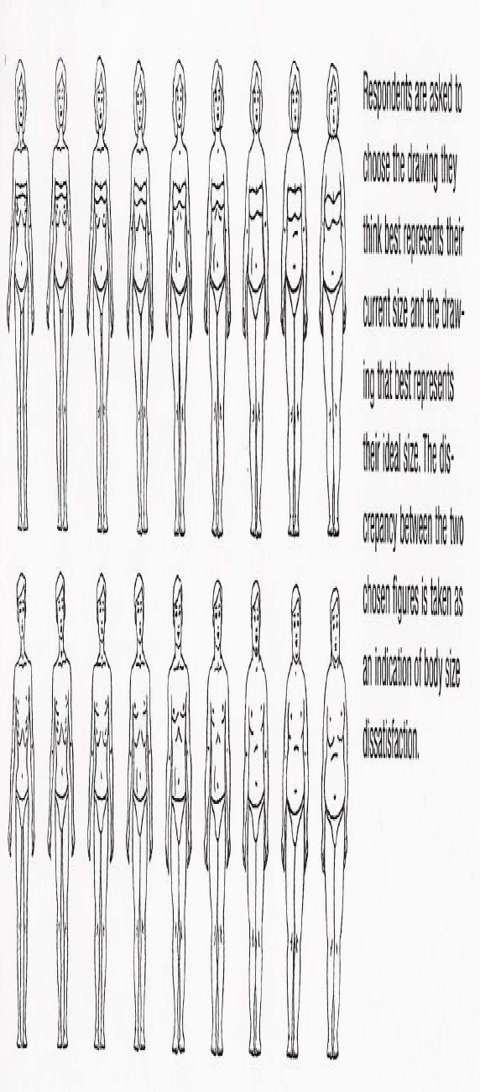
Perceptual Measurement

Slide 21
Cognitive measures
Consist of questionnaires that assess the degree of satisfaction with one’s body shape
–An individual rates his/her level of satisfaction with items on a list
–An individual chooses images from a series of drawings, selecting ones that represent his/her current size and ideal size
– E.g. BESAA
Criticism: Some scales do not adequately measure concerns about muscularity

Slide 22
Affective measures
Assess feelings such as worry, shame, anxiety, comfort, embarrassment, and pride in relation to the body
Greater negative feelings are associated with greater body image disturbance
Also measure:
Social physique anxiety
Body comfort

Slide 23
Physical Activity and Anxiety About the Body
Anxiety arises over concerns with self-presentation of the body
Self Presentation:
  The attempt by an individual to present one-self and to omit self-relevant information to maximize the likelihood that positive social impression will be generated and undesired impression will be avoided.
Physical Activity and Anxiety About the Body
Social Physique Anxiety (SPA)
Women who possess high SPA view their physical appearance more negatively
Women with high SPA individuals often exercise for self-presentation reasons (e.g. Weight loss, to improve appearance, and body tone)
Women low in SPA were more likely to exercise for the purpose of fitness, mood enhancement, & health.

Slide 24
Research on Body Image and Exercise
Exercise training can lead to significant improvements in body image
Both aerobic exercise and weight training can improve body image, but researchers have found weight training to be more effective

Slide 25
Exercise vs. Psychological Interventions
Cognitive behaviour therapy (CBT) can improve body image
Individuals use certain strategies (i.e., relaxation, stress management, desensitization) to improve thoughts, feelings, and behaviours toward their bodies
Exercise is just as effective as CBT for improving body image, and has the added bonus of also improving people’s health and physical fitness

Slide 26
Mechanisms of Change
Mechanisms for this:
  Improved Fitness
  Improved awareness of physical capabilities
  Increased self efficacy

Slide 27
What are the causes?
Exercise improves body image by making people aware of their physical capabilities (McDonald & Thompson, 1992)
Exercise related improvements in physical self-efficacy leads to more positive feelings about one’s body (McAuleyet al, 2002)
Improved Physical Fitness
Improvements in body image have been shown with little or no significant physical alterations
Majority of body image studies interested in relationship between body comp and body image.
The result are mixed…
Improved body composition generally accounts for less than 10 % of the total change in body image.
Body Image and Strength/Endurance Training
Few studies have examined this relationship.
Improvements in strength and endurance seems to account for only modest changes in body image.

Slide 28
Increased Awareness of Physical Capabilities
Exercise may make people more aware of physical capabilities and may reduce their focus on physical appearance
Particularly important for women, who tend to place greater value on their appearance
When they exercise to improve such things as satisfaction with physical function, they are more likely to experience greater success and body satisfaction
Increased Self-Efficacy
When physical capabilities improve, physical self-efficacy improves
Changes in self-efficacy then lead to improvements in body image
Increases in physical self-efficacy are associated with decreases in social physique anxiety

Slide 29
Who Benefits Most from Exercise Interventions?
Greatest impact is on people who have the poorest body image
Women with the poorest self-image (Tucker & Mortell, 1993) diagnosed with breast cancer (Martin & Lichtenberger, 2002) and Obese women (Foster, et al, 1997).
Particular benefit to those whose body image is threatened by disease or illness
Little is known about effects of exercise training on the following:
  Children
  Younger men
  People drawn from ethnic groups or socioeconomic strata other than well-educated Caucasians

Slide 30
Influence of Body Image on Exercise Behaviour
Exercise motivation:
Body image concerns are a powerful motivator
Desire to lose weight or increase muscle tone often shifts to desire for continued physical and psychological well-being
Body image can also be a de-motivator: some people avoid exercise completely
Exercise setting and attire preference
People with high social physique anxiety exercise in private or far away from instructor, in baggy non revealing clothes

Slide 31
Physical Activity and SPA
Regular physical activity has been shown to reduce SPA
Women with high SPA stand in back and wear baggy clothing in aerobic classes ( Brewer, et al, 2004)
Being in groups with people one perceives as similar physically also reduces SPA.
Females experience less SPA in group aerobic and weight training classes)
Instructors who lead classes primarily for self-presentation reasons (e.g. an instructor who wants to show you that they are better than you) can cause high SPA
Instructor who lead classes primarily for leadership (e.g. sensitive to client’s level) opportunities possess lower SPA

Slide 32
Body Image & Exercise
Findings:
Exercise training can lead to significant improvements in body image of women (Martin & Lichtenberger, 2002)
Both aerobic and weight training improved body image with weight training having the greatest impact.
Exercisers are less dissatisfied with their weight
High active women evaluated their physical appearance better than inactive women
Women (active and inactive) are overly preoccupied with weight loss

Slide 33
Physical Activity & Behaviour
Overweight people often do not exercise because they feel self-conscious if others see them huffing and puffing.
  Being observed
  Being evaluated by others
  Classes where physique is emphasized produces more SPA
Influence of Body Image on Exercise Behaviour
Exercise participation motives for men and women are to lose weight and increase muscle tone are keys to start an exercise program (Rodger & Gauvin, 1994)
Exercise behaviour is effected by one’s low body image or High SPA.
People who are overweight or obese avoid signing up for exercise programs because of embarrassment and shame of their appearance (Bain, et al., 1989).

Slide 34
Recommendations:
People who enjoy their workouts show the biggest exercise related improvements in body image.
Fitness instructors need to teach people about body image and exercise behaviour.
Monitor progress of bodily changes in strength and body composition throughout your program.
Fitness instructors should encourage clients to wear loose-fitted, comfortable exercise attire.
Media promotion materials of classes or exercise campaigns should show a wide range of body shapes, sizes, and physical abilities.
Exercise programs should focus on improving physical function, strength, and endurance rather than on changing physical appearance

