Slide 1
Justifying the State
State of Nature Arguments

Slide 2
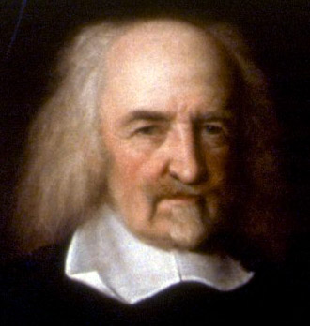
Thomas Hobbes
1588-1679
Without a strong state human nature would bring man into conflict with one another

Slide 3
Hobbes – Desire, Power and Felicity
Desire – An internal motion towards an object
Power – You present means to achieve some future good
Felicity – Continual success in achieving your desires

Slide 4
The State of Nature
We are all equal
Goods are scarce
No morality – everyone has a right to everything

Slide 5
State of War
Human nature is not cruel
We need to secure power
  We fight for safety, glory and reputation

Slide 6
Laws of Nature
‘Every man ought to endeavour Peace, as farre as he has hope of obtaining it; and when he cannot obtain it, he may seek, and use, all helps, and advantages of Warre’

Slide 7
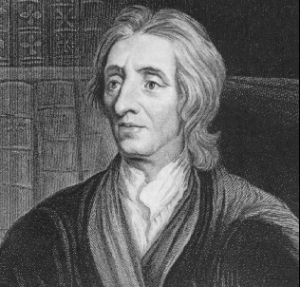
John Locke
1632-1704
A State of Perfect Freedom
A State of Equality
Bound by the Law of Nature

Slide 8
No one ought to harm another in his life, health, liberty or possessions
God’s property
We are duty bound to preserve our own station and where possible preserve others

Slide 9
There is a natural right to punish those who go against the Law of Nature

Slide 10
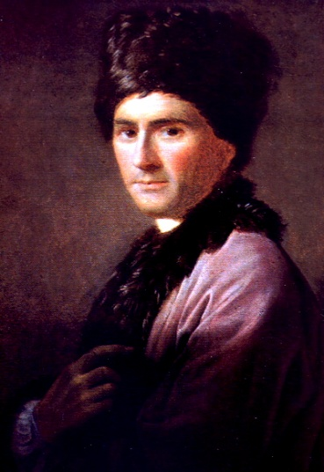
Jean-Jacques Rousseau
1712-1788
We have an innate repugnance at seeing a fellow creature suffer
Man is corrupted by Society
We are motivated by both self preservation and pity
Brought together by the chance of self-improvement

Slide 11
Society creates public values
Establishes private property
  Greed & inequality
Formation of government secures inequalities

Slide 12
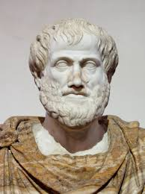
Aristotle
(384BC – 322 BC)
Man is by nature a political animal
  Speech allows people to communicate principles of justice
Men and women unite to reproduce
The master and the slave unite for self preservation
Households develop in order to meet people’s needs
Households form together to produce villages
Several villages form together to make a city-state
The state forms to aid survival, but also allows for the good life.
  The city-state is natural as humans are not self-sufficient
  The legal system allows for virtue

