Slide 1

Psychology and Mental Health
Eating Disorders, Schizophrenia and Personality Disorder

Slide 2
Aims and Objectives
Aim
Aim: To link psychological theory to specific mental health conditions.
Describe
Describe theories of the development of mental health conditions.
Discuss
Discuss the development and maintenance of eating disorders.
Discuss
Discuss the hypotheses around schizophrenia.
Hypothesise
Hypothesise specific case management for the mental health of people with autism.

Slide 3
Eating Disorders
What are eating disorders?

Slide 4
Eating Disorders
Eating disorders are defined as one having an unhealthy attitude towards food, whereby it has control over a person's life.
What types of eating disorders do you know of?

Slide 5
Eating Disorders in the DSM 5 TR
Anorexia nervosa
Bulimia nervosa
Binge eating disorder
Other specified feeding or eating disorder (OSFED)
Pica
Rumination disorder
Avoidant/Restrictive food intake disorder (ARFID)

Slide 6
Statistics
Between 1.25 and 3.4 million people in the UK alone.
25% male.
40% bulimia, 10% anorexia.

Slide 7
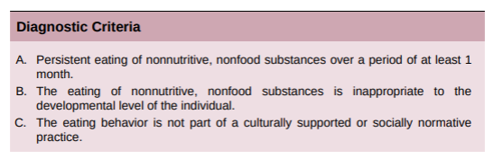
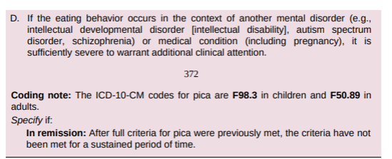
Pica
Persistent eating of one or more non-nutritive foods.
It must be severe enough to warrant clinical attention.
Typically paper, soap, hair, soil, metal, stone, charcoal, string or cloth.
Typically no aversion to food.
It can be an associated feature of other disorders, ID, AS, schizophrenia.

Slide 8
Pica
Minimum age of diagnosis is over the age of two. Why?
Around 5% of school-age children, 1/3 of pregnant women.
Associated with trichotillomania, excoriation disorder and ARFID.

Slide 9
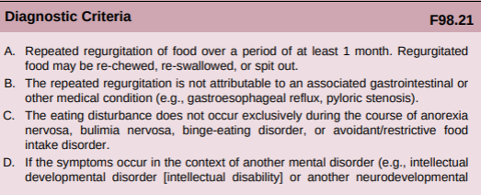

Rumination Disorder

Slide 10
Rumination Disorder
Regurgitation usually occurs within 15 minutes of eating/
Often misdiagnosed as GERD.
Linked to emotional neglect in infancy, OCD, anxiety, depression and ADHD.

Slide 11
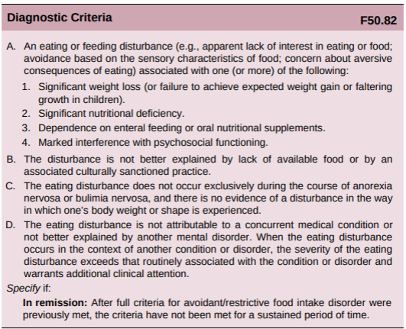
ARFID

Slide 12
ARFID
Disturbances must not be linked to a fear of weight gain or body dysmorphia.
Linked to AS, ADHD and anxiety disorder (Fisher et al., 2014).
A lack of literature on medication-based treatment.

Slide 13
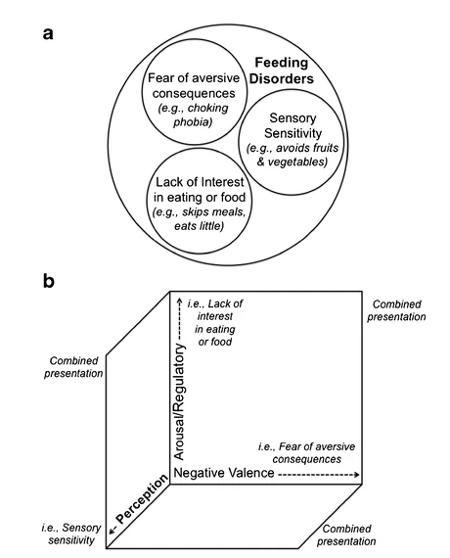
Avoidant/restrictive eating models a – Categorical b - Dimensional

Slide 14
Development of eating disorders
What factors could contribute to the development of eating disorders?

Slide 15
Development of eating disorders
Traumatic childhood experiences (Rabito-Alcon, Baile and Vanderlinden, 2021) .
Escaping conscious awareness of unbearable emotions and cognitive states.
Low/High BMI in childhood (AN/BN or BED respectively).
Neglect/abuse/trauma
Parental relationships (Teasing – AN-BP, BN, BED, Pressure to eat - ARFID)
Social factors (Exposure to the ideal body, early puberty, elite sports, body dissatisfaction)

Slide 16
Genetics
Parental diagnosis or familial diagnosis (Thornton, Mazzeo and Bulik, 2011)
Twin studies have shown high concordance rates for weight and body perceptions (Mazzeo et al., 2009)

Slide 17
Gender
Hereditary patterns show a disproportionate amount of female diagnoses (34)
Genetic factors that affect females do not appear to affect males as severely.
Gender dysphoria is linked to ED's, particularly in pre-op transgender people, compared with post-operative (Milano et al., 2019).
Sexual and gender minorities are more likely to develop an ED (Nagata, Ganson and Austin, 2020)

Slide 18
Abuse and trauma
Emotional abuse
Sexual harrassment
Childhood neglect
Bullying
(Bakarat et al., 2023)

Slide 19
Maintenance of eating disorders
What factors may make an eating disorder endure?

Slide 20

Maintenance of eating disorders
Family relationships and parenting style (Erriu, Cimino and Cerniglia, 2020).
Maladaptive perfectionism (Williams and Levinson, 2021)
Disgust, whether at the self or food, leading to avoidance behaviours (Anderson et al., 2021).
Gut biome disruption (Terry, Barnett and Gibson, 2022)

Slide 21
Treating Eating disorders
Why are eating disorders so hard to treat?
https://youtube.com/watch?v=3Bac8ijH038

Slide 22
Treating Eating disorders
CBT, focal dynamic psychotherapy, family-based therapy.
NICE (2017) guidelines dictate medication should not be a sole focus.
Fluoxetine for BN is the only approved medication across Europe (Monteleone et al., 2022)
Most research focuses on adolescents and children in this field.
What about mental capacity?

Slide 23
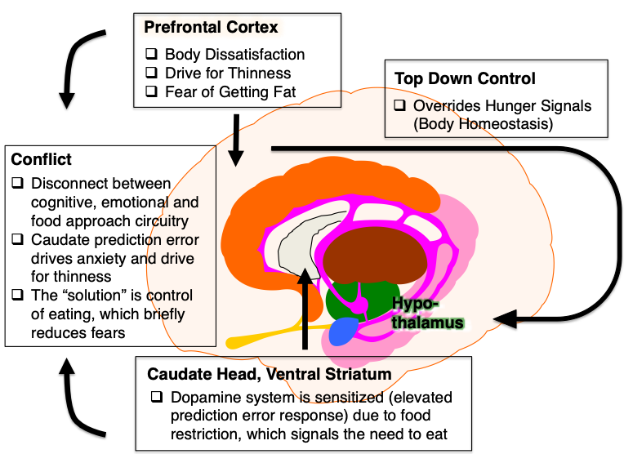
Eating disorders in the brain

Slide 24
Schizophrenia
What comes to mind when thinking of schizophrenia?

Slide 25
schizophrenia
A disorder characterised by fundamental and characteristic distortions of thinking and perception, and blunted or inappropriate affects.
Clear consciousness and intellectual capacity are usually maintained.
Thought echo, thought insertion or withdrawal.
Thought broadcasting, delusional perception and delusions of control.
Influence or passivity, hallucinatory voices, thought disorders and negative symptoms.

Slide 26
Positive and Negative symptoms?
Positive meaning changes in behaviour or thoughts.
Negative meaning withdrawal from society or lack of interest in life.

Slide 27
Types of schizophrenia
Paranoid schizophrenia
Hebephrenic schizophrenia
Catatonic schizophrenia
Undifferentiated schizophrenia
Post-schizophrenic depression
Residual schizophrenia
Simple schizophrenia

Slide 28
Diagnosis
There is no set test for this condition.
It is based upon observation.
DSM 5 – six months of symptoms, ICD-11 – one month.

Slide 29
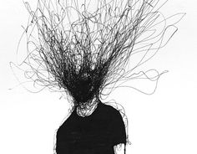
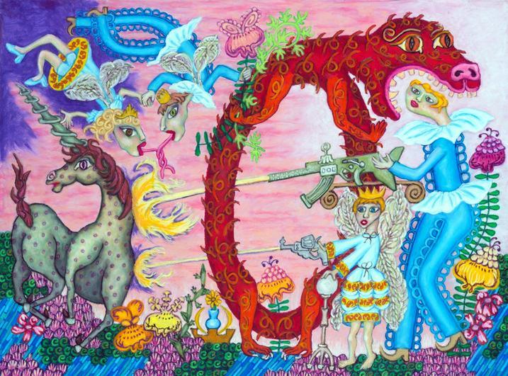
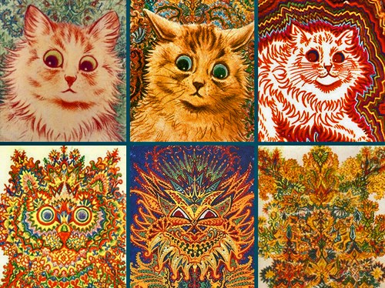
Schizophrenic Art

Slide 30
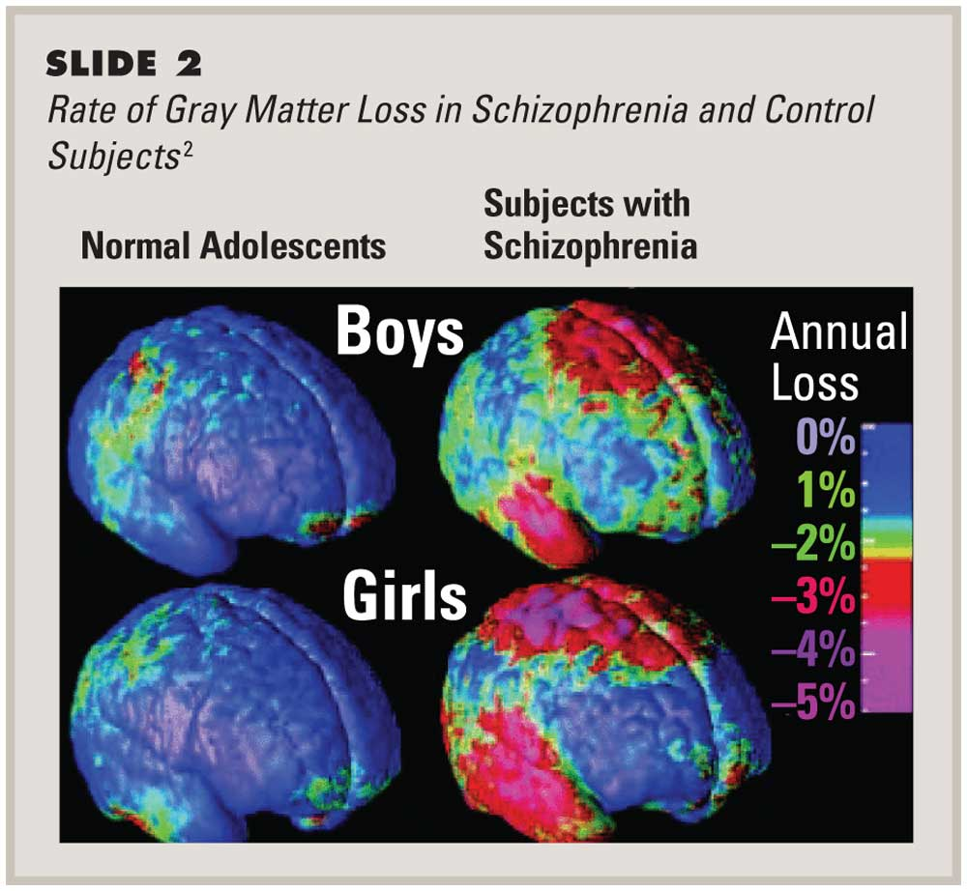
Neurobiology

Slide 31
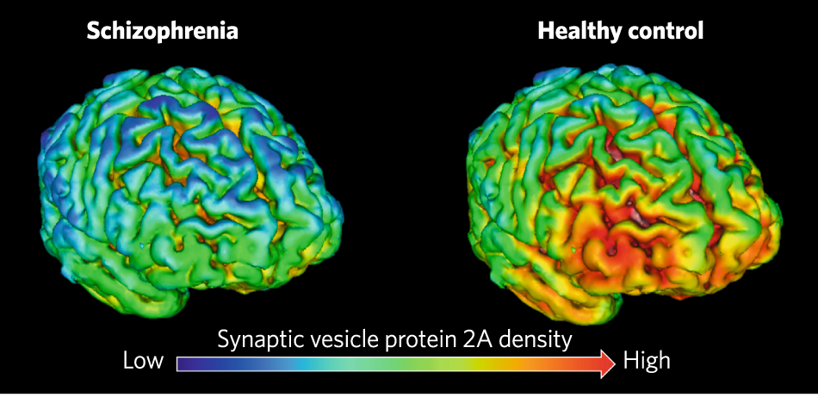
Neurobiology

Slide 32
Experience of Schizophrenia
https://www.youtube.com/watch?v=63lHuGMbscU
Warning: This is quite realistic and has been affirmed by individuals with schizophrenia as fairly accurate.

Slide 33
Treating schizophrenia
Psychopharmacology is the common treatment model.
This is tailored to individuals and may be very different from person to person.
Treatment resistant schizophrenia is a threat to successful treatment options.
This can require stronger antipsychotics and includes risks of relapse.

Slide 34
Personality disorder
Personality, as we have previously covered is a myriad of traits or states.
What do we call a normal personality?
Where does abnormality begin?
How abnormal does a personality have to be to warrant a diagnosis of PD?

Slide 35
Personality disorders
Over the age of 18
Exclusion of primary causes, ABI, disease, medication, substances.
Significant functional impairment
Intra/interpersonal suffering

Slide 36
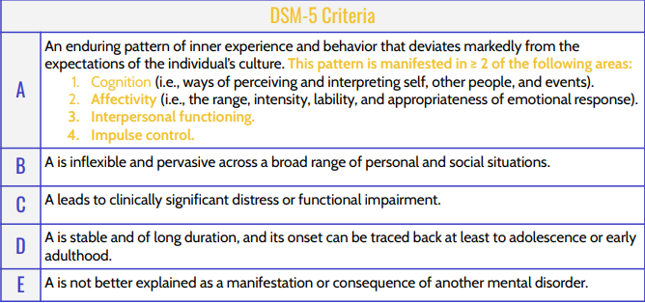
Personality disorders: DSM 5

Slide 37
Types of Personality disorder
Cluster A – Paranoid, Schizoid, Schizotypal
Cluster B – EUPD, Histrionic, Narcissistic, Antisocial
Cluster C – Avoidant, Dependent, Obsessive compulsive

Slide 38
Paranoid PD
Characterised by splitting the self and others as all good or all bad.
Denial, projection and projective identification are key defence mechanisms.
Psychotherapy and antipsychotics

Slide 39
Schizoid PD
Limited social interactions, indifferent to criticism/praise, prefers solitary activity.
Low levels of pleasure in activities, lacks close friends, emotionally cold.
Isolation of affect, intellectualisation, fantastical daydreaming.
Psychotherapy and anti psychotics recommended.

Slide 40
Schizotypal PD
Odd thought patterns, imaginations and perception.
Pervasive pattern of social and interpersonal deficits, discomfort around close relationships.
Suspicious ideation, inappropriate affect, excessive social anxiety.
Regression, denial, splitting and fantasy defence mechanisms.
Psychotherapy and antipsychotics recommended

Slide 41
Cluster A
What do you notice around Cluster A PD's?
Eccentric thinking
Excessive ideation of reference
Perceived as odd.
Psychotic features

Slide 42
Emotionally unstable PD
Sense of identity is unstable, chronic feelings of inner emptiness.
Unstable mood, tendency to extremes of emotions.
Frantic efforts to avoid real/imagined abandonment, unstable and intense interpersonal relationships.
Impulsivity, recurrent suicidal behaviour, stress-related paranoid ideation.
Psychotherapy, mood stabilisers and SSRI's recommended

Slide 43
Histrionic PD
Excessive attention seeking behaviour, self dramatisation, provocative behaviour
Uncomfortable when not the centre of attention, rapidly shifting and shallow expression of emotions.
Suggestible, impressionistic style of speech, considers relationships to be more intimate than they are.
Repression, dissociation, sexualisation and regression.
Directive psychotherapy, antianxiety or antidepressant drugs.

Slide 44
Narcissistic PD
Pervasive pattern of grandiosity, a need for admiration and lack of empathy.
Preoccupied with fantasies of unlimited success, power, beauty, love etc.
Belief in being special, requires excessive admiration, a sense of entitlement.
Lacks empathy, interpersonally exploitative, envious, arrogant.
Rarely seeks or accepts treatment, episodic anxiety/depression can be treated symptomatically.

Slide 45
Antisocial pd
A pervasive pattern of disregard and violation of the rights of others.
Failure to conform to social norms, unlawful behaviour, deceitfulness.
Impulsivity, irritability, reckless disregard for safety of self and others.
Evidence of conduct disorder before the age of 15, lack of remorse.
Long term hospitalisation, group therapy.

Slide 46
Cluster b
Any commonalities here?
Emotions towards others.
Interpersonal issues.
Impulsivity, emotional lability and dramatic behaviour.
Excessive emotions, loss of control - EUPD, HPD
Low emotions, high degree of control – NPD, ASPD

Slide 47
Avoidant PD
Social inhibition, feelings of inadequacy and hypersensitivity to negative evaluation.
Avoids activities due to fear of criticism or rejection.
Restraint in relationships, preoccupied with being criticised.
Views self as socially inept, unappealing or inferior.
Psychological treatment, group therapy, antianxiety medication

Slide 48
Dependent PD
Pervasive, excessive need to be taken care of. Submissive, clinging behaviour.
Fear of separation, difficulty making decisions individually.
Needs others to assume responsibility for them, goes to excessive lengths to be nurtured and supported.
Urgently seeks another relationship for care and support when one ends.
Psychological behaviour therapies, antianxiety medication

Slide 49
Obsessive compulsive pd
Pervasive pattern of preoccupation with orderliness, perfectionism and mental and interpersonal control.
Details, rules, lists, schedules, perfectionism interferes with task completion.
Excessively devoted to work and productivity.
Reluctant to delegate, stubborn, miserly in spending, money is hoarded.
Directive and supporting individual or group therapy.

Slide 50
Cluster c
What links these together?
Emotions towards the self are the issue.
Intrapersonal problems.
A lot of anxiety and fear.

Slide 51
Reclassification
We no longer diagnose the subtypes of PD.
This has been reclassified in the ICD-11.
This is now based on severity rather than subtype.
Categorical vs dimensional.

Slide 52
reclassification
New trait domains
Negative Affectivity
Detachment
Dissociality
Anankastia
Disinhibition

Slide 53

Pd in the brain
Similarities to PTSD
Amygdala hyperactivity – increased grey matter
Anterior cingulate cortex – emotional regulation – reduced volume
Prefrontal cortex – decision making – reduced volume
Disruption of the HPA Axis

Slide 54
References
Anderson, L.M., Berg, H., Brown, T.A., Menzel, J. and Reilly, E.E., (2021). The role of disgust in eating disorders. Current psychiatry reports, 23, pp.1-12
Barakat, S., McLean, S.A., Bryant, E., Le, A., Marks, P., Touyz, S. and Maguire, S., (2023). Risk factors for eating disorders: findings from a rapid review. Journal of eating disorders, 11(1), pp.8.
Erriu, M., Cimino, S. and Cerniglia, L., (2020). The role of family relationships in eating disorders in adolescents: a narrative review. Behavioral Sciences, 10(4), pp.71.
Fisher, M.M., Rosen, D.S., Ornstein, R.M., Mammel, K.A., Katzman, D.K., Rome, E.S., Callahan, S.T., Malizio, J., Kearney, S. and Walsh, B.T., (2014). Characteristics of avoidant/restrictive food intake disorder in children and adolescents: a “new disorder” in DSM-5. Journal of Adolescent Health, 55(1), pp.49-52.
Mazzeo S.E., Mitchell K.S., Bulik C.M., Reichborn-Kjennerud T., Kendler K.S. and Neale M.C.. (2009) Assessing the heritability of anorexia nervosa symptoms using a marginal maximal likelihood approach. Psychol Med ;39(3), pp.463–73
Milano, W., Ambrosio, P., Carizzone, F., De Biasio, V., Foggia, G. and Capasso, A., (2020). Gender dysphoria, eating disorders and body image: an overview. Endocrine, Metabolic & Immune Disorders-Drug Targets (Formerly Current Drug Targets-Immune, Endocrine & Metabolic Disorders), 20(4), pp.518-524.

Slide 55
References
Monteleone, A.M., Pellegrino, F., Croatto, G., Carfagno, M., Hilbert, A., Treasure, J., Wade, T., Bulik, C.M., Zipfel, S., Hay, P. and Schmidt, U., (2022). Treatment of eating disorders: a systematic meta-review of meta-analyses and network meta-analyses. Neuroscience & Biobehavioral Reviews, 142, pp.104857.
Nagata, J.M., Ganson, K.T. and Austin, S.B., (2020). Emerging trends in eating disorders among sexual and gender minorities. Current opinion in psychiatry, 33(6), pp.562-567.
Rabito-Alcon, M.F., Baile, J.I. and Vanderlinden, J., (2021). Mediating factors between childhood traumatic experiences and eating disorders development: a systematic review. Children, 8(2), pp.114.
Terry, S.M., Barnett, J.A. and Gibson, D.L., (2022). A critical analysis of eating disorders and the gut microbiome. Journal of eating disorders, 10(1), pp.154.
Thornton LM, Mazzeo SE, Bulik CM. (2011) The heritability of eating disorders: methods and current findings. In: Adan RAH, Kaye WH, editors. behavioral neurobiology of eating disorders. Berlin, Heidelberg: Springer;. pp. 141–56
Williams, B.M. and Levinson, C.A., (2021). Intolerance of uncertainty and maladaptive perfectionism as maintenance factors for eating disorders and obsessive‐compulsive disorder symptoms. European Eating Disorders Review, 29(1), pp.101-111.

