Slide 1

Report on the disappearance of Dr Hart
Module name: Academic Skills for the Digital Era Module code: (BMSW4013_CARD) Student: Ewa Szkudlarek, 2423444 Lecturer: Ffion Cumberpatch

Slide 2

Introduction
Dr Hart, age 42
Senior in AI and Robotic Pioneering work at NovaTech
Patented the "Harmony AI" system, used to synchronize robotic movements with human emotions cues
Last seen; leaving her Lab at NovaTech on Jan 5th, 2025 at 9.30pm
Was her disappearance connected to her work?
Did anyone was jealous about her project?
Did anyone want to still her ideas?
Any witness and what they seen?

Slide 3
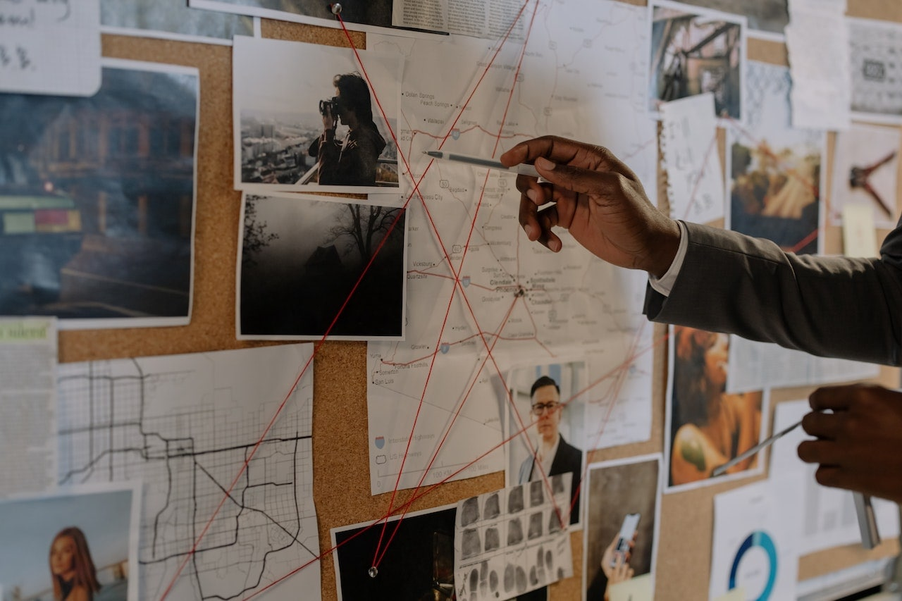
Key Evidence and Analisys
Dr Hart missing 6th Jan 2025, her assistant Peter Singh found her office trashed
Lab had open drawers means someone was looking for something specific and had knowledge Dr Hart work was seeking sensitives information to AI
The equipment was untouched, someone was not interested in stealing physical asset but of specific data
Cyntia Ramirez (neighbours) saw strange SUV outside her house before she disappeared
Dr Fox( Rival) competitor a company (people was saying he had disagreement with Dr Hart) over AI ethic
Peter Singh (lab assistant) he was the last person to see Dr Hart , he was saying she was stressed about meeting with company

Slide 4

Evidence 1
Point : Dr Hart disappearance is connected to her work, probably involving someone with knowledge her work and motive steal her ideas or silence her due ethical disagreement
Her disappearance is mysterious and no clear explanation
Witnesses reported seeing outside her house SUV, her office was trashed, she was nervous before some meeting
Dr Hart feeling stressed about upcoming meeting with company executives hints at international pressures within NovaTech
These factors suggest that Dr Harts disappearance was not a voluntary act but may involve foul play or an accident this need investigation to uncover the truth her vanishing

Slide 5

Theories and Conclusions
In conclusion the evidence, it seems like Dr Hart disappearance is connected to her work, involving someone with knowledge of her research and a motive to steal her ideas. The rival from other company Dr Fox has a clear motive steaming from professional rival and potential disagreement over AI , he wants to steal her ideas and silence her ethical disagreements.

Slide 6

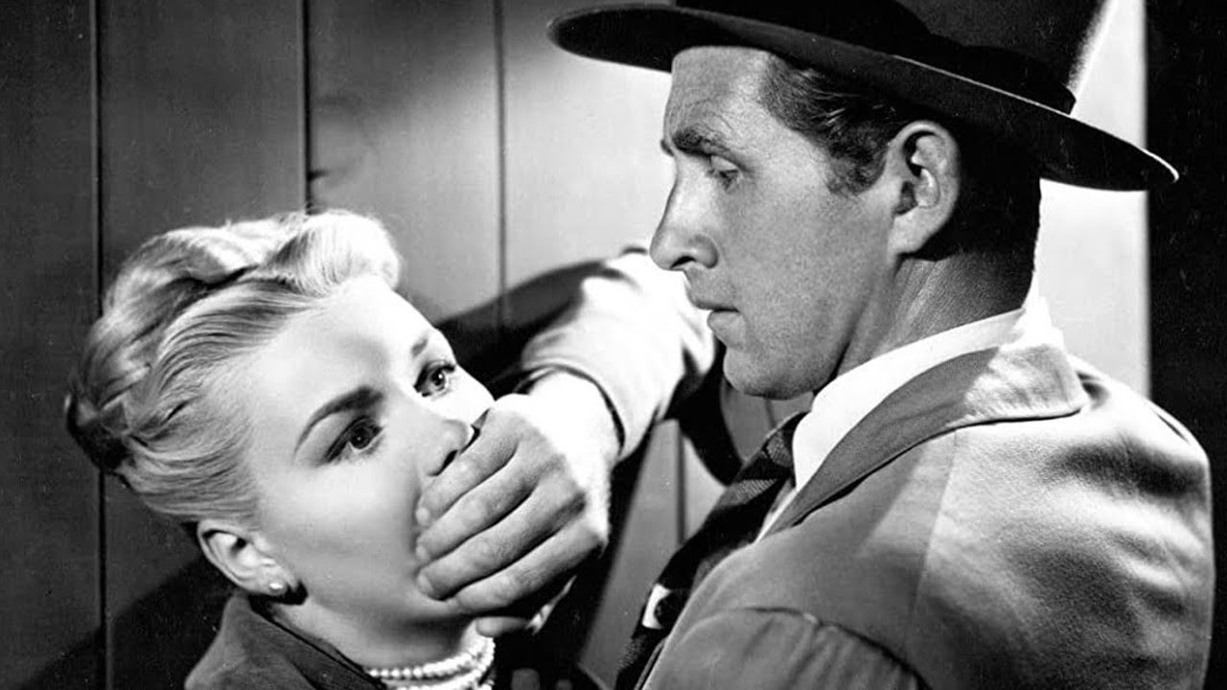
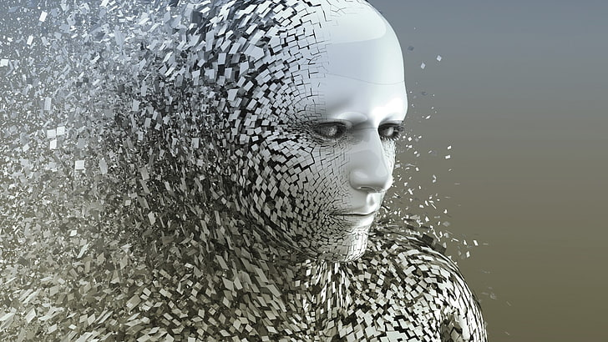

Reflection
Reflecting on the investigation Dr Hart disappearance, several challenges, emerged that complicated the investigation
Limited the frame: the disappearance was reported only a day after she was last seen
Lack of physical evidence: Dr Hart office the absence of any physical evidence, such as fingerprints or stolen items, suggested that the person was knowledgeable enough to target only specific information without learning traditional clues
Technological complexity: the advanced nature Dr Hart work in AI and robotics posted a challenge, as understanding of her research was necessary to identify potential motives related to intellectual property theft.
The process of examining evidence Dr Fox Alariac is a key suspectg in Dr Hart disepearance. His known rivarly with her over ethical concerns in AI suggest that he may had both motive and opporrtunity. If he belived her works posed a threat to his own, he may have taken drastic measures to eliminate her, potentially organize her abduction after monitoring her movments.

Slide 7
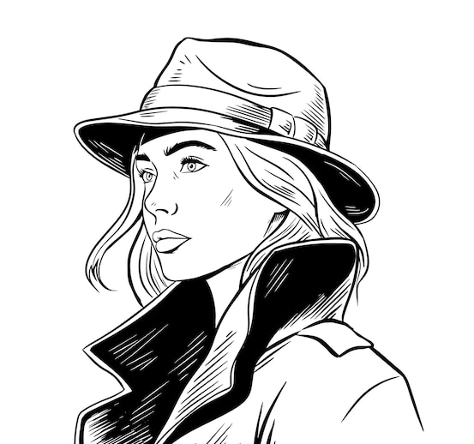
References
Fairness and Bias in AI (Angwin et al,2016), Machine bias in ethics data of analytics (pp.254-264). Aurbach publication
Articles "The Impact of organizations Culture on Ethical Decisions – making" ( Trevino et al.,2014)
Ethic in Engineering Educations: A literature Review ( Davis,2012)
"AI and robotics: ethical challenges and opportunities" ( European Commision, 2020)
Academic articles such as "Ethical Implications of Robotics and Artificial Intelligence" (Bornstein et al.,2017).

