Slide 1

Module Name: Problem and decision making
Module Code: LCLM4004_LON
Student Name: Bogdan Cibric
Student ID: 2511869
Lecturer: Toyin Adisa

Slide 2
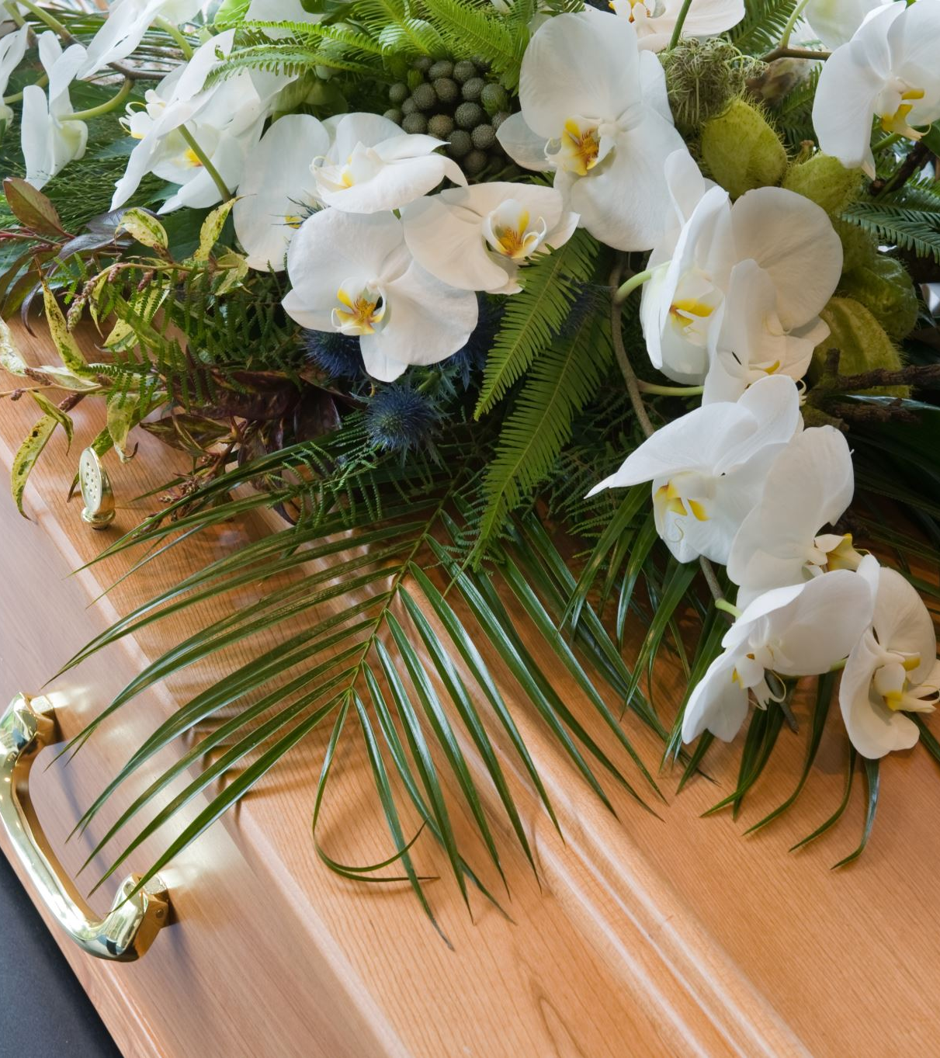
Introduction
Green Heaven Florists is a small independent business located in Norwich, UK. Last 12 months Green Heaven Florists has suffered a 30% decrease in revenue due to strong competitors and loss of foot traffic in their store.

Slide 3

Company Background
Green Heaven Florists
Founded: 2016 Norwich, UK.
Owners: Liam, Priya Patel
Sells: Floral Arrangements, Walk-In Bouquets, Corporate Businesses, Weddings.
Community Ties: Thrived through personal detailed touches, sustainable packaging which won the attention of environmental conscious clients building a tighter connection leading to loyal customers.
Adaptation: The business has taken the step towards online orders, increasing gradually.
Business Location: High Street – used to have high foot traffic percentage, now decreased due to strong image businesses shifting towards online activities only.
Client Feedback: In store has always had a positive feedback, however the business has difficulties through their online website – outdated, difficult to navigate.
Competitors: Trendy Boutique Florist with a strong Instagram presence; National chain florist offering aggressive bulk prices as well as delivery insurance.

Slide 4
Problem: Nature and Scope
5W2H
What?
Decrease in revenue by 30% due to weak social media image, requires more focus on social media as well as an update of the website created due to access difficulties.
Why?
An improvement is necessary since they stand no chance against competitors with a powerful social media image, easier access of websites, faster deliveries and insurance. If the business won’t take action immediately it’s most likely to reach bankruptcy (Jones N, Borgman R, Ulusoy E, 2015)
Where?
Located in Norwich, UK, on the high-street.
When?
Actions are advised to be taken promptly in order not to reach bankruptcy of the business
Who?
A change needs to be done by the owners of the business – Liam and Priya Patel as well as discussing with a business advisor before proceeding.
How?
An update needs to be made towards the online website, creating a easier way of access, also including promotion deals in order to attract clientele. Researching a business plan before proceeding. Creating a social media base through Instagram, Facebook, Threads etc.
How Much?
In order to calculate the prices the owners and business advisor need to come to a common agreement. Budget could vary depending on the investment approx. 500 – 5000.

Slide 5
Pestle Analysis: Green Heaven Florists
Political:
Environmental Regulations
Trade Regulations and Tariffs
Economic:
Inflation (rising prices for raw materials)
Consumer Confidence (insurance for deliveries)
Social:
Demographic Shifts (age, customer base)
Ethical Consumerism (strong ethics, environmental awareness)

Slide 6

Pestle Analysis: Green Heaven Florists
Technological:
E-commerce and digital marketing (selling and marketing)
Research and Development
Legal:
Consumer Protection Laws (product safety, quality, detailed labelling)
Data Protection and Privacy
Environmental:
Pollution and Toxins
Climate and Weather (natural disasters, weather change)

Slide 7
Cause and Effect Analysis: Fishbone Diagram
Digital
Social Media
Competition
Outdated
No image
Aggressive Bulk
Hard access
No clientele
Social Media
Loss of clientele
No promotions
Slow
Revenue
Loss
Hard access
Lower price
No Insurance
Foot Traffic
Bulk
Delivery
Figure 1: ASQ, 2024

Slide 8

Conclusion
In order for the Green Heaven Florists to progress and increase the business revenue it is mandatory to begin building a social media image, improve the online website and make it more efficient, easier to access, create an innovative design to differentiate from other competition.
Bulk prices and promotions. To maximize profits and creating a company where clients can rely on a high quality, consistent product every time (Floral express, 2024) the best option is including selling bouquets at bulk prices for corporate businesses as well as weddings and any other events.
Promotions. It’s the best advice to add promotions and deals in order to become unique and increase clientele.
Delivery insurance. Deliver peace of mind to the customers, meaning providing guarantee for the parcels for arrival. In the event of anything going wrong, the insurance provides a safety net against any loss or damage during transit. This protects both the company and ensures the customer receive any compensation necessary. (Louise,2023)

Slide 9

References
Asq.org. (2024). What is a Fishbone Diagram? Ishikawa Cause & Effect Diagram | ASQ. [online] Available at: https://asq.org/quality-resources/fishbone?srsltid=AfmBOooYUG5E0gMKPZOEapyAqW9m_74EFrvsCt-XrbjUPyoQMfN3TYOO
Accessed on 08 March 2026
BBC (2023). Political factors - External factors - National 5 Business management Revision - BBC Bitesize. [online] BBC Bitesize. Available at: https://www.bbc.co.uk/bitesize/guides/zgfrpbk/revision/2 Accessed on 08 March 2026
Jones N, Borgman R, Ulusoy E (2015), "Impact of social media on small businesses". Journal of Small Business and Enterprise Development, Vol. 22 No. 4 pp. 611–632, Availabe at: https://doi.org/10.1108/JSBED-09-2013-0133- Accessed on 08 March 2026
Louise (2023). The European Business Review. [online] The European Business Review. Available at: https://www.europeanbusinessreview.com/the-benefits-of-courier-insurance-to-safeguard-deliveries/ Accessed 08 March 2026
Rayam@yourdigitalagents.com (2024). Floral Express. [online] Floral Express Wholesale. Available at: https://floralexpress.ca/top-reasons-to-buy-flowers-in-bulk/ Accessed 08 March 2026
‌

