Slide 1
DIGITAL SKILLS
By Miguel Martinez

Slide 2

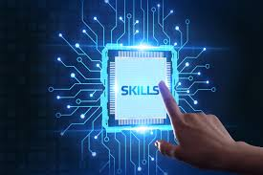
What are they?
Digital skills are essential abilities for using technology confidently and securely in work and daily life, including communicating online, managing information, transacting securely, and problem-solving.

Slide 3

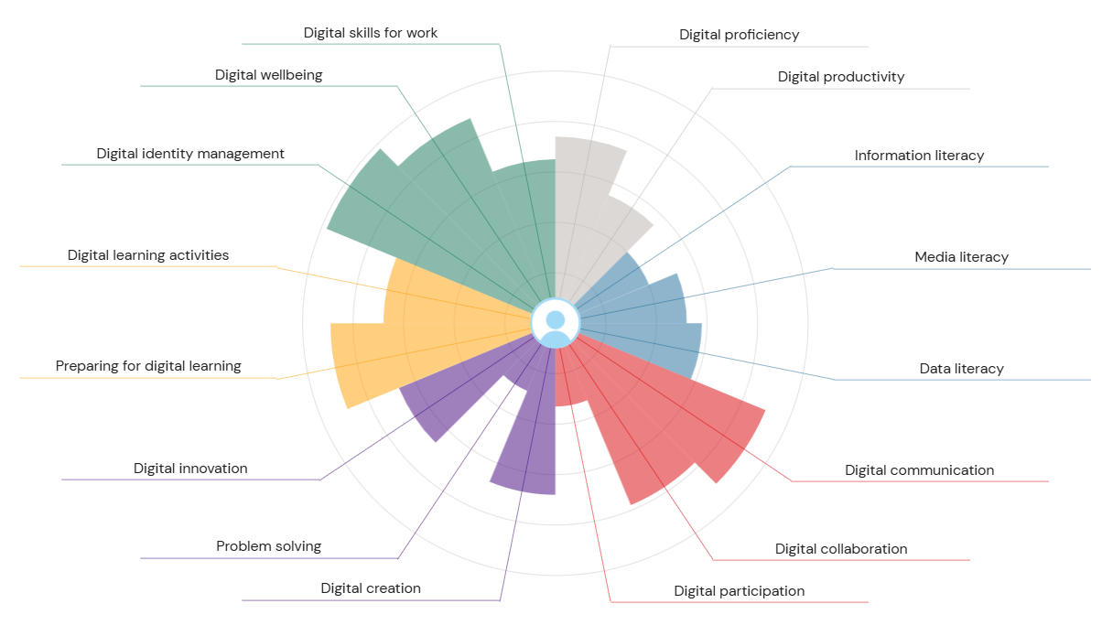
JiSC

Slide 4
SKILLS SET
Productivity and Proficiency (Grey)
Information and Data Literacy (Blue)
Communication and Collaboration (Red)
Creation and Problem Solving (Purple)
Learning (Yellow)
Identity and Wellbeing (Green)

Slide 5







Slide 6



Slide 9


