Slide 1
Operating Hotel Facilities
Student No:2220488
Module Title: Hotel Placement
Operating Facilities
Module Code: BMIH4006
Lecturer: Neil Dyer

Slide 2
Table of Contents
Introduction……………………………………… 3
Understanding the room cleaning checklist ………. 4
Importance of following standards……………….. 5
Cleaning procedures for bedroom………………….. 6
Cleaning procedures for bathrooms ………………..7
Cleaning procedures general ……………………….. 8
Employee engagement model ………………………. 9
Principles of employee engagement model…………..10
Conclusion…………………………………….. 11
References………………………………………. 12

Slide 3

Introduction
Training helps employees to develop practical skills and knowledge that help to increase their production.
Employee engagement is essential as it helps to increase employees' job satisfaction and productivity.
Presentation on training employees on how to carry out housekeeping focusing on the created cleaning checklist
Notes:
Training employees and fostering employee engagement are essential aspects of organisational success. Training employees on how to carry out the housekeeping duties is vital as it offers them skills to stay current and relevant to their roles. Skill development helps employees increase hotel productivity (Eby et al., 2019). It is also essential to carry out training programs for the employees as it allows them to ensure that they are equipped with the tools and knowledge required to perform the tasks, reducing errors and time waste in creating mistakes (Jaworski et al., 2018). It is also essential to ensure that employees are engaged with the hotel management as it helps to increase their ability to meet quality standards and safety. This presentation aims at training employees on how to carry out housekeeping based on the new room cleaning checklist created in component 2. The exhibition also links the training with the employee engagement model and its principles.

Slide 4
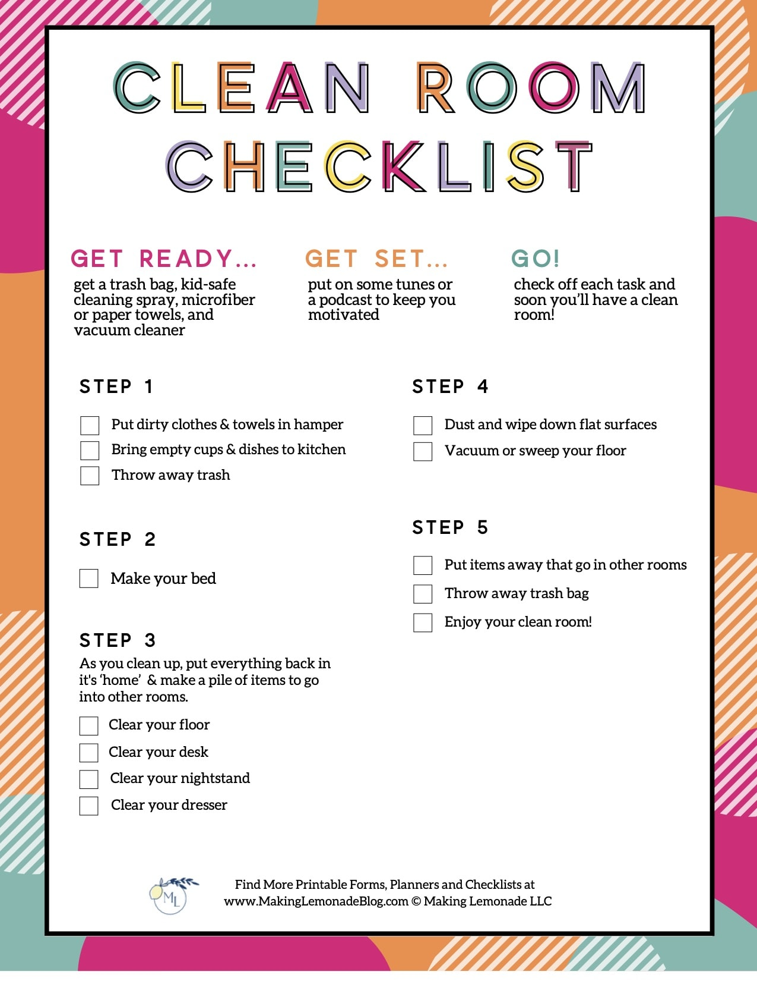
Understanding the room cleaning checklist
It serves as a detailed guide for housekeeping staff to ensure they clean each room effectively.
The checklist will help employees follow a systematic approach that guides them through a logical sequence of tasks.
It will serve as a valuable training tool for the new staff and provide them with a clear outline of expectations and procedures.
The checklist is flexible and adaptable based on the evolving needs, standards and guest preferences.
Notes:
The new employees need to understand the new cleaning checklist as it helps them to gain more insights into what is required. The room cleaning checklist is a detailed guide for housekeeping staff to ensure they thoroughly and consistently clean each room. The employees must cover all the essential tasks for the bedrooms, bathroom and general areas. It also included specific instructions for changing the bed lines, dusting, vacuuming and emptying trash bins. It will be necessary for the employees to follow the checklist as it follows a systematic approach, guiding the housekeeping staff through a logical sequence of tasks to avoid overlooking any critical cleaning steps. It is also essential for the housekeeping staff to know that the checklist is a valuable training tool for the new team, providing them with a clear outline of expectations and procedures (Ambardar, Singh and Singh, 2023). We have to ensure that we clean the cleaning rooms by following the checklist as it helps to align with the brand standards, which maintain consistent and recognisable guest experience. The list is flexible and can be adapted based on the organisation’s evolving needs, industry standards and specific guest preferences.

Slide 5
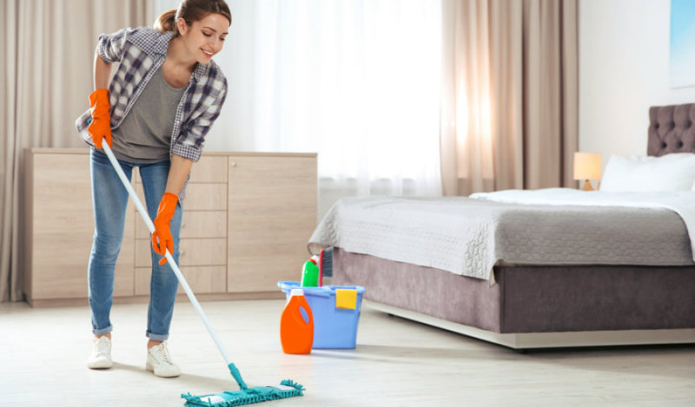
Importance of following the standards
Following standards helps to increase guest satisfaction and experience
It enables the housekeeper to improve and enhance brand reputation
Following cleaning standards helps housekeepers remain consistent in cleaning practices
Notes:
As a housekeeper, it is essential to follow the standards as they help increase guest satisfaction and experience. It is also necessary for a housekeeper to adhere to the cleaning standards directly as they help to create a positive guest experience and retain them effectively. A clean and well-maintained room creates a positive first impression, influencing the guest's satisfaction. It is also essential for a housekeeper to ensure that they follow the standards as it will help retain guests since satisfied guests become repeat customers and recommend the establishment to others. It is also essential to follow the criteria as it helps build the brand and enhances the hotel's productivity. Following the standards helps you as a housekeeper maintain high cleanliness levels.

Slide 6
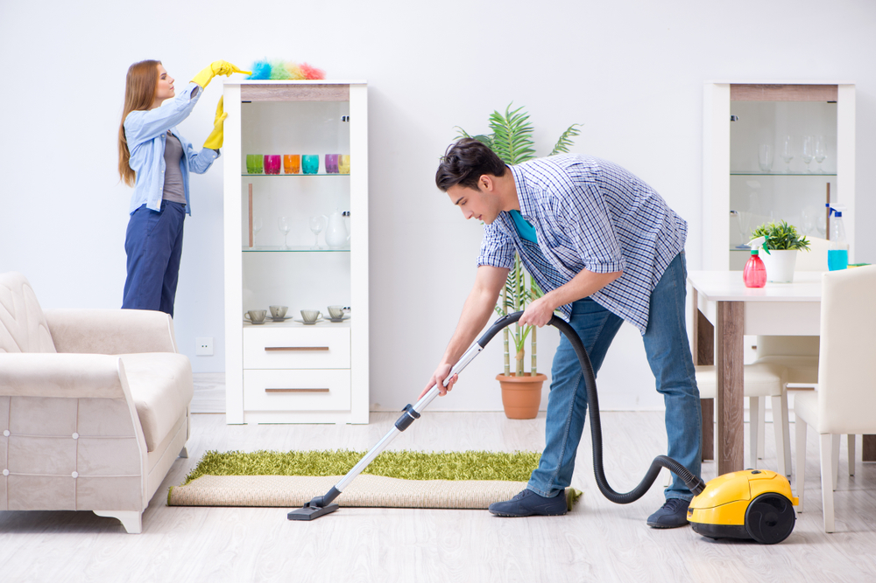
Cleaning procedures for bedrooms
Change bed linens
Dust and wipe surfaces
Carry out vacuuming and sweeping
Empty trash bins
Clean mirrors and glasses
Notes:
During this training session, it will be necessary for the housekeeper to learn how to carry out cleaning procedures for the bedroom facilities. It will be essential to change the bed lines by removing the old lines without causing dust and debris to scatter. As a housekeeper, you must inspect the mattress and pillowcases for stains and damage. Fresh cleanliness contributes to guest satisfaction and comfort. Regular inspection ensures overall cleanliness and hygiene. Carry out dusting and wiping off the surfaces. Housekeepers should also carry out vacuuming or sweeping, which helps to clean the carpets and remove all the tiny dust that may have stuck on the carpets or floors (Akbar, 2021). Emptying trash and ins is significant as it helps to replace the trash can liners with new ones and maintains a clean and hygienic environment. Cleaning mirrors and glasses is essential as it helps to contribute to the visual appeal of the room.

Slide 7
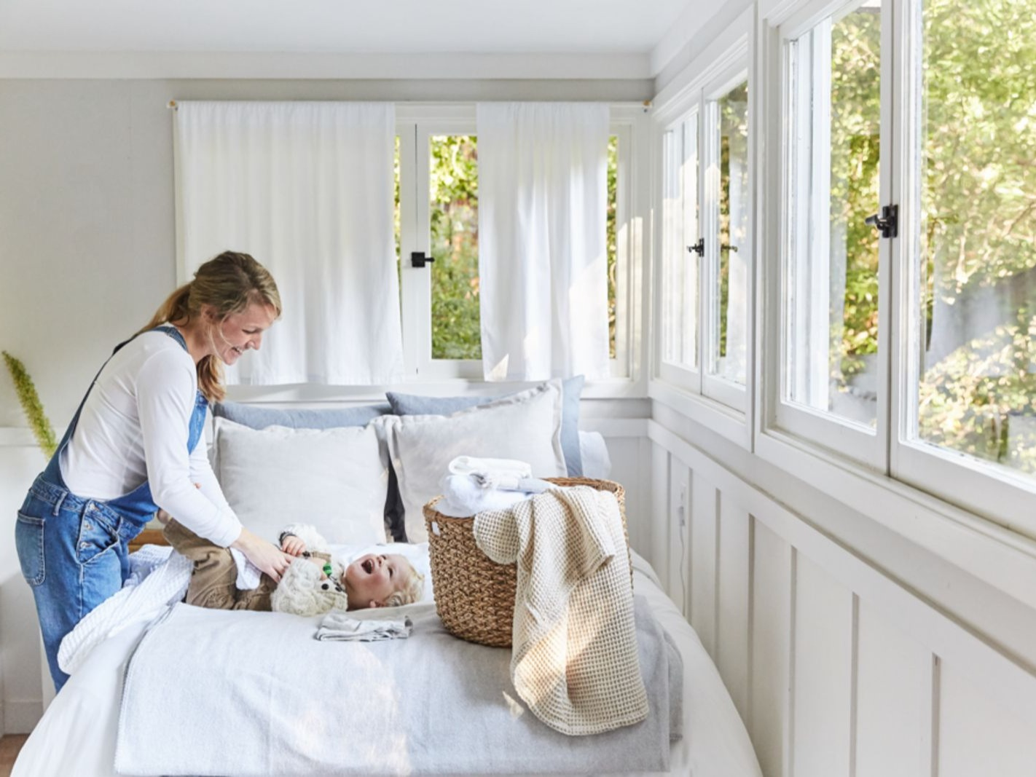
Cleaning procedures for bathrooms
Sanitize and Clean Surfaces
Clean and Disinfect Toilet
Clean Shower and Tub
Replace Toiletries
Notes:
The housekeeper needs to sanitise and clean surfaces, which helps to ensure that the countertops and sinks are kept clean. Shelving and cabinets must also be cleaned by paying attention as guests use them to store their stuff. It is also essential for you as a housekeeper to clean and disinfect the toilet. This helps ensure the guest is comfortable, as clean and sanitised toiletry is vital for guest comfort and satisfaction. As a housekeeper, it is essential to clean the shower and tub. You can carry out this through grouting and tile cleaning and showerhead and faucets that will help to prevent Mold and mildew growth; thus, you should carry out this regularly. It is also essential to replace toiletries. As a housekeeper, ensure that you perform quick inventory checks and provide an adequate supply of toiletries for the incoming guests, hence guest convenience (Quinones and Rojas, 2022).

Slide 8

Cleaning procedure for the general areas
Dust and Clean Furniture
Vacuum Carpets and Upholstery
Check and Replenish Supplies
Inspect for Maintenance Issues
Inspect Electronics
Inspect Windows
Notes:
As a housekeeper, you need to carry out dusting and cleaning the furniture as it helps to increase the visual appeal of the space. They also help to enhance the guest experience as they can stay in a conducive and comfortable atmosphere. Carrying vacuum cleaning of the carpets and upholstery is essential as it helps to increase hygiene and allergen control. It also helps to improve aesthetics and presentation, as clean carpets and upholstery contribute to the space's overall aesthetic. As a housekeeper, it is essential to check and replenish supplies. This ensures that stores are adequately stocked, crucial to guest convenience. It also prevents inconvenience for guests and demonstrates attention to their needs (Aldabbagh et al., 2022). As a housekeeper, ensure that you check and replenish supplies as it increases operation efficiency and reduces the likelihood of last-minute rushes and disruptions. Ensure you have insect maintenance issues, which helps to identify and dress the problems promptly. Inspecting allegations is essential as it helps to ensure that guests are comfortable and their overall satisfaction.

Slide 9

Employee engagement model
Understanding individual needs and increasing skills development
Linking training to organisational goals
Personalising training plans
Carrying out continuous feedback
Recognition and rewards
Notes:
Ensuring that the housekeepers understand the guest's needs, preferences, and expectations is essential, which will help increase satisfaction regarding the cleaning. It is also necessary to ensure that I identify the skills and strengths of each housekeeper, which will help to tailor the training programs to their unique abilities. I will also ensure that I engage with the employees and communicate how the training aligns with the organisation's overall goals and vision. It will also be essential to ensure that I show employees how their individual development contributes to the success of the team and the company (Mone, London and Mone, 2018). I will also develop personalised training plans to help employees choose the training modules that align with their career goals and interests. I will also ensure that I implement regular feedback sessions to enhance employee satisfaction in the training programs (Antony, 2018). Encouraging open communication about the effectiveness of the training is essential as it will improve employee improvement. It is also vital to ensure that I carry out recognition that acknowledges and rewards employees for completing training milestones.

Slide 10

Principles of employee engagement model
Clear communication
Providing employees with work that aligns with their skills and aspirations
Recognition and appreciations
Offering opportunities for growth
Notes:
Clear communication is essential between leadership and employees. Clear communication helps the housekeepers to understand the organisational goals, expectations and their role in achieving success. Preventing the housekeepers with challenging, exciting work aligned with their skills and privations (Motyka, 2018). Meaningful work enhances job satisfaction and encourages employees to invest time and energy in tasks. Acknowledging and appreciating employees' contributions is essential as it helps boost their morale and foster a culture of appreciation. Offer professional development opportunities and career-developed paths (Sun and Bunchapattanasakda, 2019). Growth opportunities demonstrate the organisation’s commitment to long-term success and well-being.

Slide 11
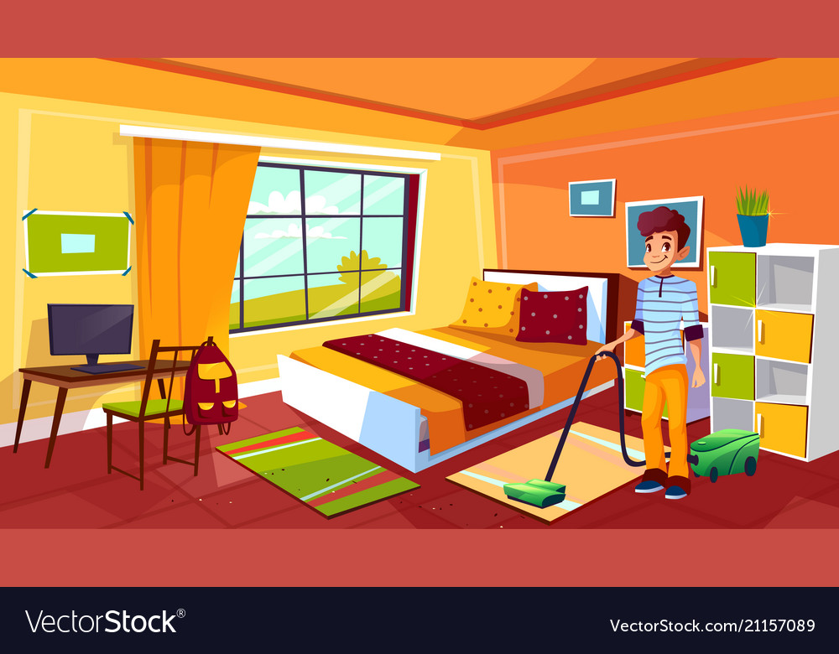
Conclusion
Fostering employee engagement creates a thriving workplace
Room cleaning checklist helps housekeepers ensure consistency, efficiency, dn high standards in housekeeping operations
The following criteria help to increase guest satisfaction, brand reputation and guest experience.
Notes:
Fostering employee engagement is vital as it creates a thriving workplace that increases employee productivity and performance. Training employees on cleaning checklists is essential as it helps to ensure that the housekeepers follow the standards and models for employee engagement. A well-designed room cleaning checklist is vital as it provides consistent, efficient and high standards for housekeeping operations. Following cleaning and operational standards is directly linked to guest satisfaction, brand reputation and the overall guest experience.

Slide 12
References
Akbar, M.F. (2021). Performance Appraisal Design in The Grand Mutiara Hotel Housekeeping Division Using BARS Assessment Model. International Journal of Innovation in Enterprise System, 5(01), pp.65-77.
Aldabbagh, A., Neyazi, D., Alsahafi, M., Sarhan, A. and Palaniswamy, T. (2022). Improving the Quality of The Housekeeping Management Process for Stay at Bridge Suites Hotel. Journal of Advances in Humanities Research, 1(1), pp.26-41.
Ambardar, A., Singh, A. and Singh, V. (2023). Barriers on Implementing Ergonomic Practices in Hotel Housekeeping. International Journal of Hospitality & Tourism Systems, 16(2).
Antony, M.R. (2018). Paradigm shift in employee engagement–A critical analysis on the drivers of employee engagement. International Journal of Information, Business and Management, 10(2), pp.32-46.
Eby, L.T., Allen, T.D., Conley, K.M., Williamson, R.L., Henderson, T.G. and Mancini, V.S. (2019). Mindfulness-based training interventions for employees: A qualitative review of the literature. Human Resource Management Review, 29(2), pp.156-178.
Jaworski, C., Ravichandran, S., Karpinski, A.C. and Singh, S. (2018). The effects of training satisfaction, employee benefits, and incentives on part-time employees’ commitment. International Journal of Hospitality Management, 74, pp.1-12.
Mone, E., London, M. and Mone, E.M. (2018). Employee engagement through effective performance management: A practical guide for managers. Routledge.
Motyka, B. (2018). Employee engagement and performance: a systematic literature review. International Journal of Management and Economics, 54(3), pp.227-244.
Quiñones, D. and Rojas, L. (2022). CHECKHI: A Checklist for Evaluating the Customer Experience of Tourism in the Hotel Industry. Sustainability, 14(24), p.16676.
Sun, L. and Bunchapattanasakda, C. (2019). Employee engagement: A literature review. International Journal of Human Resource Studies, 9(1), pp.63-80.

