Slide 1
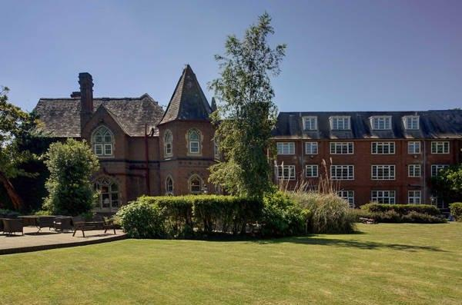
BMIH4006
Operating Hotel Facilities
AS3
Student: Silvia Daniela Grecu
Student no: 2245642
Lecturer:
Natalie Brailsford Daniel Payne Lisa Bassler Giulia Ghifari Ben Chong Scott James

Slide 2
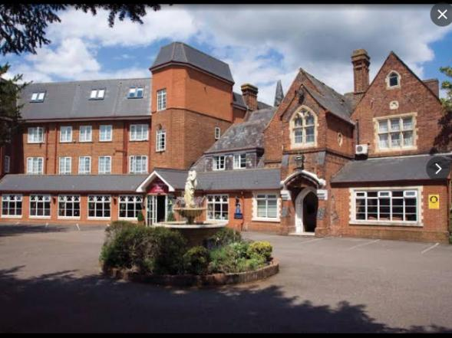
Contents
2. Importance of ventilation before cleaning
3. Selection of eco-friendly cleaning products
4. Chemical safety: avoiding mixing
5. Proper lifting techniques
6. Identifying and addressing slippery surfaces
7. Storing cleaning supplies safely
8. Prompt hazard reporting procedures
9. Conclusion
10. References
Introduction
The presentation will focus on the health and safety system of the organisation.
The presentation will focus on the room cleaning health and safety training of the employees of “Best Western Abbots Barton Hotel, Canterbury” by using gloves, aprons and masks so that the employees can stay safe from chemicals used in room cleaning (Tokarz-Kocik et al, 2023).
Notes:
1. Introduction
2. Importance of ventilation before cleaning
3. Selection of eco-friendly cleaning products
4. Chemical safety: avoiding mixing
5. Proper lifting techniques
6. Identifying and addressing slippery surfaces
7. Storing cleaning supplies safely
8. Prompt hazard reporting procedures
9. Conclusion
10. References

Slide 3
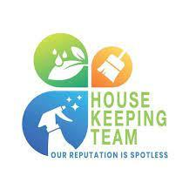
A plan for the housekeeping team
The Housekeeping team of Best Western Abbots Barton Hotel, Canterbury always ensures Housekeeping Standards and Safety. The organisation and its housekeeping team emphasis the best services in the hotel to ensure the safety of staff and guests (Asshofi et al, 2023). The plan for the house keeping team is-
Defining roles and responsibilities
Staff training
Cleaning standards
Quality control
Eco-friendly practices
Health and safety
Schedule management
Continuous improvement
Performance metrics
Notes:
The Housekeeping team of Best Western Abbots Barton Hotel, Canterbury always ensures Housekeeping Standards and Safety. The organisation and its housekeeping team emphasis the best services in the hotel to ensure the safety of staff and guests (Asshofi et al, 2023). The plan for the house keeping team is-
Defining roles and responsibilities
Staff training
Cleaning standards
Quality control
Eco-friendly practices
Health and safety
Schedule management
Continuous improvement
Performance metrics

Slide 4
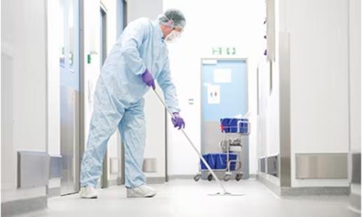
SOPs for Housekeeping and cleaning standards
The housekeeping team have to follow the cleaning protocols and inspect room carefully.
The team also have to ensure the commitment of the cleaning standards of Best Western Abbots Barton Hotel, Canterbury. For example, the team have to clean and sanitise all areas in the room.
They also need to ensure a clean environment in the hotel to present a welcoming environment by regularly cleaning lobbies, hallways, elevators etc. (Asshofi et al, 2023).
Notes:
The housekeeping team have to follow the cleaning protocols and inspect room carefully.
The team also have to ensure the commitment of the cleaning standards of Best Western Abbots Barton Hotel, Canterbury. For example, the team have to clean and sanitise all areas in the room.
They also need to ensure a clean environment in the hotel to present a welcoming environment by regularly cleaning lobbies, hallways, elevators etc. (Asshofi et al, 2023).

Slide 5
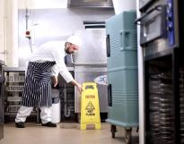
Hazard Identification and Reporting
The cleaning team have to take proactive approach after identifying hazards in cleaning areas.
They will have to take immediate actions. For example, after finding a hole in the hotel area the housekeeping team will cordon off the area (Ibragimovich et al, 2023).
They will use warning signs around the hole to make it visible for other to prevent accidents.
After that the team will take necessary steps to fix the hole safely.
Notes:
The housekeeping team have to follow the cleaning protocols and inspect room carefully.
The team also have to ensure the commitment of the cleaning standards of Best Western Abbots Barton Hotel, Canterbury. For example, the team have to clean and sanitise all areas in the room.
They also need to ensure a clean environment in the hotel to present a welcoming environment by regularly cleaning lobbies, hallways, elevators etc. (Asshofi et al, 2023).

Slide 6
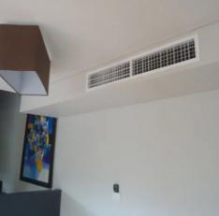
Importance of ventilation before cleaning
In hotel rooms of “Best Western Abbots Barton Hotel, Canterbury” different types of airborne particles and doors are present that can create unhealthy environments to overcome this issue ventilation process before cleaning plays a crucial role and improves the air quality of hotel rooms (Alhassan et al, 2023).
Air quality improvement
Chemical exposure reduction
Prevention of airborne contaminants
Notes:
Ventilation plays a very important role in the cleaning process to ensure safety while cleaning. Below the importance of it are presented-
Air quality improvement: In hotel rooms of “Best Western Abbots Barton Hotel, Canterbury” different types of airborne particles and doors are present that can create unhealthy environments to overcome this issue ventilation process before cleaning plays a crucial role and improves the air quality of hotel rooms (Alhassan et al, 2023).
Chemical exposure reduction: A proper ventilation process supports to reduction of chemical exposure in the rooms of “Best Western Abbots Barton Hotel, Canterbury” during the cleaning procedure. The cleaning team of the organisation use different types of cleaning agents that produce chemicals which can be harmful to the guests as well as the employees so the ventilation process is a must (Valdivia Nodal et al, 2023).
Prevention of airborne contaminants: During the process of room cleaning the rooms of “Best Western Abbots Barton Hotel, Canterbury” can be polluted by dust that can pollute the air quality of the rooms. The ventilation process supports to removal of dust from the air making the air fresh and ensuring a healthy room environment for the guest (Ibragimovich et al, 2023).

Slide 7

Selection of eco-friendly cleaning products
The cleaning team of “Best Western Abbots Barton Hotel, Canterbury” always prefer eco-friendly cleaning products such as Green multipurpose cleaners in the cleaning process to support the environment and nature. Green multipurpose cleaners are all-natural ingredients that make no impact on the environment while cleaning (Korpacz et al, 2023).
Green multipurpose cleaners
Biodegradable All-Purpose Soaps
Natural Disinfectants
Notes:
Green multipurpose cleaners: The cleaning team of “Best Western Abbots Barton Hotel, Canterbury” always prefer eco-friendly cleaning products such as Green multipurpose cleaners in the cleaning process to support the environment and nature. Green multipurpose cleaners are all-natural ingredients that make no impact on the environment while cleaning (Korpacz et al, 2023).
Biodegradable All-Purpose Soaps: “Best Western Abbots Barton Hotel, Canterbury” applies Biodegradable All-Purpose Soaps such as Castile soap in its cleaning process to support the environment. This soap is free from toxic chemicals and synthetic fragrances that support the hotel to ensure a better environment in rooms after cleaning (Mun et al, 2023).
Natural Disinfectants: It is important to use disinfectors in the cleaning process of hotel rooms to maintain safety standards after cleaning. The cleaning team of “Best Western Abbots Barton Hotel, Canterbury” apply hydrogen peroxide and tea tree oil in the cleaning process because of their antibacterial properties (Orhan et al, 2023).

Slide 8
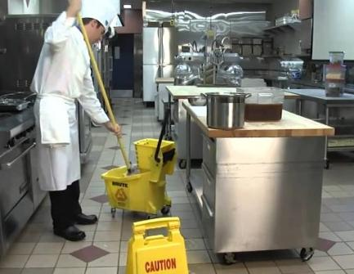
Chemical safety: avoiding mixing
The hotel management team of “Best Western Abbots Barton Hotel, Canterbury” always ensures proper training of the cleaning team in hotel rooms to ensure chemical safety.
The cleaning staffs of the organisation follow the instructions on cleaning product labels and do not mix products of different brands to ensure chemical safety in hotel rooms.
Besides this, the cleaning team of “Best Western Abbots Barton Hotel, Canterbury” never use one cleaning product a second time to avoid chemical issues during the cleaning process in hotel rooms (Asshofi et al, 2023).
Notes:
The hotel management team of “Best Western Abbots Barton Hotel, Canterbury” always ensures proper training of the cleaning team in hotel rooms to ensure chemical safety. The cleaning staffs of the organisation follow the instructions on cleaning product labels and do not mix products of different brands to ensure chemical safety in hotel rooms. Besides this, the cleaning team of “Best Western Abbots Barton Hotel, Canterbury” never use one cleaning product a second time to avoid chemical issues during the cleaning process in hotel rooms. The cleaning professionals of the organisation monitor the use of chemicals regularly and ensure proper ventilation processes to ensure chemical safety (Asshofi et al, 2023).

Slide 9
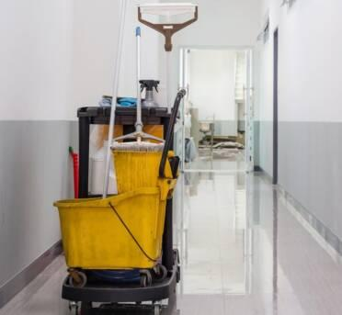
Proper lifting techniques
The cleaning team analyse cleaning tasks and identifies necessary equipment for cleaning before starting their activities so that during cleaning they do not have to take pressure which can create issues.
The cleaning team of “Best Western Abbots Barton Hotel, Canterbury” apply trolleys, cleaning supplies, and other equipment to ensure better cleaning by maintaining safety.
“Best Western Abbots Barton Hotel, Canterbury” provides safety equipment like helmets, gloves, aprons, masks etc. to the cleaning staff to ensure their safety during the cleaning process (Tokarz-Kocik et al, 2023).
Notes:
In the cleaning process of hotel rooms cleaning staff have to work with different types of machinery so they can get injured. The cleaning team of “Best Western Abbots Barton Hotel, Canterbury” apply proper lifting techniques in the cleaning process to avoid unwanted issues with the staff. Below they are explained-
The cleaning team analyse cleaning tasks and identifies necessary equipment for cleaning before starting their activities so that during cleaning they do not have to take pressure which can create issues.
The cleaning team of “Best Western Abbots Barton Hotel, Canterbury” apply trolleys, cleaning supplies, and other equipment to ensure better cleaning by maintaining safety (Koutoulas et al, 2023).
“Best Western Abbots Barton Hotel, Canterbury” provides safety equipment like helmets, gloves, aprons, masks etc. to the cleaning staff to ensure their safety during the cleaning process (Tokarz-Kocik et al, 2023).

Slide 10
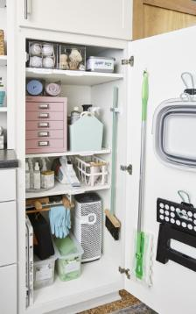
Storing cleaning supplies safely
“Best Western Abbots Barton Hotel, Canterbury” a well designated cleaning supplies area where the organisation can safely store the cleaning supplies and also access easily during cleaning.
The cleaning team securely store suppliers in different cabinets and shelves to store safely and keep away from unauthorized individuals (Korpacz et al, 2023).
Besides this, “Best Western Abbots Barton Hotel, Canterbury” ensures ventilation in the storing system of cleaning supplies and also focus on temperature control in the storing area to protect cleaning supplies and chemicals (Mun et al, 2023).
Notes:
“Best Western Abbots Barton Hotel, Canterbury” a well designated cleaning supplies area where the organisation can safely store the cleaning supplies and also access easily during cleaning.
The cleaning team securely store suppliers in different cabinets and shelves to store safely and keep away from unauthorized individuals (Korpacz et al, 2023).
Besides this, “Best Western Abbots Barton Hotel, Canterbury” ensures ventilation in the storing system of cleaning supplies and also focus on temperature control in the storing area to protect cleaning supplies and chemicals (Mun et al, 2023).

Slide 11
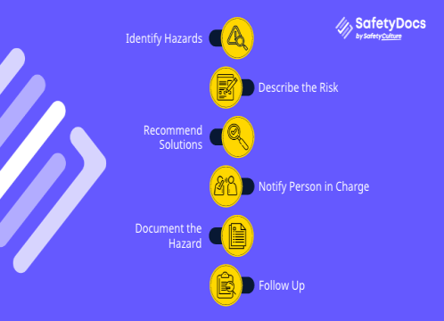
Prompt hazard reporting procedures
The safety management team implement a clear reporting system in the hotel to establish a straightforward hazard reporting system.
“Best Western Abbots Barton Hotel, Canterbury” ensures proper training to the staff of the organisation to face hazards and reporting in time to develop safety procedure (Orhan et al, 2023).
“Best Western Abbots Barton Hotel, Canterbury” established online hazard reporting system and display reporting information to understand hazard clearly to take necessary action successfully (Asshofi et al, 2023).
“Best Western Abbots Barton Hotel, Canterbury” ensures flexibility in hazard reporting system by implementing different reporting channels such as messaging, phone call, email etc. (Koutoulas et al, 2023).
Notes:
The safety management team implement a clear reporting system in the hotel to establish a straightforward hazard reporting system.
“Best Western Abbots Barton Hotel, Canterbury” ensures proper training to the staff of the organisation to face hazards and reporting in time to develop safety procedure (Orhan et al, 2023).
“Best Western Abbots Barton Hotel, Canterbury” established online hazard reporting system and display reporting information to understand hazard clearly to take necessary action successfully (Asshofi et al, 2023).
“Best Western Abbots Barton Hotel, Canterbury” ensures flexibility in hazard reporting system by implementing different reporting channels such as messaging, phone call, email etc. (Koutoulas et al, 2023).

Slide 12
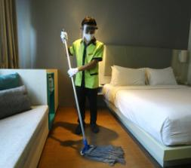
Conclusion
In the end, it is a must to ensure clean and safe environment in hotel business organisation to bring success in the organisation and its performance.
“Best Western Abbots Barton Hotel, Canterbury” always try to follow the cleaning and safety standards in their hotel operation and ensure proper monitoring the cleaning process to create opportunities by satisfying customers (Ibragimovich et al, 2023).
Notes:
In the end, it is a must to ensure clean and safe environment in hotel business organisation to bring success in the organisation and its performance. “Best Western Abbots Barton Hotel, Canterbury” always try to follow the cleaning and safety standards in their hotel operation and ensure proper monitoring the cleaning process to create opportunities by satisfying customers (Ibragimovich et al, 2023).

Slide 13
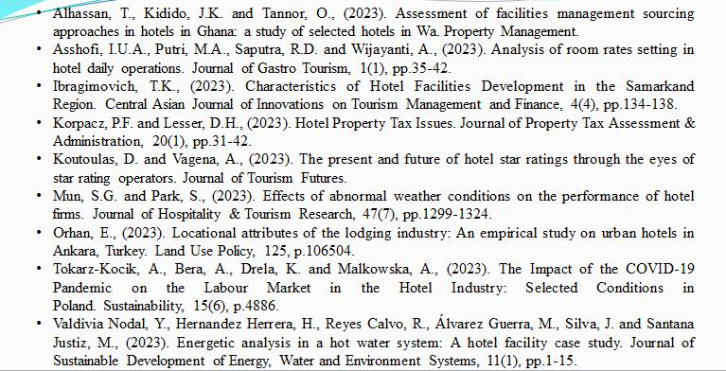
References
Notes:
Alhassan, T., Kidido, J.K. and Tannor, O., (2023). Assessment of facilities management sourcing approaches in hotels in Ghana: a study of selected hotels in Wa. Property Management.
Asshofi, I.U.A., Putri, M.A., Saputra, R.D. and Wijayanti, A., (2023). Analysis of room rates setting in hotel daily operations. Journal of Gastro Tourism, 1(1), pp.35-42.
Ibragimovich, T.K., (2023). Characteristics of Hotel Facilities Development in the Samarkand Region. Central Asian Journal of Innovations on Tourism Management and Finance, 4(4), pp.134-138.
Korpacz, P.F. and Lesser, D.H., (2023). Hotel Property Tax Issues. Journal of Property Tax Assessment & Administration, 20(1), pp.31-42.
Koutoulas, D. and Vagena, A., (2023). The present and future of hotel star ratings through the eyes of star rating operators. Journal of Tourism Futures.
Mun, S.G. and Park, S., (2023). Effects of abnormal weather conditions on the performance of hotel firms. Journal of Hospitality & Tourism Research, 47(7), pp.1299-1324.
Orhan, E., (2023). Locational attributes of the lodging industry: An empirical study on urban hotels in Ankara, Turkey. Land Use Policy, 125, p.106504.
Tokarz-Kocik, A., Bera, A., Drela, K. and Malkowska, A., (2023). The Impact of the COVID-19 Pandemic on the Labour Market in the Hotel Industry: Selected Conditions in Poland. Sustainability, 15(6), p.4886.
Valdivia Nodal, Y., Hernandez Herrera, H., Reyes Calvo, R., Álvarez Guerra, M., Silva, J. and Santana Justiz, M., (2023). Energetic analysis in a hot water system: A hotel facility case study. Journal of Sustainable Development of Energy, Water and Environment Systems, 11(1), pp.1-15.

