Slide 1
Exercise and Cognitive Function
Dr Stuart Jones

Slide 2
Aims of the Lecture
To explore the historical studies that have helped formed theories regarding the exercise/cognitive function relationship.
To highlight issues in relation to this research and how might these be addressed.
To discuss regions of the brain linked to cognitive function and how might exercise impact on this.

Slide 3
Aims of the lecture
To examine the impact of both exercise and cognitive tasks on cerebral blood flow and how these might be linked.
To look at the role of noradrenaline in relation to cognitive functioning and exercise.
To look at the relationship between physical activity and cognitive achievement.

Slide 4
Aims of the lecture
To explore the relationship between exercise, cognitive function and the elderly
To explore the relationship between COPD, cognitive function and exercise.

Slide 5
Task
In groups:
Think of the pro and cons of exercise / physical activity.
Why do people who exercise (or have a physically active lifestyle) make these choices.
Why do people who do not exercise choose not to exercise?

Slide 6
Introduction
It has been long considered “common sense” that the fitness of the body can influence the mind…..
Piaget (1936) stated that motor development could influence the cognitive development in children.
Kephart (1960) – went further and claimed that children with learning disabilities may be suffering from perceptual motor problem.

Slide 7
Introduction
And why not……
It is largely accepted that exercise can be beneficial to physical organs such as the heart, lungs etc… in addition to muscle, bones etc.
The Brain, like the heart and lungs is a physical organ.
Therefore, why is it less widespread about the possible benefits on exercise on the brain?

Slide 8
Why doesn’t the benefits of exercise on cognition make the news?
Actual measures that support these theoretical viewpoints have been unclear until very recently.
Why do you think that is?

Slide 9
What is Cognition?
Areas of Cognition include:
Attention
Concentration
Sensory Skills
Motor Skills

Slide 10
What is Cognition?
Areas of Cognition include:
Language
Visual Skills
Memory
Problem Solving
Moral Reasoning

Slide 11
How to Measure Cognitive Function
Not as simple as first thought.
  Major factor to consider when formulating a hypothesis on the role of exercise.
Some researchers will evaluate cognition at a global level (e.g. General Intelligence).
Others will explore specific processes (e.g. Attention, Memory etc).

Slide 12
Neurophysiological measures
Widespread interest in direct measures of brain activity.
Structural and Functional Imaging devises.
  Structural Imaging Devices = Measuring the Structure of Brain.
    E.g. CT Scans, MRI scans.
  Functional Imaging Devices = Measuring the function of the Brain – The Brain in Action.
    E.g. Pet Scans, Functional MRI

Slide 13
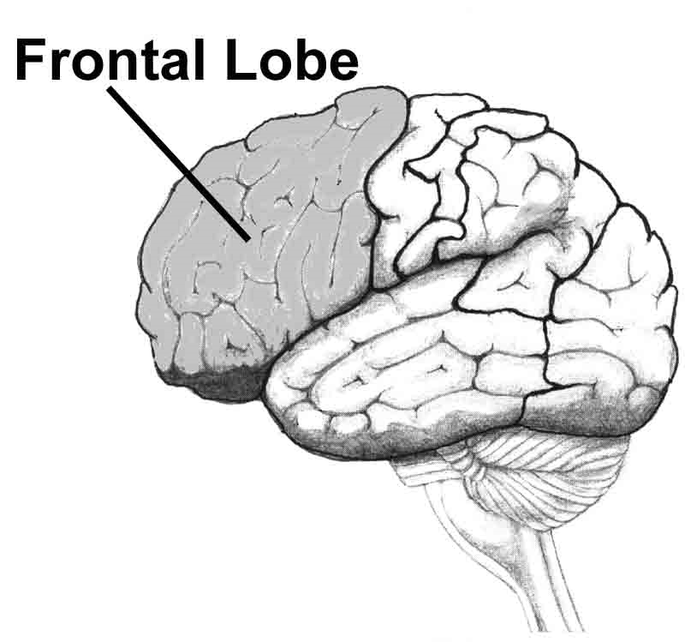
Structures in the Brain Implicated with Memory
Frontal Lobe
Receives multiple inputs.
  Cortical and Subcortical areas.
Essential for
  Decision Making
  Goal Directed Behaviour
  Memory
  Attention

Slide 14
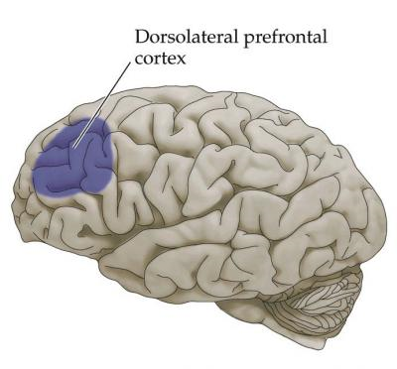
Structures in Brain implicated with Memory
Dorsolateral Prefrontal Cortex (DLPC).
  Dorso = Part of the Dorsal Pathway
    Occiptal Lobe →Parietal Lobe→Dorsolateral Prefrontal Cortex
  Lateral = Towards the side
Primarily Implicated with:
  Goal Selection, planning, sequencing, self-awareness, self-monitoring.

Slide 15

Memory?
Murray & Ranganath, (2007).
  Activation of Dorsolateral Prefrontal Cortex when asked to compare two items.
  Used in the process in remembering the association between two items.
Keenan et al (2001).
  When damaged or temporary anaesthetised
    Inability to recall picture of own face.
      Memory of information that is personally meaningful.

Slide 16
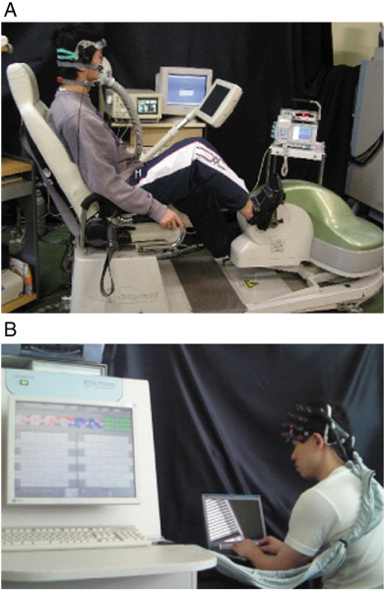
Role of Exercise on DLPC.
Yanagisawa et al (2010).
Used Neuro imaging to examine the Neural activation and stroop performance pre and post moderate acute exercise.
1) Improved Stroop performance in the post performance.
2) Enhanced activation of the Dorsolateral Prefrontal Cortex in the post performance.
  Compared also to a control condition – were there was no exercise between sessions.
  Similar findings – Byun et al, 2014.

Slide 17
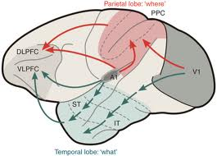
Structures in Brain implicated with Memory
Ventrolateral Prefrontal Cortex (VLPC).
  Ventro = Part of the Ventral Pathway
    Occiptal Lobe →Temporal Lobe→Ventrolateral Prefrontal Cortex
  Lateral = Towards the side
Primarily Implicated with:
  Blocking distractions, detection of threats,
  Attention
  Working Memory (D'Esposito et al, 2000).

Slide 18
Role of Exercise of VPC
Fumato et al (2010) – using EEG technology reported greater activation of the VPC following a 15 minute exercise bike (cycle ergometer) training.
They also reported an increase in positive mood and inferred this was due to increase serotonin production in this region.
Note – they did not assess cognition in their study.

Slide 19
The Story of Phineas Gage
One of the most famous case studies in Psychology.
June 1848
Accident in his work (Foreman of a railroad construction crew).
Explosion and a tamping iron shot out and passed through Gage’s skull.

Slide 20
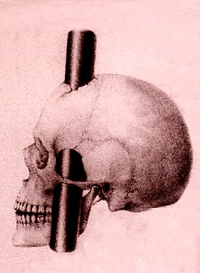
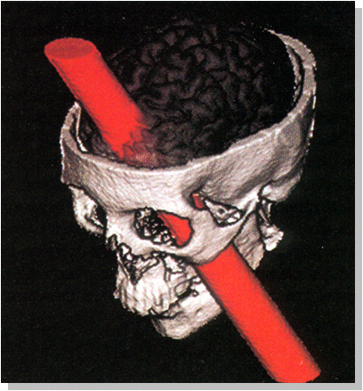
Amazingly Gage survived the accident
Never lost consciousness
Physical wounds generally healed
What about his personality?

Slide 21
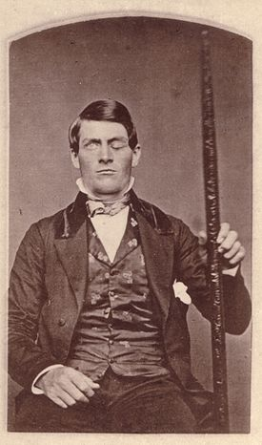
Gage’s physical wounds seemed to heal after a few months.
Gage personality POST accident described by his doctor as.
  “Irreverent, indulging in grossest profanity, manifesting in little deference to his fellows, impatient of restraint or advice when it conflicts with his desires”
    MacMilan (1986).

Slide 22
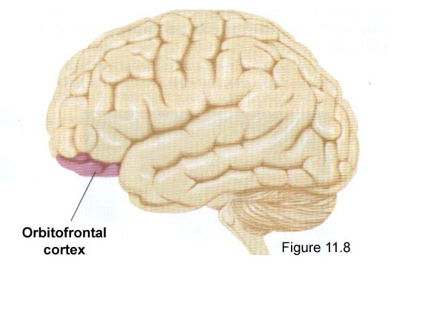
Gage suffered a massive lesion of the left orbitofrontal cortex (amongst other regions)
It is part of the Prefrontal Cortex.
Name based on its location –
  Located immediately above the orbits in which the eyes are located.

Slide 23
More recent studies on the Orbitofrontal Cortex
Beer et al (2006)
Patients with Orbitofrontal Cortex damage were videotaped while being engaged in social interactions with a stranger.
Compared to healthy controls, and also patients with brain injury in other regions of the brain.

Slide 24
Beer et al (2006) findings
Orbitofrontal Cortex Damaged patients would perform badly in Social Interaction.
  Inappropriate topics and were often rude to the stranger.
Appeared unaware of Social Mistakes
  Felt they performed well in the social setting and behaved well.
However, deep regret and embarrassment when viewing the clip.
  So knew appropriate from inappropriate behaviour as an outsider.
  However, follow ups – still engaged in many social mistakes.

Slide 25
Exercise and the Orbitofrontal Cortex.
Interestingly, neuroscience studies have suggested that exercise can lower the neural activation in this region (Evero et al, 2012).
The orbitofrontal cortex also has a significant role in dietary cravings…. and communicates with the DLPC in relation to this.
  Increased DLPC activation can increase dietary self-control.
Sugar (Glucose) can increase the activation of the Orbitofrontal cortex significantly (Chambers et al 2009).

Slide 26
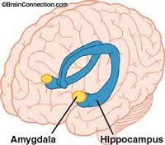
The Limbic System
Amygdala
  Our emotion centre
  Emotional Memories
    Fear and Anxiety Responses
Hippocampus
  Long term memory
    Activation can result in consolidation and storage of memories.

Slide 27
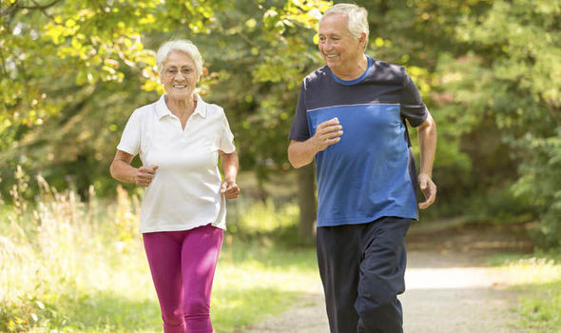

Exercise and the Hippocampus
A number of studies, such as Erickson et al (2009) and Honea et al (2009) have reported that older adults who have higher fitness levels typically have larger Hippocampus and Medial Temporal Lobe (e.g. Limbic System) regions.

Slide 28
Exercise and the Hippocampus
Erickson et al (2010) –
120 older participants involved in a single blind Randomized Control Trial.
Group 1 – Moderate intensity exercises 3 days a week for a year.
Group 2 – Stretching.
  Results – Group 2 - increases the size of the hippocampus
  Group 1 – Decreases in the size of the hippocampus

Slide 29
Exercise and Neurophysiological Measures
The ability to measure changes in neural activity while participants are performing cognitive tests provides evidence on the role of exercise on cognitive function.
Often such studies will measure brain activity pre and post exercise regime.

Slide 30
Cerebral Blood Flow
Moderate to high intensity exercise has been shown to increase the cerebral blood flow.
  Jorgensen et al 1992 amongst other authors.
Hypothesised that this will provide the brain with nutrients to enhance cognitive function.
  E.g. Oxygen, Glucose
    Jacobs et al 1969; Madden et al 1989

Slide 31
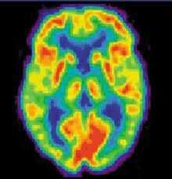
Cerebral Blood Flow
Modern studies
Several functional imaging studies using PET scans have suggested that is in an increase in cerebral blood flow in the areas of the brain highlighted previously when conducting cognitive task.
Brain areas require nutrients (e.g. Glucose) to conduct the cognitive tasks?

Slide 32
Noradrenaline
Also known as norepinephrine (in the USA).
Neurotransmitter (NT) and Hormone.
Evidence has suggested Noradrenaline increases after an acute bout of exercise (e.g. Mitchell et al, 1990)

Slide 33
Noradrenaline
Breedlove et al (2010) – Increased activation in noradrenaline in rats when doing memory tasks.
Breedlove et al (2010) – Noradrenaline associated with concentration.

Slide 34
However…..
Many potential issues with such studies…..
Can you think of some of these???

Slide 35
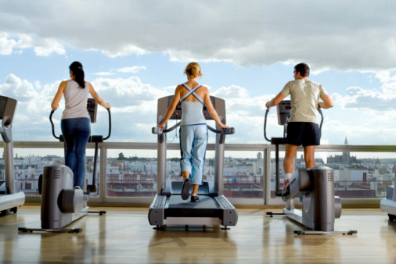
Some critical questions
Will you see the impact of exercise on cognitive function almost instantly or is the impact only felt as part of a long term training regime?

Slide 36
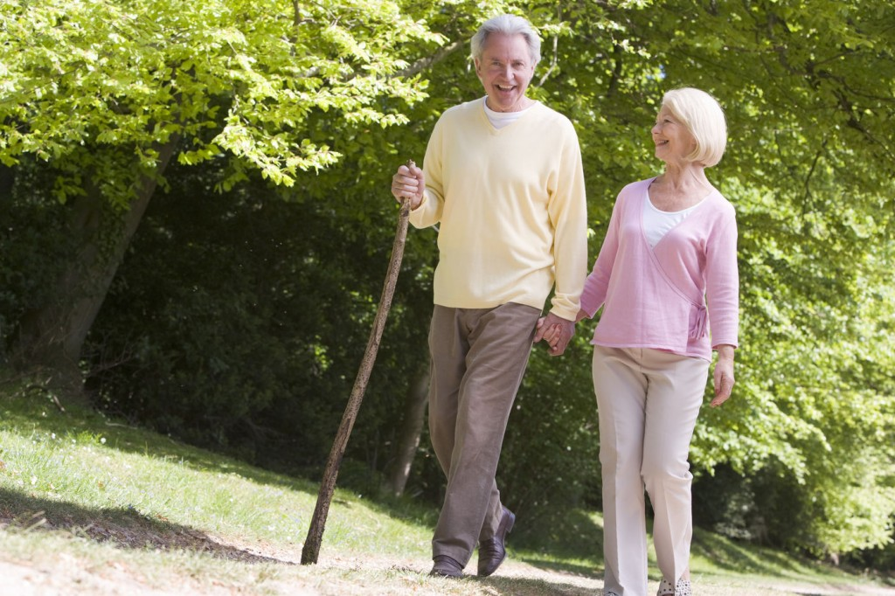
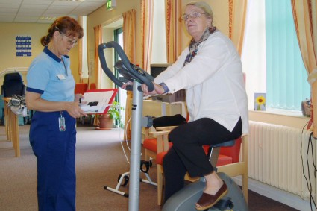
Some critical questions
What group of people will the impact of exercise on cognitive function have most.
  Elderly?
  Vulnerable people? (e.g. suffering from chronic illness)
  All groups?

Slide 37
Issues
Due to ethics and cost it is very difficult to replicate these neurophysiological studies on humans.
Micro-dialysis in humans is allowed but the practical and cost implications far greater.

Slide 38
What about non-invasive Neurophysiological studies.
E.g. Use of PET scans.
Lab based so can question the ecological validity.
PET scans only tell us about the glucose levels of the neural pathways.
  Active neurons require more glucose.
  However it is an INDIRECT measure of neural activity
    Can only INFER that an increased glucose levels are as a consequence of active neurones that are critical for the task.

Slide 39


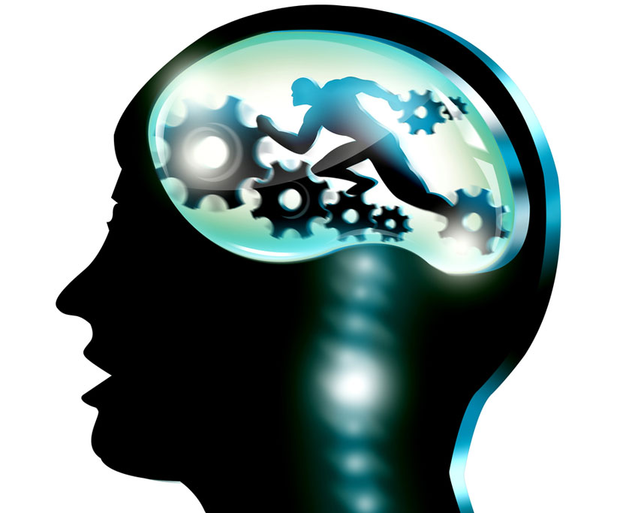
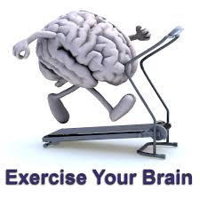
Other Approaches:

Slide 40
Physical Activity and Cognitive Achievement
As a consequence of Piaget’s claim a large band of research has explored Physical activity and Cognitive Achievement.
Clarke (1958) – Review of studies – positive correlation between physical fitness and cognitive achievement.
Harris (1973) – No correlation between motor performance and academic achievement.

Slide 41
Physical Activity and Cognitive Achievement.
Thomas and Thomas (1999)
  No relationship between Academic Achievement and perceptual-motor development, athletic level and physical education attendance.
Anthony (1991)
  Review of studies – high correlation between exercise participation and intellectual and memory capability.

Slide 42
The findings that have looked at physical activity and cognitive achievement is mixed??
Why is this??

Slide 43
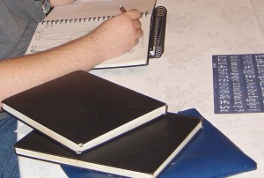

Do we need to be more specific about the cognitive task?
Weingarten (1973) – stated that fitness levels had a beneficial impact on performance in complex tasks.
  But no relationship regarding simple cognitive tasks.

Slide 44
What about the nature of the exercise?
Grubner (1975) –
Only exercise that involves co-ordinated movement AND thought and planning will enhance cognitive function
These movements and planning must be related to cognitive function.

Slide 45
Etnier et al (1997)
Considered one of the first comprehensive meta analytic review of studies exploring the relationship between exercise and cognition.
Meta Analysis = statistical technique for combining the findings from independent studies.
  Two or more studies.
  Often used in relation to health care interventions.
    May use published studies or non-published studies.

Slide 46
Etnier et al (1997)
Analysed 134 studies that have explored the impact of exercise and cognitive function.
These studies took a variety of approaches.
Findings: Overall: exercise exerts a small but significant effect on cognitive function.
  Studies that looked at chronic (longer term) exercise programmes = greater effect size than those that looked acute exercise (short bouts).

Slide 47
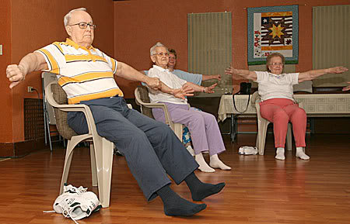
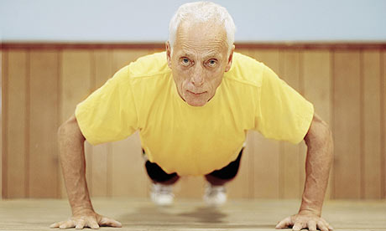
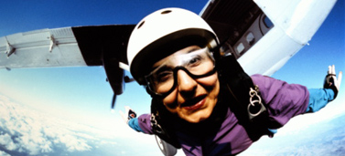
Exercise, Cognitive Development in the Elderly.

Slide 48
http://www.youtube.com/watch?v=5qMCyyM_AtE

Slide 49
Denny’s (1982, 1984) Model of Physical and Cognitive Aging.
Age related changes of physical and cognitive functioning follow a inverted U shaped curved.
Individual differences based on how people “excerise” these skills.
  Not just physical excerise but also mental exercises.
  Unexercised abilities will have a lower peak performance.

Slide 50
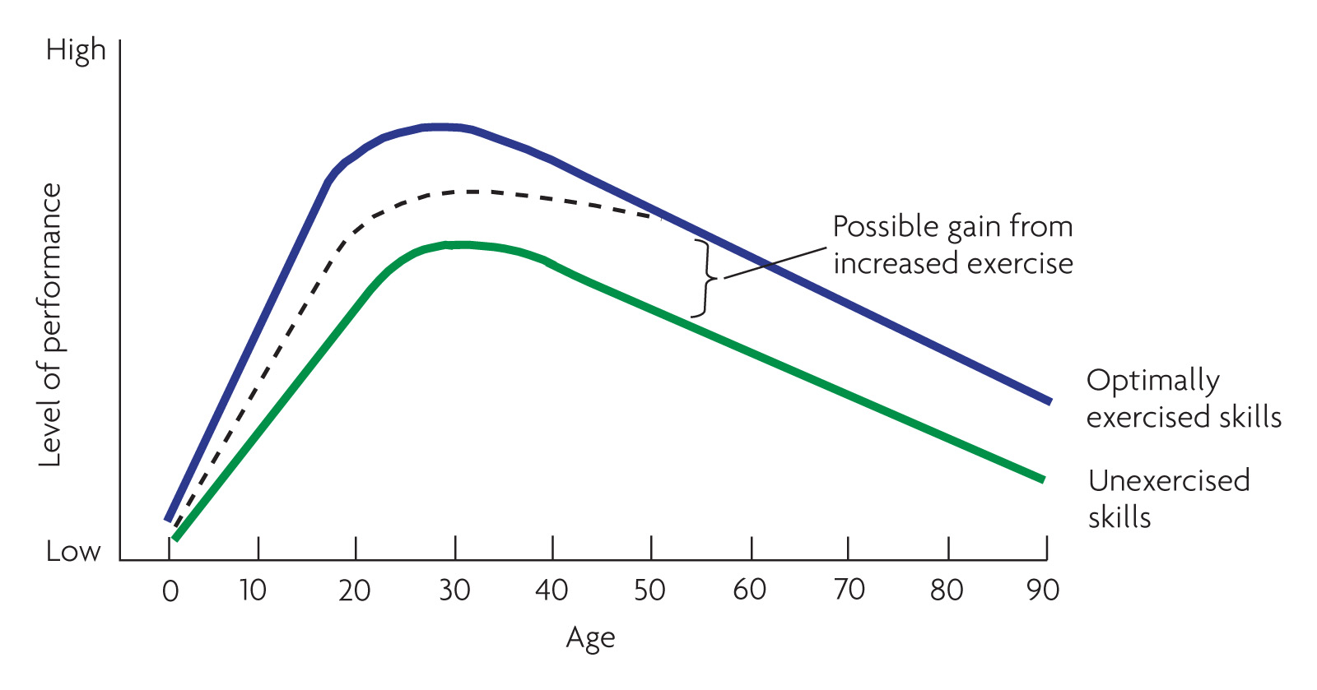
Denney’s Model of Physical and Cognitive Aging
(Denny 1982, 1984)
Notes:
Denny’s model suggests a basic decay curve and a fairly large gap between actual and level of performance on exercised and unexercised abilities

Slide 51
Research
Kramer et al (2002, 2003) observed that long term (over 6 months) training was associated with improved executive functioning in elderly participants (60-75 years).
  Planning
  Scheduling
  Working Memory
  Inhibition.

Slide 52
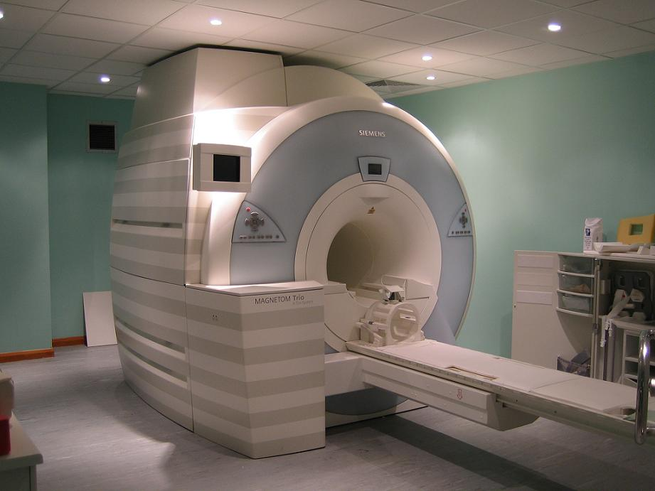
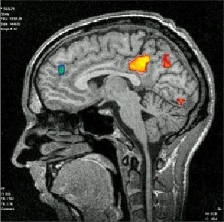
Evidence from Neuroscience
Colcombe et al (2004).
FMRI Study– Functional Magnetic Resonsance Imagining Study.
  Similar findings in terms of performance as Kramer et al’s (2002) findings.
  Brain activation influenced by task requirements.

Slide 53
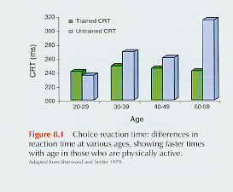
Cognitive Benefits

Slide 54
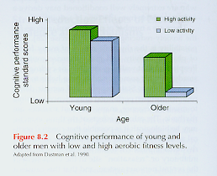
Cognitive Benefits

Slide 55
Exercise and Dementia Risk
Elwood et al (2013) – Cardiff University.
A study of 2,235 men aged 45-59 (Caerphilly) initially commenced in 1979.
  Battery of measures of lifestyle choices.
    Exercise / Physical activity participation
    Diet
    BMI
    Smoking behaviour.
    Cambridge Cognitive Examination
Follow up study – 2004 – On surviving members of initial group.
  Comparison of lifestyle questions
  Cambridge Cognitive Examination
  Medical Records.

Slide 56
Findings
People who engaged in 4 out of the following 5 behaviours in 1979 and stuck at it had a 60% reduced risk of developing dementia.
  Exercise regularly
  No Smoking
  Acceptable BMI
  Low Alcohol Intake (Weekly)
  Healthy Diet.
Those who had seemed to develop significant cognitive impairment in the years between 1979 and 2004 significantly more likely NOT to engage in healthy behaviours.
  Cognitive impairment = scored <83 on Cambridge test OR 10 points less than when measured in 1979.

Slide 57
Findings
Poor cognitive function at middle age was also a big predictor of dementia at old age.
  However, even omitting those people from findings the study showed the impact of exercise and healthy behaviours.
Important to note that despite numerous health promotion initiative in the surrounding area the likelihood of people who move from sedentary (unhealthy behaviours) lifestyle to active into old age was very small.
  Changing behaviour and exercise adherence a huge issues (Elwood et al 2013).

Slide 58
Norton et al (2014)
Meta Analysis study:
Physical Activity is the biggest predictor of dementia.
A third of all dementia COULD be attributed to poor lifestyle choices.
People who do moderate physical activity (such as walking) significantly reduce the links of dementia.
  20 mins a day, 3 days a week.

Slide 59
Lautenschlager et al (2008)
Older adults at “risk” for Alzheimer’s disease.
  Family history
  Cognitive test scores.
Home-based exercise intervention OR educational control intervention.
  6 months.
Adminstered the Alzheimer Disease Assessment Scale (ADAS) at 4 stages.
  Baseline (before intervention)
  Immediately following intervention (6 months after baseline)
  12 months following intervention.
  18 months following intervention.

Slide 60
Findings
Those in the exercise group had better ADAS scores immediately after exercise intervention than those in the control.
This was also reported, although the differences were smaller in the 12 months and 18 month period.
Still could be other confounding variables which might impact on the findings.

Slide 61
More Studies in this field
Adlard et al (2005) study of lab rats:
Demonstrated that five months of exercise decrease amyloid plaques in frontal cortex and hippocampus. Rats also showed enhanced rate of learning on the Morris water maze.

Slide 62
Remembering Erikson et al 2010
Erikson et al (2010).
Randomised Controlled Study of 120 older adults.
1 Group -moderate intensity aerobic exercise 3 days/week pr stretching and toning exercises for one year
MRI pre and post –
Aerobic exercise increased anterior hippocampal volume by 2% after one year leading to improve memory

Slide 63
EXERCISE, Cognitive Function and COPD.

Slide 64
Chronic Obstructive Pulmonary Disease (COPD)
Umbrella term for a number of chronic illness that result in the obstruction of the pulmonary artery or lung.
Chronic and terminal disease – it can never be cured, although medical treatment has made major inroads in quality of life.
  Chronic Bronchitis
  Emphysema
  NOT ASTHMA

Slide 65
Symptoms
Dyspnea (laboured breathing)
Increased risk of infections.
Heightened feelings of insecurity and panic attacks.
  Imagine the feeling that you just get enough oxygen into your body.
Declines in cognitive function – consequence of less oxygenated blood traveling to brain.
  Memory
  Abstract thinking
  Reactions

Slide 66
COPD
Major applied research initiative into exploring the effects of exercise intervention in this field.
Almost universal support into the positive impact of exercise in reducing the physical decline associated with COPD.
What about in relation to cognitive decline?

Slide 67
Emery et al (1998)
Randomised controlled experiment with older COPD participants.
Group 1 (29 participants) – 10 weeks of exercise programme (pulmonary rehab centre) with education and stress management programme.
Group 2 (25 participants) – education and stress management programme alone
Group 3 (25 participants) – waiting list control – not having any intervention.

Slide 68
Emery et al (1998)
Findings
Verbal fluency scores improved for the exercise group compared to the 2 others groups.
However, no significant change between groups 1 and 2 in relation to attention and motor speed.
Preliminary, but limited evidence of exercise-cognition relationship in COPD.

Slide 69
COPD and Acute Exercise
Emery et al (2001)
Short term after-effects of acute aerobic exercise on COPD suffers with aged match (non COPD patient) controls.
Twenty minutes of cycling.
Enhance verbal fluency of those with COPD but no effect on healthy controls.
COPD suffers may be especially sensitive to the benefits of long term and short term exercise.

Slide 70
Emery et al (2003)
28 participants – initially given a 10 week rehabilitation (exercise) programme.
Battery of cognitive tests taken at three different periods.
    Verbal fluency test
    Digit symbol of the Weschler scale (sequencing, implicit memory)
    Trail making test – mental sets (flexbility) as aswell as sequencing.
Baseline, immediately after programme, 1 year programme had stopped.
  Immediately after improvement in all 3 tests.
1 year on interesting –
  Only those that had maintained their exercise activity continued to make gains.

Slide 71
Lecture Conclusion
As research becomes more apparent our understanding on the impact of exercise (and the type of exercise) has on cognitive functioning is becoming clearer.
However caution with some of the findings?
Age of sample, type of exercise and what aspect of cognitive function needs to be clearer.

Slide 72
Lecture Conclusion
We are still a long way to fully understand the workings of the brain, researchers are in a position to begin to infer findings…. However there must still be caution.
Still major issues between the relationship of the environment, exercise and cognitive function.
  What about the social side of exercise?
    How our social environment can shape our cognitive and neural development.

Slide 73
References (not on Moodle)
Mitchell, J. B., Flynn, M. G., Goldfarb, A. H., Ben-Ezra, V., & Copmann, T. L. (1990). The effect of training on the norepinephrine response at rest and during exercise in 5 degrees and 20 degrees C environments. The Journal of Sports Medicine and Physical Fitness, 30(3), 235-240.
Piaget, J. (1936). Origins of intelligence in the child. London: Routledge & Kegan Paul.

Slide 74
Kephart, N. C. (1960). The slow learner in the classroom. Columbus, C. E. Merrill Books.
Jørgensen, L. G., Perko, G., & Secher, N. H. (1992). Regional cerebral artery mean flow velocity and blood flow during dynamic exercise in humans. Journal of applied physiology, 73(5), 1825.
Jacobs, L. A., Klopp, E. H., Seamone, W., Topaz, S. R., & Gott, V. L. (1969). Improved organ function during cardiac bypass with a roller pump modified to deliver pulsatile flow. The Journal of thoracic and cardiovascular surgery, 58(5), 703.

Slide 75
Clarke, H. H. (1958). Physical Fitness Benefits: A summary of research. Education 78: 460-466.
Hams.D.V. (1973) Involvement in Sport: A Somatophysic Rationale for Physical Activity. Philadelphia: Lea and Febiger.
Thomas, K.T. and Thomas, J.R. (1999). What squirrels in the trees predict about expert athletes. International Journal of Sport Psychology, 30, 221–234.

Slide 76
Anthony, J. (1991). Psychologic aspects of exercise. Clinics in sports medicine, 10(1), 171-180.
Weingarten, G. (1973). Mental performance during physical exertion: The benefit of being physically fit. International Journal of Sport Psychology, 4(1), 16-26.

Slide 77
Denny, N.W. (1982). Aging and cognitive changes. In B.B. Wohlman (Ed.), Handbook of Developmental Psychology (pp.807-827). Englewood Cliffs, NJ: Prentice-Hall.
Denny, N. W. (1984). A model of cognitive development across the life span. Developmental Review, 4(2), 171-191.

Slide 78
Sherwood, D. E., & Selder, D. J. (1978). Cardiorespiratory health, reaction time and aging. Medicine and science in sports, 11(2), 186-189.

