Slide 1

Developing relationships and workplace achievement
Student: Radu Andreescu 2026729
Lecturer: Sujeewa Herath
Module: BMSW5102
This Photo by Unknown Author is licensed under CC BY

Slide 2

Content
Slide 3 ……….Introduction
Slide 4 ……….What is motivation?
Slide 5 ……….Types of motivation
Slide 6 ……….Differences
Slide 7 ……….My motivation
Slide 8 ……….Advantages of motivation
Slide 9 ……….Conclusion
Slide 10 ……...References

Slide 3
Introduction
“Find a job you enjoy, and you will never have to work a day in your life”
Motivation is a 2 faced coin that brings benefit for business or organization as well an important factor for employees well-being. (Van den Broeck at all., 2021)

Slide 4

Motivation
Willingness to do something or something that cause that willingness according to Cambridge dictionary.
At workplace motivation it is the energy that maintain behaviors performance oriented.
Employees are considered as motivated when they have a behavior or a course of action usually regarding
company goals that comes together with a desired reward, reward that is to their like for their needs and wants.
Motivation it is a characteristic needed to make employees feel good at their job and to have a good performance
at their workplace (Ganta, 2014)

Slide 5

Types of motivation
Extrinsic motivation | Intrinsic motivation
Earned by employees reaching goals and achievements, meted out by employer. Salary increase Bonuses New benefits Promotions Punishments Withholding payments Criticism | It is motivation embedded in the process of work Comes along with enthusiasm Challenge Fun Belonging to a team Experiencing new things

Slide 6
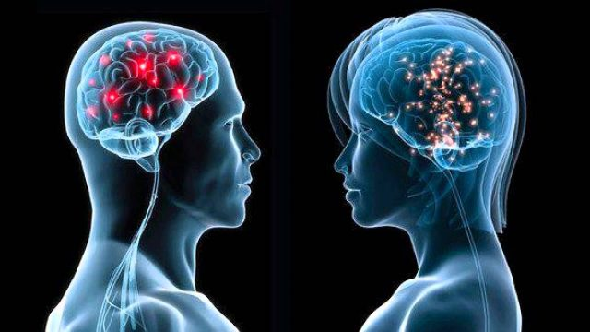
Key differences
Intrinsic motivation is:
internal type of motivation
Self centered
Employee encounter pleasure and satisfaction taking part on activities (Mahmood and Sarwar, 2020)
Extrinsic motivation is:
External type of motivation
Good achievements and reaching goals are encouraged with bonuses and rewards
The motivation do not come from activity itself , it is associated with an extrinsic consequence. (Gagne and Deci, 2005)

Slide 7

My motivation
I am protagonist (ENFJ-A/ANFJ-T) ENFJs
Always motivated by improving others life, higher goals,
Achievement and challenge are highly motivating me
Idealistic, Over empathetic.
All those motivations are intrinsic motivation
Yet balance is important and I keep an eye on Extrinsic motivation at workplace. I know the value of my work and extrinsic motivation is the sign that the value is acknowledged.
I consider criticism as a positive extrinsic motivation
This Photo by Unknown Author is licensed under CC BY
Notes:
Highest types of motivation for me are Achievement, Creativity, Altruism, Inspiration, Responsibility, Learning, Power, Customer Orientation.

Slide 8

Advantages/Disadvantages of motivation types
 | Advantages | Disadvantages
Intrinsic Motivation | Very effective in jobs with complex nature like creative, innovative, performance is boosted by this type of motivation. Engagement booster. Learning is more effective Persistence in acquiring the goals. | Can assume immoral dimensions like lust for power, hate, vengeance. (Frey and Osterloch,2001) It is not self-sufficient at workplace. People can ignore standards.
Extrinsic Motivation | Increase productivity Can create an atmosphere of chasing goals Can serve to discipline emotions | Makes learning process slower and diminishes the will to learn as workers focus on rewards. Do not create passion in work activity
Notes:
Extrinsic motivation also stimulates employees focus on their tasks. Help employees reach their tasks

Slide 9
Conclusions
Motivation it is an important factor at workplace and is vital to generate performance
It is needed a balance in between types of motivation intrinsic and extrinsic to achieve the goals.
People are different and is important to identify the motivating factor (Makhijaa and Akbarb, 2019)
Communication between employee and organization is essential in finding the good mix of motivation where the needs of both sides are fulfilled and generates performance , specially in extrinsic motivation. (Turner A.,2017)

Slide 10
References
Frey, B.S. and Osterloh, M. eds., 2001. Successful management by motivation: Balancing intrinsic and extrinsic incentives. Springer Science & Business Media.
Gagné, M. and Deci, E.L., 2005. Self‐determination theory and work motivation. Journal of Organizational behaviour, 26(4), pp.331-362.
Ganta, V.C., 2014. Motivation in the workplace to improve the employee performance. International Journal of Engineering Technology, Management and Applied Sciences, 2(6), pp.221-230.
Mahmood, S. and Sarwar, M.A., 2020. Effects of Extrinsic and Intrinsic Factors on Employee Motivation.
Makhijaa, S. and Akbarb, W., 2019. Linking rewards and creative performance: Mediating role of intrinsic and extrinsic motivation and moderating role of rewards attractiveness. International Journal of Innovation, Creativity, and Change, 8(12), pp.36-51.
Sansone, C. and Harackiewicz, J.M. eds., 2000. Intrinsic and extrinsic motivation: The search for optimal motivation and performance. Elsevier.
Turner, A., 2017. How does intrinsic and extrinsic motivation drive performance culture in organizations?. Cogent Education, 4(1), p.1337543.
Van den Broeck, A., Howard, J.L., Van Vaerenbergh, Y., Leroy, H. and Gagné, M., 2021. Beyond intrinsic and extrinsic motivation: A meta-analysis on self-determination theory’s multidimensional conceptualization of work motivation. Organizational Psychology Review, 11(3), pp.240-273.

