Slide 1
Effective Team Working
Presentation by
Samantha Jones
2010718

Slide 2
Aim and Objectives
Aim
To provide an insight on why working as a team can be effective.
Objectives
The differences between working as a team compared to working as a group
Factors that contribute to why team working is successful.

Slide 3
Presentation Plan
Slide | Content
1 | Effective Team Working
2 | Introduction: Aims and Objectives
3 | Presentation Plan
4 | Presentation Feedback
5 | Successful attributes of teamwork
6 | Negative attributes of teamwork
7 | Teamwork vs Group
8 | Differences of teamwork and working as part of a team
9 | Belbin team roles
10 | Conclusion
11 | References
12

Slide 4
Presentation Feedback
Presentation Evaluation Sheet
Module: BMSK4002 Part 1: Effective Team Working
Date | Name of Presenter:
 | Feedback
 | Weak | Fair | Good | Excellent
Prepared for Presentation
Presented in an interesting way
Objectives of the presentation are clear
Used visual aids effectively
Organised the presentation logically
Spoke loudly enough
Spoke slowly and clearly
Presented within appropriate time
Responded to questions accurately
What can I do better next time? | What went well?

Slide 5
Successful attributes of teamwork
Blends complementary strengths
Splits difficult tasks into simpler ones
More ideas brought forward
Promotes strong working relationships
Increased support

Slide 6
Negative attributes of teamwork
Unclear roles
Lack of communication
Free riders
Personality clashes
Blame and responsibility issues

Slide 7
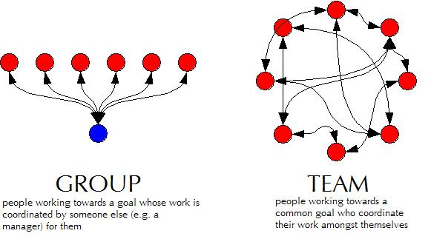
Teamwork vs Group

Slide 8
The differences of teamwork and working as part of a group
Working as a group:
Has a leader
A group may work together however their end goal focuses on one's own outcome
Individual work
Discusses, decides, and delegates
Working as a team:
Shared leadership role
Everyone is aiming for the same end goal and will support and help each other along the way
Collective work
Discusses, decides and then works together

Slide 9
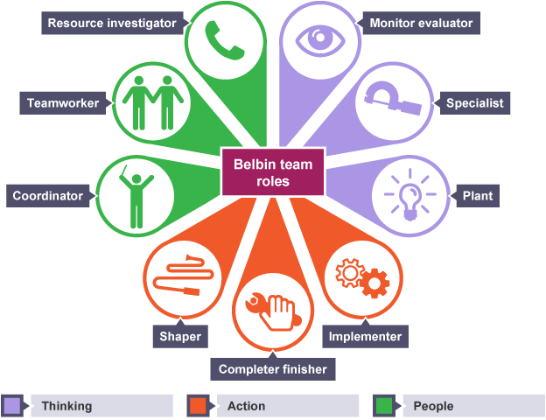
Belbin Team Roles
There are the 9 Belbin team roles, as shown they are split in to 3 categories, thinking, action and people.
Each category would have different people for the roles as everyone has different strengths and weaknesses, therefore using these categories to determine each persons’ role will give the best team working results.

Slide 10
Conclusion
My conclusion on working as a team is that done the correct way it is very successful, with communication and people being put in the correct roles such as categories that the Belbin theory demonstrates, it makes teamworking a very strong model. Everyone has different strengths and weaknesses, so this really does make team working better overall.

Slide 11
References
Nguyen, M. (2017) Learn Belbin team roles by reflection
Available at: Learn Belbin Team Roles through Reflection – {Dotnet}.Share(knowledge) (wordpress.com)
(Accessed: 19 May 2021).
Ribeiro, S. (2020) ‘Workplace Collaboration: Team vs Group’ Flock Talk [blog]. 1 May. Available at: https://blog.flock.com/workplace-collaboration-teams-vs-groups
(Accessed: 19 May 2021).

