Slide 1

AUDIT of Holiday Inn
BA International Hotel Management
Management and Organisational Behaviour
M5X01924
Lecturer: Dr Olu Adegbite
Presented by: Stilyana Mincheva (1816276)

Slide 2
Introduction
The organizational audit can be described as an assessment that reflects the organization’s capacity in each area such as planning, marketing, revenue collection, and other events.
The audit is especially essential as it helps in attaining various corporate objectives and helps in mitigating risks which can stop businesses from gaining economic sustainability.
Notes:
In the report, the organizational audit report of Holiday Inn has been discussed along with its strategic report and current performance.

Slide 3
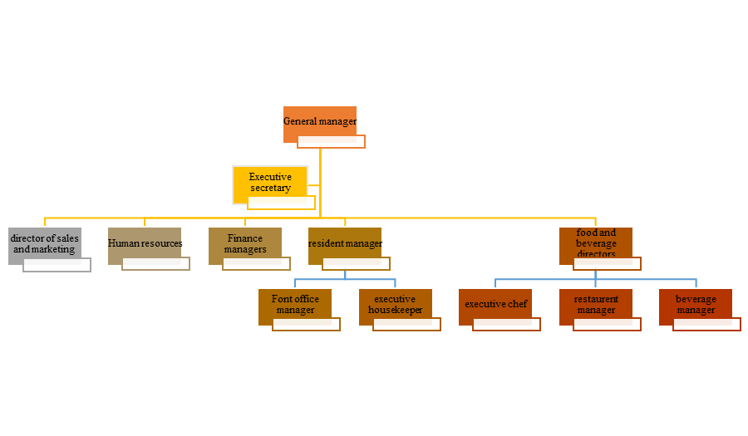
Organizational Structure, Culture, and Values
IHG UK follows the authentic functional organizational structure where each hotel has its general manager under which various departments such as HR, Finance, Food and beverage, and marketing department works (IHG, 2020).
The company has a diverse and inclusive culture in its workplace and concentrates on maintaining a culture based on its Code of Conduct which further influences them to aim higher and do the right thing.
IHG’s value is to do business in the right way while maintaining transparency in the business and value the safety of the guests (Camelia et al. 2019).
Notes:
The company also maintains a culture where every colleague feels included, respected as well as valued. Moreover, IHG has employed a team of global risk specialists who monitor as well as coordinate the safety and security of the guests as well as employees so that better culture can be created.

Slide 4
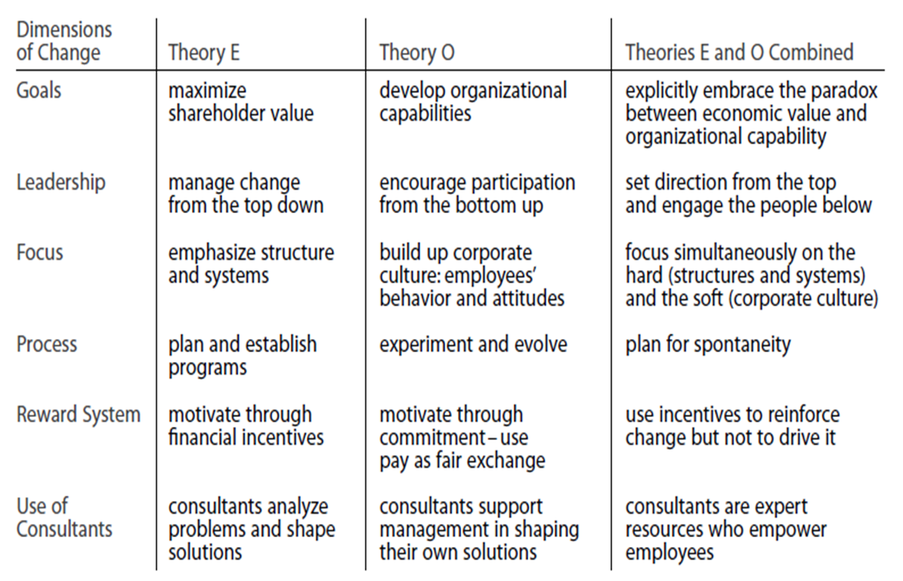
Recent Change Initiatives and Their Impact
Due to COVID-19, the world has witnessed a drastic change in the way hotels function and have increased their safety and security levels (Karim et al. 2020).
IHG has applied the Theory Of E and Theory of O combined based on which the company has created a paradox between economic value as well as organizational capacity and resources.
https://www.google.com/imgres?imgurl=x-raw-image%3A%2F%2F%2F593a01c4d6827206fcda225f951ddc319bdc69517009556bc3a5c6db1b696032&imgrefurl=https%3A%2F%2Fwww.iia.nl%2FSiteFiles%2FYung%2C%2520Jessie_Afstudeerscriptie%2520EIAP_ABS.pdf&tbnid=BnKC1sQBOll7_M&vet=12ahUKEwjnkLK5y7rqAhWVHLcAHaeADSQQMygTegUIARC4AQ..i&docid=oRPnlxUmDcVfZM&w=1101&h=615&q=theory%20of%20E%20and%20o&ved=2ahUKEwjnkLK5y7rqAhWVHLcAHaeADSQQMygTegUIARC4AQ
Notes:
IHG has used science-led protocols as well as service measures to enhance the way of cleaning. Moreover, IHG understands the roles and responsibilities that the company has towards the local communities and economies and is determined to be part of the process.

Slide 5
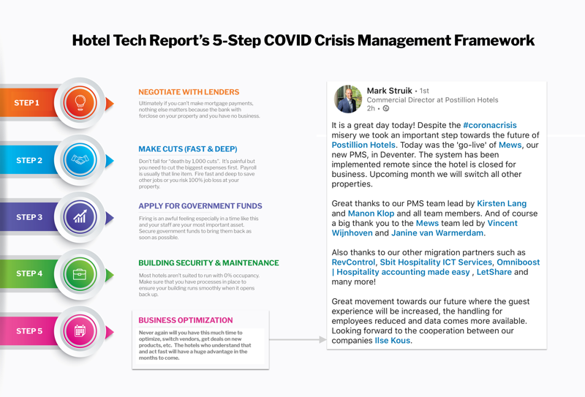
Recent Change Initiatives and Their Impact
The company has created resources in terms of safety and flexibility for the well-being of the guests while monitoring everyday work and having regular contact with the authorities of the UK government (Samsudin and Wahab, 2018).
The company has sheltered the homeless people of the UK based on government regulations and has provided 300 beds for which the government allocated which £236m (IHG, 2020).
The company has created ‘Book Now Pay Later’ options so that the guests do not have to deal with cancellation charges and initiated changes in the IHG Rewards Club loyalty program so that loyal customers can protect their status as well as points (IHG, 2020).
https://www.google.com/url?sa=i&url=https%3A%2F%2Fhoteltechreport.com%2Fnews%2Fcoronavirus&psig=AOvVaw3ZE2FzuGBhcsVddCZkF7id&ust=1594192409227000&source=images&cd=vfe&ved=0CAIQjRxqFwoTCLDJs9vLuuoCFQAAAAAdAAAAABAD
Notes:
In terms of cleanliness, the company has brought visible changes as in the reception area they have reduced contact at check-in and inspired to use touchless transactions. Moreover, deep cleaning with hospital-grade disinfectants has been introduced so that the guests can feel secure and have no complaints regarding the service of the company.

Slide 6
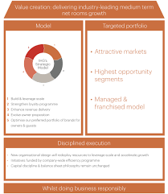
Strategic Direction and Current Business Performance
The company has its IHG strategic model that is based on factors such as are “Build and leverage scale, Strengthen loyalty program, Enhance revenue delivery, Evolve owner proposition and Optimise preferred portfolio of brands for owners & guests” which focuses on value creation and accelerate growth (IHG, 2020).
The company has managed to gain $4627m in total revenue and an operating profit of $630m due to its strategic direction (IHG, 2020).
https://www.google.com/imgres?imgurl=https%3A%2F%2Fwww.ihgplc.com%2F-%2Fmedia%2Fihg%2Fimages%2Fabout-us%2Fdia_winning_model.jpg%3Fla%3Den%26hash%3DB6D3202359EC33BFE7E258D7DBFFC3E5&imgrefurl=https%3A%2F%2Fwww.ihgplc.com%2Fen%2Fabout-us%2Four-strategy&tbnid=DsF1ZT58nOzYNM&vet=12ahUKEwjC287wy7rqAhUxSHwKHcDLDsAQMygAegUIARCjAQ..i&docid=3On3DiJeUkNa-M&w=2006&h=2316&q=ihg%20strategic%20report&ved=2ahUKEwjC287wy7rqAhUxSHwKHcDLDsAQMygAegUIARCjAQ
Notes:
Therefore, it can be said that in the increasingly competitive environment, IHG is well-paced due to its strategic model which helps them to grow their core business and in return achieve maximized return on new initiatives.

Slide 7
Recommendations
The company can include Performance management software to save time and improve the overall performance of the employees.
The management can create a feedback process that includes the working performance of the employees so that in terms of cleaning and managing guest's better performance can be provided.
Moreover, setting regular meetings with the management and employees to look after the COVID-19 situation and ensure the safety and care for the guests.
Notes:
Therefore, to improve and maintain the overall performance, it is required to create a strategy that can connect the organizational culture with employee performance and the current performance of IHG.

Slide 8
Conclusion
While concluding the report, it can be said that IHG has successfully gained the highest opportunities in the market.
The company has successfully invested in development resources which further help them to gain outstanding operating support to the owners.
It cannot be denied that structure is essential for the growth of the company and in IHG follows an authentic functional organizational structure which gives the effective oversight and provides them with strategic direction.
Moreover, the culture of the company ensures diversity as well as an inclusive culture.
Furthermore, their culture is to welcome and care about the guests. Their goal is to create memorable guests' experiences and to create thoughtful programs so that environment can be saved.
Notes:
However, due to COVID-19, the company is facing tremendous challenges for which they have upgraded their safety and security measures and invested money in their cleaning process.

Slide 9
Reference List
Belias, D., Mantas, C. and Tsiotas, D., (2019). The impact of corporate culture in the performance of the front desk employees—The case of five-star hotels in Greece. In Smart tourism as a driver for culture and sustainability (pp. 563-576). Springer, Cham.
Camelia, G., Ioana-Valentina-Alexandra, M. and Larisa-Andrea, N., (2019). Organizational Culture: A Case Study Of The Impact Of Ethical Organizational Culture On The Efficiency Of Accor Hotels. Romanian Economic and Business Review, 14(2), pp.86-96.
Elbanna, S., (2016). Managers' autonomy, strategic control, organizational politics and strategic planning effectiveness: An empirical investigation into missing links in the hotel sector. Tourism Management, 52, pp.210-220.
Gössling, S., Scott, D. and Hall, C.M., (2020). Pandemics, tourism and global change: a rapid assessment of COVID-19. Journal of Sustainable Tourism, pp.1-20.
Hancock, A. (2020). IHG warns coronavirus is hotels’ ‘most significant challenge. Accessed on: 11/7/2020. Available at: https://www.ft.com/content/2a470537-ab84-43b8-80b2-df088de2a72f
IHG, (2020). Our culture. Accessed on: 11/7/2020. Available at: https://www.ihgplc.com/responsible-business/our-culture
Karim, W., Haque, A., Anis, Z. and Ulfy, M.A., (2020). The movement control order (mco) for covid-19 crisis and its impact on tourism and hospitality sector in Malaysia. International Tourism and Hopitality Yournal, 3(2), pp.1-7.
Pawirosumarto, S., Sarjana, P.K. and Gunawan, R., (2017). The effect of work environment, leadership style, and organizational culture towards job satisfaction and its implication towards employee performance in Parador Hotels and Resorts, Indonesia. International Journal of Law and Management.
Samsudin, F. and Wahab, S.A., (2018). Sustainable Development in Franchising: Measuring the Impacts of Strategic Direction in Franchise Organization.

Slide 10
Thank you
Any question?

