Slide 1
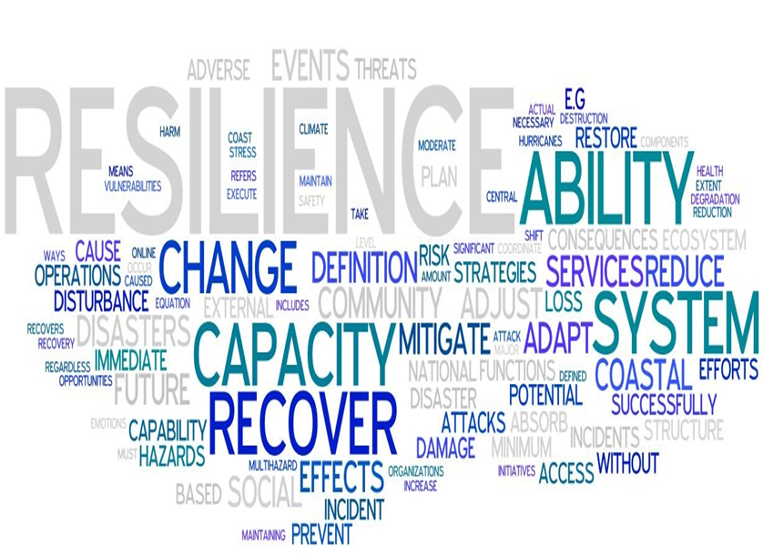
Supply Chain Vulnerability, Risk, Robustness and Resilience
Dr. Irina Neaga

Slide 2
Learning Objectives
Understand supply chain risk, vulnerability, resilience and robustness and their critical importance in logistics and supply chain management (SCM)
Provide and discuss working definitions for key concepts
Understand the resilience concept in logistics and supply chains and the related framework
Explain and discuss a resilient SC Solution: Case study- DHL Resilience360

Slide 3
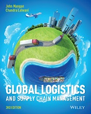
Risk
Probability or a measure of the range of possible outcomes from a single rational decision and their values, in terms of upside gains and downside losses
Particular type of hazard or threat
Down-side only consequences of a rational decision in terms of the resulting financial losses or number of casualties

Slide 4
Identifying Supply Chain Vulnerability
What has disrupted operations in the past?
What known weaknesses do we have?
What ‘near misses’ have we experienced?
What would be the effect of a shortage of a key material?
What would be the effect of the loss of our distribution site?
What would be the effect of the loss of a key supplier or customer?

Slide 5
The shortcomings of risk management
Decision Theory and Managerial Tendencies
  Managers focus on the possible losses associated with plausible outcomes
  Decisions involving risk are heavily influenced by their impact on the manager’s own performance targets
  There is unlikely to be a single unified attitude to risk taking within a large organisation

Slide 6
Objective Risk and Perceived
Risk
A view of risk set out by the engineers and physicists of The Royal Society:
  ‘Objective risk’: determined by experts applying quantitative scientific means
  ‘Perceived risk’: the imprecise and unreliable perceptions of ordinary people
  ‘Detriment’: the numerical measure of harm or loss associated with an adverse event

Slide 7
Objective Risk and Perceived Risk
Social scientists contend that, where people are involved, objective and perceived risk become inseparable
  Risk is not a discrete or objective phenomenon
  Risk is an interactive culturally determined one
  Risk is inherently resistant to objective measurement

Slide 8
Objective Risk and Perceived Risk
Engineering-derived ‘objective’ views lead to a business process engineering and control perspective
Open interactive societal systems views offer a persuasive argument for perceived risk
The global supply chain view illustrates that culturally determined perceptions of risk could vary greatly from one region to another
Hence the forces of nature can demonstrate just how far removed from a controlled environment this all might be

Slide 9
The Role of IT and Information Sharing

Slide 10
The need for holistic approaches
SCM is integrative and interdisciplinary
Logistics is just one of several established sub-disciplines
‘Wicked Problems’:
  Societal problems are inherently different from the problems that scientists and some engineers tackle
  Involve multiple stakeholders
  Any solution, after being implemented, will generate waves of consequences

Slide 11
Robust SCM
Robust SCM strategy enables a firm to manage regular fluctuations in demand efficiently under normal circumstances regardless of the occurrence of a major disruption

Slide 12

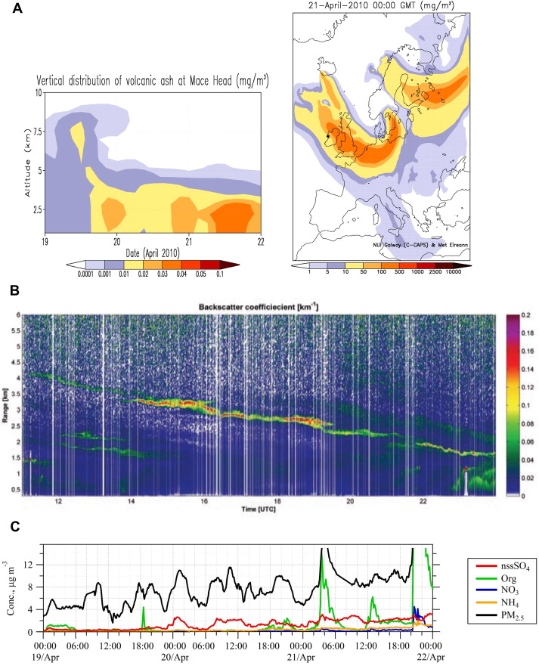
Case study
The Icelandic volcano Eyjafjallajökull ash cloud in April 2010.
Brought air operations to a stand still in Europe.
DHL's operations heavily disrupted.
They were able to show resilience through fast decision making and quick contingency plan
Delivered goods on day 1 of incident without financial losses.
Source (O'Dowd, et al., 2012).

Slide 13
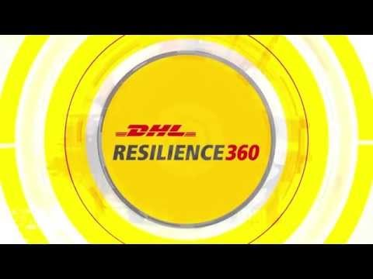
Resilience 360 Solution
robustness and
Notes:
https://youtu.be/I7e_Eg7hQnI

Slide 14
Resilience
The ability of a system to return to its original (or desired) state after being disrupted
Consideration of risk and resilience in SCM:
  Requires the whole system perspective
  Explicitly accepts that disturbances happen
  Implies adaptability to changing circumstances

Slide 15

Definition
"Supply Chain (SC) resilience addresses the SC's ability to cope with the consequences of unavoidable risk events in order to return to its original operations or moves to a new, more desirable state after being disturbed" (Christopher & Peck, 2005).

Slide 16
Changing times and an uncertain world
  Known Known
  Knowable Unknowns
  Unknowable Unknowns
  Creeping crises
Identify examples

Slide 17
Sources of external shocks to the supply chain
Technology shifts
Shortage of key supplies
Financial crises, corporate accounting problems, and fraud
Actions by upstream suppliers tarnishing image
Terrorism and other security threats
Protests, blockades, strikes
Bio-threats
Weather and other extreme events

Slide 18
Business Continuity Management
Rooted in IT disaster recovery, but its remit has expanded greatly
Helps to prove that management have acted with ‘due diligence’
Start with the preparation of a Business Continuity Plan (BCP)
Best practice:
  An on-going programme of training, rehearsals and reviews of the initial plans to cope with various eventualities
  Careful consideration to the management of an after-the-event recovery phase

Slide 19
VUCA Framework
From Volatility to Vision
From Uncertainty to Understanding
From Complexity to Clarity
From Ambiguity to Agility

Slide 20
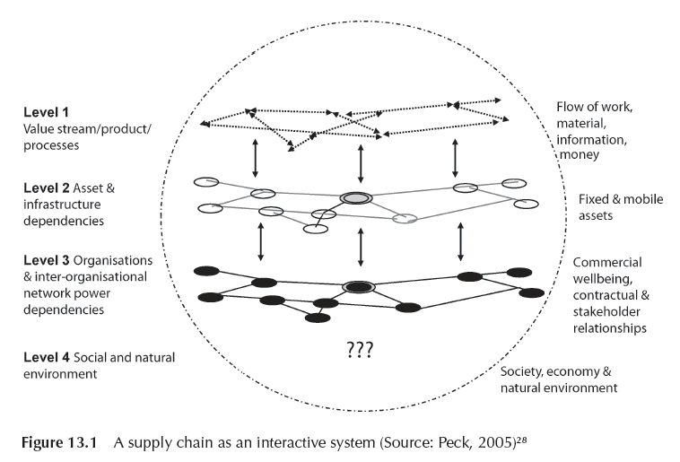
A supply chain as an interactive system
²⁸ Peck, H. (2006) Resilience in the Food Chain: A Study of Business Continuity in the Food and Drinks Industry, Department for Environment, Food and Rural Affairs, London.

Slide 21
A framework for a ‘wicked problem’
Supply chain can be broken down into its component parts and can be looked at each of the following levels to manage risk:
  Level 1 – process engineering and inventory management
  Level 2 – assets and infrastructure dependencies
  Level 3 – organisations and inter-organisational networks
  Level 4 – the macro-environment

Slide 22
Level 1 - Process Engineering and Inventory Management
Process engineering and inventory management focuses on what is being carried – work, cash, and information flows – and process design within and between organisations.
Risk management focuses on:
  Improved visibility
  Velocity
  Control

Slide 23
Level 2 – Assets and Infrastructure Dependencies
Assets and infrastructure dependencies consider the fixed and mobile assets used to source, produce or carry the goods and information flows.
Risk is defined in terms of Probability X Severity within a given timeframe.

Slide 24
Level 3 – Organisations and Inter-Organisational Networks
Organisations and inter-organisational networks consider supply chain risk from the strategic point of view
Risk is perceived as the financial consequences of an event or decision and the impact on budget or shareholders

Slide 25
Level 4 – The Macro-Environment
The Political, Economic, Social and Technological (PEST) analysis of environmental changes used in strategic management is considered at this level.

Slide 26





Key Measures of resilience
Visibility
Collaboration
Velocity
Efficiency
Notes:
To achieve resilience, a company needs to know what affects the resilience of a supply chain. We have identified four measures as being keys for achieving a resilient supply chain. Namely, Visibility, Collaboration, Velocity and Efficiency. This information has been gathered by analyzing journals and DHL resilience strategies. We were able to in turn connect them to the case of DHL.

Slide 27

Visibility
- See from one end of the pipeline to the other
- External: Suppliers and customers
- Internal: Clear lines of communication
- Higher visibility -> investment in better technologies
- Decide on level of investment for desired coverage
Notes:
The first key Measure, Visibility, means that one can see from one end of the pipeline to the other. The main purpose is to improve the company performance, also by supporting the decision making process. One can distinguish internal and external visibility. External visibility includes collaborating closely with suppliers and customers (upstream, downstream). For internal visibility, a company needs to set clear lines of communication within the company. For gaining higher visibility companies need to invest in better technologies which make it expensive. They have to decide on the desired coverage and therefore the level of investment.

Slide 28

Collaboration
- relationship between two or more suppliers working
together to a common goal
- improves speed, service levels, customer satisfaction
- Example: Cable Co -> survived financial crisis
- Day to day costs higher due to less bargaining power
Notes:
Collaboration in Supply chain resilience is the relationship to suppliers and how a company works with them to achieve a common goal. Collaboration can improve speed, service levels, and customer satisfaction as products can be tailored to the needs of the customer. An example of a case where collaboration helped a company to survive the financial crisis in 2009 is the company Cable Co. A customer collapsed and their market share price in turn fell by 35 %. Cable Co. collaborated with their supplier and agreed on lower raw material prices to survive. Collaborative supplier relationships are more resilient than basic relationships but it is at a cost.

Slide 29
Velocity
- speed of a supply chain to react to market changes
- achieved by clear visibility and knowledge of disruption
- Example: Icelandic volcano

Slide 30
Efficiency
- getting the right product to the right place at the right time
with minimum costs
- Maintaining the standard of performance

Slide 31

Conclusion
+ Companies are required to assess the importance and cost of maintaining resilience.
+ There is increased prospects by being more resilient than competitors.
+Adds a level of security to a company.
-The cost of being resilient can be high.

Slide 32
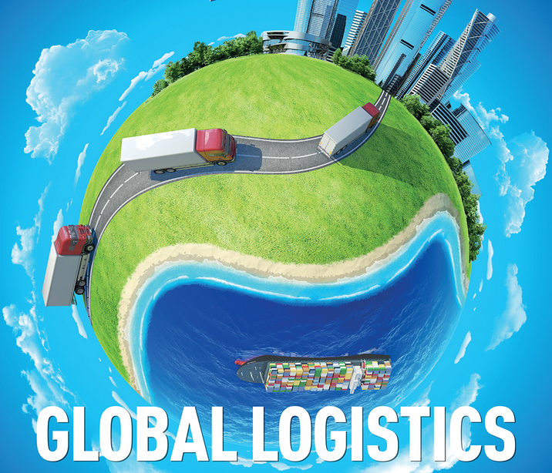
CHAPTER 13

Slide 33
Recommended Reading
lcantara, P., 2015. SUPPLY CHAIN RESILIENCE REPORT 2015, Caversham: Business Continuity Institute.
Ambulkar, S., Blackhurst, J. & Grawe, S., 2015. Firm's resilience to supply chain disruptions: Scale development and empirical examination. Journal of Operations Management, Volume 33-34, pp. 111-122.
Beckett, V., 2015. TalkTalk cyber-attack leaves 4m vulnerable.. Reactions, Volume 1, pp. 1-1.
Benavides, L., Eskinazis, V. D. & Swan, D., 2016. Six steps to successful supply chain collaboration. [Online]
Available at: http://www.supplychainquarterly.com/topics/Strategy/20120622-six-steps-to-successful-supply-chain-collaboration/
[Accessed 2 11 2016].
Choi, T.-M. & Sethi, S., 2010. Innovative quick response programs: A review. Production Economics, 127(1), pp. 1-12.
Christopher, M. & Peck, H., 2005. Building the resilient supply chain. The International Journal of Logistics Management, 15(2), pp. 1-13.
DHL, 2010. A high-performance network - even during a crisis. [Online]
Available at: https://www.dpdhl.com/en/media_relations/abonnements/financial_media_newsletter/background_q1_2010.html
[Accessed 21 10 2016].
DHL, 2014. Holistic View of Dupont Supply Chain Improves Resilience and Avoid Cost Customer Challenges . [Online]
Available at: http://www.dhl.com/content/dam/downloads/g0/logistics/resilience360/dupont_case_study_en.pdf
[Accessed 21 10 2016].
DHL, 2016. DHL Resilience360 – Managing Risks in Your Supply Chains. [Online]
Available at: http://www.dhl.co.uk/en/logistics/supply_chain_solutions/what_we_do/resilience_360.html#riskandresiliencyassessment
[Accessed 7 10 2016].
Click Gibson, B. J., Hanna, J. B., Defee, C. C. & Haozhe, C., 2014. Definitive Guide to Integrated Supply Chain Management, The: Optimize the Interaction between Supply Chain Processes, Tools, and Technologies. Upper Saddle River: Pearson Education.
Guilati, R., 2010. Reorganize for resilience: Putting customers at the center of your business. Boston: Harvard Business Review Press.
Juttner, U. & Maklan, S., 2011. Supply chain resilience in the global financial crisis: an empirical study. Supply Chain Management: An International Journal, 16(4), pp. 246 - 259.
Klibi, W. & Martel, A., 2012. Scenario-based Supply Chain Network risk modeling. European Journal of Operational Research, 223 (3), p. 644–658.
Mangan, J., Lalwani, C. & Butcher, T., 2008, 2012 . Global Logistics and Supply Chain Management. Chichester: John Wiley & Sons Ltd.
Mohammaddusta, F. et al., 2015. Developing lean and responsive supply chains: A robust model for alternative risk mitigation strategies in supply chain designs. International Journal of Production Economics.
O'Dowd, C. et al., 2012. Volcanic ash over Europe during the eruption of Eyjafjallajöekull on Iceland, April-May 2010. Atmospheric Environment, Volume 48, pp. 143-151.
Press, T. C., 2010. SAS says losses narrow in Q1, ash cloud disruptions to cost $64 million. [Online]
Available at: Business Source Corporate Plus.
[Accessed 27 10 2016].
Svensson, G., 2002. A conceptual framework of vulnerability in firms’ inbound and outbound logistics flows.. International Journal of Physical Distribution & Logistics Management, Volume 32, pp. 110-134.
Thomas, K., 2012. Supply Chain Nation. [Online]
Available at: http://blog.jda.com/jda-software-supply-chain-velocity-how-to-get-there/
[Accessed october 2016].
Wang, E. T. G. & Wei, H.-L., 2007. International Governance Value Creation: Coordinating for Information Visibility and Flexibility in Supply Chains. Decision Sciences, 38(4), pp. 647-674.
Ward, J., 2016. Supply Chain Risk Management Report 2016 DHL Resilience 360, Bonn: Deutch Post AG.
WEF, 2013. Building Resilience in Supply Chain, Geneva: World Economic Forum.

Slide 34
Discussion Topics [in the tutorial]
Why a robust SC is not necessarily a resilient SC?
What is the role of information technology systems to support SC resilience?
Identify examples or case studies

Slide 35

Thank you!
Any questions?

