Slide 1
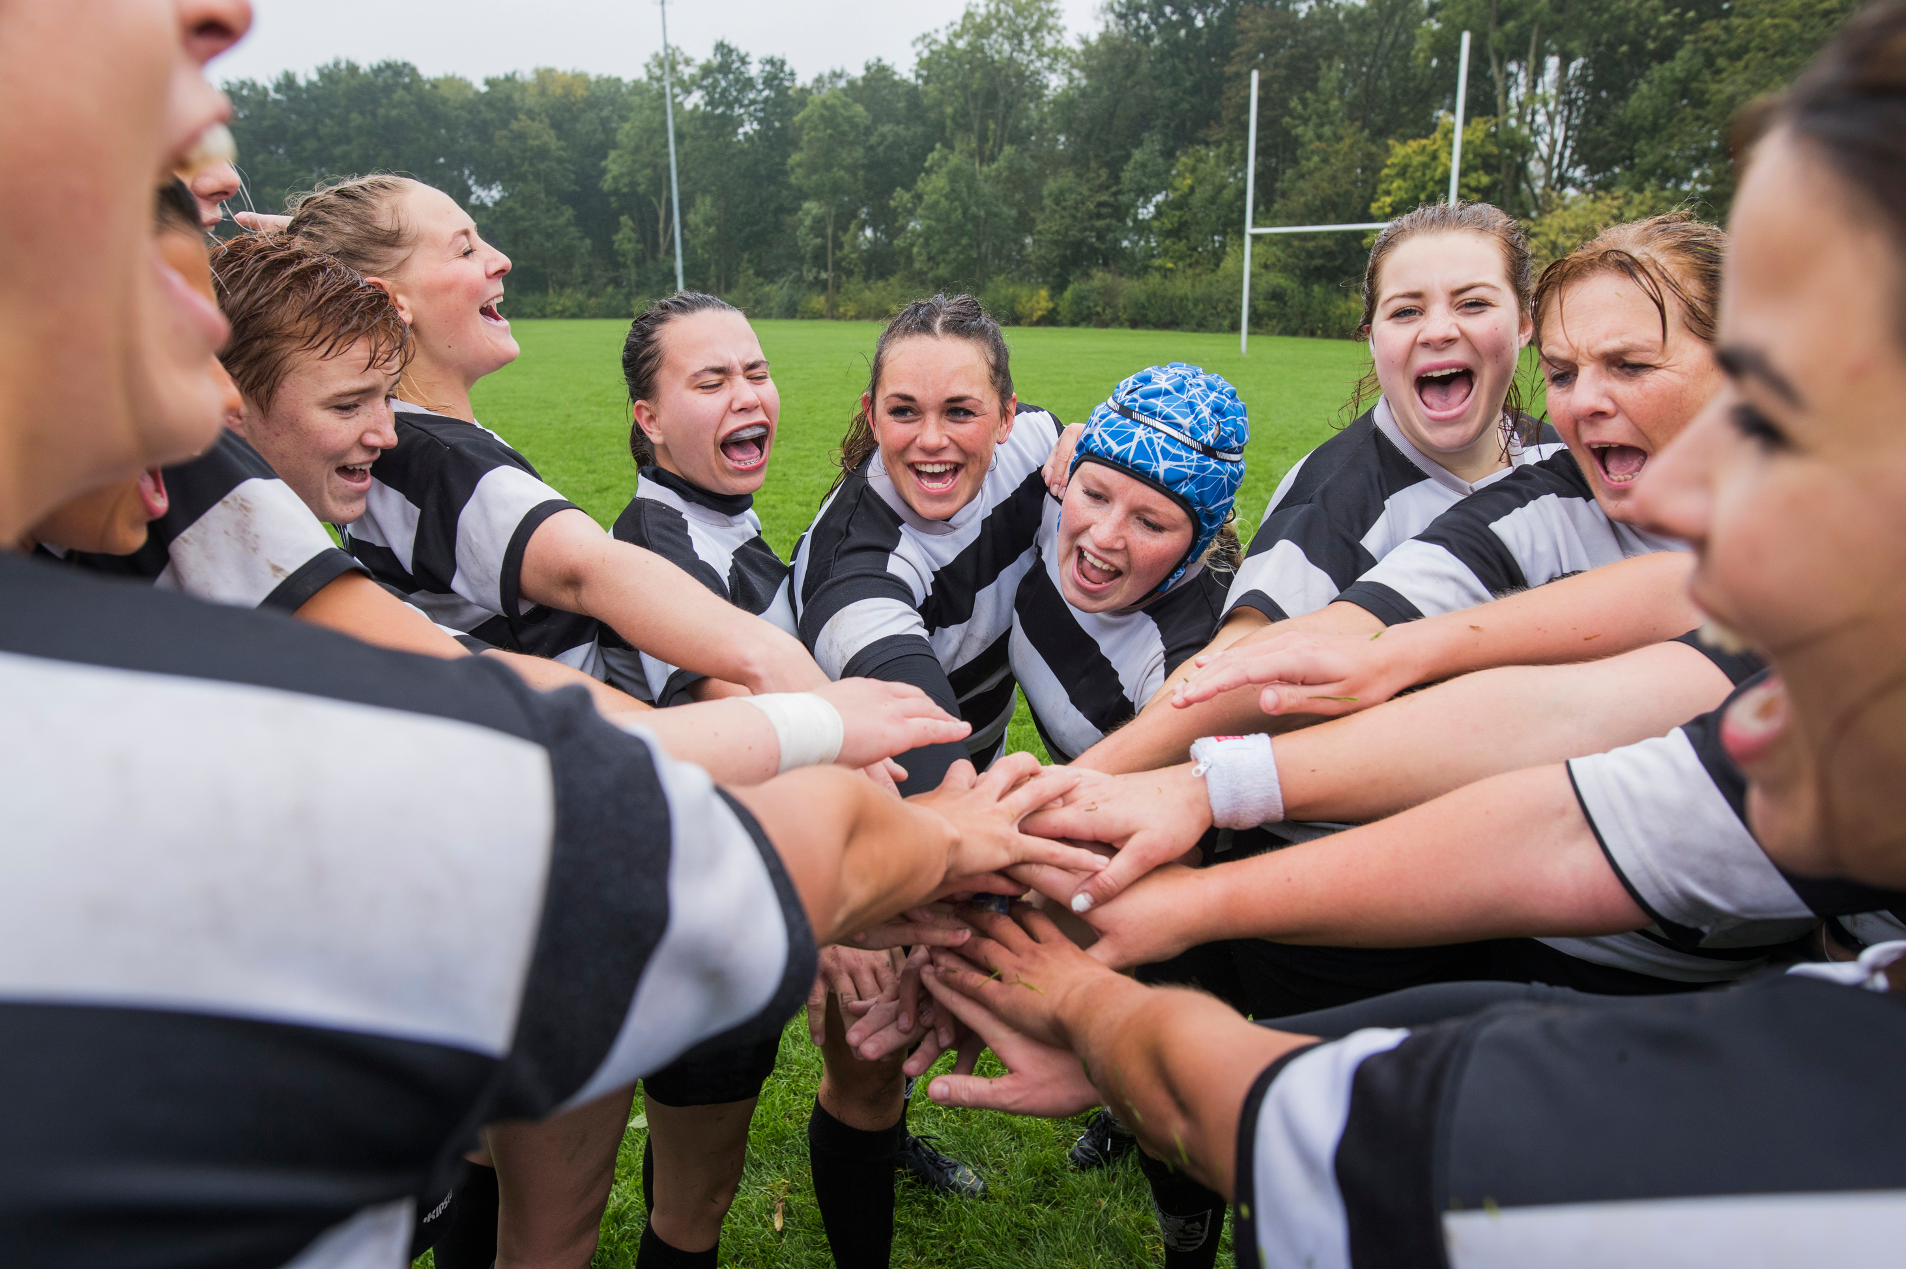
Working in teams (Teamwork)
Name: Dornequa Fleming
Student Number:2440155
Module Code:4009
Module Name: Professional Development within Health and Social
Letuer Name: Besty Jose

Slide 2


Introduction
Working in Teams
Working together with a group of people to achieve a common goal. Teamwork is sometimes an important feature of a business because it is often required for colleagues to work successfully together, giving their all in any situation. People will strive to cooperate, using their own skills and delivering constructive comments, notwithstanding any personal dispute between individuals ( Monash University, ND).
I have chosen working in teams as my chosen skill because working in health and social care, workers must work closely with others every day to provide safe and effective care. Teamwork helps professionals share ideas, support each other, solve problems faster, and ensure patients receive the best possible care. Good teamwork also improves communication in health and social care settings, with strong teamwork over time can improve patient safety , reduce mistakes, and help workers manage stressful situations more effectively.

Slide 3

Key skills
Adult nursing is the chosen role and working in teams (teamwork) is an important skill needed when working as a nurse especially in a health industry, where nurses tends to work with different health professionals to provide safe, effective, and person-centred care. Adult nurse regularly work alongside doctors, healthcare assistance , physiotherapist, pharmacies, and social workers to meet a patient’s physical, emotional, and social needs.

Slide 4
Importance of that skill
Advantages/Benefits
Sharing od ideas and creativity
Different skills and experiences combined
Workload is shared among members
Tasks completed faster and more efficiently
Better problem solving
Increase Productivity
Builds trust and good relationships
Improves Communication skills
Makes difficult tasks easier to handle
Promotes Unity and teamwork spirit
Disadvantages/Barriers
Difficulty in making decisions
Misunderstanding of roles and responsibilities
Competition instead of Cooperation
Group pressure that may limit individual creativity
Delays caused by lack of coordination
Leadership problems or poor management
Poor communication among team members
Conflicts and disagreements within groups
Resistance to new ideas or changes
Unequal participation or laziness by some members

Slide 5
Practical Example
Working in teams is an essential skill needed for working as an adult nurse therefore I will give a scenario how working in teams can be used in adult nursing.
An adult nurse is caring for a patient whose condition suddenly becomes worse. The nurse works together with doctors, other nurses, and healthcare assistants to provide quick treatment and monitor the patient closely. Through teamwork and good communication, this patient receives safe and effective care.

Slide 6
Applying Tuckman’s Model to working in teams
Tuckman’s model is a theory develop by Bruce Tuckman (1965) that explains how teams develop and become effective over time.
Forming- Team members meet and learn.
Storming- Differences or disagreements may occur and need to be resolved.
Norming- Team members build trust and work well together.
Performing- The team works effectively to provide high-quality patient care.
Adjourning- The team reflects build trust and work well together.
Applying to Adult Nursing
Tuckman’s model helps nurses understand how teams develop. Effective teamwork improves communication, patient safety, and the quality of care provided to patients.

Slide 7
Reflection
Working in a team has taught me the importance of communication, cooperation, and respect for other’s ideas. I learned that teamwork helps people achieve goals more effectively because responsibilities are shared among members. During group activities, I developed better listening and problem-solving skills by working with people who had different opinions and experience.
I also realized that teamwork can sometimes be challenging due to misunderstandings or different working styles. However, these challenges helped me improve my patience, adaptability, and conflict-resolution skills.
As I look at working in teams as an adult nurse it is an essential skill needed when working with many professionals in different fields, where you work closely with doctors, healthcare assistance, physiotherapist and other professionals who provide safe and effective patient care. Reflecting on teamwork has helped me understand the value od supporting others and understanding the value of supporting others and contributing positively to a team environment.

Slide 8

Conclusion
In conclusion, teamwork is important because it promotes creativity, improves productivity, strengthens communication, and helps people achieve common goals successfully.

Slide 9
References
Monash University (2023) Teamwork. Available at: https://www.monash.edu/business/marketing/marketing-dictionary/t/teamwork (Accessed: 23rd May 2026).

