Slide 1
The Jews in the Modern World
The Origins of Anti-Semitism

Slide 2
Definition of Terms
Anti-Judaism: opposition to the Jewish religion
Anti-Semitism: hatred of the Jews in a racial sense.
Holocaust: it stems from the Greek translation of the Hebrew word olah (burnt offering) – to appease a wrathful God?
Shoah: the Hebrew word for destruction (desolation and doubt).

Slide 3
Key Issues and Topics in the 21st century
Attitude to the state of Israel.
Relationship with the Palestinians and their Jewish neighbours.
Rise of anti-Semitism across Europe and America.

Slide 4
Historical Origins
Jesus and his Jewish movements: his Jewish followers believed that he was the Messiah (30-33 CE).
One Jewish group among others: Sadducees, Pharisees, Zealots, Essenes.
Consequences of the destruction of the Temple in Jerusalem in 70 CE.
The work of the apostle Paul – spread of Christianity through the Roman Empire

Slide 5
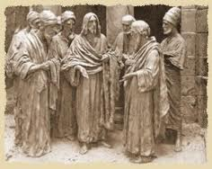
Developments around 70 CE
Pharisees – reconstruction in the form of rabbinic Judaism; the descendants of Moses and Ezra. They are the main opponents of Jesus according to the Gospels, but they have much in common:
The coming of the Messiah
Angels
Life after death
Resurrection of the dead
Day of Judgement (Eschatology)
How reliable is the presentation of the Pharisees in the four Gospels? Tendency to generalize and to offer stereotypes, depicting them in complete opposition to Jesus (negative impact on later relations between Jews and Christians).

Slide 6
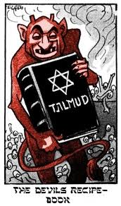
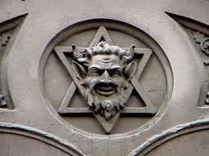
John’s Gospel and “the Jews”
‘You are the children of your father, the devil, and you seek to fulfil the wishes of your father. He was a murderer from the beginning; he does not stand in the truth for there is no truth in him’ (John 8:44).

Slide 7
Accusations against the Jews
So when Pilate saw that he could do nothing, but rather that a riot was beginning, he took some water and washed his hands before the crowd, saying “I am innocent of this man’s blood…”. Then the people as a whole answered, “His blood be on us and on our children!”’ (Matthew 27:24-25).

Slide 8
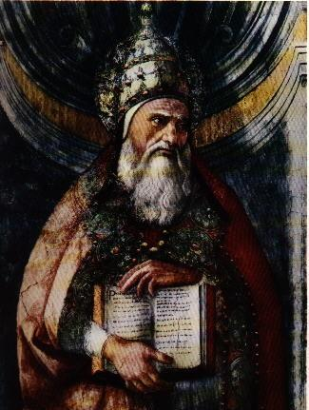
Breaking the Link?
The heretic Marcion (90-155 CE) sought to remove every passage from the Christian Bible that had ‘Jewish elements’.
Rejection of the Hebrew Bible
Wrathful God of the old covenant
Loving God of the new covenant

Slide 9
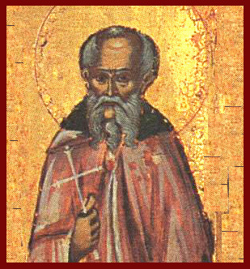
The Church Fathers (3rd – 5th centuries ce)
Sermons against the Jews:
Jews did not understand that the purpose of the OT was to prepare the way for the coming of Christ (Jerome)
The Jews were responsible for ‘deicide’ when they crucified Jesus (Melito of Sardis)
The Jews are the children of Cain and they are dispersed as divine punishment for their sins – ‘the wandering Jew’ (Augustine)
Jewish homes are the dwelling-places of thieves and murderers (John Chrysostom).

Slide 10
The Spread of Christianity
By 380 CE Christianity had been established as the official religion of the Roman Empire (4th century) under the leadership of the Emperor Constantine (285-337 CE).
Building of ca. 500 churches in places of importance during Jesus’ life (increase in pilgrimages).
No immediate Jewish response to Christianity (but see Toledot Yeshu).

Slide 11
Persecution of the Jews in 5th century ce
Restriction on the rights of Jews: Theodosian Code (438 CE). They were not allowed:
To have Christian slaves
To engage in missionary activities
To hold public office in the government
To be in the military
To build new synagogues
Judaism remains a religio licita: freedom to worship according to Jewish laws and customs.
Protection of the Jews until the second coming of Jesus as witnesses to the truth of the Gospel that they rejected.

Slide 12
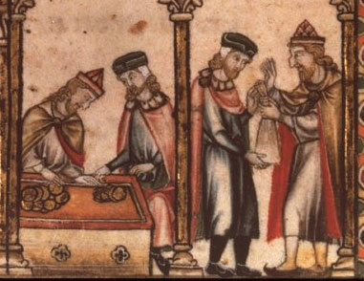
The Middle Ages
Christians now present a more united front (10th-16th centuries).
Jews were ‘the other group’; they were expelled from many parts of Europe (including England in 1290 CE).
Deterioration in attitudes towards the Jews: prohibition by local authorities; closing of synagogues; enforced baptism; burning of the Talmud.
Image of Jewish money-changers (France): pointed hat and circle of red/yellow material on garments.

Slide 13
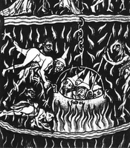
Accusations against the Jews:
Demonic Origins
Links with the Antichrist
Demonic and Satanic associations:
Burning in hell
Emphasis on Jews as ‘the children of Satan’ (cf. John 8:44).

Slide 14
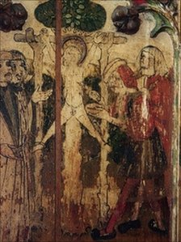
Accusations against the Jews:
Ritual Murder
Rumours that Jews were murdering young Christian boys and using their blood to prepare matzah (unleavened bread).
William of Norwich (1144 CE) – accusations against the Jews of the city.
Saint Hugh of Lincoln (1255 CE): murdered as a parody of the crucifixion.
Jews expelled from England in 1270 CE.

Slide 15
The Crusades and the Black Death
10,000 Jews killed in Germany in 1096 CE.
Anti-semitic attack against Jews in York during the third Crusade (1190 CE).
The Black Death (1346-1361 CE): Jews accused of poisoning wells and causing the death of a third of Europe’s population (25 million).

Slide 16
Expulsions of the Jews in Europe
England (1290)
France (1394)
Spain (1492)
Portugal (1498)
Cities of Germany (1388-1519)

Slide 17
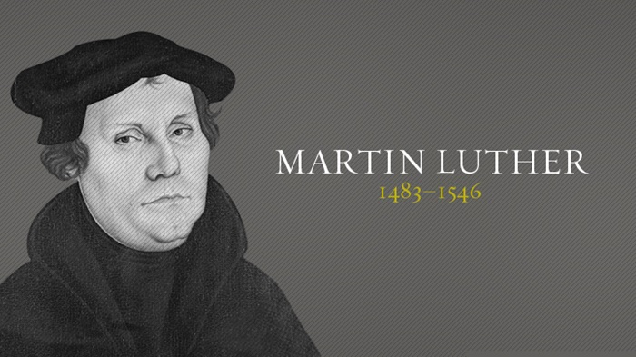
The Protestant Reformation (1517 – 1648)
Martin Luther (1483-1546): significant shift in attitude towards the Jews (becomes more anti-Jewish; cf. About the Jews and their Lies [1543])

Slide 18
The Diversity within Judaism
Orthodox, Conservative and Reform Denominations

Slide 19
Activity
Using the notes that have been given to you, the Diversity within Judaism PowerPoint on Moodle and other academic sources that you can find can you design a short PowerPoint Presentation on Orthodox, Conservative and Reform Judaism.
You can work individually or in groups.
When you have finished the PowerPoint can you please email it to me at: j.keady@uwtsd.ac.uk

