Slide 1

Terrorism and Cybercrime
Week 4 – Terrorism and Human Rights

Slide 2

The Dilemma
For Governments to provide Safety and Security whilst protecting Human Rights…

Slide 3
Historical Context – England 1939
January to June 1939 127 bombings – IRA
Coventry August 1939
5 killed and 80 injured
Peter Barnes and Frank McCormick, were hanged for the Coventry Street bombings
Prevention of Violence (Temporary Provision) Act of 1939 introduced

Slide 4
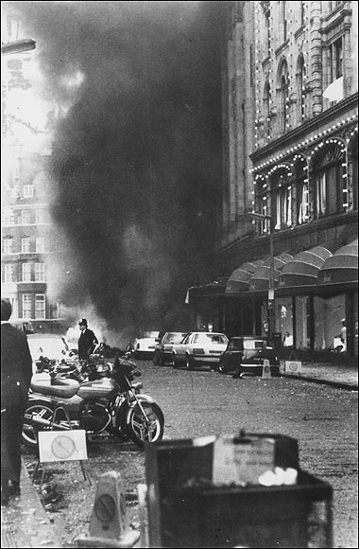
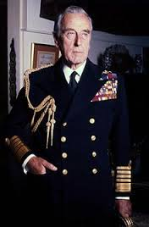
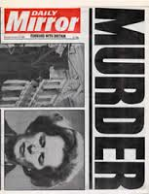
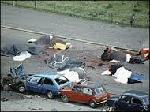
Historical Context
The Prevention of Terrorism (Temporary Provisions) Act 1989
In force for 12 years
Focused on countering Irish Related Terrorism (IRT) activity
The Terrorism Act 2000 introduced in February 2001
Notes:
The Prevention of Terrorism (Temporary Provisions) Act 1989, often referred to as the PTA 1989, was a piece of legislation in the United Kingdom aimed at countering terrorism. It was part of a series of laws enacted in response to the threat of terrorism, particularly from groups like the Irish Republican Army (IRA) during the late 20th century.
Key points regarding the Prevention of Terrorism (Temporary Provisions) Act 1989 include:
1. Context: The PTA 1989 was introduced as a response to the ongoing conflict in Northern Ireland and the threat posed by the IRA. It was part of a broader legislative effort to address terrorism in the UK.
2. Temporary Provisions: The term "Temporary Provisions" in the Act's title indicated that it was intended to be a temporary measure rather than a permanent law. The Act included a sunset clause, meaning that it would automatically expire after a set period, unless renewed by Parliament.
3. Detention Powers: The PTA 1989 granted significant powers to law enforcement agencies, including the ability to detain individuals suspected of involvement in terrorism without trial. These detention powers were highly controversial and were seen by some as a departure from traditional legal norms.
4. Judicial Oversight: The Act included provisions for judicial oversight of detention orders. Detainees had the right to challenge their detention in court, and judges had the authority to review cases.
5. Renewals: The Act was subject to regular parliamentary reviews and renewals, as it included a sunset clause. It was periodically extended over the years, with modifications and amendments, as the threat of terrorism persisted.
6. Repeal: The PTA 1989 was eventually repealed in 2005 with the introduction of the Prevention of Terrorism Act 2005. The 2005 Act introduced control orders as an alternative to internment and made other changes to counter-terrorism measures.
The PTA 1989 was a highly controversial piece of legislation, primarily due to its provisions allowing for the detention of individuals without trial. Critics argued that it represented a departure from established legal principles and civil liberties. It was eventually replaced by subsequent legislation as the nature of the terrorist threat and the political landscape evolved in the UK.

Slide 5
Counter Terrorism (CT) Offences
The Terrorism Act 2000
Several key pieces of legislation have become enacted since 2000 which have sought to enhance and refine the 2000 act, and to give Counter Terrorism officers more powers such as:
Anti-terrorism, Crime and Security Act 2001
Terrorism Prevention and Investigation Measures Act 2011
Terrorism Act 2006
Counter Terrorism Act 2008
Terrorist Asset-Freezing Act 2010
Counter Terrorism and Security Act 2015
& Counter Terrorism and Border Security Act 2019
Notes:
The Terrorism Act 2000 (known as TACT2000) is the primary legislation relating to terrorism, from which all current offences are based. This was enacted in the year 2000 following on from temporary legislation that had existed for some years beforehand.
The Anti-Terrorism section amends some of 2000 Act extended powers of stop and search to include internal flights.
The Prevention of Terrorism Act 2005. This legislation created control orders – effectively a house arrest for suspected terrorists. This was repealed and replaced with the Terrorism Prevention & Investigation Measures Act 2011. Persons who cannot be charged and brought before a court may be subject to a TPIM measure i.e. relocate to a certain part of the country, restriction on association, restriction on mobile phones, restriction on bank accounts, restriction on computer use, restrictions on travel.
The Terrorism Act 2006 which has introduced some 9 new terrorism offences and amends some of the 2000 Act powers.
The CT Act 2008 – persons convicted under CT legislation to be registered, to live at approved premises, have their photographs taken and regularly updated, to report to a police station under certain circumstances
The Terrorist Asset freezing Act 2010 has little bearing on Police work and was introduced to allow the treasury to freeze bank accounts of suspected terrorists
CT & Security Act 2015 – this legislation made amendments to parts of the terrorism Act 2000 and Aviation Security Act 1982 to deal with travellers. Most importantly it brought in a lot of PREVENT directives to Higher Education & Further Education organisations.
The Counter-Terrorism and Border Security Act 2019 is a piece of legislation in the United Kingdom that aims to strengthen the country's counter-terrorism measures and enhance border security. The Act was introduced in response to the evolving threat of terrorism and security concerns. The Act provides increased powers to border security agencies, including the ability to stop, question, and detain individuals at the border to determine if they are engaged in or connected to terrorism. The Act provides law enforcement agencies with enhanced powers to access and monitor communications, subject to appropriate safeguards and oversight.

Slide 6
Powers of these Acts
Do these, in your evaluation, infringe on human rights in any serious way?
Are they justified in the response to perceived threat of terrorism?

Slide 7

Human Rights Act 1998
Right to life
Freedom from torture / degrading treatment / slavery
Right to security
Right to fair trial / no punishment without law ruling
Respect of family / private life
Freedom of speech
Freedom of assembly and association
Right to education / free participation in elections
Abolition of death penalty
Notes:
The Human Rights Act 1998 is a significant piece of legislation in the United Kingdom that incorporates the rights and freedoms protected by the European Convention on Human Rights (ECHR) into UK law. It was enacted to make these rights directly enforceable in UK courts and has had a profound impact on the protection of human rights in the country.

Slide 8
Wilkinson (2007)
Spoke of the dangers of:
  Overreaction,
  Over reliance on military force
  Measures that involve curtailment of democracy,
  Abuses of Human rights and the Rule of law and the threat that these pose to democracy.
Notes:
Paul Wilkinson discusses the complex and challenging issues surrounding the response of liberal democratic states to acts of terrorism. One of the key topics he addressed is the tension between the imperative to combat terrorism and the need to protect and uphold human rights.
Balancing Security and Human Rights: Wilkinson delves into the delicate balance that liberal democratic states must strike between maintaining security and safeguarding human rights. He highlights the potential tension between counterterrorism measures, which often involve expanded state powers, and the protection of individual liberties and rights.
Civil Liberties and Due Process: The book examines how counterterrorism measures can impact civil liberties, such as freedom of expression, privacy, and due process. It discusses issues such as surveillance, detention without trial, and restrictions on free speech, which can raise concerns about violations of human rights.
State Response to Terrorism: Wilkinson analyzes the various responses that states may adopt when confronted with acts of terrorism. He discusses measures like emergency legislation, enhanced intelligence sharing, and international cooperation and evaluates their compatibility with human rights standards.
Judicial Oversight: The book considers the role of the judiciary in upholding human rights in the context of counterterrorism. It examines cases in which courts are called upon to assess the legality and proportionality of counterterrorism measures, including their impact on human rights.
International Legal Framework: Wilkinson also explores how international law, including human rights treaties, shapes the counterterrorism efforts of states. He assesses the implications of international human rights law on the actions of states when responding to terrorism.
The Impact on Democracy: The book discusses how the response to terrorism can affect the democratic character of a state. It considers how restrictions on civil liberties and the expansion of state powers can challenge the principles of liberal democracy.
Overall, Wilkinson's provides a comprehensive examination of the complex and multifaceted relationship between counterterrorism efforts and the protection of human rights in liberal democratic states. He highlights the challenges faced by governments in striking the right balance between security imperatives and the preservation of individual liberties and human rights.

Slide 9
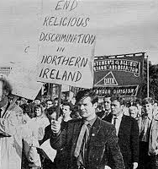
Northern Ireland- Discrimination
1966 : Catholic minority population discriminated against-politically, socially and economically.
Many had no vote as they were not ratepayers,
Electoral wards were ‘gerrymandered’ so that even where there was a Catholic majority there was still a Protestant council
Harland and Wolff shipbuilders had a workforce of 100,000 only 400 were Catholic.
The Catholic Community described itself as “an oppressed minority”-they had plenty to be angry about.
Allocation of Housing
Employment: “ When I went for jobs, I found out I was asked if I was Catholic, not whether I had the qualifications. If I said I was Catholic, I was told the job was not available” (Belfast woman)
Notes:
1966 : Catholic minority population discriminated against-politically, socially and economically.
Many had no vote as they were not ratepayers,
Electoral wards were ‘gerrymandered’ so that even where there was a Catholic majority there was still a Protestant council
"Gerrymandered" is a term used to describe a political manipulation or redrawing of electoral district boundaries to give an unfair advantage to one political party or group. This manipulation is typically done to ensure that a particular party or group gains a majority of seats in the legislature, even if their actual share of the vote doesn't warrant it. Gerrymandering can be used to dilute the voting power of certain communities, thereby distorting the democratic representation within a country or state.
Harland and Wolff shipbuilders had a workforce of 100,000 only 400 were Catholic.
The Catholic Community described itself as “an oppressed minority”-they had plenty to be angry about.
Allocation of Housing,
Employment: “ When I went for jobs, I found out I was asked if I was Catholic, not whether I had the qualifications. If I said I was Catholic, I was told the job was not available” (Belfast woman)

Slide 10
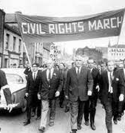
Northern Ireland Civil Rights
The Catholic minority were persecuted – homes burnt down / driven from the areas they live in.
Demanded Civil Rights, the Protestant majority resisted
The Catholic community blamed the Police (largely Protestant), no action = violence
Enter the Troops:
The British Army were temporarily deployed to NI in 1969.
On their arrival they were welcomed by the Catholic community who saw the army as ‘protectors’ they were the ‘Good Guys’ – birth of the PIRA
The sight of heavily armed troops on the civilian streets did not fit well within communities
Notes:
In the 1960s, Northern Ireland experienced a significant civil rights movement that emerged from deep-seated grievances related to discrimination against the Catholic nationalist community in the region. The civil rights campaign sought to address a range of issues and injustices, with a primary focus on securing equal rights and an end to discriminatory practices.
Key issues and events surrounding civil rights in Northern Ireland during the 1960s include:
Housing Discrimination: One of the central issues was discrimination in housing. Many Catholic families faced housing inequalities, with complaints that social housing allocation favored Protestants, contributing to segregated communities.
Employment Discrimination: Catholics often faced employment discrimination, with allegations that many job opportunities were restricted to Protestants.
Electoral Reform: The civil rights movement called for reforms to the electoral system, arguing that gerrymandering and property qualifications unfairly favored the Protestant majority, resulting in Catholic underrepresentation.
Police Bias: Complaints of police bias and brutality were widespread. The Royal Ulster Constabulary (RUC) was accused of using excessive force against civil rights protesters, deepening tensions.
Civil Rights Campaign: The civil rights movement in Northern Ireland gained momentum in the mid-1960s. Inspired by the U.S. civil rights movement, activists organized marches and protests to draw attention to their demands for equal rights and an end to discrimination.
The Bogside Massacre: The situation escalated in 1969 when clashes between civil rights demonstrators and the RUC led to violence in the Bogside area of Derry. This event, known as the Bogside Massacre, marked a turning point in the conflict.
British Troops Deployment: Following the escalating violence and unrest, the British government deployed troops to Northern Ireland in 1969, marking the beginning of the Troubles, a period of conflict that would last for decades.
Resumption of Direct Rule: In 1972, the British government suspended the Northern Ireland Parliament and government, instituting direct rule from London. This marked a significant change in the governance of Northern Ireland.
The civil rights movement in Northern Ireland in the 1960s laid the groundwork for a period of intense political and sectarian conflict. The issues raised by the movement, particularly those related to discrimination and political representation, remained central to the broader conflict that would become known as the Troubles, lasting until the late 1990s with the signing of the Good Friday Agreement.

Slide 11
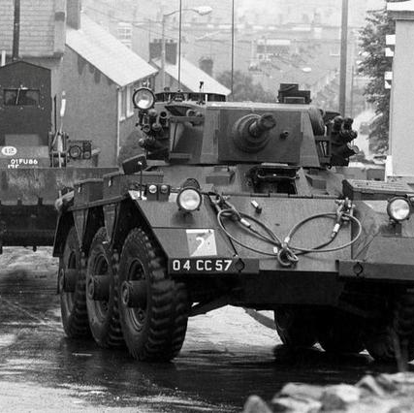
Overreaction
A Recruitment Tool
Community Unrests -
‘Operation Motorman’ saw the deployment of 31000 troops tasked with tearing down barricades protecting Catholic ‘no go’ areas,
Internment without trial (almost entirely against Catholics),
Bloody Sunday (30th Jan 1972 British Soldiers shoot dead 13 during a Civil Rights march)
Notes:
Operation Motorman was a major military operation carried out by the British Army in Northern Ireland on July 31, 1972. It was a significant event during "The Troubles," a period of conflict and political violence in Northern Ireland. The primary objective of Operation Motorman was to reassert control over areas of Northern Ireland that had become "no-go" zones for the security forces and were effectively controlled by nationalist and republican paramilitary groups.
Key points about Operation Motorman include:
Background: By 1972, several areas in Northern Ireland had become "no-go" zones for the British Army and the police, particularly in Derry (Londonderry) and Belfast. These areas were effectively controlled by republican paramilitary groups like the Provisional Irish Republican Army (IRA). The British government and the security forces decided to reassert control over these areas.
Large-Scale Military Operation: Operation Motorman was a massive military operation that involved thousands of British soldiers and armoured vehicles. Its scale was unprecedented in the history of the conflict.
Occupation of No-Go Areas: The primary goal of the operation was to reoccupy and re-establish control over the "no-go" areas in Derry, particularly the Bogside, and the Creggan, and in Belfast, particularly the Lower Falls area.
Use of Force: The operation involved the use of force, including the use of armoured vehicles to break through barricades that had been set up by residents and paramilitary groups. There were confrontations and violence during the operation.
End of No-Go Areas: By the end of Operation Motorman, British forces had regained control over the areas that had been "no-go" zones. The barricades were removed, and the security forces established a visible presence in these areas.
Escalation of the Conflict: Operation Motorman marked a significant escalation of the conflict in Northern Ireland. It resulted in a surge in violence and tensions in the short term.
Impact on the Troubles: While the operation succeeded in re-establishing government control over these areas, it did not bring an end to the Troubles. The conflict continued for decades, with political and military developments in the years that followed.
Operation Motorman remains a significant and controversial event in the history of the Northern Ireland conflict. It is remembered for its use of military force in urban areas and the impact it had on the dynamics of the conflict.
Bloody Sunday, which occurred on January 30, 1972, was a tragic and highly controversial event during "The Troubles" in Northern Ireland. On that day, a civil rights march in the city of Derry (Londonderry) ended in a violent confrontation between British soldiers and civilian demonstrators, resulting in the deaths of 14 unarmed civilians and the injury of many others. The incident had profound consequences for the Northern Ireland conflict and its political landscape.
Key points about Bloody Sunday 1972 include:
Civil Rights March: The march, organized by the Northern Ireland Civil Rights Association, was intended to protest against the policy of internment without trial and to demand civil rights and an end to discrimination against the Catholic nationalist community in Northern Ireland.
Confrontation: As the marchers approached the area around the Bogside, a nationalist neighborhood in Derry, they encountered a heavy military presence. Tensions escalated, and a confrontation between the demonstrators and British soldiers, particularly members of the Parachute Regiment, turned violent.
Shootings: On that fateful day, British soldiers opened fire on the crowd of unarmed civilians. Fourteen people were killed, and many more were injured. The victims included both men and boys, with the youngest being just 17 years old.
Immediate Impact: Bloody Sunday had an immediate and deeply emotional impact in Northern Ireland. It led to a surge in violence and outrage among the nationalist and republican communities, and it intensified the conflict.
Widely Criticized: The events of Bloody Sunday were widely condemned, both nationally and internationally. The British Army's actions were seen as excessive and unjustified, as the victims had been participating in a peaceful civil rights march.
Widely Investigated: The British government established the Widgery Tribunal to investigate the events of Bloody Sunday. However, the tribunal's findings, released in April 1972, were criticized for exonerating the British soldiers involved.
Saville Inquiry: The campaign for justice continued for decades. In 1998, the British government established the Saville Inquiry, which took 12 years to complete. In 2010, the Saville Inquiry published its findings, which concluded that the killings were unjustified and that the victims were innocent.
Official Apology: Following the Saville Inquiry, then-Prime Minister David Cameron issued an official apology in the House of Commons, expressing regret for the events of Bloody Sunday and acknowledging the innocence of the victims.
Bloody Sunday remains a significant and painful chapter in the history of the Northern Ireland conflict. It contributed to further polarization and violence, highlighting the deep-seated grievances and tensions in the region. The impact of the events of that day is still felt in Northern Ireland today.

Slide 12
Think back to Wilkinson
Overreaction?
Over reliance on military force?
Curtailment of democracy, Human rights and the Rule of law?
Notes:
The events of Bloody Sunday in 1972 were widely seen as a tragic violation of human rights and a failure in upholding the rule of law. The incident involved the fatal shooting of unarmed civilian demonstrators by British soldiers during a civil rights march in Derry, Northern Ireland. While it may not be accurately characterized as the curtailing of democracy (as it was a response to a protest for civil rights), it was undoubtedly a severe breach of human rights and a challenge to the rule of law.
Key points related to democracy, human rights, and the rule of law in the context of Bloody Sunday include:
Violation of Human Rights: The use of lethal force against unarmed civilians participating in a peaceful demonstration was a clear violation of their human rights, particularly the right to life.
Right to Assemble and Protest: The marchers were exercising their right to assemble and protest, which are fundamental components of democratic societies. The violent response to the protest was a breach of these rights.
Use of Force and the Rule of Law: The use of lethal force by the military in a situation involving unarmed demonstrators raised questions about the application of the rule of law and the appropriate use of force in maintaining public order.
Impact on Democracy: While the march itself was an expression of demands for civil rights, the violent response by the military exacerbated tensions and deepened divisions in Northern Ireland. It did not directly curtail democracy but contributed to an environment of conflict and political instability.
Inquiry and Apology: The British government's subsequent establishment of the Widgery Tribunal and the later Saville Inquiry, along with the formal apology by Prime Minister David Cameron, were efforts to address the failures in the rule of law and human rights that had occurred on Bloody Sunday.
Bloody Sunday was a significant violation of human rights and a failure to uphold the rule of law. While it was not a direct curtailing of democracy, it had profound implications for the political and social landscape of Northern Ireland during a period of intense conflict.

Slide 13
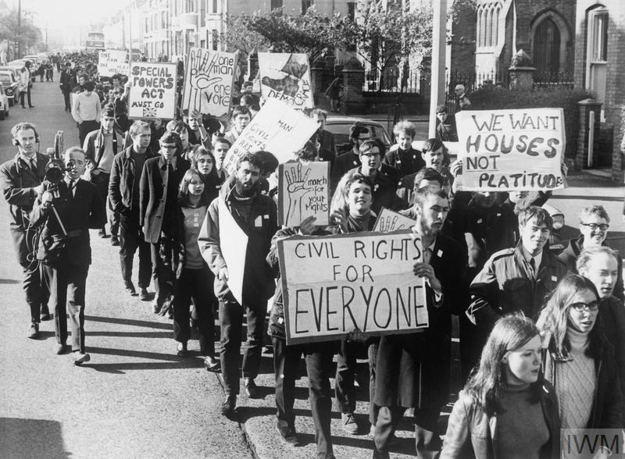
Community Effects
Loss and Grief
Outrage and Anger
Polarization
Escalation of the Conflict
Process: Long Quest for Justice
Memorialization
Symbol of Injustice
Complex Legacy
Notes:
The effects of Bloody Sunday on the community, particularly in Derry and the broader nationalist and republican communities in Northern Ireland, were profound and enduring. The incident had a lasting impact on individuals, families, and the overall dynamics of the conflict. Some of the key effects on the community include:
Loss and Grief: The immediate and most tragic effect was the loss of 14 innocent lives, with many more injured. This led to profound grief and mourning among the victims' families and the wider community.
Outrage and Anger: The community's response to the events of Bloody Sunday was one of outrage and anger. Many believed that the British Army's actions were not only unjust but also a deliberate provocation.
Polarization: Bloody Sunday intensified the already deep-seated political and sectarian divisions in Northern Ireland. The nationalist and republican communities felt alienated and further radicalized.
Escalation of the Conflict: The incident marked a significant escalation in the violence and conflict. It fueled further paramilitary activity on both sides, leading to more deaths and injuries.
Impact on the Peace Process: The legacy of Bloody Sunday cast a long shadow over the peace process in Northern Ireland. It remained a contentious issue for many years, complicating efforts to achieve reconciliation.
Long Quest for Justice: The victims' families and the wider community pressed for justice and accountability for decades. The Saville Inquiry's findings in 2010, which declared the victims innocent, marked a crucial moment in the community's quest for justice.
Memorialization: The memory of Bloody Sunday has been preserved through various forms of memorialization, including commemorations, murals, and annual events to remember the victims.
Symbol of Injustice: For many in the nationalist and republican communities, Bloody Sunday became a symbol of British oppression and injustice, strengthening their resolve in the face of political and social challenges.
Complex Legacy: The legacy of Bloody Sunday is complex. While it contributed to a sense of victimization and alienation within the community, it also spurred activism, resilience, and a determination to see justice done.
The effects of Bloody Sunday continue to shape the collective memory and narrative of the conflict in Northern Ireland. The incident remains a significant and emotionally charged chapter in the history of the region, highlighting the enduring impact of political violence on communities and the quest for truth and reconciliation

Slide 14
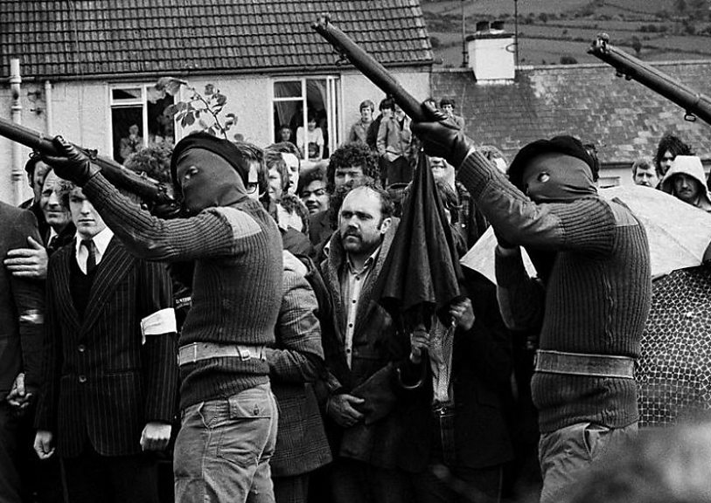
The Troubles
Whilst the combined Military/Police approach failed to deal with the PIRA there were arguably some successes
Numbers of those killed as result of terrorist attack reduced significantly:
1972 – 467 deaths
The late 1980's - 90’s less than 100 per year
Prevented escalation of troubles to civil war and made the peace process possible
Notes:
The Troubles, a period of conflict in Northern Ireland that lasted from the late 1960s to the late 1990s, had devastating consequences for the region. The conflict resulted in loss of life, injuries, and significant social and economic costs. However, it is important to acknowledge that there were several significant successes in the efforts to bring about peace, reconciliation, and political progress in Northern Ireland. Some of the key successes include:
Good Friday Agreement (Belfast Agreement) of 1998: The Good Friday Agreement is arguably the most significant success of the peace process. It established a framework for devolved government in Northern Ireland, addressing key issues like power-sharing, human rights, policing, and justice. The agreement provided a pathway to peace and helped end the violent conflict.
Demilitarization: Over the years, there was a significant reduction in the military presence and checkpoints in Northern Ireland. The removal of military installations and a more visible police presence contributed to a sense of normalcy.
Cessation of Violence: While the road to peace was long and challenging, paramilitary organizations like the Provisional Irish Republican Army (IRA) and loyalist groups eventually declared ceasefires. These declarations marked a significant reduction in violence.
Paramilitary Disarmament: The decommissioning of paramilitary weapons was a crucial step in the peace process. It demonstrated the commitment of various groups to a peaceful resolution.
Economic Growth: Northern Ireland experienced economic growth and investment as the peace process took hold. The improvement in security conditions and political stability attracted businesses and investors.
Reconciliation Initiatives: Various initiatives aimed at promoting reconciliation and building relationships between communities were undertaken. These efforts included cross-community projects, dialogue, and cultural exchanges.
Devolved Government: The establishment of the Northern Ireland Assembly and the Executive following the Good Friday Agreement allowed for self-governance and power-sharing between unionist and nationalist parties.
Human Rights Protections: The peace process led to improvements in human rights and civil liberties in Northern Ireland. Key human rights issues were addressed in the Good Friday Agreement.
Cross-Border Cooperation: The peace process facilitated cooperation and communication between Northern Ireland and the Republic of Ireland, helping to strengthen relations and mutual understanding.
End of Internment: The policy of internment without trial, which had been a major grievance in the early years of the Troubles, came to an end.
While the Troubles had devastating consequences, these successes demonstrate that political and social progress was possible. The path to peace and reconciliation in Northern Ireland was long and challenging, and it required the efforts of many individuals, political leaders, and international stakeholders. The achievements in Northern Ireland serve as a hopeful example of how conflicts can be resolved through dialogue, negotiation, and compromise.

Slide 15

The UK’s CT Network

Slide 16
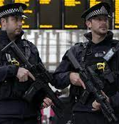
Scotland Yards Anti Terrorist Branch (SO13)
The main burden of containing and defeating terrorists lies with the Police as the methods used to detect and prosecute persons for terrorism are similar to those used to detect and prosecute criminality.
Prior to the events of 7th of July 2005 the National responsibility for the Investigation of terrorism lied with Scotland Yard Anti-Terrorist Branch, a section of the Metropolitan Police Service

Slide 17
Scotland Yard Anti-Terrorist Branch
The partnership forged between the ATB and MI5 (supported by MPSB) had reaped rewards as the combination of the intelligence agencies together with the specialist knowledge relating to the terrorists, weapons, tactics, bomb disposal and bomb scene management skills possessed by the specialist resources within the ATB paid off.
Notes:
The "Scotland Yard Anti-Terrorist Branch" refers to a specialized unit within the Metropolitan Police Service (MPS) in London, also known as New Scotland Yard. This branch was historically responsible for counter-terrorism and investigating terrorist threats and incidents in the United Kingdom, particularly in the London area.
MI5, officially known as the Security Service, is the United Kingdom's domestic counter-intelligence and security agency. MI5's primary responsibility is to protect the UK from security threats, including terrorism. They are involved in intelligence gathering, analysis, and the protection of national security.
MPSB likely refers to the Metropolitan Police Service's Specialist Firearms Command, which is responsible for armed policing and responding to various high-risk situations, including counter-terrorism operations.
The partnership between the Anti-Terrorist Branch (ATB) and MI5, supported by the Metropolitan Police Specialist Firearms Command (MPSB), represents a coordinated approach to counter-terrorism efforts. MI5 provides intelligence and counter-terrorism expertise, while the ATB and MPSB work to implement and respond to these intelligence insights in the field, ensuring the safety and security of the public in London and the wider UK. This partnership is crucial in addressing the evolving threat of terrorism and ensuring the protection of the nation.

Slide 18

PIRA on the Back-Foot!
Arguably it was the successes of this partnership and the successful prosecution of several key PIRA players that brought about the ‘ceasefire’ called in 1994 and ultimately led to the ‘Peace Process’ following the election of the Labour government in 1997.

Slide 19

MI5 and Crime
Following it’s success in gathering intelligence against PIRA there were calls for the Service to be used to tackle Serious Crime most significantly the illicit drug trade.
However, whilst MI5 focussed upon serious crime, PIRA and more latterly RIRA, as a result they neglected to identify the emergence of Al Qaeda and its affiliated groups
Notes:
RIRA stands for the "Real Irish Republican Army." It is a dissident republican paramilitary organization that emerged in the late 20th century in Northern Ireland and the Republic of Ireland. The RIRA is one of several splinter groups that broke away from the Provisional Irish Republican Army (IRA) in the late 1990s due to disagreements over the peace process.
The RIRA was formed in 1997 and has been responsible for several violent incidents and attacks in its efforts to oppose the peace process in Northern Ireland and advocate for a united Ireland. The group has been involved in bombings, shootings, and other forms of violence, primarily targeting security forces and symbols of the British state.
The RIRA is considered a terrorist organization, and its activities have been widely condemned by political leaders and peace advocates. It is distinct from the original IRA, which declared a ceasefire in the 1990s and eventually decommissioned its weapons as part of the peace process. The RIRA is one of the factions that rejected the ceasefire and continued to engage in paramilitary activities.

Slide 20
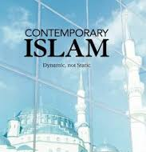
The Contemporary Wave of Islamism
The successes of the Iranian Revolution in 1979 and the multinational campaign against the Soviets in Afghanistan between 1979 and 1989 instilled in the minds of many young Muslims that they could ‘take on’ the US and were attracted by the ideology of a global jihad that appealed to a wide and disparate following in the Muslim world.
Notes:
The contemporary wave of Islamism refers to the political and ideological movements within the Muslim world that advocate for the establishment of Islamic governance, often based on a strict interpretation of Islamic law, known as Sharia. This wave has been particularly prominent in the late 20th and early 21st centuries and has had a significant impact on politics and society in many predominantly Muslim countries.
Political Activism: Islamist movements have become politically active in many countries, participating in elections, forming political parties, and advocating for Islamic principles to be incorporated into the legal and political systems.
Diverse Ideological Trends: The Islamist movement is not monolithic, and there is a wide range of ideological perspectives within it. Some Islamist groups are more moderate and advocate for a peaceful, democratic approach, while others are more radical and may support violent means to achieve their goals.
Challenges to Secularism: Islamism often challenges the secular nature of government in countries where it gains influence. Islamists may seek to implement Sharia law, which can raise questions about the separation of religion and state.
Social Conservatism: Many Islamist movements promote conservative social values and advocate for restrictions on issues such as women's rights, freedom of expression, and personal behaviour.
Role of Religion in Politics: Islamism emphasizes the role of religion in the public sphere and seeks to apply Islamic principles to various aspects of governance and society.
Anti-Western Sentiment: Some Islamist movements are critical of Western influence in Muslim-majority countries and may express anti-Western sentiment.
Terrorism and Extremism: A minority of Islamist groups, often referred to as jihadist or extremist, advocate for violence and terrorism as a means to achieve their goals. These groups have been responsible for a number of high-profile terrorist attacks.
Peaceful Activism: Many Islamists engage in peaceful political activism and participate in democratic processes. Islamist parties have won elections and held positions of power in countries such as Turkey, Egypt, and Tunisia.
Regional Variations: The manifestation of Islamism varies from one region to another. For example, the Muslim Brotherhood in Egypt has a different approach and history than the Taliban in Afghanistan.
Government Responses: Governments in Muslim-majority countries often have complex relationships with Islamist movements. They may respond with repression or seek to engage in dialogue and cooperation, depending on the specific group and its objectives.
The contemporary wave of Islamism is a multifaceted and dynamic phenomenon that reflects the diversity of perspectives within the Muslim world. It has had a significant impact on regional and global politics and continues to shape the social and political landscapes in many countries.

Slide 21
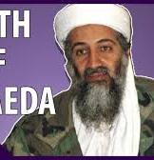
Birth of Al Qaeda
Following the Soviet withdrawal from Afghanistan in 1989 the group known as al-Qaida al Sulbah (‘The Solid Base’) began to support and assist local jihadist groups who opposed their governments in Muslim countries such as Algeria, Bosnia, Chechnya before developing its own Operational capability in close cooperation with several Egyptian Terrorist Groups (Egyptian Islamic Jihad, Islamic Group of Egypt) and becoming simply Al Qaida (The Base).
Notes:
Al-Qaeda, meaning "The Base" in Arabic, is a transnational extremist organization that emerged in the late 20th century. Its birth and development can be traced to a series of key events and ideological influences:
Soviet-Afghan War (1979-1989): The origins of Al-Qaeda can be linked to the Soviet-Afghan War. During the 1980s, the Soviet Union invaded Afghanistan, leading to a resistance movement by Afghan mujahideen (holy warriors) with support from various countries, including the United States and Saudi Arabia. Many Arab volunteers, including Osama bin Laden, went to Afghanistan to join the fight against the Soviets. This experience served as a catalyst for the formation of Al-Qaeda.
2. Osama bin Laden: Osama bin Laden, a wealthy Saudi Arabian, played a central role in the formation of Al-Qaeda. He was a key figure in the Arab volunteer efforts in Afghanistan and used his family's wealth to fund the mujahideen. Bin Laden's experiences in Afghanistan, his radicalization, and his desire to create a pan-Islamic militant group contributed to Al-Qaeda's birth.
3. Formation of Al-Qaeda: Al-Qaeda was officially founded by Osama bin Laden in 1988, with the goal of establishing a network of like-minded jihadist groups to promote Islamist extremism and carry out attacks against perceived enemies of Islam. Its primary objective was to expel foreign forces from Muslim-majority countries and establish Islamic states governed by strict interpretations of Sharia law.
4. Ideology and Goals: Al-Qaeda's ideology is rooted in extremist interpretations of Islam. It sought to create a global jihadist movement that transcended national borders, aiming to unite Muslims under a single banner to combat perceived Western aggression and influence in Muslim-majority countries. It advocated for the overthrow of "apostate" governments in the Muslim world.
5. Early Attacks: Al-Qaeda gained international notoriety in the early 1990s with a series of high-profile attacks. Notable incidents include the 1993 World Trade Center bombing in New York City and the 1998 U.S. embassy bombings in Kenya and Tanzania. These attacks signaled Al-Qaeda's willingness to target the United States and its interests.
6. September 11, 2001: The most infamous and deadly act attributed to Al-Qaeda was the terrorist attacks on September 11, 2001. Nineteen hijackers, under the leadership of Osama bin Laden, carried out coordinated suicide plane attacks on the World Trade Center in New York City and the Pentagon in Washington, D.C. These attacks led to the deaths of nearly 3,000 people and marked a turning point in global counterterrorism efforts.
After the 9/11 attacks, the United States, along with its allies, launched a global campaign against Al-Qaeda, resulting in the removal of the Taliban regime in Afghanistan, which had provided safe haven to the group. Al-Qaeda's leadership faced significant setbacks, and Osama bin Laden was eventually located and killed by U.S. forces in Pakistan in 2011.
While the core leadership of Al-Qaeda has been disrupted, the organization has evolved and inspired or directed other Islamist extremist groups. It continues to pose a threat, and its ideology remains a driver for acts of terrorism around the world.

Slide 22
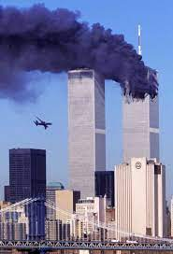
11th September 2001
The transformation of AQ from the ‘supporter’ or ‘facilitator’ seen during it’s early days to becoming Operational culminated in the attacks on the Twin Towers during which by recruiting Western educated Islamists they were able to strike deep inside the West. The resulting focus of the worlds security service forced the organisation to switch their attention to countries where it was easier to operate such as Indonesia, Pakistan and Chechnya.

Slide 23
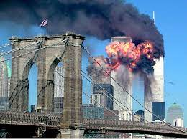
THE CHANGING THREAT

Slide 24
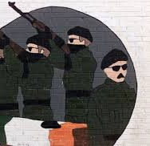
Irish Republican Terrorism
United Ireland
Hierarchal
Coded warnings
Non-suicidal
Infra structure
Targets and Collateral Death
Dialogue with HMG

Slide 25
Change of Intelligence Function
Following the Cold War MI5 were handed the intelligence function for Countering the PIRA on the UK mainland previously the responsibility of the Metropolitan Police Special Branch (MPSB)
They quickly Identified significant Intelligence ‘gaps’ and working in partnership with the Metropolitan Police’s Ant- Terrorist Branch had substantial successes in capturing key PIRA suspects planning terrorist attacks.
Arguably these successes led to the PIRA ceasefire of 1994 and paved the way for the ‘Peace Process’.

Slide 26
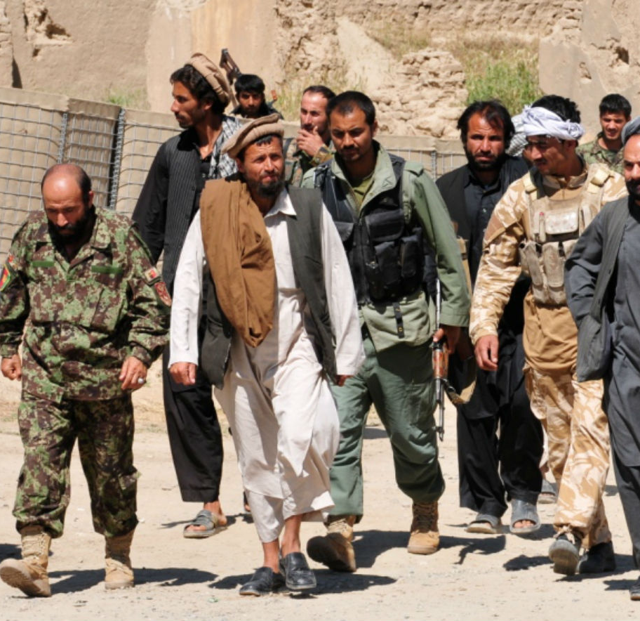
International Terrorism
An Interpretation of Islam
Disparate groups / individuals
Suicide
High collateral deaths
Vengeance
No dialogue with HMG
Recruited locally
Single Narrative

Slide 27
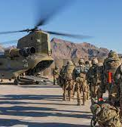
11th September 2001
The invasion of Afghanistan that followed the Twin Towers attacks forced AQ to alter its hierarchical structure into a movement that comprised of loosely affiliated or ‘localised groups and in order to continue to spread its ideology to resort to intensive networking.

Slide 28
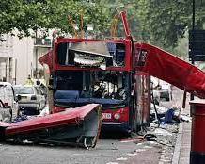
The Threat to the UK
As early as 2003 the Head of MI5 and the Commissioner of Police for London had expressed the view that it was not ‘if’ but ‘when’ the UK would be attacked by Islamist extremists associated with AQ.
The attacks that took place on the 7th July 2005 bore all the hallmarks of such an attack (no warning, mass casualties, maximise publicity)

Slide 29
CTU's and CTIU's
HMIC recommended regionalisation of CT activity to provide coordination of intelligence gathering activity
Intel gathering and handling in accordance with NIM
Through Tasking and coordination process they provide regional strategic assessments of terrorism and other threats
Standardisation of Special Branch procedures
Notes:
Counter-Terrorism Unit (CTU): In the context of law enforcement and security, CTU typically stands for Counter-Terrorism Unit. A Counter-Terrorism Unit is a specialized law enforcement or security agency responsible for preventing and responding to terrorist threats and acts of terrorism. These units are tasked with gathering intelligence, conducting operations, and coordinating efforts to counter terrorist activities.
Counter-Terrorism Intelligence Unit (CTIU): CTIU may also refer to a Counter-Terrorism Intelligence Unit. This would be a specialized division or unit within a law enforcement or intelligence agency that focuses on gathering and analysing intelligence related to terrorist threats and activities. CTIUs play a critical role in identifying and monitoring potential threats and sharing intelligence with relevant agencies.
The specific meaning of CTU and CTIU can vary based on the country, organization, or agency using these acronyms. They are typically part of broader efforts to address and counter the challenges posed by terrorism.

Slide 30
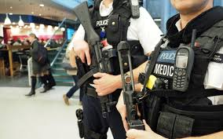
Policing Terrorism Government Responses

Slide 31
Muslims in Britain today
The ONS 2018 revealed there is 3M Muslims living in Britain, by 2030 this number is estimated to grow to 5.5M,
In 2011 a study conducted at Durham University on behalf of the Equality and Human Rights Commission by Choudhury and Fenwick revealed that:
60% of Muslims are under 34,
In 2010 87% of terrorist prisoners were Muslim,
There appeared a disconnect between what the Government described as the major threat to communities (CT) and what the communities believed were the major threats (Criminality).

Slide 32
But who are the Terrorists?
Whilst the UK Muslim population is acknowledged as being law abiding and peaceful research conducted post 7/7 indicated some support for the bombings
“Few terrorist movements have lasted for long without a ‘supportive community’ (Marc Sageman)
Notes:
The quote, "Few terrorist movements have lasted for long without a ‘supportive community’," is often attributed to Marc Sageman, a forensic psychiatrist, and former CIA officer. Sageman is known for his research and writing on terrorism and the social networks of terrorist organizations. This quote underscores the role of a supportive environment or community in the sustainability of terrorist movements. It suggests that terrorists often rely on sympathetic or supportive networks to recruit, plan, and carry out their activities. Sageman's work has contributed to the understanding of the social dynamics of terrorism and the importance of addressing these support networks in counterterrorism efforts.

Slide 33
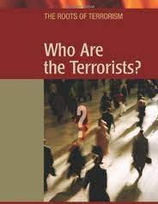
But who are the Terrorists?
“A supportive community does not condone violence, and certainly, most people in it would not want to become personally involved...whether or not they condone violence they see terrorists are sharing their world view, part of the struggle to which they belong.”
(McGhee 2008:69).

Slide 34
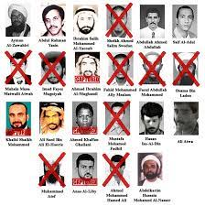
Who are the Terrorists?
The suggestion of a ‘supportive’ rather than suspect community is a key point in the discourse surrounding the way in which Muslim communities are viewed as it implicates a far greater percentage of the Muslim population and it is this community support, sympathy or merely ‘seeing no evil’ which provides terrorists with the ability to plan and carry out their attacks
(Lambert 2008)

Slide 35
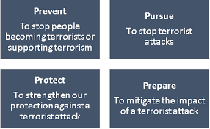
UK Govt Responses to Terrorism
Body Scanners,
Section 44 Terrorism Act,
Schedule 7 Terrorism Act,
CONTEST (PREVENT),
CT Network,
ANPR
CCTV
Notes:
The United Kingdom has implemented various government responses to address the threat of terrorism over the years. These responses have evolved in response to changing security challenges and include legislative, law enforcement, and intelligence measures. Some key UK government responses to terrorism include:
Prevent Strategy: The Prevent strategy is a key component of the UK's counter-terrorism efforts. It focuses on preventing individuals from becoming involved in terrorism or supporting extremist ideologies. Prevent includes initiatives to identify and support individuals at risk of radicalization, as well as addressing the root causes of extremism.
Counter-Terrorism Legislation: The UK has enacted several pieces of counter-terrorism legislation to enhance law enforcement powers. Examples include the Terrorism Act 2000, the Anti-Terrorism, Crime, and Security Act 2001, the Terrorism Act 2006, and the Terrorism Act 2006. These laws provide authorities with the legal framework to investigate and prosecute terrorism-related offenses.
Security and Intelligence Agencies: The UK's security and intelligence agencies, such as MI5 and MI6, play a vital role in counter-terrorism efforts. They are responsible for gathering intelligence, monitoring potential threats, and disrupting terrorist plots.
Border Security: The UK has implemented border security measures to prevent the entry of individuals who may pose a threat to national security. These measures include watchlists and border control procedures.
International Cooperation: The UK collaborates with international partners to combat global terrorism. It is a member of various international organizations and agreements, such as INTERPOL, Europol, and the United Nations, to share information and coordinate efforts to counter terrorism.
Joint Terrorism Analysis Centre (JTAC): JTAC is a UK government agency that assesses the threat level posed by terrorism. It provides threat assessments to government agencies, law enforcement, and the public.
Enhanced Policing: The UK has increased police resources and capabilities to respond to potential terrorist threats. Specialized counter-terrorism units, such as the Metropolitan Police's Counter Terrorism Command, have been established to investigate and prevent terrorist activities.
Crisis Response: The government has established emergency response protocols to manage and respond to terrorist incidents, such as the COBRA (Cabinet Office Briefing Rooms) meetings.
Public Awareness and Vigilance: The government encourages public awareness of the threat of terrorism and advises individuals to remain vigilant. The "See It, Say It, Sorted" campaign is an example of public awareness efforts.
De-Radicalization and Rehabilitation Programs: The UK offers programs to support individuals who have been involved in extremist activities to disengage from terrorism and reintegrate into society.
These responses reflect the UK's commitment to addressing the threat of terrorism through a multi-faceted approach that encompasses prevention, intelligence, law enforcement, border security, and international cooperation. The government continues to adapt its strategies and legislation to address evolving security challenges.

Slide 36
Muslims in Britain Today:
The new Suspect Community?
Many Muslims believe that they are treated as the new ‘suspect community’ and question the Government’s stance that International Terrorism is the greatest threat to communities.
Many believe that the threat from drugs, gangs, unemployment and racist violence is greater than that of terrorism.
Notes:
The question of whether Muslims in Britain are viewed as the "new suspect community" in counter-terrorism efforts is a complex and debated issue. It is important to note that not all Muslims are treated as suspects, and it is a topic that involves various perspectives and experiences.
Diversity within the Muslim Community: The Muslim community in the UK is diverse and encompasses a wide range of ethnicities, backgrounds, and beliefs. It is essential to avoid generalizations and recognize that the vast majority of Muslims in the UK are law-abiding citizens who reject terrorism.
Counter-Terrorism Measures: In the UK, counter-terrorism measures are based on intelligence and risk assessments rather than religious or ethnic profiling. Counter-terrorism efforts focus on preventing and responding to threats from various sources, not solely the Muslim community.
Impact of Counter-Terrorism Policies: Some counter-terrorism policies and strategies, such as the Prevent strategy, have faced criticism for disproportionately affecting Muslim communities. Critics argue that these policies can stigmatize and alienate some members of the Muslim community.
Balancing Security and Civil Liberties: The UK, like many other countries, faces the challenge of balancing national security with the protection of civil liberties and human rights. Striking the right balance is an ongoing and complex task.
Public Perception: Public perception and media portrayal can influence whether Muslims in the UK feel stigmatized or treated as a suspect community. Negative stereotypes and biases can contribute to this perception.
Community Engagement: Some efforts have been made to engage with Muslim communities to build trust and cooperation in counter-terrorism efforts. Initiatives to involve communities in preventing radicalization and extremism have been developed.
It is important to approach this topic with sensitivity and consider the experiences and perspectives of individuals within the Muslim community. While the perception of Muslims as a "suspect community" in terrorism-related matters has been a concern for some, it is not a universally held viewpoint. The government and various organizations are working to address these issues and promote inclusivity and cooperation in counter-terrorism efforts.

Slide 37
Muslims in Britain Today:
The new Suspect Community?
Since 9/11 and 7/7 the overwhelming focus of CT work has been toward Muslim Communities,
The words “Muslim” and “terrorist” have become almost synonymous,
Concerns about the compliance of CT laws and policies with Human Rights (Section 44)

Slide 38
Remember Wilkinson
Overreaction?
Curtailment of democracy,
Human rights, and
The Rule of law?

Slide 39
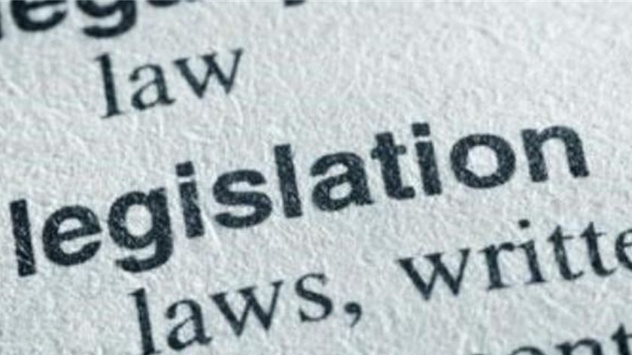
Terrorism Legislation

Slide 40

Why Do we need Terrorism Legislation?
To Provide the Police with Powers
To authorise Action to be taken
To Regulate Police Action
Notes:
Terrorism legislation is designed to address the specific challenges posed by acts of terrorism. Several key reasons necessitate the need for terrorism legislation:
Protection of National Security: Terrorism poses a significant threat to national security. Acts of terrorism can result in loss of life, destruction of property, and disruption of societal functions. Terrorism legislation provides a legal framework for governments to take action to prevent, investigate, and respond to terrorist acts.
Definition and Classification: Terrorism legislation provides clear definitions of what constitutes a terrorist act, including criteria related to intent, motive, and methodology. This enables law enforcement and the judicial system to differentiate between ordinary criminal activities and acts of terrorism.
Enhanced Investigative Powers: Terrorism legislation often grants law enforcement agencies enhanced investigative powers to gather intelligence, conduct surveillance, and arrest individuals suspected of involvement in terrorism. These powers are essential for identifying and preventing potential threats.
Preventive Measures: Terrorism legislation allows for proactive measures to identify and address radicalization and extremism before acts of terrorism occur. It includes strategies to counter the spread of extremist ideologies.
International Cooperation: Terrorism is a global issue, and international cooperation is crucial for addressing cross-border threats. Terrorism legislation often aligns with international agreements and conventions, allowing for collaboration with other nations in counter-terrorism efforts.
Punishment and Deterrence: Terrorism legislation establishes penalties for those found guilty of terrorism-related offenses. The legal consequences act as a deterrent to potential terrorists and those who might support or facilitate terrorism.
Protection of Human Rights: While terrorism legislation grants authorities certain powers, it is also expected to safeguard human rights. Many countries include provisions that require adherence to human rights standards and principles, ensuring that counter-terrorism measures respect individual freedoms and due process.
Response to Evolving Threats: Terrorism is an evolving threat, and legislation must adapt to new tactics and methods used by terrorists. Governments periodically review and update their terrorism laws to address emerging challenges.
Public Safety and Confidence: Effective terrorism legislation enhances public safety and instills confidence that the government is taking measures to protect citizens from the threat of terrorism. It also provides a legal basis for governments to respond to and manage crises.
It's important to strike a balance between effective counter-terrorism measures and the protection of civil liberties and human rights. Terrorism legislation is often subject to scrutiny and debate to ensure that it achieves its intended goals while respecting the rule of law and democratic values.

Slide 41
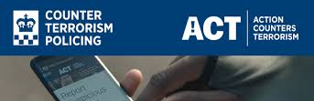
Why Do the Police need Powers?
Need to Question People
Need to Search People and Premises
Need to Arrest People
Need to Seize and detain Property
Notes:
The police require terrorism powers to effectively address and respond to the unique and often high-stakes challenges posed by acts of terrorism.
Prevention of Terrorism: Terrorism powers enable law enforcement agencies to take proactive measures to prevent acts of terrorism. This may include conducting surveillance, intelligence gathering, and investigations to identify and disrupt potential threats.
National Security: Acts of terrorism can pose a significant threat to national security, potentially resulting in loss of life, damage to critical infrastructure, and social disruption. Terrorism powers are necessary to protect the safety and security of the nation and its citizens.
Investigation of Terrorism Offenses: Terrorism legislation grants law enforcement the authority to investigate and prosecute individuals involved in terrorist activities. This includes gathering evidence, making arrests, and building cases against suspected terrorists.
Counterterrorism Operations: Specialized counterterrorism units and agencies are often established to respond to terrorist threats. These units are equipped with the training, expertise, and resources necessary to handle terrorism-related incidents.
Enhanced Surveillance: Terrorism powers may include provisions for surveillance, wiretapping, and monitoring of communications, enabling authorities to intercept and analyze information related to potential threats.
Emergency Response: In the event of a terrorist incident, law enforcement agencies need the authority to respond quickly and decisively. Terrorism powers provide the legal framework for emergency response actions, including securing scenes, evacuating areas, and managing crises.
Coordination with Intelligence Agencies: Terrorism powers often involve close cooperation with intelligence agencies to share information, analyze threats, and implement counterterrorism strategies effectively.
Protection of Critical Infrastructure: Critical infrastructure, such as transportation hubs, energy facilities, and government buildings, can be prime targets for terrorist attacks. Police with terrorism powers work to protect these assets and maintain their security.
Public Safety: Terrorism powers are used to enhance public safety by preventing, deterring, and responding to potential terrorist threats. This is essential to maintain the trust and confidence of the public.
International Cooperation: Given the transnational nature of terrorism, law enforcement agencies require the authority to collaborate with foreign counterparts and international organizations to address global terrorism threats.
It is important to note that while terrorism powers are necessary for effective counterterrorism efforts, they must be used in a manner consistent with the rule of law, human rights, and civil liberties. The balance between security and individual freedoms is a critical consideration in the development and application of terrorism powers.

Slide 42
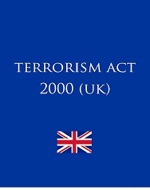
The Terrorism Act 2000
Defined Terrorism *
Outlawed ‘Proscribed Organisations’
Provided new Stop and Search Powers
Provided new Border Powers
Provided new offences of Weapons handling/Training
Introduced new ‘fund raising’ offences
Introduced 'snooping charter’ re mobile telephone data

Slide 43
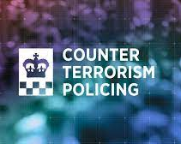
Terrorism Act 2000:
Problems with Police Powers
Allegations that Police Officers abused this power as it required no ‘Reasonable Suspicion’
Less than 1% of stops under this power resulted in arrest
Many photographers, tourists and train-spotters were stopped

Slide 44
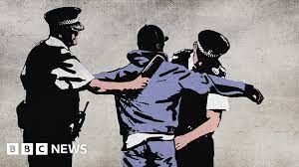
Stop and Search
Section 44 of the Terrorism Act allowed Police officers to Stop and Search people without Reasonable Suspicion
Section 44 also states that it is an offence to intentionally obstruct a police officer who is carrying out such a search.
A ruling by the European Court of Human Rights declared this power to be unlawful and it has since been repealed

Slide 45
Stop and Search
Section 44 was replaced via a Parliamentary Remedial Order.
It states that:
"Authorising Officers should only use the power when they reasonably suspect that an act of terrorism will take place, and he / she considers it necessary to prevent such an act".

Slide 46
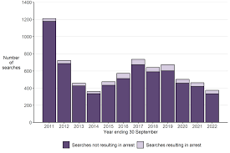
Stop and Search at Ports
The Guardian 2011 Reported:
“Asian people 42 times more likely to be held under terror law
People from ethnic minorities more likely than white people to be stopped under schedule 7 of the Terrorism Act”

Slide 47

Additional Legislation
Even though Lord Lloyds review of Terrorism Legislation and the Introduction of the Terrorism Act 2000 was supposed to bring terrorism legislation together more legislation was introduced following the 9/11 attacks most notably:
  The Anti-Terrorism Crime and Security Act 2001

Slide 48
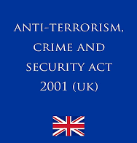
The Anti - Terrorism Crime and Security Act 2001
This Act permitted the Home Secretary to indefinitely detain without charge or trial foreign nationals suspected of terrorism.
The Tory/Lib Dem Coalition scrapped Control Orders which had been ruled unlawful by the House of Lords and replaced them with Terrorism Prevention and Investigation Measures (TPIM’s)
Notes:
The Anti-Terrorism, Crime and Security Act 2001 (ATCSA) is a piece of legislation in the United Kingdom that was enacted in response to the increased threat of terrorism, particularly after the 9/11 attacks in the United States. The Act was introduced to enhance the government's counter-terrorism powers.
Detention of Suspected Terrorists: One of the most controversial provisions of the ATCSA was the power to detain foreign nationals suspected of involvement in terrorism without trial. Under this Act, non-UK citizens could be detained indefinitely, leading to concerns about human rights violations.
Deportation: The Act also contained provisions for the deportation of foreign nationals suspected of involvement in terrorism, even if they might face torture or other ill-treatment in their home countries. These provisions were also controversial and raised human rights concerns.
Terrorism Offenses: ATCSA expanded the list of terrorism-related offenses and provided authorities with increased powers to investigate and prosecute those suspected of terrorism.
Freezing of Assets: The Act gave the government the authority to freeze the assets of individuals or organizations suspected of involvement in terrorism, preventing them from accessing their financial resources.
Control Orders: ATCSA introduced control orders, which allowed authorities to impose restrictions on individuals suspected of involvement in terrorism. These restrictions could include curfews, electronic monitoring, and limitations on communications and movements.
Aviation Security: The Act included measures to enhance aviation security, particularly in response to the heightened risk of terrorism involving aircraft.
Amendments to Other Laws: ATCSA amended various existing laws, such as the Terrorism Act 2000, to strengthen counter-terrorism provisions.
Review and Repeal: Some of the provisions of the ATCSA, particularly those related to detention without trial, were highly controversial and faced legal challenges. In response to these challenges, the government introduced the Prevention of Terrorism Act 2005, which replaced some of the most contentious parts of the ATCSA.
The ATCSA was seen as a significant piece of counter-terrorism legislation, but it generated considerable debate and criticism, particularly concerning the detention of foreign nationals without trial. It highlighted the ongoing challenge of balancing national security and individual civil liberties in the context of counter-terrorism efforts.

Slide 49
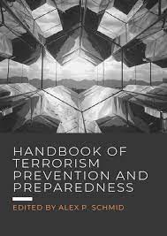
Terrorism Prevention and Investigation Measures
If you are subject to the TPIM’s you might not be able to:
Leave your house overnight, Go beyond the geographical boundaries decided by the Home Office
Take off your electronic monitoring tag, Talk to or meet with whoever you wanted
Have friends or family to your home unless approved by the Home Office, approval which can be removed at any time, Travel overseas
Stop the police or staff from the monitoring company entering and searching your home without a warrant
If you did any of these things in breach of the TPIM’s notice you could be put in jail for up to five years.
Notes:
Terrorism Prevention and Investigation Measures (TPIMs) are a set of counter-terrorism measures used in the United Kingdom to manage and monitor individuals who are suspected of involvement in terrorism but cannot be prosecuted or detained under the existing legal framework. TPIMs were introduced as part of the Terrorism Prevention and Investigation Measures Act 2011, replacing the previous control orders that were considered more restrictive.
Restrictions on Movement: TPIMs can impose geographical restrictions on the individual, requiring them to reside in a specified location or limiting their movements to a defined area. They may also be required to report regularly to a police station.
Electronic Monitoring: Individuals subject to TPIMs may be required to wear an electronic monitoring device, such as an ankle tag, to track their movements and ensure compliance with the restrictions.
Internet and Communication Restrictions: TPIMs can include limitations on an individual's use of the internet and other communication devices. Authorities may require them to provide details of their online communications.
Financial Reporting: Individuals may be required to report their financial transactions and provide information about their financial activities to authorities.
Associations: TPIMs can include restrictions on an individual's associations, preventing them from contacting certain individuals who may be of concern to authorities.
Travel Restrictions: Individuals may be prohibited from traveling overseas or may be subject to additional scrutiny when traveling.
Regular Review: TPIMs are subject to periodic review by the government to assess whether they should be continued or modified. The aim is to ensure that they remain necessary and proportionate.
Derogation from Human Rights: The use of TPIMs allows the government to derogate from certain human rights obligations, which means they can be applied even if they would otherwise be considered a violation of an individual's rights. However, the government must demonstrate that TPIMs are necessary to protect national security.
TPIMs are intended to provide a legal framework to monitor and manage individuals who are considered a security risk but cannot be prosecuted or detained due to insufficient evidence or other legal constraints. The use of TPIMs is subject to legal oversight and parliamentary scrutiny to ensure that they are applied in a manner consistent with human rights and the rule of law.

Slide 50
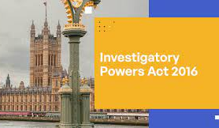
Investigatory Powers Act 2016
The so called 'Snoopers Charter' which allows the authorities 'hack' thousands of devices en masse,
Requires internet providers to collect browsing histories and make them available to public bodies,
Permits the mass collection of data .
Liberty (2019)
Notes:
The Investigatory Powers Act 2016, commonly known as the "Snooper's Charter," is a piece of legislation in the United Kingdom that governs the surveillance and investigative powers of various government agencies, including law enforcement, intelligence, and security agencies. The Act, which received royal assent in November 2016, consolidates and updates existing laws related to surveillance, data collection, and privacy.
Bulk Data Collection: The Act authorizes the bulk collection of communication data, including internet browsing history, from telecommunications and internet service providers. This data can be accessed by various government agencies for legitimate purposes, such as national security and law enforcement.
Interception of Communications: The Act provides legal powers for the interception of communications, including phone calls, emails, and internet communications. These powers are subject to strict oversight and require warrants from the Secretary of State.
Retention of Communications Data: It obliges communication service providers to retain customer communications data for a specific period, making it accessible to authorized agencies.
Equipment Interference: The Act allows security and intelligence agencies to engage in equipment interference, commonly known as hacking, to collect information from devices and networks.
Bulk Personal Datasets: Government agencies can collect, store, and analyze large datasets containing personal information about individuals for security and law enforcement purposes.
Authorization and Oversight: The Act establishes a system of judicial commissioners responsible for overseeing surveillance activities and authorizing warrants. This helps ensure that surveillance and data collection are conducted lawfully and proportionally.
Safeguards and Protections: The Act includes safeguards and privacy protections to limit the abuse of surveillance powers and to protect individual rights, such as the requirement to obtain warrants and conduct surveillance activities only for specified purposes.
Access to Encrypted Information: The Act grants authorities the power to compel technology companies to assist in breaking encryption or providing access to encrypted data when it is technically feasible and lawful.
Data Access by Law Enforcement: The Act allows various law enforcement agencies to access communications data and intercepted content for the investigation of criminal offenses.
Extraterritorial Reach: The Act has extraterritorial reach, meaning that it can apply to companies and individuals outside the UK if they provide services or equipment used within the country.
The Investigatory Powers Act 2016 has been a subject of significant debate and controversy, with concerns raised about its impact on individual privacy and civil liberties. It represents the UK's legal framework for surveillance, and its implementation is closely monitored to ensure that it complies with human rights standards and the rule of law.

Slide 51
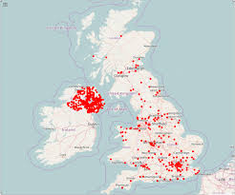
Policing Terrorism – UK Statistics
Since June 2002 865 people convicted on terrorism related charges
Over 70 people murdered including three police officers
Innocent member of public mistakenly shot

Slide 52
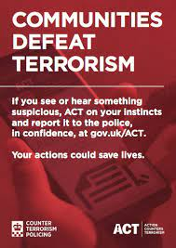
The Future?
Learn to live with some aspects and incidents of terrorism
Address the underlying causes
Avoid over militarisation
Follow Rule of Law
Recognise central role of intelligence
Coordinate all erasures e.g. finance, technology, forensic
Counter narrative against terrorist to undermine credibility
English (2009)

Slide 53
References
https://www.bbc.co.uk/news/uk-england-birmingham-54573551
https://terrorismlegislationreviewer.independent.gov.uk/wp-content/uploads/2014/07/2014-Public-Law-403-20.pdf
https://www.equalityhumanrights.com/en/human-rights/human-rights-act
Wilkinson, P. (2011). Terrorism versus democracy : the liberal state response (3rd ed.). Routledge.
https://www.ohchr.org/documents/publications/factsheet32en.pdf
http://www.liberty-human-rights.org.uk/human-rights/terrorism/control-orders/index.php
http://www.guardian.co.uk/uk/2011/may/23/counter-terror-stop-search-minorities
http://www.guardian.co.uk/commentisfree/libertycentral/2009/jan/22/explainer-terrorism-legislation
http://www.independent.co.uk/news/uk/home-news/photographers-snap-over-use-of-section-44-by-police-officers-1833839.html
http://www.homeoffice.gov.uk/publications/counter-terrorism/terrorism-act-remedial-order/
https://www.ons.gov.uk/aboutus/transparencyandgovernance/freedomofinformationfoi/muslimpopulationintheuk
https://www.gov.uk/government/statistics/operation-of-police-powers-under-the-terrorism-act-2000-quarterly-update-to-june-2021

Slide 54

Week 4 Complete!
Thank you for listening!
See you all next week!

