Slide 1
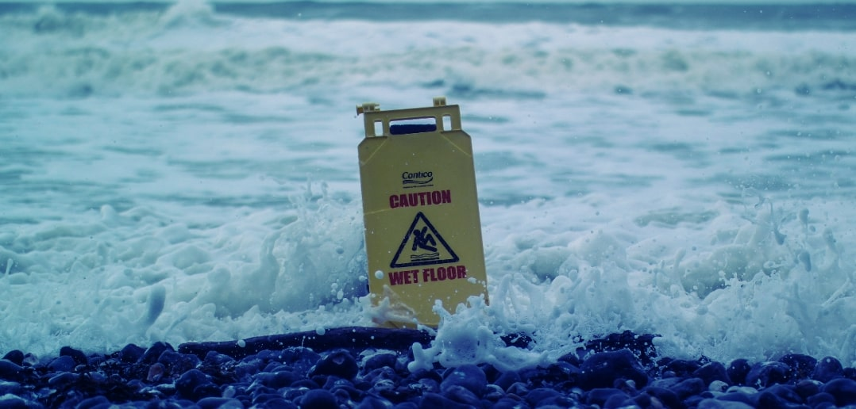

Notes:
I was thinking when it came to this that yeah the end is here. Not that I’m trying to blag my way through this but more our industry his hitting some really ambitious goals, and when you look back you can see that there is a problem. It’s us, notably us in the room, we’re the driving force and future of the industry but we consistently get ourselves into problems where we can be injured or worse expelled… I mean killed.
We constantly strive to improve our health and safety within the industry, but we’ve always lacked an enthusiastic approach, it’s always been this is the rule because we’ve run tests and in relation to this and that. I want to bring attention to you some numbers and a few little graphs of last years RIDDOR accidents.
Exciting I know! But, someone has to talk about it I guess.

Slide 2
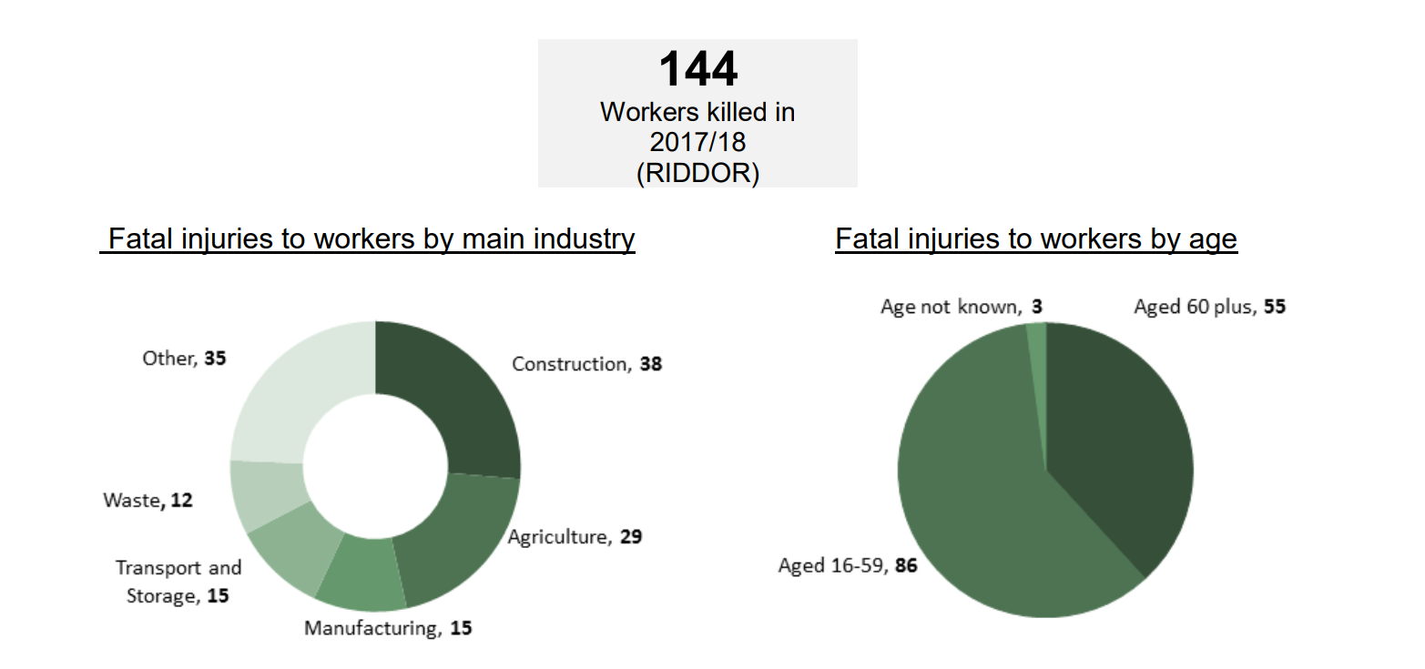
Notes:
Between 2017/18 there have been 144 fatalities associated with the construction industry in the UK. The construction industry is accountable for 38 of these fatalities, steadily since 2012 to 2018 there has been a flat downward trend in fatalities, however they are still prevalent. With this high proportion of fatalities this could perhaps be an indication that the industry needs new approaches to help improve current safety protocols or environments for workers, and for the public on sites.
Research in construction safety has typically been based on analysis on historical data, interviews, and evaluations on safety. These approaches have assisted in identifying issues on job sites, it’s believed that more quantitative techniques should be implemented to help identify safety management practices and their success in preventing injuries if applicable.

Slide 3
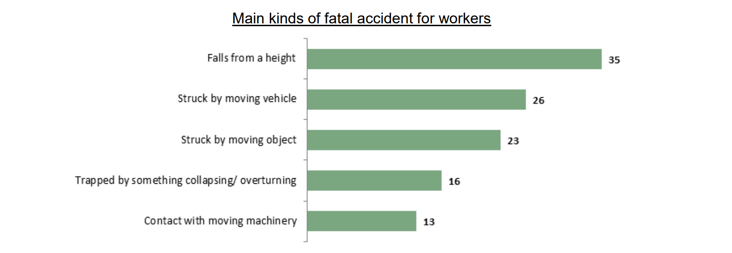
Notes:
Here is a breakdown of these accidents or fatalities involved. Mostly it’s due to heights. So remember from the last image the largest number was associated with the under 60’s and that’s putting us in there. Yeah we’re new to the site, but look back if you’ve been involved in a situation and someone said “Don’t use that, it’s a bit finnicky.” Or “Don’t listen to the supervisor, they haven’t fixed that, I advise…” I can personally tell you this has happened more than once to me when I’ve worked on site.
The work we do is dangerous, things can go wrong. Nothing in work sites is ever in tip top shape as the veil and ideas presented in H&S documents or videos. They often put the ideas of common sense as “You cheeky rascal you” and a lot of times they don’t factor the person themselves. Just “We better cover our own end and do what is expected, if they mess up it’s their fault” and that’s not entirely wrong, and it does show our negligence, quite often it is just our fault for taking a risk for our own convenience, which we shouldn’t do, but 9/10 times we do. There’s a reason Friday is called POETS day.

Slide 4

Notes:
So I have an idea. What about those people who have worked the normal everyday construction job for their whole career and went into retirement. I bet if you’ve spoken to anyone they have some interesting stories to tell. They’ve also been involved in some serious situations that they either got out of or learnt from. I have a thought that, perhaps if we stopped and listened to them and took on what they have to say. It could help our own situations and maybe even spark some ideas of change. It’s a long shot, maybe pointless, but they’ve been there as some of us haven’t and quite often we do ignore the “sensible” route of warnings. It’s also why I’ve not put any text on screen, you can listen and see if my idea is worth it, or you can stare at the pretty pictures. H&S isn’t exciting, but I guess being able to hit next Friday is.
So readying for the next slide, I’m proposing to gather information and potentially be able to test in controlled situations some ideas that others have tried, that don’t quite follow the standard rules. As Bear Grylls once said “Adapt and Overcome”.

Slide 5
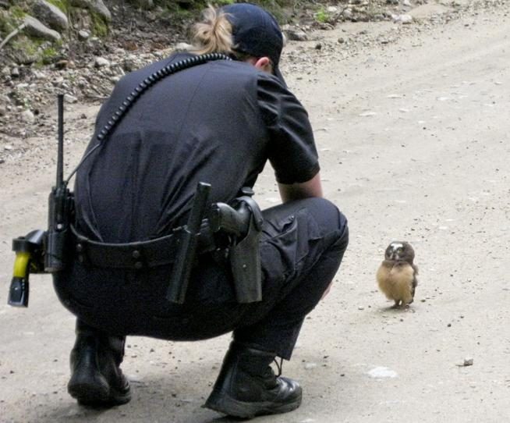

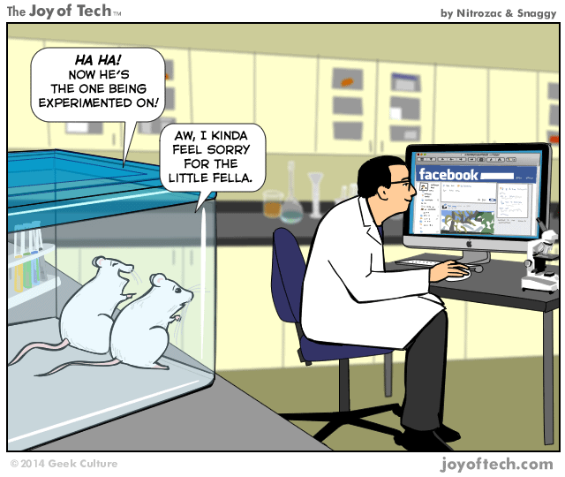
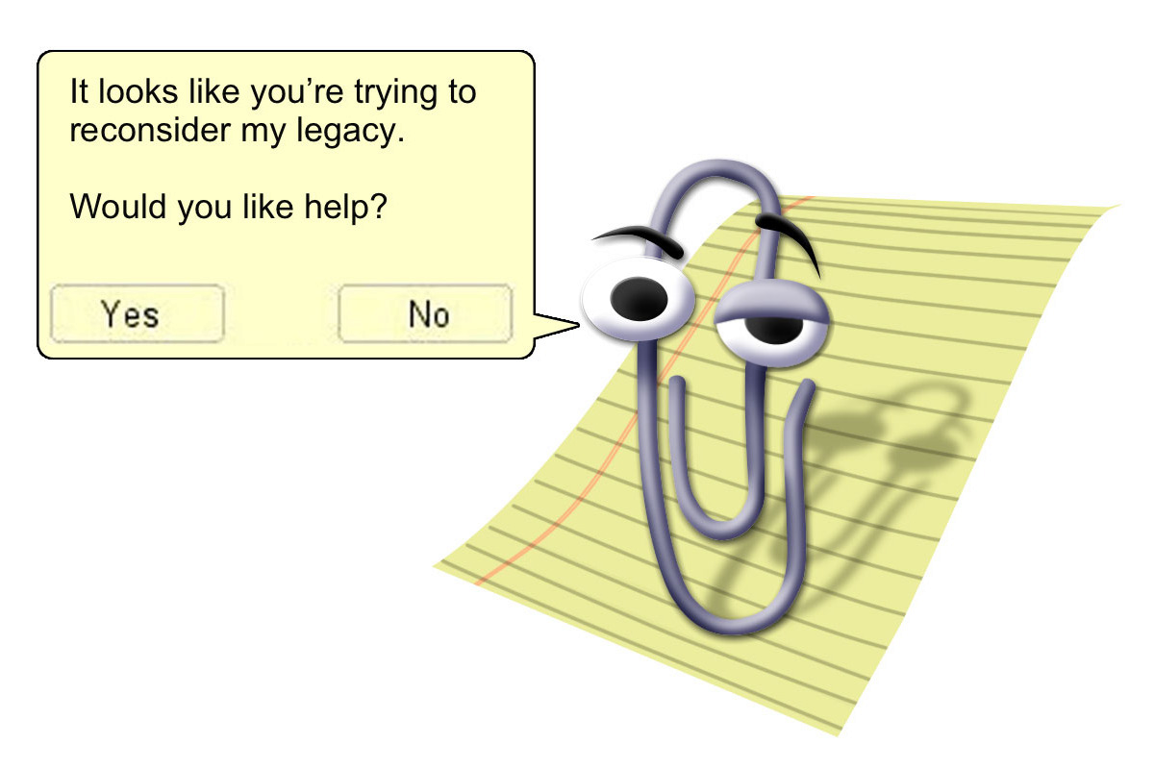
Assessment of safety factors
Identification of practices
Experimentation
It looks like you’re trying to do a Pecha Kucha.
Safety Recommendations
Notes:
Assessment of safety factors: Evaluate and identify the most common safety related factors in operations. This assessment will be performed looking into previous studies of construction safety, interviews with workers and managers, and possibly assessments on job site visits.
Identification of practices: Evaluate and identify the practices related to risks in operations. Survey questionnaires can be utilised to gather data on practices implemented by companies and their success in reducing incidents.
Experimentation: Once practices have been identified, an experiment could be designed and utilised to assess whether the practices are efficient in reducing near misses, injuries, and fatalities in operations. Different implementations can be studied to verify whether the practices are successful with safety incident reductions. Although with an experiment of this nature it is understood that the complexity and variation of construction, not to mention current ethics will allow this. Although, this challenge if allowed can be overcome with proper design, understanding of experiments that comply with health and safety, along with assistance with the construction industry.
Safety Recommendations: The optimal practices to help improve safety will be identified as a result of comparison of results from the experiment of the previous phase. This can provide information regarding a combination of different practices that can be utilised on job sites.

Slide 6
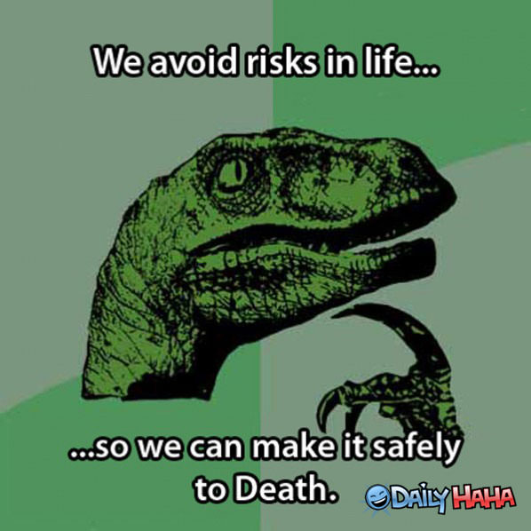
Notes:
Previously, safety research has brought a limited diagnosis to safety issues and lacked recommendations on how to improve the safety on construction sites. Recently, a shift has happened in which pre-construction design has been implemented to reduce hazards from operations. Other efforts have concentrated on the development of training and others in improving safety. What I’m proposing is a step forward in the same directions.
I think that qualitative and quantitative research can be utilised together in a way that can promote new strategies which can be monitored and their effect in reducing hazards evaluated. This approach could help outcomes derived from statistical analysis of current data such as interviews with personnel and the combined outcomes of different practices. The understanding of the most effective safety practices will be based on valid considerations of data from experiments and projects completed. These practices will be incorporated in the experiment, and analysis of data. Field data of different behaviours of workers with regards to situations and equipment in predefined hazard zones will be used to help accredit some procedures and data as needed. This information should hopefully allow a better identification of behaviour, while ensuring safety considerations in performing construction tasks.

