Slide 1

Goal Setting

Slide 2
Goal Setting with Clients
Once the client has decided which area they would like to develop, we can then support them in setting goals.
The aim of goal setting is to explore and consider different strategies that enable the cliet to feel motivated and engaged with moving forward.

Slide 3

Developing Goals
SMART goals
S – Specific
M – Measurable
A – Achievable
R – Realistic
T – Timebound
The more defined the goals are, the more likely theya re to be achievable

Slide 4
Clarifying Goals
When developing goals, it is also important to consider why they are being set and the reason for choosing that goal.
Considering our values is important when we are thinking about goals. We need to think about what is important to us.

Slide 5
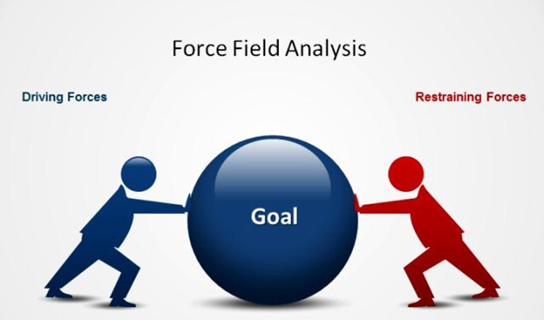
Force Field Analysis

Slide 6
Triad Work
In your skills practice each client identifies a goal. Within your triad, consider all the forces that are helpful to achieve the change and all the forces that are resisting the change.

