Slide 1
Module Name : Signals and System
Module Code : ACDA4009
Topic : ADC
Lecture : 5
Lecture By,
Mrs. Jenifer Prince Devaraj,
Lecturer - Embedded Electronics,
Faculty of Applied Computing,
UWTSD
Email:j.prince-devaraj@uwtsd.ac.uk

Slide 2
Analog to Digital Converter
LEARNING OUTCOMES
Upon the successful completion of this lecture, the student should be able to know:
ADC
Types of ADC
ACDA4009 – Signals and System

Slide 3
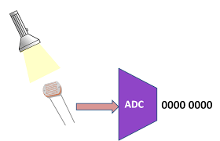
Analog to Digital Converter
ADC
An Analog to Digital Converter (ADC) converts an analogue signal into a digital signal.
The digital signal is represented with a binary code, which is a combination of bits 0 and 1.
ACDA4009 – Signals and System

Slide 4
Analog to Digital Converter
Types of ADC
      Direct ADC
      Indirect ADC
ACDA4009 – Signals and System

Slide 5
Analog to Digital Converter
      Direct ADC
      If the ADC performs the analogue to digital conversion directly by utilizing the internally generated equivalent digital (binary) code for comparing with the analogue input, then it is called as Direct type ADC.
ACDA4009 – Signals and System

Slide 6
Analog to Digital Converter
      Examples- Direct ADC
          Counter type ADC
          Successive Approximation ADC
          Flash type ADC
ACDA4009 – Signals and System

Slide 7
Analog to Digital Converter
      Counter type ADC
          A counter type ADC produces a digital output, which is approximately equal to the analogue input by using counter operation internally.
            The counter type ADC mainly consists of 5 blocks:
                Clock signal generator,
                Counter,
                DAC,
                Comparator and Control logic.
ACDA4009 – Signals and System

Slide 8
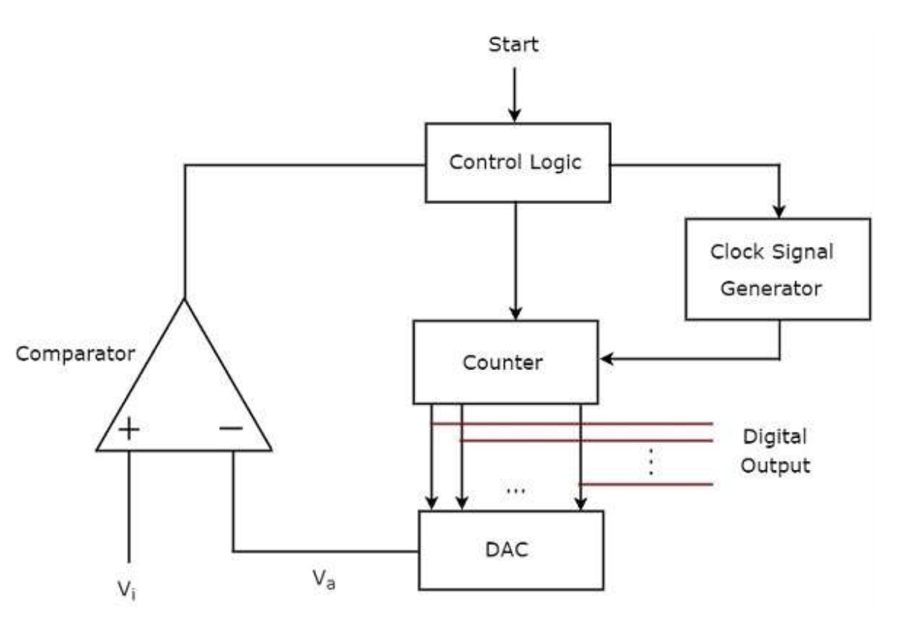
Analog to Digital Converter
      Counter type ADC
ACDA4009 – Signals and System

Slide 9
Analog to Digital Converter
      Counter type ADC
          Control logic : The control logic resets the counter and enables the clock signal generator to send the clock pulses to the counter, when it received the start commanding signal.
          Counter :
            The counter gets incremented by one for every clock pulse and its value will be in binary (digital) format.
            This output of the counter is applied as an input of DAC.
ACDA4009 – Signals and System

Slide 10
Analog to Digital Converter
          DAC :
          DAC converts the received binary (digital) input, which is the output of counter, into an analogue output.
          For an n-bit DAC, there are 2^n voltage levels. The voltage at each level is determined by the combination of bits that are set to '1' in the binary representation of the current count.
ACDA4009 – Signals and System

Slide 11
Analog to Digital Converter
          Comparator :
          Comparator output will be ‘1’ when 𝑉𝑖 >Va : if the control logic receives ‘1’ from the output of comparator.
          Comparator output will be ‘0’ when Vi ≤ Va :If the control logic receives ‘0’ from the output of comparator, the control logic disables the clock signal generator.
          The output of the counter will be displayed as the digital output which is almost equivalent to the corresponding external analogue input value Vi.
ACDA4009 – Signals and System

Slide 12
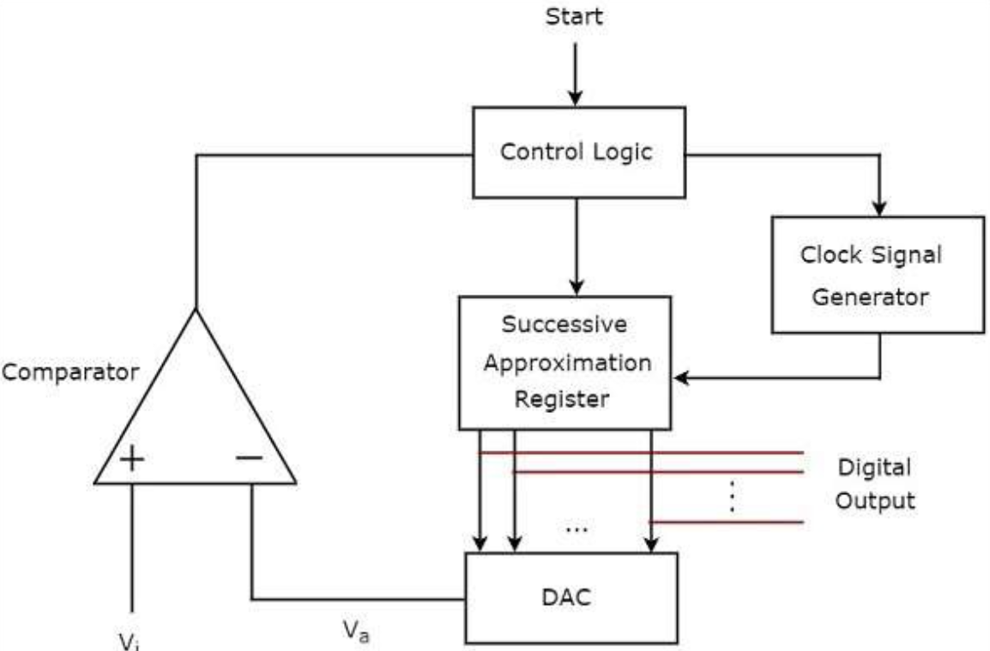
Analog to Digital Converter
      Successive Approximation ADC
ACDA4009 – Signals and System

Slide 13
Analog to Digital Converter
      Successive Approximation ADC
          A successive approximation ADC uses successive approximation Register internally.
          The successive approximation ADC mainly consists of 5 blocks Clock
                Control logic,
                Successive Approximation Register (SAR),
                DAC and
                Comparator
ACDA4009 – Signals and System

Slide 14
Analog to Digital Converter
      Operation of Successive Approximation ADC
          Start: The process begins with a start signal to the control logic.
          Control Logic (Bit Testing):
              The control logic initiates the bit testing sequence by setting the MSB in the SAR every time when the clock changes.
              The DAC converts the current digital code (starting with the MSB set) into an analogue voltage (𝑉𝑎​).
ACDA4009 – Signals and System

Slide 15
Analog to Digital Converter
      Operation of Successive Approximation ADC
          3. Clock: Control logic enables clock signal generator to send the clock pulses to SAR, when it received the start commanding signal.
          4. DAC:
          Input of the DAC will be updated by the Control Logic each for each clock cycle.
          The output of DAC will be the Analogue signal which will be the input signal of the comparator
ACDA4009 – Signals and System

Slide 16
Analog to Digital Converter
      Operation of Successive Approximation ADC
          5. Comparator(Comparison):
            The comparator compares 𝑉𝑎​ with 𝑉𝑖:
              If 𝑉𝑎​ is less than or equal to 𝑉𝑖, the bit remains set.
              If 𝑉𝑎 is greater than 𝑉𝑖, the bit is cleared.
              The result of the comparison is fed back to the SAR, updating the digital code accordingly.
ACDA4009 – Signals and System

Slide 17
Analog to Digital Converter
      Operation of Successive Approximation ADC
          5. Comparison(Iteration Continues):
            The process repeats for each subsequent bit from MSB to LSB.
            Each time, the SAR updates the digital code, the DAC converts it to an analogue voltage, and the comparator performs the comparison.
ACDA4009 – Signals and System

Slide 18
Analog to Digital Converter
      Operation of Successive Approximation ADC
          6. Digital Output:
            After all bits have been tested and set or cleared, the final digital output is available.
            This digital output represents the closest approximation of the input analogue signal within the ADC's resolution.
ACDA4009 – Signals and System

Slide 19
Analog to Digital Converter
      Example of SAR Operation: (For Input voltage is 10V)
          Initialization (Clock Cycle 0):
            The control logic initializes the SAR to 0000.
            The clock signal initiates the start of the conversion process.
          First Bit Testing (Clock Cycle 1):
          Set Bit 3 to 1: Digital code becomes 1000 (equivalent to 8 volts).
          DAC output (𝑉𝑎​ ) = 8 volts.
          Comparator: 𝑉𝑖 (10 volts) > 𝑉𝑎 (8 volts), keep Bit 3 as 1.
          Updated digital code: 1000
ACDA4009 – Signals and System

Slide 20
Analog to Digital Converter
      Example of SAR Operation:
          Second Bit Testing (Clock Cycle 2):
          Set Bit 2 to 1: Digital code becomes 1100 (equivalent to 12 volts).
          DAC output (𝑉𝑎) = 12 volts.
          Comparator: 𝑉𝑖 (10 volts) < 𝑉𝑎 (12 volts), clear Bit 2 to 0.
          Updated digital code: 1000
ACDA4009 – Signals and System

Slide 21
Analog to Digital Converter
      Example of SAR Operation:
          Third Bit Testing (Clock Cycle 3):
          Set Bit 1 to 1: Digital code becomes 1010 (equivalent to 10 volts).
          DAC output (𝑉𝑎​) = 10 volts.
          Comparator: 𝑉𝑖 (10 volts) = 𝑉𝑎 (10 volts), keep Bit 1 as 1.
          Updated digital code: 1010
ACDA4009 – Signals and System

Slide 22
Analog to Digital Converter
      Example of SAR Operation:
          Fourth Bit Testing (Clock Cycle 3):
          Set Bit 0 to 1: Digital code becomes 1011 (equivalent to 11 volts).
          DAC output (𝑉𝑎) = 11 volts.
          Comparator: 𝑉𝑖 (10 volts) < 𝑉𝑎 (11 volts), clear Bit 0 to 0.
          Updated digital code: 1010
ACDA4009 – Signals and System

Slide 23
Analog to Digital Converter
      Example of SAR Operation:
          Final Value
            Final Digital Code: 1010
            Equivalent Analog Value: 10 volts (in a 4-bit ADC with a reference range of 0 to 15 volts)
          The final digital code 1010 represents the closest approximation to the input analogue voltage of 10 volts, given the resolution of the 4-bit ADC. This digital output can then be used for further digital processing or display.
ACDA4009 – Signals and System

Slide 24
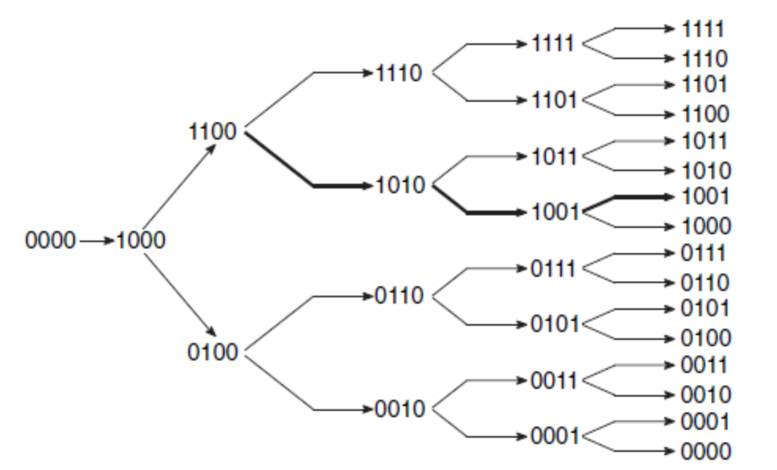
Analog to Digital Converter
      Successive Approximation Register Algorithm
ACDA4009 – Signals and System

Slide 25
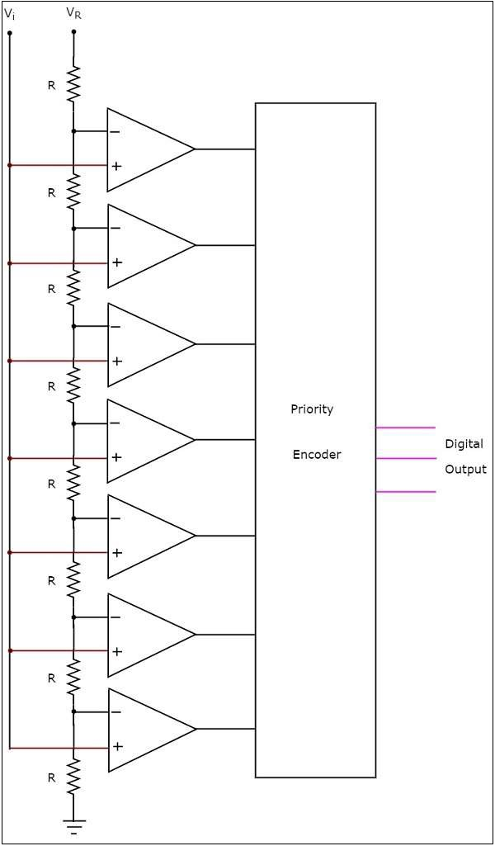
Analog to Digital Converter
      Flash Type ADC
          A flash type ADC produces an equivalent digital output for a corresponding analogue input in no time.
          It converts an analogue input signal into a digital output signal almost instantaneously by using many comparators, each corresponding to a specific voltage level.
          The flash type ADC is used in the applications where the conversion speed of analogue input into digital data should be very high.
ACDA4009 – Signals and System

Slide 26
Analog to Digital Converter
      Flash Type ADC
          Structure of Flash Type ADC
          A Flash ADC typically consists of the following components:
              Resistor Ladder Network
              Comparators
              Encoder
ACDA4009 – Signals and System

Slide 27
Analog to Digital Converter
          Resistor Ladder Network
            A series of resistors (R) connected in a ladder-like configuration.
            Divides the reference voltage (𝑉𝑅) into multiple reference levels.
            Each junction between resistors provides a different reference voltage to the comparators.
ACDA4009 – Signals and System

Slide 28
Analog to Digital Converter
          Comparators: A series of resistors (R) connected in a ladder-like configuration.
            Several comparators are shown, each with two inputs (+ and -).
            The inverting input (-) of each comparator is connected to one of the reference voltages from the resistor ladder.
            The non-inverting input (+) of all comparators is connected to the input analogue signal (𝑉𝑖).
            Each comparator outputs a digital signal:
                High (1) if 𝑉𝑖​ is greater than the reference voltage at the inverting input.
                Low (0) if 𝑉𝑖 is less than the reference voltage at the inverting input.
ACDA4009 – Signals and System

Slide 29
Analog to Digital Converter
          Comparators: A series of resistors (R) connected in a ladder-like configuration.
            Each comparator outputs a digital signal:
                High (1) if 𝑉𝑖​ is greater than the reference voltage at the inverting input.
                Low (0) if 𝑉𝑖 is less than the reference voltage at the inverting input.
ACDA4009 – Signals and System

Slide 30
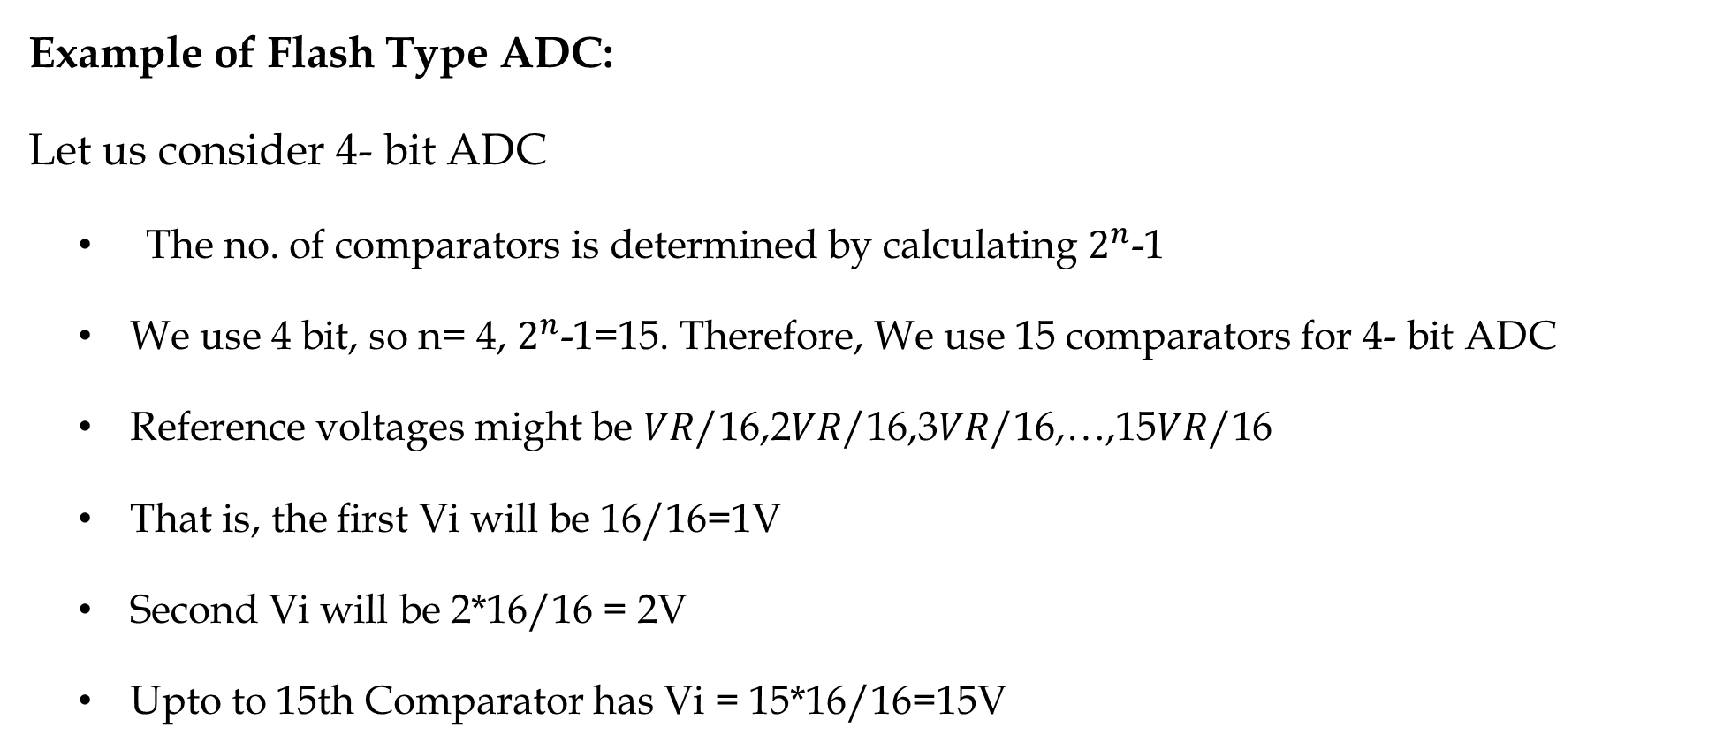
Analog to Digital Converter
          Example of Flash Type ADC:
          Let us consider 4- bit ADC
          The no. of comparators is determined by calculating $2^{n}$-1
          We use 4 bit, so n= 4, $2^{n}$-1=15. Therefore, We use 15 comparators for 4- bit ADC
          Reference voltages might be 𝑉𝑅/16,2𝑉𝑅/16,3𝑉𝑅/16,…,15𝑉𝑅/16
          That is, the first Vi will be 16/16=1V
          Second Vi will be 2*16/16 = 2V
          Upto to 15th Comparator has Vi = 15*16/16=15V
ACDA4009 – Signals and System

Slide 31
Analog to Digital Converter
          Example of Flash Type ADC:
          Assume Reference Voltages are1V, 2V, 3V, ..., 15V and the input voltage is 10V
          Comparator Outputs:
            Comparators with reference voltages 1V to 10V output 1 (since 𝑉𝑖=10𝑉 is greater than these reference voltages).
            Comparators with reference voltages 11V to 15V output 0 (since 𝑉𝑖=10𝑉 is less than these reference voltages).
ACDA4009 – Signals and System

Slide 32
Analog to Digital Converter
          Example of Flash Type ADC:
          Priority Encoder: The highest priority comparator that outputs a 1 determines the output code(from left).
          Comparator Outputs: 111111111100000
          For a 4-bit ADC, the binary representation of 10 is 1010 which is the output of the Encoder
ACDA4009 – Signals and System

Slide 33
Analog to Digital Converter
          Priority Encoder
Priority Encoder
Inputs | Output
100000000000000 | 1
110000000000000 | 2
111000000000000 | 3
111100000000000 | 4
111110000000000 | 5
111111000000000 | 6
111111100000000 | 7
111111110000000 | 8
111111111000000 | 9
111111111100000 | 10
111111111110000 | 11
111111111111000 | 12
111111111111100 | 13
111111111111110 | 14
111111111111111 | 15
ACDA4009 – Signals and System

Slide 34
Analog to Digital Converter
          Exercise
          Convert the Analogue 9V into Digital Output Using 4- bit Flash Type ADC
ACDA4009 – Signals and System

Slide 35
Thank You

