Slide 1
Kings and Courts

Slide 2
Monarchy
Constitutional Monarchy
Absolutist Monarchy
Monarchy Limited by a constitution (written or unwritten)
Does not set policy or choose leaders
‘reigns but doesn’t rule’
(e.g. Britain)
Theoretically unrestricted political power
Can have subordinate political entities, but serve at whim of monarch.
(e.g. Louis XIV ; ‘l’état c’est moi’)

Slide 3
Hereditary monarchy
'How do hereditary monarchies of the patrimonial type reproduce themselves from one ruler to the next, often over a period of centuries? (Spawforth 2007, 5 after Elias 1983)

Slide 4
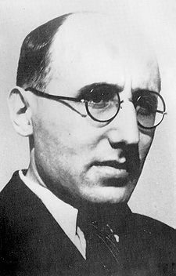
Norbert Elias and the study of courts
Born in Breslau in Prussia (1897)
Fought for German Army in WWI
Joined German Zionist movement (PhD in Philosophy 1922)
Joins Mannheim at Frankfurt in his sociological institute (to work on his habilitation Der höfische Mensch completed in 1933)
1933 flees to Paris
1935 to the UK (1939 LSE -> 1941 Cambridge -> 1954 Leicester in Sociology retired in 1962)
1969: Die höfische Gesellschaft. Untersuchungen zur Soziologie des Königtums und der höfischen Aristokratie (based on the 1933 habilitation). Neuwied/Berlin: Luchterhand. (Published in English translation by Edmund Jephcott as The Court Society, Oxford: Blackwell, 1983).

Slide 5
Elias Thesis (based on the court of Louix xiv)
The royal court served as a rational power game
Nobles could be virtual prisoners – unable to escape court without paying serious penalty
The people around the court were in fact people
The social pressures of the court shaped the people and the processes

Slide 6
Elite
Monarch
Court

Slide 7
Revisionist views of Elias
Overstated views on the absolutist nature of the court of Louix XIV
Underplays the role of mutual negotiation
Less exciting now – ‘trappings’ and ‘substance’ of monarchy
Use of sociological concepts (e.g. conspicuous consumption and status) (now the normal approach)

Slide 8
Ancient court societies
Assyria
Babylonia
Egypt
Homeric Greece
Macedon
Successor Kingdoms
Early Rome
Imperial Rome
China
India

Slide 9
Time Periods
For the purposes of this course, use comparative evidence but be careful in doing so. If you want to use evidence from the French court, you will need to be able to justify why.
The main focus will be on the Hellenistic period, but there are strong influences from earlier periods and things that may be visible only in later periods.

Slide 10
Levantine Courts
Neo-Assyrian Court
Egyptian Court
Neo-Elamite Court
Achaemenid Court
Courts in Asia Minor Anatolia
Macedonian Court
Alexander’s +
Seleukid/Ptolemaic Courts
Chinese Court
Sasanian Court
Roman and Byzantine Courts

Slide 11
Types of Sources
Literary
Epigraphic
Papyrological
Iconographic
Numismatic
Material remains

Slide 12
Example of Literary sources
When the army assembled at Apamea and a mutiny broke out among the soldiers on account of some arrears of pay that were owing to them, observing that the king was very nervous and alarmed at such a movement taking place at so critical a time, Hermeias engaged to discharge the whole sum due, if the king would consent that Epigenes should take no part in the campaign; as he said there would be no chance otherwise of anything being properly managed in the army in view of the bitterness of the quarrel between them. The king was displeased at this request, and would fain have refused, being anxious for Epigenes to accompany him on the campaign owing to his military capacity, but beset as he was and preoccupied through Hermeias' nefarious machinations by court etiquette and by a host of guards and attendants, he was not his own master, so that he gave way and acceded to the request. When Epigenes retired, as he was bidden, into civil life, the members of the council were intimidated by this consequence of Hermeias' jealousy, but the troops upon their demands being met experienced a revulsion of feeling and grew well disposed to the man who had procured payment of their pay.
Polybius 5.50

Slide 13
Epigraphic
Whereas in the beginning King Antiochos, son of King
Seleukos, having succeeded to the kingdom and conducting a
noble and honorable policy, sought to restore the cities
throughout the Seleukis, which were beset by difficult
circumstances because of those rebelling against the state, to
peace and their former prosperity, and (sought), by punishing
as was right those who attacked the state, to recover
his ancestral rule; for which reason, both pursuing a laudable
and just ambition and having not only his Friends and
the forces as his supporters in contending for the state, but
(having) also the divine as his well-disposed helper, he restored
the cities to peace and the kingdom to its previous
Condition;
…
with good fortune, be it decreed by the council and the
people that the priestess, the hieronomoi and the prytaneis
pray to Athena of Ilion together with the envoys that the
arrival of the king and his sister the queen, the Friends, and
the forces should have been for the best, and that all other
good things should come about for the king and the queen,
and that the state and their kingdom should last, increasing
as they themselves desire.
OGIS 219 = I.Ilion 32

Slide 14
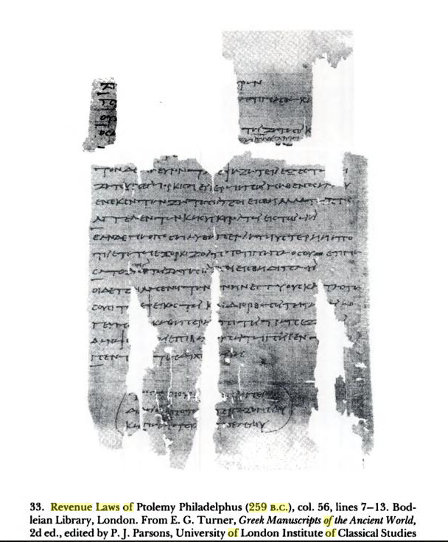

Slide 15
PEnt 26 = Select Papyri, 2.268
(Loeb)
To King Ptolemaeus greeting from Ctesicles. I am being wronged by Dionysius and my daughter Nicē. For though I had nurtured her, being my own daughter, and educated her and brought her up to womanhood, when I was stricken with bodily infirmity and my eyesight enfeebled she would not furnish me with any of the necessaries of life. And when I wished to obtain justice from her in Alexandria, she begged my pardon and in year 18 she gave me in the temple of Arsinoe Actia a written oath by the king that she would pay me twenty drachmae every month by means of her own bodily labour ; if she failed to do so or transgressed any of the terms of her bond, she was to forfeit to me 500 drachmae on pain of incurring the consequences of the oath. Now, however, corrupted by Dionysius, who is a comedian, she is not keeping any of her engagements to me, in contempt of my old age and my present infirmity. I beg you therefore, O king, not to suffer me to be wronged by my daughter and Dionysius the comedian who has corrupted her, but to order Diophanes the strategus to summon them and hear our case ; and if my words are true, let Diophanes deal with her corrupter as seems good to him and compel my daughter Nicē to yield me my rights. . . . For by this means I shall no longer be wronged, but having sought your protection, O king, I shall obtain justice. {Docketed} We have delegated . . . {Endorsed} Year 1, Gorpiaeus 30 Tubi 13. Ctesicles against Dionysius and Nicē his daughter concerning a written oath.

Slide 16
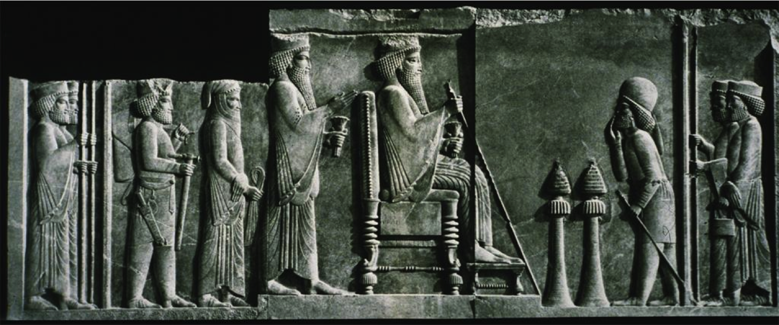
Persepolis palace relief

Slide 17
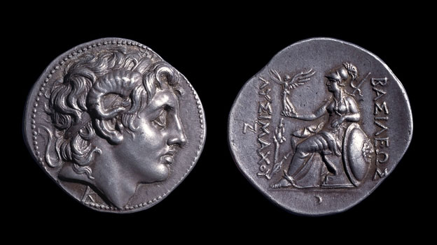
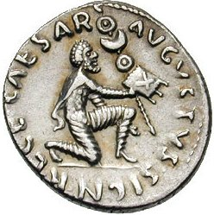

Slide 18
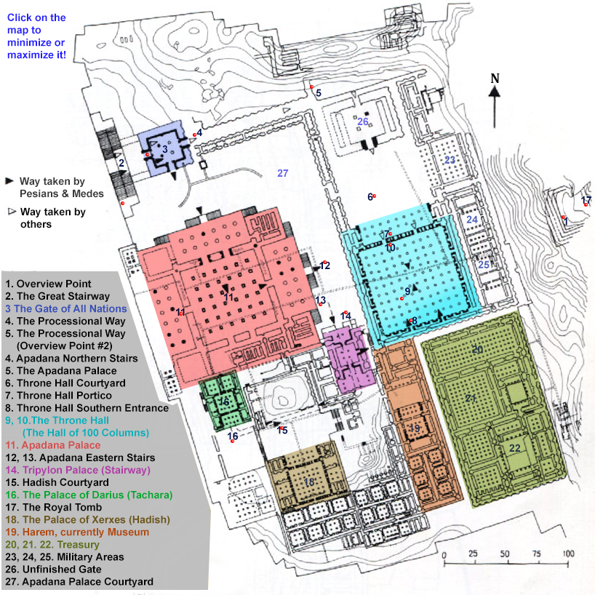

Slide 19
People at court

Slide 20
philia
Philia = ritualised friendship
xenia = ‘guest-friendship’

Slide 21
Philia
‘a mutually intimate, loyal and loving bond between two or a few persons that is understood not derive primarily from membership in a group normally marked by native solidarity, such as family, tribe, or other such ties. Friendship is thus what anthropologists call an achieved rather than an ascribed relationship, the latter being based on status whereas the former is in principle independent of a prior formal connection such as kingship.’ - Konstan 1997: 1.
Are there differences between ‘friends of the king’ and normal ‘friendship’
obligations of service v. obligations of friendship

Slide 22
Members of the court
Royal philoi
  Often come from beyond the empire – (according to Herman linked to philia and xenia networks)
    prōtoi philoi (first friends)
    timōmenoi philoi (honoured friends)
    prōtoi kai prōtimōmenoi philoi (first and highly honoured friends)
suntrophoi – people raised with the king
Kolakes (flatterers)
Parasitoi (parasites)
Tropheus (master of the pages)
Archiatros (Chief physician)
archigrammateus (chief secretary)

Slide 23
Binding members of the court
Philia and xenia relationships
Ritualised gift exchange
Fictive kinship: titles such as sungeneis or adelphoi (relatives or brothers)
‘philia at the royal courts had two functions. First, it was instrumental in creating unity by stressing that the philoi immediately surrounding the king belonged to the same status group and were ideally each other’s peers. Second, it created a sense of accord which in turn facilitated collective action.’ – Strootman 2014: 149

Slide 24
Herman, G 1997: 208
Many of the courtiers…were recruited through the instrumentality of xenia, an ancient form of fictive kinship… The Hellenistic rulers… availed themselves of pre-existing xenia networks to draw new allies into their orbit. These networks account not only for the preponderance of Greeks among the newly recruited Hellenistic court members, but also for the increasing similarities between the three courts. The Hellenistic court societies, then, did not operate in vacuo. Instead, they were part of a wider, interactive, international society of ritualized friends.

Slide 25
Sunedrion = royal council
King and his most powerful philoi
(e.g. for Alexander it included the hetairoi)
In theory, membership by the choice of the king
Present a united decision making front
Problem and importance of parrhēsia (freedom of speech)

Slide 26
Interacting at court
Banquets and symposia
Hunting
Royal weddings

Slide 27
Ath. 539e-f = Phylarchos FGrh 81 F 41
And Phylarchus, in the twenty-third book of his History [ Fr_41]… was far less than the daily sums squandered by Alexander; for he had a tent capable of containing a hundred couches, and fifty golden pillars supported it. And over it were spread golden canopies wrought with the most superb and costly embroidery, to shade all the upper part of it. And first of all, five hundred Persian Melophori stood all round the inside of it, clad in robes of purple and apple-green; and besides them there were bowmen to the number of a thousand, some clad in garments of a fiery red, and others in purple; and many of them had blue cloaks. And in front of them stood five hundred Macedonian Argyraspides; and in the middle of the tent was placed a golden chair, on which Alexander used to sit and transact business, his body-guards standing all around. And on the outside, and round the tent, was a troop of elephants regularly equipped, and a thousand Macedonians, in Macedonian uniform; and then ten thousand Persians: and the number of those who wore purple amounted to five hundred, to whom Alexander gave this clothing for them to wear. And though he had such a numerous retinue of friends and servants, still no one dared to approach Alexander of his own accord; so great was his dignity and the veneration with which they regarded him. And at that time Alexander wrote letters to the cities in Ionia, and to the Chians first of all, to send him a quantity of purple; [540] for he wished all his companions to wear purple robes.

Slide 28
Receiving ambassadors
Waiting (lots of waiting)
Entertainment and feasting
Acceptance of a gift by the king implied granting of (part of) the accompanying request

Slide 29
PERSIAN COURT? An example for Macedon?

Slide 30
Creation of the Persian Empire
Settlement in eastern Elam (Persis = modern Fars) c. 1000 BC
Tribal society made up of clans and extended family groups
Herodotus gives us 9 tribes (Pasargadae, Maraphians, and the Maspians, the settled Panthialaens, the Derusians and the Germanians, the nomadic Mardians, Dropicians and Sargartians) (Hdt. 1.125)
Pasargadae are the leading tribe by the time Cyrus II (559-530 BC) founds the empire
Achaemenid empire named after Achaemenes the founder of 'empire' (i.e. Cyrus' family kingdom)

Slide 31
Influences on Persian Court
Persian Tribal Society
Elam/Neo-Elamite court
Media
Lydia
Babylon
Assyria
Egypt

Slide 32
Court etiquette (from Media)
It was Deioces first who established the rule that no-one should come into the presence of the king, but all should be dealt with by the means of messengers; that the king should be seen by no man; and that it should be in particular a disgrace for any to laugh or to spit in his presence. He was careful to hedge himself with all this state in oder that men of his own age (who had been bred up with him and were nobly born as he and his equals in manly excellence), instead of seeing him and being thereby vexed and haply moved to plot against him, might by reason of not seeing him deem him to be changed from what he had been.
Hdt. 1.99

Slide 33
The importance of closeness and distance
Cyrus conceived a desire to establish himself as he thought became a king, but he decided to do so with the approval of his friends, in such a way that his public appearances should be rare and solemn and yet excite as little jealousy as possible… So Cyrus stationed a large circle of Persian lancers about him and gave orders that no-one should be admitted except his friends and the officers of the Persians and the allies.
Xen. Cyr. 7.5.37,41

Slide 34
Women at the court
Court of Nebuchadnezzar II (604-562 BC) – functionaries:
Chief baker
Chief of the kasiru
Superintendent of the palace
The major-domo
The functionary of the House of the Palace Women
The scribe of the House of the Palace Women
Chief Engineer
Chief of couriers (or chief barber)

Slide 35
Questions of Rank
[Will any of the] 'eunuchs' (and) the bearded (officials), the king's entourage, or (any) of his brothers or uncles
[his kin], his fa[ther's line], or junior members of the royal line, or the 'third men', chariot drivers (and) chariot fighters,
[or the recruitment officers, or] the prefects of the exempt military, or the prefects of the cavalry, or the royal bodyguard, or his personal guard,
[or the keepers] of the inner gates or the keepers of the outer gate, or the .. 'eunuchs', the mounted(?) scouts (and) trackers,
[or the lackeys, tailor]s, cup-bearers, cooks, confectioners, the entire body of craftsmen,
Or the Itu'eans and the Elamites, the mounted bowmen (?), the Hittites (or) the Gurreans, or the Aramaeans, [or the Cimmerians, o]r the Philistines, or the Nubians (and) the Egyptians or the Shabuqeans, [or the 'eunuchs' who b]ear [arms], or the bearded (officials) who bear arms and stand guard for the king.
SAA 4 no. 142 = Kuhrt 1995: 529-30

Slide 36
The person of the king
Through their (the bodyguard's) court also the king would go on foot, Sardis carpets, on which no-one else but the king ever walked, having been spread on the ground. And when he reached the last court he would mount his chariot, or sometimes his horse; but he was never seen on foot outside the palace. (Athen. 12.514c)
Whenever the king descended from his chariot…he never leaped down, although the distance to the ground was small, nor did he lean on anyone's arms; rather, a golden stool was always set in place for him, and he descended by stepping on this; and the king's stool-bearer attended him for this purpose. (Dionon apud Athen. 12.514)

Slide 37
People with Frequent access to the king
Servants (chiefly, but not exclusively Persian) (also often non-Persian eunuchs)
King's spear-bearer, bow-bearer, axe-bearer
Head of the king's bodyguard (hazarapatis)
Head of the palace administration
Head of the royal treasury
Chief scribe
Keeper of the gate
Priests
Nobles who serve as the the King's Councillors
Royal Judges
King's Eye
Physicians (often, if not exclusively, non-Persian)

Slide 38
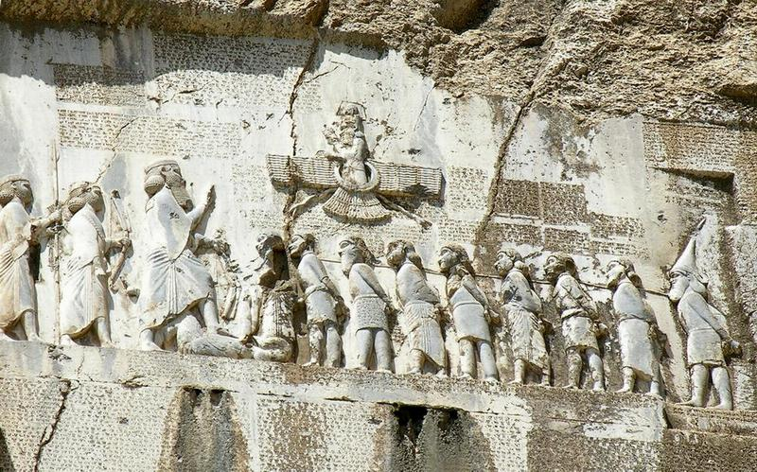
Notes:
At Naqshi-Rustam identified as Gobryas, the Patischoraean, spear-bearer of Darius the King
Aspathines, the bow-bearer, (who) holds the king's axe

Slide 39
The Persian Palace
The king himself, they say, lived in Susa or Ecbatana, invisible to all, in a marvellous palace with a surrounding wall flashing with gold, electrum and ivory, it had a succession of many gate-towers, and the gateways, separated by many stades from one another, were fortified with brazened doors and high walls; outside these the leaders and most eminent men were drawn up in order, some as personal bodyguards and attendants to the king himself, some as guardians of each outer wall, called Guards and Listening-Watch, so that the king himself, who had the name of Master and God might see everything and hear everything.
Ps.Aristotle, de Mundo 398a

Slide 40
Military v civil
Not a firm distinction
Hazarapatis = Chiliarch (in Greek) = military official
Under Darius I administrative head was Parnaka son of Arsames (uncle of the King)

Slide 41
Instructions
Tell Yamaksedda the wine-carrier, Parnaka spoke as follows: '2,000 quarts of wine are to be issued to Artystone the princess. It was ordered by the king.' Month 1, year 19. Ansukka wrote the text. Maraza communicated the message. (Fort. 1795)
http://ochre.lib.uchicago.edu/PFA_Online/

Slide 42
Officials
King's Councillors
  Royal family and nobility
    Act as political advisors
    Unclear how many there were or if there was ever a fixed number
    Probably ranked
  Royal Judges
    Permanent office
    Uneven in number (Diod. 15.10.1)
    Higher than the local judges in the satrapies
  King's Eye
    Intelligence gathering
  Royal Women
    Clearly present
    Can hold their own courts

Slide 43
Royal Physicians
Mostly from Egypt and Greece
  E.g. Democedes of Croton, Apollonides of Cos, and Ctesias of Cnidus
  Udjahorresnet (physician to Cambyses II)
  "His Majesty assigned to me the office of chief physician. He caused me to be beside him as a companion administrator of the palace. I made his royal titulary, his name being the King of Upper Egypt and Lower Egypt Mesuti-Re.'
  Brosius 2000: no. 20

Slide 44
Outer Court
Not as close to the king
Both permanent and temporary members
Extended royal family (often in service elsewhere)
Satraps (often family members)
Persian Nobility (i.e. the families of the six nobles that rebelled with Darius)\
  Intaphernes, Otanes, Gobryasm Hydarnes, Megabyxus, Ardumanish

Slide 45
Approaching the king
Officials regulate access
  Even those with access need to be summoned
    Cautionary tale of Intaphernes
  Outsiders often need to wait at the palace gate to be admitted (cf. Hdt. 3.140)

Slide 46
Dinner
All who attend upon the Persian kings when they dine first bathe themselves then serve in white cloths, and spend nearly half the day on preparations for dinner. Of those who are invited to eat with the king, some dine outdoors, in full sight of anyone who wishes to look on; others dine indoors in the king's company. Yet even those do not dine in his presence, for there are two rooms opposite each other, in one of which the king has his meal, in the other the invited guests. The king can see them through the curtain at the door, but they cannot see him. Sometimes, however, on the occasion of a public holiday, all dine in a single room with the king, in the great hall. And whenever the king commands a symposium (which he does often), he has about a dozen companions at the drinking. When they have finished dinner, that is, the king by himself, and the guests in the other room, these fellow-drinkers are summoned by one of the eunuchs; and entering they drink with him, though even they do not have the same wine; moreover, they sit on the floor while he reclines on a couch supported by feet of gold; and they depart after having drunk to excess.
Heracleides FGrH 689 F 2 = Athen. 4.145

Slide 47
Royal entourage
(after CurtIus Rufus 3.3.8-16)
Fire carried on 2 silver altars
Magi
365 men in purple robes
White horses pulling the chariot of Ahuramazda
Horse of the sun
10 chariots
Horsemen of 12 nations
10,000 immortals
15,000 royal kindred
Spear bearers
King's chariot
10,000 lancers
200 king's relatives on the right and left
30,000 infantry
400 king's horses
Chariots of the king's mother and king's wife
Women of the queen's household on horseback
King's harmamaxa for children and eunuchs
365 concubines
600 mules, 300 camels
The wives of the King's relatives and Friends
The troops of sutlers and batmen
The band of light-armed troops

Slide 48
Physical Space: Palace at persepolis
City not yet excavated
Royal terrace built 18 m above the ground (uses natural rock to support it)
Large fortification wall
Access to Terrace by Gate of Four Lands (big double staircase first)
Sit and wait
Apadana (Throne hall)
https://oi.uchicago.edu/collections/photographic-archives/persepolis/apadana

Slide 49
A city and the empire
The cedar timber was brought from a mountain called Lebanon. The Assyrian people brought it to Babylon. From Babylon the Carians and Ionians brought it to Susa. The sissoo-timber was brought from Gandara and Carmania. The gold which was worked here was brought from Sardis and from Bactria. The precious stone lapis lazuli and carnelian which was worked here was brought from Sogdiana. The precious stone turquoise, which was worked here, this was brought from Chorasmia. The silver and ebony were brought from Egypt. The ornamentation which the wall was adorned was brought from Ionia. The ivory which was worked here was brought from Ethiopia, and from India and from Arachosia. The stone columns which were worked here were brought from a village called Abiradu, in Elam. The stone-cutters who worked the stone were Ionians and Sardians. The goldsmiths who worked the gold were Medes and Egyptians. The men who worked the wood were Sardians and Egyptians. The men who worked the baked brick were Babylonians. The men who adorned the wall were Medes and Egyptians (Darius building inscription at Susa 4)

Slide 50
Knowing the king
And whenever Cyrus wished to honour anyone it seemed proper to address him by name. Furthermore, it seemed to him that those who were conscious of being personally known to the their general exerted themselves more to be seen doing something good and were more ready to abstain from doing anything bad. (Xen. Cyr. 5.3.47-8)
(Xerxes) riding in a chariot past the men of each nation he questioned them, and his scribes wrote all down, till he had gone from end to end of the infantry and cavalry. This done… Xerxes alighted from his chariot into a ship of Sidon, sitting wherein under a golden canopy he was carried past the prows of ships, questioning of them in the manner as of the army and making the answers to be written down. (Hdt. 7.100)

Slide 51
Giving and Receiving
And besides this he used to reward with gifts and positions of authority and seats of honour and all sorts of preferment others whom he saw devoting themselves most eagerly to the attainment of excellence; and thus he inspired in all an earnest ambition, each striving to appear as deserving as he could in the eyes of Cyrus (Xen. Cyr. 8.1.39)
'it was no less the mark of a king and lover of his fellow men to accept small gifts graciously and with a ready goodwill; and so, on a time when he was riding by, and a simple labourer, possessed of nothing else, took water from a river in his two hands and offered it to the king, he accepted it pleasantly and with cheerful smile, measuring the favour by the ready goodwill of the giver, and not by the service rendered by the gift.' (Plut. Mor. 172B)

Slide 52
Basics of the Macedonian Court

Slide 53
Political Organisation: Upper and Lower Macedonia
Lower Macedonia was mainly organised in feudal-type villages with several noble families being in the political forefront.
In the classical period, there was a gradual process of urbanisation.
The new cities, however, did not aspire to independence in the Greek model as far as we can tell.
Upper Macedonia was organised tribally with several ruling families (lesser royal houses).
There was little if any urbanisation, mainly due to the influence of the nearby tribes and the pastoral lifestyle of the inhabitants.

Slide 54
The Macedonian Kingship
The kingdom was hereditarily ruled by the Macedonian Royal House: the Temenids.
There was also an assembly of the Macedonians that had the right to elect the next king, as well as potentially depose him.
The king was the personification of the state and was the official representative of the state in relation to foreign affairs.
The king owned all land in the kingdom, held supreme command in war and was the ultimate judicial authority.
Service in war, taxes and dues were all rendered to the king, not the kingdom.

Slide 55
The Royal Court
There were two classes of nobles in the Macedonian court.
The hetairoi or Companions were members of the old noble families that could boast kinship ties with the Temenids. They were the king’s guard in war and his generals. The Royal Council was made up of Companions.
In the fourth century, the urbanisation process essentially created a “middle class” or a lesser class of nobles. They took up the ranks of a new type of Companion, the Pezaiteroi or Foot-Companions.

