Slide 1
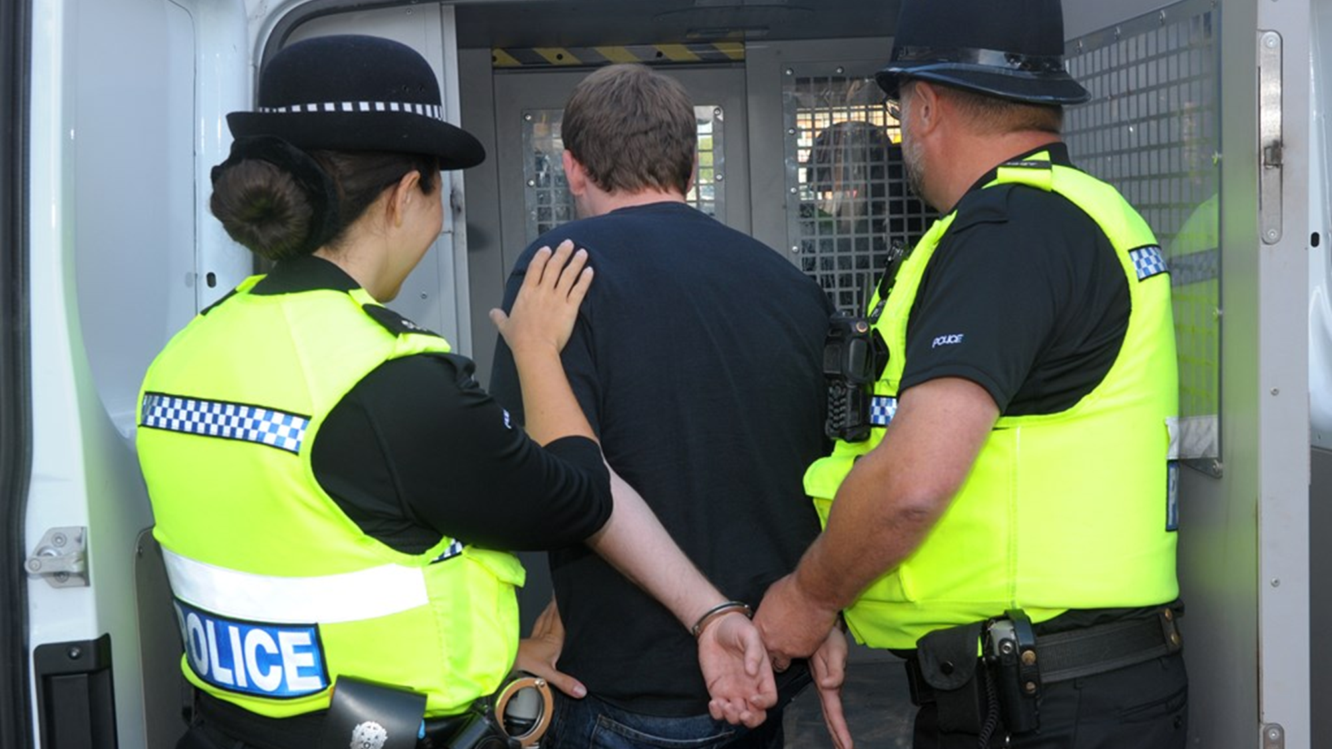
Code G of PACE 1984 and its impact on the approach to dealing with suspects

Slide 2
Introduction to Code G
Prior to Code G, the arrest power under Section 24 of PACE 1984 was broader, which sometimes resulted in inconsistencies and overuse.
Code G clarified the conditions for lawful arrest, ensuring it is only exercised when necessary.
There are multiple criteria and tests that arresting officers must check to prove that the arrest was lawful.
(Gov.UK, 2022)

Slide 3
Reasonable Grounds
A lawful arrest requires two elements:
A person’s involvement or suspected involvement or attempted involvement in the commission of a criminal offence;
AND
Reasonable grounds for believing that the person’s arrest is necessary.
both elements must be satisfied, and
it can never be necessary to arrest a person unless there are reasonable grounds to suspect them of committing an offence.
(Gov.UK, 2022)

Slide 4
Necessity Test
Arrest may be necessary if:
The suspect is a danger to themselves or others
The officer believes the suspect will not turn up to an interview or to court
The person has made false statements of their name and or address
To preserve evidence
And to prevent the suspect from fleeing
Officers must have valid reasons to believe that an arrest is necessary for these specific purposes to ensure a fair and lawful arrest.
(Gov.UK, 2022)

Slide 5
Necessity
Officers must also take into account the suspects circumstances and situation, the nature of the offence, and if arrest is necessary for the investigation.
Hayes v Chief Constable of Merseyside Police (2011), says that the necessity test is partly subjective. This has made it so police cannot arrest people just because, they must have reasonable grounds as well.
Code G prevents unnecessary detentions, easing the burden on police and the justice system. It promotes alternatives like voluntary interviews, reducing the impact on individuals.
(Gov.UK, 2022)
(Hayes v Chief Constable Merseyside Police [2011] 2 Cr App R 30).

Slide 6
Necessity of arrest: Minors
When dealing with minors who have committed offences it is necessary to ensure their safety before anything else.
The arrest of a minor should be the last resort unless there is a safeguarding issue.
In cases where the minor has been in possession of or has taken any classified substances it would be necessary to arrest to ensure that young person is safe.
(College of Policing, 2024)

Slide 7
Cautioning during arrests
Under PACE Code G, when making an arrest, a police officer must inform the individual that they are under arrest, state the grounds for the arrest, and deliver the standard caution.
If the police question someone without giving a caution, it’s still an "interview," but any evidence may be inadmissible.
This makes for a more fair and just trial as the suspect has the right to be aware and informed on what is going on and that what they say can be used against them in court.
(Liberty, 2024)

Slide 8
Unlawful Arrests and the Change Needed.
Examples of unlawful arrests corrected my Code G:
Discrimination (which is protected under Article 5 Human Rights Act 1998) (Gov.UK)
Lack of reasonable suspicion- Code G makes it so officers cannot arrest someone for a mere hunch.
Improper procedure- Code G makes it so officers must caution a suspect before arrest.
Extensive detention- police cannot keep a suspect longer than 24hrs unless they get a warrant to extend it to 36 hours.
(CPS, 2018)

Slide 9
Protection of Suspects Rights
Respecting the sanctity of the Human Rights Act is one of the most crucial parts of policing. Code G reinforces Article 5 which is the right to Liberty and Sanctity.
Police have previously failed to uphold this through unlawful detention, procedural failures, exceeding the permitted detention period, and holding someone without a valid justification.
But thanks to Code G these are being corrected and carefully watched to ensure fairness.
(Gov.UK, 2020)

Slide 10
Alternatives to Arrest brought by Code G
Code G requires officers to consider other practical alternatives to arrest:
Grant street bail after arrest
Report for summons or for charging by post
Issue a penalty notice
Youth offending services
(College of Policing, 2018)

Slide 11
Accountability and Transparency from Police
Code G has made it so police must be open and transparent about their proceedings during arrests.
They are required to record the reasons for the arrest and justify their actions.
This reduces the risk of the misuse of power from the police ensuring there is no discriminatory behaviour or actions taking place in the investigation.
(College of Policing, 2023)

Slide 12
Further Analysis of the Results of Code G
Since the implementation of Code G there has been a clear and significant change in how the police handle arrests and prisoners.
The police are more mindful and focused on ensuring equality and fairness.
Unnecessary arrests have gone down since Code G.
There is a rise in public understanding of legal procedures and people are becoming more aware of the process of arrest
The police have had to hold themselves accountable, reducing levels of discrimination and approaches of target hardening.
An overall improvement in trust and respect from the public.

Slide 13
References
College of Policing (2024) Children and young persons, College of Policing. Available at: https://www.college.police.uk/app/detention-and-custody/detainee-care/children-and-young-persons. (Accessed: 2 March 2025).
College of Policing (2023) Accountability, compliance and malpractice | College of Policing, www.college.police.uk. Available at: https://www.college.police.uk/guidance/pnc-and-leds/guidance-code-practice-pnc-and-leds/accountability-compliance-and-malpractice. (Accessed: 3 March 2025).
College of Policing (2018) Arrest and other positive approaches, College of Policing. Available at: https://www.college.police.uk/app/major-investigation-and-public-protection/domestic-abuse/arrest-and-other-positive-approaches. (Accessed: 3 March 2025).
CPS (2018) The Code for Crown Prosecutors, Cps.gov.uk. Crown Prosecution Service. Available at: https://www.cps.gov.uk/publication/code-crown-prosecutors. (Accessed: 4 March 2025).
Gov.uk (2020) Human Rights Act 1998, Legislation.gov.uk. Available at: https://www.legislation.gov.uk/ukpga/1998/42/schedule/1/part/I/chapter/4. (Accessed: 3 March 2025).
Hayes v Chief Constable Merseyside Police [2011] 2 Cr App R 30.
Home Office (2022) PACE Code G 2012, GOV.UK. Available at: https://www.gov.uk/government/publications/pace-code-g-2012/pace-code-g-2012-accessible. (Accessed: 2 March 2025).
Lexology (2012) Arresting development: changes to PACE Code G clarify law on arrest, Lexology. Kingsley Napley LLP. Available at: https://www.lexology.com/library/detail.aspx?g=e513bc5d-ce5d-47d4-b639-df0063aa3b1f (Accessed: 3 March 2025).
Liberty (2024) Police powers of arrest, Liberty. Available at: https://www.libertyhumanrights.org.uk/advice_information/police-powers-of-arrest-2/. (Accessed: 2 March 2025).
Wrongful Arrest And Unlawful Detention By The Police | Duncan Lewis (no date) www.duncanlewis.co.uk. Available at: https://www.duncanlewis.co.uk/Wrongful-Arrest--And-Unlawful-Detention-By-The-Police.html. (Accessed: 4 March 2025).

