Slide 1

University Of Wales
Trinity Saint David
MSc Property and Facilities Management
Research Methods and Professional Development
Lecturer: Chris House Created By: Allyn Pritchard
Submission Deadline: 30th March 23 Student No.: 1101011

Slide 2

An evaluation of whole Homes Assessments for Retrofit: The case of Social Housing
Figure 1

Slide 3
Contents
Introduction
Aims & Objectives
Current Literature
Methodology
Challenges
Timeframe
References
List of Figures
A4 Summary Sheet
Figure 1

Slide 4
Introduction
Background
Registered Social Landlords and Local Authorities currently carryout out stock condition surveys under WHQS every 5 years or at change of tenancy.
(Welsh Housing Quality Standard, 2008)
(Housing Stock Condition Survey’s: Guidance for Local Authorities , 2008)
WHQS 2023 (Draft), PAS 2035/PAS2038 and the Climate Change Act 2019 (Amendment) have now set new requirements for social landlords to produce a whole home assessment and a targeted energy pathways for each property, considering both building condition and social condition of properties.
(PAS 2035:2019 Retrofitting dwellings for improved energy efficiency, 2019)
(PAS 2038:2019 Retrofitting non-domestic buildings for improved energy efficiency, 2019)
Figure 1

Slide 5
Introduction cont.
Assumptions
WHQS 2023 launched without amendment from Welsh Government this year some time.
Whole Home Assessments and Targeted Energy Pathways are carried out as per pervious guidance (every 5 years or at change of tenancy).
Limitations
Both the current Stock Condition Reports and the new Whole Home Surveys are snapshots in time, and without whole home monitoring which is extremely costly, these reports can not reflect changes within the properties that the landlord is not aware of.
Figure 1

Slide 6
Aims & Objectives
Research Aim
Define the arbitrary frequency of a Whole Home Reassessment and at what point do you reassess.
Objectives
Identify what gaps exist within current guidance documents and legislation to support reassessment.
Evaluate PAS 2035/2038 and its role in reassessment.
Assess customers understanding of reassessment
  Consider the role of communication in best practice/legislation reassessment
  Assess what social markers are fit for reassessment.
Propose a best practice set of recommendations (or decision-making tool) for reassessment
Figure 1

Slide 7
Current Literature Within the Social Housing Sector
Legislation
Climate Change Act 2019 (Amendment).
Rented Homes Wales Act 2022 (Amendment).
Guidance/Standards Documents
Welsh Quality Housing Standard 2008.
Welsh Quality Housing Standard 2023 (Draft).
Housing Health and Safety Rating System Wales 2006.
PAS 2035:2019 Retrofitting dwellings for improved energy efficiency.
PAS 2038:2019 Retrofitting non-domestic buildings for improved energy efficiency.
Figure 1

Slide 8
Current Literature Within the Social Housing Sector cont.
Academic Literature
Current academic literature around whole home assessments is limited, with only very brief mentions within articles and Journals focus on retrofit at scale and Welsh housing.
“whole house” deep approach can provide huge financial, comfort, carbon and social benefits but that costs to undertake the retrofit works were still prohibitively high to undertake at scale”
(Patterson, 2016)
“Specific retrofit opportunities are identified via on-site home energy assessments that can be inconvenient to homeowners, expensive, and of variable accuracy”
(Zeifman, 2020)
Figure 1

Slide 9
Current Literature Within the Social Housing Sector cont.
“Understand the effectiveness of different retrofit approaches in practice, and the degree to which these approaches are evidence based, and applicable to the Welsh context”
(Green, 2020)
“PAS 2035 sets out a requirement for the proper assessment of dwellings and design and implementation of retrofits”
(Edwards, 2020)
Figure 1

Slide 10
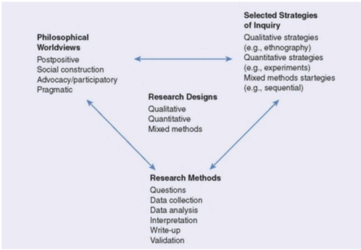
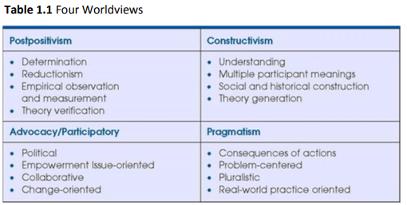
Methodology
Creswell states that there are 4 philosophical worldviews which influence research
(Creswell, 2009, p25)
(Creswell, 2009, p24)
Figure 1

Slide 11
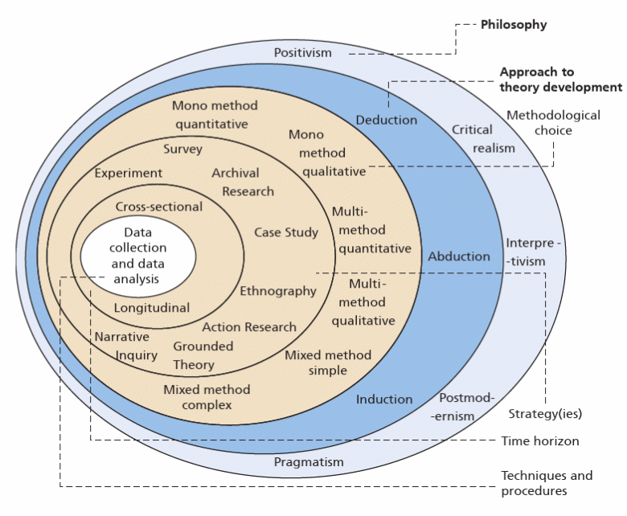
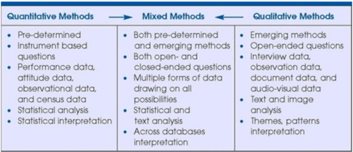
Methodology cont.
(Creswell, 2009, p32)
(Saunders, Lewis & Thornhill, 2019, p130)
Figure 1

Slide 12
Methodology cont.
Pragmatism approach based on real word problem solving.
Mixed Methods approach utilising both Quantitative and Qualitive Research.
    Housing Stock Information and data.
      This information will be quantitative data including, building energy performance , component replacement costs, etc.
    Interviews
      Interviews with unbased and balanced experts within the social housing sector, this would be from both registered social landlords and suitable qualified experts within retrofit, decarbonisation and asset management.
      Customers would also be interviewed to understand what baseline knowledge exists around retrofit.
    Questionnaires
      Questionnaires with the wider housing sector including customers. Both housing professionals and customers would have a tailor-made set of questions available to their respective settings.
      These would look at the wider landscape of retrofit and whole home assessment .
Grounded Theory using mixed methods to formulate a new approach.
Figure 1

Slide 13
Challenges
Currently Whole Home Surveys and Targeted Energy Pathways are not being completed due to WHQS 20023 still in draft form. Announcement Date of January 31st, 2023, has lapsed with no further comminutions from Welsh Government.
Reassessing social factors like overcrowding, hording, and other lifestyle choices is an extremely difficult task and can require specialist housing intervention.
Gap in literature, given how new Whole Home Surveys and Targeted Energy Pathways are.
Understand from customers.
Applying non-traditional construction logic to construction (Housing/Social).
Figure 1

Slide 14
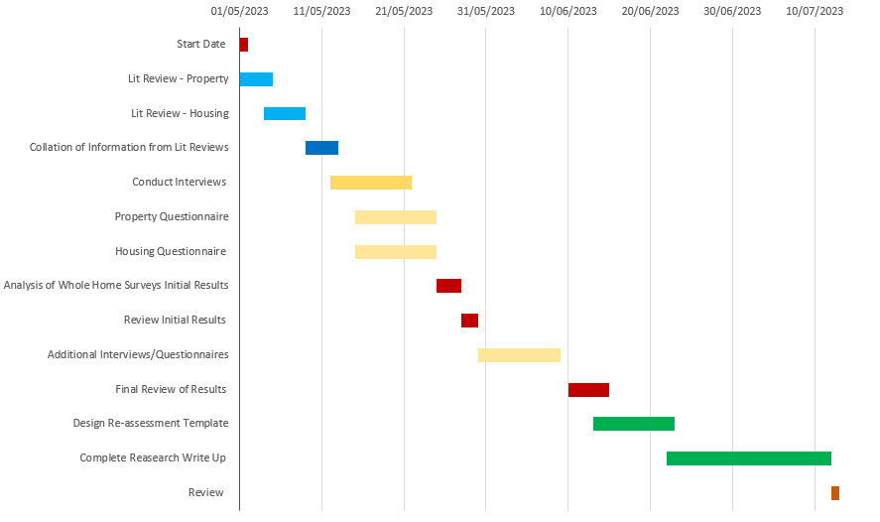
Timeframe
Figure 1

Slide 15
References
housinglin.org.uk, 2008. WHQS. [Online]
Available at: https://www.housinglin.org.uk/_assets/Resources/Housing/Regions/Wales/housingwhqsguide.pdf
[Accessed 20 February 2023].
gov.wales, 2008. Housing Stock Condition Survey’s: Guidance for Local Authorities. [Online]
Available at: https://www.gov.wales/sites/default/files/publications/2019-06/housing-stock-condition-surveys-guidance-for-local-authorities.pdf
[Accessed 20 February 2023].
BSI Group (2019). PAS 2035:2019 Retrofitting dwellings for improved energy efficiency. London British Standards Ltd.
BSI Group (2019). PAS 2038:2019 Retrofitting non-domestic buildings for improved energy efficiency. London British Standards Ltd.
Patterson, J. L. (2016). Evaluation of a Regional Retrofit Programme to Upgrade Existing Housing Stock to Reduce Carbon Emissions, Fuel Poverty and Support the Local Supply Chain. Sustainability, 1261-1261.
Zeifman, M. (2020). Residential retrofits at scale: opportunity identification, saving estimation, and personalized messaging based on communicating thermostat data. Energy Efficiency, 393-405
Green, E. (2020). Decarbonising the Welsh housing stock: from practice to policy. Buildings & Cities, 277-292
Edwards, J. (2020). New standards in retrofit. Property Journal, 20-21.
Creswell, J. W. (2009). Research Design: Qualitative, Quantitative, and Mixed Methods Approaches. London : Sage Publications Ltd.
Mark Saunders, Philip Lewis, Adrian Thornhill. (2019). Research Methods for Business Students. London: Pearson Education, Limited.
Figure 1

Slide 16
List of Figures
Figure 1
Saviour Energy Solutions Ltd[Online]
Available at: https://saviourenergysolutionsltd.com/energy-assessment/
[Accessed 20 February 2023].
Figure 1

Slide 17
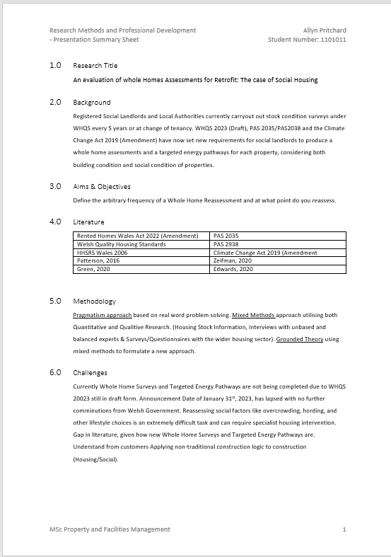
A4 Summary Sheet
Link to A4 Summary Sheet –
Presentation Summary Sheet - Allyn Pritchard.docx

Slide 18
Thank you very much any questions?

