Slide 1
AYESHA MASOOD 2220784
Quality Assurance and Service and Service Improvements
LCHS7006
Dr Fahad Khan
Component 1
Individual Presentation

Slide 2

Case Study:
Mid Staffordshire NHS Foundation Trust

Slide 3
Background
Between 2005 and 2009, patients at Mid Staffordshire NHS Foundation Trust experienced serious failings in care. Reports identified poor nursing standards, inadequate nutrition and hydration, delays in treatment and a lack of dignity and compassion (Francis, 2013).
The Public Inquiry found that these problems were linked to weaknesses in staffing, leadership, governance and organisational culture rather than one isolated error (Francis, 2013).
Aim
To examine the causes of the Mid Staffordshire scandal using the Swiss Cheese Model and consider how policy decisions affected the quality of care provided.

Slide 4

Several problems occurred at the same time:
Nurse staffing levels were too low to meet patient needs (Francis, 2013).
Patient complaints were often ignored or not investigated properly (Francis, 2013).
Staff concerns were not always listened to by senior managers (Dixon-Woods et al., 2014).
Clinical governance systems failed to identify declining standards of care (Scally and Donaldson, 1998).
Senior management focused heavily on achieving Foundation Trust status and meeting targets (Powell, 2013).
External organisations failed to respond quickly enough to warning signs (Francis, 2013).
These weaknesses developed across different parts of the organisation and contributed to poor patient care (Reason, 2000).

Slide 5
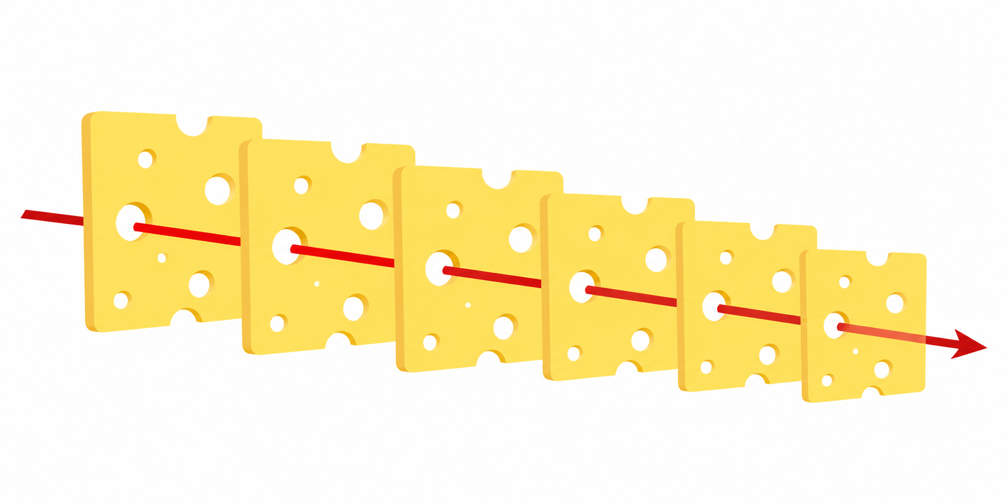
THE SWISS CHESSE MODEL
Appling to Mid Staffordshire NHS Foundation Trust
Patient harm occurs when weaknesses in multiple layers of defence align, allowing problems to pass through the system
Safe Staffing Systems
Ensure enough staff are available to provide safe patient care
Clinical Governance
Monitor quality standards and identify risks.
Incident Reporting and Complaints
Identify problems and learn from mistakes.
Leadership and Management
Support safe and effective patient care.
Regulatory Oversight
Detect poor performance and intervene when necessary.
Organisational Culture
Encourage staff to speak up and raise concerns.
System / Process Failures
Patient Harm
When weaknesses in several layers of defence align, failures can reach the patient and result in avoidable harm (Reason, 2000).

Slide 6
BENCHMARKING AND SERVICE IMPROVEMENT
Benchmarking compares performance against recognised standards to identify areas requiring improvement (Batalden and Davidoff, 2007).
INDICATOR | NATIONAL BENCHMARK | IMPROVEMENT FOCUS
Safe staffing levels | NHS Workforce Guidance | Increase nurse staffing
Patient experience | Friends and Family Test | Improve patient-centred care
Staff confidence to raise concerns | NHS Staff Survey | Strengthen speaking-up culture
Patient safety incidents | NHS Patient Safety Framework | Improve reporting and learning
Governance compliance | CQC Standards | Improve accountability

Slide 7
QUALITY MANAGEMENT – DONABEDIAN MODEL
Donabedian (1988) proposed that healthcare quality can be assessed through structure, process and outcome.
Structure
Staffing levels
Leadership arrangements
Governance systems
Process
Patient monitoring
Communication between staff
Complaint handling
Outcome
Poor patient experience
Increased risk of harm
Loss of public confidence
The Mid Staffordshire case shows how weaknesses in organisational structures affected care processes and led to poor outcomes (Donabedian, 1988).

Slide 8

POLICY ISSUES
Foundation Trust Reforms
NHS organisations were encouraged to achieve Foundation Trust status, creating pressure to focus on financial performance and targets (Powell, 2013).
Workforce Pressures
Nursing shortages across the NHS increased pressure on frontline staff and reduced workforce capacity (West et al., 2017).
Regulation
Regulators did not respond effectively despite concerns regarding mortality rates and patient complaints (Francis, 2013).
Organisational Culture
Staff often lacked confidence that concerns would be addressed appropriately (Dixon-Woods et al., 2014).

Slide 9
IMPACT ON SERVICE PROVISION
Quality
• Poor nursing care (Francis, 2013).
• Increased risk of patient harm (Francis, 2013).
• Reduced dignity and patient satisfaction (Francis, 2013).
Efficiency
• Significant costs linked to investigations and service improvements (Berwick, 2013).
• Increased monitoring and inspection requirements (Berwick, 2013).
Equity
• Older and vulnerable patients were affected most because they relied heavily on nursing care and support (Francis, 2013).
Public Confidence
The scandal reduced trust in NHS organisations and patient safety systems (Martin et al., 2023).

Slide 10
STRUCTURE OF COMPONENT 2 REPORT
Chapter 1 – Introduction
Chapter 2 – Literature Review
Chapter 3 – Overview of Mid Staffordshire NHS Foundation Trust
Chapter 4 – Swiss Cheese Model and Root Causes
Chapter 5 – Policy Issues and Service Delivery
Chapter 6 – Impact on Quality, Efficiency and Equity
Chapter 7 – Recommendations and Conclusion

Slide 11

SUMMARY
The Mid Staffordshire scandal shows how weaknesses in staffing, governance, leadership, reporting systems and organisational culture can combine to affect patient safety. The Swiss Cheese Model helps explain how these failures developed across different parts of the organisation (Reason, 2000). The case also highlights the importance of quality management, effective leadership and continuous service improvement within health and social care services.

Slide 12
Reference List
Batalden, P.B. and Davidoff, F. (2007) ‘What is quality improvement and how can it transform healthcare?’, Quality and Safety in Health Care, 16(1), pp. 2–3.
Berwick, D. (2013) A Promise to Learn – A Commitment to Act: Improving the Safety of Patients in England. London: Department of Health.
Dixon-Woods, M., Baker, R., Charles, K., Dawson, J., Jerzembek, G., Martin, G., McCarthy, I., McKee, L., Minion, J., Ozieranski, P., Willars, J., Wilkie, P. and West, M. (2014) ‘Culture and behaviour in the English National Health Service: overview of lessons from a large multimethod study’, BMJ Quality & Safety, 23(2), pp. 106–115.
Donabedian, A. (1988) ‘The quality of care: How can it be assessed?’, JAMA, 260(12), pp. 1743–1748.
Francis, R. (2013) Report of the Mid Staffordshire NHS Foundation Trust Public Inquiry. London: The Stationery Office.
Martin, G., Dixon-Woods, M., Leslie, M. and Minion, J. (2023) ‘A decade after Francis: is the NHS safer and more open?’, BMJ, 380, p. 513.
Powell, T. (2013) The Francis Report and the Government’s Response. London: House of Commons Library.
Reason, J. (2000) ‘Human error: models and management’, BMJ, 320(7237), pp. 768–770.
Scally, G. and Donaldson, L. (1998) ‘Clinical governance and the drive for quality improvement in the NHS in England’, BMJ, 317(7150), pp. 61–65.
West, M., Eckert, R., Collins, B. and Chowla, R. (2017) Caring to Change: How Compassionate Leadership Can Stimulate Innovation in Health Care. London: The King’s Fund.

