Slide 1
Converting Research into Practice LCDB 7010
Week 2 – Foundations of Social Research and Research Proposals
Notes:
Fill in the relevant information for the cohort

Slide 2
Session Plan
Presentation and Discussion on Crotty’s Foundation of Social Science Research
Reflect on your research topic vis-à-vis theory covered
Overview of Research Proposal and Discussion
  Logic and structure
  Basic criteria of successful research proposals
  Selling an idea
Activity on identifying research area/topic; research questions; objectives
Reflective reading on Part 2 of the Book by Descombe – Provide answers to the following questions ( 2- 3pm)
What is the aim of your research? What do we already know? What do we need to find out? How will we get the necessary information? How long will it take? Is the research socially acceptable? What will be the benefits of your research?
5. Workshop by Ivana on Library Resources - Upcoming workshops?

Slide 3
Article by Micheal Crotty on Introduction to Research
Week 1 - MichaelCrotty_1998_1IntroductionTheResea_TheFoundationsOfSocial Research.pdf
Present your understanding of the article next week in class

Slide 4
Forum Question ( Next week)
Discuss the methodological differences between Survey Research, Ethnography, Phenomenological Research, Grounded Theory and Action Research – Cite examples!

Slide 5
Foundations of social science research
Scaffolding
  Provides stability and direction
What methodologies and methods will be employed?
How do we justify the choice made?
  Answer lies in the Purpose of research
What methods do we propose to use?
• What theoretical perspective lies behind the methodology in question?
• What epistemology informs this theoretical perspective?

Slide 6
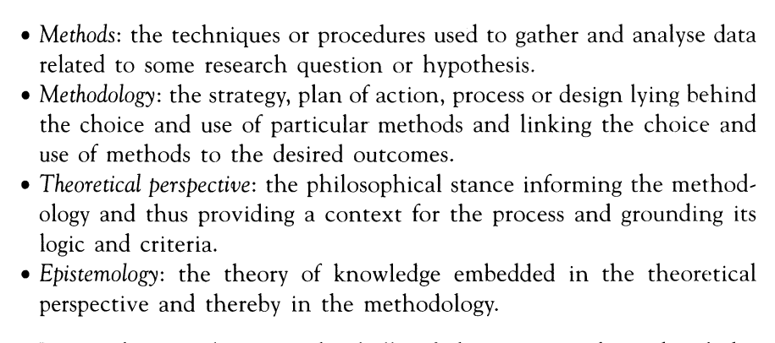

Slide 7
Reflections on Crotty’s article ?

Slide 8
RESEARCH PROPOSALS - logic of research proposals
Worthwhile
Feasible
Selling an idea …… a target audience

Slide 9
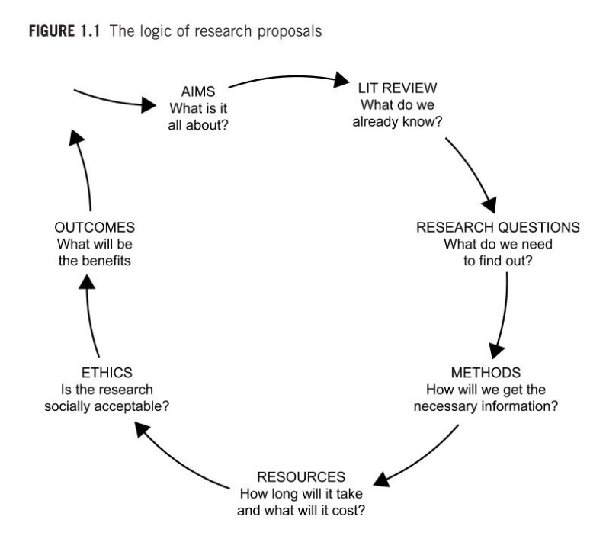
Logic of the research proposal

Slide 10
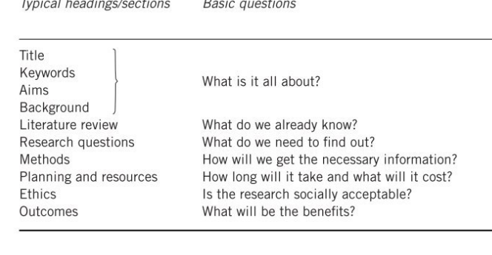

Slide 11
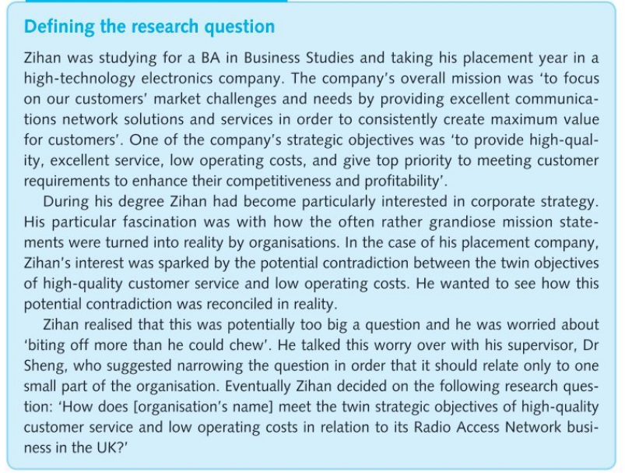

Slide 12
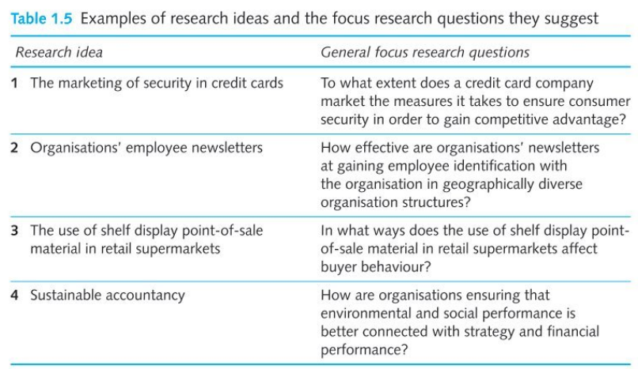

Slide 13
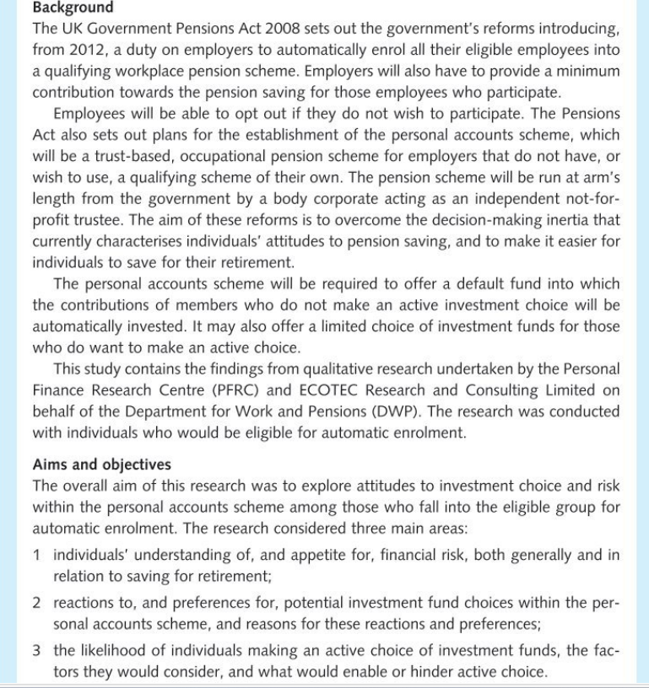

Slide 14
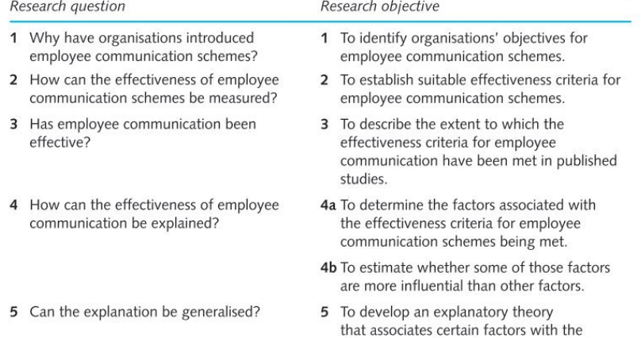

Slide 15
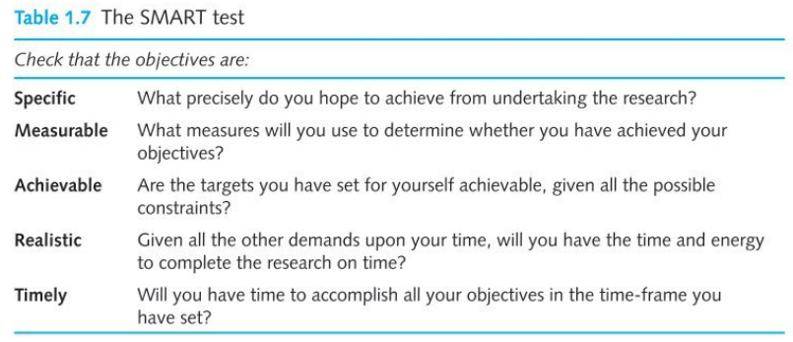

Slide 16
Class Activity:
RESEARCH IDEA/TOPIC AND POSSIBLE RESEARCH QUESTIONS

Slide 17
Class activity 2
Reading and reflecting and making notes on the Chapters 4- 10 (Martyn Denscombe 2012) – Book is available on the ONLINE reading list.

Slide 18
For Next Week:
How do I produce a good research proposal
Read Chapters Chapter 4- 10 (Martyn Denscombe 2012) – Book is available on the ONLINE reading list.
Complete your research proposal and do a presentation next week.
This is the basis of your Research Article (Assessment Part1)

Slide 19
Remember next week’s FORUM Question!
.

