Slide 1
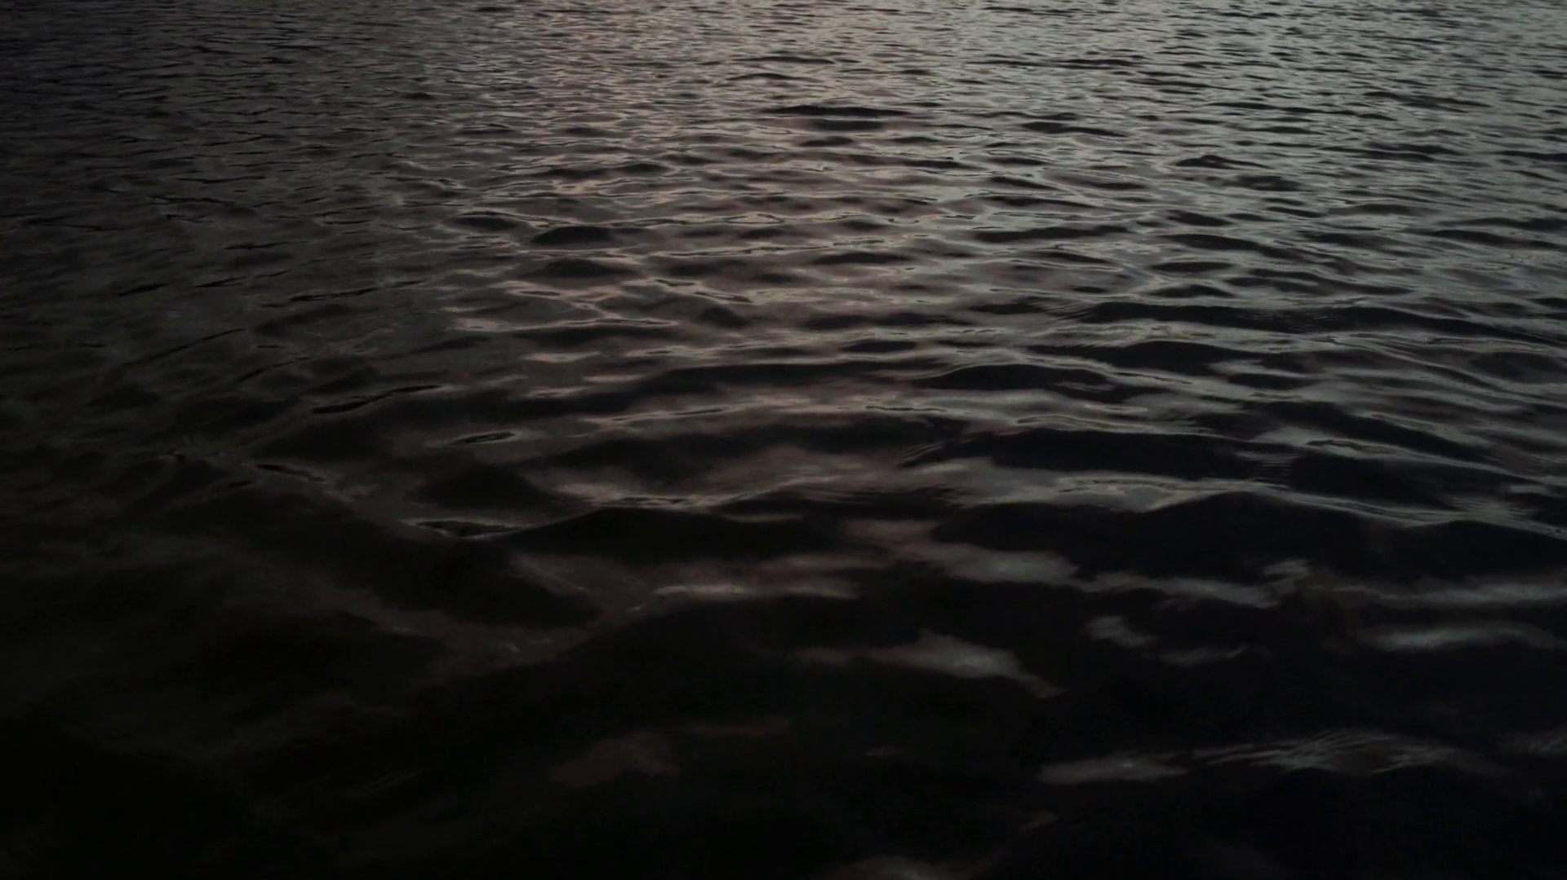

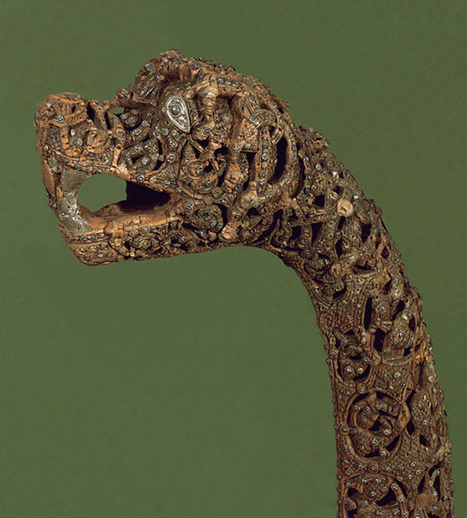
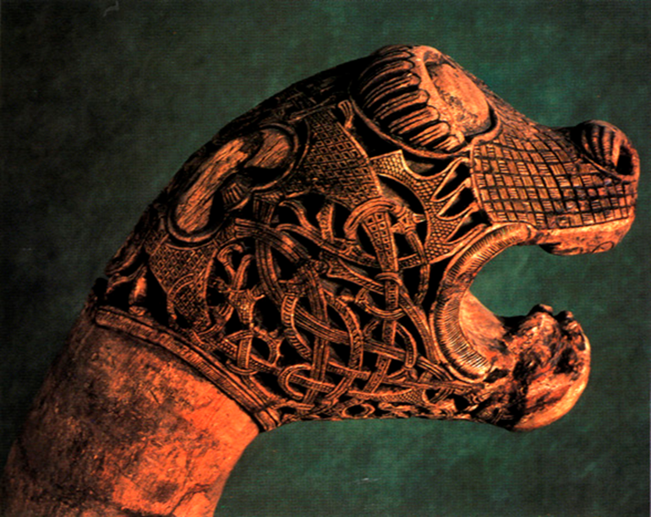
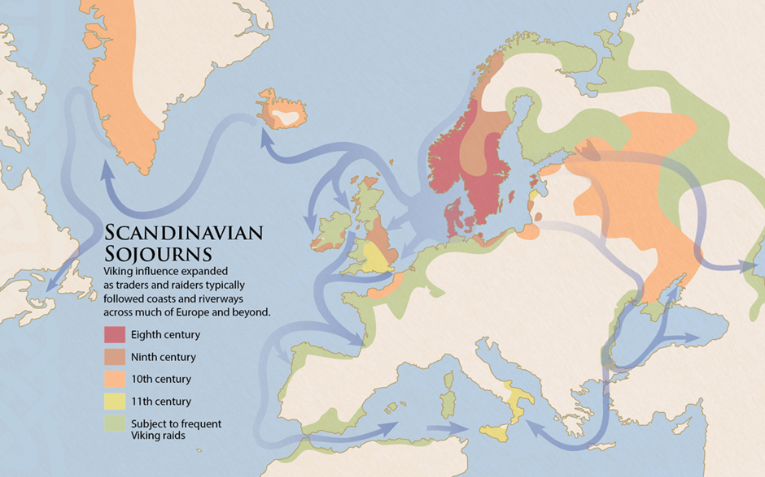
The Inspiration for Viking Monsters
By Samuel Beach UWTSD
Introduction:
This investigation was attempting to emulate Adrienne Mayor’s research into the origins of Greek and Roman myths and monsters but for the Viking myths and monsters instead. In doing so the aim was to prove that the myths and monsters of the Vikings were actually misinterpreted fossil remains or misidentified animals that lived alongside them.
Background:
The approach I took when starting to research the inspiration for the Vikings monsters is in large part inspired by the works of Adrienne Mayor, specifically The First Fossil Hunters published in 2000. In this volume Mayor describes how the Roman and Greek myths and monsters could have been influenced by an early version of palaeontology. Mayor states that fossils such as mammoths and dinosaurs could be the source of the myths of Satyr’s and Centaurs that pervade much of Greek and Roman myths (Mayor. A, 2000, p3) Originally I looked at pictorial evidence but switched to literature and then iconography to find the monsters I was trying to find the inspiration of.
Methodology:
The methodology used in my investigation is similar to Mayor’s in that it compared fossil evidence to descriptions of mythical creatures to be found largely in their iconography. However I will make the comparison with fish and aquatic fauna fossil remains to be found Scandinavia and Britain with the sea monsters found in the iconography of the Oseberg ship. Originally, I had hoped to use Pictorial evidences of Viking sea monsters as my second data set, as Mayor had used ancient Greek and Roman iconography and pictures to explore relationships between fossils and mythos, but after conducting some research into this it became clear that there is less relevant imagery to be found in the Viking material culture, and many of the images that can be used are of land-based monster. In the end my data sets became the Carved animal posts on the Oseberg Ship and Skeletal remains.
Data set 1:
Data set one is Iconography found in ships such as the Oseberg ship found in 1904 in Oseberg, Norway.
Data set 2:
Data set two is fish and aquatic faunal skeletal evidence and consists of the remains of fish and aquatic fauna fossils such as whales. The data set had to be limited to the known range of the Vikings such as Scandinavia, Britain and northern islands such as Iceland and Greenland.
Results:
I found several sites that had fish and evidence of whale remains, which suggests that there were large amounts of fishing and therefore a large amount of skeletal remains. However, many of these fish remains were not identified to a species and were just labelled as fish remains and were therefore not useful in identifying and comparing more complete skeletons to the Oseberg ship animal head posts.
There is no identifiable correlation between where the iconography I chose to look at and the aquatic faunal and fish remains I researched were found either . The only site relatively close to the iconography I was trying to compare to is that of Uppsala and its evidence of early whaling. Whilst whales are large creatures they do not actually bare any resemblance to the Oseberg ship’s iconography.
Conclusion:
There is not enough evidence to say whether the aquatic faunal remains and the fish remains could have been the origins of the sea monsters of Viking myth and legend. However, there is certainly no relationship between the fish records I used, or the site’s fish remains in Ludlow and the Oseberg ships animal head Posts. Even the evidence of whaling and therefore the catching of large animals cannot be claimed to be the origins of the iconography that I was researching
Reference List:
Carrot, J. Hall, A. Johnstone, C. Kenward, H. (2000/7) Assessment of Biological remains from Corve Street, Ludlow, Shropshire (site code: B1910A) Available at: https://www.york.ac.uk/inst/chumpal/EAU-reps/eau00-07.pdf (Accessed on 7/11/2018)
Colm (2012) Irish Archaeology. Available at: http://irisharchaeology.ie/2012/09/the-oseberg-viking-ship-burial/ (accessed on 9/11/2018)
Koffmar, L. (2018) Uppsala University. Available at: https://www.uu.se/en/news-media/news/article/?id=10954&area=2,6,10,16,22,34,42&typ=artikel&lang=en (accessed on 7/11/2018)
Mayor, A. (2000) The First Fossil Hunters Dinosaurs, Mammoths, and Myth in Greek and Roman Times. New Jersey: Princeton University Press.

