Slide 1



AI-Assisted Smart Estate,
Safety and IT Support
Management Platform
Final Viva Presentation
Name: Abubarkar Dembele
Student ID: 2128085
Supervisor: Dr Mohamed Ben Farah
Course: ACCA6020 Independent Project
🏙️ smart estate concept
🏠 estates 🌱 tenant grow plots 🧠 AI support 🔐 human review

Slide 2
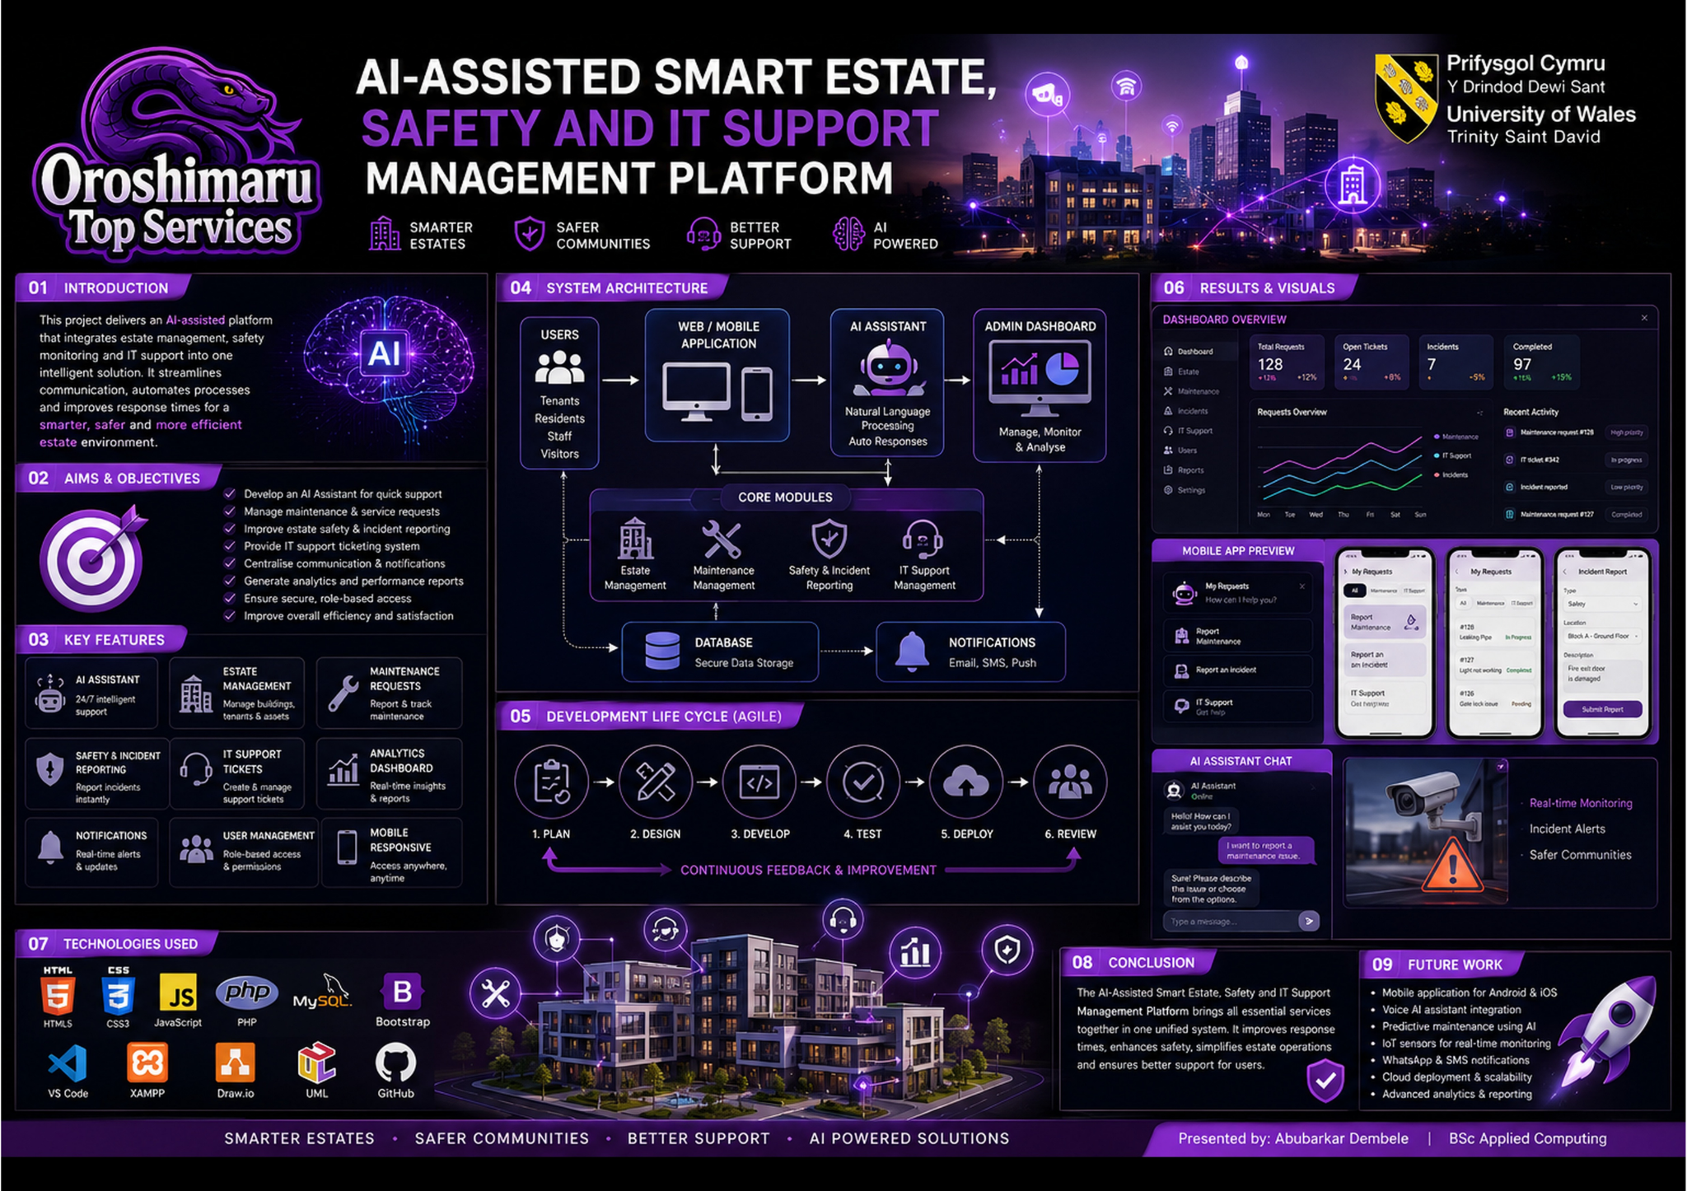
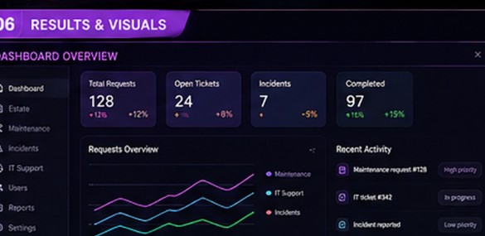
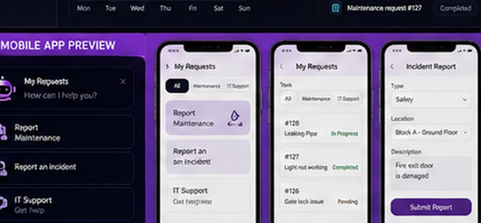
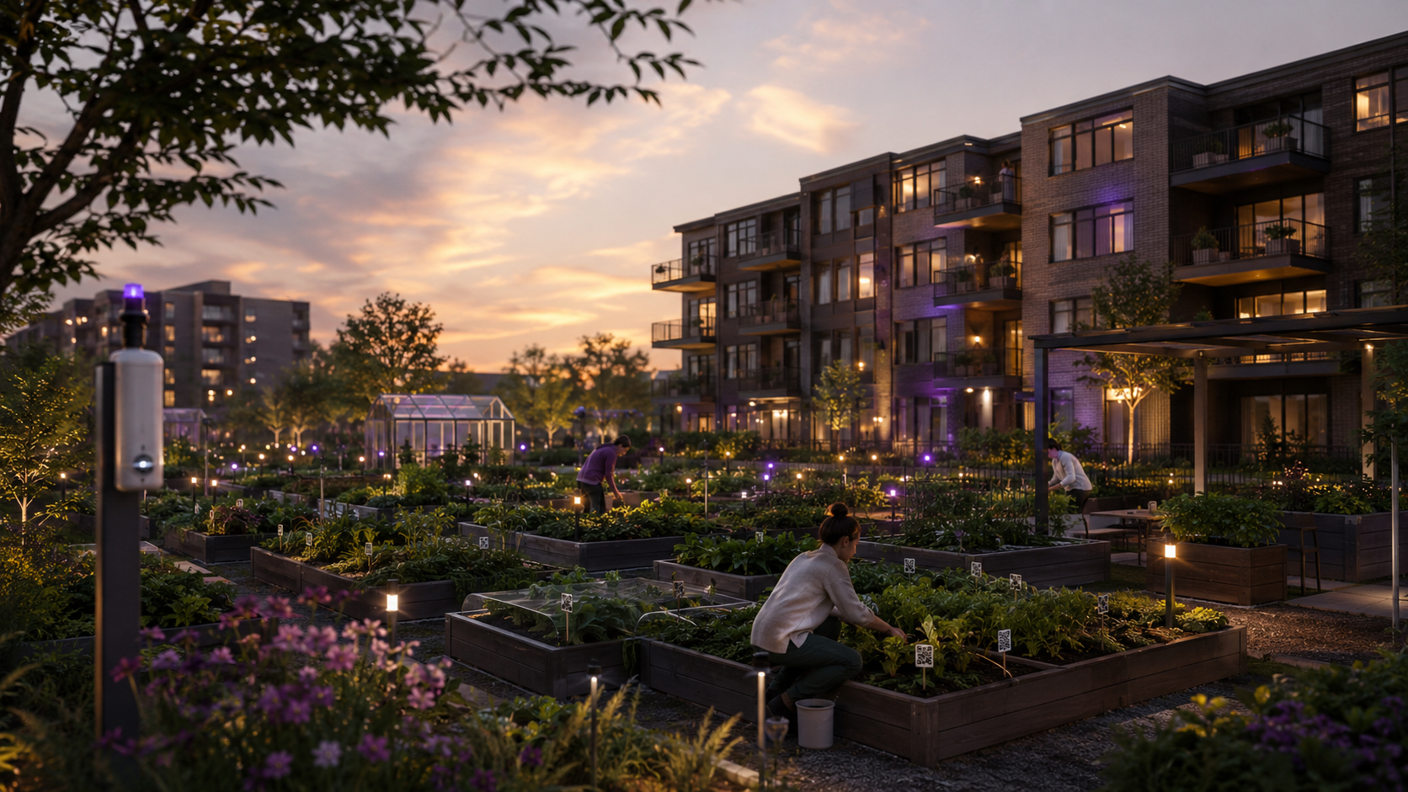
Viva story flow
02
📩
1 Problem
🎯
2 Aim
📚
3 Research
🛠️
4 Build
poster
dashboard
📲
5 Prototype
📊
6 Evaluate
🔐
7 Risks
🌱
8 Future
Problem → build → prototype evidence → evaluation → risks → future.
mobile
future plots
Final Viva • Abubarkar Dembele

Slide 3


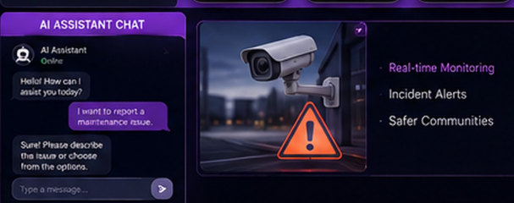
Problem and rationale
03
ODTS requests arrive through WhatsApp, social media, calls and email.
Scattered channels risk missed enquiries and slow follow-up.
The prototype captures, classifies, tracks and reviews requests with AI draft support [1][3][4].
IT support
service tracking
Core issue: accountability. Record the request, review and next action.
estate work
AI draft
Final Viva • Abubarkar Dembele
[1][3][4]

Slide 4
Aim, objectives and research questions
04
🎯 Aim
Design, develop and evaluate an AI-powered service platform prototype for ODTS.
RQ1 📩
What problems come from disconnected service channels?
RQ2 🧠
Which AI-assisted functions are useful and appropriate?
Review AI, estate, maintenance, usability and responsible AI literature.
Identify requirements.
Build and evaluate V1: request capture, AI suggestion, ticket tracking and admin review [12][13].
RQ3 📊
How usable, understandable and trustworthy is Prototype Version 1?
form
concept
Final Viva • Abubarkar Dembele
[12][13]

Slide 5
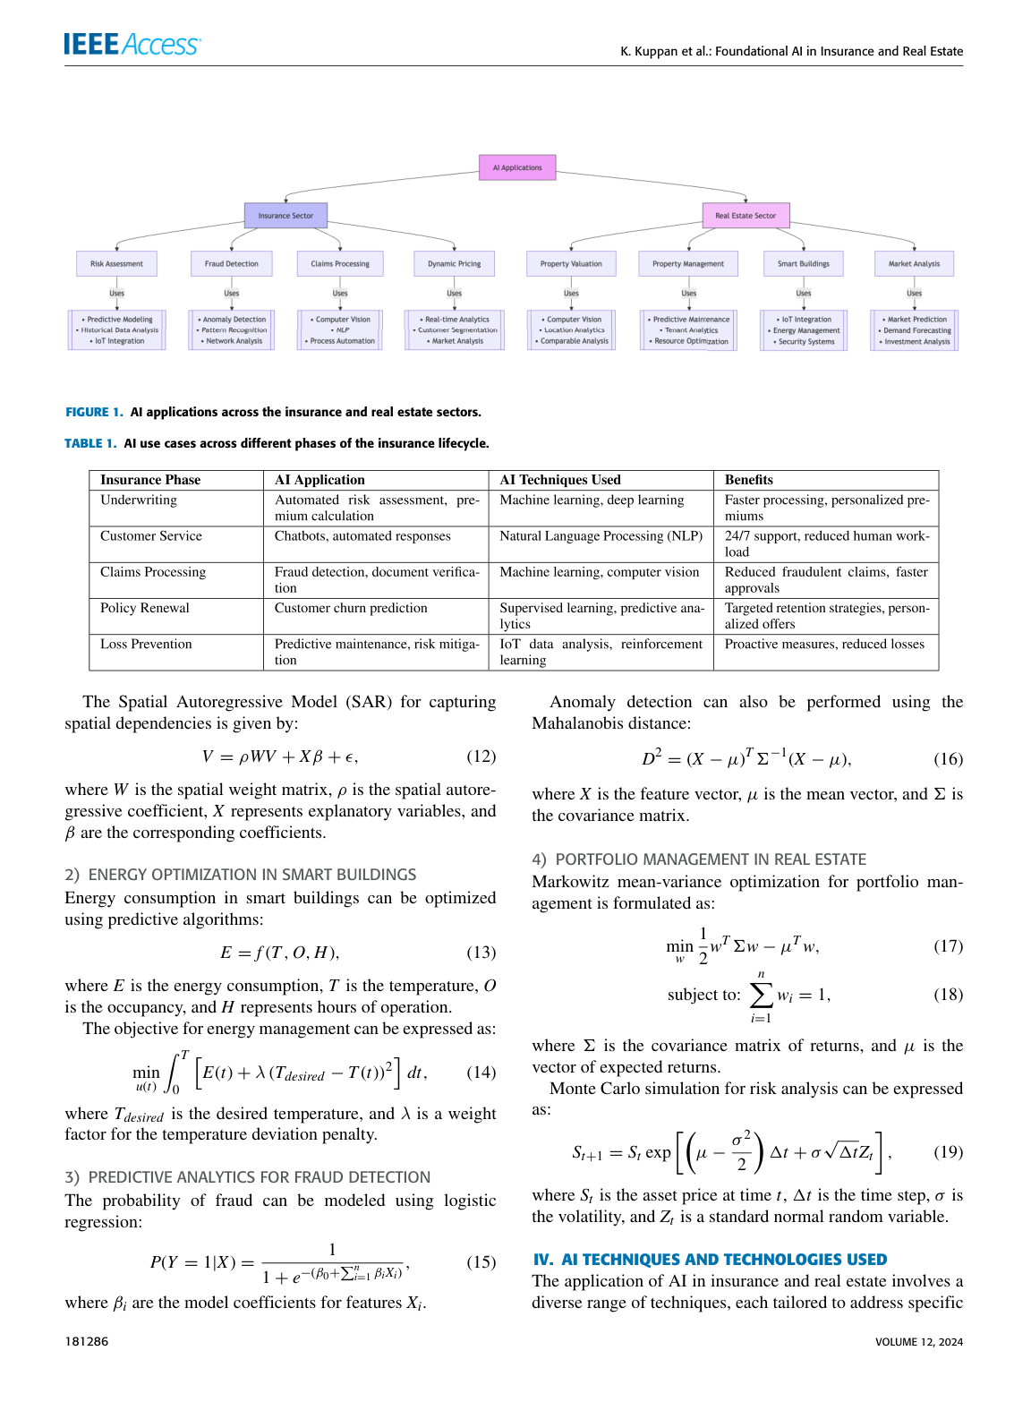
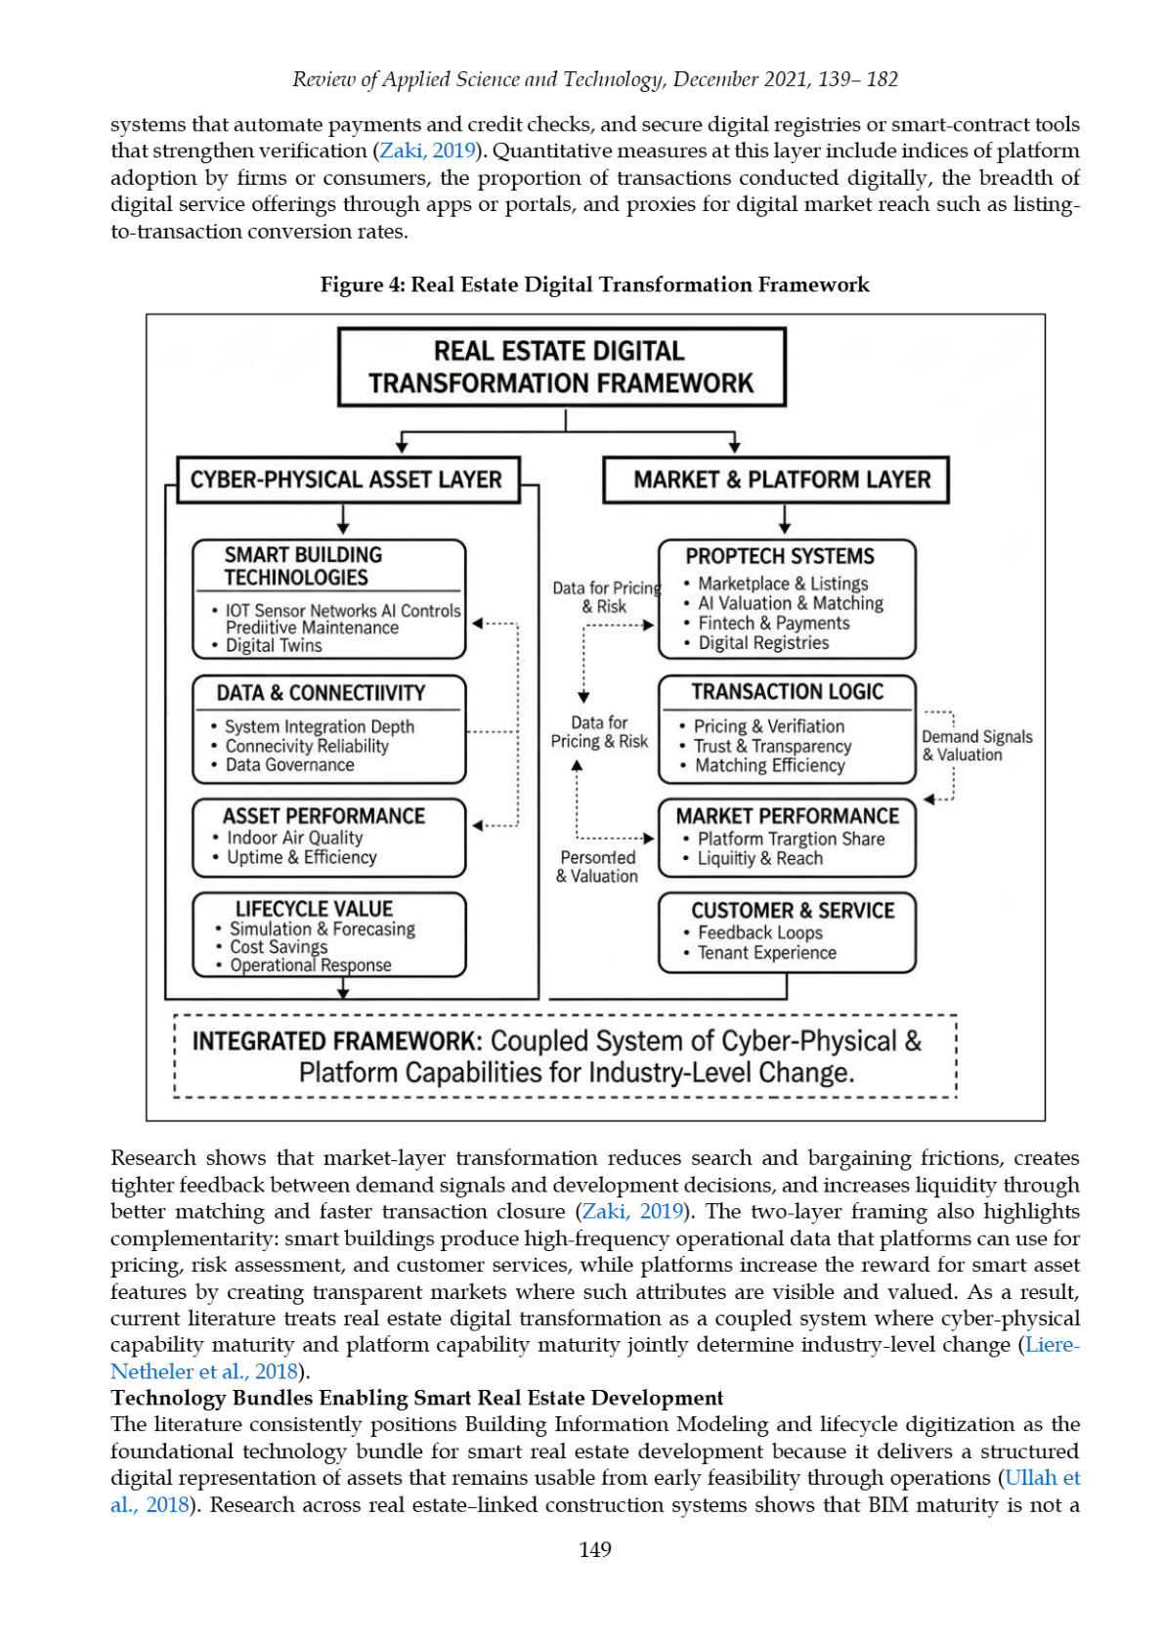
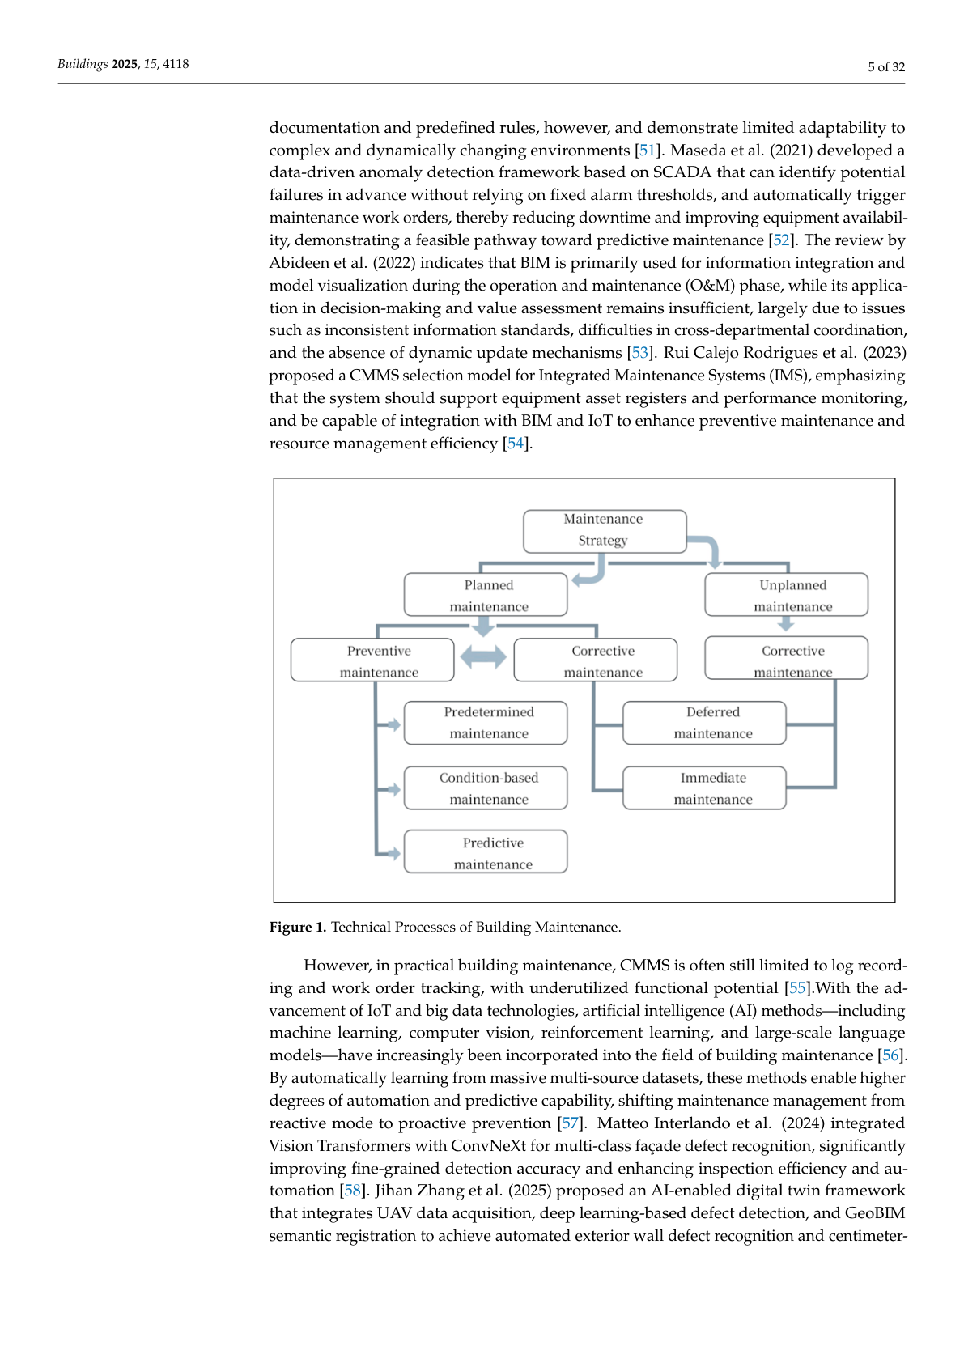
Research foundation and gap
05
AI service uses
smart estate framework
maintenance intelligence
Gap: small-business practicality. The prototype keeps AI useful, affordable and human-reviewed [2][3][4][8][9][16][17].
Final Viva • Abubarkar Dembele

Slide 6
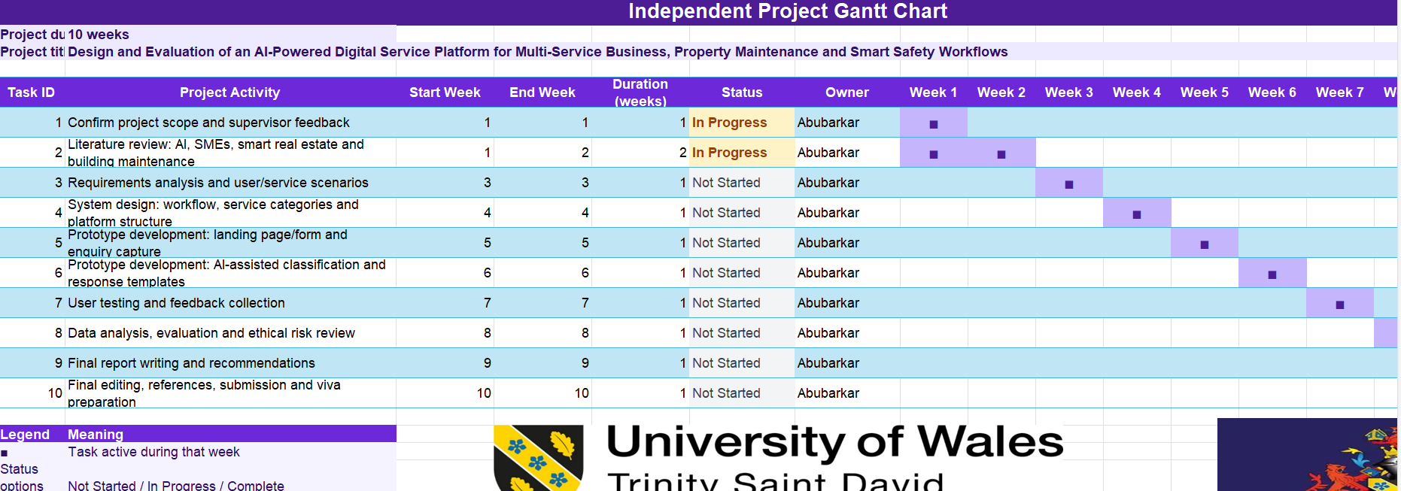
Methodology and implementation
06
Literature review and requirements analysis.
Prototype design: roles, dashboards, forms, AI review and status tracking.
Evaluation: tasks, comments and ethical risk review [6][13].
project timeline
🛠️ Tools: Canva • HTML/CSS/JS • Forms/tracker • Draw.io • GitHub
dashboard
mobile
AI
Final Viva • Abubarkar Dembele
[6][13]

Slide 7
System workflow sequence
07
👤 User submits
📝 Capture details
🧠 AI suggests
✅ Human reviews
🎫 Ticket assigned
📌 Status updated
AI proposes; a human approves. This keeps accountability inside the workflow [8][9].
user view
admin dashboard
AI review
estate context
Final Viva • Abubarkar Dembele
[8][9]

Slide 8
Prototype evidence and screens
08
Dashboard / service entry
Maintenance and safety report forms
IT support ticket flow
AI assistant / draft response
Ticket status tracker
Admin dashboard and filters
dashboard
mobile requests
It proves workflow and interface logic, not a finished commercial system [1][2][4][6].
AI assistant
estate module
poster
Final Viva • Abubarkar Dembele
[1][2][4][6]

Slide 9
Evaluation findings and evidence status
09
Structured design review checked the main journey: service choice → AI review → confirmation → ticket tracking.
Strengths: clear service routes, separate user/worker/admin roles, visible status and human approval before action.
Improvements: reduce dense screens, make Back/Status controls consistent and explain AI limits more clearly.
⚠️ What could not be completed: full participant testing, live analytics and real deployment statistics.
Therefore, findings are exploratory; no percentages or fake user results are claimed [13].
dashboard check
mobile check
AI review
human review
📊 Evidence status
Completed: prototype review + testing protocol.
Not claimed: live user statistics.
Final Viva • Abubarkar Dembele
[13]

Slide 10
Reliability, validity and limitations
10
🔁 Reliability
Same task script and feedback questions so the review can be repeated.
🎯 Validity
Tasks link to RQs: clarity, usefulness, trust, privacy and workflow control.
🌍 Generalisation
One ODTS case study, so findings are exploratory, not universal.
Limitations: static linked prototype, fictional data, no live database/API, no emergency/IoT deployment and limited time for participant testing.
Mitigation: anonymised feedback plan, editable AI output, human approval, clear limitation statement and Version 2 change log [8][9][13].
future grow-plot evidence
Final Viva • Abubarkar Dembele
[8][9][13]

Slide 11
Future project: tenant grow plots
11
🏡 Estate value
Community, sustainability and engagement.
📲 Digital workflow
QR code or mobile form links each plot to a request record.
🛠️ Service link
Maintenance, safety and support in one dashboard.
🌱 tenant food-growing plots
Future direction
Tenants could have growing plots. The platform could record plot number, requests, maintenance, watering and safety notes.
poster evidence
Final Viva • Abubarkar Dembele
[2][4][16][17]

Slide 12
Conclusion and key references
12
Conclusion
The project gives ODTS a practical prototype foundation: structured enquiries, AI support, human review, workflow, privacy and future implementation.
Key references / evidence base
[1] Kiran (2025) real-estate AI and digital support.
[2] Zheng et al. (2025) AI for building maintenance.
[3] Kuppan et al. (2024) AI in real estate.
[4] Jahidi (2021) smart real-estate framework.
[6] Inam (2023) estate system and web tools.
[8] NIST (2023) AI Risk Management Framework.
[9] ICO (2023) AI and data protection guidance.
[12] Davis (1989) technology acceptance.
[13] Braun & Clarke (2006) thematic analysis.
[16][17] property management / smart-estate studies.
Full Harvard-style reference list is in the written report.
Final message
Focused prototype now. Scalable platform later.
ODTS
Final Viva • Abubarkar Dembele

Slide 13
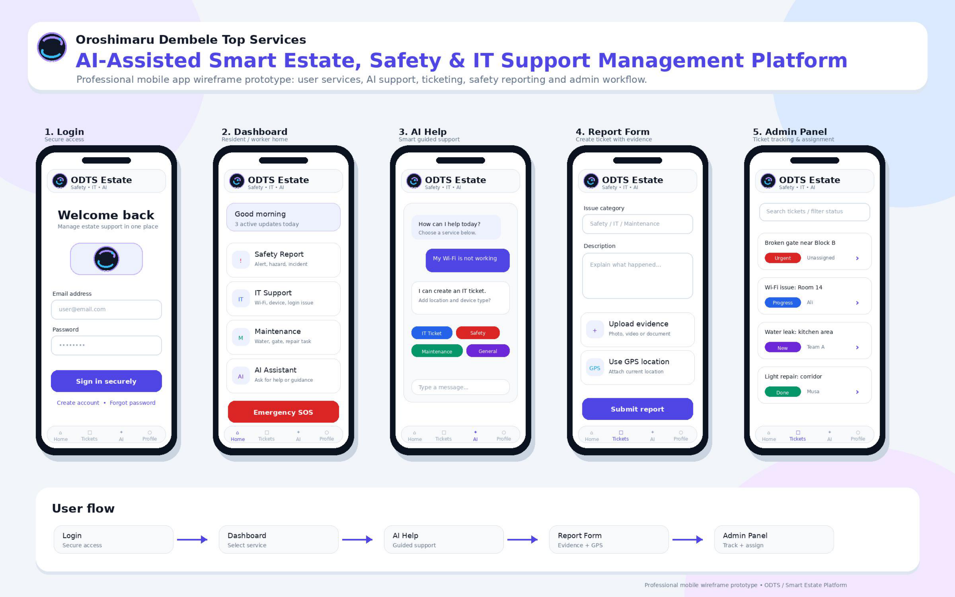
Prototype walkthrough: overview
13
📲 Prototype Version 1
Static linked prototype.
Shows workflow, not live deployment.
👥 Three roles
🧩 Five screens
Resident • worker
• admin.
Login • dashboard
• AI • report • admin.
🎫 One record
✅ Human review
Trackable ticket.
Editable AI.
Defend: scope, evidence, limits and Version 2.
Five-screen workflow
Final Viva • Abubarkar Dembele

Slide 14
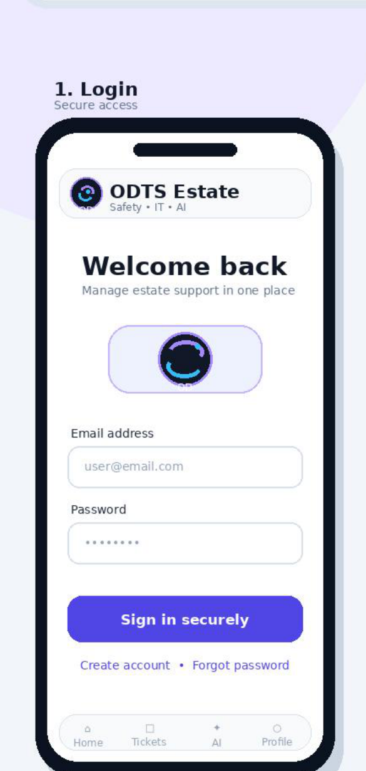
Prototype screen 1: secure login
14
🔐 Purpose
Role-based access.
👤 User benefit
🧑‍💼 Admin benefit
Simple sign-in.
Permission control.
⚠️ Current limit
🔭 Improvement
No live server.
MFA + encryption.
🎤 Viva defence point
Secure login
Security before dashboard.
Final Viva • Abubarkar Dembele

Slide 15
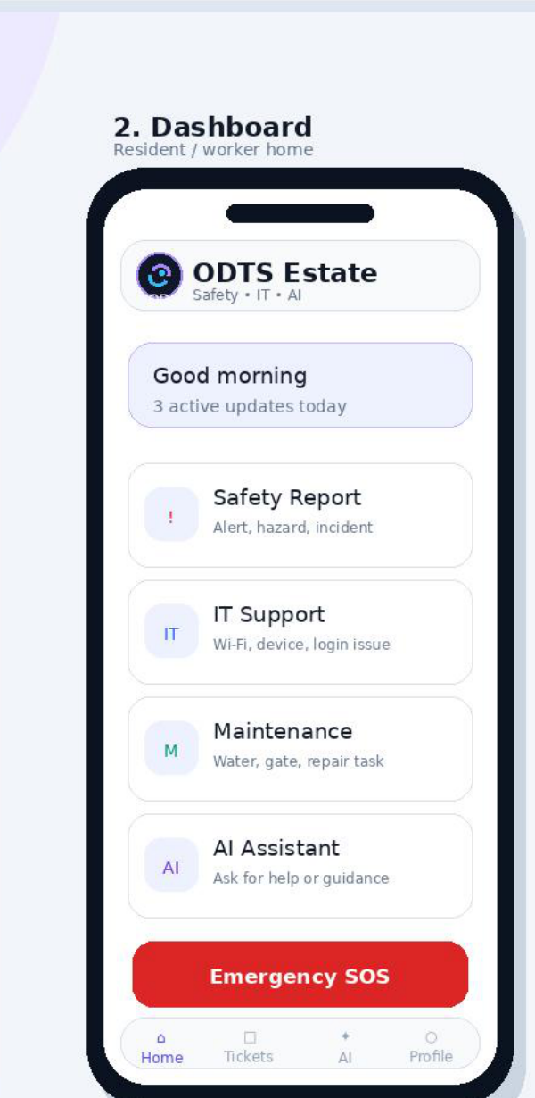
Prototype screen 2: service dashboard
15
🚨 Safety report
💻 IT support
Hazards and incidents.
Devices and access.
🛠️ Maintenance
🧠 AI assistant
Estate repairs.
Guided help.
📌 Design decision
Clear routes.
SOS stays separate.
Service dashboard
Final Viva • Abubarkar Dembele

Slide 16
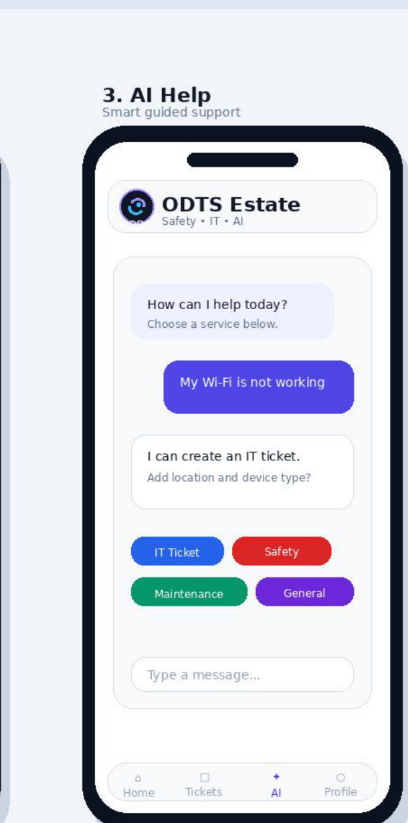
Prototype screen 3: AI assistant
16
🧠 AI suggestion
✅ Human approval
🤝 Clear guidance
⚠️ Not emergencies
🔭 Confidence +
escalation
🔐 Human review required [8][9]
AI assistant
Final Viva • Abubarkar Dembele

Slide 17
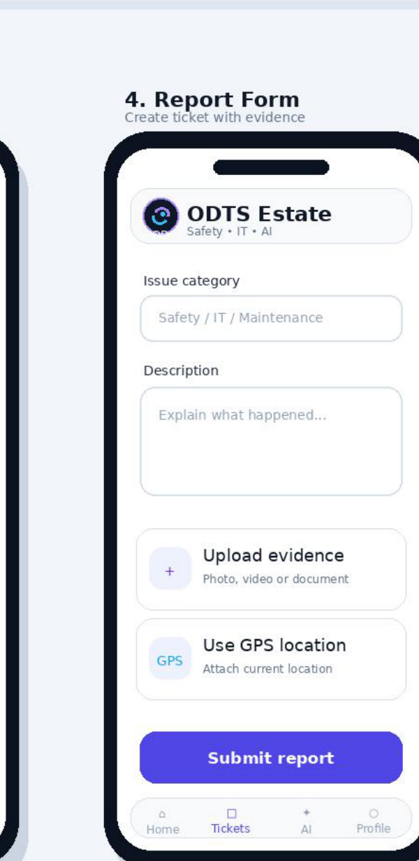
Prototype screen 4: report form
17
1️⃣ Select category
Safety • IT • maintenance.
2️⃣ Describe the issue
Short explanation.
📸 Add evidence
📍 Use location
Photo or document.
Permission-based GPS.
🛡️ Privacy and confirmation
Necessary data • ticket reference.
Report form
Final Viva • Abubarkar Dembele

Slide 18
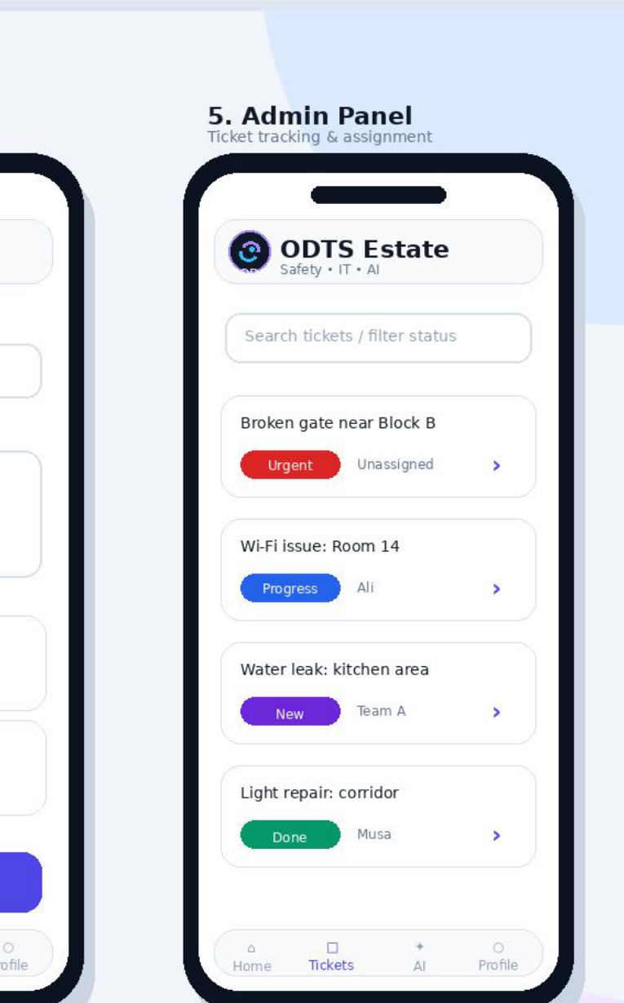
Prototype screen 5: admin panel
18
🧑‍💼 Administrator workspace
All requests.
🔎 Filter and search
👷 Assign ownership
Status • category
• location.
Named owner.
🚦 Set priority
📊 Track performance
Urgent • progress • done.
Time • backlog.
📌 Accountability
Admin panel
Who • what • when.
Final Viva • Abubarkar Dembele

Slide 19
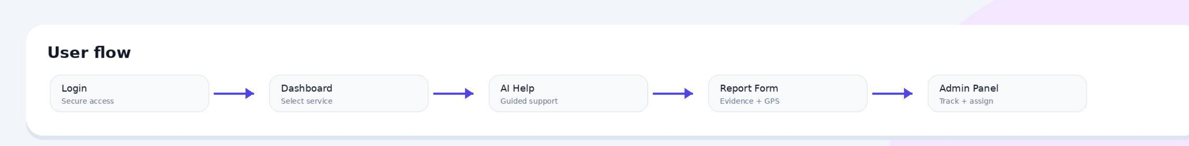
Prototype walkthrough: complete user flow
19
🔐 Login
🏠 Dashboard
🧠 AI
📝 Report
🎫 Admin
➜
➜
➜
➜
🎯 End-to-end value
Connected, accountable workflow.
Complete user flow
Final Viva • Abubarkar Dembele

Slide 20
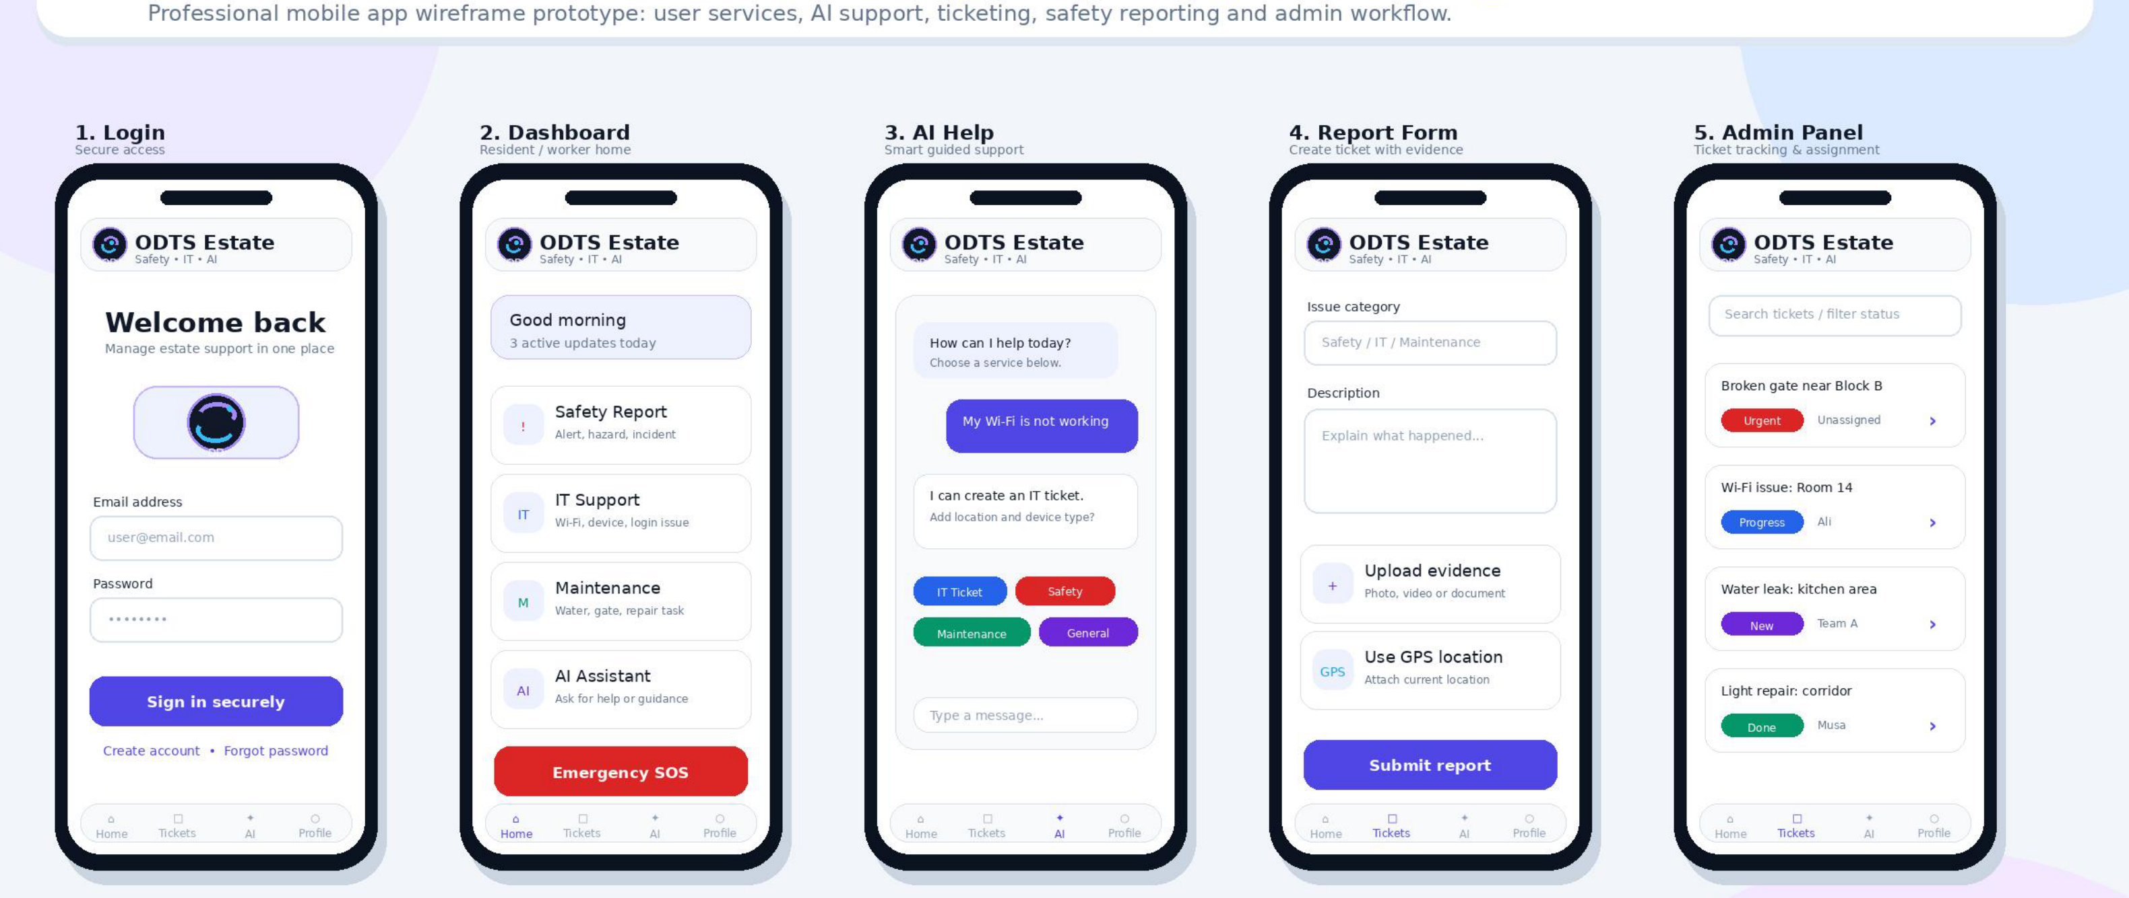
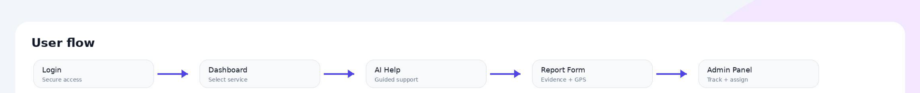
Complete prototype wireframe
20
📲 Complete wireframe: Login → dashboard → AI help → report form → admin panel
Final Viva • Abubarkar Dembele

Slide 21
Exhibition poster
21
🎯 Project overview
📲 Prototype evidence
🌱 Future development
Full exhibition poster included as visual evidence for the final viva.
Final Viva • Abubarkar Dembele

