Slide 1
BSc (Hons) Cloud Computing
Module Code : ACCA5019 – Business and Web Management
Week 06 : Online Branding & Web Analytics
Dr Mobolanle Bello

Slide 2
Objectives
Week 7: Online Branding & Analytics
Importance of Online Branding
Digital Marketing Strategies
Web Analytics & Tracking

Slide 3
WHAT IS A BRAND?
A brand is essentially a product or company's identity, as perceived by consumers.
It's a combination of tangible and intangible elements that work together to create a distinct image and experience.
It is a powerful tool for businesses to build trust, loyalty, and recognition with their target audience.

Slide 4
What Is A Brand?
Here's how to break down what a brand is:
Differentiation
Perception
Value proposition

Slide 5
What Is A Brand?
Differentiation: A brand distinguishes a company's offerings from competitors. It includes things like a logo, name, design, and even packaging. These elements help consumers recognize and remember the brand.
Perception: A brand is more than just a logo; it's the feeling or idea that consumers associate with it. This perception is shaped by the brand's marketing, advertising, customer service experiences, and overall product quality.
Value proposition: A strong brand conveys a message about what the product or service stands for. This could be things like reliability, luxury, affordability, or environmental friendliness. The value proposition tells consumers why they should choose this brand over others.

Slide 6
WHAT IS BRANDING?
Branding is all about creating a distinct identity for your business or product in the minds of consumers.
It's more than just a logo and a catchy slogan; it's the whole experience that people have with your brand, from the way you interact with them on social media to the quality of the products you sell.

Slide 7
The Role of Branding
Branding provides benefits for both buyers and sellers.
Brands help buyers identify specific products that they do and do not like, a process that in turn facilitates the purchase of items and satisfies their needs and reduces the time required to purchase the product.
It also helps buyers evaluate the quality of a product, especially when they are unable to judge its characteristics. In other words, a purchaser for a brand symbolizes a certain quality level will transfer that perception of quality to the unknown item.
A brand thus helps to reduce a buyer’s perceived risk of purchase. In addition, it may offer the psychological reward that comes from owning a brand that symbolises status.

Slide 8
The Role of Branding
A brand thus helps to reduce a buyer’s perceived risk of purchase. In addition, it may offer the psychological reward that comes from owning a brand that symbolises status.
Sellers benefit from branding because each company’s brands identify its products, which makes repeat purchasing easier for consumers.
Branding helps a company to introduce a new product that carries the name of one or more of its existing products, because buyers are already familiar with the company’s existing brand.

Slide 9
The Role of Branding
Branding also facilitates promotional efforts because the promotion of each branded product indirectly promotes all other products that are similarly branded
Branding also helps sellers by fostering brand loyalty. When buyers become loyal to a specific brand, the market share for that product achieves a certain level of stability, allowing the company to use its resources more efficiently.

Slide 10
ONLINE BRANDING
Online branding is the specific area of branding that focuses on creating and managing a brand's image and presence on the internet.
It leverages digital channels like websites, social media, search engines, and online advertising to connect with your target audience and build brand awareness.

Slide 11
Online Branding
Online branding involves:
Building a strong website
Social media presence
Content marketing
Search engine optimization (SEO)
Online reputation management

Slide 12
Online Branding
1) Building a strong website: Your website is your digital storefront, and it should be a reflection of your brand identity. This includes a user-friendly design, clear messaging, and high-quality content.
2) Social media presence: Social media platforms offer a powerful way to connect with your audience, share your brand story, and build relationships. Consistency is key here, so maintaining a regular posting schedule and engaging with your followers is crucial.
3) Content marketing: Creating valuable and informative content, like blog posts, articles, or videos, establishes your brand as an expert in your field. This attracts potential customers and keeps them engaged.

Slide 13
Online Branding
4) Search engine optimization (SEO): Optimizing your website and content to rank higher in search engine results helps potential customers find your brand online.
5) Online reputation management: Monitoring and managing your online reputation is essential. Respond to reviews, address negative feedback promptly, and actively participate in online conversations to shape how people perceive your brand.

Slide 14
Critical Success Factors for Online Branding
Compelling brand identity
High-quality content
Search engine optimization (SEO)
Social media strategy
Data-driven decision-making
Positive online reputation
Engagement
Adaptability

Slide 15
Critical Success Factors for Online Branding
1) Compelling brand identity: Your online presence should be a cohesive representation of your overall brand identity. This includes having a consistent visual style, brand voice, and messaging across all platforms.
2) High-quality content: Creating valuable and informative content that resonates with your target audience is essential. This could be blog posts, infographics, videos, or anything that educates, entertains, or inspires your audience.
3) Engagement: Don't just broadcast messages online; actively engage with your audience. Respond to comments, answer questions, and participate in conversations. This fosters a sense of community and builds stronger brand loyalty.

Slide 16
Critical Success Factors for Online Branding
4) Search engine optimization (SEO): Optimizing your website and content to rank higher in search engine results pages (SERPs) increases the chances of potential customers finding your brand online.
5) Social media strategy: Having a well-defined social media strategy is crucial. Choose the platforms where your target audience spends their time and tailor your content accordingly. Consistency in posting and engagement is key to building a strong social media presence.
6) Data-driven decision-making: Track your online branding efforts using analytics tools. This data can help you understand what's working and what's not, allowing you to refine your strategy and optimize your content for better results.

Slide 17
Critical Success Factors for Online Branding
7) Positive online reputation: Actively manage your online reputation. Respond to reviews, both positive and negative, and address any customer concerns promptly.
8) Adaptability: The online landscape is constantly evolving. Be prepared to adapt your online branding strategy based on new trends, technologies, and audience preferences.

Slide 18
DIGITAL MARKETING
Digital technology has revolutionized the marketing landscape, leading to a shift in strategies and a focus on customer relationship management.
Digital marketing involves promoting services and products on various online platforms, such as emails, blogs, social networks, websites, mobile, and SEO.
It aims to convert leads into loyal customers with a positive experience.
Digital marketing offers a set of strategies, tools, techniques, and operations coordinated through the internet to increase sales.
It differs from traditional marketing in methods and channels, allowing for real-time measurement of customer experience.

Slide 19
Digital Marketing
New technologies, particularly the potential of networks, complement digital marketing activities, including website notices, emailing, search marketing, social networking platforms, and blog marketing.
Companies must establish an adequate digital marketing strategy to generate traffic, capture potential customers, and improve communication.
Digital marketing uses various mediums, including mobile devices, social media, and search engines, to reach customers.
While traditional marketing and digital marketing have similar approaches, the methods of making contacts and delivering information to customers are more innovative in the latter.

Slide 20
DIGITAL MARKETING STRATEGIES
Viral Marketing or Buzz Marketing
Email Marketing
Social Media Marketing (SMM)
Corporate Blogs
Mobile Apps
Electronic product configurators and verifiers
Affiliate Marketing
Electronic coupons
e-Survey
Search Engine Marketing

Slide 21
DIGITAL MARKETING STRATEGIES
1) Viral Marketing or Buzz Marketing
Viral marketing, also known as electronic word of mouth (eWOM), is a digital strategy that encourages individuals to quickly convey commercial messages to others, resulting in exponential growth in exposure.
This strategy spreads like a virus through the network, with users sharing and transmitting the message.
The costs associated with viral marketing are low or zero.
To effectively spread eWOM campaigns, companies should ensure that their content is easily shared and transmitted, with easy access to downloads, formats, and applications.
This approach can be particularly effective for interesting articles, videos, images, applications, and documents on social networks.

Slide 22
Digital Marketing Strategies
2) Email Marketing
The digital marketing strategy uses electronic mail as a loyalty tool to attract and retain customers.
With over one trillion emails sent daily, email marketing is an effective and fast tool for one-to-one marketing campaigns.
It offers benefits like interactivity, customization, low intrusiveness, savings, and reduced time and distances.
It also avoids legal and brand risks, aiming to generate a good price to induce desired purchases.

Slide 23
Digital Marketing Strategies
3) Affiliate Marketing
Digital marketing strategy involves online platforms where advertisers advertise their brand, products, or services.
Advertisers pay a commission to the media for using their advertising, which is then used by affiliate networks.
Affiliate marketing is a form of internet distribution where advertisers reward publishers for generating business through links on the website, either directly selling products or directing users to the selling company's page.

Slide 24
Digital Marketing Strategies
4) Search Engine Marketing
Search engine optimization (SLR) involves using techniques to locate websites using keywords, with the goal of being well-positioned in the network, ideally among the first thirty results.
The key is visibility to users.

Slide 25
Digital Marketing Strategies
5) Social Media Marketing (SMM)
The internet has revolutionized communication between customers and companies, enabling unique and personalized conversations.
Social Media (SMM) platforms like Facebook, Twitter, Instagram, MySpace, YouTube, and LinkedIn allow companies to publish content where users make decisions.
Facebook marketing is a significant SMM approach, as it serves as a meeting place for customers with similar needs and interests, making it an important social network worldwide.
Companies often have their profiles on Facebook, making it an effective tool for customer interaction.

Slide 26
Digital Marketing Strategies
6) Corporate Blogs
A blog is a frequently updated, chronologically structured website providing informal, accessible information on various topics.
These blogs can be personal, journalistic, business, or technological, and can serve as management tools for knowledge and external communication, strengthening client relationships.
Corporate blogs are published to achieve business objectives such as the positioning of the brand, the firm, and the internal communication where blogs act as a management tool for knowledge and external communication to strengthen relationships with key groups of clients

Slide 27
Digital Marketing Strategies
7) Other Tools
Mobile Apps
Electronic product configurators and verifiers
Electronic coupons
e-Survey

Slide 28
Digital Marketing Strategies
7) Other Tools
I) Mobile Apps:
Mobile applications are crucial in e-marketing strategies, as they enhance customer experience and brand reputation.
It is recommended to include mobile applications within a company’s mobile marketing strategy and take advantage of the capabilities of mobile phones, making them simple and useful, integrating them into a marketing strategy of the company, using external Apps, choosing the right platform, including social networks, attracting the client and measuring the result.

Slide 29
Digital Marketing Strategies
7) Other Tools
II) Electronic product configurators and verifiers:
An online product configurator and product verifier are software and hardware systems that allow buyers to customize products and showcase them from various perspectives.
They are particularly useful in clothing, enhancing brand perception and promoting

Slide 30
Digital Marketing Strategies
7) Other Tools
III) Electronic coupons:
E-coupons allow buyers to choose a brand, product, or store in exchange for discounts, samples, or free products, reducing the traditional process of visiting the establishment.
IV) e-Survey:
This tool aids marketing research by assessing loyalty ratios, satisfaction levels, and customer service, enhancing customer relationships, understanding tastes, and segmenting personalized offers.

Slide 31
DIGITAL MARKETING PLAN
A digital marketing plan is a strategic document that takes the current situation of a particular organisation to set some midterm goals and to determine the strategy and means to accomplish them.
This document also describes the responsibilities, the time frame and control tools for monitoring.
The aims of a digital marketing plan include discussing organisations and their environment.
Likewise, it needs to be a roadmap of how to manage the organisation’s marketing strategy, so that resources are properly allocated.
The plan also helps control and evaluate output and tackle any potential deviation from the organisation’s expected outcomes.
In this line, a marketing plan becomes a flexible document that must be adapted to the situation of the company and that must feed into the results obtained by each of the actions developed, especially in the digital arena.
The development of an online marketing plan is similar to a conventional one in its structure, but it also includes some variations at an operational level.

Slide 32
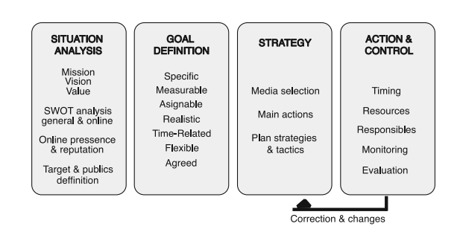
Digital Marketing Plan
Marketing Plan

Slide 33
Digital Marketing Plan
Situational Analysis
A strategic document should define the baseline situation of an organization and its environment to develop a reality-based action plan.
This involves defining the mission, vision, and values of the organization, which guide marketing actions.
An internal-external analysis is necessary to identify weaknesses and strengths, while an external analysis aims to determine threats and opportunities.
Both analyses lead to a SWOT matrix.
A digital marketing plan should also analyze the organization's online presence and position, determining a concrete digital strategy and comparing results with the initial situation.
Tools such as Mention, Google Alerts, and Hootsuite can be used to monitor keywords, competition, and sectors.
Social network evaluation and competition benchmarking are also essential.
Audiences must be defined, with a focus on the target group and their needs in the digital world.
This phase helps identify potential gaps in the organization's situation, allowing for the design of a future strategy.

Slide 34
Digital Marketing Plan
Goal Setting
Setting goals is a crucial phase in any marketing plan, enabling adjustments to the strategy.
Goals must follow SMART criteria, being specific, measurable, assignable, realistic, and time-related.
In online marketing, goals must be flexible and reachable through consensus.
Common types include scope, activity, conversion, and loyalty goals.
These goals are implemented through key performance indicators for measurement and monitoring.

Slide 35
Digital Marketing Plan
Planning a Strategy
A strategy is a plan to achieve goals, implemented through activities.
An online marketing strategy is based on the AIDA model, which includes Awareness, Interest, Desire, and Action.
However, recent changes in marketing and the digital world have reshaped this model to include conversion and loyalty strategies.
The complexity of the new media reality has also emphasized the importance of defining means and actions in determining a strategy.

Slide 36
Digital Marketing Plan
Planning a Strategy
Companies must also understand and combine earned media, paid media, and owned media to build audiences effectively.
Each media has its advantages and scenarios, and brands must analyze which is more appropriate for them and on which return on investment is higher.
Digital marketing actions include e-commerce, web search marketing, email marketing, and social media marketing.

Slide 37
Digital Marketing Plan
Action and Control
Setting up a digital marketing strategy involves defining numerous actions and identifying potential theme areas for content development.
Time planning is crucial for successful implementation, with tasks and timings assigned to each action.
All departments should have a copy of the marketing plan, including professionals involved in its development.
Costs for technical and operational actions, as well as professional development and monitoring, must be considered.
Constant feedback and quantitative data allow for constant control of the strategy's evolution.
Periodic assessments of actions and tools are recommended, taking into account the total duration of the digital strategy and the techniques used.
The strategic document should be reviewed and updated to maximize efficiency in the next phase, and the process should be repeated at the end of each phase.

Slide 38
SOCIAL MEDIA MARKETING
Social media networks have significantly influenced communication and marketing, with the internet and technology playing a crucial role in this process.
The use of social networking platforms like Facebook, Twitter, LinkedIn, and Google Plus has led to millions of users worldwide, allowing marketers to engage with consumers and create effective brand identities.
Social media consists of various ways of interaction among people, allowing them to create, share, exchange, and comment on content in virtual communities and networks.
These tools are used for communication, adding value to customers, creating brand awareness, staying updated with trends, demonstrating products, and saving costs and improving productivity.

Slide 39
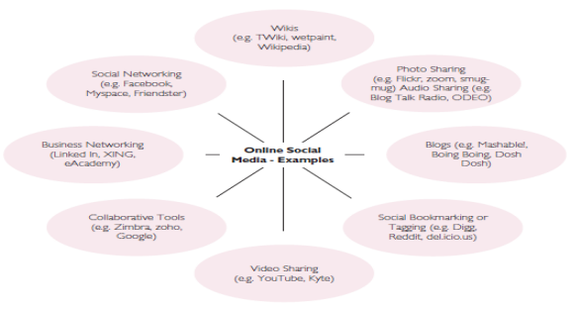
Social Media Marketing
Different Social Media Platforms

Slide 40
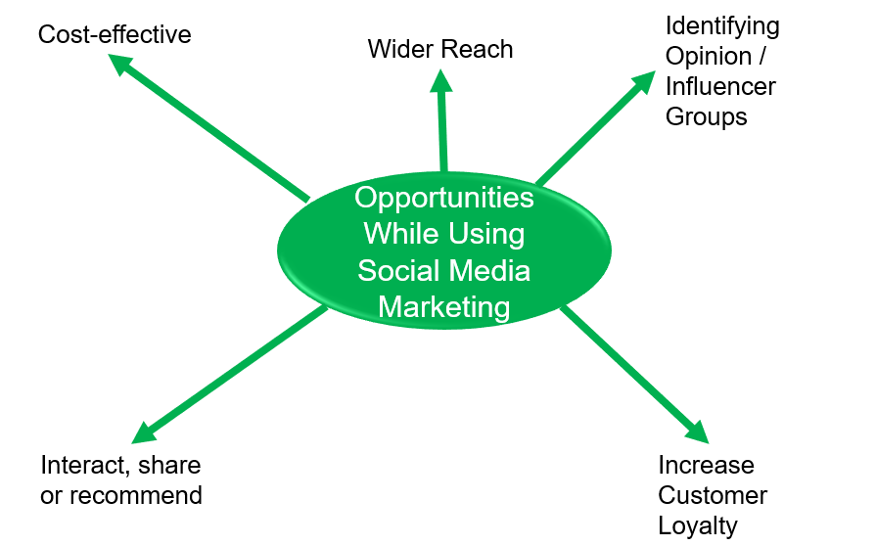
Opportunities While Using Social Media Marketing

Slide 41
Opportunities While Using Social Media Marketing
1) Cost-effective:
Traditional marketing for products and services involves huge cost implications at a time when profits are shrinking, and competition is increasing.
Social Media Marketing stands a major chance because of its wide users and the cost of advertising is still less as compared to traditional marketing.
The effectiveness of social media has not been documented or proved sufficiently because of less research or a lack of marketing indices in social media.

Slide 42
Opportunities While Using Social Media Marketing
2) Wider Reach:
The spread of social media is limitless. Due to its virtual nature and higher number of subscribers for various social media networks like Facebook, Twitter, Flicker, MySpace, Instagram, YouTube etc.
Facebook alone enables companies all over the world to reach more than one billion people because of its huge user base.
Twitter stands with more than 500 million users who tweet more than 140 million tweets per day.

Slide 43
Opportunities While Using Social Media Marketing
3) Identifying Opinion / Influencer Groups:
By using Social media peer or influencer groups can be easily located and identified.
Through the influencers, others can be easily guided and convinced to go for a particular brand or to
select.
4) Interact or share or recommend:
By using interactive web tools like video, applications, games, photos etc, consumers can be provoked to interact more on social media networks.
Moreover, the traffic to the company website or brand website can be increased significantly.

Slide 44
Opportunities While Using Social Media Marketing
5) Increase Customer Loyalty:
Consumers have greater control over the content published on social media. It is not very easy to build customer loyalty because it may also backfire negatively.

Slide 45
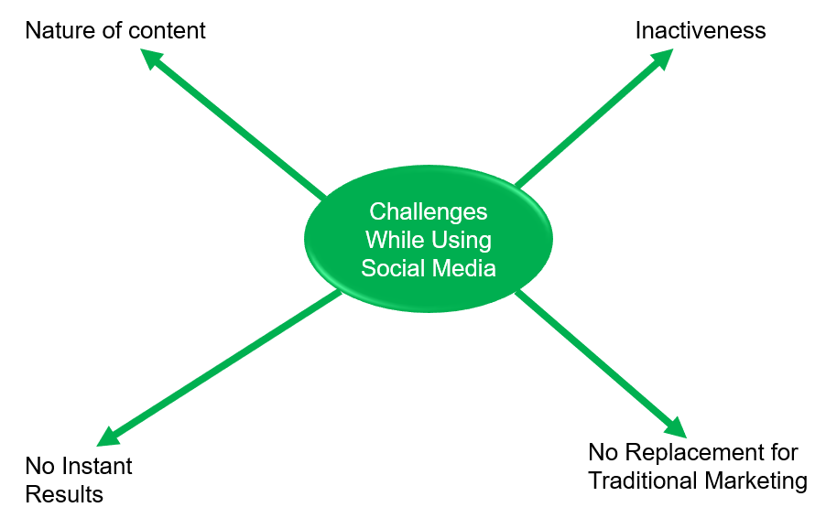
Challenges While Using Social Media

Slide 46
Challenges While Using Social Media
1) Nature of content:
The content to be displayed or shared has to be chosen very
carefully otherwise it can create a negative influence on a number of consumers.
The cultural aspects have to be considered while carrying out brand promotion.
2) Inactiveness:
There should not be any inactiveness on the part of the communicator, otherwise the whole efforts would be unproductive.
Moreover the inactiveness could create doubt in the minds of consumer about the genuineness of the content & brand itself.

Slide 47
Challenges While Using Social Media
3) No Instant Results:
Social Media Marketing does not guarantee overnight results of success in brand promotion.
To achieve results more time should be devoted. SMM cannot be used as a short-term strategy.
4) No Replacement for Traditional Marketing:
Social Media Marketing tends to support Traditional Marketing rather than replacing it completely.
Notes:
4) There is no documented evidence about the effectiveness of SMM used alone for Brand Promotion.

Slide 48
SOCIAL MEDIA PLAN
A Social Media Plan (SMP) is a crucial document for an organization's social media presence, guiding its setup, maintenance, and integration into digital marketing strategies.
It follows a stable structure, including goal setting, audience types, platforms, strategies, tools, and output measurement, which is crucial for its liveliness in the virtual world.

Slide 49
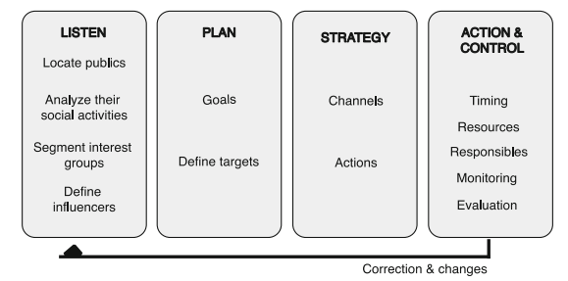
Social Media Plan
Social Media Plan

Slide 50
Class Activity
Imagine you are the marketing manager for a new organic skincare company called "PureEssence." Your team has developed a unique line of products that use sustainably sourced ingredients and eco-friendly packaging. As you prepare to launch the brand, you are considering different elements of branding and branding strategies to differentiate "PureEssence" in the competitive skincare market.
Task:
Create a social media content calendar

Slide 51
WEB ANALYTICS
Web Analytics is a process that involves measuring, collecting, analysing, and reporting internet data to understand and optimize web usage.
It's not a technology for producing reports but a virtuous cycle for website optimization.
The process starts with defining goals, setting KPIs, collecting data, analysing it, and implementing changes based on the goals and KPIs set in the first two steps.

Slide 52
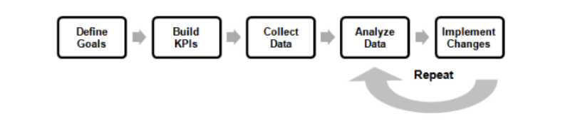
Web Analytics
The Web Analytics Process

Slide 53
Who Uses Web Analytics
Web Analytics is a valuable tool for various stakeholders, including server administrators, web designers, product managers, and software architects.
Server administrators monitor website availability, traffic patterns, and predict resource needs.
Web designers assess user experience and usability by analysing user behaviour patterns, device usage, screen resolution, and click train.
Marketers use Web Analytics to track the effectiveness of advertising activities, including online and offline ads. They can identify which ads generate the most clicks and purchases and track the performance of search engine keywords. For example, a popcorn chain in New Jersey discovered that users are more likely to search for "chocolate popcorn" and "caramel popcorn" when searching for "gourmet popcorn."

Slide 54
WEB ANALYTICS DATA COLLECTION
Data collection focuses on capturing behavioural data from websites for Web Analytics, focusing on the data collection process.
Four main methods include Web Logs data, JavaScript Tagging, Web Beacons, and Packet Sniffing.

Slide 55
Web Analytics Data Collection
Web Logs
JavaScript Tagging
Web Beacons
Packet Sniffing

Slide 56
Web Analytics Data Collection
1) Web Logs
The Web Logs method collects website data by recording user requests in a log file, such as the Extended Log File Format.
This file format records information like the computer's IP, transaction completion date, time, bytes transferred, cache hit, and page referrer.
Advantages include the website owner owning the data, backwards availability for analysis, and saving web crawler behaviour for a better understanding of search engine ranking.
Web Logs are collected when a customer enters a URL, and the requested page is returned to the customer.

Slide 57
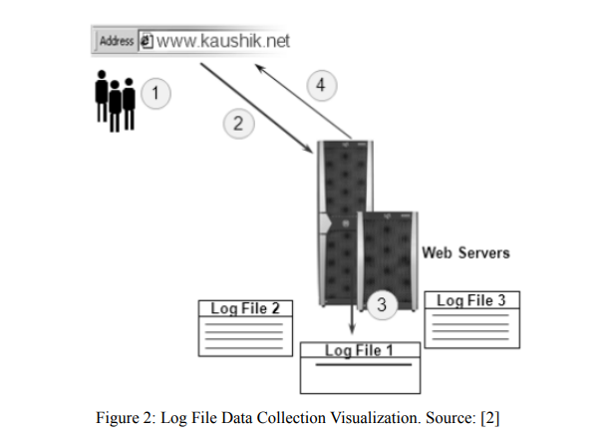
Web Analytics Data Collection
1) Web Logs
Log File Data Collection

Slide 58
Web Analytics Data Collection
2) JavaScript Tagging
JavaScript Tagging works by inserting a small JavaScript code in every page of a website.
Then every time a visitor opens a page, this JavaScript code is activated, and the visitor information and actions are saved in a separate file.

Slide 59
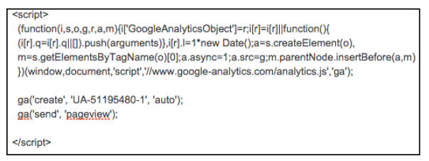
Web Analytics Data Collection
2) JavaScript Tagging
Google Analytics Tracking Code

Slide 60
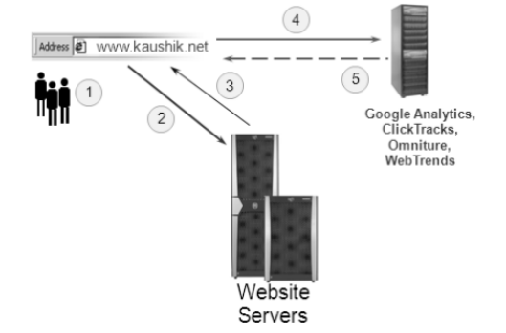
Web Analytics Data Collection
2) JavaScript Tagging
Javascript Tagging Data Collection Visualisation

Slide 61
Web Analytics Data Collection
3) Web Beacons
In this method, a “tracking pixel” is used to measure banner impressions and click-throughs.
So this method is mainly used with online advertising, specially when using banner ads.
As banner ads are usually images, one pixel of the banner image is utilized to be the tracking

Slide 62
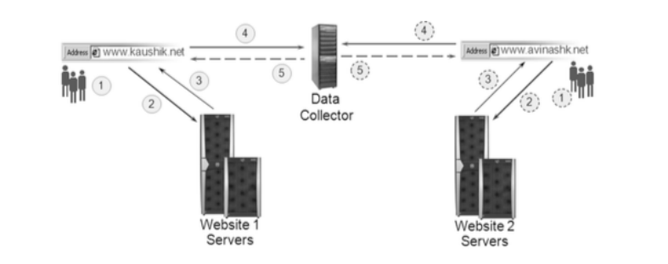
Web Analytics Data Collection
3) Web Beacons
Web Beacon Data Collection Visualisation (notice tracking across 2 different websites)

Slide 63
Web Analytics Data Collection
4) Packet Sniffing
In this method, packets go through a packet sniffer that collects the packet’s attributes.
A packet sniffer is a software or hardware that resides between the user’s device and the Web Server and used to read the packets that are passing between the two.

Slide 64
Web Analytics Data Collection
4) Packet Sniffing
The advantage of packet sniffing is that there is no need to tag pages like the case with some of the previous methods because all the information passes through the packet sniffer.

Slide 65
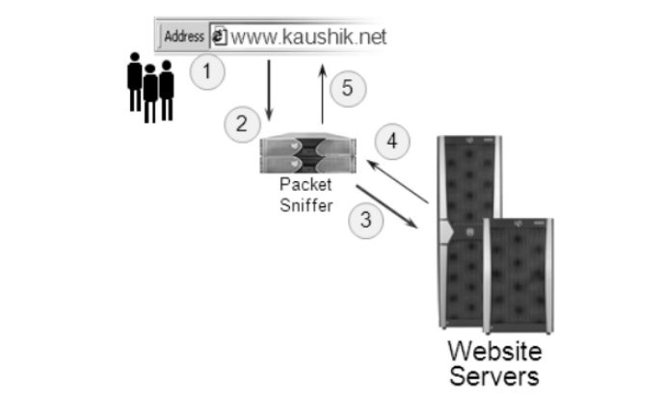
Web Analytics Data Collection
4) Packet Sniffing
Packet Sniffing Data Collection Visualisation

Slide 66
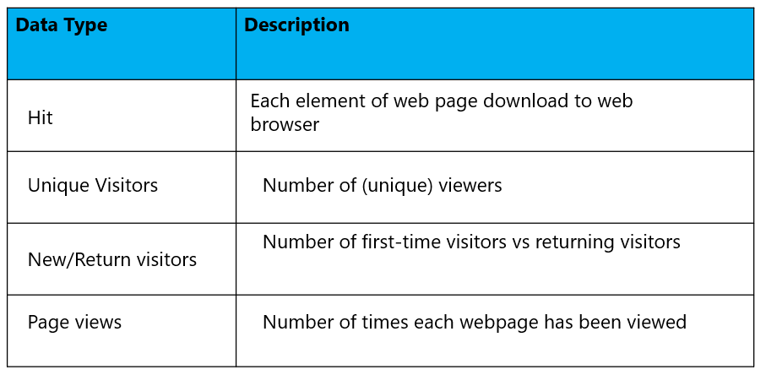
TYPES OF DATA COLLECTED IN WEB ANALYTICS

Slide 67
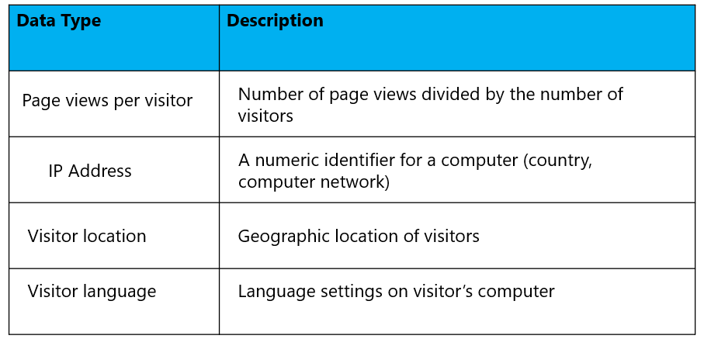
Types of Data Collected in Web Analytics

Slide 68
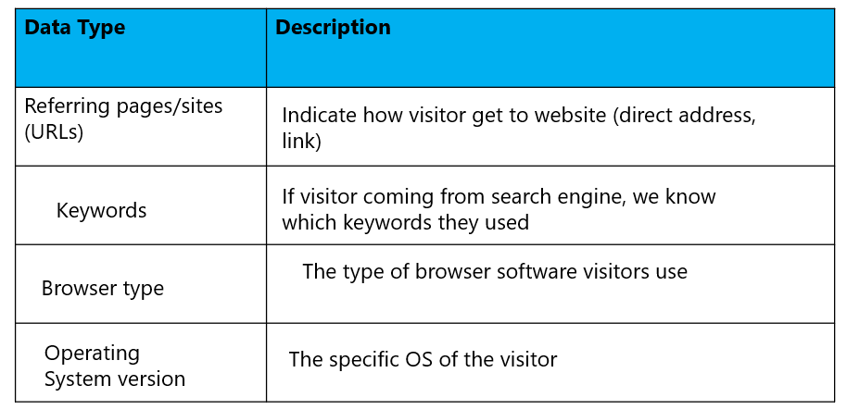
Types of Data Collected in Web Analytics

Slide 69
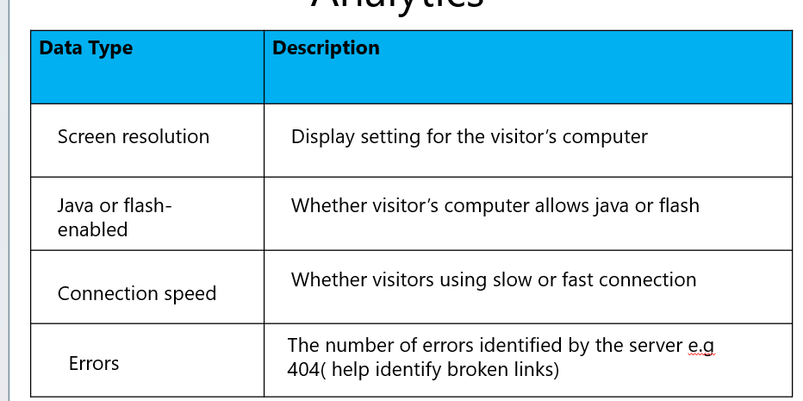
Types of Data Collected in Web Analytics

Slide 70
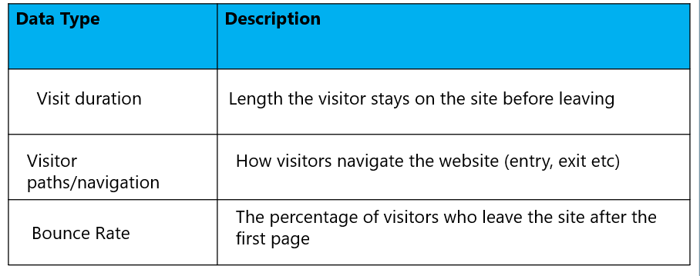
Types of Data Collected in Web Analytics

Slide 71
WEB ANALYTICS AND TRACKING TOOLS
Google Analytics
Adobe Analytics
Hotjar
Mixpanel
Matomo

Slide 72
Web Analytics and Tracking Tools
Google Analytics: The most widely used web analytics platform, offering a range of features to track and analyse website traffic.
Adobe Analytics: A comprehensive analytics solution for tracking and analysing customer interactions across various touchpoints.
Hotjar: Provides heatmaps, session recordings, and feedback polls to understand user behaviour.
Mixpanel: Focuses on user-centric analytics, tracking actions users take within a website or app.
Matomo (formerly Piwik): An open-source alternative to Google Analytics, offering similar features with full data ownership.

Slide 73
Questions & Answers

Slide 74
References
Chaffey, D. & Smith, P. R. (2017) (5th Ed.) Digital Marketing Excellence: Planning, Optimizing and Integrating Online Marketing. Routledge.
Chaffey, D. (2019) (7th Ed.) Digital Business and ECommerce Management, Pear.
Kingsnorth, S. (2016) Digital Marketing Strategy: An Integrated Approach to Online Marketing. Kogan Page.
Damian, R. & Jones, C (2016) (4th Ed.) Understanding Digital Marketing: Marketing Strategies for Engaging the Digital Generation. Kogan Page.

