Slide 1
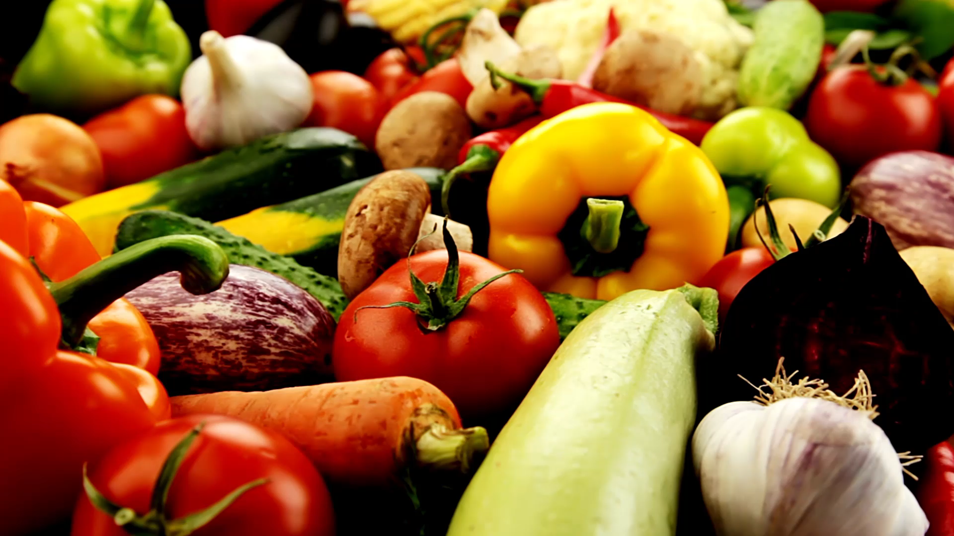
Periodised or Personal Nutrition
A GUIDE

Slide 2
What does this mean?
In any aspect of Nutrition there is no ‘One size fits all’
This is becoming more apparent in sports nutrition – it needs to match performance and training
It needs to translate theoretical concepts into practise – that is food!

Slide 3
Personalised plan
This provides a nutrition plan that provides specific advice on nutritional supplements.
Factors that influence a plan
GOALS – winning, personal bests , optimal performance, finishing, weight, health, gaining muscle
EVENT – duration, intensity, position, sport type, distance.
INDIVIDUAL – genetics, weight, fitness, metabolism, food intolerances
ENVIROMENT – weather, altitude, humidity, food shopping

Slide 4

NUTRIGENOMICS
Many companies are offering genetic tests that may effect your health related outcome.
Is there any evidence for this?
At this moment in time – NO!

Slide 5
Periodised Nutrition
Planned
Purposeful
Strategic
Nutrition interventions targeted by exercise sessions
Change for different days

Slide 6
Nutritional training
This means the methods that may be used in a periodised plan
A planned approach
Some methods that may be used are shown on the following slides

Slide 7

What are we aiming for?
TRAIN HIGH
Training with high muscle and liver glycogen
CHO focus is on high intake pre training and replenishment
Generally a high CHO intake

Slide 8
TRAIN LOW
Usually training at least twice a day
Limited CHO between sessions
Training fasted so liver/muscle glycogen is low
Encouraging an adapted state of training – increasing fat adaptation
Sleep low – training tends to take place later in the day – several studies indicate this may improve fat adaptation
Low CHO/High Fat intake

Slide 9
Training the gut
Stomach comfort – intakes of large fluid
Gastric emptying
Absorption
Competition nutrition
We will look at this in more detail next year

Slide 10
Training Dehydrated
Training in a dehydrated state

Slide 11
Training with supplements
Timing and use of supplements

Slide 12
What does this mean in practice
An individual plan for each athlete that looks at macro and micro nutrients

Slide 13
Applications for team games
Match day nutrition
Prematch nutrition
Nutrition in the match
Half time
Post match

Slide 14
Marathons
Training
Avoiding the wall!
The race
Refuelling

Slide 15
Injuries
Taper intake down
Look at protein for recovery
Weight management

Slide 16
Sports
Each sport is different and as a sports nutritionist you need to understand the sport – training, events, matches etc
You cannot understand each sport – but there is plenty on governing body websites that can help
May be some useful books in the library as well

Slide 17

Any Questions?

