Slide 1
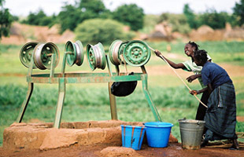
Water and Health:
Local communities facing global challenges
by Andy Bevan, Lecturer in Ethical & Political Studies, UWTSD Lampeter

Slide 2
Some important “sources”
VSO Technical Desk: my first experience of Kenya in 1988 – studying rural water supply (Mwingi and Rapogi), informal sector manufacturing and community-based building
Expanding these programmes and designing adaptation training for skilled personnel (with WEDC, Loughborough and ITDG, Ryton)

Slide 3
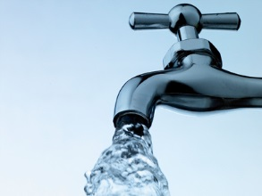
Water – a resource we take for granted
“Just turn on the tap!”
In the UK, water consumption is 150 litres per person per day
This has increased by 1% per year, every year since 1930
We use drinking quality water for everything i.e. without thinking

Slide 4
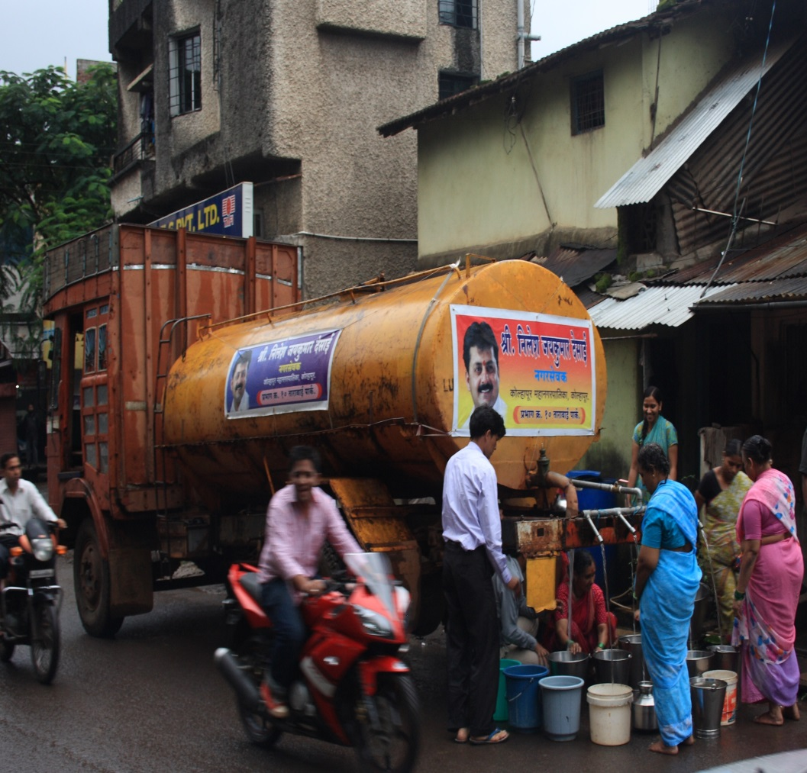
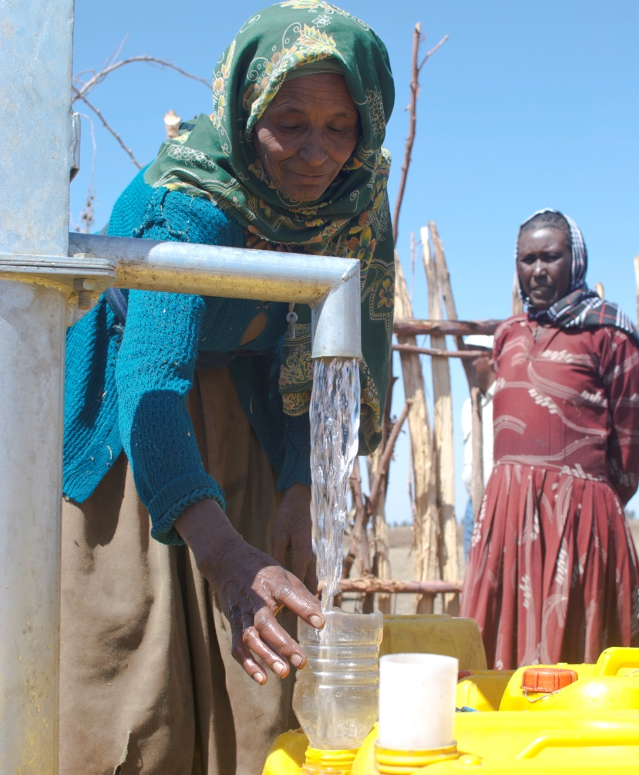
Not everywhere in the world is so lucky…

Slide 5
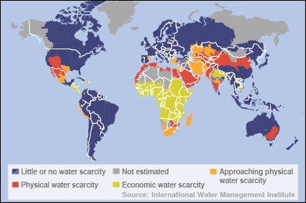
Water scarcity is a reality for millions

Slide 6
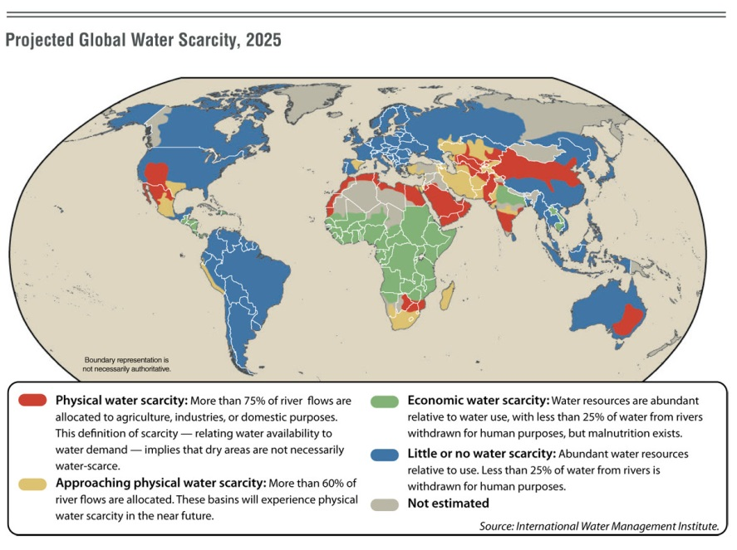
…and predictions for 2025?

Slide 7

Water quality and quantity has a profound impact on human health…

Slide 8
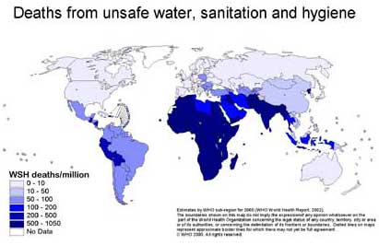

Slide 9
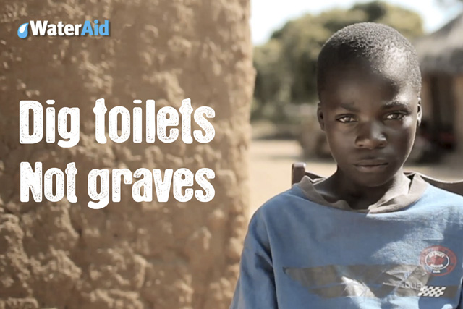
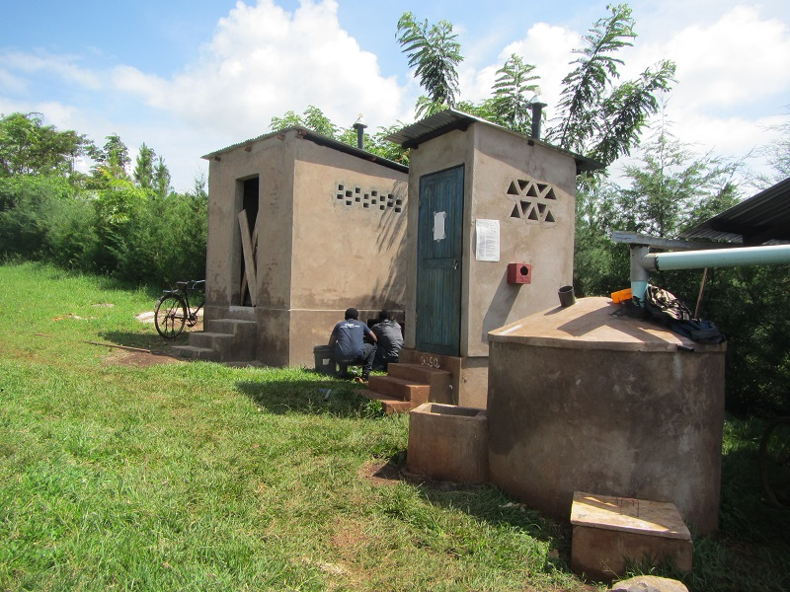
Alongside improved water supply… improved sanitation is also vital
(and the removal of breeding sites for mosquitoes)

Slide 10
Water-related and water-borne diseases
Including:
Diarrhoeal diseases
Cholera and typhoid
Guinea worm
Bilharzia/schistosomiasis
River blindness/onchocerciasis
Malaria, dengue fever etc.

Slide 11
Water and Health: Some key facts
1 in 10 people worldwide lack access to safe water
1 in 3 people lack access to a toilet
Women and children spend 125m hours per day collecting water

Slide 12
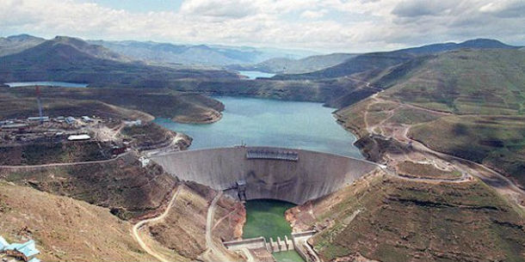
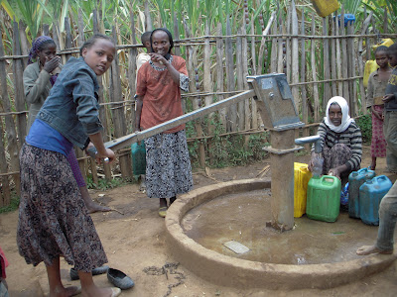
What strategy (and balance/priorities) for improved water supply and sanitation?
Big engineering projects?
Foreign Aid; imported skills and materials
Small-scale, local initiatives?
Self-help; local skills and materials

Slide 13
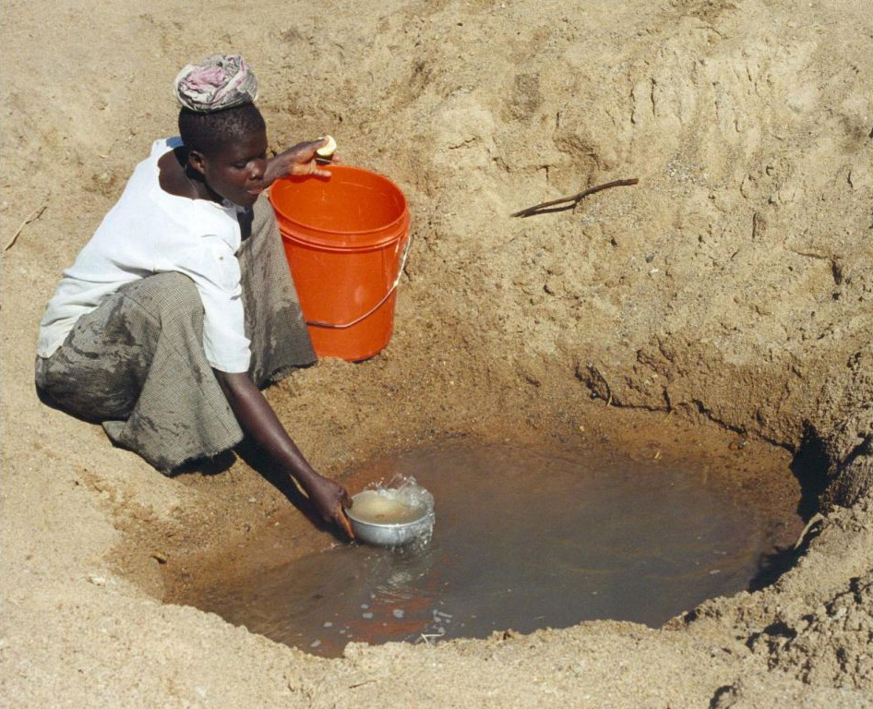
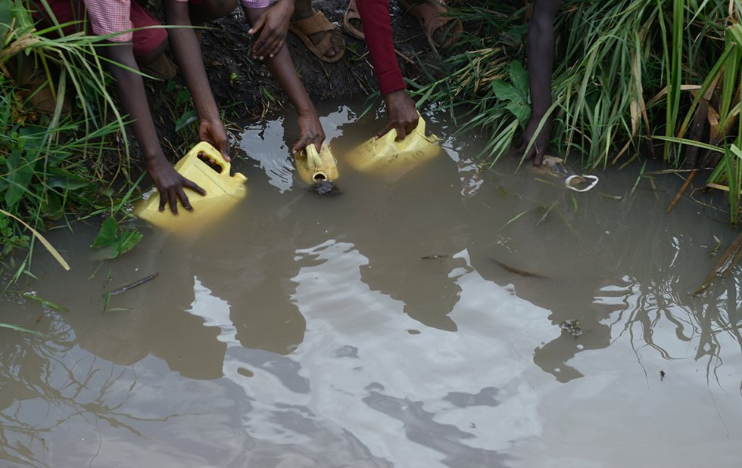
10% of the world’s population draws water from an “unimproved source” (particularly in rural areas)

Slide 14
Some community-based options for improved water supply
Rainwater catchment (for human consumption and crops)
Sub-surface dams/sand dams
Improved wells
Spring protection
Improved water storage
Small-scale filtration
Boreholes/powered pumps
Gravity-fed (piped) water supply/village tapstands
Village level operation and maintenance (VLOM) and sustainability

Slide 15
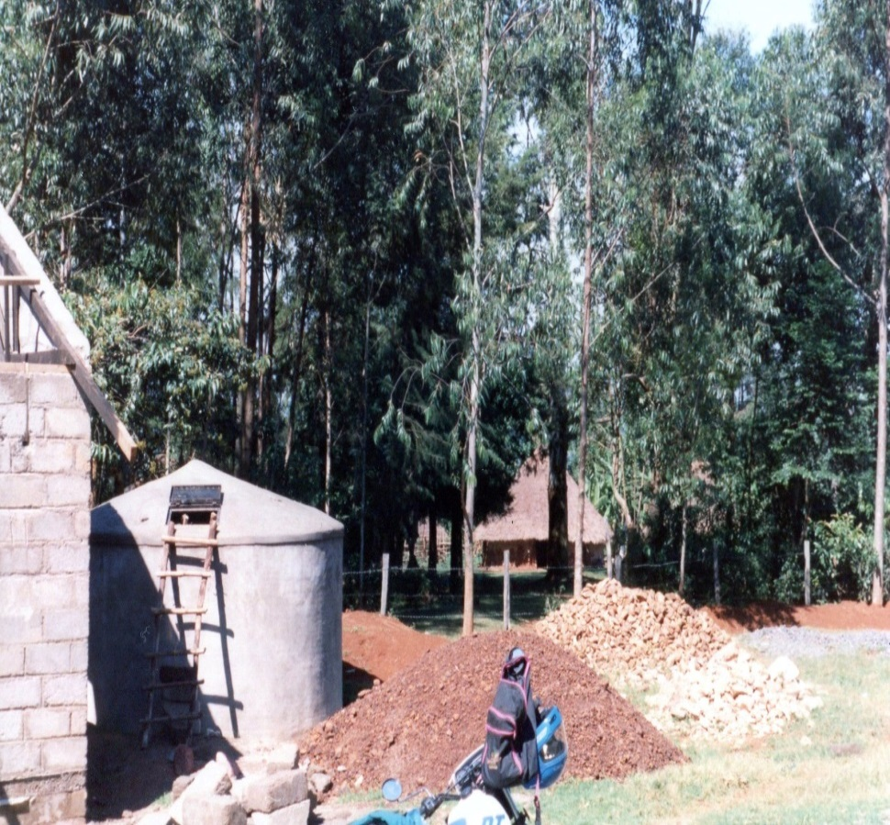
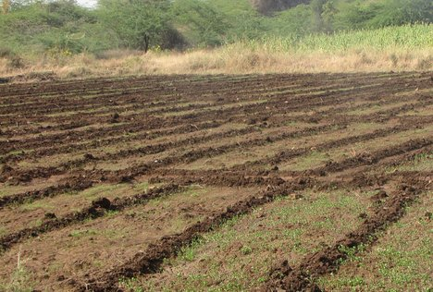
Rainwater catchment – for drinking and washing…and for crops

Slide 16
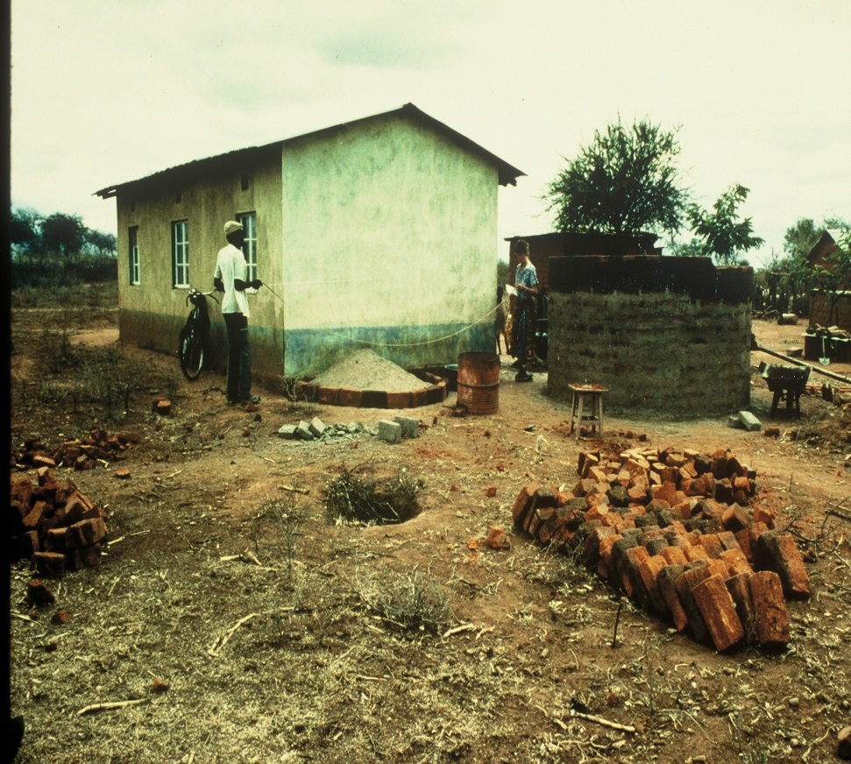
Rainwater catchment in Mwingi, Kenya

Slide 17
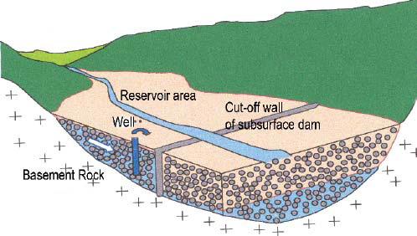
Sub-surface dams/sand dams

Slide 18
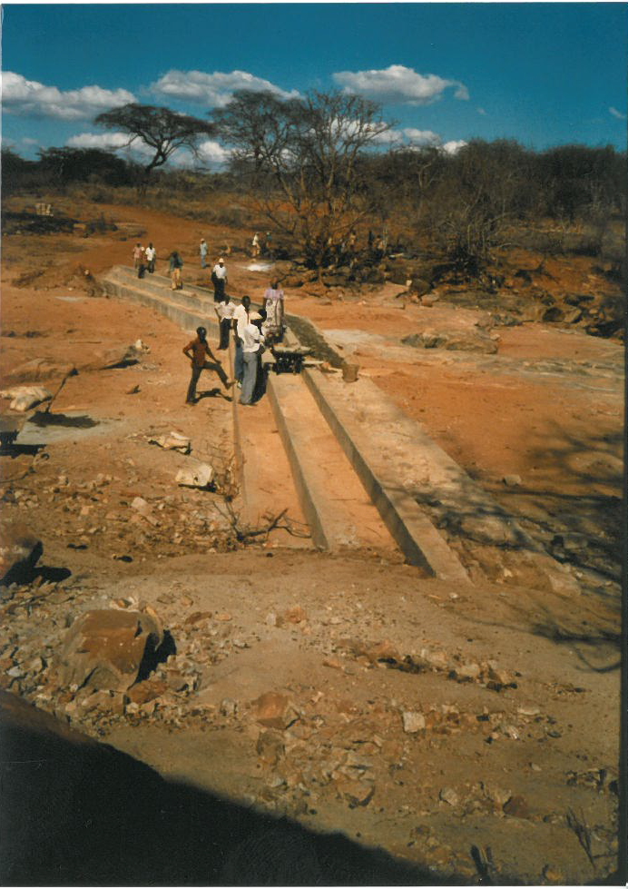
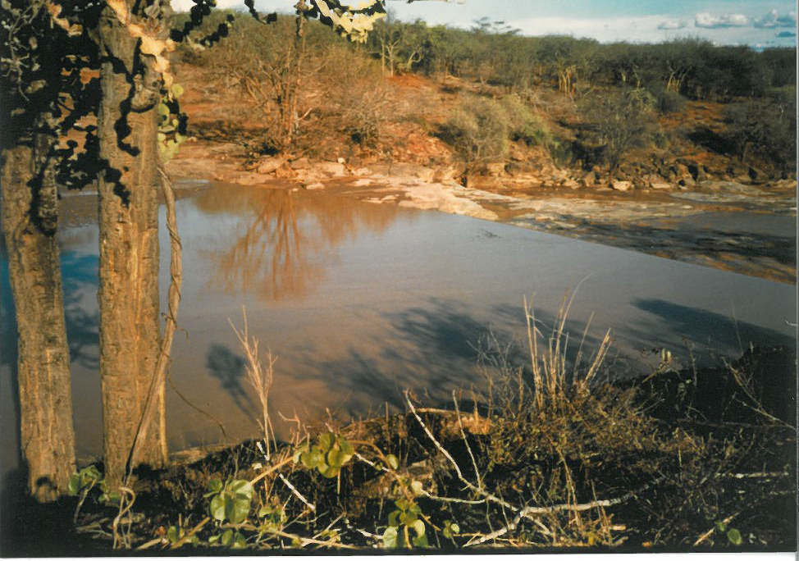
Sand dam at Kweluu, Mwingi, Kenya
Left: Nearing completing before the November rains
Right: Five days later!

Slide 19
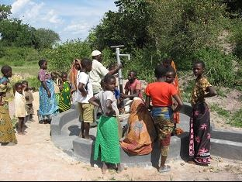
Improved wells

Slide 20
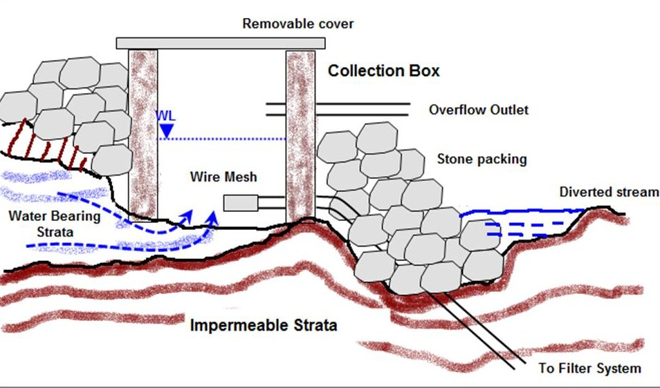
Spring protection

Slide 21
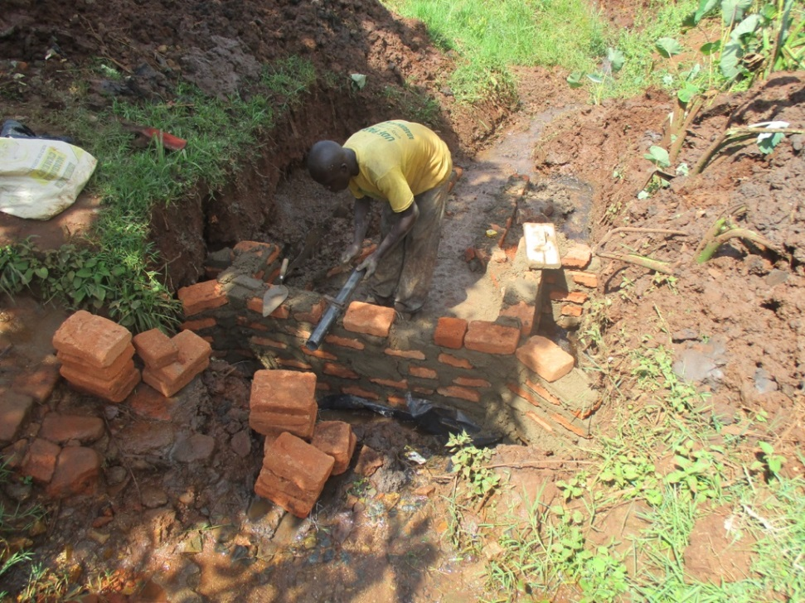
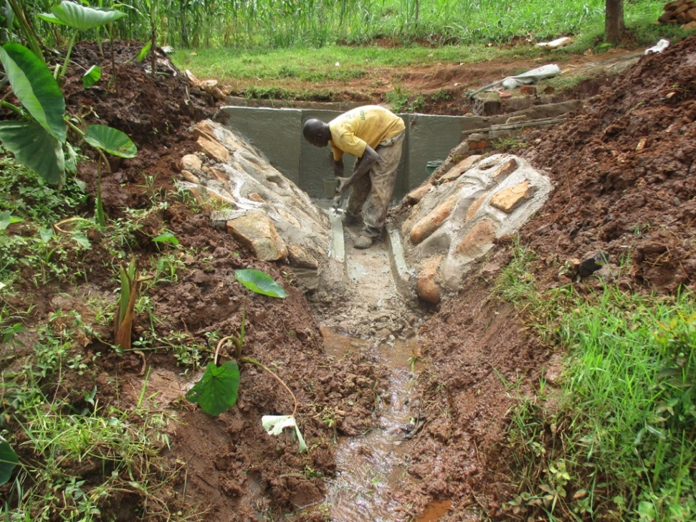
Spring protection

Slide 22
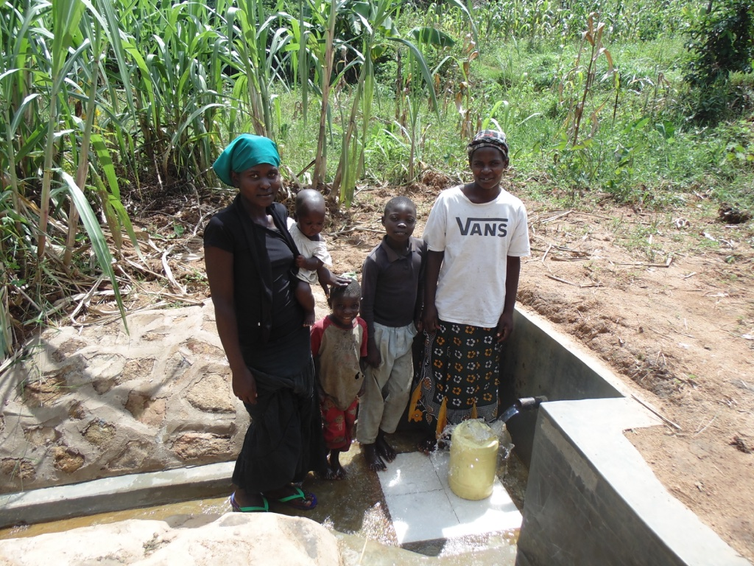
The finished “spring box” in use

Slide 23
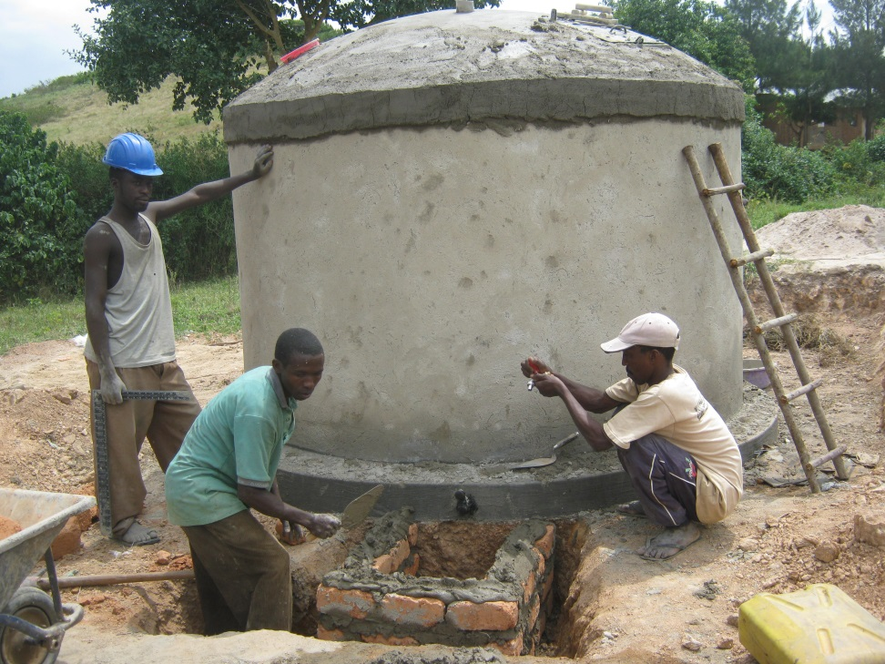
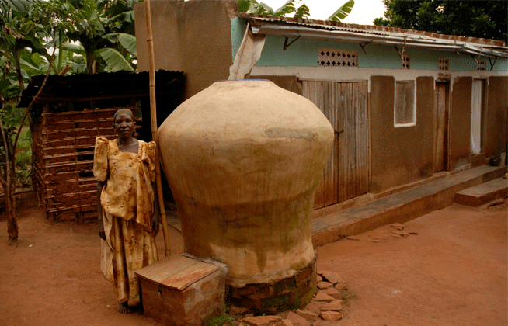
Improved water storage

Slide 24
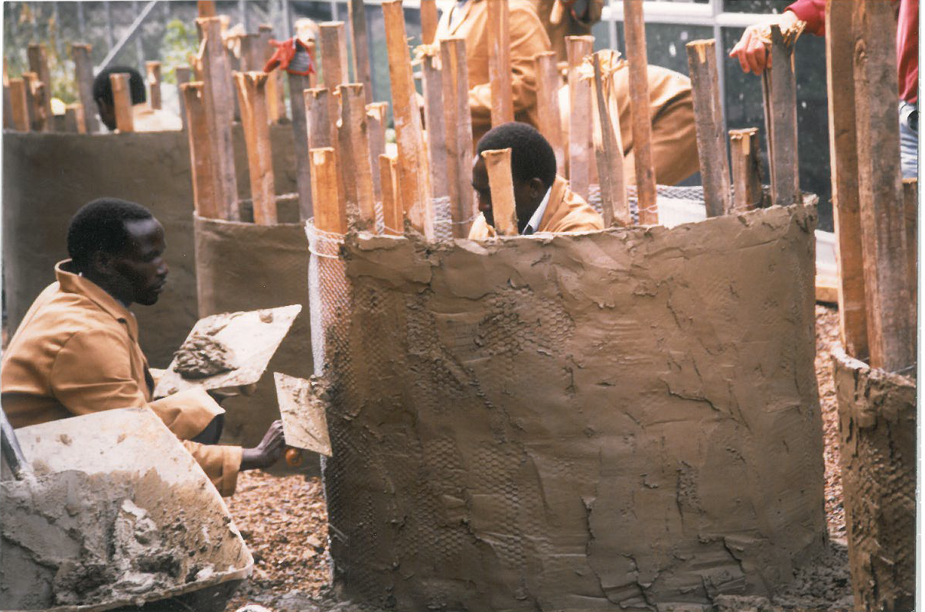
Water storage – ferro-cement water tanks

Slide 25
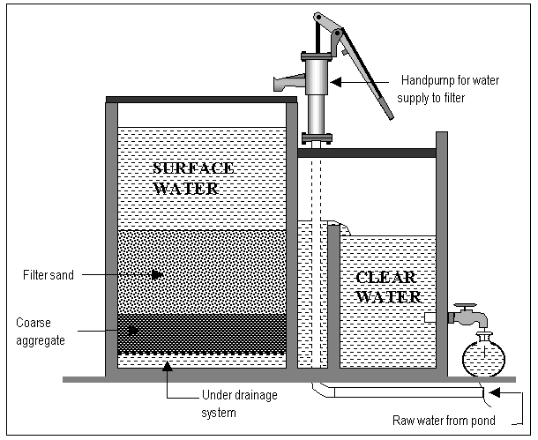
Small-scale filtration

Slide 26
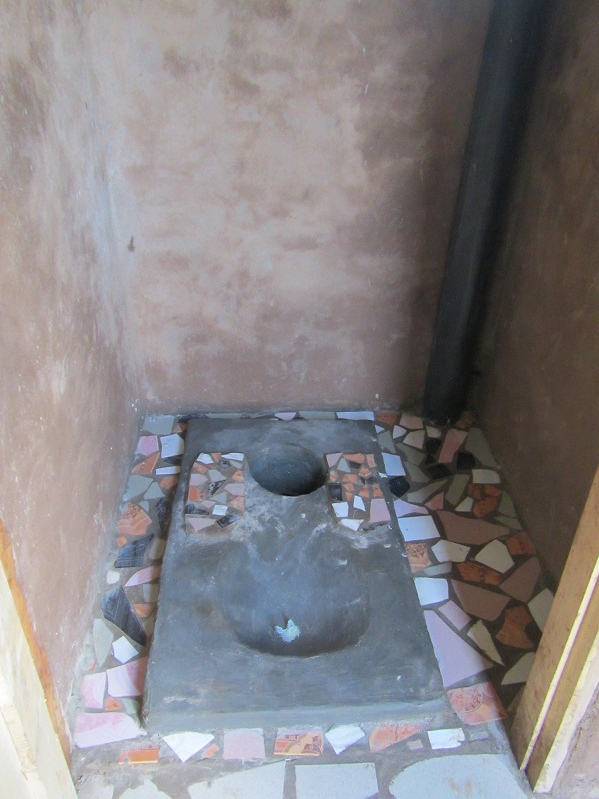
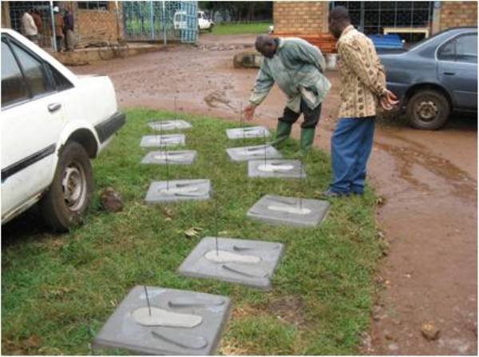
…and all important, improved sanitation

Slide 27
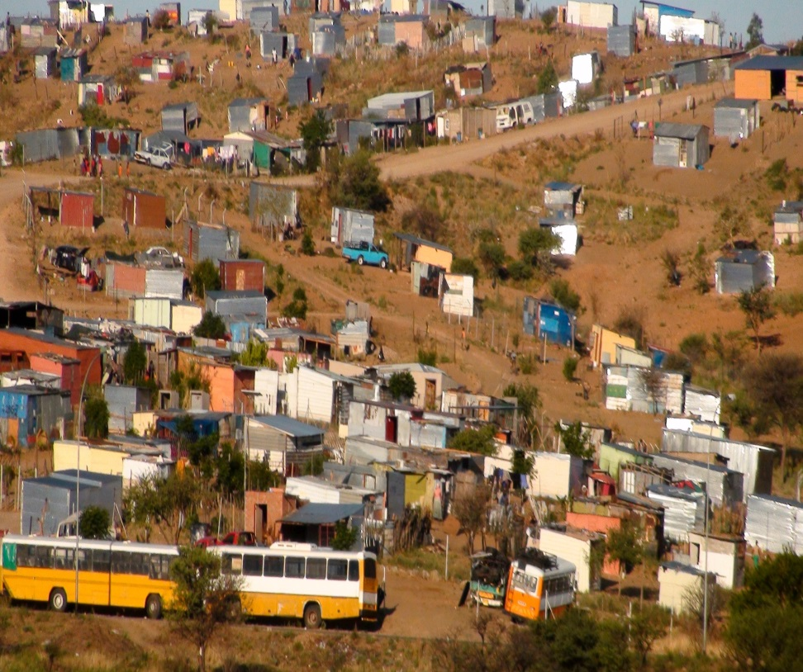
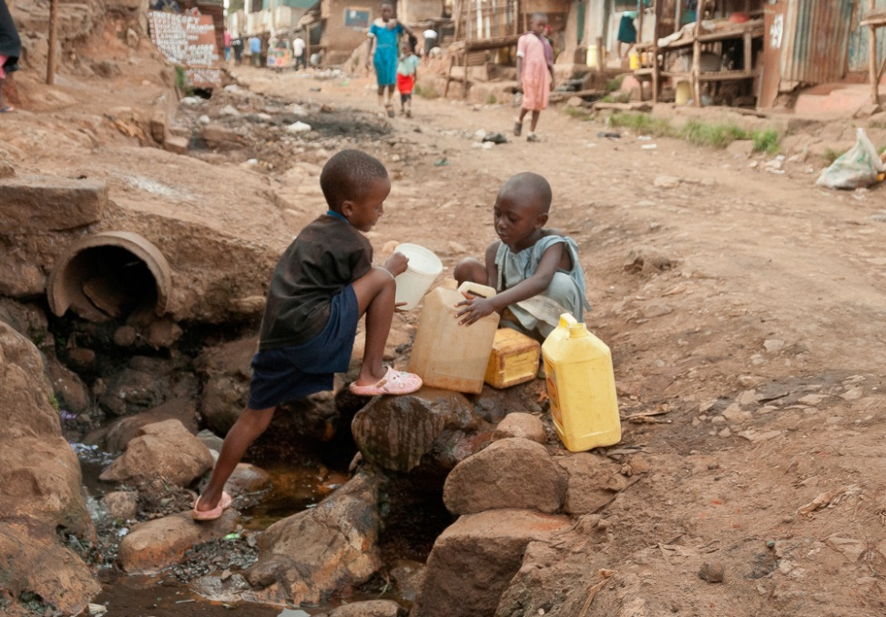
The challenges of rapid urbanisation for water supply and sanitation…
Katutura, Namibia
Kibera, Nairobi, Kenya

Slide 28
Urban water supply and sanitation
Self-help
Collective action/democratic pressure
Municipal organisation and governance
Intermediate and larger-scale solutions also needed

Slide 29
Challenges for improved water supply in the era of globalisation
Debt burden
Structural Adjustments Programmes (SAPs)
Privatisation of urban (and communal) water supply
Private distribution of water…and “pay-as-you-go” urban water and sanitation schemes

Slide 30
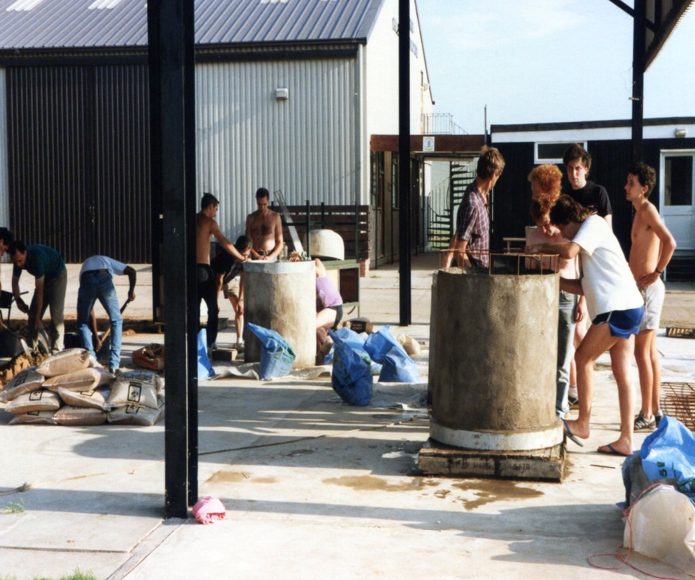
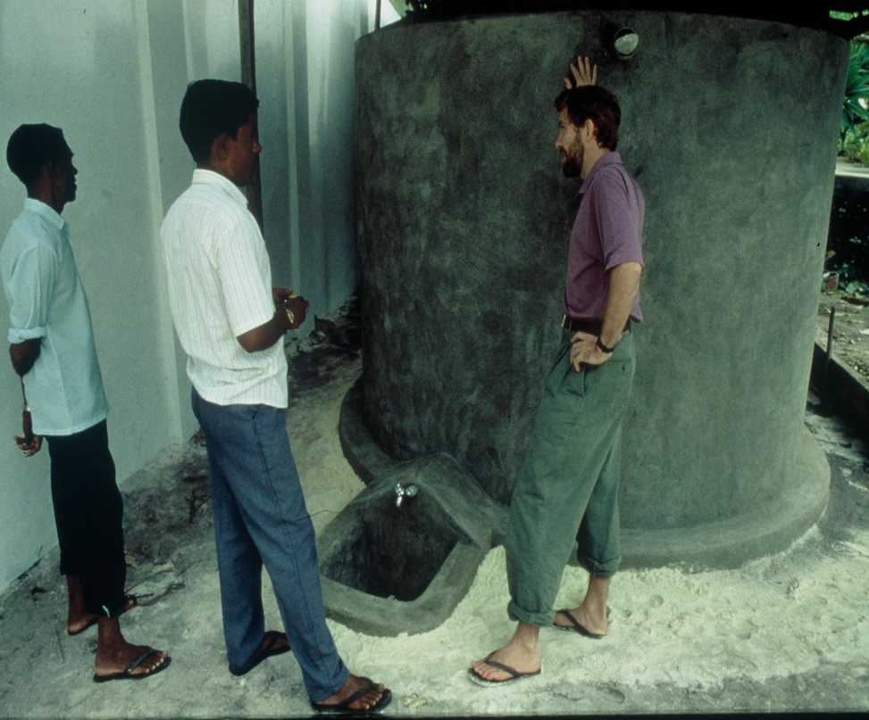
Do we have a part to play?
Perhaps we have a different “angle”, and we can gain a new insight into our problems too…
Being open to sharing ideas and experience: local knowledge
Adapting to a very different reality: training

Slide 31

Most important of all, for sustainable progress…
Local management and “ownership”

Slide 32
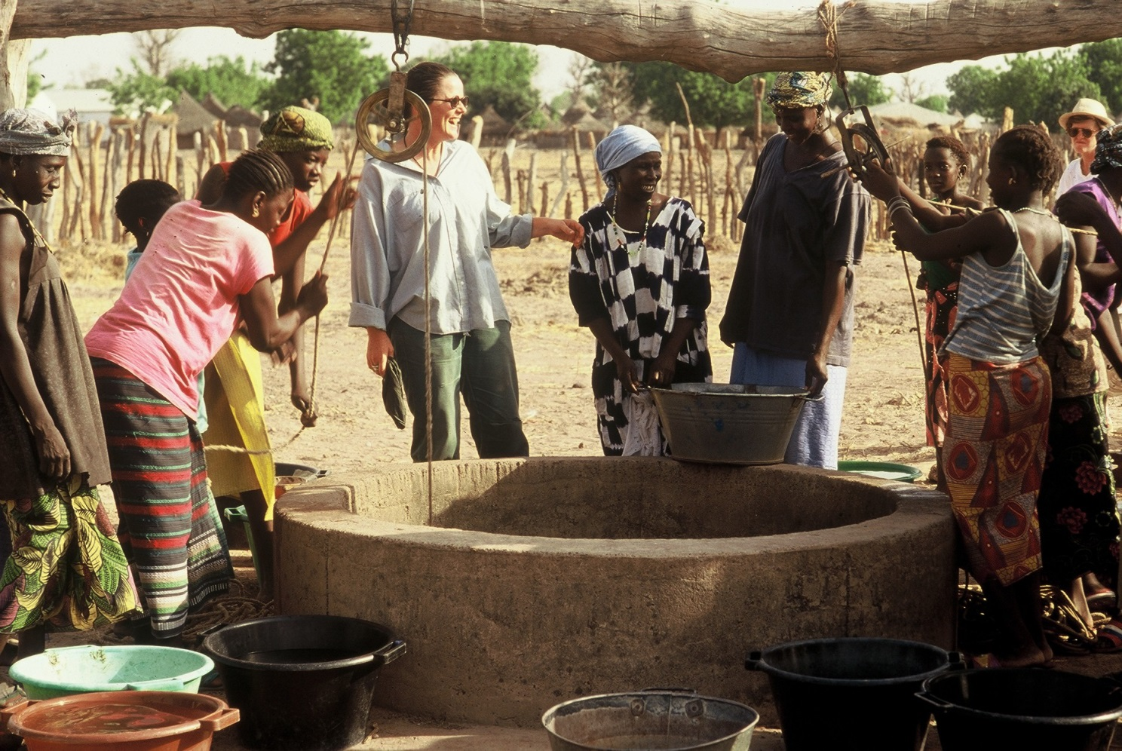
UN Sustainable Development Goal No.6: “Ensure availability and sustainable management of water and sanitation for all”

Slide 33
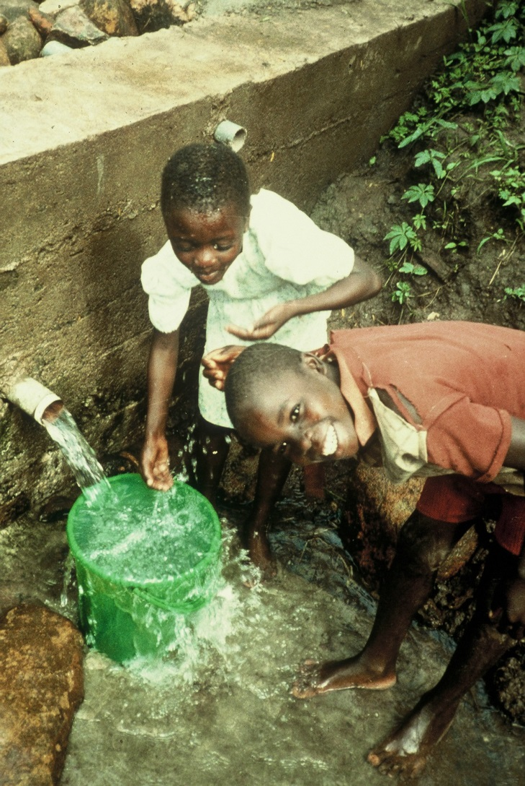
Finally…Some themes which have interested me over the past 30 years
Water engineering > community development & cultural/anthropological study > politics of change
Rural water supply issues > urban challenges > politics of globalisation

