Slide 1
Data Mining & Visualisation
ACCB7015
Lecture 6 – Cluster Analysis
Prof. Nik Whitehead

Slide 2
Problem of Cluster Detection
Requirements for clustering solutions
  Scalability
  Able to deal with different types of attributes
  Able to discover clusters of arbitrary shapes
  Minimal requirements for domain knowledge to determine input parameters
  Able to deal with noise and outliers
  Insensitive to order of input data records
  Able to deal with high dimensionality
  Incorporation of user-specified constraints
  Interpretability and usability

Slide 3
Measures of Proximity
Basics
  Proximity between two data objects is represented by either similarity or dissimilarity
  Similarity: a numeric measure of the degree of alikeness, dissimilarity: numeric measure of the degree of difference between two objects
  Similarity measure and dissimilarity measure are often convertible; normally dissimilarity is preferred
  Measure of dissimilarity:
    Measuring the difference between values of the corresponding attributes
    Combining the measures of the differences

Slide 4
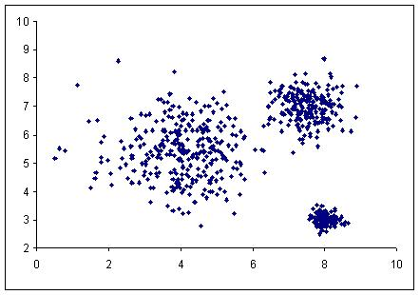
Categories of Clustering Solutions
Partition-based and density-based
Partition-based
Density-based
: Dense areas

Slide 5
K-means, a Basic Clustering Method
Outline of main steps
  Define the number of clusters (k)
  Choose k data objects randomly to serve as the initial centroids for the k clusters
  Assign each data object to the cluster represented by its nearest centroid
  Find a new centroid for each cluster by calculating the mean vector of its members
  Undo the memberships of all data objects. Go back to Step 3 and repeat the process until cluster membership no longer changes or a maximum number of iterations is reached.

Slide 6
K-means, a Basic Clustering Method
Illustration of the method:

Slide 7
K-means, a Basic Clustering Method
Strengths & weaknesses
  Strengths
    Simple and easy to implement
    Quite efficient
  Weaknesses
    Need to specify the value of k, but we may not know what the value should be beforehand
    Sensitive to the choice of initial k centroids: the result can be non-deterministic
    Sensitive to noise
    Applicable only when mean is meaningful to the given data set

Slide 8
K-means, a Basic Clustering Method
Overcoming the weaknesses:
  Using cluster quality to determine the value of k
  Improving how the initial k centroids are chosen
    Running the clustering a number of times and select the result with highest quality
    Using hierarchical clustering to locate the centres
    Finding centres that are farther apart
  Dealing with noise
    Removing outliers before clustering?
    K-medoid method, using the nearest data object to the virtual centre as the centroid.
  When mean cannot be defined,
    K-mode method, calculating mode instead of mean for the centre of the cluster.

Slide 9
K-means, a Basic Clustering Method
Choosing initial k centroids
  Running the clustering many times (only trial and error)
  Using hierarchical clustering to locate the centres (why partition based?)
  Finding centres that are farther apart

Slide 10
K-means, a Basic Clustering Method
K-medoid:
Bisecting K-means

Slide 11
Exercise
Use the wine.arff dataset
Select the clustering attributes (i.e. remove class)
Run clustering with
  k=2, Euclidean distance, default seed
Record
  Cluster sizes, centroid values, number of iterations
Repeat clustering with k=3 and k=3
Record
  Cluster sizes, centroid values, SSE, cluster membership
How does changing k impact cluster cohesion?
Do clusters appear meaningful?
Which value of k would you recommend, and why?

Slide 12
Density-based Clustering
Treating data as points in a N-dimensional space
Density: centre-based or region-based
Dense regions with high concentration of points are likely to be clusters
DBSCAN: a density-based algorithm
  Centre-based density
  Classifying data points as core, border or noise
  Incomplete clustering (not all data are members of a cluster)
Enough neighbours within the circle?
Dense and sparse regions

Slide 13
DBSCAN Algorithm
Types of Data Points
  Given:
    Eps: the radius
    MinPts: the minimum number of data points within Eps
  Core point c: |N_{Eps}(c)| ≥ MinPts
  Border point b: |N_{Eps}(b)| < MinPts and
  b ∈ N_{Eps}(c) and |N_{Eps}(c)| ≥ MinPts
  Noise point n: Outside Eps of any core and |N_{Eps}(n)| < MinPts
N_{Eps}(t)
Eps
t
Noise
Border
Core

Slide 14
DBSCAN Algorithm
Density Reachable
  Density reachable
  Direct density reachable
d
b
c
f
a
Points a and d are density reachable while points a and f are not.
Point a is direct density reachable by point b, but not by point c.

Slide 15
DBSCAN Algorithm
Algorithm Outline
  Scan the data set and label each data record as core, border or noise;
  All noise points are labeled as members of the default noise cluster;
  Scan through all core points and assign core points that are direct density reachable to the same cluster. Core points that are not direct density reachable are assigned to different clusters;
  Scan through all border points and assign density reachable border points to the cluster of their core points.

Slide 16
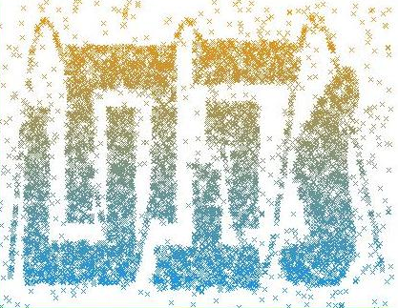
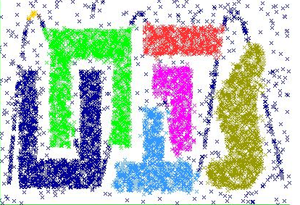
DBSCAN Algorithm
Illustration (DBSCAN in Weka)
Original Data
Result Clusters
Eps=0.0225, MinPts=15

Slide 17
Cluster Evaluation & Interpretation
Cluster quality
  Principle:
    High-level similarity/low-level variation within a cluster
    High-level dissimilarity between clusters
  The measures
    Cohesion: sum of squared errors (SSE), and sum of SSEs for all clusters (WC)
    Separation: sum of distances between clusters (BC)
    Combining the cohesion and separation, the ratio BC/WC is a good indicator of overall quality.
Cluster tendency
  Cluster tendency: do clusters really exist?
  Measures for tendency:
    Quality measure: when BC and WC are similar, it means clusters do not exist.

Slide 18
Cluster Evaluation & Interpretation
Cluster quality illustrated
Cluster c₂
Cluster c₁
∴ C₁ is a better quality cluster than C₂.

Slide 19
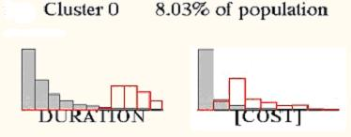
Cluster Evaluation & Interpretation
Cluster interpretation
  Within cluster
    How values of the clustering attributes are distributed
    How values of supplementary attributes are distributed
  Outside cluster
    Exceptions and anomalies
  Between cluster
    Comparative view
Value distributions for the cluster
Value distributions for the population
Value distributions for the population
Value distributions for the cluster

Slide 20
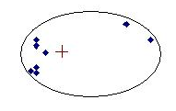
Limitations of Basic Solutions
Limitations of the K-means Method
  Effects by the outliers
  Unable to detect clusters of different sizes
  Unable to detect clusters of arbitrary shapes
Centroid affected by outliers
points are closer to centre of another cluster
Only detecting clusters of convex shapes

Slide 21
Clustering in Practice
Process of a Clustering Project
  Data Preparation;
  Selecting a sensible proximity function;
  Selecting a suitable clustering solution;
  Selecting clustering attributes
  Conducting clustering with specific settings of parameters;
  Evaluating cluster quality
  Attempting to interpret the meaning of the clusters

Slide 22
Clustering in Practice
Factors Influencing Solution Selection
  Completeness of clustering results (all data records, all possible clusters, all attributes involved?)
  Cluster characteristics (shapes, sizes, densities, etc)
  Cluster descriptors and description constraints
  Data characteristics (types, presence of outliers, etc.)
  Considerations given to algorithms (e.g. capability of determining the number of clusters, capability of determining relevance of attributes to clusters, algorithm performances, etc.)

Slide 23
Summary
A clustering solution must provide a sensible proximity function, effective algorithm and a cluster evaluation function
Proximity is normally measured by a distance function that combines measures of value differences upon attributes
Partition-based algorithms (e.g K-Means) continue to refine prototype partitions until membership changes no longer occur
Density-based algorithms (e.g. DBScan) treat clusters as regions where there is a greater concentration of data points
Good clustering results mean high similarity among members of a cluster and low similarity between members of different clusters

Slide 24
Exercise/Homework
Use the breast-cancer-wisconsin.arff dataset
Run SimpleKMeans with
  k=2, Euclidean distance, default seed
Record
  Cluster sizes, SSE, attribute distributions per cluster
Run DBSCAN (you may need to add the package)
  Start with default Eps and MinPts
  Adjust parameters if clustering fails or is too noisy
Record
  Number of clusters, number of noise points, cluster membership patterns
Which algorithm produced more meaningful clusters?
How did noise/outliers affect each method
What role do Eps and MinPts play in DBSCAN?
When would you chose one algorithm over the other in real world problems?

Slide 25
Looking ahead
Next session: Other Data Mining Techniques

