Slide 1
Individual Presentation
Student ID- 2109713
Student name- Cristea Alexandra

Slide 2
Table of contents
Introduction……………………………………………………………………………………………………………………..3
Employee Retention…………………………………………………………………………………………………………….4
Effective strategies to address retention………………………………………………………………………………………..5
Analyzing the relationship……………………………………………………………………………………………………….6
Nature of managerial work…………………………………………………………………………………………………..…7
Effective Management and leadership…………………………………………………………………………………………..8
Behavioral approach to management…………………………………………………………………………………………...9
Motivation and engagement issues…………………………………………………………………………………………........10
Organizational examples………………………………………………………………………………………………………..11
Conclusion………………………………………………………………………………………………………………………12
References………………………………………………………………………………………………………………….......13-14

Slide 3

Introduction
The main aim of this presentation is to analyse the relationship between structure, culture, people, and organisational performance. The essential nature of work performed at managerial level as well as various processes and functions will be communicated in the presentation. The role of leadership, and other variables taking place within an organization will be determined with effectiveness of management as well as the theories of leadership. Various other factors influencing the behaviour of an individual as well as the behavioural approaches will also be exaggerated in the context. The company conducted a thorough investigation into the chosen corporation's previous personnel and ability management strategy and conducted a serious evaluation of the same regarding the efficiency of such procedures in terms of accomplishing the corporation's specific aims. The organization chosen for this presentation is “Premier Inn”. The adoption of the concepts of the classical method by practicing managers revealed that it was impossible to achieve complete effectiveness and implementations.

Slide 4
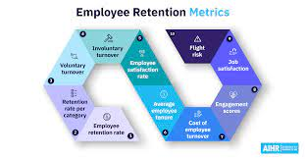
Employee Retention
The disclosure of Whitbread's interim results shows that resort areas in England face severe labor shortages. It asserted that it was in a great spot than the majority of competitors since it had retained more employees during Covid-19 downturn than what was initially anticipated. In October, Premier Inn made the announcement that it needed to hire 2,000 people for jobs in the kitchen, marketing, and cleaning. According to Whitbread CEO Alison Britain, "the operating climate in September and into September has been hard in large measure due to our exceptionally high guestrooms, economy access to raw materials, and a stricter workforce in the hotel. “In order to ensure that staff compensation remained competitive, the company claimed that it would monitor the market. This month, it announced a pay increase for the members of its periodically scheduled group, with optimum pay rates increasing by more than 5%. It should also cost the firm between £12 and billion annually this year, according to the results released. The company conducted a thorough investigation into the chosen corporation's previous personnel and ability management strategy and conducted a serious evaluation of the same regarding the efficiency of such procedures in terms of accomplishing the corporation's specific aims (Singh, 2019).
(Source: aihr, 2022)

Slide 5


Effective strategies to address retention
The adoption of the concepts of the classical method by practicing managers revealed that it was impossible to achieve complete effectiveness and implementations.
This led to the development of the behavioral approach to managing. The behavioral management theory stresses what the traditional champions Employees' workloads frequently grow when they watch their coworkers go.
A downhill slide of absences and tension may result from this. Employees that are dissatisfied and overwhelmed become less prone to excel, which lowers the quality of the company's item or service and increases the likelihood that customers may engage negatively with it (Yamin, 2020).
It's tough to fully estimate the effects. Companies may encourage individuals to acknowledge the contributions of their immediate employees. They can even go a step further or reward employees who exceed their duties on a divisional or corporate level.
A dedicated learning and development team works to support and nurture individuals. At Heat Technology, controllers of instant messenger teams face particular challenges with performance management.
It is more crucial than ever in a remote global environment with flexible schedules that could cause disengagement, confinement, and disillusion (Okwakpam, 2019).
(Source: Bookworld, 2022)

Slide 6
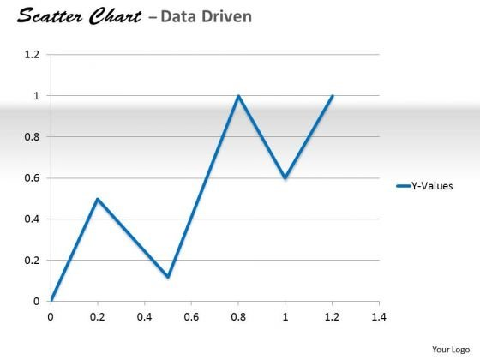
Analyzing the Relationship
The corporation asserted that they would keep an eye on the market to make sure that employee salaries remained reasonable. It announced a pay raise for the individuals of its occasionally scheduled group in October, with minimum pay scales rising by more than 5%.
According to the figures made public, it must have cost the company approximately £12 and billion every year. The firm carried out an extensive research into the prior staff and capabilities of the chosen business and carried out a serious analysis of the same to determine the success of such operations in regard to meeting the industry's unique goals.
Given the noted worldwide shortage of skilled, the presentation also employs this inquiry to develop a number of suggestions concerning how to possibly increase talent growth and acquisition. e corporation asserted that they would keep an eye on the market to make sure that employee salaries remained reasonable (Jin and Oh, 2019).
It announced a pay raise for the individuals of its occasionally scheduled group in October, with minimum pay scales rising by more than 5%. According to the figures made public, it must have cost the company approximately £12 and billion every year.
(Source: slidegeeks, 2022)

Slide 7
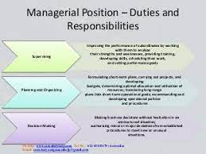
Nature of managerial work
If businesses are to properly handle these concerns, management must take the lead. By excellent management, modernized organizations make substantial progress toward becoming more competitive globally.
On the other hand, ineffective management dooms the business to stagnation and, occasionally, total failure. In light of this, we shall now investigate the fundamentals of governance.
Despite the fact that our talk primarily focuses on administrators, we would really like to underscore that this also applies to the behaviour of improve an existing.
Now that we understand the findings of this inquiry, we can begin looking into how management may use what they learn from cognitive science to increase their efficiency in a commercial setting.
In a broad sense, senior management job is to coordinate and effectively use the company's resources in order to promote performance and protracted goal achievement (Faraziani, 2021).
This approach makes it obvious that everyone who needs to collaborate with others in achieving organisational goals can benefit from learning about managing, companies, or institutional arrangements effectively.
(Source: academia, 2022)

Slide 8
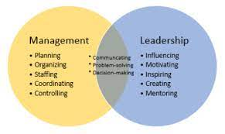
Effective Management and leadership
Both formal and unofficial leaders are present in organisations. A supervisor is an individual who is recognized by people outside the group as the company's official leader.
The organization actually selects the technical leader to serve as its company secretary. Warren Welch served as General Electric's designated CEO, and Leonard Klein served as the group's chosen spokesperson (Dani, 2019).
Almost every managers will have formal leadership responsibilities as part of their position description. Organizations. Enterprises that allow group members to select the individual who will lead their group use temperament work teams.
The company's informally chairman is the person whom the campaign's followers acknowledge to be its leadership. Unofficial leaders, or those who have a large impact on the team while not holding a formal leadership position, are typically found in athletic teams. In reality, every work group has at some one informally leader (Mccaffery, 2018).
Like formal leaders, informally leaders can help or hinder a company depending over whether their influence motivates follower to behave in conformity with the pair's aims.
(Source: educba, 2022)

Slide 9
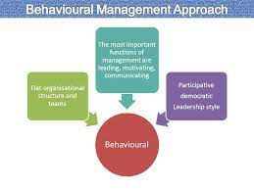
Behavioral approach to management
The adoption of the concepts of the classical method by practicing managers revealed that it was not possible to achieve complete economy and implementations. This resulted in the invention of the behavioral approach to managing.
The behavioral approach to leadership brought attention to the human element, which the classical proponents had disregarded. The psychological proponents examined the organizing from the standpoint of the individual, whereas the classical economists considered it from the position of produce.
The psychological management strategy addressed both personal and social patterns, and it emphasized the significance of social behaviors in the workplace. The approaches to human relations and the cognitive science technique are the two branches of the behaviorist approach.
Administrators using the humanist method should understand the emotional and social influence on their employees' behaviour as well as the reasons behind it (Mandysova, 2019).
(Source: slideplayer, 2022)

Slide 10
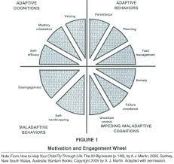
Motivation and engagement issues
The WINcard has a way to track employee involvement at work. Each year, all employees receive a reassessment of the findings of an interview. Terms & conditions are used to construct a corporation action plan, which is distributed to every person.
The company believes it provides excellent working environments and terrific solutions for its employees. Premier Inn attempts to provide employees with an accommodating, supporting office culture to make it simpler for them to balance caring for children (Ucar, 2020).
A dedicated learning and development team works to support and nurture individuals. At Heat Technology, controllers of instant messenger teams face particular challenges with performance management.
It is more crucial than ever in a remote global environment with flexible schedules that could cause disengagement, confinement, and disillusion (Bissessar, 2021).
(Source: innovation, 2022).

Slide 11
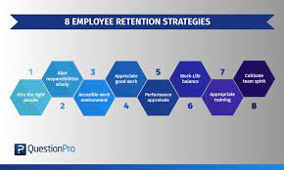
Organizational Examples
Merck & Co., Inc. (TRR: 24.7) Compared to 2020, only 8 of the Fortune 100 companies met the rigorous criteria. The TRR Scores of the two businesses that took the top two slots were 162% and 125% less, respectively, than the international financial services standard (50.89). The TRR Score for Cardinal Health was 19.4, while the TRR Score for Northrop Aviation Incorporated was 22.6. Merck (TRR: 24.7), Pfizer (TRR: 24.9), and Telecoms grab the following five spots (TRR: 32.9). Merck improved two points from the prior year to finish third (TRR: 24.7).
Lockheed Martin Corporation (TRR: 34.3) Thanks to intelligent machines, it has become possible to detect talent pools that is prepared for new challenges, predict upcoming skill gaps, and professionals to better instability. So according Dr. Christy Petrosso, Chief Data Scientist and Talent Social Scientist at Workforce Logiq, these insights—which are at the core of our Working Best Awards—give organisations a major advantage when it comes to retaining and growing their labour force during uncertain times.
(Source: questionpro, 2022).

Slide 12
Conclusion
Presentation aims to analyze the relationship between structure, culture, people, and organisational performance. Whitbread's interim results shows that resort areas in England face severe labor shortages. In October, Premier Inn made the announcement that it needed to hire 2,000 people for jobs. The corporation asserted that they would keep an eye on the market to make sure that employee salaries remained reasonable. According to the figures made public, it must have cost the company approximately £12 and billion every year. The firm carried out an extensive research into prior staff and capabilities of the chosen business. Both formal and unofficial leaders are present in organisations. A supervisor is an individual who is recognized by people outside the group as the company's official leader. Unofficial leaders, or those who have a large impact on the team while not holding a formal leadership position, are typically found in athletic teams. The WINcard has a way to track employee involvement at work. Terms & conditions are used to construct a corporation action plan, which is distributed to every person. Premier Inn attempts to provide employees with an accommodating, supporting office culture. Heat Technology's instant messenger teams face particular challenges with performance management.

Slide 13
References
Bissessar, C., 2021. Trinidadian and Grenadian Teachers’ Perceptions of Students’ Attendance, Motivation, and Engagement During Emergency Remote Teaching. In Emergency Remote Learning, Teaching and Leading: Global Perspectives (pp. 3-20). Springer, Cham.
Dani, S., 2019. Strategic supply chain management: creating competitive advantage and value through effective leadership. Kogan Page Publishers.
Faraziani, F., 2021. Analyzing The Relationship Between Ethical Culture And Organizational Ethics And Occupational Involvement.
Jin, S., Oh, M. and Kim, S., 2019. Analyzing the relationship between dynamic capability of project-based organization and the competitive advantage in the E&C companies. Korean Journal of Construction Engineering and Management, 20(1), pp.73-85.
Mandysová, I., 2019. Classical management biases and behavioral approach comprehension. Scientific papers of the University of Pardubice. Series D, Faculty of Economics and Administration. 46/2019.

Slide 14
References
McCaffery, P., 2018. The higher education manager’s handbook: Effective leadership and management in universities and colleges. Routledge.
Okwakpam, J.A., 2019. Effective succession planning: A roadmap to employee retention. Kuwait Chapter of the Arabian Journal of Business and Management Review, 8(2), pp.1-10.
Singh, D., 2019. A literature review on employee retention with focus on recent trends. International Journal of Scientific Research in Science and Technology, 6(1), pp.425-431.
Ucar, H. 2020. Enhancing online EFL learners’ motivation and engagement through supplementary activities on Facebook. Asian Journal of Distance Education, 15(1), pp.154-168.
Yamin, M., 2020. Examining the role of transformational leadership and entrepreneurial orientation on employee retention with moderating role of competitive advantage. Management Science Letters, 10(2), pp.313-326.

Slide 15
Thank You

