Slide 1

Name: Jaylan Lee
Student Number: 2220768
Module Code: ACCB6000
Module Title: Advanced Cybersecurity
Assignment Title: Analysing, Ethically Hacking and Securing an Enterprise Network

Slide 2
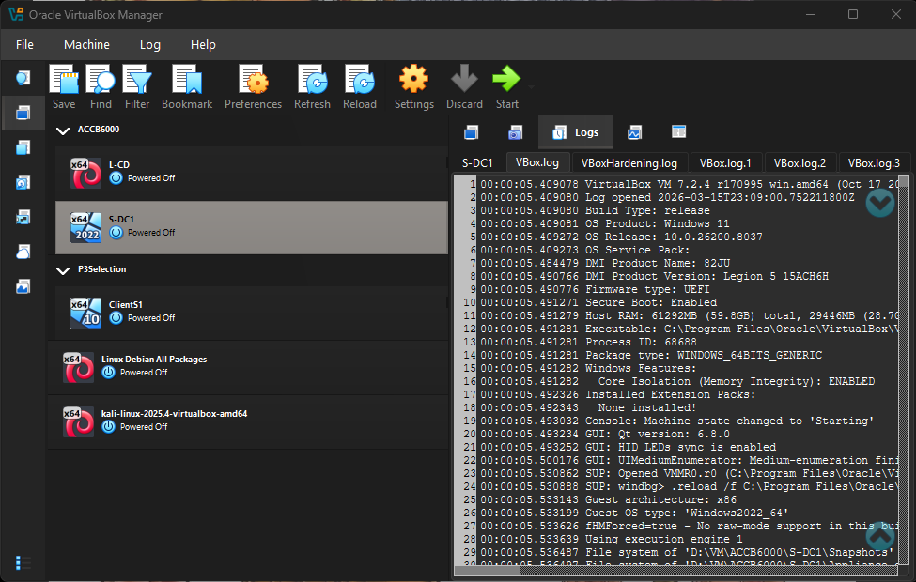
Network
I am using 2 networks Windows server which is from Swansea and a Linux server

Slide 3
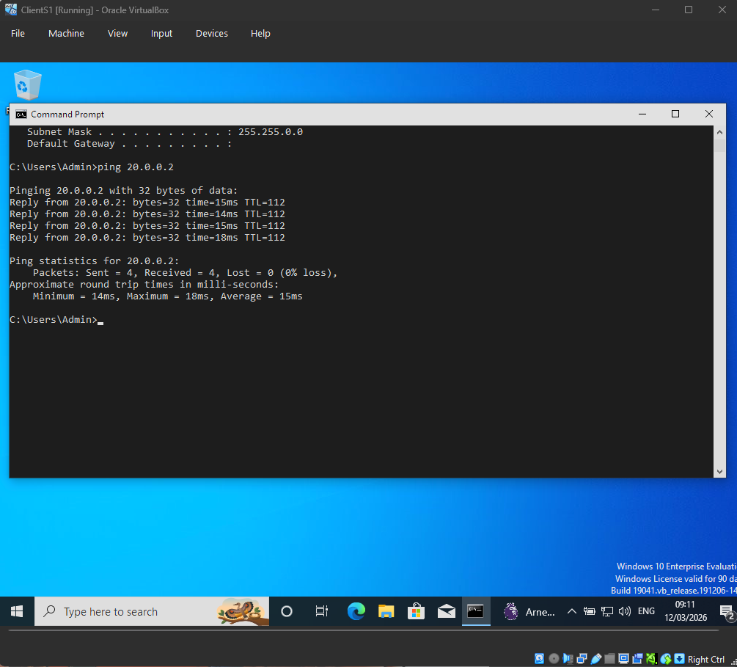
Network test
I successfully pinged the Linux server using the Windows client. This shows the network is working because for the Windows client to ping the Linux server, it had to go through the Windows server to get to the Linux server.

Slide 4
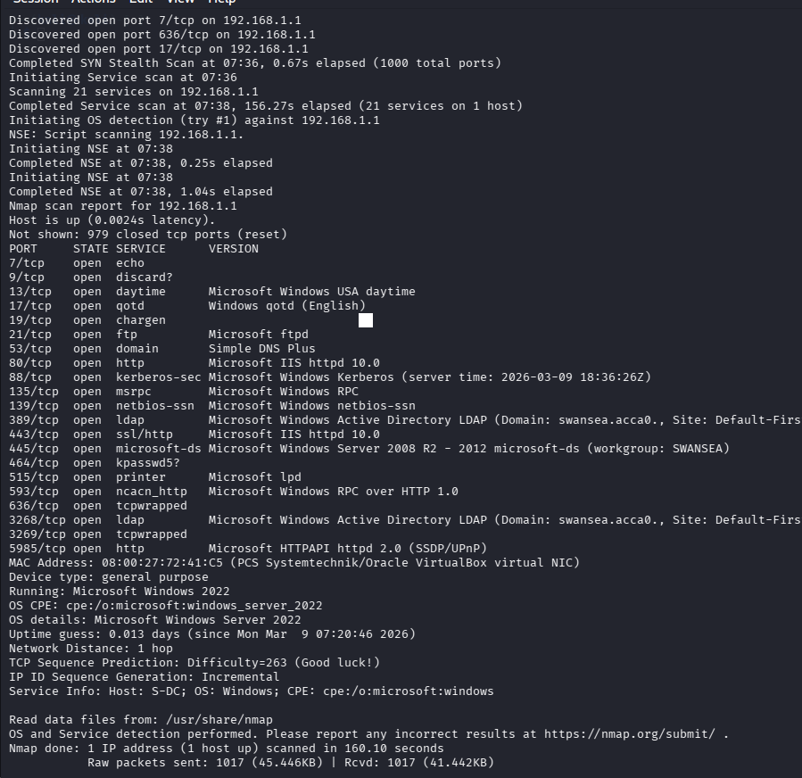
Reconnaissance using nmap Windows server
The attack pc Kali was used to scan the Host by using the command nmap –sV –O –v
Findings
The http is open and the host is running windows 2022
This information can be used to exploit the system

Slide 5
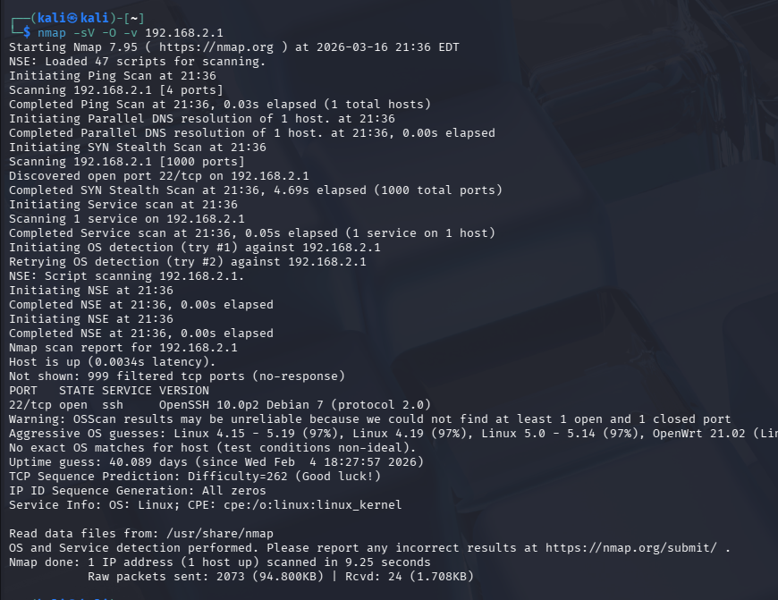
Reconnaissance using nmap Linux Server
The attack pc Kali was used to scan the Linux server by using the command nmap –sV –O –v
Findings
There are only one port open and the server is running Linux Debian 7

Slide 6

Vulnerability assessment

Slide 7
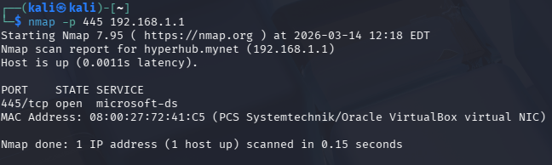
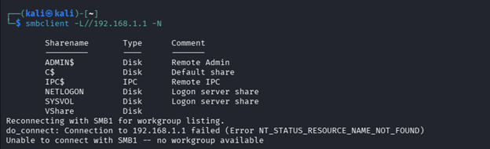
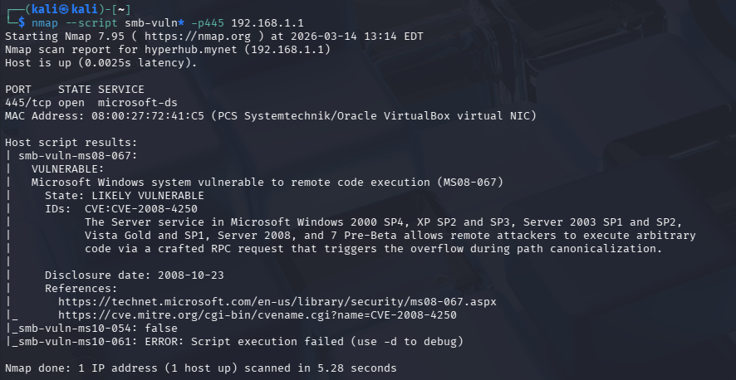
Port 445
High Severity: The scan of port 445 exposed it to be open and running a file sharing service on the Windows network smb
smbclient -L //192.168.1.1 –N command was used to put all the smb services that were on the host into a list
A vulnerability scan using nmap --script smb-vuln* -p445 192.168.1.1 reveals it is Vulnerable to a remote code execution. This can be used by attackers to exploit the smb service by submitting forged remote procedure call requests to execute code remotely.

Slide 8
Security measures port 445
Create more barriers for users to access files, such as an authenticator, or users cannot be anonymous to modify, share or access the shared files. Patching the files using a security patch [1]

Slide 9
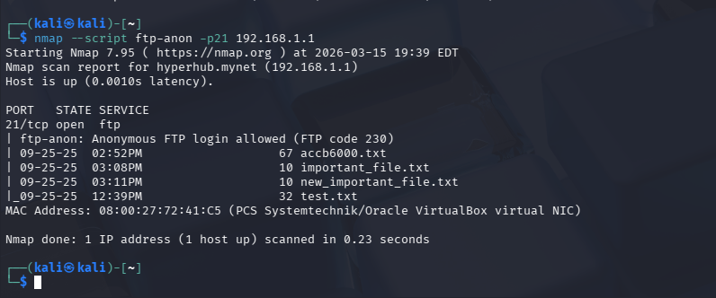
FTP Access
High Severity: nmap—script ftp-anon –p21 192.168.1.1 was used to login to p21. This exploit can be used by attackers to gain access and modify files without authorisation.

Slide 10
Security measures FTP
Regulate access from ftp files and disable logins from anonymous ftp files [2]

Slide 11
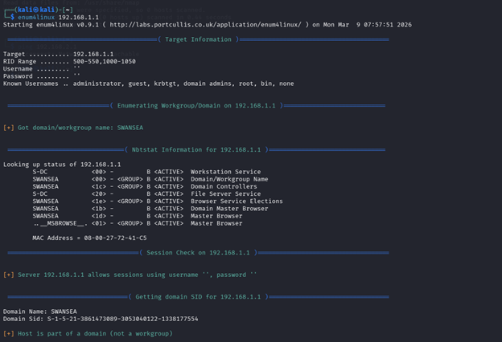
Smb
Medium severity: The enum4linux scans 192.168.1.1, the domain controller, and exposes information that can be used to further exploit the system

Slide 12
Security measures smb
Require user authentication to access

Slide 13
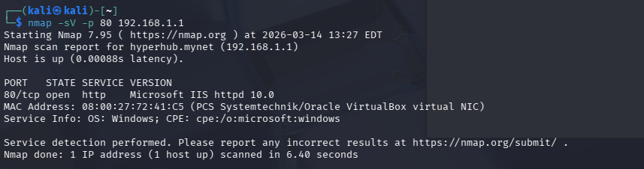
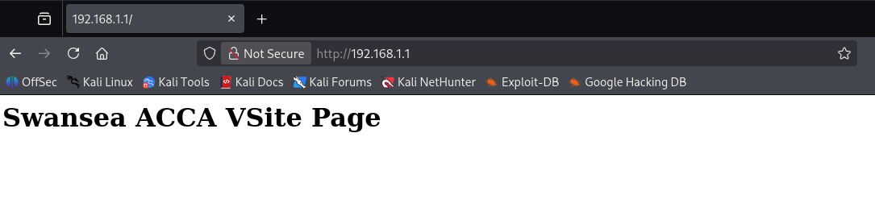
HTTP
Low severity: port 80 was scanned using nmap -sV -p 80 192.168.1.1, revealing the host’s web server. This information cannot be exploited alone by attackers but can be used as stepping stone to find exploits

Slide 14
Security measures
A Web application fire wall can keep some of the Information secure [2]

Slide 15
Reference
[1] T. DeForge, “Ultimate Penetration Testing with Nmap: Master Cybersecurity Assessments for Network Security, Monitoring, and Scanning Using Nmap,” Orange Education Pvt Limited, 2023 [2]G. Khawaja, in Kali Linux Penetration Testing Bible, John Wiley & Sons, 2021.

Slide 16
[2] | G. Khawaja, in Kali Linux Penetration Testing Bible, John Wiley & Sons, 2021.

