Slide 1
Open Shortest Path First – Part 3

Slide 2

Understanding OSPF Network Types

Slide 3
OSPF Network Types
Network Type | Description | Example
Broadcast | A multiaccess broadcast network. DR / BDR required. | All Ethernet networks
Point-to-point | A network that joins a single pair of routers. No DR / BDR required. | Serial link using PPP / HDLC
Nonbroadcast multiaccess (NBMA) | A network that interconnects more than two routers but that has no broadcast capability. DR / BDR may or may not be required. There are five modes of OSPF operation available for NBMA networks: RFC-compliant modes: non-broadcast point-to-multipoint Cisco proprietary modes: broadcast point-to-multipoint non-broadcast point-to-point The choice of mode depends on the topology of the NBMA network. | Frame Relay ATM X.25
OSPF defines three types of network:

Slide 4
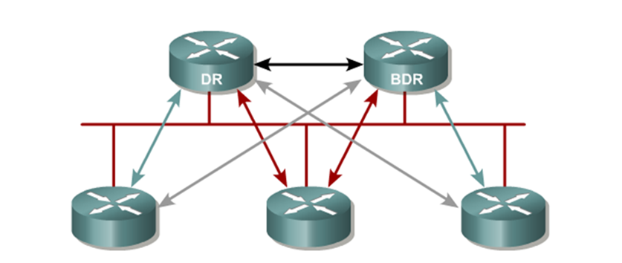
Broadcast
DR /BDR election required since there could be many devices.
  Establishing adjacencies with all routers in a broadcast network would easily overload a router due to the overhead of maintaining those adjacencies.
  Instead, OSPF routers form full adjacencies with the DR and BDR only.
Packets to all OSPF routers are forwarded to 224.0.0.5.
Packets to the DR / BDR are forwarded to 224.0.0.6.

Slide 5
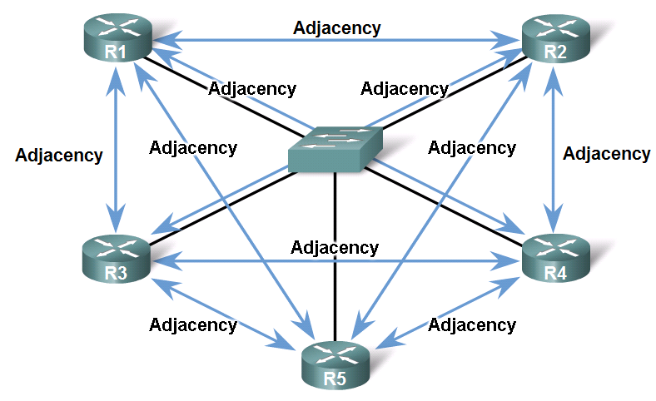
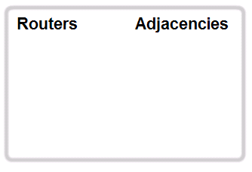
Broadcast Challenge: Multiple Adjacencies
A challenge of broadcast network is the number of adjacencies that would be required.
  One adjacency for every pair of routers.
  This would increase network traffic and load on each router to manage each individual adjacency.

Slide 6
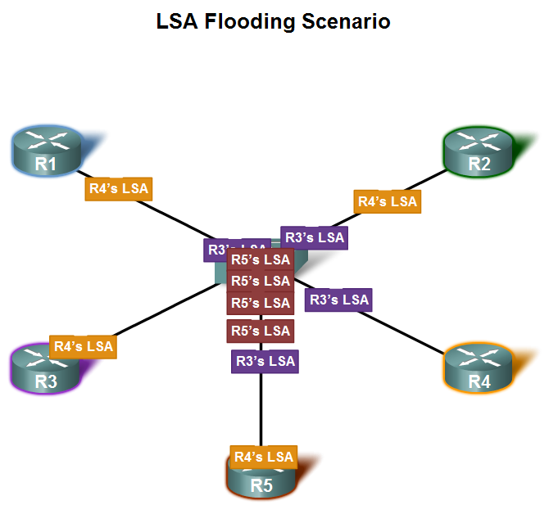
Broadcast Challenge: Extensive LSAs
Another challenge is the increase in network LSAs.
  Every LSA sent out also requires an acknowledgement.
Consequence:
  Lots of bandwidth consumed
  Chaotic traffic

Slide 7
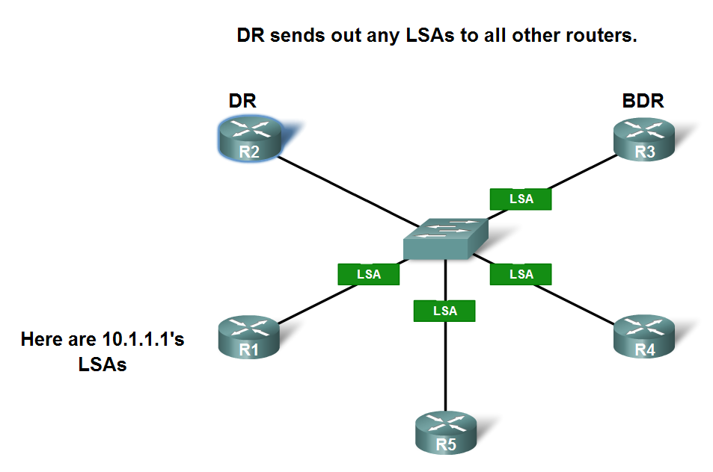
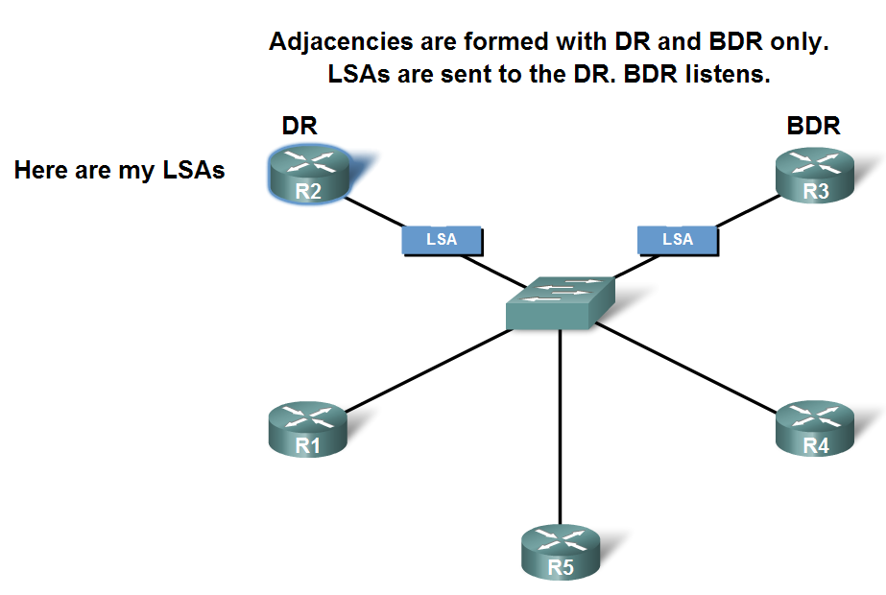
Solution: Designated Router
A designated router (DR) and backup designated router (BDR) solve these challenges because they:
  Reduce routing update traffic
  Manage link-state synchronization
Notes:
The DR and BDR add value to the network in the following ways:
Reducing routing update traffic—The DR and BDR act as a central point of contact for link-state information exchange on a given multiaccess broadcast network; therefore, each router must establish a full adjacency with the DR and the BDR only. Instead of each router exchanging link-state information with every other router on the segment, each router sends the link-state information to the DR and BDR only. The DR represents the multiaccess broadcast network in the sense that it sends link-state information from each router to all other routers in the network. This flooding process significantly reduces the router-related traffic on a segment.
Managing link-state synchronization—The DR and BDR ensure that the other routers on the network have the same link-state information about the internetwork. In this way, the DR and BDR reduce the number of routing errors.
Note: DR/BDR elections DO NOT occur in point-to-point networks.

Slide 8
Designated Router (DR)
The DR is elected and becomes responsible for maintaining the topology table for the segment.
This DR has two main functions:
  To become adjacent to all other routers on the network segment.
  To act as a spokesperson for the network.
As spokesperson the DR becomes the focal point for collecting and sending routing information (LSAs).
Notes:
If a router joins a broadcast network in which there is already a DR and BDR, it will get to the two-way state with all routers, including the DR and BDR, and those that are DROTHER (not DR or BDR).
The joining router will form full bidirectional adjacencies only with the DR and BDR.
Only the DR exchanges and synchronizes link-state information with the routers to which it has established adjacencies. Having the DR represent the network in this capacity reduces the amount of routing update traffic.

Slide 9
Backup Designated Router (BDR)
For fault tolerance, a second router is elected as the BDR.
  The BDR must also become adjacent to all routers on the network and must serve as a second focal point for LSAs.
  However, the BDR is not responsible for updating the other routers or sending network LSAs.
The BDR keeps a timer on the DR's update activity to ensure that it is operational.
  If the BDR does not detect activity from the DR after the timer expires, the BDR immediately becomes the DR and a new BDR is elected.

Slide 10
DR/BDR
DRs and BDRs are elected on a per-network basis and therefore each network segment has its own DR and BDR.
  For example, a router connected to multiple multiaccess broadcast networks can be a DR on one segment and a regular (DROTHER) router on another segment.
The election process is accomplished dynamically using the Hello protocol.
  However, the election can be manually manipulated the ip ospf priority number interface configuration command.
After a DR and BDR have been selected, any router added to the broadcast network establishes full adjacencies with the DR and BDR only.

Slide 11
Assigning Router Priority
Assign a specific OSPF priority to the router.
Router(config-if)#
ip ospf priority number
A router interface can have a priority number between 0 - 255:
  0 = DROTHER - Router cannot be a DR
  1 = Favorable - Default for all routers
  255 = Very favorable - Ensures at least of a tie.
The priority must be configured before the election takes place to figure into the election.
To display an interface's priority value and other key information use the show ip ospf interface command.

Slide 12
The Election of the DR
All neighbors with a priority > 0 are listed.
The router with highest priority is elected BDR.
    If there is a tie, the highest router IDs are used.
If there is no DR, the BDR is promoted as DR.
The neighbor with the next highest priority is elected BDR.
Notes:
If two routers have the same priority, the router with the highest router ID (IP Address) will be selected.
The router ID can be manipulated by configuring an address on a loopback interface.
A router can be configured to win an election on one interface, and lose an election on another.

Slide 13
Manipulating the Election Process
The DR / BDR maintain these roles until they fail even when more routers with higher priorities show up on the network.
To influence the election of DR & BDR, do one of the following:
  Boot up the DR first, followed by the BDR, and then boot all other routers.
  OR
  Shut down the interface on all routers, followed by a no shutdown on the DR, then the BDR, and then all other routers.

Slide 14
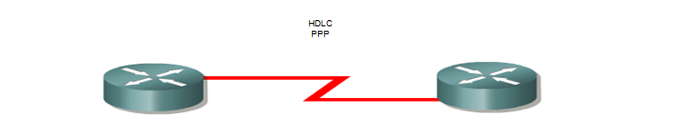
Point-to-Point
Both routers become fully adjacent to each another.
Usually a serial interface running either PPP or HDLC.
  May also be a point-to-point subinterface running Frame Relay or ATM.
No DR /BDR election required since there are only two devices.
OSPF autodetects this type of network.
Packets are sent to 224.0.0.5.

Slide 15
Nonbroadcast Multiaccess (NBMA)
Frame Relay, ATM, and X.25 are examples of NBMA networks.
The default OSPF hello and dead intervals on NBMA interfaces are 30 seconds and 120 seconds, respectively.
Although NBMA networks can support more than two routers, they have no inherent broadcast capability.
  This can create reachability issues.
To implement broadcasting or multicasting, the router replicates the packets to be broadcast or multicast and sends them individually on each permanent virtual circuit (PVC) to all destinations.
  This process is CPU and bandwidth intensive.

Slide 16
DR Election in an NBMA Topology
By default, OSPF cannot automatically build adjacencies with neighbor routers over NBMA interfaces.
OSPF considers the NBMA environment to function similarly to other multiaccess media such as Ethernet.
  However, NBMA networks are usually hub-and-spoke (star) topologies using PVCs or switched virtual circuits (SVCs).
  In these cases, the physical topology does not provide the multiaccess capability on which OSPF relies.
The election of the DR becomes an issue in NBMA topologies because the DR and BDR need to have full Layer 2 connectivity with all routers in the NBMA network.
The DR and BDR also need to have a list of all the other routers so that they can establish adjacencies.

Slide 17
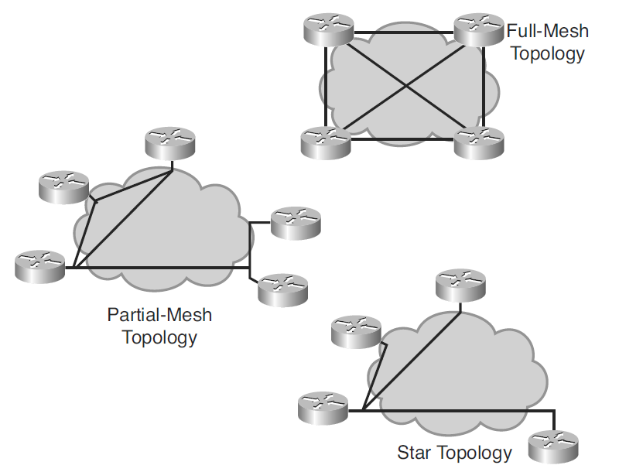
OSPF over NBMA Topology
Depending on the network topology, several OSPF configuration choices are available for a Frame Relay network.
  Star
  Full-mesh
  Partial-mesh
Notes:
The following examples are types of Frame Relay topologies:
Star topology—A star topology, also known as a hub-and-spoke configuration, is the most common Frame Relay network topology. In this topology, remote sites connect to a central site that generally provides a service or application. The star topology is the least expensive topology because it requires the fewest PVCs. The central router provides a multipoint connection because it typically uses a single interface to interconnect multiple PVCs.
Full-mesh topology—In a full-mesh topology, all routers have virtual circuits (VCs) to all other destinations. This method, although costly, provides direct connections from each site to all other sites and allows for redundancy. As the number of nodes in the full-mesh topology increases, the topology becomes increasingly expensive. To calculate how many VCs are needed to implement a full-mesh topology, use the formula n(n – 1)/2, where n is the number of nodes in the network.
Partial-mesh topology—In a partial-mesh topology, not all sites have direct access to a central site. This method reduces the cost compared to implementing a full-mesh topology.

Slide 18
OSPF over NBMA Topology
There are five NBMA topology modes of operation:
  Two official OSPF modes described in RFCs
  Three customized Cisco modes.
RFC 2328-compliant modes are as follows:
  Nonbroadcast (NBMA)
  Point-to-multipoint
Cisco modes are as follows:
  Point-to-multipoint nonbroadcast
  Broadcast
  Point-to-point
OSPF NBMA topology modes are configured using the ip ospf network interface configuration command.
  Some modes require that a neighbor be manually configured using the neighbor router configuration command.
Notes:
The choice between nonbroadcast and point-to-multipoint modes determines how the Hello protocol and flooding work over the nonbroadcast network.
The main advantage of point-to-multipoint mode is that it requires less manual configuration. The main advantage of nonbroadcast mode is that there is less overhead traffic compared to point-to-multipoint mode.

Slide 19
Assign an NBMA Topology Mode
Define an OSPF network type on an interface.
Router(config-if)#
ip ospf network [{non-broadcast | point-to-multipoint [non-broadcast] | broadcast | point-to-point}]
The choice of mode depends on the NBMA topology.
The default OSPF mode on a Frame Relay:
  Interface is non-broadcast mode.
  Point-to-point subinterface is point-to-point mode.
  Multipoint subinterface is non-broadcast mode.
Notes:
The ip ospf network interface command has several options. Each option applies to a different NBMA OSPF mode. Your students should be comfortable configuring OSPF over NBMA using the two RFC-compliant modes (non-broadcast and point-to-multipoint) and the three Cisco modes (broadcast, point-to-multipoint non-broadcast, and point-to-point)
Over the next couple of slides, we will detail the OSPF configurations for the five NBMA modes.

Slide 20
NBMA Topology Modes of Operation
NBMA Modes | Description
non-broadcast (RFC-compliant) | One IP subnet. Neighbors must be manually configured. DR and BDR are elected. DR and BDR need to have full connectivity with all other routers. Typically used in a full- or partial-mesh topology.
point-to-multipoint (RFC-compliant) | One IP subnet. Uses a multicast OSPF hello packet to automatically discover the neighbors. DR and BDR are not required. The router sends additional LSAs with more information about neighboring routers. Typically used in a partial-mesh or star topology.
point-to-multipoint nonbroadcast (Cisco proprietary) | If multicast and broadcast are not enabled on the VCs, the RFC-compliant point-to-multipoint mode cannot be used, because the router cannot dynamically discover its neighboring routers using the hello multicast packets; this Cisco mode should be used instead. Neighbors must be manually configured. DR and BDR election is not required.
broadcast (Cisco proprietary) | Makes the WAN interface appear to be a LAN. One IP subnet. Uses a multicast OSPF hello packet to automatically discover the neighbors. DR and BDR are elected. Full- or partial-mesh topology.
point-to-point (Cisco proprietary) | Different IP subnet on each subinterface. No DR or BDR election. Used when only two routers need to form an adjacency on a pair of interfaces. Interfaces can be either LAN or WAN.
Notes:
The choice between nonbroadcast and point-to-multipoint modes determines how the Hello protocol and flooding work over the nonbroadcast network.
The main advantage of point-to-multipoint mode is that it requires less manual configuration. The main advantage of nonbroadcast mode is that there is less overhead traffic compared to point-to-multipoint mode.

Slide 21
Identify a Neighboring Router
Statically define adjacent relationships in NBMA networks.
Router(config-router)#
neighbor ip-address [priority number] [poll-interval number] [cost number] [database-filter all]
Parameter | Description
ip-address | Specifies the IP address of the neighboring router.
priority number | (Optional) Specifies priority of neighbor. The default is 0, which means that the neighboring router does not become the DR or BDR.
poll-interval number | (Optional) Specifies how long an NBMA interface waits before sending hellos to the neighbors even if the neighbor is inactive. The poll interval is defined in seconds.
cost number | (Optional) Assigns a cost to the neighbor in the form of an integer from 1 to 65535. Neighbors with no specific cost configured assume the cost of the interface based on the ip ospf cost command. For point-to-multipoint interfaces, the cost keyword and the number argument are the only options that are applicable. This keyword does not apply to nonbroadcast mode.
database-filter all | (Optional) Filters outgoing LSAs to an OSPF neighbor.
Notes:
The ip ospf network interface command has several options. Each option applies to a different NBMA OSPF mode.

Slide 22
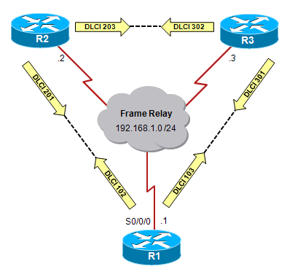
Non-Broadcast Mode Example (Full-Mesh)
Characteristics of the RFC-compliant non-broadcast parameter include:
  A full-mesh topology is typically used therefore the DR and BDR are dynamically elected.
    DR / BDR require full connectivity with all other routers.
  One IP subnet.
  OSPF neighbors must be manually configured.
R1(config)# interface S0/0/0
R1(config-if)# ip ospf network non-broadcast
R1(config-if)# exit
R1(config)# router ospf 1
R1(config-router)# network 192.168.1.0 0.0.0.255 area 0
R1(config-router)# neighbor 192.168.1.2
R1(config-router)# neighbor 192.168.1.3
Notes:
Typically fully-meshed but can also be partial mesh.
In nonbroadcast mode, neighbor statements are required only on the DR and BDR.
In a full-mesh NBMA topology, you might need neighbor statements on all routers unless the DR and BDR are statically configured using the ip ospf priority command.

Slide 23
Non-Broadcast Mode Example (Partial-Mesh)
Characteristics of the RFC-compliant non-broadcast parameter include:
  If a partial-mesh topology is used then the DR and BDR are elected manually using the priority parameter on the hub router.
  One IP subnet.
  OSPF neighbors must be manually configured.
R1(config)# interface S0/0/0
R1(config-if)# ip ospf network non-broadcast
R1(config-if)# exit
R1(config)# router ospf 1
R1(config-router)# network 192.168.1.0 0.0.0.255 area 0
R1(config-router)# neighbor 192.168.1.2 priority 0
R1(config-router)# neighbor 192.168.1.3 priority 0
Notes:
In a hub-and-spoke topology, neighbor statements must be placed on the hub, which must be configured to become the DR by being assigned a higher priority. Neighbor statements are not mandatory on the spoke routers.
If the routers are not fully meshed, the DR and BDR should be selected manually to ensure that the selected DR and BDR have full connectivity to all
other neighbor routers. Neighboring routers are statically defined to start the DR/BDR election process. When using nonbroadcast mode, all routers are on one IP subnet. For flooding over a nonbroadcast interface, the LSU packet must be replicated for each PVC. The updates are sent to each of the interface’s neighboring routers, as defined in the neighbor table.
The priority parameter is set to 0 for R2 and R3 to ensure that R1 becomes the DR. Only R1 has full connectivity to the other two routers because the topology is not a full-mesh. No BDR will be elected in this case.
When few neighbors exist in the network, nonbroadcast mode is the most efficient way to run OSPF over NBMA networks because it has less overhead than point-to-multipoint mode.

Slide 24
Point-to-multipoint Mode Example
Characteristics of the RFC-compliant point-to-multipoint parameter include:
  Used with partial-mesh or hub-and-spoke (star) topology.
  One IP subnet.
  DR and BDR not required.
  Uses multicast OSPF hello packets to dynamically discover neighbors.
R1(config)# interface S0/0/0
R1(config-if)# ip ospf network point-to-multipoint
R1(config-if)# exit
R1(config)# router ospf 1
R1(config-router)# network 192.168.1.0 0.0.0.255 area 0
R1(config-router)#
Notes:
In large networks, using point-to-multipoint mode reduces the number of PVCs required for complete connectivity, because you are not required to have a full-mesh topology. In addition, not having a full-mesh topology reduces the number of neighbor entries in the neighborship table.
Point-to-multipoint mode has the following properties:
Does not require a full-mesh network—This environment allows routing to occur between two routers that are not directly connected but that are connected through a router that has VCs to each of the two routers. All three routers connected to the Frame Relay network in Figure 3-21 could be configured for point-to-multipoint mode.
Does not require a static neighbor configuration—In nonbroadcast mode, neighboring routers are statically defined to start the DR election process, and allow the exchange of routing updates. However, because point-to-multipoint mode treats the network as a collection of point-to-point links, multicast hello packets discover neighboring routers dynamically. Statically configuring neighboring routers is not necessary.
Uses one IP subnet—As in nonbroadcast mode, when using point-to-multipoint mode, all routers are on one IP subnet.
Duplicates LSA packets—Also as in nonbroadcast mode, when flooding out a nonbroadcast interface in point-to-multipoint mode, the router must replicate the LSU. The LSU packet is sent to each of the interface’s neighboring routers, as defined in the neighbor table.

Slide 25
Point-to-multipoint non-broadcast Mode
Characteristics of Cisco’s point-to-multipoint non-broadcast parameter include:
  DR and BDR not required.
  OSPF neighbors must be manually configured.
  Used in special cases where neighbors cannot be automatically discovered.
R1(config)# interface S0/0/0
R1(config-if)# ip ospf network point-to-multipoint non-broadcast
R1(config-if)# exit
R1(config)# router ospf 1
R1(config-router)# network 192.168.1.0 0.0.0.255 area 0
R1(config-router)# neighbor 192.168.1.2 cost 10
R1(config-router)# neighbor 192.168.1.3 cost 20
Notes:
The point-to-multipoint non-broadcast mode is a Cisco extension of the RFC-compliant point-to-multipoint mode and is used when the media does not support broadcast (such as classic IP over ATM: see “Configuring OSPF” white paper). You must statically define neighbors, and you can modify the cost of the link to the neighboring router to reflect the different bandwidths of each link. The RFC point-to-multipoint mode was developed to support underlying point-to-multipoint VCs that support multicast and broadcast; therefore, this mode allows dynamic neighboring router discovery. If multicast and broadcast are not enabled on the VCs, the RFC-compliant point-to-multipoint mode cannot be used because the router cannot dynamically discover its neighboring routers using the hello multicast packets; this Cisco mode should be used instead.
Also, it is a good idea to configure the neighbor cost. Otherwise, the local router will assume equal cost to the configured neighbors. In the example, RTA is configured as a neighbor with a cost of 10 and RTC is configured as a neighbor with a cost of 20. These cost values are purely arbitrary and are only meant for demonstration purposes. You would, of course, configure an accurate cost value in a live network configuration.

Slide 26
Broadcast Mode Example
Characteristics of Cisco’s broadcast parameter include:
  DR and BDR are elected and require full connectivity with all other routers.
  Can be configured for a full-mesh topology or a static election of the DR based on the interface priority.
  One IP subnet.
  Uses multicast OSPF hello packets to dynamically discover neighbors.
R1(config)# interface S0/0/0
R1(config-if)# ip ospf network broadcast
R1(config-if)# exit
R1(config)# router ospf 1
R1(config-router)# network 192.168.1.0 0.0.0.255 area 0
Notes:
The Cisco broadcast mode is a workaround so that you don’t have to statically listing all existing neighbors. The interface is set to broadcast and behaves as though the router connects to a LAN. DR and BDR election is still performed; therefore, take special care to ensure either a full-mesh topology or a static election of the DR based on the interface priority.
This mode has the following characteristics:
Makes the WAN interface appear to be a LAN.
One IP subnet.
Uses multicast OSPF hello packet to automatically discover the neighbors.
DR and BDR elected.
Requires a full-mesh topology.

Slide 27
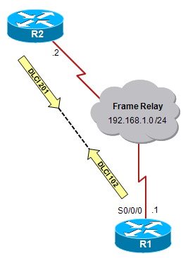
Point-to-point Mode Example
Characteristics of Cisco’s point-to-point parameter include:
  Partial mesh or star topology.
  DR and BDR not required.
  Only IP subnet.
R1(config)# interface S0/0/0
R1(config-if)# ip address 192.168.1.1 255.255.255.0
R1(config-if)# encapsulation frame-relay
R1(config-if)# ip ospf network point-to-point
R1(config-if)# exit
R1(config)# router ospf 1
R1(config-router)# network 192.168.1.0 0.0.0.255 area 0
R1(config-router)#

Slide 28
Subinterfaces
OSPF can also be run over subinterfaces.
  A subinterface is a physical interface that can be split into multiple logical interfaces.
  Each subinterface requires an IP subnet.
Subinterfaces can be defined as either a point-to-point or multipoint interface.
  A point-to-point subinterface has similar properties to a physical point-to-point interface.
  Note:
    The ip ospf network command is not required.
Notes:
It is important to remember that OSPF defaults to:
Point-to-point mode on point-to-point subinterfaces
Nonbroadcast mode on the multipoint subinterfaces.

Slide 29
Define a Subinterface
Define a subinterface.
Router(config)#
interface serial number.subinterface-number {multipoint
| point-to-point}
Parameter | Description
number.subinterface-number | Specifies the interface number and subinterface number. The subinterface number is in the range of 1 to 4294967293. The interface number that precedes the period (.) is the interface number to which this subinterface belongs.
multipoint | Specifies that the subinterface is multipoint; on multipoint subinterfaces routing IP, all routers are in the same subnet.
point-to-point | Specifies that the subinterface is point-to-point; on point-to-point subinterfaces routing IP, each pair of point-to-point routers is in its own subnet.

Slide 30
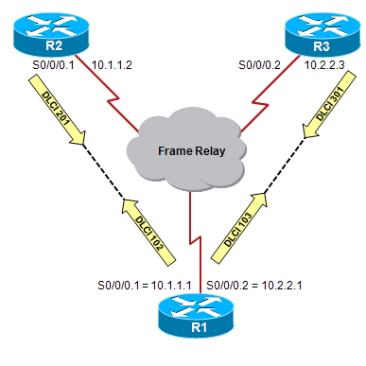
Using Point-to-point Subinterfaces
Characteristics:
  Same properties as any physical point-to-point physical interface
  DR and BDR not required.
  One IP subnet per subinterface pair.
  Used when only 2 routers need to form an adjacency on a pair of interfaces.
R1(config)# interface S0/0/0
R1(config-if)# encapsulation frame-relay
R1(config-if)# interface S0/0/0.1 point-to-point
R1(config-subif)# ip address 10.1.1.1 255.255.255.0
R1(config-subif)# interface S0/0/0.2 point-to-point
R1(config-subif)# ip address 10.2.2.1 255.255.255.0
R1(config-subif)# router ospf 1
R1(config-router)# network 10.1.1.0 0.0.0.255 area 0
R1(config-router)# network 10.2.2.0 0.0.0.255 area 0
Notes:
As we already know, a physical interface can be split into multiple logical interfaces, called subinterfaces. Each subinterface is defined as a point-to-point or a point-to-multipoint interface. Subinterfaces were originally created to better handle issues caused by split horizon over an NBMA for distance vector-based routing protocols. Each subinterface requires an IP subnet. There is no need to use the ip ospf network command since IOS treats these interfaces like physical point-to-point interfaces.
This mode can also be used in a hub-and-spoke topology and includes that following characteristics:
One IP subnet.
No DR or BDR election.
Used when only two routers need to form an adjacency on a pair of interfaces.
Interfaces can be either LAN or WAN.

Slide 31
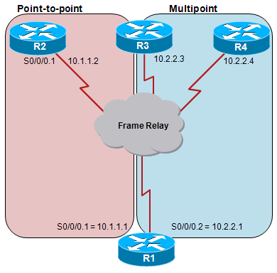
Using Multipoint Subinterfaces
The example has one point-to-point subinterface and one multipoint subinterface.
  The multipoint subinterface supports two other routers in a single
  Multipoint Frame Relay subinterfaces default to OSPF nonbroadcast mode, which requires neighbors to be statically configured and a DR and BDR election.
R1(config)# interface S0/0/0
R1(config-if)# encapsulation frame-relay
R1(config-if)# interface S0/0/0.1 point-to-point
R1(config-subif)# ip address 10.1.1.1 255.255.255.0
R1(config-subif)# interface S0/0/0.2 multipoint
R1(config-subif)# ip address 10.2.2.1 255.255.255.0
R1(config-subif)# router ospf 1
R1(config-router)# network 10.0.0.0 0.255.255.255 area 0
R1(config-router)# neighbor 10.2.2.3 priority 0
R1(config-router)# neighbor 10.2.2.4 priority 0
Notes:
Multipoint Frame Relay subinterfaces default to OSPF nonbroadcast mode, which requires neighbors to be statically configured and a DR and BDR election.

Slide 32
OSPF over NBMA Topology Summary
OSPF Mode | NBMA Preferred Topology | Subnet Address | Hello Timer | Adjacency | RFC or Cisco | Example
Non-broadcast | Full or partial mesh | Same | 30 sec | Manual configuration DR/BDR elected | RFC | Frame Relay configured on a serial interface
Point-to- multipoint | Partial mesh or star | Same | 30 sec | Automatic No DR/BDR | RFC | OSPF over Frame Relay mode that eliminates the need for a DR; used when VCs support multicast and broadcast
Point-to-multipoint nonbroadcast | Partial mesh or star | Same | 30 sec | Manual configuration No DR/BDR | Cisco | OSPF over Frame Relay mode that eliminates the need for a DR; used when VCs do not support multicast and broadcast
Broadcast | Full or partial mesh | Same | 10 sec | Automatic DR/BDR elected | Cisco | LAN interface such as Ethernet
Point-to-point | Partial mesh or star, using subinterfaces | Different for each subinterface | 10 sec | Automatic No DR/BDR | Cisco | Serial interface with point-to-point subinterfaces

Slide 33

Configuring and Verifying Advanced OSPF Features

Slide 34
OSPF Passive-Interface
Prevent OSPF updates out a specified router interface.
Router(config-router)#
passive-interface type number [default]
Set a particular interface or all router interfaces to passive.
The default option sets all router interfaces to passive.
For OSPF, the command:
  The specified interface appears as a stub network in the OSPF domain
  The OSPF routing information is neither sent nor received through the specified router interface.
  Prevents neighbor relationships from being established.

Slide 35
Passive-Interface Example
192.168.1.96 /27
64 kbps
.101
S0/0/1
R1
S0/0/0
.102
R2
.1
Internet
.1
S0/0/0
192.168.1.0 /27
Fa0/0
.1
Fa0/0
172.16.1.0 /24
172.17.2.0 /24
Alternate configuration:
R1(config)# router ospf 1
R1(config-router)# passive-interface default
R1(config-router)# no passive-interface S0/0/0
R1(config)# router ospf 1
R1(config-router)# passive-interface fa0/0
R1(config-router)#
R2(config)# router ospf 10
R2(config-router)# passive-interface fa0/0
R2(config-router)#
R2(config)# router ospf 10
R2(config-router)# passive-interface default
R2(config-router)# no passive-interface S0/0/0
R2(config-router)# no passive-interface S0/0/1
Notes:
In this configuration, routing updates are no longer sent on interface Fa0/0 of R1 and R2.
The alternative configuration makes all interfaces passive and then makes interface S0/0/0 not passive. This method is efficient when there are many interface that should be passive and only a few that should not be passive.
Commands to verify include:
show ip protocols
show ip ospf neighbors

Slide 36
Propagating a Default Route
To propagate a default route in OSPF, use the default-information originate router configuration command.
  A default static route also needs to be configured on the originating router
Once configured, the default route has to be propagated into the OSPF domain.

Slide 37
default-information originate Command
Configures a router to generate a default external route into an OSPF routing domain.
Router(config-router)#
default-information originate [always] [metric metric-value] [metric-type type-value] [route-map map-name]
Parameter | Description
always | (Optional) Specifies that OSPF always advertises the default route regardless of whether the router has a default route in the routing table.
metric metric-value | (Optional) A metric used for generating the default route. If you omit a value and do not specify a value using the default-metric router configuration command, the default metric value is 1. Cisco IOS Software documentation indicates that the default metric value is 10; testing shows that it is actually 1.
metric-type type-value | (Optional) The external link type that is associated with the default route that is advertised into the OSPF routing domain. It can be one of the following values: 1—Type 1 external route 2—Type 2 external route. The default is type 2 external route (indicated by O*E2 in the routing table).
route-map map-name | (Optional) Specifies that the routing process generates the default route if the route map is satisfied.

Slide 38
default-information originate Example
0.0.0.0 Cost 10
172.16.1.0 /24
10.1.1.1
R1
.1
.2
ISP A
OSPF Domain
172.17.1.0 /24
10.2.1.1
R2
.1
.2
ISP B
0.0.0.0 Cost 100
R1(config)# router ospf 1
R1(config-router)# network 10.1.1.1 0.0.0.0 area 0
R1(config-router)# default-information originate metric 10
R1(config-router)# exit
R1(config)# ip route 0.0.0.0 0.0.0.0 172.16.1.2
R1(config)#
R2(config)# router ospf 1
R2(config-router)# network 10.2.1.1 0.0.0.0 area 0
R2(config-router)# default-information originate metric 100
R2(config-router)# exit
R2(config)# ip route 0.0.0.0 0.0.0.0 172.17.1.2
R2(config)#
Notes:
In this example the OSPF network multihomed to dual ISPs and therefore it makes no sense to redistribute all the ISP’s routes into OSPF.
In this case, default routes are sent into OSPF.
The optional metric parameter has been used to prefer the default route to ISP A with its metric of 10, over the backup connection to ISP B with its metric of 100.
The default route being generated has a metric-type of E2 by default, so the metric does not increase as it goes through the area.
As a result, all routers, regardless of their proximity to the border router, prefer ISP A over ISP B.
Because the always parameter is not used on these routers, a default route must exist in the IP routing table for the router to advertise a default route into OSPF.
Both routers have a default static route configured.

Slide 39
Route Summarization
Route summarization involves consolidating multiple routes into a single advertisement.
Proper route summarization directly affects the bandwidth, memory and CPU, that are consumed by the OSPF process.
  If a network link fails or flaps, the topology change will not be propagated into the backbone or other areas.
  It protects routers from needless routing table recalculations.
  Because the SPF calculation places a significant demand on the router's CPU, proper summarization is an imperative part of OSPF configuration.
Notes:
With route summarization, the ABR or ASBR routers consolidate multiple routes into fewer advertisements.
ABR routers summarize type 3 LSAs and ASBR routers summarize type 5 LSAs.
Instead of advertising many specific prefixes, the ABR routers and ASBR routers advertise only one summary prefix.

Slide 40
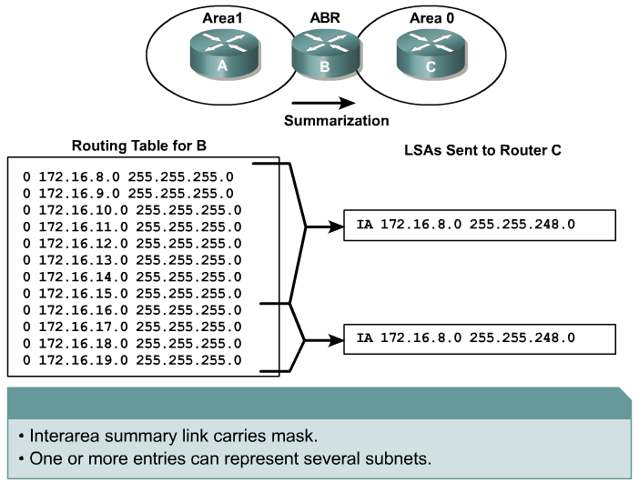
Using Route Summarization
IA 172.16.8.0 255.255.248.0
IA 172.16.16.0 255.255.252.0

Slide 41
Types of Route Summarization
Inter-area summarization
  Performed at the ABR and creates Type 3 LSAs.
External summarization
  Performed at the ASBR and creates Type 5 LSAs.
Both have the same fundamental requirement of contiguous addressing.
If summarization is not configured correctly and there are multiple ASBRs, or multiple ABRs in an area, suboptimal routing is possible.
  For example, summarizing overlapping ranges from two different routers can cause packets to be sent to the wrong destination.

Slide 42
Intra-Area Summarization
Configure an ABR to summarize routes for a specific area.
Router(config-router)#
area area-id range address mask [advertise | not-advertise] [cost cost]
Parameter | Description
area area-id | Identifies the area subject to route summarization.
address | The summary address designated for a range of addresses.
mask | The IP subnet mask used for the summary route.
advertise | (Optional) Sets the address range status to advertise and generates a type 3 summary LSA.
not-advertise | (Optional) Sets the address range status to DoNotAdvertise. The type 3 summary LSA is suppressed, and the component networks remain hidden from other networks.
cost cost | (Optional) Metric or cost for this summary route, which is used during the OSPF SPF calculation to determine the shortest paths to the destination. The value can be 0 to 16777215.

Slide 43
Intra-Area Summarization Example
Area 0
172.16.96.0 /24 - 172.16.127.0 /24
Area 1
172.16.32.0 /24 - 172.16.63.0 /24
Area 2
172.16.64.0 /24 - 172.16.95.0 /24
R1
R2
R1(config)# router ospf 100
R1(config-router)# network 172.16.32.1 0.0.0.0 area 1
R1(config-router)# network 172.16.96.1 0.0.0.0 area 0
R1(config-router)# area 0 range 172.16.96.0 255.255.224.0
R1(config-router)# area 1 range 172.16.32.0 255.255.224.0
R1(config-router)#
R2(config)# router ospf 100
R2(config-router)# network 172.16.64.1 0.0.0.0 area 2
R2(config-router)# network 172.16.127.1 0.0.0.0 area 0
R2(config-router)# area 0 range 172.16.96.0 255.255.224.0
R2(config-router)# area 2 range 172.16.64.0 255.255.224.0
R2(config-router)#

Slide 44
External Summarization
Configure an ASBR to summarize external routes.
Router(config-router)#
summary-address ip-address mask [not-advertise] [tag tag]
Parameter | Description
ip-address | The summary address designated for a range of addresses.
mask | The IP subnet mask used for the summary route.
not-advertise | (Optional) Used to suppress routes that match the address/mask pair.
tag tag | (Optional) A tag value that can be used as a “match” value to control redistribution via route maps.
Notes:
Summarization of external routes can be done on an ASBR for type-5 LSAs (redistributed routes) before injecting them into the OSPF domain. A summary route to null 0 is automatically created for each summary range.

Slide 45
External Summarization
OSPF Area 1
172.16.64.0 /24
ABR
OSPF Area 0
External AS – RIPv2
172.16.32.0 /24 – 172.16.63.0 /24
.1
R1
R2
R1(config)# router ospf 100
R1(config-router)# network 172.16.64.1 0.0.0.0 area 1
R1(config-router)# summary-address 172.16.32.0 255.255.224.0
R1(config-router)#
Notes:
RIPv2 routes must also be redistributed into OSPF in this example; redistribution is covered in Chapter 4.

Slide 46
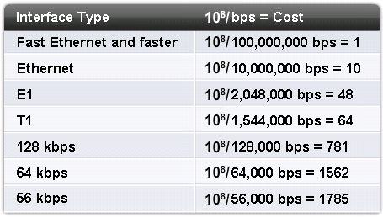
Changing the Reference Bandwidth
The reference bandwidth defaults to 10⁸ (100,000,000 bps or 100 Mbps).
  This can be a problem when using interfaces faster than 100 Mbps and higher since they would all have the same OSPF cost of 1.
The reference bandwidth can be modified using the auto-cost reference-bandwidth router configuration command.

Slide 47
Changing the Reference Bandwidth
Change the reference bandwidth for faster interfaces.
Router(config-router)#
auto-cost reference-bandwidth ref-bw
The ref-bw parameter is the reference bandwidth in megabits per second.
  The range is from 1 to 4,294,967.
  The default is 100.
Use this command if interfaces are faster than 100 Mbps.
  The command must be configured on all OSPF routers to ensure accurate route calculations.

Slide 48
Modifying the Cost of a Link
The cost of a link can be modified using either the:
  bandwidth interface command
  ip ospf cost interface command
The configured bandwidth value is used by the SPF algorithm to calculate the cost.
  For example, configuring the bandwidth 128 command on a serial interface would generate a cost of 1,562.
    Cost = 100,000,000 / 128,000 = 1,562.
Using the ip ospf cost interface command achieves the same result without the calculation.
  For example, the interface cost could be statically configured using the ip ospf cost 1562 command.

Slide 49
Override the Default Interface Cost
Manually define the cost of an interface.
Router(config-if)#
ip ospf cost interface-cost
The interface-cost is an integer from 1 to 65,535.
  The lower the number, the better (and more preferred) the link.
Can be used as an alternative to the bandwidth command.

Slide 50
Configuring and Verifying Advanced OSPF Authentication

Slide 51
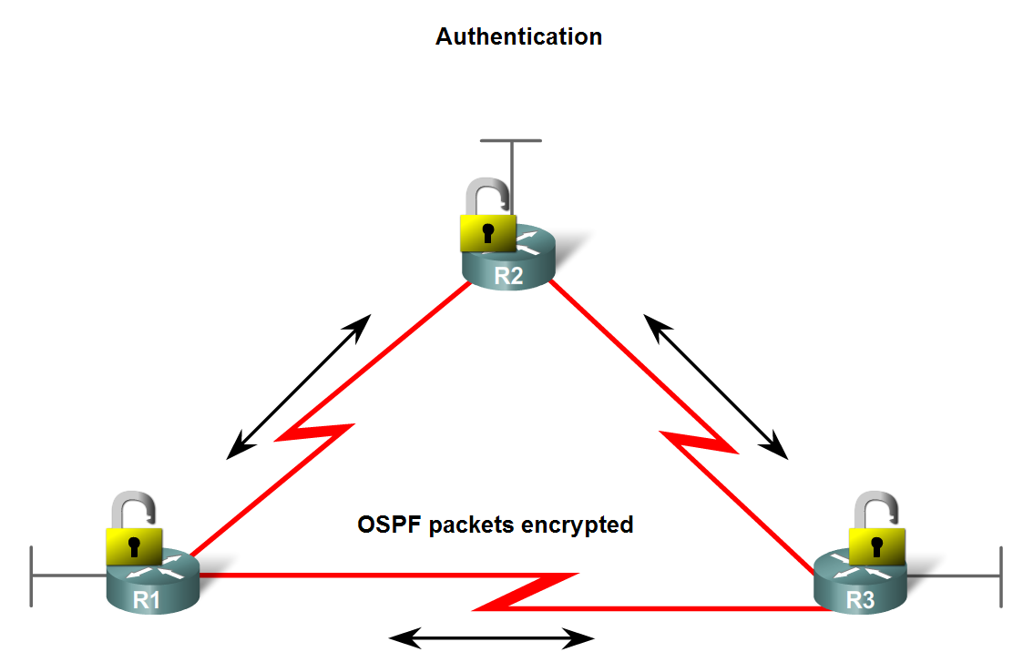
OSPF Authentication
Purpose is to authenticate routing information.
  This is an interface specific configuration.
  Routers will only accept routing information from other routers that have been configured with the same authentication information.

Slide 52
OSPF Authentication Types
Router generates and checks each packet and authenticates the source of each update packet it receives
Requires a pre-defined “key” (password)
  Note: All participating neighbors must have the same key configured
OSPF supports 2 types of authentication:
  Simple password authentication (plain text)
    Less secure
  MD5 authentication
    More secure and recommended
Notes:
Authentication types: simple password authentication (plain text) and MD5 authentication
Recall that when neighbor authentication has been configured on a router, the router authenticates the source of each routing update packet that it receives. This is accomplished by the exchange of an authenticating key (sometimes referred to as a password) that is known to both the sending and the receiving router.
By default, OSPF uses null authentication, which means that routing exchanges over a network are not authenticated.

Slide 53
Planning for OSPF
The following key parameters must be defined in enough detail before configuring OSPF authentication:
  The authentication mode (simple password versus MD5)
  The definition of one or more keys to authenticate OSPF packets, according to the network security plan.
Once defined, the following steps may be implemented:
  Assign a password (key) to be used.
    The actual command varies depending on the authentication mode used.
  Specify the authentication mode (simple password or MD5).

Slide 54
  Configure A Key for Simple Authentication
Define a password to use for simple password authentication.
Router(config-if)#
ip ospf authentication-key password
The password parameter can be entered up to 8 bytes in length.
This command is used in conjunction with the ip ospf authentication command.

Slide 55
Configure the MD5 Key-ID and Key
Define a password to use for MD5 authentication.
Router(config-if)#
ip ospf message-digest-key key-id md5 key
The key-id parameter is an identifier in the range from 1 to 255.
The key parameter can be entered up to 16 bytes in length.
All neighboring routers on the same network must have the same key-id and the same key value.
This command is used in conjunction with the ip ospf authentication message-digest command.
Notes:
Usually, one key per interface is used to generate authentication information when sending packets and to authenticate incoming packets.
All neighboring routers on the same network must have the same password to be able to exchange OSPF information; in other words, the same key-id on the neighbor router must have the same key value.

Slide 56
  Configure the Authentication Mode for OSPF
Specify the authentication type.
Router(config-if)#
ip ospf authentication [message-digest | null]
  Before using this command, configure a password.
The command without any parameters specifies that simple password authentication will be used.
The message-digest parameter specifies that MD5 authentication will be used.
The null parameter specifies that no authentication is used.
  This can be useful for overriding simple password or MD5 authentication.
Notes:
For backward compatibility, authentication type for an area is still supported.
If the authentication type is not specified for an interface, the authentication type for the area will be used (the area default is null authentication).
To enable authentication for an OSPF area, use the area area-id authentication [message-digest] router configuration command.

Slide 57
Configuring Simple Password Authentication
R1# show running-config
!
<output omitted>
!
interface Fa0/0
ip address 10.1.1.1 255.255.255.0
!
<output omitted>
!
interface Serial0/0/1
ip address 192.168.1.101 255.255.255.224
ip ospf authentication
ip ospf authentication-key PLAINPAS
!
<output omitted>
!
router ospf 10
log-adjacency-changes
network 10.1.1.1 0.0.0.0 area 0
network 192.168.1.0 0.0.0.255 area 0
!
<output omitted>
Area 0
192.168.1.96 /27
.101
R1
S0/0/1
.102
R2
.1
S0/0/1
Fa0/0
.1
Fa0/0
10.1.1.0 /24
10.2.2.0 /24

Slide 58
Configuring Simple Password Authentication
R2# show running-config
!
<output omitted>
!
interface Fa0/0
ip address 10.2.2.1 255.255.255.0
!
<output omitted>
!
interface Serial0/0/1
ip address 192.168.1.102 255.255.255.224
ip ospf authentication
ip ospf authentication-key PLAINPAS
!
<output omitted>
!
router ospf 10
log-adjacency-changes
network 10.2.2.1 0.0.0.0 area 0
network 192.168.1.0 0.0.0.255 area 0
!
<output omitted>
Area 0
192.168.1.96 /27
.101
R1
S0/0/1
.102
R2
.1
S0/0/1
Fa0/0
.1
Fa0/0
10.1.1.0 /24
10.2.2.0 /24
Notes:
Notice that the connecting interfaces on both R1 and R2 are configured for the same type of authentication with the same authentication key. Simple password authentication is configured on interface serial 0/0/1 on both routers, with the ip ospf authentication command. The interfaces are configured with an authentication key of PLAINPAS.

Slide 59
  Verifying Simple Password Authentication
Displays adjacency-related events of a successful connection.
R1# debug ip ospf adj
OSPF adjacency events debugging is on
R1#
<output omitted>
*Feb 17 18:42:01.250: OSPF: 2 Way Communication to 10.2.2.1 on Serial0/0/1, state 2WAY
*Feb 17 18:42:01.250: OSPF: Send DBD to 10.2.2.1 on Serial0/0/1 seq 0x9B6 opt 0x52 flag 0x7 len 32
*Feb 17 18:42:01.262: OSPF: Rcv DBD from 10.2.2.1 on Serial0/0/1 seq 0x23ED opt0x52 flag 0x7 len 32 mtu 1500 state EXSTART
*Feb 17 18:42:01.262: OSPF: NBR Negotiation Done. We are the SLAVE
*Feb 17 18:42:01.262: OSPF: Send DBD to 10.2.2.1 on Serial0/0/1 seq 0x23ED opt 0x52 flag 0x2 len 72
<output omitted>
R1# show ip ospf neighbor
Neighbor ID Pri State Dead Time Address Interface
10.2.2.1 0 FULL/ - 00:00:34 192.168.1.102 Serial0/0/1
Notes:
The debug ip ospf adj command is used to display OSPF adjacency-related events and is very useful when troubleshooting authentication. This displays a successful connection.
The output of the show ip ospf neighbor command shown in the figure illustrates that R1 has successfully formed an adjacency with the R2.

Slide 60
Troubleshooting Simple Password Problems
Simple authentication on R1, no authentication on R2:
R1#
*Feb 17 18:51:31.242: OSPF: Rcv pkt from 192.168.1.102, Serial0/0/1 : Mismatch Authentication type. Input packet specified type 0, we use type 1
R2#
*Feb 17 18:50:43.046: OSPF: Rcv pkt from 192.168.1.101, Serial0/0/1 : Mismatch Authentication type. Input packet specified type 1, we use type 0
Notes:
If simple password authentication is configured on the R1 serial 0/0/1 interface but no authentication is configured on the R2 serial 0/0/1 interface, the routers will not be able to form an adjacency over that link. The outputs of the debug ip ospf adj command shown in the upper portion of the figure illustrates that the routers report a mismatch in authentication type; no OSPF packets will be sent between the neighbors.
NOTE: The different types of authentication have the following type codes:
null: type 0
simple password: type 1
MD5: type 2

Slide 61
Troubleshooting Simple Password Problems
Simple authentication on R1 and R2, but different passwords.
R1#
*Feb 17 18:54:01.238: OSPF: Rcv pkt from 192.168.1.102, Serial0/0/1 : Mismatch Authentication Key - Clear Text
R2#
*Feb 17 18:53:13.050: OSPF: Rcv pkt from 192.168.1.101, Serial0/0/1 : Mismatch Authentication Key - Clear Text
Notes:
If simple password authentication is configured on the R1 serial 0/0/1 interface and on the R2 serial 0/0/1 interface, but with different passwords, the routers will not be able to form an adjacency over that link. The outputs of the debug ip ospf adj command shown in the lower portion of the figure illustrates that the routers report a mismatch in authentication key; no OSPF packets will be sent between the neighbors.

Slide 62
Configuring MD5 Authentication
R1# show running-config
!
<output omitted>
!
interface Fa0/0
ip address 10.1.1.1 255.255.255.0
!
<output omitted>
!
interface Serial0/0/1
ip address 192.168.1.101 255.255.255.224
ip ospf authentication message-digest
ip ospf message-digest-key 1 md5 SECRETPASS
!
<output omitted>
!
router ospf 10
log-adjacency-changes
network 10.1.1.1 0.0.0.0 area 0
network 192.168.1.0 0.0.0.255 area 0
!
<output omitted>
Area 0
192.168.1.96 /27
.101
R1
S0/0/1
.102
R2
.1
S0/0/1
Fa0/0
.1
Fa0/0
10.1.1.0 /24
10.2.2.0 /24

Slide 63
Configuring MD5 Authentication
R2# show running-config
!
<output omitted>
!
interface Fa0/0
ip address 10.2.2.1 255.255.255.0
!
<output omitted>
!
interface Serial0/0/1
ip address 192.168.1.102 255.255.255.224
ip ospf authentication message-digest
ip ospf message-digest-key 1 md5 SECRETPASS
!
<output omitted>
!
router ospf 10
log-adjacency-changes
network 10.2.2.1 0.0.0.0 area 0
network 192.168.1.0 0.0.0.255 area 0
!
<output omitted>
Area 0
192.168.1.96 /27
.101
R1
S0/0/1
.102
R2
.1
S0/0/1
Fa0/0
.1
Fa0/0
10.1.1.0 /24
10.2.2.0 /24
Notes:
Notice that the connecting interfaces on both R1 and R2 are configured for the same type of authentication with the same authentication key. Simple password authentication is configured on interface serial 0/0/1 on both routers, with the ip ospf authentication command. The interfaces are configured with an authentication key of PLAINPAS.

Slide 64
Verifying MD5 Authentication
R1# show ip ospf interface
Serial0/0/1 is up, line protocol is up
Internet Address 192.168.1.101/27, Area 0
Process ID 10, Router ID 10.1.1.1, Network Type POINT_TO_POINT, Cost: 64
Transmit Delay is 1 sec, State POINT_TO_POINT
<output omitted>
Neighbor Count is 1, Adjacent neighbor count is 1
Adjacent with neighbor 10.2.2.1
Suppress hello for 0 neighbor(s)
Message digest authentication enabled
Youngest key id is 1
<output omitted>
R1#
R1# show ip ospf neighbor
Neighbor ID Pri State Dead Time Address Interface
10.2.2.1 0 FULL/ - 00:00:31 192.168.1.102 Serial0/0/1
Notes:
Notice that the show ip ospf interface output shows that router R1 has on adjacent neighbor and that message digest authentication is enabled. The show ip ospf neighbor command output shows that that the neighbor state is FULL, indicating that the two routers have successfully formed an OSPF adjacency.

Slide 65
Verifying MD5 Authentication
R1# debug ip ospf adj
OSPF adjacency events debugging is on
<output omitted>
*Feb 17 17:14:06.530: OSPF: Send with youngest Key 1
*Feb 17 17:14:06.546: OSPF: 2 Way Communication to 10.2.2.2 on Serial0/0/1, state 2WAY
*Feb 17 17:14:06.546: OSPF: Send DBD to 10.2.2.2 on Serial0/0/1 seq 0xB37 opt 0x52 flag 0x7 len 32
*Feb 17 17:14:06.546: OSPF: Send with youngest Key 1
*Feb 17 17:14:06.562: OSPF: Rcv DBD from 10.2.2.2 on Serial0/0/1 seq 0x32F opt 0x52 flag 0x7 len 32 mtu 1500 state EXSTART
*Feb 17 17:14:06.562: OSPF: NBR Negotiation Done. We are the SLAVE
*Feb 17 17:14:06.562: OSPF: Send DBD to 10.2.2.2 on Serial0/0/1 seq 0x32F opt 0x52 flag 0x2 len 72
*Feb 17 17:14:06.562: OSPF: Send with youngest Key 1
<output omitted>
R1# show ip ospf neighbor
Neighbor ID Pri State Dead Time Address Interface
10.2.2.2 0 FULL/ - 00:00:35 192.168.1.102 Serial0/0/1
Notes:
The output of the debug ip ospf adj command illustrates a successful MD5 authentication on R1 after the serial 0/0/1 interface, on which authentication has been configured, comes up.
The output of the show ip ospf neighbor command shown in the figure illustrates that R1 has successfully formed an adjacency with the R2.

Slide 66
Troubleshooting MD5 Authentication
MD5 authentication on both R1 and R2, but R1 has key 1 and R2 has key 2, both with the same passwords:
R1#
*Feb 17 17:56:16.530: OSPF: Send with youngest Key 1
*Feb 17 17:56:26.502: OSPF: Rcv pkt from 192.168.1.102, Serial0/0/1 : Mismatch Authentication Key - No message digest key 2 on interface
*Feb 17 17:56:26.530: OSPF: Send with youngest Key 1
R2#
*Feb 17 17:55:28.226: OSPF: Send with youngest Key 2
*Feb 17 17:55:28.286: OSPF: Rcv pkt from 192.168.1.101, Serial0/0/1 : Mismatch Authentication Key - No message digest key 1 on interface
*Feb 17 17:55:38.226: OSPF: Send with youngest Key 2
Notes:
If MD5 authentication is configured on the R1 serial 0/0/1 interface and on the R2 serial 0/0/1 interface, but R1 has key 1 and R2 has key 2, the routers will not be able to form an adjacency over that link, even though both have the same passwords configured. The outputs of the debug ip ospf adj command shown in the figure illustrate that the routers report a mismatch in authentication key. No OSPF packets will be sent between the neighbors.
NOTE: When configuring any authentication, watch for the “space” at the end of the authentication key. It is a common mistake to hit the space bar after a word when setting passwords/authentication keys. Checking for potential typos can save a great deal of troubleshooting time.

Slide 67
Chapter 3 Summary
The chapter focused on the following topics:
Characteristics of link-state routing protocols.
OSPF's two-tier hierarchical area structure, with a backbone area 0 and regular areas.
How OSPF routers use the Hello protocol to build adjacencies.
The OSPF metric calculation, which is based on the link bandwidth.
The five types of OSPF packets—hello, DBD, LSR, LSU, and LSAck.
The neighbor states that OSPF interfaces may pass through: down, init, two-way, exstart, exchange, loading, and full.

Slide 68
Chapter 3 Summary (cont.)
The five fields in the hello packet must match on neighboring routers: hello interval, dead interval, area id, authentication password, and stub area flag.
Planning OSPF implementations, including the IP addressing, network topology, and OSPF areas.
Basic OSPF configuration commands including:
  router ospf process-id global configuration command
  network ip-address wildcard-mask area area-id interface configuration command
  ip ospf process-id area area-id [secondaries none] interface configuration command
  bandwidth kilobits interface configuration command
  router-id ip-address router configuration command

Slide 69
Chapter 3 Summary (cont.)
Commands for verifying OSPF operation:
  show ip protocols
  show ip ospf neighbor
  show ip route
  show ip route ospf
  show ip ospf interface
  show ip ospf
  debug ip ospf events
  debug ip ospf adj
  debug ip ospf packet

Slide 70
Chapter 3 Summary (cont.)
How the OSPF router ID is selected with the router-id ip-address router configuration command, the highest IP address on any active loopback interface, or the highest IP address of any active physical interface when OSPF starts.
The three types of networks defined by OSPF: point-to-point, broadcast, and NBMA.
How a DR and BDR are selected.

Slide 71
Chapter 3 Summary (cont.)
The five modes of OSPF operation available for NBMA networks: nonbroadcast and point-to-multipoint RFC modes; and broadcast, point-to-multipoint nonbroadcast, and point-to-point Cisco modes.
The different types of OSPF routers: internal routers, backbone routers, ABRs, and ASBRs.
The 11 different OSPF LSA types.
The three kinds of OSPF routes: intra-area (O), interarea (O IA), and external (either O E1 or O E2).
Configuring OSPF LSDB overload protection using the max-lsa router configuration command.

Slide 72
Chapter 3 Summary (cont.)
Using the passive-interface type number [default] router configuration command.
Propagate an OSPF default route using the default-information originate [always] router configuration command.
OSPF summarization can be configured on an ABR using the area area-id range address mask [advertise | not-advertise] [cost cost] router configuration command, and on an ASBR using the summary-address ip-address mask [not-advertise] [tag tag] router configuration command.
Virtual links are configured with the area area-id virtual-link router-id router configuration command, and verified with the show ip ospf virtual-links command.
The several area types defined in OSPF: standard areas, backbone (transit) areas, stub areas, totally stubby areas, NSSAs, and totally stubby NSSAs.

Slide 73
Chapter 3 Summary (cont.)
The types of OSPF authentication: null, simple password authentication (also called plain-text authentication), and MD5 authentication.
The commands to configure OSPF simple password authentication:
  ip ospf authentication-key password interface configuration command
  ip ospf authentication interface configuration command or the area area-id authentication router configuration command
The commands to configure OSPF MD5 authentication:
  ip ospf message-digest-key key-id md5 key interface configuration command
  ip ospf authentication message-digest interface configuration command or the area area-id authentication message-digest router configuration command

Slide 74
Resources
OSPF Deisgn Guide
  http://www.cisco.com/en/US/tech/tk365/technologies_white_paper09186a0080094e9e.shtml
Configuring OSPF
  http://www.cisco.com/en/US/docs/ios/12_0/np1/configuration/guide/1cospf.html
OSPF Technology Page
  http://www.cisco.com/en/US/tech/tk365/tk480/tsd_technology_support_sub-protocol_home.html
OSPF Authentication
  http://www.cisco.com/en/US/tech/tk365/technologies_configuration_example09186a0080094069.shtml

