Slide 1

Individual Presentation
Student: Cristina Varzari
ID: 2110951

Slide 2


Aim and Objectives
Aim:
To identify the impact of flexibility at work in ALDI
Objectives:
To evaluate flexibility working related to inequality at work in ALDI
To describe the role of HR management in addressing the inequality issues at ALDI that arise from flexibility.
Notes:
ALDI is a German supermarket chain company. The company serves its business through its 2000 stores across 36 states. The customers of the company are offered various products at super-low prices. Most of the products of ALDI are exclusive store brands which make the company different from others. The main focus of the company is on a no-frills shopping experience. ALDI also looks to limit its inventory to a lean selection of privately labelled products (ALDI, 2022).

Slide 3

Table of content
Introduction
Flexible working related to inequality at work
Role of HR management to address the concerns of inequality that arise from flexible working
Conclusion
References

Slide 4

Introduction
The purpose of the study: The study will address how flexibility is connected to inequality in organisations like ALDI.
The study will address the role of HR department of ALDI in addressing the issue.
About ALDI: It is a German supermart company.
The company is focused on providing items to the customers at a very low cost (ALDI, 2022).
Notes:
The study will be looking to focus on the implementation of flexibility in work while relating it to inequality in ALDI. It will also look to define flexibility in work along with HR management. This study will also discuss the role of HR management while addressing the concerns of inequality that arise from flexible working.

Slide 5

Flexible working related to inequality at work
Flexibility motivates the workers and increases their productivity.
Flexibility allows workers to work within their comfort (Gov.uk, 2022).
Notes:
Flexible working is referred to as a non-traditional working argument. It is all about taking into account the personal needs of an individual. This involves some degree of working from home also. This is a highly required thing in the workplace of a company as it allows employees to balance their personal life and professional life. Flexibility boosts the level of productivity of the workers as it motivates them to work with higher efficiency. Such benefits are often cited with flexible work but it also divides opinion. Flexibility is the main cause of too much employee freedom which reduces expectations of productivity. It is also responsible for bringing inequality to the workforce (Gov.uk, 2022).

Slide 6

Flexible working related to inequality at work
Unequal work distribution is considered as inequality at work.
Unequal behaviour comes in the same bracket.
Notes:
Inequality at work is all about the unequal treatment of employees based on their gender, race, accent, and age. Unequal distribution of work also can cause critical problems at the workplace which can affect the productivity of the workers negatively.

Slide 7

Flexible working related to inequality at work
Flexibility has influenced facilities like ”work from home”.
Due to the effective implementation of flexibility, people with physical disabilities and various health issues are also able to work with ALDI.
Notes:
ALDI is facing some similar problems related to inequality at the workplace for which flexibility has been considered the reason. Flexibility is beneficial for the workers at ALDI. They are in support of it as they can do their work as per their choice of time and comfort. Many people operate their work from remote locations due to physical disabilities and some health issues. This is a good thing about the flexibility that is enjoyed and appreciated by the workers at ALDI.

Slide 8

Flexible working related to inequality at work
ALDI has invested in digitalization to increase flexibility at work.
Old workers are not able to cope up with the latest way of increasing flexibility.
Notes:
The company looks to increase flexibility in the workplace by implementing various aspects of digitalisation and bringing in new technology. This has increased flexibility for many for sure. At the same time, it has been problematic for many older employees who are not good with their digital skills. This is why they cannot be efficient and effective enough with their work. The urge of using digital skills is related to flexibility and it has created inequality in the workplace of ALDI.

Slide 9

Role of HR management to address the concerns of inequality that arise from flexible working
HR management is useful for operating key business operation related to workforce like recruiting, hiring, training, and developing workers.
HR managers are also involved in motivating workers.
Notes:
Human resource management is all about an approach which strategically and comprehensively helps companies to manage workers, work culture, and working environment. The HR management group of a company always looks to implement effective strategies for motivating employees to work more efficiently and increase productivity. They are mainly responsible for recruiting, hiring, providing training, and developing the workforce. They also look to help the workforce to accomplish both short-term and long-term goals and objectives of the organisation. This is why the role of HR management is huge if a company wants to succeed in the competitive market (Ozkeser, 2019).

Slide 10

Role of HR management to address the concerns of inequality that arise from flexible working
HR management of ALDI uses various strategies to increase efficiency of the workers.
HRM of ALDI considers inequality as a big issue.
Notes:
ALDI is well aware of this fact and the HRM of the company uses various strategies to increase the productivity of the workers and improve the overall performance of the company. The issue of inequality is a major issue that has been identified by the HR department. Although flexibility offers various advantages, few employees are unsatisfied as they are the victims of inequality.

Slide 11

Role of HR management to address the concerns of inequality that arise from flexible working
HR group of ALDI has addressed the issue by spotting the workers with lack of motivation.
The workers are not even interested in effective communication.
Notes:
The lack of motivation while working is clearly visible on the face of the workers who are being treated unequally at ALDI. The role of the HR management team is to stay with the employees and ask if they are facing any difficulties while working. But, the demotivated and unequally treated workers are not interested in any sort of communication with the managers.

Slide 12
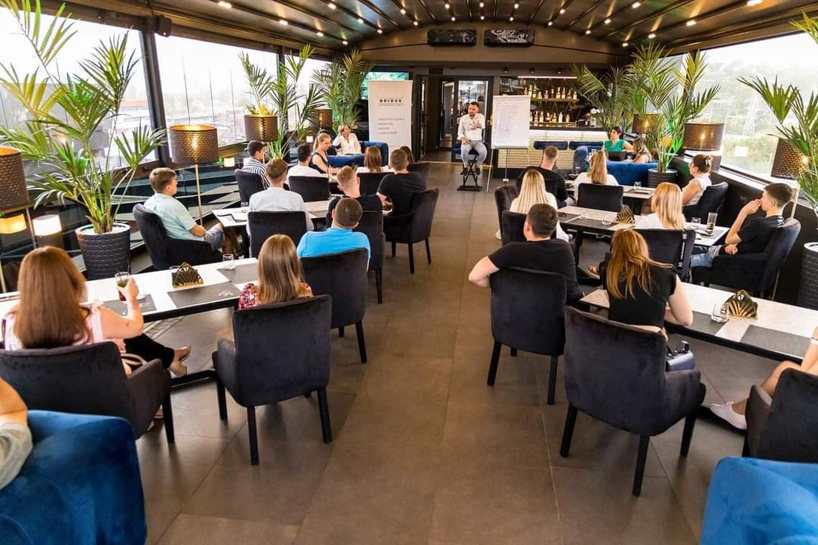
Role of HR management to address the concerns of inequality that arise from flexible working
The workers are unable to work efficiently.
This has decreased their productivity level
Notes:
The gap in effective communication between the workers and the managers has helped the HR department to address the issues of inequality. At the same time, the body language of the workers also justifies their condition as they are not capable of doing work effectively due to advanced modes of providing flexibility. This has affected their productivity negatively (Peoplescout, 2022).

Slide 13
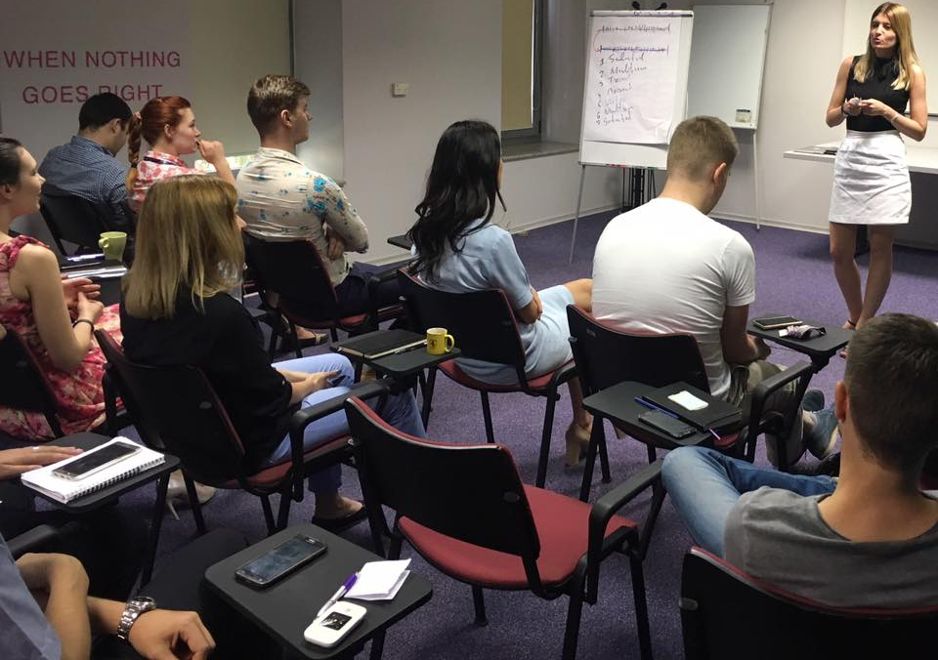
Conclusion
Flexibility is highly important for the development of an organisation.
Inequality is a drawback of flexibility at workplace.
Notes:
The study has concluded that flexibility is important for the development of a workforce and a company. This helps workers to work in their own comfort. At the same time, it also has drawbacks as any other things do. Flexibility has created a curse-like situation for old workers at ALDI as they are not able to use technologies to take advantage of flexibility. This issue has been addressed by the HR department of the company. The lack of communication from the end of those workers has made a clear sign of their dissatisfaction which has impacted their work negatively.

Slide 14
References
Aldi, 2022. Aldi grocery store, ALDI Grocery Stores - Quality Food. Everyday Low Prices. Available at: https://www.aldi.us/ (Accessed: November 18, 2022).
Gov.uk, 2022. Flexible working, GOV.UK. GOV.UK. Available at: https://www.gov.uk/flexible-working (Accessed: November 18, 2022).
Ozkeser, B., 2019. Impact of training on employee motivation in human resources management. Procedia Computer Science, 158, pp.802-810.
Peoplescout, 2022. Age discrimination in the Workplace, PeopleScout. Available at: https://www.peoplescout.com/insights/age-discrimination-in-the-workplace/#:~:text=According%20to%20the%2n.d.EA%2C%20the,to%20taking%20on%20new%20projects' (Accessed: November 18, 2022).

Slide 15
Any Questions?

