Slide 1
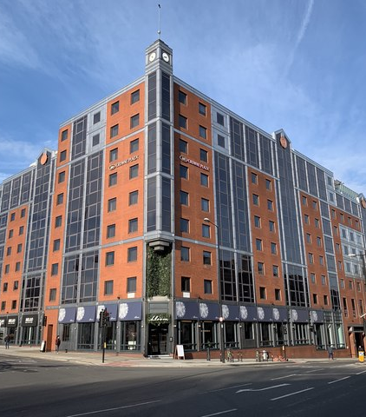
MARKETING PLAN FOR HOTEL CROWNE PLAZA
MOHAMMED S MIAH
2118790
This Photo by Unknown Author is licensed under CC BY-SA

Slide 2
CROWNE PLAZA
HOTEL
LONDON, UK
For over 50 years, Crowne Plaza Hotels & Resorts have been offering exceptional hospitality.
With innovative marketing strategies during the past five years that have seen their popularity soar, as evidenced by their continued reputation as one of the most trusted names in luxury accommodations.
As the hospitality industry evolves, the Crowne Plaza Hotel is always looking for the right opportunities to bring innovative technologies to its guests.

Slide 3
BENEFITS OF INTRODUCING AI CHATBOTS AND ROBOT CONCIERGE
This marketing plan outlines how the Crown Plaza Hotel can capitalize on artificial intelligence (AI) to improve response times, deliver a more personalized customer experience, and increase sales.
At the core of this plan is the introduction of AI technology for late response and robots as concierge. The hotel’s existing customer base can be tapped into in order to grow the profile of the brand, allowing for a greater spread of AI technology throughout the hospitality industry.

Slide 4
SITUATION ANALYSIS 5 'C's OF HOTEL CROWNE PLAZA
In order to gain a thorough understanding of the business and create a successful marketing strategy, it is important to conduct a Situation Analysis of the 5 “C’s”; Company, Customers, Competition, Collaborators, and Climate.
COMPANY:
Hotel Crowne Plaza is a 5-star, luxury lodging option that offers guests a luxurious and comfortable experience. Moreover, a focus on personal customer service is a primary feature of Hotel Crowne Plaza that distinguishes it from competitors.
Furthermore, the hotel is part of the InterContinental Hotels Group and is certified as meeting international standards for quality and service.

Slide 5
Customers:
Hotel Crowne Plaza caters to business and leisure travelers alike., makes it an ideal destination for business travelers, who often seek convenient and high-quality lodging.
Collaborators:
Hotel Crowne Plaza works with numerous collaborators across uk, such as local vendors for supplies, local transportation options for guests, and other businesses to provide concierge and other services to guests. Partnering with these collaborators helps ensure that guests have access to the services and amenities they desire while staying at the hotel.
Competition:
Hotel Crowne Plaza faces competition from numerous other luxury lodging options in the London, uk area, including the Ritz Carlton, Four Seasons, and Park-Hyatt. All of these competitors provide similar service and amenities, making it difficult for Hotel Crowne Plaza to set itself apart from the rest.
Context / Climate
The current business environment that Hotel Crowne Plaza operates in is very competitive and highly reliant on creating customer loyalty and satisfaction. Furthermore, the extensive range of technological advancement makes it difficult to stay ahead of the competition. Additionally, the current market is saturated with new hotel and lodging options, making it increasingly difficult to stand out.

Slide 6
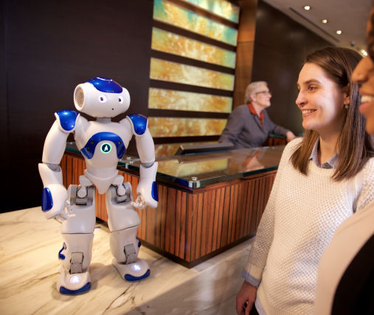
GANNT CHART
The Crowne Plaza Hotel is excited to announce our newest marketing initiative to introduce AI chatbots and robots in our hotel. This gannt chart outlines a marketing plan to ensure a successful launch and to achieve maximum impact from our AI chatbots and robots.
This Photo by Unknown Author is licensed under CC BY-NC-ND

Slide 7


Phase 1 and 2
Phase 1: Market Research
Phase 2: Design Campaign
In order to conduct a successful marketing strategy for introducing AI chatbots and robots, it's important to conduct proper market research.
This includes gathering data on the current market trends,
customer preferences, and needs.
The data collected will provide insights into the best marketing tactics to use when introducing AI chatbots and robots.
Once the data is collected, we can move on to designing the marketing campaign.
This includes the layout and design of our promotional materials,
the messaging used in the campaign, and the media vehicles used to reach the target market.

Slide 8
Phase 3: Launch Campaign
Now that we have designed an effective campaign, it's time to launch it.
We will use a mix of online and offline media to reach our target market. This includes using digital marketing tactics such as email campaigns, online advertising, and social media influencers.
Additionally, we will use traditional media such as radio, TV, and print to reach more people.
Phase 4: Monitor & Evaluate
The last step of this gannt chart is to monitor and evaluate the campaign. This involves using analytics tools to track the success of our campaign and make necessary tweaks to optimize performance.
We will also survey our target market to get feedback on the effectiveness of the campaign. By taking these steps, we can ensure that our campaign is successful and that we maximize the impact of our AI chatbots and robots.

Slide 9




4P's of marketing mix tactics strategy for crowne plaza hotel to introduce AI chatbots and robots in hotel
Affordable
Reducing cost through the use of a subscription model
By offering discounts to customers
Placing AI chatbots and robots in strategic locations
Concierge
Welcome robot
With personalised message for guests
PROMOTION
PRODUCT
PRICE
PLACE
Create customer experience bots
Simple to use
Easy to understand.
Quick response
Create promotional campaigns
Influencers
SEO content creation
Social media like Instagram twitter and ticktocks

Slide 10
CONTROL
AND IMPLEMENTATION
Finally, to ensure the success of this initiative, Crown Plaza should make sure the technology is easy to use and provides an intuitive experience for all customers.
To that end, the hotel should conduct regular customer satisfaction surveys to better understand how customers are responding to the technology and what improvements can be made.
Additionally, Crowne Plaza should create a customer service team to provide support and address customer issues that arise from using the AI technology.
Overall, the introduction of AI technology and robots for customer service can be a major benefit for Crown Plaza Hotel. With a comprehensive marketing mix and action plan in place, the hotel can ensure that its customers have the best possible experience when they book a room.

Slide 11
THANK YOU

