Slide 1

Costs and Pricing
Lecture 3

Slide 2
What You Will Learn
After completing this chapter, you should be able to:
Describe the differences between direct and indirect costs and variable and fixed costs
Explain how contribution margins and break-even analysis assist managers in making business decisions
Determine financial and pricing strategies based on cost, margin, and break-even analysis

Slide 3
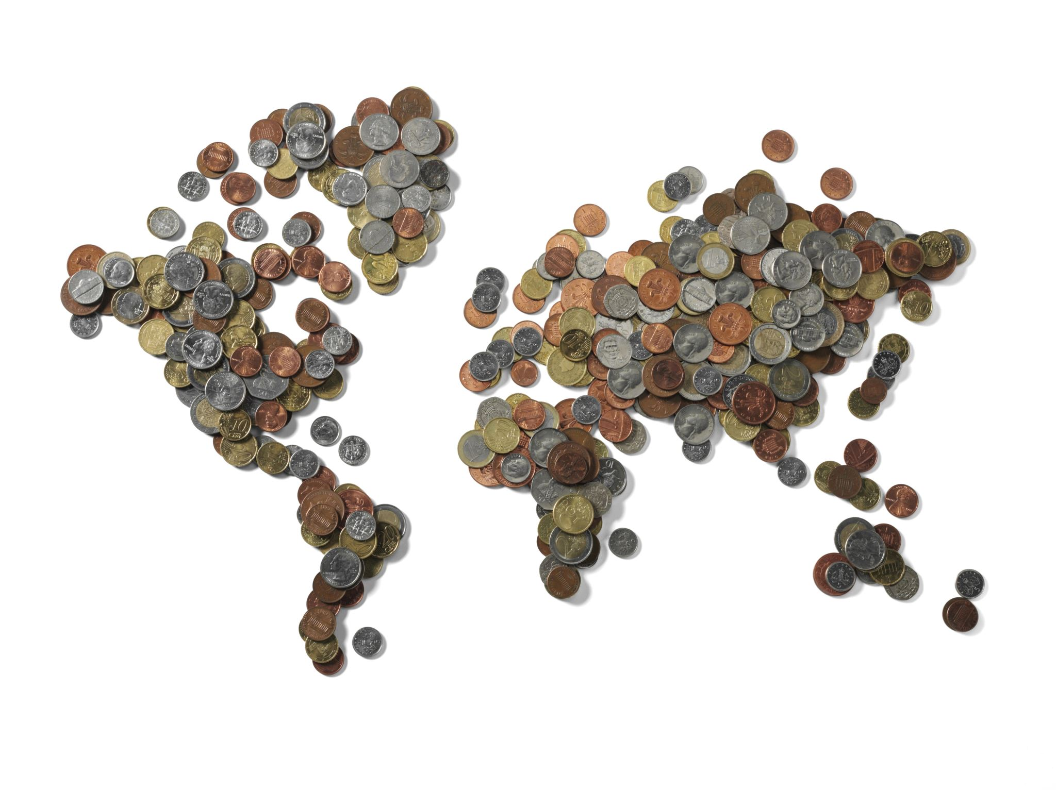
Different Types of Cost
Money comes in.
Money goes out.
Money supposed to come in.
Money supposed to go out.

Slide 4
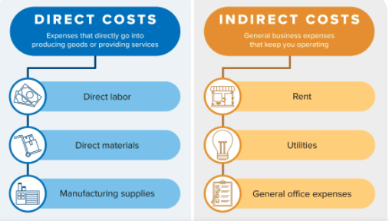
Direct and Indirect Costs

Slide 5
Direct Costs
Direct Costs expenses that can be directly tied to the production of specific goods and services.
Direct costs include labour, materials, and other expenses such as raw materials, fuel, power, etc.
For example, the direct costs for a car manufacturer would be the total wages paid to employees who build the cars and the costs of the individual parts.
Whereas the training of other employees, supervision, and other costs would not be considered direct costs.

Slide 6
Indirect Costs
Indirect costs are costs used by multiple activities and can not be assigned to specific products, services, geographical regions, distribution channels, and customers.
Instead, indirect costs are required to operate the business.
For example, indirect costs can include accounting and legal expenses, office expenses, etc.
For example, a car manufacturer's indirect costs might include water, lighting, internet, office maintenance, etc.
These items are indirect because they are used by the entire business and cannot be traced back to an individual department.

Slide 7
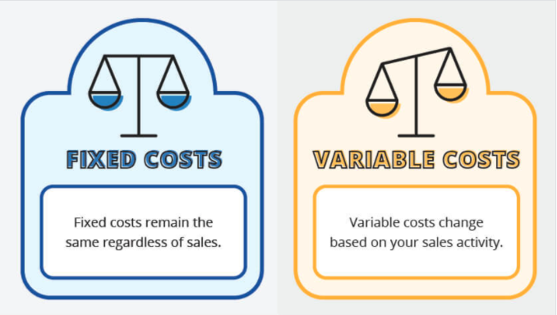
Fixed and Variable Costs
Fixed Cost: A fixed cost means that it does not change.
It is a set amount that you pay on a recurring basis.
Variable Cost: A variable cost may change due to various factors.
This means you are unable to predict exactly what it will cost.

Slide 8
Fixed Costs
Fixed costs do not really change regardless of how much business you're conducting.
Of course, fixed costs can increase over time for items like rent, salaries, insurance premiums.
However, these costs are fixed in a sense they do not change based on your production.
For example, your rent would remain the same regardless if you produced 1 chair or 25 chairs.

Slide 9
Examples of Fixed Costs
Depreciation - gradual deduction of an asset's decline in value.
Amortization - the allocation of the cost of an intangible asset over a period of time
Insurance - the liability insurance you hold on your business
Rent - the rent you pay for your office, factory, storage space
Utilities - electricity, water, and other utilities

Slide 10
Variable Costs
A variable cost is a cost that changes depending on your production level.
In other words, your sales volume directly impacts your variable costs. For example, let's say you manufacture furniture.
The packaging cost per chair remains the same.
However, the total packaging costs rise when production is greater

Slide 11
Here's how a variable cost would work:
Chairs Produced | Raw Materials Costs | Total Costs
1 | $25 | $25
100 | $25 | $2500
500 | $25 | $12,500
1000 | $25 | $25,000

Slide 12
Examples of Variable Costs
Direct Materials - the raw materials go into the production of your product
Production Supplies - the supplies that are necessary for the machinery that helps produce your product
Sales Commissions - part of an employee's salary based on the sales they make
Credit card fees - fees the merchant has to pay to offer credit card services to customers

Slide 13
Contribution Margin
Many companies and managers use various financial metrics to decide whether to discontinue or keep selling certain projects and services.
One popular financial metric used is contribution margin.
For instance, if a company has sold enough products to have a positive contribution margin, the product is making enough profit to cover its fixed costs.

Slide 14
What is a Profit?
Profit is the amount of income that remains after accounting for all expenses, debts, and operating costs.
To calculate profit, you subtract your sales or revenue from your costs or expenses (variable and fixed)
Profit = Sales - Expense (Variable Costs + Fixed Costs)

Slide 15
What is Contribution Margin?
Contribution margin is the amount an item contributes towards covering fixed costs and profitability of the company.
Simply, contribution margin is business revenue less its variable costs.
The result can be used to cover fixed costs, and anything in excess is considered earnings.
Thus, the higher the contribution margin, the more money the company has to cover its fixed costs and overhead.
A 'good' contribution margin is relative and dependent on the nature of the company, its expense structure, and whether the company is competitive among its competitors.

Slide 16
What is Contribution Margin?, contd,,
Contribution Margin Formula
The contribution margin is calculated as the difference between the product's sales price and the variable costs associated with the production and sales process.
Contribution Margin = Sales − Variable Costs

Slide 17
Contribution Margin Example
Again, let's use the furniture manufacturer as an example. Let's say the selling price for one chair is $250. The variable costs are $100 per chair, and the fixed costs are $10,000 per month. We can calculate the contribution margin as:
$250 (revenue) - $100 (variable costs) = $150 contribution margin
Now, let's subtract the fixed costs to our calculation:
$150 (contribution margin) - $10,000 (fixed expense) = $ - 9,850
So, if we sell one chair at $250, we will experience a loss of $-9,850. What happens if we increased the number of chairs sold?

Slide 18
Contribution Margin Example
Quantity | 1 chair | 2 chairs | 10 chairs
Total Sales | 250 | 500 | 2500
Variable Expense (subtract) | 100 | 200 | 1000
Contribution Margin | 150 | 300 | 1500
Fixed Expense (subtract) | 10,000 | 10,000 | 10,000
= Profit / (Loss) | (9,850) | (9,700) | (8,500)

Slide 19
Contribution Margin Example, contd,,
Unfortunately, the furniture manufacturer is still making a loss because the contribution margin is lower than the fixed expenses.
So, how much sales does the furniture manufacturer need to generate to cover all variable and fixed expenses?
We can calculate this amount by figuring the breakeven point.

Slide 20
Break-Even Point
The Break-Even Point (BEP) is the level of sales necessary to cover all variable and fixed expenses where business neither makes a profit or a loss.
In other words, BEP is the break-even point where business neither makes a profit or loss for a given period.
Break-Even Point Example:
Let's calculate the break-even point for the furniture manufacturer. The Break-Even Point is BEP = 10,000 / 150 = 66.67, i.e. when the 67th table is sold, the business will start making a profit.
Break Even Point = Fixed Costs / Contribution per Unit

Slide 21
Break-Even Point Example, contd,,
Quantity | 1 chair | 2 chairs | 10 chairs | 66 chairs | 67 chairs
Sales | 250 | 500 | 2500 | 16500 | 16750
(-) Variable Costs | 100 | 200 | 1000 | 6600 | 6700
= Contribution Margin | 150 | 300 | 1500 | 9900 | 10050
(-) Fixed Costs | 10000 | 10000 | 10000 | 10000 | 10000
= Profit / (Loss) | (9850) | (9700) | (8500) | (100) | 50

Slide 22
Break-Even Point Benefits
Companies and managers use break-even point analysis to identify pricing structures, operations, hiring employees, and obtaining future financial support. Other break-even benefits include:
Price Products & Services - Finding the break-even point helps managers decide on product or service pricing and understand how pricing will affect your profitability.
Set Revenue Targets - After completing an analysis, you will know exactly how much is needed to be sold to become profitable. This helps with establishing sales goals.
Limits Financial Strain - A break-even analysis helps companies mitigate risk by providing a realistic analysis of potential financial outcomes.
Smarter Decisions - An analysis helps entrepreneurs and managers make smarter decisions based on facts and not emotions.
Fund Your Business - Investors usually require a break-even analysis to ensure your plan is viable.

Slide 23
Cost Allocation
What is Cost Allocation
Cost allocation is the process of identifying, accumulating, and assigning costs to departments, products, programs, etc.
It involves identifying cost objects in a company, identifying the costs incurred by the cost objects, and then assigning the costs to the cost objects based on specific criteria.
Cost objects can be a brand, project, product line, division/department, or company brand.
This method of costing is essential as per the accounting standards to provide an inventory valuation which is included in the balance sheet.

Slide 24
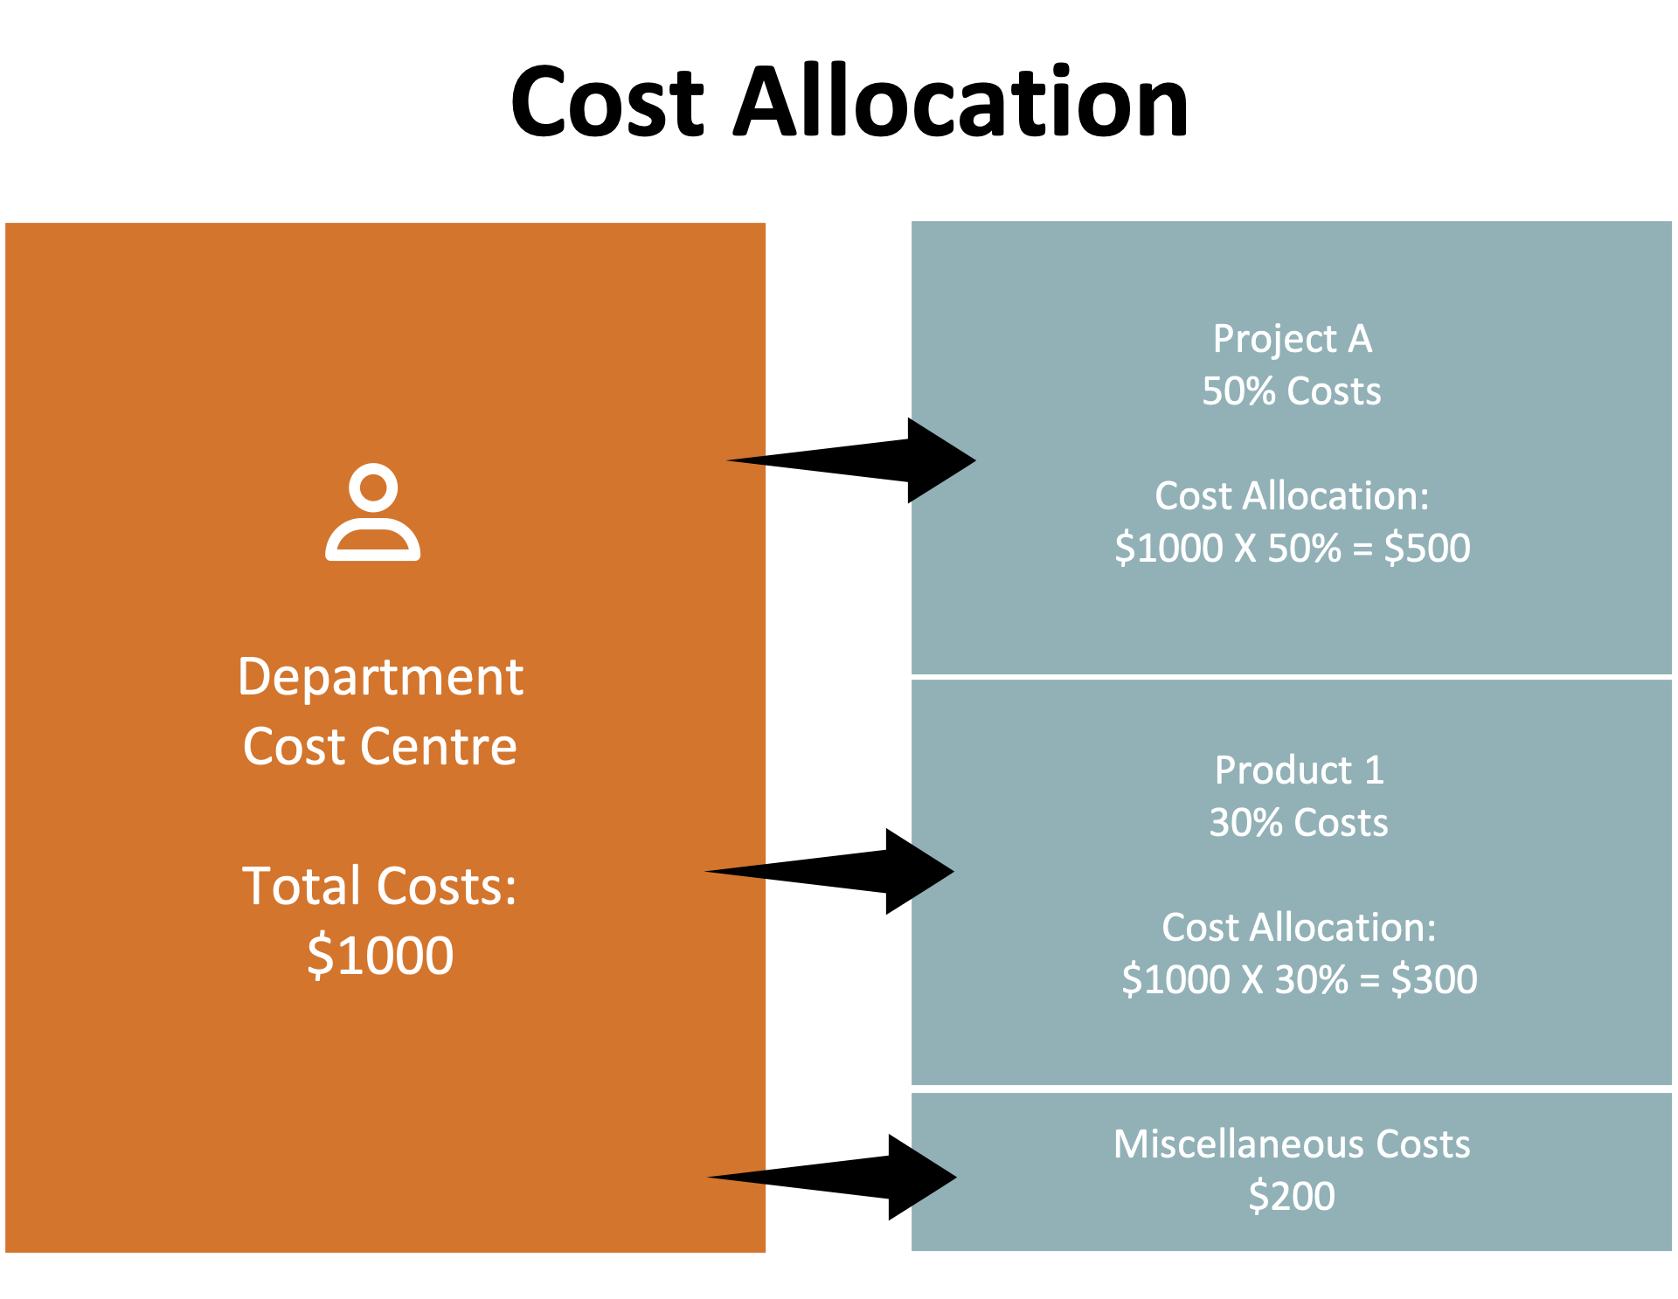

Slide 25
The Benefits of Cost Allocation
Cost allocation provides management with important information to make business decisions.
For example, when costs are allocated correctly, the business can trace the specific cost objects that make profits or losses.
If costs are misallocated, the company may assign resources to cost objects that do not yield as much profits as expected.
Cost allocation can also help management determine if specific departments are profitable or not.
If the cost object is not profitable, the company can evaluate staff performance to determine if the decline in profits is caused by the cost objects.

Slide 26
Cost Allocation Methods
Absorption Costs - A costing method that entails the full cost of manufacturing or providing a service. It includes all manufacturing costs (i.e. direct materials, direct labour, and both variable and fixed manufacturing overhead) in the cost of a product.
Activity-based costing (ABC) - A costing method designed to provide managers with cost information for strategic and other decisions that potentially affect capacity and, therefore, “fixed” as well as variable costs. Products are only charged for the costs of the capacity they use, not for the costs of capacity they don’t use.

Slide 27
Absorption Costing Method
Absorption costing provides more accurate accounting for ending inventory because inventory expenses are linked to the full cost of the inventory still on hand.
In addition, more expenses are accounted for in unsold products.
This reduces the actual expenses reported in the current period of the income statement.
The results in a higher net income calculation when compared to variable costing calculations.

Slide 28

Advantages Absorption Costing
It presents a more realistic cost of a product.
It makes calculations easier for small businesses as it is unlikely that these companies have many products.
It makes costing tasks simpler, easier and systematic for businesses that have a constant demand for products and considers the effects of fluctuating turnover as the costs attached to the products are already absorbed into the products.
It is GAAP compliant (Generally Accepted Accounting Principles).

Slide 29
Disadvantages of Absorption Costing
Since absorption costing includes allocating fixed manufacturing overhead to the product cost, it is not useful for decision-making and/or planning further actions like forecasting and budgeting.
It can be used to manipulate a company’s profitability status and increase chances of ‘creative accounting’ that could ultimately mislead the economic decisions of stakeholders, especially potential investors.
It makes it difficult for the company's management to assess the efficiency and effectiveness of business operations.

Slide 30
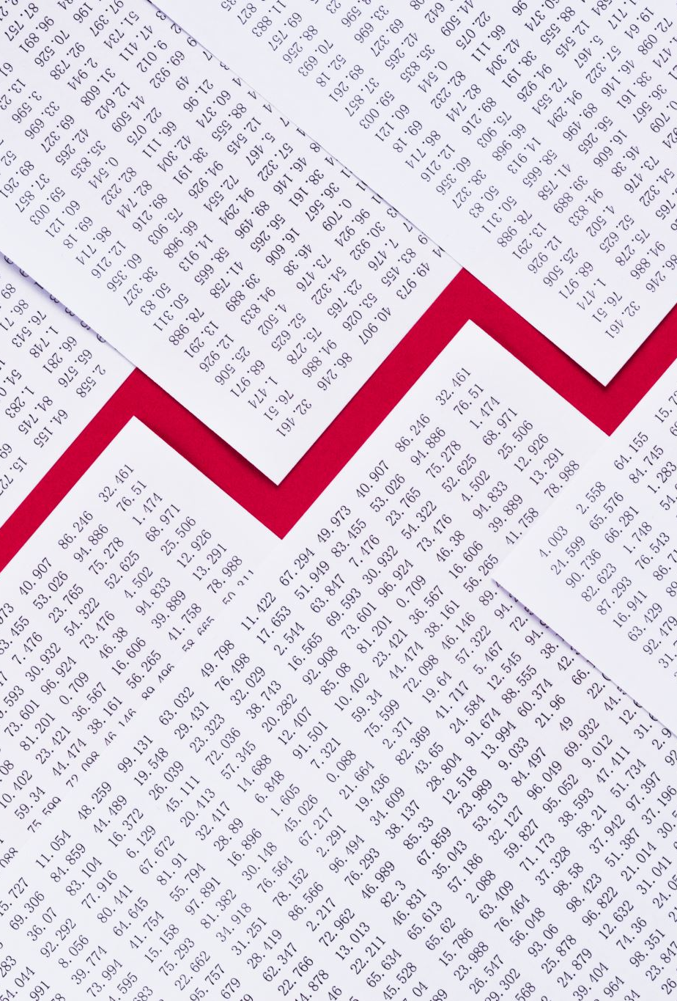
Activity-Based Costing (ABC) Method
The ABC method provides a different approach to allocating overhead costs.
The ABC costing method assigns overhead, and indirect costs related to products and services.
This accounting method of costing is mostly used in the manufacturing industry since it provides reliable cost data.
It produces nearly true costs and a better classification of costs incurred during its production process.

Slide 31
Activity-Based Costing (ABC) Method, contd,,
Activity-based costing provides management with an accurate method of product/service costing, leading to better pricing decisions.
It increases the understanding of overhead costs and cost drivers making costly and non-valuable adding activities more visible.
This allows managers to reduce or eliminate them. ABC enables an effective evaluation of operating costs to find better ways of allocating and eliminating overhead.
Also, it improves product and customer profitability analysis and supports performance management techniques like continuous improvement and scorecards.

Slide 32
Activity-Based Costing (ABC) Method, contd,,
Advantages of ABC
Provides realistic costs of manufacturing for specific products.
Determines product profit margins more precisely.
Discovers which processes have unnecessary and wasted costs.
Offers better understanding and justification of costs in manufacturing overhead.
Disadvantages of ABC
Collection and preparation of data is time-consuming.
Costs more to accumulate and analyse information.
Source data isn't always readily available from normal accounting reports

Slide 33
Break-Even Pricing & Quantity
Most companies commonly use break-even pricing to help set pricing strategy for their products or services portfolio.
Typically, management or marketers will calculate this price point to make informed decisions like increasing production or trying and lowering costs.
Understanding Break-Even Pricing
The break-even price is the price that will produce enough revenue to cover all costs at a given level of production.
At the break-even point, there is no loss or profit.

Slide 34
Break-Even Pricing Example
Let's imagine you plan to sell home-baked chocolate cookies from your home. Obviously, you do not want to lose money, but you are not trying to make a profit. You spend $24 on cookie ingredients and bake 4 dozen cookies (48 cookies). What is the break-even price for the cookie?
It's the total cost divided by the number of cookies you expect to sell. Here is the formula:
Break-Even Price = Costs/Units or $24 / 48 = $.50
You must sell your cookies at $.50 each to cover your ingredient costs. What happens if you sell only 40 cookies? The calculation would be $24 / 40 = $.60. Your break-even price goes up if you sell fewer cookies.

Slide 35
Break-Even Quantity Example
Let's take a look at calculating the break-even quantity. Here is the formula:
Break-Even Quantity (in terms of units) = Fixed Costs / Price per unit - Variable costs per unit
You have spent $24 on ingredients or costs. You plan on selling the cookies at $1 each. We calculate the formula $24 / $1 = 24 cookies. You will need to sell 24 cookies at $1 each before you break even.
Companies can set a price below the break-even point.
However, in that case, the company would be earning revenues but not making any profits. So, the motive of the company might be to increase its market share rather than earning profits.

Slide 36
Any question
Thanks

