Slide 1
Practice-based Research
Methodological considerations
LCHS7001
Week 5
Dr Diola Bijlhout
Email: d.bijlhout@uwtsd.ac.uk

Slide 2
Important notice & timelines
Week 6-7: Individual presentations
Week 8: Focus group discussion
Week 9: Formative assessment

Slide 3
Learning outcomes
On successful completion of the module, the student will be able to:
Engage in practice-based research in public health and social care settings and identify areas for improvement in terms of physical and/or mental health of the target group or community of interest.
Develop critical reflection skills, including skills of critical analysis, appraisal, and evaluation of research findings and provide relevant recommendations for health and social care professionals, policymakers, services, practice, and/or the wider population.
Critically analyse the data collection and findings from quantitative, qualitative or mixed methods research.
Develop knowledge and understanding of professional integrity and ethics in research and potential risks for participants and how to prevent them.

Slide 4
Module Summary
This module aims overall to develop student to gain knowledge of the main principles of designing, conducting, evaluating the impacts and dissemination of evidence-based research.
To conduct an independent practice-based research project within a public health and social care setting with professional integrity.

Slide 5
Session Aims
By the end of this session you should be able;
  Understand the use/types of variables and hypothesis testing
  Describe different common methodologies
  Understand Research Paradigm
  Understand Research Process
  Understand deductive and inductive approaches

Slide 6

Key Terminologies in Research
What is a hypothesis?

Slide 7
Hypothesis
A hypothesis states your predictions about what your research will find.
It is a tentative answer to your research question that has not yet been tested.
A statement which can be tested through research

Slide 8
Hypothesis
It is a statement which predicts what is expected to happen in the study
For some research projects, you might have to write several hypotheses that address different aspects of your research question.

Slide 9
Hypothesis
A hypothesis is not just a guess — it should be based on existing theories and knowledge.
It also has to be testable, which means you can support or refute it through scientific research methods (such as experiments, observations and statistical analysis of data).

Slide 10
What are the two features of a hypothesis?

Slide 11
Two features of a hypothesis
  include
  Null or Experimental
  Directional or Non-Directional

Slide 12
Hypothesis
Null Hypothesis
  This predicts no effect/relationship between variables (there will be no change)
Experimental Hypothesis
  This predicts an effect/relationship between something (something will change)

Slide 13
Hypothesis
Directional
  Specifies the direction of the effect/relationship
Non-Directional
  Predicts an effect/ relationship but not the direction (does not state whether it will have a positive or negative effect)

Slide 14
What is variables?

Slide 15
What are the two major variables required to formulate an hypothesis?

Slide 16
Variable
In research, variables are any characteristics that can take on different values, such as height, age, temperature, or test scores.
Researchers often manipulate or measure independent and dependent variables in studies to test cause-and-effect relationships.

Slide 17
Variables in hypotheses
Independent Variable
  This is the variable which causes a change in a study.
  That is something the researcher changes or controls
Dependent Variable
  This is the outcome or effect that is measured.
  That is something the researcher observes and measures.
Notes:
In statistical research, a variable is defined as an attribute of an object of study.

Slide 18
Independent and dependent variables
Independent and dependent variables are thought of in terms of cause and effect:
an independent variable is the variable you think is the cause, while a dependent variable is the effect.
In an experiment, you manipulate the independent variable and measure the outcome in the dependent variable.

Slide 19
Independent and dependent variables
For example,
In an experiment about the effect of nutrients on crop growth:
The independent variable is the amount of nutrients added to the crop field.
The dependent variable is the biomass of the crops at harvest time.

Slide 20
Independent and dependent variables
Experiments are usually designed to find out what effect one variable has on another –
You manipulate the independent variable (the one you think might be the cause)
and then measure the dependent variable (the one you think might be the effect) to find out what this effect might be.
You will probably also have variables that you hold constant (control variables) in order to focus on your experimental treatment.

Slide 21
Variables in hypotheses
For example:
  The presence of spectators at a football match will effect a player taking a penalty (IV=Spectators, DV= Players performance taking a penalty)
  Altitude training will improve endurance running compared to sea level training (IV= Type of training, DV= Endurance performance)

Slide 22
For example:
Topic: Daily apple consumption leads to fewer doctor’s visits
In this example, the independent variable is apple consumption — the assumed cause.
The dependent variable is the frequency of doctor’s visits — the assumed effect.

Slide 23
For example:
Topic: Fish consumption and dementia risk
In this example, the independent variable is fish consumption — the assumed cause.
The dependent variable is the dementia risk— the assumed effect

Slide 24
Hypothesis examples
Research question | Hypothesis | Null hypothesis
Which airlines have the most delays? | Low-cost airlines are more likely to have delays than premium airlines. | Low-cost and premium airlines are equally likely to have delays.
Can flexible work arrangements improve job satisfaction? | Employees who have flexible working hours will report greater job satisfaction than employees who work fixed hours. | There is no relationship between working hour flexibility and job satisfaction.
How effective is high school sex education at reducing teen pregnancies? | Teenagers who received sex education lessons throughout high school will have lower rates of unplanned pregnancy than teenagers who did not receive any sex education. | High school sex education has no effect on teen pregnancy rates.

Slide 25
Hypothesis examples
Research question | Hypothesis | Null hypothesis
What are the health benefits of eating an apple a day? | Increasing apple consumption in over-60s will result in decreasing frequency of doctor’s visits. | Increasing apple consumption in over-60s will have no effect on frequency of doctor’s visits.

Slide 26
Activity
Watch the video below then discuss
https://www.youtube.com/watch?v=PCgLjDDD4ek
Feedback to the whole class
Notes:
6 Steps to Formulate a STRONG Hypothesis | Scribbr 🎓 - YouTube

Slide 27
Activity
Watch the video below then discuss
https://www.youtube.com/watch?v=Lgkfy-iPxDU
https://www.youtube.com/watch?v=71-GucBaM8U
Feedback to the whole class
Notes:
How to Develop a STRONG Research Question | Scribbr 🎓 - YouTube
A Good Research Question - YouTube

Slide 28
Recap: Types of hypothesis/research question
Descriptive:
Investigate/explore phenomena
e.g. people’s experiences of living with dementia
Relational:
Relationships between phenomena
e.g. Is there a relationship between hippocampal volume and spatial memory abilities?
Causal:
Does X reduce/increase scores on y?
e.g. Does CBT reduce symptoms of depression?

Slide 29
What is a Research Process?

Slide 30
Research Process
You begin a research study by identifying a topic of study- typically an issue or problem that needs to be resolved or understood.
When a research problem has been identified, we need to justify why it is important or relevant to spend time (and often money) researching it.
Research then uses a method of data collection to find out about the problem, this information is then analysed and discussed.
Conclusion are made according to what was found and then recommendations can be made regarding how to solve the issue being researched.
(Cresswell, 2014)

Slide 31
Research Process
Research process consists of a series of steps or actions required for effectively conducting research while formulating the research problem,
Extensive literature survey,
Developing hypothesis,
Preparing the research design,
Determining sample design, collecting data, execution of the project, analysis of data, hypothesis testing,
Generalization and interpretation, and preparation of the report or presentation of the results.

Slide 32
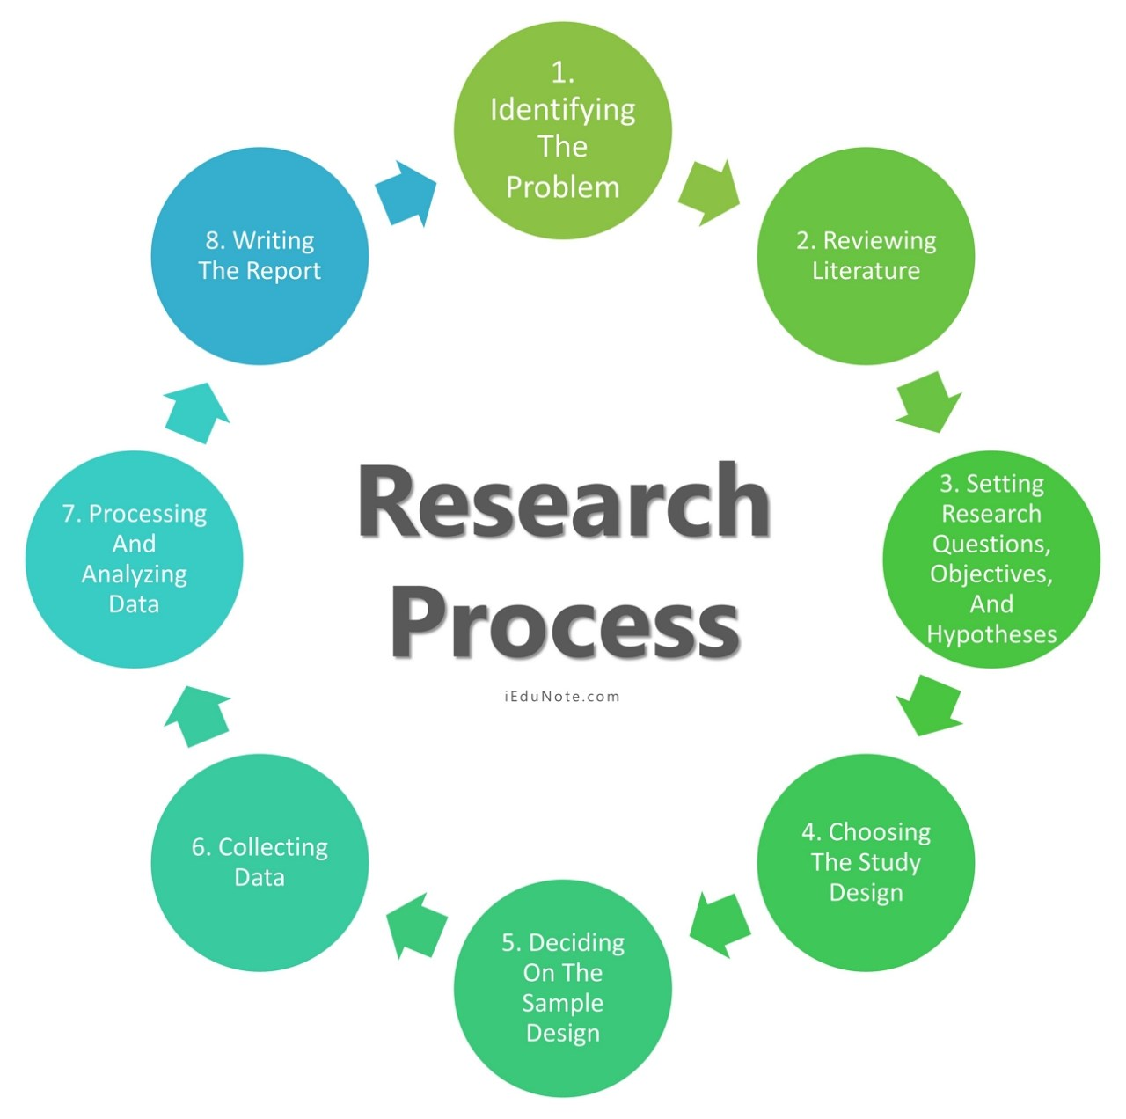
Research Process

Slide 33
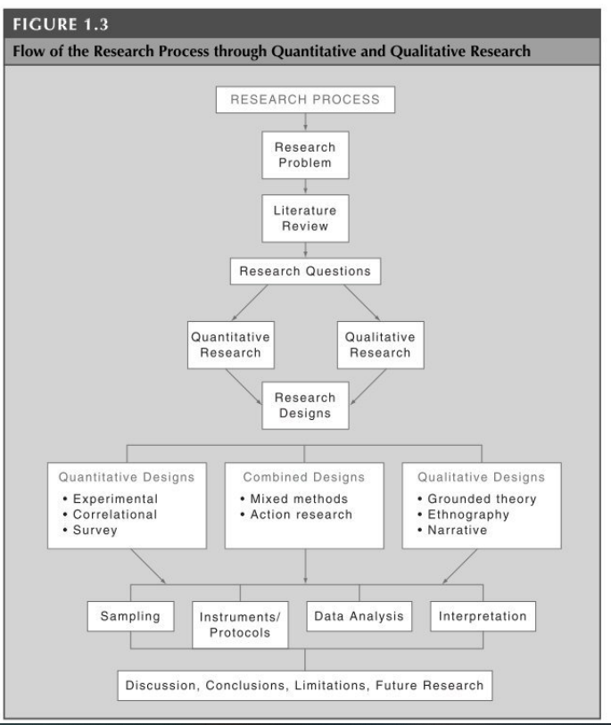
The Research Process
This diagram from Cresswell (2013, p29) shows the steps and sequence of the research process.
Notes:
Clarify the vocabulary at each stage, take each step one at a time. Highlight the ‘future research’ at the end

Slide 34
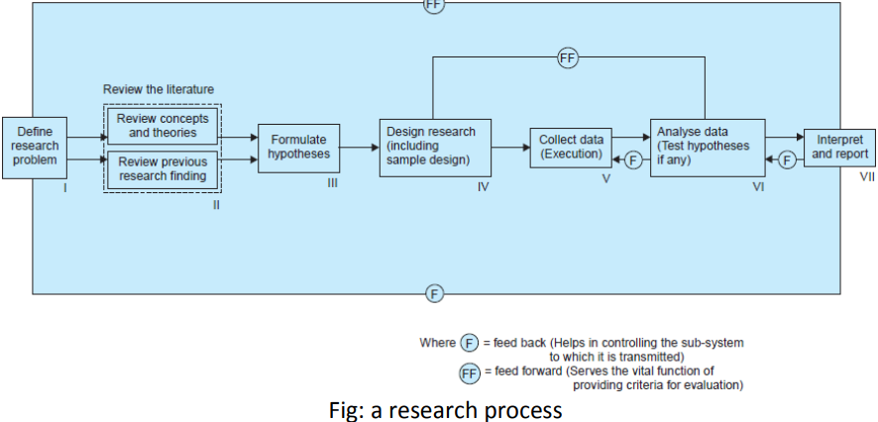
Research Process

Slide 35
Activity
Watch the video below then discuss
https://www.youtube.com/watch?v=V8ndAyxkxtA
Feedback to the whole class
Notes:
Research Process

Slide 36
Short Break
15 mins

Slide 37
Methodology
We know the problem.
We know our literature.
So how do we decide what research we can do?
There are different methodologies that can be applied to different investigations.
Should we take a qualitative or quantitative approach to dealing with this?

Slide 38
What is a Research Paradigm?

Slide 39
Research
Research is a rational and systematic exploration of valuable information which involves the collection, analysis and interpretation of data to describe and properly understand its phenomena (Mertens, 2005; Mackenzie and Knipe, 2006)
Mertens (2005) states that the specific nature of research definition is inclined towards theoretical frameworks, which are referred to as “research paradigms”.

Slide 40
Activity
Working in groups research the terms “Theoretical framework”
Feedback your findings to the whole class

Slide 41
Theoretical framework
Theoretical framework is defined as a structure that demonstrates the processes that help to understand a research phenomenon, thereby highlighting the researcher’s assumptions and philosophical views in solving a research problem (Polit and Beck, 2010).
This theoretical framework influences the knowledge and interpretation of a study, and guides the principle that drives the intention, motivation and expectation of a research study (Mackenzie and Knipe, 2006).

Slide 42
Activity
Watch the video below then discuss
https://www.youtube.com/watch?v=4y1BAqOnhMM
Feedback to the whole class
Notes:
Develop a Theoretical Framework in 3 Steps | Scribbr 🎓 - YouTube

Slide 43
Research Paradigm
Choosing a research paradigm is paramount in the early stages of a research study to lay the foundation for selecting the research design, methodology and methods to conduct a research study.

Slide 44
Paradigm
Paradigm is therefore defined as a philosophical intention or determination to conduct a research study (Cohen and mansion, 1994).
It involves the collection of reasonably related assumptions and ideas or suggestions required to conduct a research (Mackenzie and Knipe, 2006).

Slide 45
Paradigm
The association between the philosophy of research and methodology lies in the fact that methodology must be guided by a certain philosophical principle.

Slide 46
Activity
Working in groups research the term philosophical principle
Feedback your findings to the whole class

Slide 47
Philosophical principle
An accepted or professed rule of action or conduct; in a given philosophical system
It is a fundamental or general law or truth from which others are derived.
The collectivity of moral or ethical standards or judgments: a decision based on principle rather than expediency.
A fixed or predetermined policy or mode of action

Slide 48
Paradigm
These theoretical paradigms include
Positivism,
Interpretivism/constructivism and
Pragmatism.

Slide 49
Positivism
This philosophical paradigm is of the assumption that the social and the natural world can be studied using a similar approach, thereby, providing explanations of a causal nature (Mertens, 2005).
Positivists engage in observing and measuring concepts with the intention of evaluating and predicting their outcomes,
Thus achieving an objective reality independent of being influenced by the study participants (O'Leary, 2004; Mark, 2010).

Slide 50
Positivism
Positivists use a deductive research approach (top-down approach), which is an objective way of solving research problems (Feilzer, 2010; Mark, 2010).
The positivist paradigm mostly aligns with the quantitative methodological approach, which involves the collection of factual data to explore the associations between these facts and how they agree with the findings of other existing research (Mackenzie and Knipe, 2006).

Slide 51
Interpretivism
Interpretivism, also known as constructivism or subjectivism, is an approach to research that involves the intention to understand peoples’ life experiences (Cohen and Manion, 1994; Mark, 2010).
It involves the ability to be able to socially construct reality (Mertens, 2005; Mark, 2010).
Interpretivists rely on the participants’ perception of the topic being studied, since people’s experiences and the way they perceive things differs from one another, which is mainly due to socialisation (people’s background) (Creswell, 2003).

Slide 52
Interpretivism
Interpretivists use an inductive approach (bottom-up approach) to generate or develop a theory during a research process (Creswell, 2003).
The interpretivists’ paradigm, although applicable to quantitative approach, mostly aligns with the qualitative methodological approach or the mixed methodological approach that involves the combination of both the qualitative and quantitative methods to complement and support their findings
(Mackenzie and Knipe, 2006).

Slide 53
Pragmatism
Pragmatism is a paradigm that provides the fundamental theoretical framework for the mixed-methods approach, where two traditional perspectives (positivist and interpretivist) are combined to achieve a better understanding (Tashakkori and Teddlie, 2003).
Pragmatism involves the combination of different worldviews and assumptions that incorporate different data collection and analysis techniques (Creswell, 2003).
Therefore, pragmatics utilises both the qualitative and quantitative mode of data collection to achieve its research objective (Creswell, 2007).

Slide 54
Research methodology Philosophy
Positivism : philosophical system that recognises anything that can be scientifically verified or which is capable of logical or mathematical proof – quantitative research- objectivity reality
Interpretivism – a philosophical system which accepts that human beings may interpret their own environment and themselves in their own way.
Therefore reality is not an objective and externally defined construct- qualitative research- subjective reality

Slide 55
In summary

Slide 56
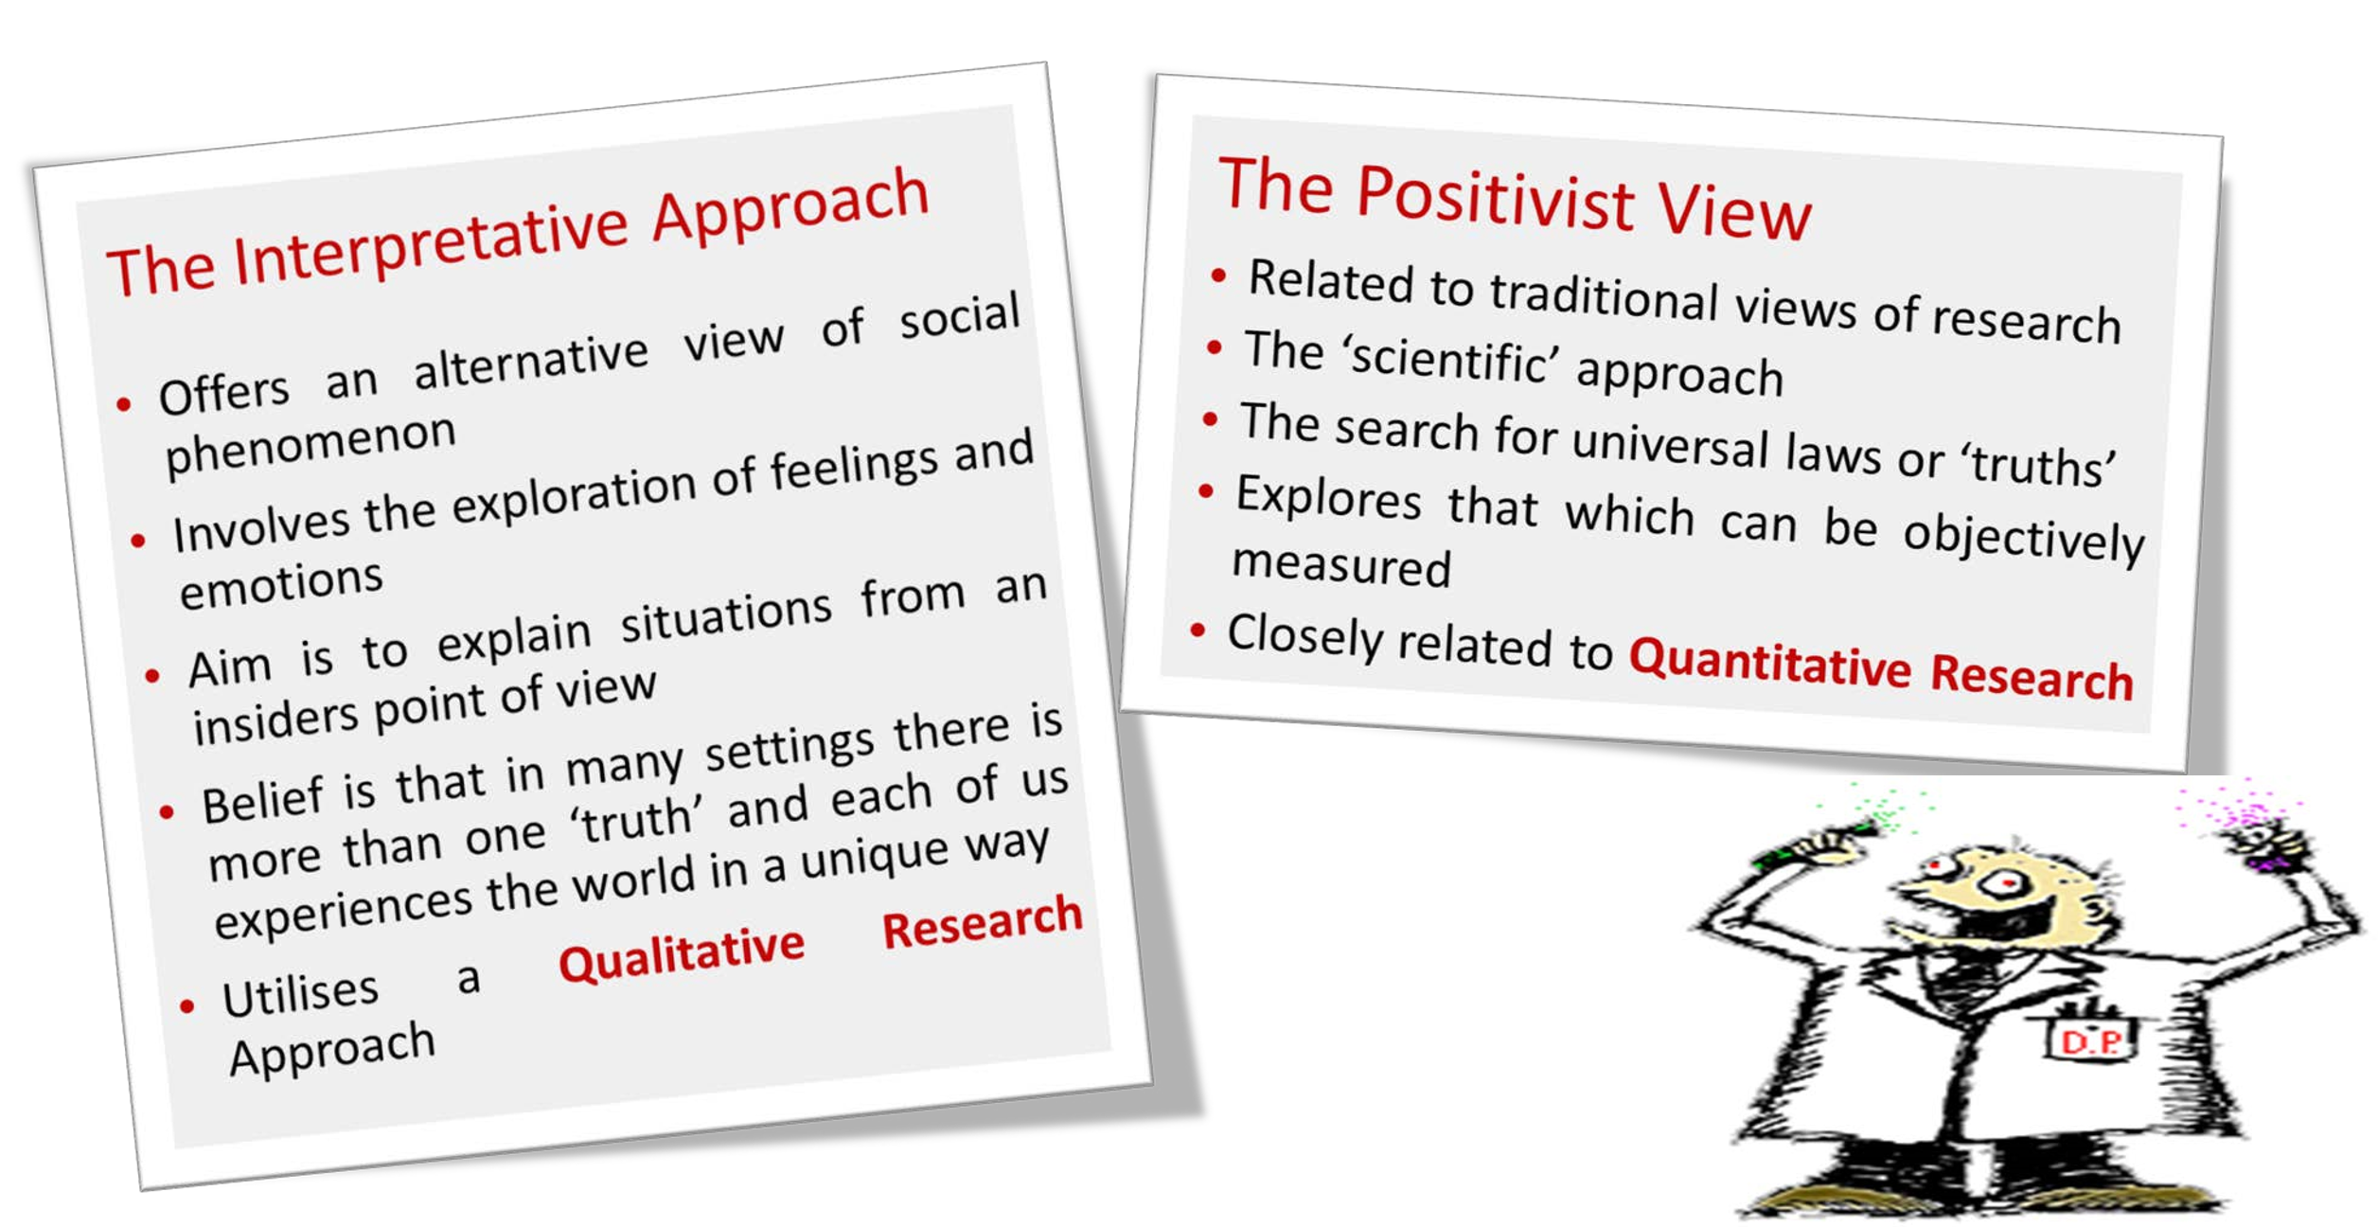
Methodology

Slide 57
Summary: Activity
Watch the video below then discuss
https://www.youtube.com/watch?v=hkcqGU7l_zU
Feedback your findings to the whole class
Notes:
Ontology, epistemology and research paradigm - YouTube

Slide 58
What are deductive and inductive approaches?

Slide 59
Deductive research approach
There are two broad methods of logical reasoning called the deductive and inductive approaches.
Deductive reasoning works from the more general to the more specific.
Sometimes this is informally called a “top-down” approach. We might begin with thinking up a theory about our topic of interest.
We then narrow that down into more specific hypotheses that we can test.
We narrow down even further when we collect observations to address the hypotheses. This ultimately leads us to be able to test the hypotheses with specific data – a confirmation (or not) of our original theories.

Slide 60
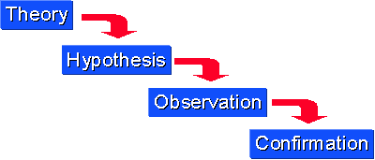
Deductive research approach

Slide 61
Inductive research approach
Inductive approach works the other way, moving from specific observations to broader generalizations and theories.
Informally, we sometimes call this a “bottom up” approach (please note that it’s “bottom up” and not “bottoms up”.
In inductive reasoning, we begin with specific observations and measures, begin to detect patterns and regularities, formulate some tentative hypotheses that we can explore, and finally end up developing some general conclusions or theories.

Slide 62
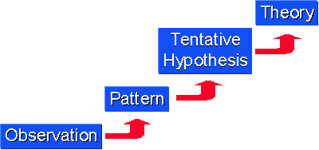
Inductive research approach

Slide 63
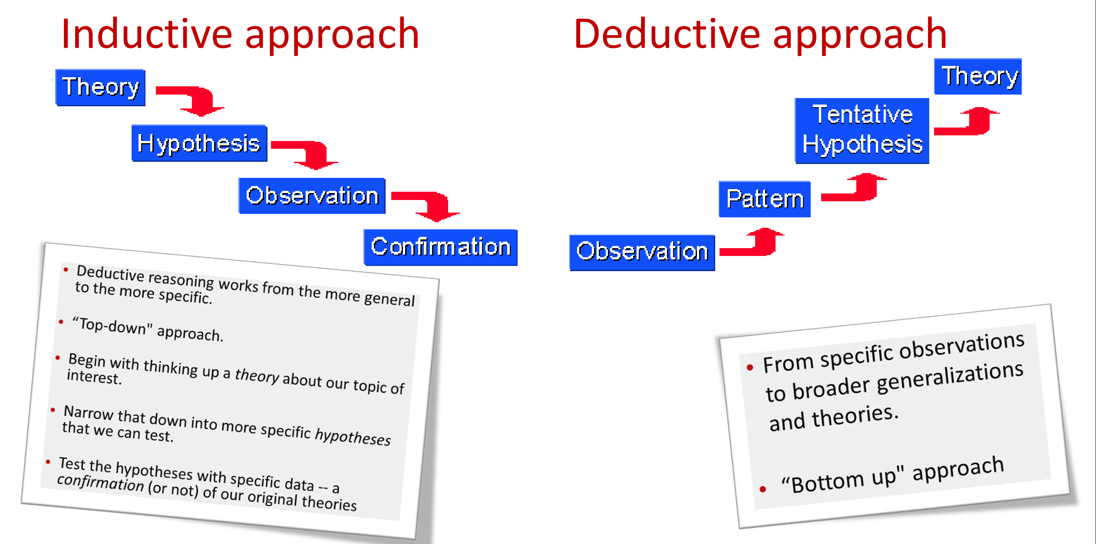

Slide 64
Inductive and Deductive Research Approach
These two methods of reasoning have a very different “feel” to them when you are conducting research.
Inductive reasoning, by its very nature, is more open-ended and exploratory, especially at the beginning.
Deductive reasoning is more narrow in nature and is concerned with testing or confirming hypotheses.

Slide 65
Inductive and Deductive Research Approach
Even though a particular study may look like it is purely deductive (e.g., an experiment designed to test the hypothesized effects of some treatment on some outcome),
Most social research involves both inductive and deductive reasoning processes at some time in the project.
Even in the most constrained experiment, the researchers may observe patterns in the data that lead them to develop new theories.

Slide 66
Inductive and Deductive Research Approach
Inductive research methods analyse an observed event,
while deductive methods verify the observed event.
Inductive approaches are associated with qualitative research,
And deductive methods are more commonly associated with quantitative analysis.
Notes:
https://conjointly.com/kb/deduction-and-induction/

Slide 67
Activity
Watch the video below then discuss
https://www.youtube.com/watch?v=yAjkQ1YqLEE
feedback to the whole class
Inductive and Deductive Research Approaches
https://www.youtube.com/watch?v=QB41z6_mUxk
https://www.youtube.com/watch?v=gctAuZGrdbQ
Notes:
https://www.youtube.com/watch?v=QB41z6_mUxk
Deductive & Inductive Research - YouTube

Slide 68
Activity
Watch the video below then discuss
https://www.youtube.com/watch?v=3Dd8P6IYzdE
Feedback to the whole class
Notes:
Research Design: Defining Your Research Aims and Approach | Scribbr 🎓 - YouTube

Slide 69
Activity
Watch the video below then discuss
https://www.youtube.com/watch?v=yplWZs3dqNQ
Feedback to the whole class
Notes:
How to Write a Research Methodology in 4 Steps | Scribbr 🎓 - YouTube

Slide 70
Summary of Quantitative/Qualitative Distinction

Slide 71
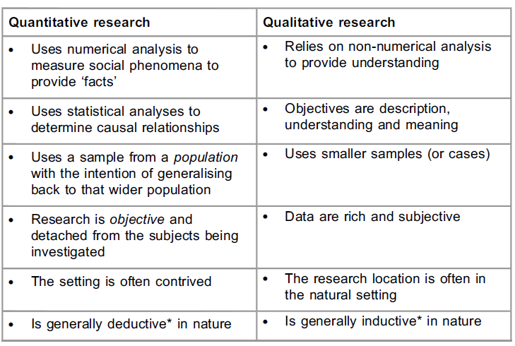


The Quanti/Quali Distinction: Summary
Notes:
deliberately created rather than arising naturally or spontaneously.
created or arranged in a way that seems artificial and unrealistic.

Slide 72
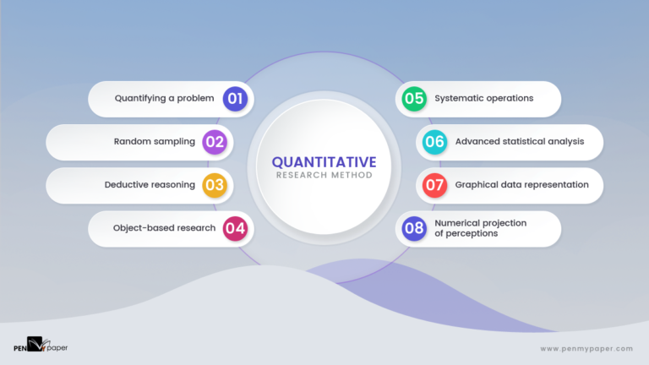
Quantitative Research
Cold hard numerical data as it deals with statistical calculations, computed data, and mathematical derivations (e.g. how many people in the UK did not comply with the COVID-19 lockdown?)
Figure 2: Aspects of Quantitative Research Design (Cresswell, 2017)

Slide 73

Qualitative Research
This data collection method is used for answers to “deep dive” issues and yields narrative (story type written account) of research findings often organised into themes (e.g. fear, poor health literacy)
Figure One: Aspects of Qualitative Research (Battendfield, 2019)

Slide 74
Some Common Methodologies
Cross- Sectional
Experimental
Case Study
Grounded Theory
Longitudinal

Slide 75
Experimental designs are used to investigate whether one variable has an impact on another (or several others).
Experimental
For example:
  Does creatinine supplementation improve performance in cycling?
  In this example you would test the cyclists on multiple occasions (experimental conditions) using a quantitative approach.

Slide 76
Cross- Sectional: This is where we capture data from participants at one point in time.
Cross- Sectional
For example:
  Cross-sectional studies can be qualitative or quantitative but would generally rely on ‘snapshot data’ collective via interviews/focus-groups/questionnaires for example
  What is the prevalence of learning support needs amongst higher education students?
  To what extent do students with learning support needs feel supported by their institution?

Slide 77
Longitudinal: Investigating the same group of people over a period of time
Longitudinal
For example:
  To what extent does our school education influence health-related behaviour across the life course?
  Multiple data-collection points are utilised over a long-term basis (potentially years).

Slide 78
Case Study
A particular issue is investigated with one person or one environment
For example:
  Multiple participants may be used but each ‘case’ is treated as unique and examined in isolation. A very small number of participants are used.
  How does an individual athlete cope with a career-ending injury?

Slide 79
Grounded Theory: Data is collected to generate theory, then the theory is tested
Grounded Theory
For example:
  How do the family members of patients perceive the quality of care provided in hospices?
  Qualitative approach whereby a theory or data is generated from the data itself (rather than being applied to it retrospectively)

Slide 80
Activity
Watch the video below then discuss
https://www.youtube.com/watch?v=ZNo-M1ldPZ8
Feedback to the whole class
Notes:
Research Design: Choosing a Type of Research Design | Scribbr 🎓 - YouTube

Slide 81
Research methods
Research methods are specific procedures for collecting and analysing data.
Developing your research methods is an integral part of your research design.
When planning your methods, there are two key decisions you will make.
First, decide how you will collect data. Your methods depend on what type of data you need to answer your research question:

Slide 82
What is a data?

Slide 83
Data
Data is the information that you collect for the purposes of answering your research question.
The type of data you need depends on the aims of your research.

Slide 84
Methods for collecting data
Qualitative vs. quantitative: Will your data take the form of words or numbers?
Primary vs. secondary: Will you collect original data yourself, or will you use data that has already been collected by someone else?
Descriptive vs. experimental: Will you take measurements of something as it is, or will you perform an experiment?

Slide 85
Types of Data
Second, decide how you will analyse the data.
For quantitative data, you can use statistical analysis methods to test relationships between variables.
For qualitative data, you can use methods such as thematic analysis to interpret patterns and meanings in the data.

Slide 86
Qualitative vs. quantitative data
Your choice of qualitative or quantitative data collection depends on the type of knowledge you want to develop.
For questions about ideas, experiences and meanings, or to study something that can’t be described numerically, collect qualitative data.

Slide 87
Qualitative vs. quantitative data
If you want to develop a more mechanistic understanding of a topic, or your research involves hypothesis testing, then collect quantitative data.

Slide 88
Qualitative vs. quantitative data
 | Pros | Cons
Qualitative | Flexible – you can often adjust your methods as you go to develop new knowledge. Can be conducted with small samples. | Can’t be analyzed statistically or generalized to broader populations. Difficult to standardize research.
Quantitative | Can be used to systematically describe large collections of things. Generates reproducible knowledge. | Requires statistical training to analyze data. Requires larger samples.

Slide 89
Qualitative vs. quantitative data
You can also take a mixed methods approach, where you use both qualitative and quantitative research methods.

Slide 90
What are Primary vs. secondary data?

Slide 91
Primary vs. secondary data
Primary data is any original information that you collect for the purposes of answering your research question (e.g. through surveys, observations and experiments).
Secondary data is information that has already been collected by other researchers (e.g. in a government census or previous scientific studies).

Slide 92
Primary vs. secondary data
If you are exploring a novel research question, you’ll probably need to collect primary data.
But if you want to synthesize existing knowledge, analyse historical trends, or identify patterns on a large scale, secondary data might be a better choice.

Slide 93
Primary vs. secondary data
 | Pros | Cons
Primary | Can be collected to answer your specific research question. You have control over the sampling and measurement methods. | More expensive and time-consuming to collect. Requires training in data collection methods.
Secondary | Easier and faster to access. You can collect data that spans longer timescales and broader geographical locations. | No control over how data was generated. Requires extra processing to make sure it works for your analysis.

Slide 94
Descriptive vs. experimental data
In descriptive research, you collect data about your study subject without intervening. The validity of your research will depend on your sampling method.
In experimental research, you systematically intervene in a process and measure the outcome. The validity of your research will depend on your experimental design.

Slide 95
Descriptive vs. experimental data
To conduct an experiment, you need to be able to vary your independent variable, precisely measure your dependent variable, and control for confounding variables.
If it’s practically and ethically possible, this method is the best choice for answering questions about cause and effect.

Slide 96
Activity
Working in groups research the term
confounding variables
Feedback your findings to the whole class

Slide 97
Answer to Activity
Confounding variables
A variable that hides the true effect of another variable in your experiment. This can happen when another variable is closely related to a variable you are interested in, but you haven’t controlled it in your experiment.

Slide 98
Descriptive vs. experimental data
 | Pros | Cons
Descriptive | Allows you to describe your research subject without influencing it. Accessible – you can gather more data on a larger scale. | No control over confounding variables. Can’t establish cause and effect relationships.
Experimental | More control over confounding variables. Can establish cause and effect relationships. | You might influence your research subject in unexpected ways. Usually requires more expertise and resources to collect data.

Slide 99
Research methods for collecting data
Research method | Primary or secondary? | Qualitative or quantitative? | When to use
Experiment | Primary | Quantitative | To test cause-and-effect relationships.
Survey | Primary | Quantitative | To understand general characteristics of a population.
Interview/focus group | Primary | Qualitative | To gain more in-depth understanding of a topic.
Observation | Primary | Either | To understand how something occurs in its natural setting.
Literature review | Secondary | Either | To situate your research in an existing body of work, or to evaluate trends within a research topic.
Case study | Either | Either | To gain an in-depth understanding of a specific group or context, or when you don’t have the resources for a large study.

Slide 100
Activity
Watch the video below then discuss
https://www.youtube.com/watch?v=q17s84ADGfA
Feedback to the whole class
Notes:
Research Design: Choosing your Data Collection Methods | Scribbr 🎓 - YouTube

Slide 101
Structuring a methods section…
Traditionally, when the methodology of a research study are reported, the following sub-sections are provided:
Participants – how many people took part, what was their demographic information etc.
Design – was a quali/quanti approach adopted. What specific method(s) was used and why?
Procedure – how was the study conducted? What processes were followed? How would this study be replicated?
Analysis – how were the data analysed?

Slide 102
Activity
Watch the video below then discuss
https://www.youtube.com/watch?v=yplWZs3dqNQ
Feedback to the whole class
Notes:
How to Write a Research Methodology in 4 Steps | Scribbr 🎓 - YouTube

