Slide 1

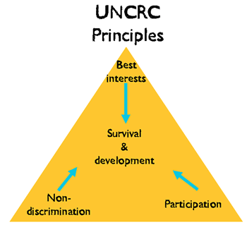
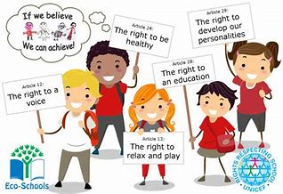



Sarah Jane Cole 1807249
The UNCRC has 54 articles. 42 which are for children and young people up to the age of 18. The others are all about how governments and adults should work together to make sure that all children and young people can access their rights. It is impossible for any welfare agency to ignore the 1989 united nations convention on the rights of the child. These rights should be met by all governments in every county.
These guidelines were built from four principles which UNCRC is built
Non- discrimination
Best interests of the child
Survival and development
Respect for views of the child
The 4 broad categories in making these 54 articles are:
The right to life
The right to develop
The right to be protected
The right to parcipate
These guiding principles, are based around three different types of rights the 3 Ps
Protection
Participation
Provision
(UNCRC! WHAT IS IT?
WHY IS IT SO IMPORTANT?
Thines Talks 2014)
The purpose of this proposed Measure is to impose a duty upon the Welsh Ministers and the First Minister to have due regard to the rights and obligations in the United Nations Convention on the Rights of the Child (UNCRC) and its Optional Protocols, when making decisions of a strategic nature about how to exercise functions which are exercisable by them.
(Rights of Children and Young Persons (Wales) Measure 2011 National assembly of wales 2018)
The social service and well-being (wales) act 2014 is an Act of the National Assembly for Wales to reform the law of social services. This provision is about improving the well-being outcomes for people who need care and support and will help carers who need the support to make provision about co-operation and partnership.
(Act 2014 Social Services and Well-being Wales)
The legislation, case law and policy that demonstrate how children’s rights, set out in the UNCRC are protected in England.
What is UNCRC? UNCRC stands for The United Nation Convention on the right of the children, the rights of the children was signed in the uk convention on 19 April 1990, approved it on 16 December 1991 and came into force on the 15th of January 1992. This is an international human rights treaty that grants all children and young people ages 17 and under a set of human rights. Every child has rights no matter what ethnicity, gender, religion, language, abilities or any other status.
In 1924 Eglantyne Jebb founder of save the children international persuaded the league of nations to adopt the declaration of Geneva on children rights.
The welsh government made the UNCRC law in wales in 2011 which gave the children the rights in wales. This means that the duty of the welsh ministers in making decisions will need to make sure they follow the protocols when making decisions.
The Voice of the child.
The voice of the child means every child has a right to be heard. Children get to be more involved in any type of family cases for example - remove them into care or disputes about child arrangement following they parent separation or divorce. Children will have they voice heard in the court of law and they will be able to make they decisions that will affect them on this matter. Simon Hughes is a minister who set out to make changes to make it easier for children and young people to communicate their views in a court proceedings. (Voice of the Child children to be more clearly heard in decisions about their future 2015)
Some of the Organisations

Slide 2
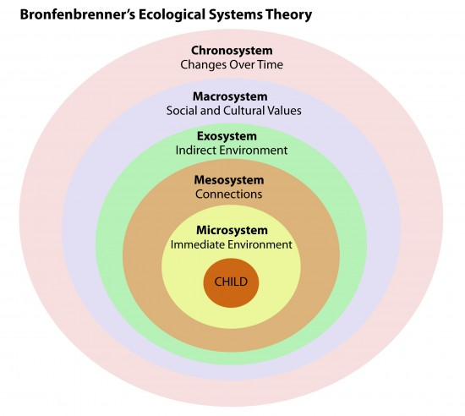
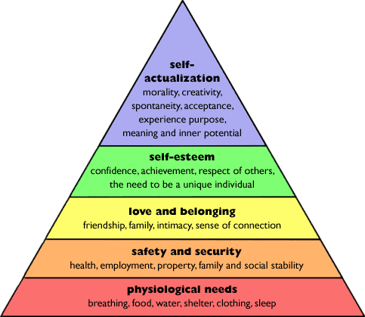
Article 6
You have the right to life and to grow up to be healthy. (Welsh Government 2015)
Children and young people should be able to grow up in conditions that don't impact negatively on their physical and mental wellbeing. It says the government should make sure they can live in these conditions in order that they can develop. . UNCRC Articles (Children & young people commissioner of Scotland 2018)
Article 27
Children have a right to a standard of living that is good enough to meet their physical and mental needs. The government should help families who cannot afford to provide this. (Welsh Government 2015)
For this to happen, they should have access to adequate food and housing. Good nourishment and nutrition are essential for children and young people to reach their full potential, while safe and well-maintained housing is necessary to ensuring their development.
Parents or guardians have the main responsibility for making sure their child or young person reaches their full potential. Where their help is not enough, however, children and young people have the right to government assistance such as child maintenance. . UNCRC Articles (Children & young people commissioner of Scotland 2018)
American psychologist, Urie Bronfenbrenner, formulated the Ecological Systems Theory to explain how the inherent qualities of a child and his environment interact to influence how he will grow and develop. Through the Bronfenbrenner Ecological Theory, Bronfenbrenner stressed the importance of studying a child in the context of multiple environments, also known as ecological systems in the attempt to understand his development. (Bronfenbrenner’s Ecological Systems Theory 2013)
Article 12
Your right to say what you think should happen and be listened to. (Welsh Government 2015)
The opinion of a child and young person should be considered everywhere, including in their home, in their workplace and at school. This is true no matter how young a child or young person is, although the weight their opinion is given should change as they grow up and become more mature. . UNCRC Articles (Children & young people commissioner of Scotland 2018)
Here is a diagram of Marslow triangle.
Maslow's (1943, 1954) hierarchy of needs is a motivational theory in psychology comprising a five tier model of human needs, often depicted as hierarchical levels within a pyramid. Maslow stated that people are motivated to achieve certain needs and that some needs take precedence over others.
( Maslow's Hierarchy of Needs Simply psychology Psychology Notes HQ 2018)
Article 29
Education should develop each child’s personality and talents to the full. It should encourage children to respect their parents, and their own and other cultures. (Welsh Government 2015)
Child or young person's education should help their mind, body and talents be the best they can. It should also build their respect for other people and the world around them. . UNCRC Articles (Children & young people commissioner of Scotland 2018)
Article 31
All children have right to relax and play, and to join in a wide range of activity. (Welsh Government 2015)
Children and young people should be able to take part freely in cultural activities, just like adults. The government should make sure it's easy for them to do this whether or not they have a disability. . UNCRC Articles (Children & young people commissioner of Scotland 2018)
Article 3
Everyone who works with children should always do what is best for each child.
(Welsh Government 2015)
This article is one of the most important articles in the UNCRC, there are a lot of article can relate to article 3. It means that the interests of children and young people should be thought about at all levels of society, and that their rights should be respected by people in power.
Adults who have power should consider what’s best for children and young people in their day to day lives when making laws, make sure children and young people are protected and cared for
make sure that groups who protect and care for children and young people are good at what they do. UNCRC Articles (Children & young people commissioner of Scotland 2018)
Article 18
Both parents share responsibility for bringing up their children, and should always consider what is best for each child. (Welsh Government 2015)
Governments should help parents by providing services to support them, especially if both parents work.
If a child or young person only lives with one parent, their other parent should provide them with support. The form this support takes will depend on what that child or young person's best interests are. Children and young people shouldn’t be discriminated against if their parents aren’t married or never were. . UNCRC Articles (Children & young people commissioner of Scotland 2018)
Conclusion
As practitioners these rights have helped children have their say in settings and protected them from harm.

Slide 3
Reference
Children & young people commissioner of Scotland (2018) UNCRC Articles Available at:
https://www.cypcs.org.uk/rights/uncrcarticles (accessed on 31st October 2018)
National assembly of wales (2018) Rights of Children and Young Persons (Wales) Measure 2011 Available at:
http://www.assembly.wales/en/bus-home/bus-third-assembly/bus-legislation-third-assembly/bus-leg-measures/business-legislation-measures-rightsofchildren/Pages/business-legislation-measures-rightsofchildren.aspx ( Accessed: 31st October 2018)
Psychology Notes HQ Bronfenbrenner’s Ecological Systems Theory (2013)
Available at: https://www.psychologynoteshq.com/bronfenbrenner-ecological-theory/ (accessed on 31st October 2018)
Simply psychology Maslow's Hierarchy of Needs (2018)
available at: https://www.simplypsychology.org/maslow.html (accessed 31 October 2018)
Social Services and Well-being (Wales) Act 2014 (anaw 4) Available at:
http://www.legislation.gov.uk/anaw/2014/4/pdfs/anaw_20140004_en.pdf ( Accessed: 31st October 2018)
Thines Talks UNCRC! WHAT IS IT? WHY IS IT SO IMPORTANT? (2014) Available on: http://www.thines-talks.co.uk/blog/uncrc-what-is-it-why-is-it-so-important Accessed on: 31st October 2018)
UNICEF HOW WE PROTECTCHILDREN'S RIGHTS Available at: www.Unicef.org (accessed: 31st October 2018)
Voice of the Child: children to be more clearly heard in decisions about their future Published 19 February 2015 Open Government Licence v3.0 Available at: www.gov.uk/government/news/voice-of-the-child-children-to-be-more-clearly-heard-in-decisions-about-their-future (accessed on 31st October 2018)
Welsh Government 2015 publish crown

Slide 4
Reference from Presentation
Children’s Rights Alliance – The United Nations Convention on the Rights of the child
Available From http://www.childrensrights.ie/childrens-rights-Ireland/un-convention-rights-child (accessed 19/10/2018)
Flying Start Good Practice Guide – additional need toolkit (2018) Jason Kingsley Publisher London
Golding, K.S. 3G al. (2013) Observing Children with Difficulties in School. Jessica Kingsley publisher London
Methods of Observing Young Children Available from Https://msu.edu/-mandrews/mary/obs_methods.htm (accessed 20/10/18)
Nurture UK, Available from http://www.nurtureuk.org/introducing-nurture/what-nurture-group-0 (Accessed 20/10/18)
TheSchoolRun 2018 Available from http://www.theschoolrun.com/how-a-senco-could-help-your-child (Accessed 20/10/18)
Welsh Government 2015 publish crown

