Slide 1
Assignment title: Self Awareness Presentation
Module code: LCHS4009
Module: Professional Development within Health and Social Care
Name: Zara Sheikh
Student Number: 2408419
Submission Deadline: 20th October 2025

Slide 2
Professional Development within Health and Social Care

Slide 3
Table of content
Introduction
Personal SWOT analysis
Conclusion
References

Slide 4

Introduction
Professional development within the health and social care is very essential for the practitioner to stay up to date with the progressions, for refining their skills for providing high quality of personalised and safe care (Matlhaba, 2025).
Notes:
The presentation will present the personal SWOT analysis which is a strategic tool for professional development as a support workers for children with learning disabilities.

Slide 5
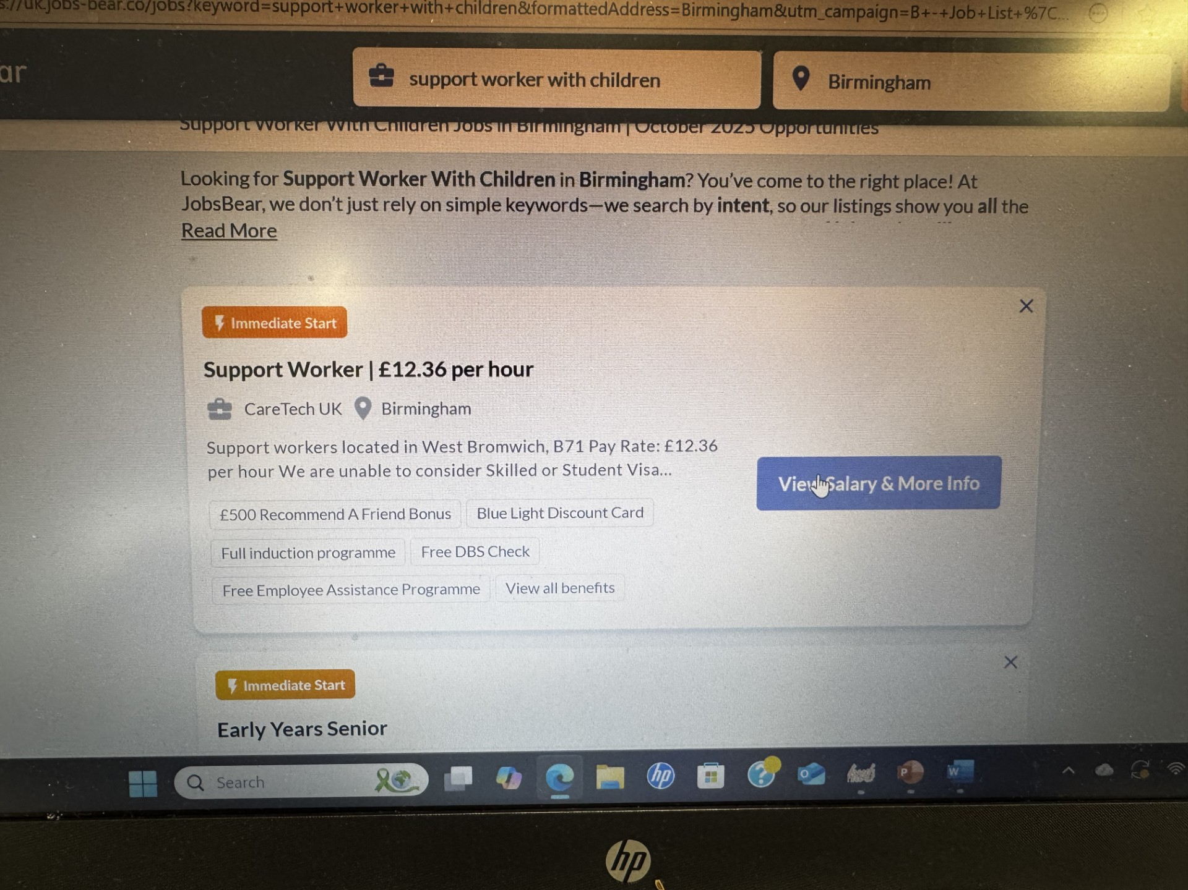
This is a practical examples:
This is the job title I am interested in
In the next slide you will be able to my skills and what the job needs requirements are.

Slide 6
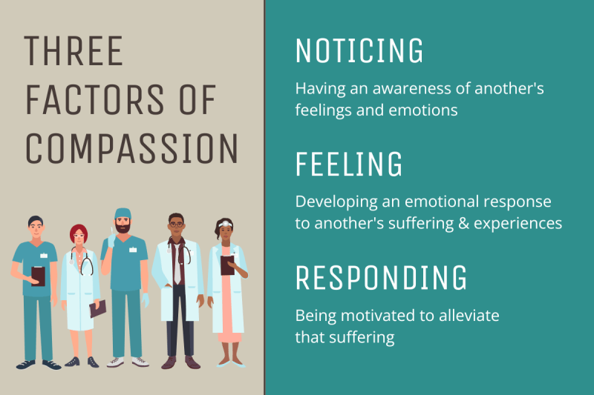
PERSONAL SWOT ANALYSIS
Strengths
My main strengths include my compassion and empathy which will allow me to build a strong and trustworthy relationship with the children whom I will support and their families.
I am extremely flexible and adaptable that is really crucial while working with the people or an individual whose routines and needs can change unexpectedly.
Notes:
I also possess strong communication skills leveraging both the verbal and nonverbal communication methods which is extremely essential for effectively interacting with the children who cannot communicate verbally.
Additionally, my resilience will enable me to stay professional and positive when encountered with physically and emotionally challenging situations.

Slide 7
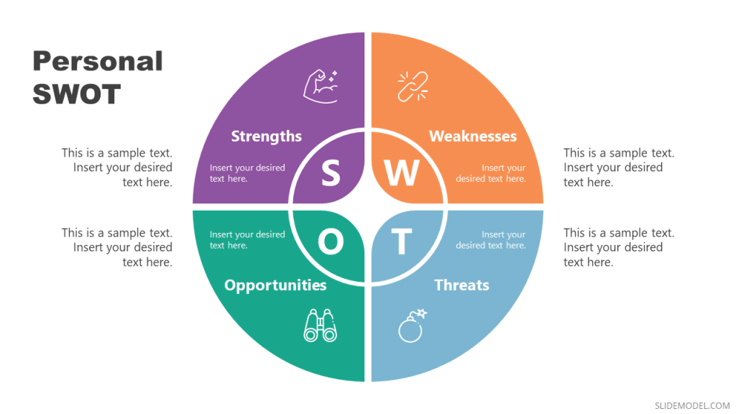
CONTINUE..
Weaknesses
My core weakness is an absence of management and leadership experience that can hinder my progress into the higher job roles.
Though I have a hands on experience but I have a restricted exposure to the advanced techniques of therapies which can further limit the depth during my practices.
Notes:
I also tussle with my self-doubt, as I occasionally question my judgements mainly within the complex situations that can impact my confidence while advocating for the needs and requirements of the children.

Slide 8

Continue..
Opportunities
The health and social care sector in UK offers various opportunities for development and growth (Modula, and Chipu, 2024).
The mounting demand for the proficient support workers for children mainly in the dedicated areas such as learning disabilities.
Notes:
There are various pathways for training exists, with specialised certifications like behaviour management and apprenticeship program.
The rising emphasis on the partnerships and multi-disciplinary working can provide chances to collaborate with the social workers, professionals, and therapist which can help me in extending my base of knowledge.

Slide 9
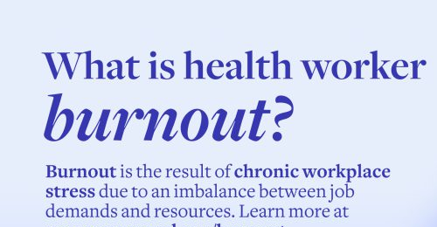
Continue..
Threats
The risk of burning out is high due to the physical and emotional demands along with the risk of understaffing (Tsolakidis, and Diamantidou, 2022).
The recent changes in the government policies can affect international hiring which can exacerbate the preceding shortage of workforce that can force the pressure on the personnel.
Notes:
Occupational aggression and violence also poses risks, necessitating for the strong mechanisms to cope and support systems.
The changes in the government policy and funding can also lead to instability and reduction in the resources for the social care services.

Slide 10
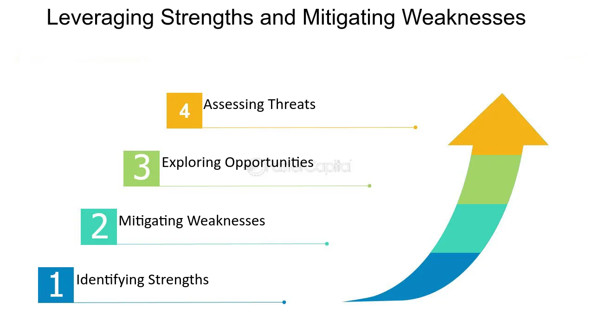
Continue..
Leveraging personal strengths, minimising threats, and Utilising opportunities
For example- By leveraging my strengths I can proactively consult with an experienced colleague during the complex meeting which can help me in addressing the self-doubt while representing the practical approach for professional development.
Notes:
For example- My resilience and adaptability will help me in minimising workforce shortages and burnouts, as I will use my skills to cultivate strategies to cope and create a team through peer examination.
For example- using my strong interpersonal skills I will develop relationship with the therapists that will help me directly in learning new techniques. My commitment to support the children with learning disabilities will help me in pursuing the higher qualifications.
For example- I can use my positive approach to initiate collaboration with the local colleges for setting up the project where the young people having the learning disabilities can develop new kills, which can create a dual advantage for building new networks professionally and enriching the lives of the children.

Slide 11

Conclusion
it highlighted how the personal strengths can be used for minimising threats and utilising the opportunities.
Notes:
The presentation presented the personal SWOT analysis which is a strategic tool for professional development as a support workers for children with learning disabilities.

Slide 12
References
Books and journals
Matlhaba, K., (2025). Professional Development and Lifelong Learning. In Enhancing Clinical Competence of Graduate Nurses (pp. 187-200). Cham: Springer Nature Switzerland.
Modula, M.J. and Chipu, M.G., (2024). Exploring information needs among family caregivers of children with intellectual disability in a rural area of South Africa: a qualitative study. BMC Public Health, 24(1), p.1139.
Tsolakidis, G. and Diamantidou, V., (2022). Nursing staff burnout: A critical review of the risk factors. International Journal of Caring Sciences, 15(1), pp.668-679.

Slide 13

Thank you

