Slide 1

Module Handbook Spring Term 2023
BMIH4003 - Hospitality & Guest Services
LEVEL 4
Student Name – Amanioaei Eliza Andreea
Student ID - 2216057

Slide 2
Table of contents
Content | Slide no
Introduction | 3
Moxy Hotels | 4
Customers of Moxy Hotel | 6
Nature, scope and role of the guest services and facilities that are provided by Moxy Hotel | 7
The need to consider the role and function of guest services | 8
The importance of hospitality and how hotels meet/exceed guest expectations | 9
Conclusion | 11
References | 12

Slide 3
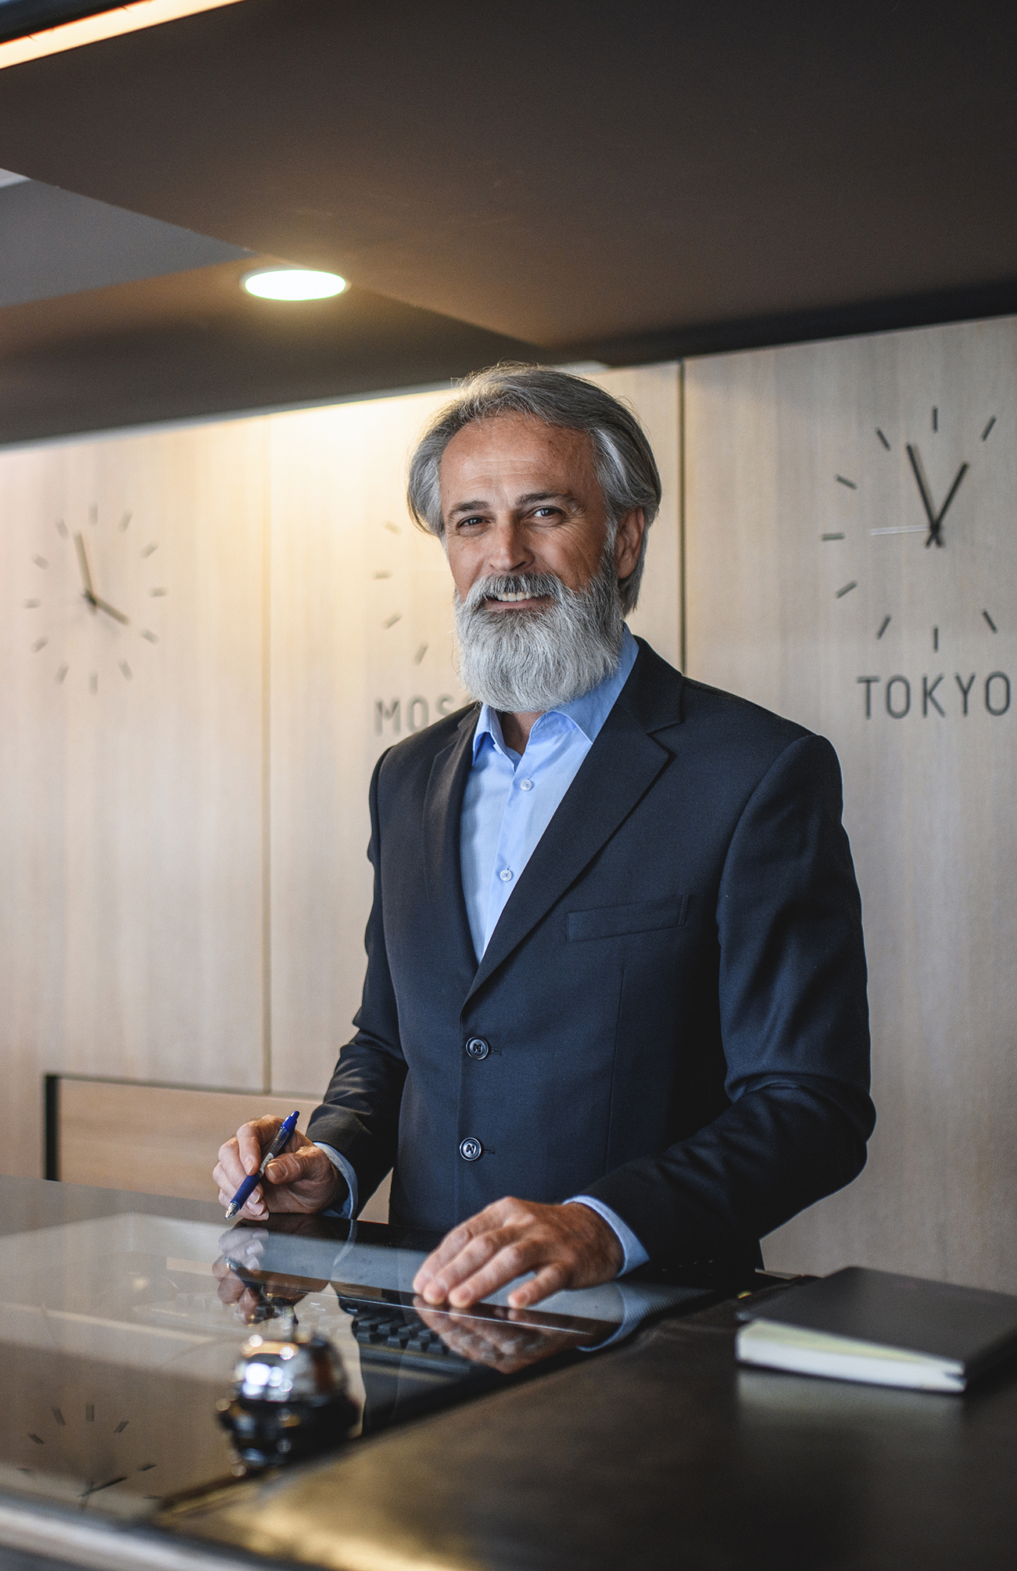
Introduction
The presentation aims to develop an understanding of the role and importance of quality service, hospitality, and guest service in the hospitality industry by highlighting “Moxy Hotels”, a brand that comes under the company “Marriott International”.
The presentation will briefly describe the Moxy Hotel and identify its main customers. Further, the presentation will examine the nature, scope, and role of the guest services and facilities that are provided by the hotel. It will also explain the need to consider the role and function of guest service in general.
Towards the end, the presentation will provide a discussion on the importance of hospitality and how hotels meet guest expectations.
Notes:
Introduction
The presentation aims to develop an understanding of the role and importance of quality service, hospitality, and guest service in the hospitality industry by highlighting “Moxy Hotels”, a brand that comes under the company “Marriott International”. The company is one of the top players in the hotel business and has successfully established a chain of hotels and a diverse range of brands across the globe. The presentation will briefly describe the Moxy Hotel and identify its main customers. Further, the presentation will examine the nature, scope, and role of the guest services and facilities that are provided by the hotel. It will also explain the need to consider the role and function of guest service in general. Towards the end, the presentation will provide a discussion on the importance of hospitality and how hotels meet guest expectations.

Slide 4
Moxy Hotels
About Moxy
Industries – Hospitality
Owned by Marriott International
Employees – 51 to 200
Headquartered in Amsterdam
Type - Public Company
Founded in 2014
(Fig: Moxy Hotel logo)
(Source: news.marriott.com, 2023)
Notes:
Moxy Hotels
Moxy Hotels is a hotel brand owned by Marriott International which is a multinational company with approximately 8000 hotels globally (statista.com, 2022). The brand was first introduced in Milan in 2014 and has since expanded to locations around the world (linkedin.com, 2023). Moxy Hotels are designed to appeal to younger, budget-conscious travelers who are looking for a fun, vibrant atmosphere. The hotels feature bright and colourful designs, large public spaces, and a variety of amenities including fitness centers, business centers, and meeting rooms. The hotels are also known for their vibrant bar scene, with many locations featuring a lively bar and lounge area. Moxy Hotels are pitched towards providing a fun, affordable, and stylish experience for travellers on a budget.
Key features of Moxy Hotel
Moxy is a hotel brand that offers playful, stylish, and affordable accommodation.
Moxy hotels have a unique check-in process at the bar.
The brand targets playful travellers and provides small but smart bedrooms and vibrant social spaces.
Moxy hotels are part of Marriott Bonvoy (marriott.com, 2023), a global travel program that offers members exclusive experiences and benefits.
The brand currently has 62 open hotels in North America, Europe, and Asia Pacific with 127 more in the pipeline (news.marriott.com, 2023).

Slide 5
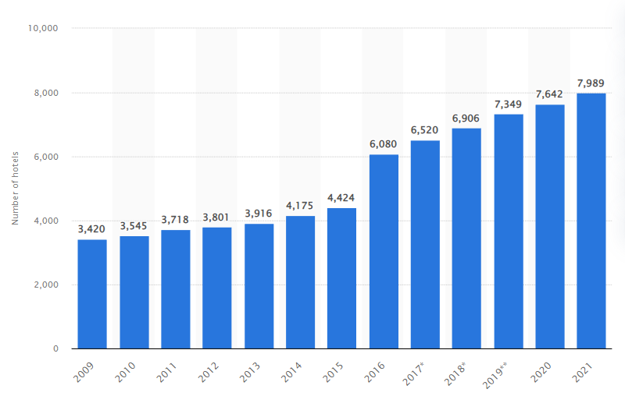
Key features of Moxy Hotel
Moxy hotels have a unique check-in process at the bar.
The brand targets playful travellers and provides small but smart bedrooms and vibrant social spaces.
Moxy hotels are part of Marriott Bonvoy (marriott.com, 2023), a global travel program that offers members exclusive experiences and benefits.
The brand currently has 62 open hotels in North America, Europe, and Asia Pacific with 127 more in the pipeline (news.marriott.com, 2023).
Moxy is a hotel brand that offers playful, stylish, and affordable accommodations.
(Fig: Global count of Marriott International hotels)
(Source: statista.com, 2022)

Slide 6
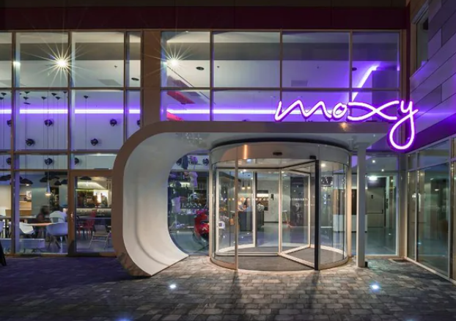
Customers of Moxy Hotel
Younger, budget-conscious travellers
Solo travellers
Business travellers
Tourists and leisure travellers
Party-goers
Social media-savvy
(Fig: Moxy Hotel in Milan)
(Source: marriott.com, 2023)
Notes:
Customers of Moxy Hotel
Moxy Hotels customers are typically younger, budget-conscious travellers who are looking for a fun and affordable option for their travels (moxy-hotels.marriott.com, 2023), whether it be for business or leisure. Moxy Hotels are designed to appeal to a specific type of customer, including:
Younger, budget-conscious travellers: Moxy Hotels are geared towards a younger demographic, particularly those who are looking for a fun and affordable option for their travels.
Solo travellers: The sleeping pod concept in Moxy Hotels is perfect for solo travellers who are looking for a budget-friendly option for accommodation.
Business travellers: Moxy Hotels offer a variety of amenities such as business centers, meeting rooms, and Wi-Fi, making them a great option for business travellers who are looking for a budget-friendly option while on the road.
Tourists and Leisure travellers: Moxy hotels are located in major tourist destinations, and they offer a comfortable and fun atmosphere, making it a great option for tourists and leisure travellers who want to explore the city in an affordable way.
Party-goers: The dazzling bars in Moxy Hotels are popular among party-goers and nightlife enthusiasts.
Social Media Savvy: Moxy hotels often have a strong online presence and social media strategy, making it popular among the younger demographic who are active on social media.

Slide 7
Nature, scope and role of the guest services and facilities that are provided by Moxy Hotel
Nature
Moxy Hotels provide a variety of guest services and facilities to ensure that guests have a comfortable and enjoyable stay.
The nature of these services and facilities is designed to cater to the needs of the target demographic of younger, budget-conscious travellers, with an emphasis on providing a fun and vibrant atmosphere.
Scope
The scope of these services and facilities includes:
Accommodation
Food and Beverage
Features such as Guestbook
Business
Entertainment
Role
The role of these hotel services (Ogunnaike et al., 2022) and facilities is to provide guests with the amenities and services they need to have a comfortable and enjoyable stay.
They are designed to cater to the specific needs of the target demographic of younger, budget-conscious travellers, with an emphasis on providing a fun and vibrant atmosphere.
Notes:
Nature, scope and role of the guest services and facilities that are provided by Moxy Hotel
Nature
Moxy Hotels provide a variety of guest services and facilities to ensure that guests have a comfortable and enjoyable stay.
The nature of these services and facilities are designed to cater to the needs of the target demographic of younger, budget-conscious travelers, with an emphasis on providing a fun and vibrant atmosphere.
Scope
The scope of these services and facilities includes:
Accommodation: Moxy Hotels offer a variety of room options, including traditional guest rooms and the unique "sleeping pod" concept for budget-friendly solo travel.
Food and Beverage: Many Moxy Hotels feature a lively bar and lounge area where guests can enjoy a variety of drinks and snacks. Some Moxy hotels offer 24/7 food service (moxy-hotels.marriott.com, 2023).
Features such as Guestbook: It streams the pictures and videos that the guests at Moxy share on social media (businesstravelnewseurope.com, 2022).
Business: Business centers, meeting rooms, and Wi-Fi are provided to accommodate the needs of business travellers.
Entertainment: Many Moxy Hotels offer a variety of entertainment options such as games, TV, music, and events to ensure that guests have a fun and enjoyable stay.
Role
The role of these hotel services (Ogunnaike et al., 2022) and facilities is to provide guests with the amenities and services they need to have a comfortable and enjoyable stay. They are designed to cater to the specific needs of the target demographic of younger, budget-conscious travellers, with an emphasis on providing a fun and vibrant atmosphere.

Slide 8

The need to consider the role and function of guest services
Guest services play a critical role in the overall guest experience, and it is important for hotels to consider the role and function of guest services in order to provide a high-quality experience for guests (Ban et al., 2019).
Meeting guests' needs
Enhancing guest satisfaction
Differentiation
Building brand loyalty
Creating revenue opportunities
Addressing guest complaints
Notes:
The need to consider the role and function of guest services.
Guest services play a critical role in the overall guest experience, and it is important for hotels to consider the role and function of guest services in order to provide a high-quality experience for guests (Ban et al., 2019).
Meeting guests' needs: Guest services are designed to meet the needs and expectations of guests, whether it be providing basic amenities such as room service or more specialized services such as concierge service.
Enhancing guest satisfaction: By providing a range of guest services that meet the diverse needs of guests, hotels can enhance guest satisfaction, leading to positive reviews and repeat customers.
Differentiation: Offering unique and high-quality guest services can differentiate a hotel from its competitors and give it a competitive edge in the market.
Building brand loyalty: By providing exceptional guest services, hotels can create a positive impression and build brand loyalty among guests.
Creating revenue opportunities: Offering additional services such as spa services, room service, or event planning can create additional revenue opportunities for hotels.
Addressing guest complaints: Guest services also play an important role in addressing guest complaints and resolving issues to ensure guest satisfaction.

Slide 9

The importance of hospitality and how hotels meet/exceed guest expectations
Hospitality is an essential aspect of the hotel industry and plays a crucial role in ensuring that guests have a positive experience (Kim and Kim, 2022). The importance of hospitality can be outlined as follows:
Creating a positive experience
Building customer loyalty
Differentiation
Meeting guest expectations
Improving guest satisfaction
Showcasing the hotel's culture
Notes:
The importance of hospitality and how hotels meet/exceed guest expectations.
Hospitality is an essential aspect of the hotel industry and plays a crucial role in ensuring that guests have a positive experience (Kim and Kim, 2022). The importance of hospitality can be outlined as follows:
Creating a positive experience: Hospitality is about creating a welcoming and comfortable environment for guests, which ultimately leads to a positive experience for the guest.
Building customer loyalty: By providing exceptional hospitality, hotels can create a positive impression and build customer loyalty, leading to repeat customers and positive word-of-mouth.
Differentiation: Exceptional hospitality can differentiate a hotel from its competitors and give it a competitive edge in the market.
Meeting guest expectations: Hospitality is about understanding and meeting the needs and expectations of guests, whether it be providing basic amenities such as room service or more specialized services such as concierge service.
Improving guest satisfaction: By providing a range of services that meet the diverse needs of guests, hotels can improve guest satisfaction, leading to positive reviews and repeat customers.
Showcasing the hotel's culture: Hospitality can also be a way for hotels to showcase their unique culture and values to guests.
To meet and exceed guest expectations, hotels can take a number of steps such as:
Providing high-quality service and amenities
Training employees to be friendly and attentive.
Being responsive to guest needs and feedback.
Continuously seeking ways to improve the guest experience.
Creating a welcoming and comfortable atmosphere
Providing exceptional customer service.

Slide 10

How Hotels Meet/Exceed Guest Expectations
Providing high-quality service and amenities
Training employees to be friendly and attentive.
Being responsive to guest needs and feedback.
Continuously seeking ways to improve the guest experience.
Creating a welcoming and comfortable atmosphere
Providing exceptional customer service.

Slide 11

Conclusion
The presentation achieved its objective and developed an understanding of the role and importance of quality service, hospitality, and guest service in the hospitality industry by keeping “Moxy Hotels” in focus. The presentation described the Moxy Hotel and identified its main customers such as business travellers, partygoers, travellers, budget-conscious travellers, etc. Further, the presentation examined the nature, scope, and role of the guest services and facilities that are provided by the hotel. It described the need to consider the role and function of guest service in general. Towards the end, the presentation provided a discussion on the importance of hospitality and how hotels meet guest expectations.
Notes:
Conclusion
The presentation achieved its objective and developed an understanding about the role and importance of quality service, hospitality, and guest service in the hospitality industry by keeping “Moxy Hotels” at focus. The presentation described the Moxy Hotel and identified its main customers such as business travellers, party goers, travellers, budget-conscious travellers, etc. Further, the presentation examined the nature, scope, and role of the guest services and facilities that are provided by the hotel. It described the need to consider the role and function of guest service in general. Towards the end, the presentation provided a discussion on the importance of hospitality and how hotels meet guest expectations.

Slide 12
References
Ban, H.J., Choi, H., Choi, E.K., Lee, S. and Kim, H.S., 2019. Investigating key attributes in experience and satisfaction of hotel customer using online review data. Sustainability, 11(23), p.6570.
businesstravelnewseurope.com, 2022. Moxy continues expansion with first Manchester hotel [Online] Available at: https://www.businesstravelnewseurope.com/Accommodation/Moxy-continues-expansion-with-first-Manchester-hotel [Accessed on 25th, January 2023].
Kim, Y.J. and Kim, H.S., 2022. The impact of hotel customer experience on customer satisfaction through online reviews. Sustainability, 14(2), p.848.
linkedin.com, 2023. Moxy Hotels [Online] Available at: https://www.linkedin.com/company/moxy-hotels [Accessed on 25th, January 2023].
marriott.com, 2023. Explore Our Brands [Online] Available at: https://www.marriott.com/marriott-brands.mi [Accessed on 25th, January 2023].
marriott.com, 2023. Marriott Bonvoy [Online] Available at: https://www.marriott.com/loyalty.mi [Accessed on 25th, January 2023].
moxy-hotels.marriott.com, 2023. EXPLORE MOXY [Online] Available at: https://moxy-hotels.marriott.com/explore/ [Accessed on 25th, January 2023].
news.marriott.com, 2023. [Online] Available at: https://news.marriott.com/brands/moxy-hotels/#:~:text=Moxy%20is%20a%20playful%2C%20affordable,check%2Din%20at%20the%20Bar. [Accessed on 25th, January 2023].
Ogunnaike, O.O., Agada, S.A., Ighomereho, O.S. and Borishade, T.T., 2022. Social and cultural experiences with loyalty towards hotel services: the mediating role of customer satisfaction. Sustainability, 14(14), p.8789.
statista.com, 2022. Number of Marriott International hotels worldwide from 2009 to 2021 [Online] Available at: https://www.statista.com/statistics/247285/number-of-marriott-international-hotels-worldwide/ [Accessed on 25th, January 2023].
Notes:
References
Ban, H.J., Choi, H., Choi, E.K., Lee, S. and Kim, H.S., 2019. Investigating key attributes in experience and satisfaction of hotel customer using online review data. Sustainability, 11(23), p.6570.
businesstravelnewseurope.com, 2022. Moxy continues expansion with first Manchester hotel [Online] Available at: https://www.businesstravelnewseurope.com/Accommodation/Moxy-continues-expansion-with-first-Manchester-hotel [Accessed on 25th, January 2023].
Kim, Y.J. and Kim, H.S., 2022. The impact of hotel customer experience on customer satisfaction through online reviews. Sustainability, 14(2), p.848.
linkedin.com, 2023. Moxy Hotels [Online] Available at: https://www.linkedin.com/company/moxy-hotels [Accessed on 25th, January 2023].
marriott.com, 2023. Explore Our Brands [Online] Available at: https://www.marriott.com/marriott-brands.mi [Accessed on 25th, January 2023].
marriott.com, 2023. Marriott Bonvoy [Online] Available at: https://www.marriott.com/loyalty.mi [Accessed on 25th, January 2023].
moxy-hotels.marriott.com, 2023. EXPLORE MOXY [Online] Available at: https://moxy-hotels.marriott.com/explore/ [Accessed on 25th, January 2023].
news.marriott.com, 2023. [Online] Available at: https://news.marriott.com/brands/moxy-hotels/#:~:text=Moxy%20is%20a%20playful%2C%20affordable,check%2Din%20at%20the%20Bar. [Accessed on 25th, January 2023].
Ogunnaike, O.O., Agada, S.A., Ighomereho, O.S. and Borishade, T.T., 2022. Social and cultural experiences with loyalty towards hotel services: the mediating role of customer satisfaction. Sustainability, 14(14), p.8789.
statista.com, 2022. Number of Marriott International hotels worldwide from 2009 to 2021 [Online] Available at: https://www.statista.com/statistics/247285/number-of-marriott-international-hotels-worldwide/ [Accessed on 25th, January 2023].

Slide 13


