Slide 1
Big Data – Introduction to Hadoop
Dr Tim Bashford

Slide 2
Introduction
Remember: scale is important. Terabytes or petabytes.
  Facebook stores 400TB of data, and grows 4TB/day.
  Internet archive growing at ~20PB / month.
Data coming from lots of different places, almost certainly in lots of different formats.
  Some of these formats may be text which can be transformed.
  Some are likely to be, for example, pictures, which require effort to process.
    Note that Facebook recently got very good at facial recognition, among other things. Why?...

Slide 3
Remember the four Vs
Volume – large scale, lots of data.
Velocity – data coming in at speed, which needs to be processed quickly if it’s to be useful. Some different paradigms, like real-time vs batch.
Variety – Different kinds of data, as mentioned in the previous example.
Veracity – hard to assess quality and consistency of lots of forms of data.

Slide 4
Challenges of big data
Think all the way back to computer architecture. There are some complex issues in storing/retrieving data. For example:
  Magnetic hard drive transfers ~325MB/s, with an 8.5ms seek. Sounds insignificant, but quickly adds up per access.
  Cannot cache data well due to volume. Scales poorly.
  Capacity is expensive, especially for high-performance hard drives.
  Failure rate can be a real issue. If a machine has 1 mean failure / 3 years, a cluster of 5000 machines has 1 mean failure / 5 hours.

Slide 5
Challenges of big data
Ideally, a failure should reduce performance, not kill the system dead.
  Failover/load balancing clustering – will discuss in a second.
Failures should be recoverable, i.e. if a node fails, another should continue where it left off with neither data nor significant performance loss.
Should be scalable, able to add or remove nodes as needed.
How far can we parallelise? Do we have to have central storage accessible by a single machine?
  As you’ve likely all learned, parallelism is complicated.
  Inevitably, we spend quite a bit of time figuring out how this is achieved.

Slide 6
Hadoop
Hadoop aims to solve many of these problems.
  Splits data across multiple nodes.
  Designed to scale.
  Each node provides computational power and storage, i.e. no central store needed.
Uses its own filesystem, either Hadoop Distributed File System (HDFS) or Google File System (GFS).
  Designed to be reliable, efficient and easy to use. The last one is maybe a tad questionable!

Slide 7
Design principles
Store and process masses of data (Petabytes).
Scale linearly.
Modular design, simple core.
Failure is expected – manage and self-heal.
Does not require server-grade hardware; runs on consumer-grade machines. This is relevant to us!
  Beowulf cluster.

Slide 8
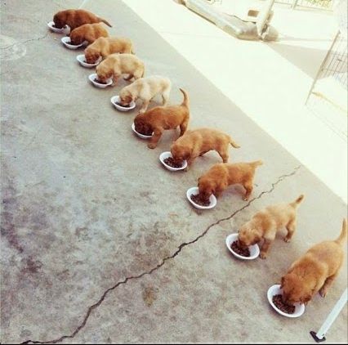

Parallel puppies

Slide 9
Hadoop vs Relation Database Management Server
Relational databases are all about structured data, while Hadoop does well on both structured and unstructured data.
Scaling of databases is expensive, limited. Hadoop scales near linearly.
RDBMSes tend to use highly structured query languages (like SQL). Hadoop works from the other end – give the result you want, the software works backwards.
Distributed databases require a lot of coordination. Hadoop is distributed by design, so performs well at this.
RDBMSes often scale by trying to grow an increasingly huge puppy. Hadoop just adds more puppies of about the same size.

Slide 10
Hadoop vs Relation Database Management Server
RDBMS struggle to gracefully handle failure. Hadoop can usually detect when a node fails, and re-do the lost processing.
Hadoop can handle 2-3 orders of magnitude more data.
Hadoop cannot run in an interactive mode – batch only.
RDBMS ensure data integrity, Hadoop does not.
Remember: Hadoop is a fantastic tool for doing exactly what it’s designed to do, i.e. distributed processing of big data problems. It is not a replacement for RDBMS in most other circumstances!
  Doesn’t support relationships or key pairs.
  RDBMSes and Hadoop nonetheless tend to play nicely together.

Slide 11
Cluster configuration
Hadoop comprises:
  At least (often exactly) one name node.
    The head/master node which manages storage across the other nodes.
    One name node takes control, others are secondary used for redundancy.
  Multiple data nodes.
    Storage and processing.
MapReduce comprises:
  A job tracker
    Manages the jobs in the system.
  Multiple task trackers
    Responsible for running the jobs specified by the job tracker.

Slide 12
Cluster configuration
This is a typical master/slave configuration.
Most nodes are data nodes and task trackers.
The name node and job tracker may or may not be the same physical machine.
Can run in one of three modes:
  Standalone. No cluster at all, only really for debugging.
  Pseudo-distributed. Multiple processes, but all on the same physical machine. Facilitates some degree of local parallelism.
  Fully-distributed. Multiple processes across multiple physical machines – this is what Hadoop really exists for.

Slide 13
Current users
Search:
  Yahoo, Amazon
Log processing:
  Facebook, Yahoo, Last.fm
Recommendation systems:
  Facebook
Data Warehouse:
  Facebook, AOL
Video and image analysis:
  New York Times

Slide 14
Conclusion
Scales linearly, very efficient.
Use many small puppies (highly parallel).
Failure and fault tolerant (self-healing to an extent).
Highly cost-effective.
Data is localised, code moves to data.

